Slide 1


Direct search for Dark Matter
with the EDELWEISS-II experiment:
status and results
Claudia Nones
CSNSM-Orsay
On behalf of the EDELWEISS-II collaboration
TeV Particle Astrophysics 2010 - July 19th - 23th, 2010 - Paris, France

Slide 2
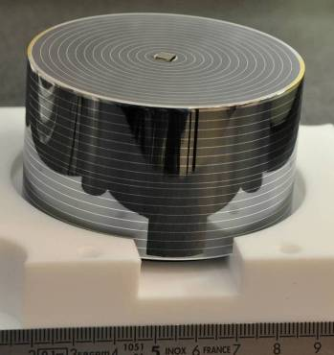
Outline
The EDELWEISS-II collaboration
The detectors and the set-up
WIMP hunting: run 12
A background analysis
What’s going on
The next future: EURECA
Conclusions & Perspectives

Slide 3
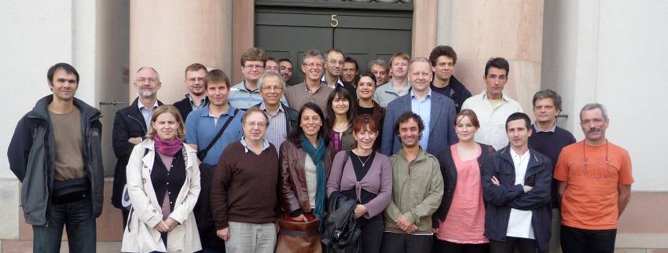
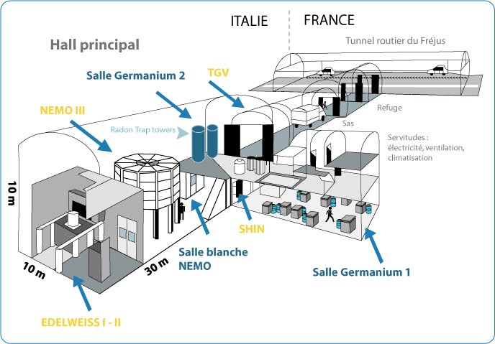
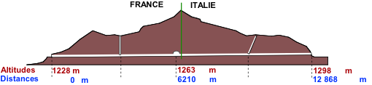
EDELWEISS-II: the collaboration
CEA Saclay (IRFU & IRAMIS) Detectors, electronics, acquisition, data handling, analysis
CSNSM Orsay Detectors, cabling, cryogenics
IPN Lyon Electronics, cabling, low radioactivity, analysis,detectors, cryo.
Institût Néel Grenoble Cryogenics, electronics
Karlsruhe KIT (+ IPE in 2011) Vetos, neutron detectors, background
JINR Dubna Background, neutron and radon detectors
Oxford University New comer 2009 : Detectors, cabling, cryogenics, analysis
Sheffield University New comer 2010: MC simulation
~ 50 persons (10 thesis, 4 post-doc)
4800 mwe
LSM (Fréjus)
EDW Coll meeting/Karlsruhe 2009

Slide 4
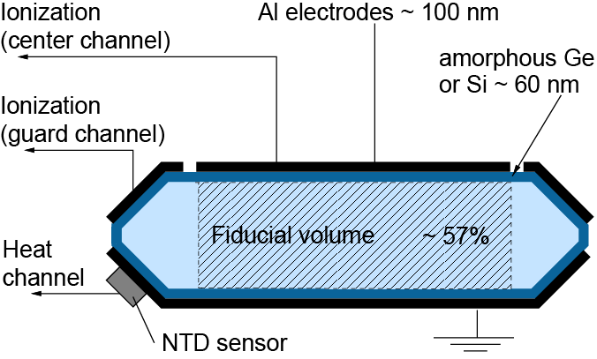
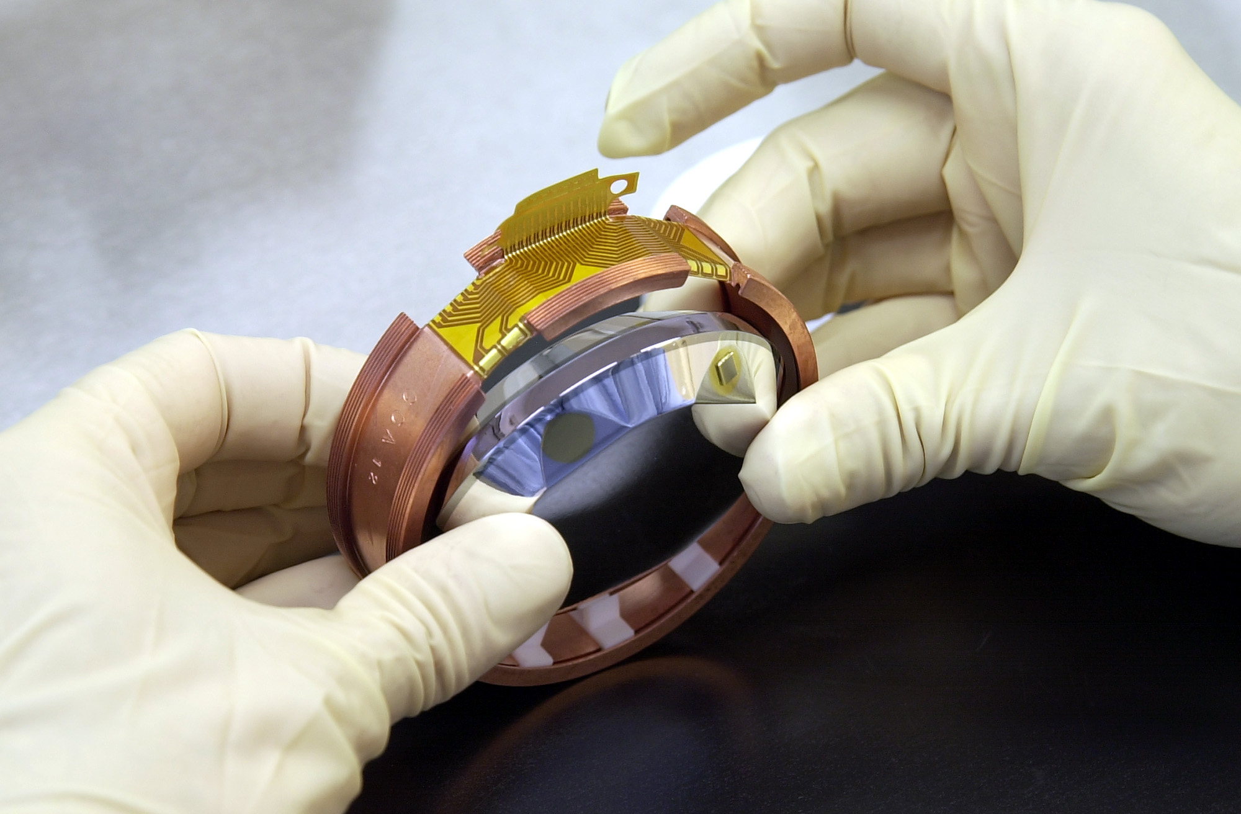
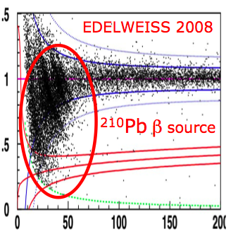
The EDELWEISS detectors: basic principle
Simultaneous measurement
• Heat @ 20 mK
with Ge/NTD thermometer
• Ionization @ few V/cm
with Al electrodes
Evt by evt identification of the recoil
Q=E_{ionization}/E_{recoil}
  • Q=1 for electron recoils
  • Q≈0.3 for nuclear recoils

Slide 5
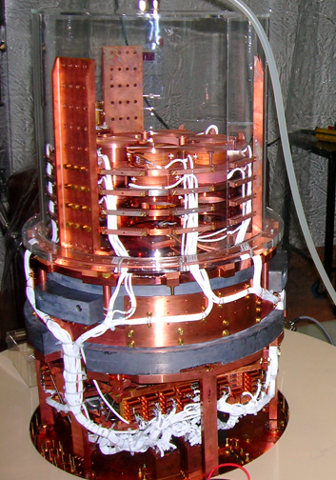
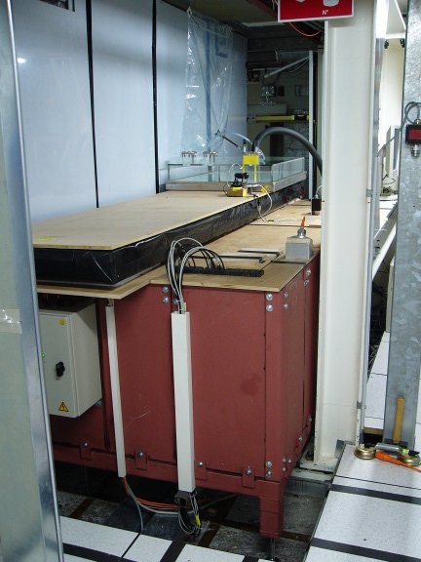
From EDELWEISS-I to EDELWEISS-II
Operated at the Underground Laboratory of Modane (4μ/day/m²) - deeper than Soudan
Goal 5*10⁻⁹ pb
Cryogenic installation (18 mK) :
  Reversed geometry cryostat, pulse tubes
  Remotely controlled
  Can host up to 40 kg of detectors
Shieldings :
  Clean room + deradonized air
  Active muon veto (>98% coverage)
  PE shield 50 cm
  Lead shield 20 cm
  ⇒ γ background reduced by ~3 wrt EDW1
!!! 12 cool-downs already operated since 2006 !!!
(Many) others :
  Remotely controlled sources for calibrations + regenerations
  Detector storage & repair within the clean room
  Radon detector down to few mBq/m³
  He3 neutron detector (thermal neutron monitoring)
  Liquid scintillator 1 T neutron counter (study of muon induced neutrons)
Liquid scintillator neutron counter
Precise studies of muon induced neutron

Slide 6
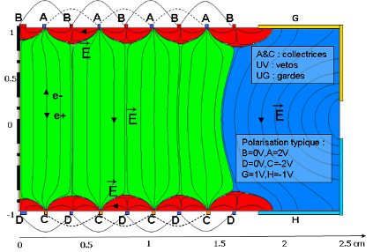
ID detectors: surface event rejection with interleaved electrodes
First detector built 2007
1x200g + 3x400g tested in 2008
10 IDs build in few months end of 2008
- 5 with Photolitho @ Canberra
- 5 with evaporation @ CSNSM
- NTD glued @ CEA/SEDI
ID401 to 405: Φ 70mm, H 20mm, 410g
14 concentric electrodes (width 100μm, spacing 2mm) without beveled edge.
ID2 to ID5: Φ 70mm, H 20mm, 370g
13 concentric electrodes (width 200μm for ID2, 50 μm for ID3, spacing 2mm) with beveled edge 8 mm.
Keep the EDW-I NTD phonon detector
- Modify the E field near the surfaces with interleaved electrodes:
M_{Fid}~40-50%
- Biases to have an electric field
~ horizontal near the surface and
~ vertical in the bulk
- The rings are alternately connected by ultra-sonic bonded wires.
→ Easy cuts on « veto » + guard electrodes define the fiducial zone

Slide 7
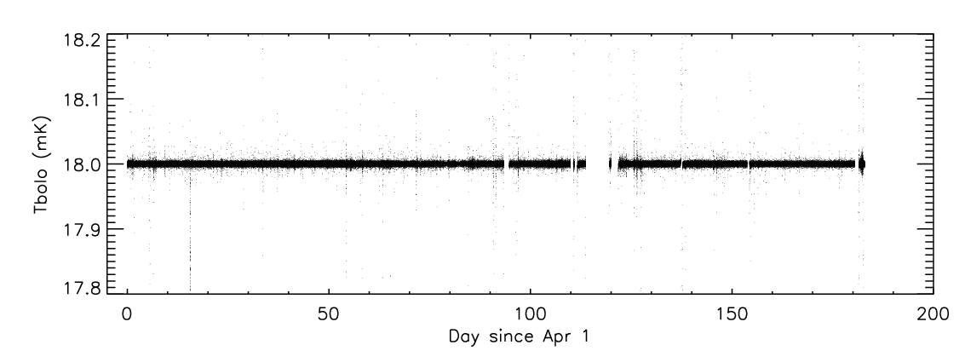
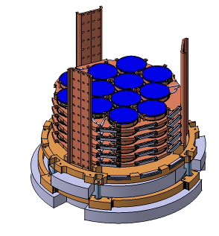
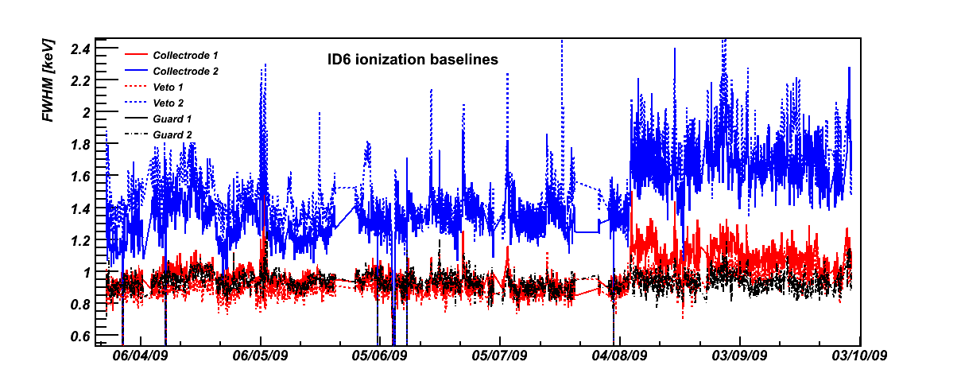
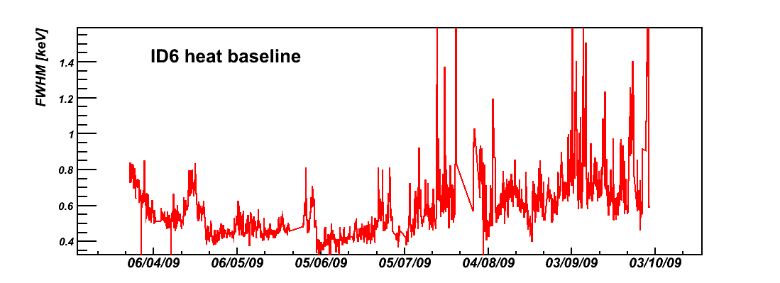
WIMP hunting with ID detectors
Run 12 (1st april 2009 – 20 may 2010): stability over 14 months
418 days
322 data (77% of 418)
305 physics (73% of 418)
All bolo working, 90% electronics channels ok
9/10 bolo for Physics
8 d gamma
5 d neutron
4,5 d «other»
  Incl. PE tests
« One of the coldest place in the Universe »
Continuously at 18 mK during more than 1 year !
Ionisations baseline
Heat baseline

Slide 8
The worst enemy: the background
Estimated background for the full statistics run
Sources
Counts
Gamma: ¹³³Ba calib rejection x observed bulk γ <1.0
Beta: β source rejection x observed surface evts <0.2
Neutrons from μ’s: μ veto efficiency x observed muons <0.25
Neutrons from Pb: measured U limits x Monte Carlo simu <0.1
Neutrons from rock: measured neutron flux x Monte Carlo simu <0.1 MC tuned with outside strong AmBe source
SUM < 1.6 counts for the whole WIMP run (90% CL)

Slide 9
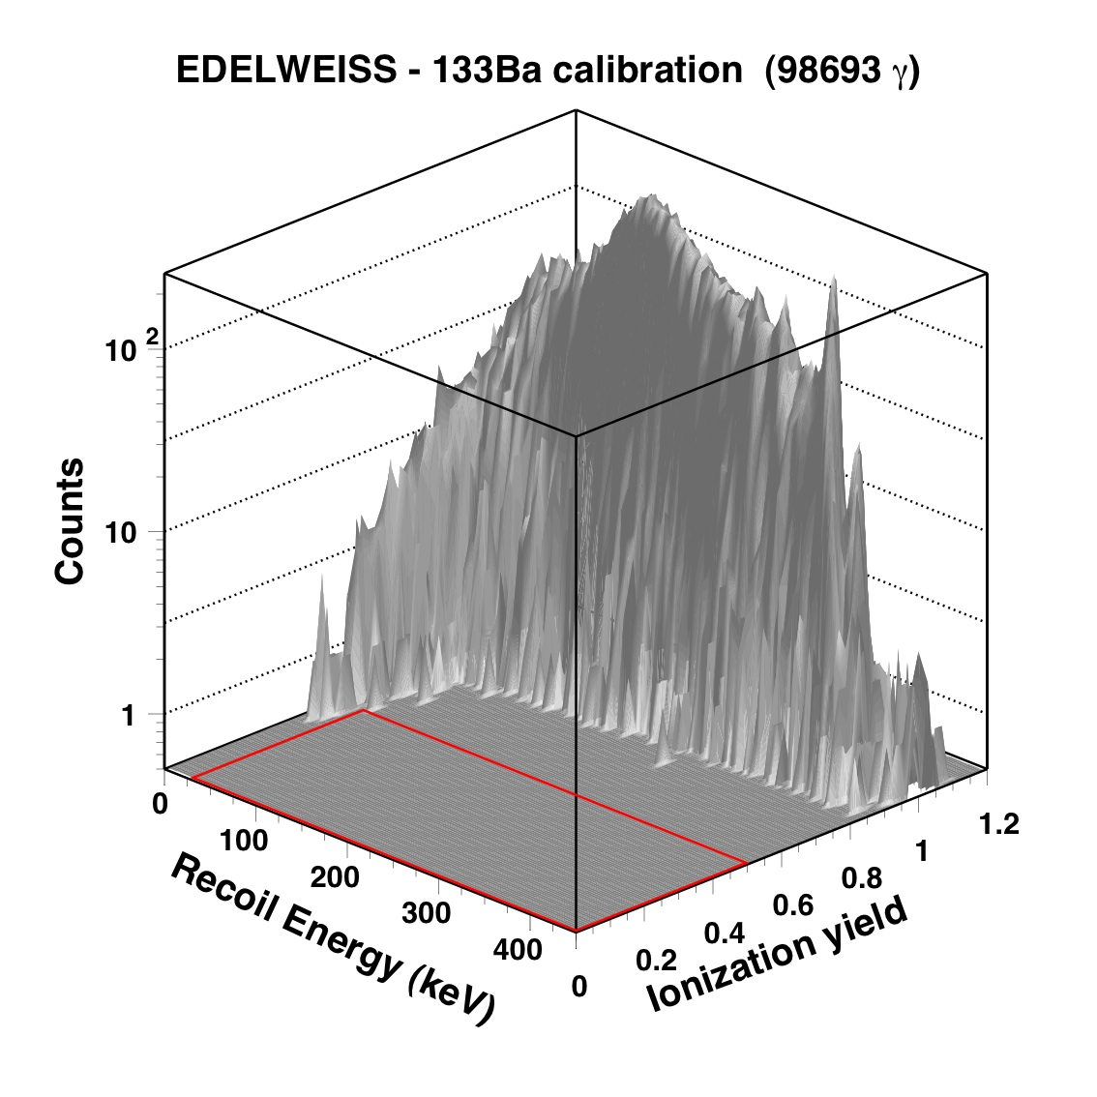
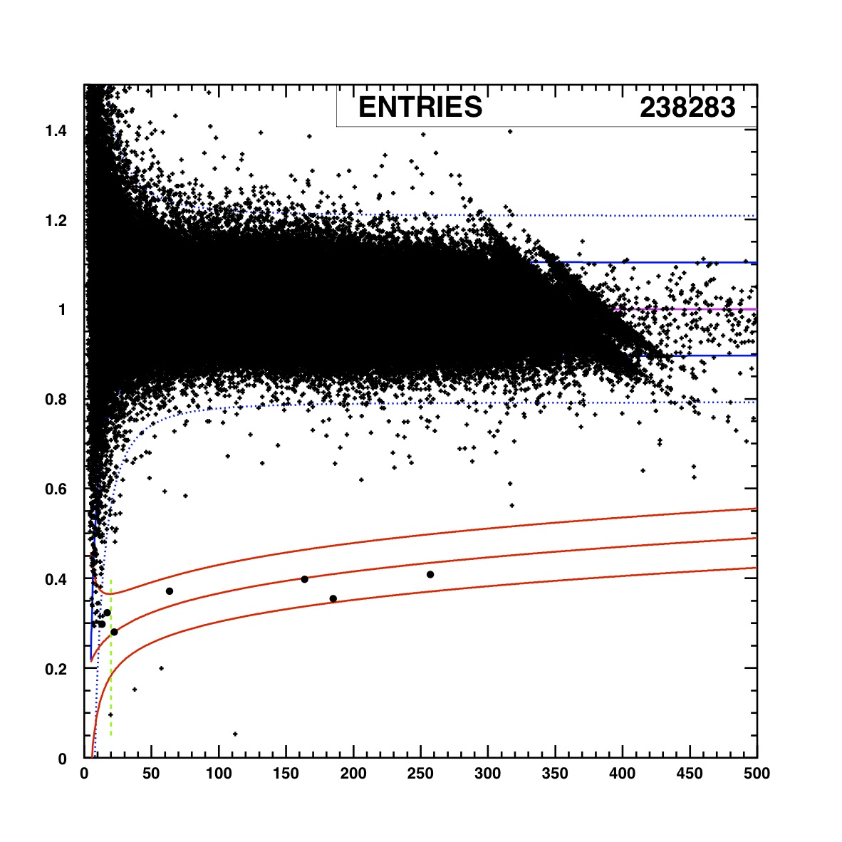
Gamma calibrations
First 6 months
Full statistics – 14 months
preliminary
0 evts
4 evts in NR band
20<Er<200 keV
2 det, gaussian behaviour, no cand event
Stat * 2.5, all 10 detectors, 4 evts
¹³³Ba calib: 150 000 evts in 20-200 keV => < 1 evt exp in 16 600 evts in WIMP run (90% CL)
Knobs to understand/improve
  Recombination e-h : optimise operation of polarisation voltages, regeneration procedures
  Pile up, multisite events : fast readouts on heat and ionisation
  2 NTD heat measurements, segmentation

Slide 10
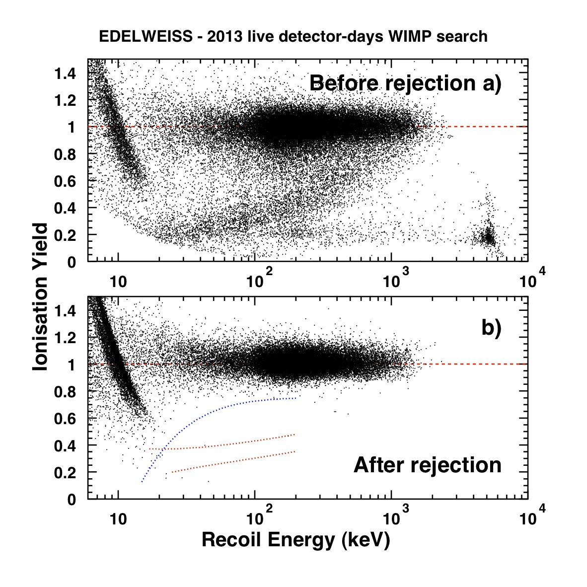
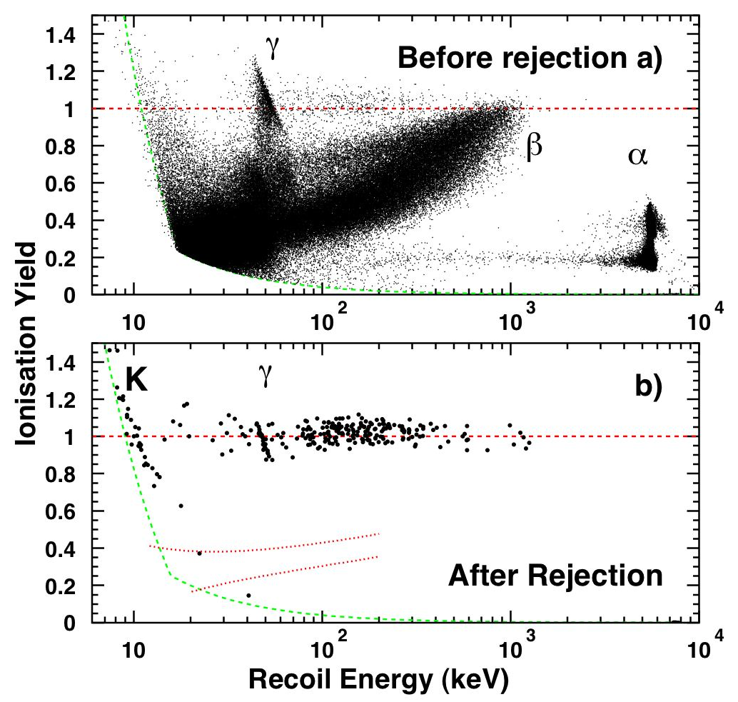
Beta calibrations & Backgrounds
Data for WIMP search
²¹⁰Pb calibration
6x10⁴
²¹⁰Bi
6x10⁴
²¹⁰Po
6x10⁴
²¹⁰Pb
preliminary
99.99 % γ limit
1 evt
NR band
Identified surface events in data
  < 0.2 evt expected after rejection
Knobs to improve
  change surface treatment
  better E resolutions
PLB 681 (2009) 305-309 [arXiv:0905.0753]

Slide 11
WIMP search: the first 6 months
EDELWEISS Coll. / E. Armengaud et al. Physics Letters B 687 (2010) 294–298 [arXiv:0912.0805]
* 15
Expected rates from first 6 months from previous calibrations/simulations
- gamma < 0.01 evt (99.99% rejection, gaussian behaviour)
beta ~ 0.06 evt (from ID201 calibration + observed betas)
neutrons from ²³⁸U in lead < 0.1 evt
neutrons from ²³⁸U+(α,n) in rock ~ 0.03 evt
neutrons from muons < 0.04 evt
1 candidate: E_{r}= 21 keV
Estimated background < 0.24
15* better than EDW-I
Best limit 1*10⁻⁷ pb @ M_{w}~80 GeV

Slide 12
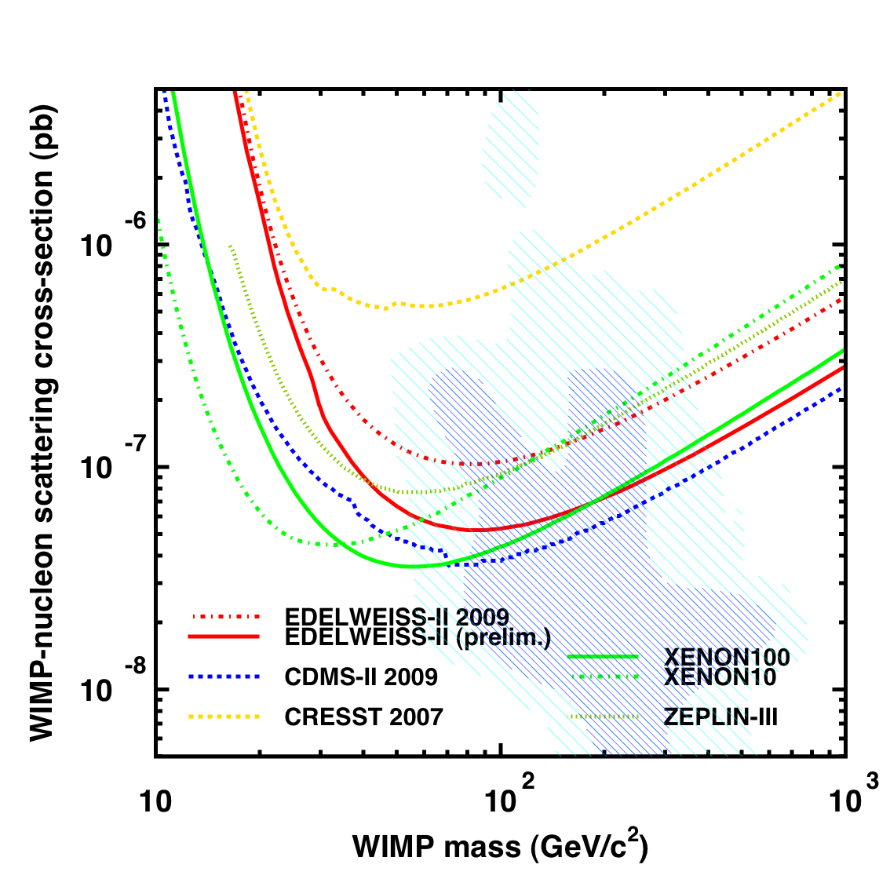
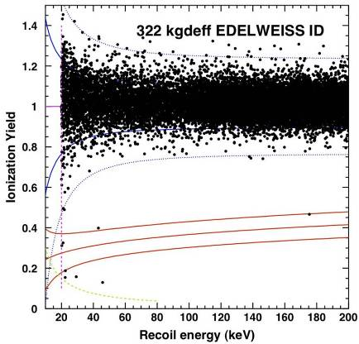
WIMP search: preliminary results of the all 14 months
* 2
preliminary
Preliminary results: end of data taking in may 2010 - 2nd analysis ongoing
Sensitivity increased by a factor 2 (it scales with stat!)
3 candidates near threshold, 2 outliers (1 @ 175 keV in NR band)
Best limit 5*10⁻⁸ pb @ M_{w}~80 GeV
Background starts to appear → Studies in progress…

Slide 13
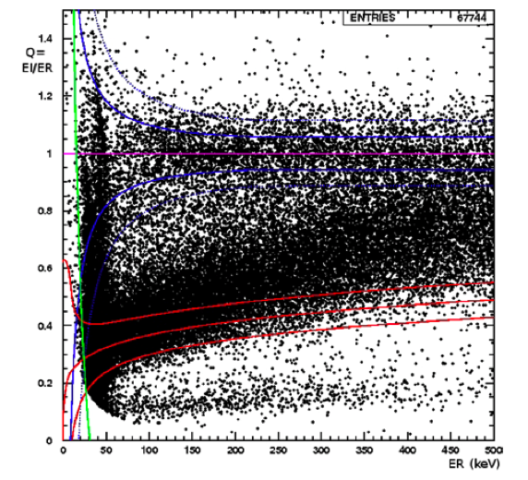
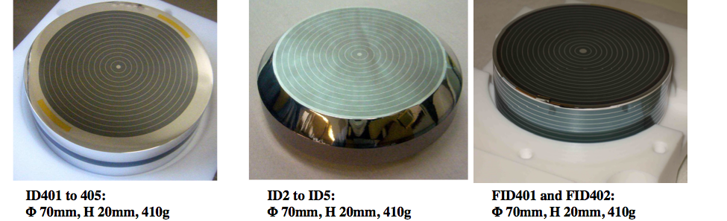
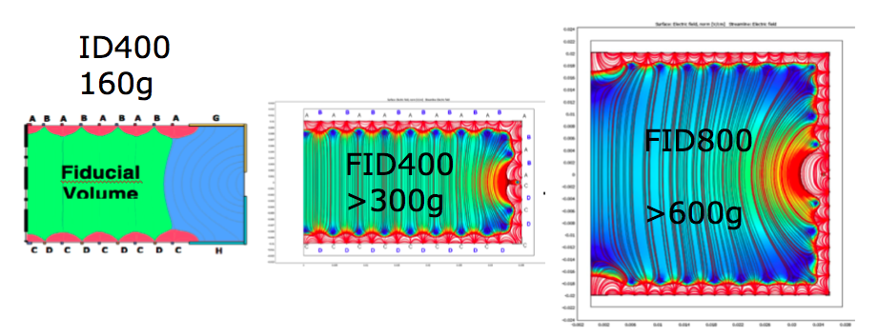
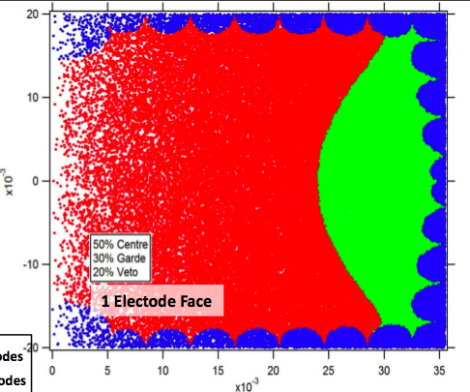
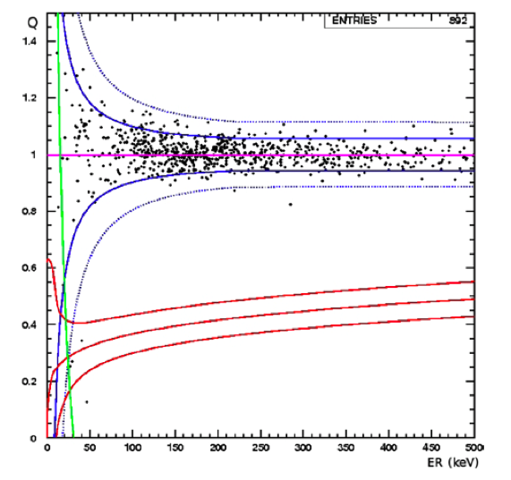
What’s next: from ID to FID detectors
before selection
After fiducial selection
FID400 beta rejection
4/68000 for E>25keV
Fiducial mass x2 x4
ID200 => ID400 => FID400 => FID800
²¹⁰Pb source @LSM

Slide 14
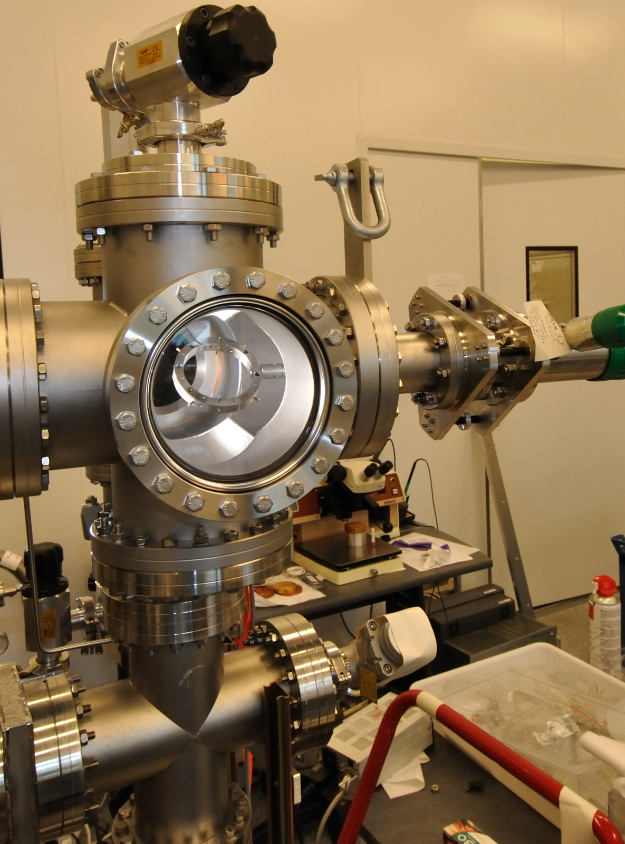
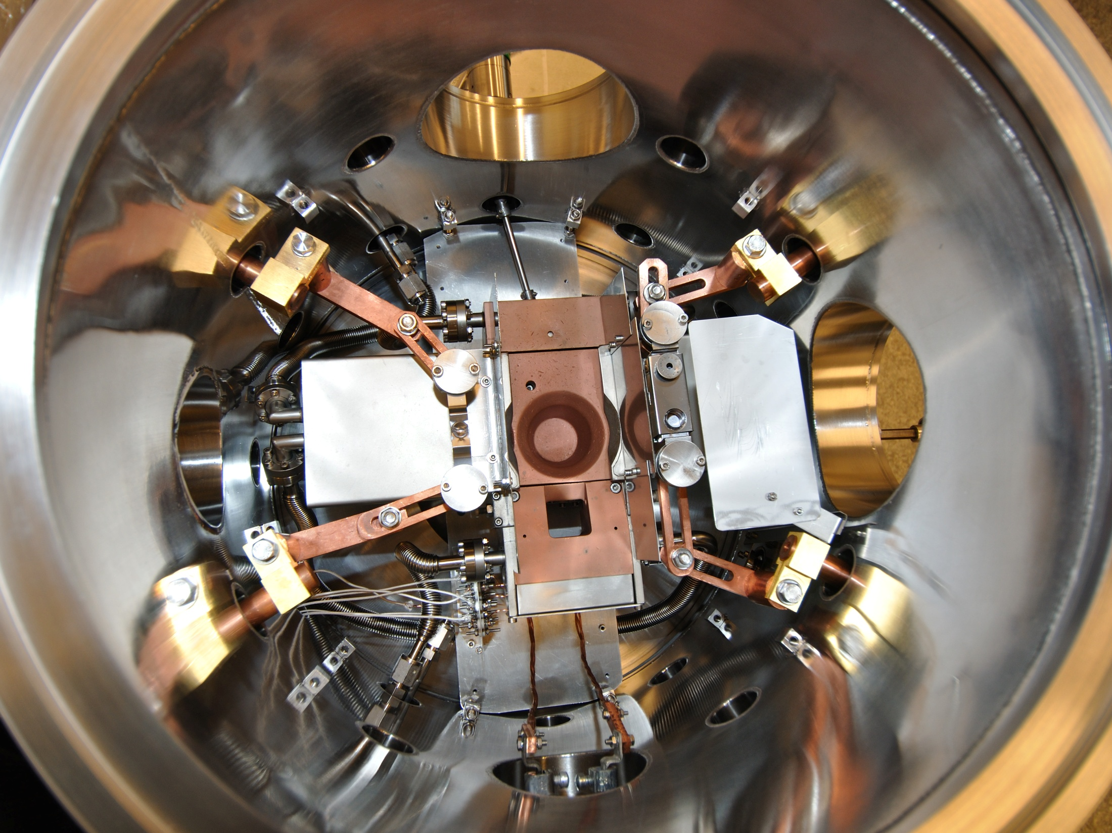
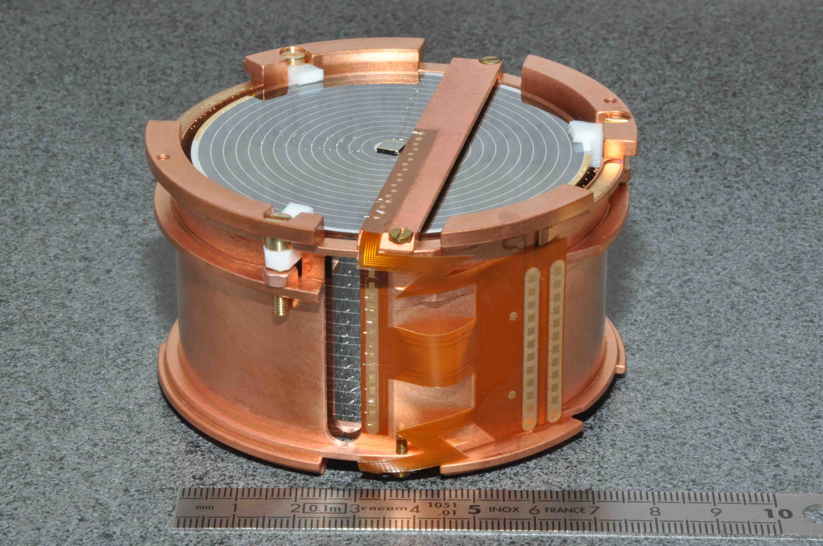
FID production @ CSNSM-Orsay
218 ultrasonic bonding
218 ultrasonic bondings/detector
Production of FID detectors performed @ CSNSM-Orsay in a dedicated evaporator.

Slide 15
What’s next…
3rd of July 2010: installation of 4 FID 800g @ LSM
15th of July 2010: cooling down of the cryostat
4 "towers" of 4 detectors each:
10 ID 400g, 2 FID 400g, 4 FID800g
End of July: detector optimisation
Beginning of August: start of run 13
End of the year: run 13 outcome

Slide 16
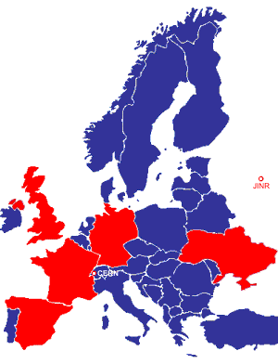

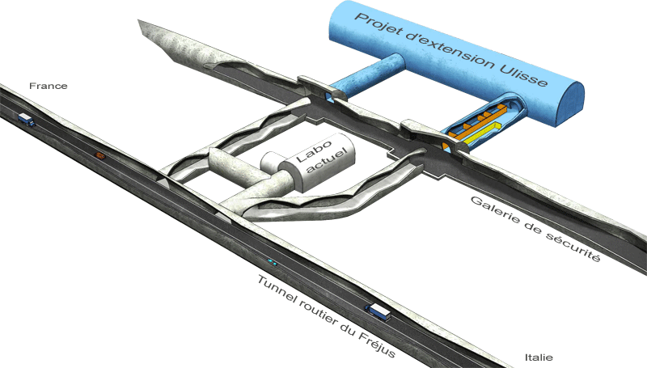

The next future: EURECA
EURECA: European Underground Rare Event Calorimeter Array
Joint European collaboration of teams from EDELWEISS, CRESST, ROSEBUD, CERN, + others...
It is a part of the ASPERA European Roadmap.
The goal: 10⁻¹⁰ pb, 500 kg – 1 ton cryogenic experiment.
2nd generation experiment with huge efforts in background reduction, detector development and build infrastructures.
Preferred site: 60000 m² @ ULISSE (extension of present LSM, to be dig in 2011-2012)
N.B. Collaboration agreement with SuperCDMS & GeoDM for common studies!

Slide 17
Conclusions and perspectives
Edelweiss ID detectors
  Robust detectors with a very high beta rejection
  1 year of data analysis (preliminary)
      No evidence of WIMPs
      5*10⁻⁸ pb: the achieved sensitivity
Next goal: 5*10⁻⁹ pb
  Background improvement and comprehension
      Increased redundancy for both heat and ionisation channels
      Fast readout (multisite, pile-up)
      Internal PE shield
  New prototypes FIDs 800 g
      2011 = 1000 kg*d
  Build 40 detectors, upgrade of the set-up
      2012 = 3000 kg*d
The next future: EURECA

Slide 19
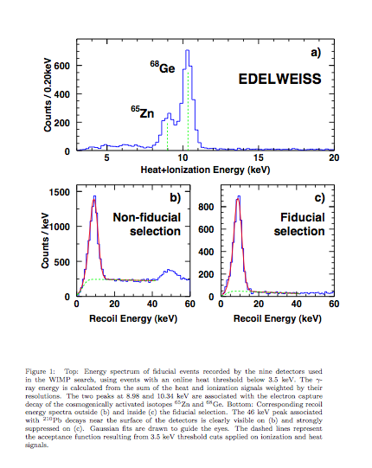

Slide 20
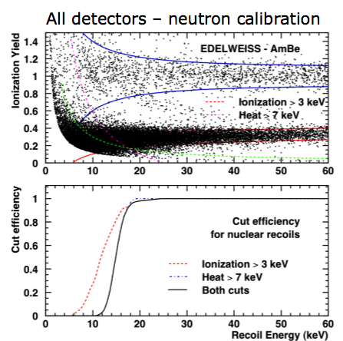
Data analysis of first 6 months
2 independent processing pipelines
Pulse fits with optimal filtering using instantaneous noise spectra
Period selection based on baseline noises
  80% efficiency
Pulse reconstruction quality (chi2)
  97% efficiency
Fiducial cuts based on ionization signals (160g)
90% nuclear recoil acceptance
99.99% gamma rejection
Bolo-bolo & bolo-veto coincidence rejection
WIMP search threshold fixed a priori Er > 20 keV (100 % acceptance)
Agreement between the results of the two analyses

