Slide 1
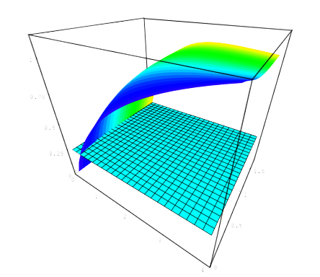
The Distribution of DM in Galaxies
Paolo Salucci (SISSA)
TeVPa Paris,2010

Slide 2
OUTLINE
  DM as explanation of the mass discrepancy in galaxies
  The amount and distribution of DM in Spirals
  The nature of DM
  1996 MNRAS, 281, 27 Persic, M.; Salucci, P.; Stel, F.
  The universal rotation curve of spiral galaxies - I. The dark matter connection
  2007 MNRAS, Salucci , Lapi, Gentile, Klein
  The universal rotation curve of spiral galaxies out the virial radius II

Slide 3
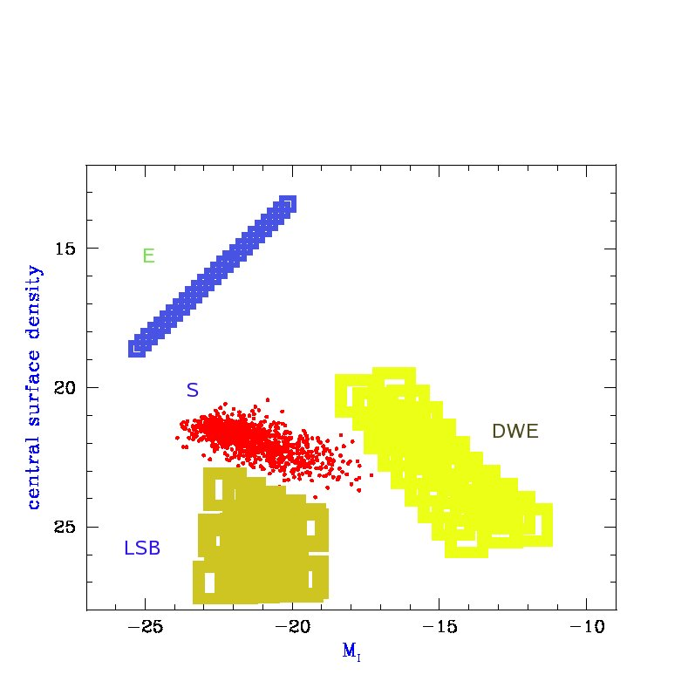
The Realm of Galaxies
15 mag range, 4 types, 16 mag arsec-2.range
Central surface brightness vs magnitude

Slide 4
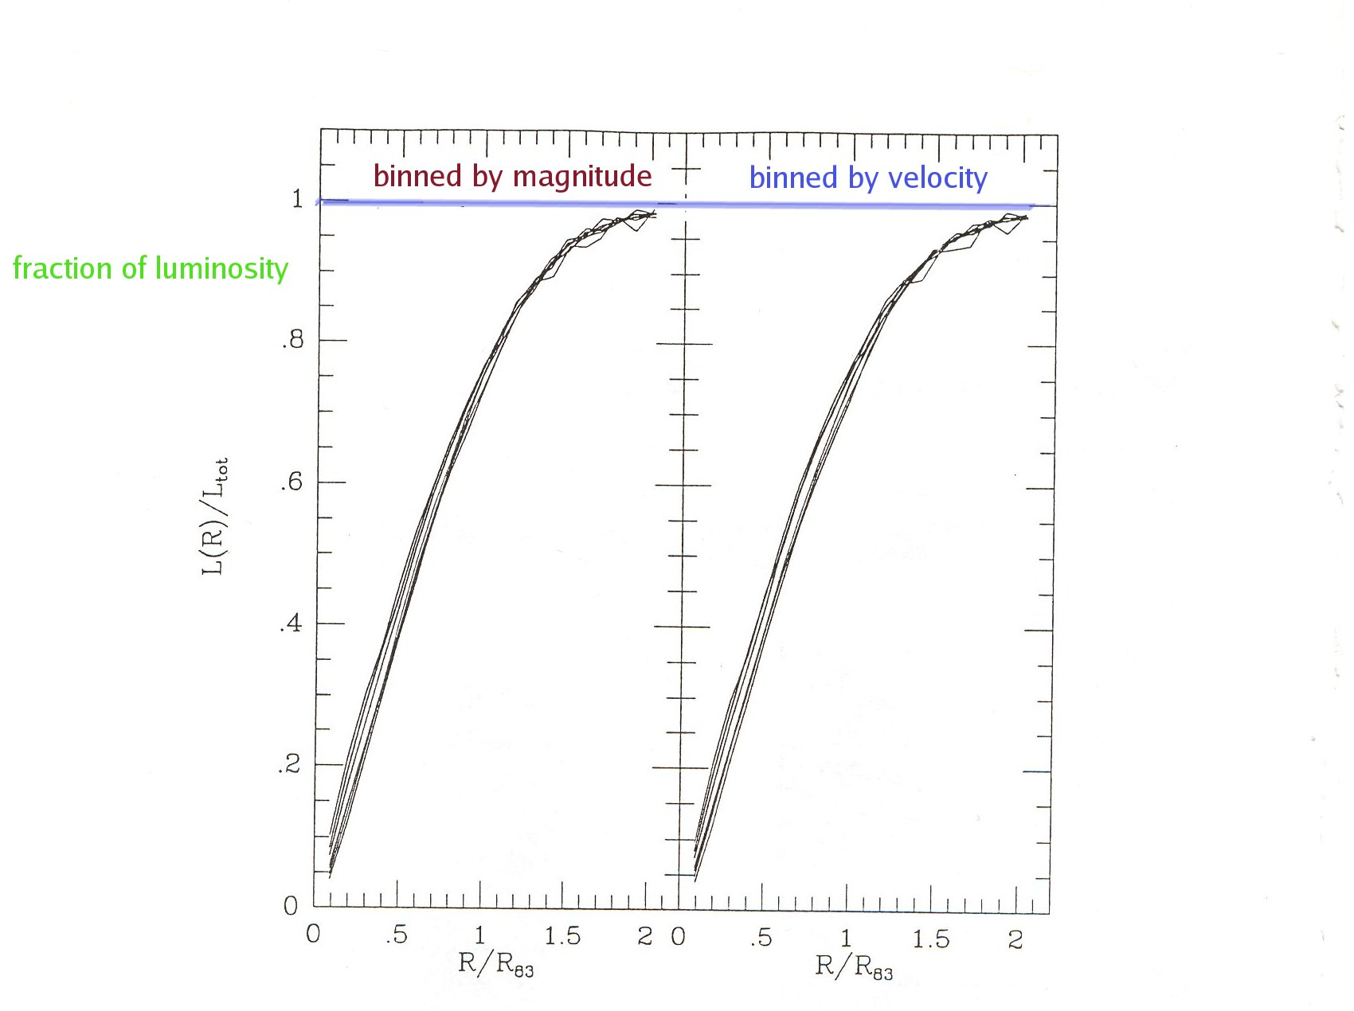
Luminosity profile is Universal.
Spirals /galaxies have a lenght-scale
Distribution of stars: L(R/R_{D})/L_{T} independent of Luminosity

Slide 5
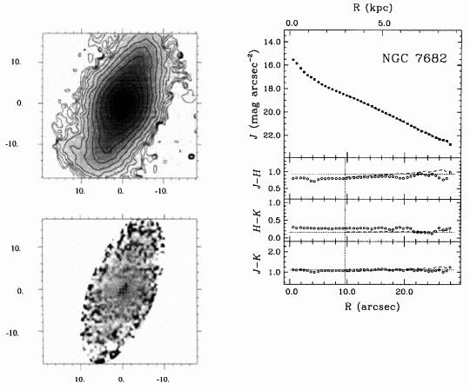
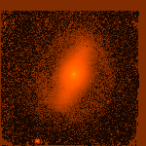
The light distribution in spirals is invariant I(r) = I₀exp[-R/R_{D}]

Slide 6
The mass distribution is luminosity dependent. Gravitating matter related with luminosity
TF RELASHIOSHIP:
Vmax
The relation: magnitude vs velocity @ different radii xi RD, [ xi=0.5,1,…5]
3 samples (600, 89, 78) M =ai + bi log V(xi)

Slide 7
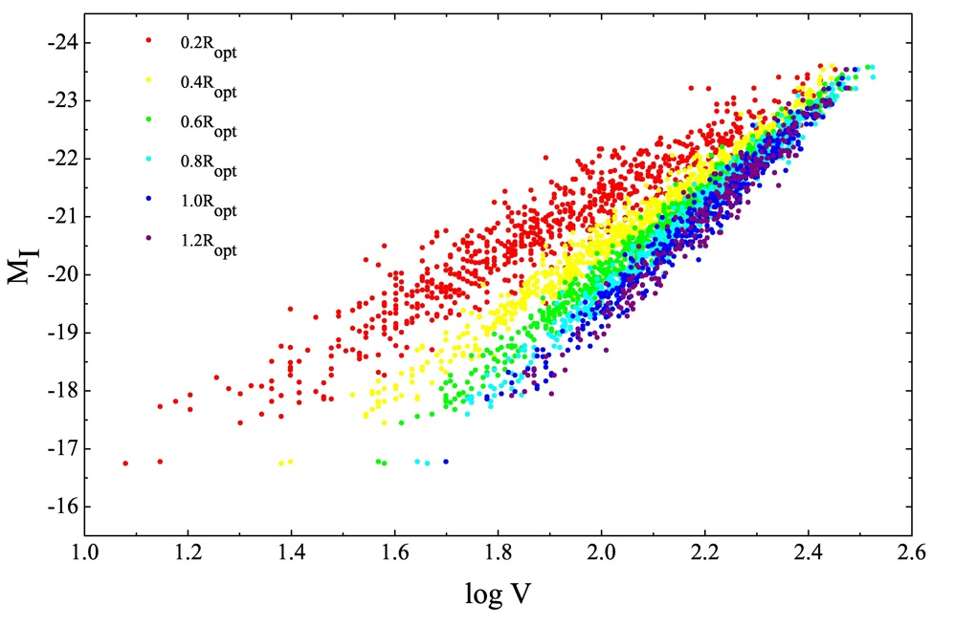
Radial TF relationships
TF exists at local level

Slide 8
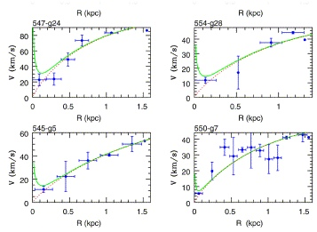
In the very inner circular velocities: light traces the mass No DM!
DISK ONLY

Slide 9
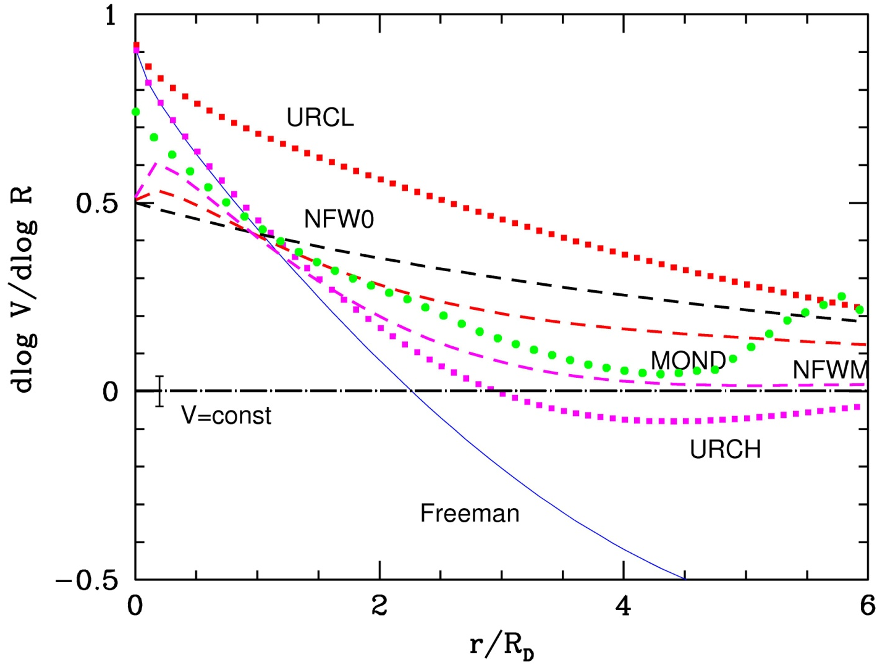
The slope of the RC a crucial quantity
OBSERVED
OBSERVED

Slide 10
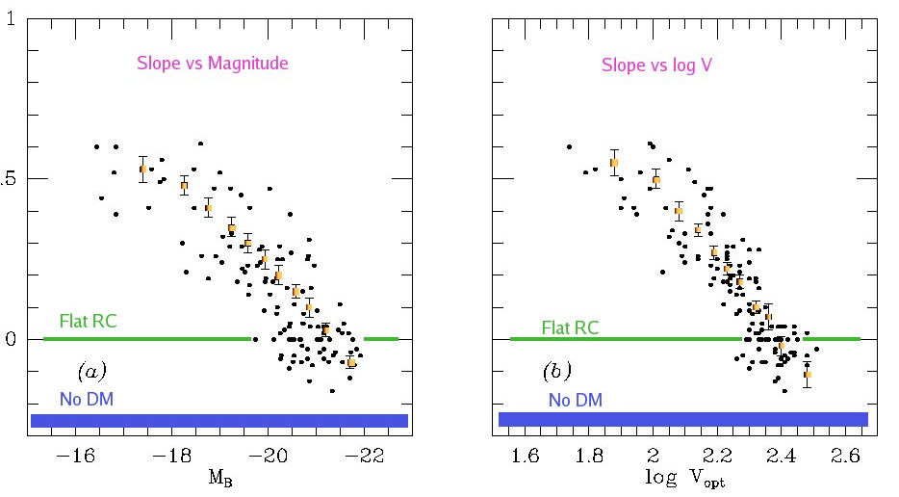
The RC slope indicates the presence and the amount of Dark Matter
‏

Slide 11
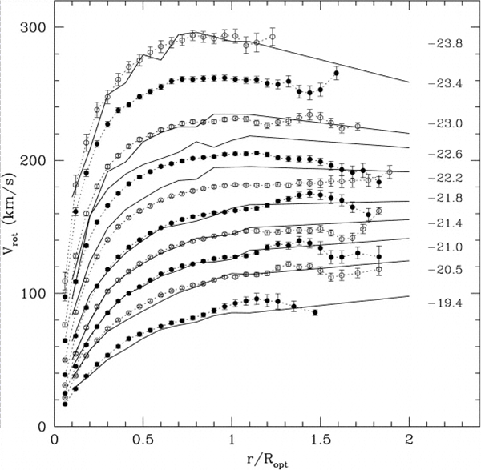
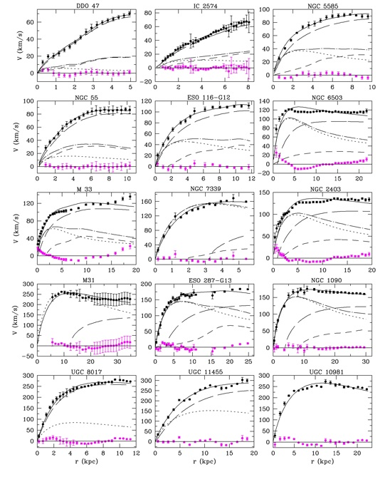
3200 coadded Individual
The rotation curves
C+06
PSS

Slide 12
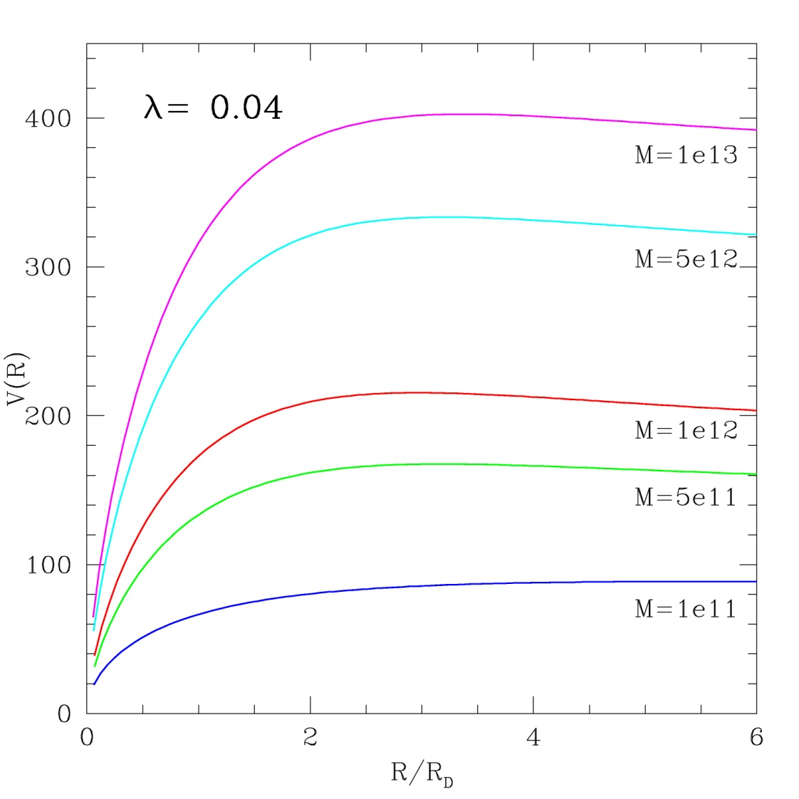
ΛCDM Universal Rotation Curve from NFW profile and MMW theory

Slide 13
The URC Concept
the Cosmic Variance of the values of RCs V(x,L) of galaxies of luminosity L @ a radius x=R/R_{D} is negligible with respect to the variation that:
in each galaxy, V(x,L) has as x varies.
@ each x, V(x,L) has as L _{varies}

Slide 14
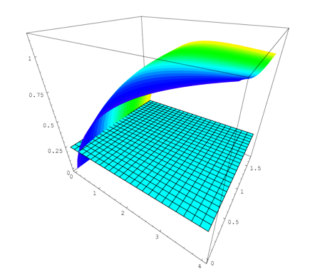
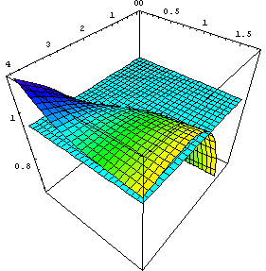
The URC
L
V
R
V
R
L

Slide 15
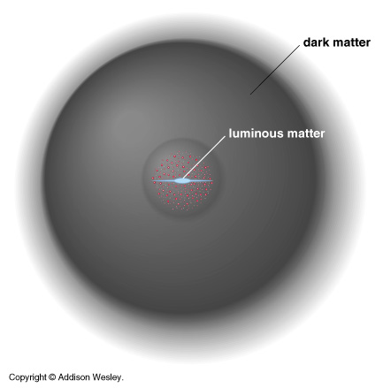
INTERPET:

Slide 16
Rotation curve decomposition.
: from I-band photometry
: from HI observations
• dark halos with constant density cores
• dark halos with “cusps” (NFW, Moore)
• HI-scaling
• MOdified Newtonian Dynamics
2-3 FREE PARAMETERS: MUST INVOLVE THE RC SLOPE

Slide 17
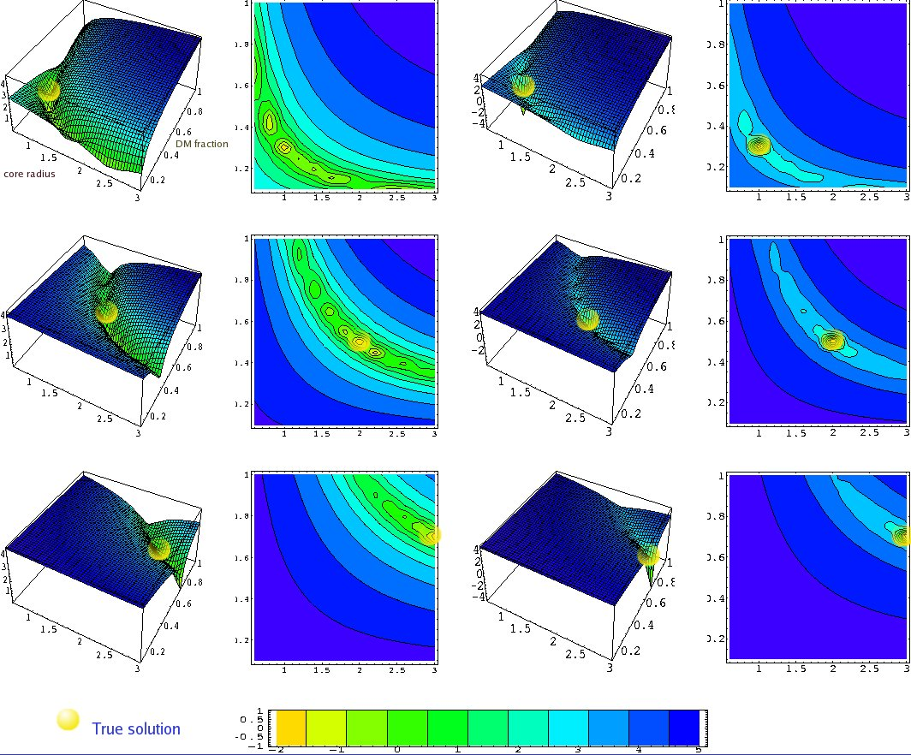
We can uniquely mass model a RC
disk-halo components, known surf phot, reliable V(R) and dV/dR, resolution ~ 0.3 RD

Slide 18
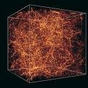
Dark halos from ΛCDM simulations
Halos form hierarchically bottom-up via gravit. amplification of initial density flucts. Most evident property: CENTRAL CUSP
Navarro, Frenk & White, ApJ 462, 563 (1996)
Bullock et al., MNRAS 321, 559 (2001)
Klypin,2010
The cusp vs core issue
cuspy NFW density profiles disagree with observed kinematics.
comparison galaxy by galaxy and of coadded kinematics highlights a CDM crisis.
Moore, Nature 370, 629 (1994)
Kravtsov et al., ApJ 502, 48 (1998)
Salucci & Burkert, ApJ 537, L9 (2000)
de Blok, McGaugh & Rubin, AJ 122, 2396 (2000)
Salucci, Walter & Borriello, A&A 409, 53 (2003)
Gentile et al., MNRAS 351, 903 (2004)
Kuzio de Naray, McGaugh & de Blok, ApJ 676, 920 (2008)

Slide 19
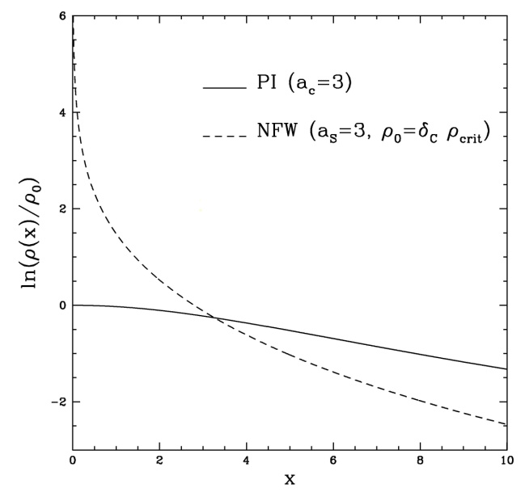
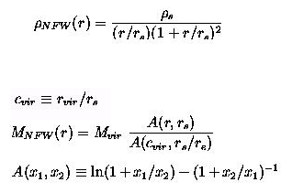
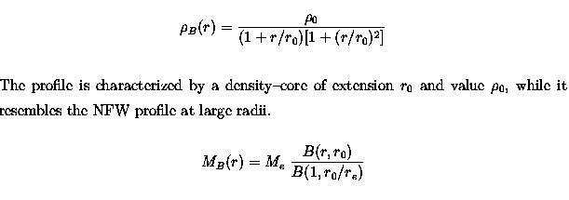
NFW Halos
Burkert-URCH-PI Halos
‏

Slide 20
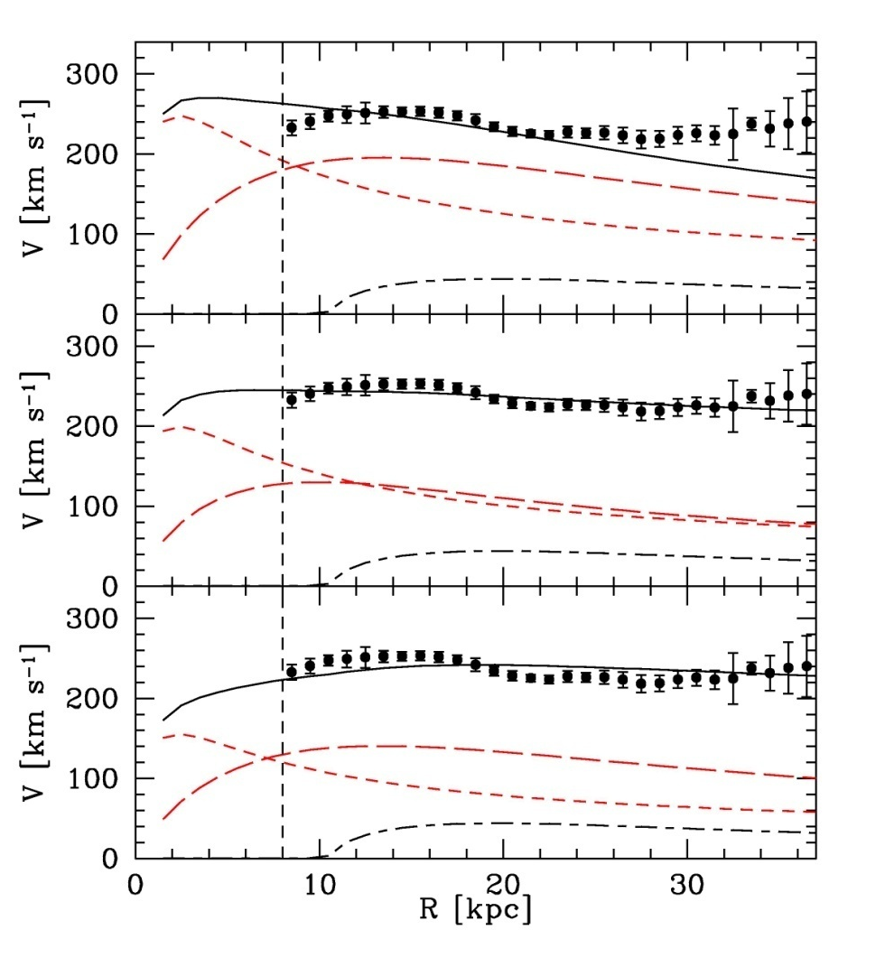
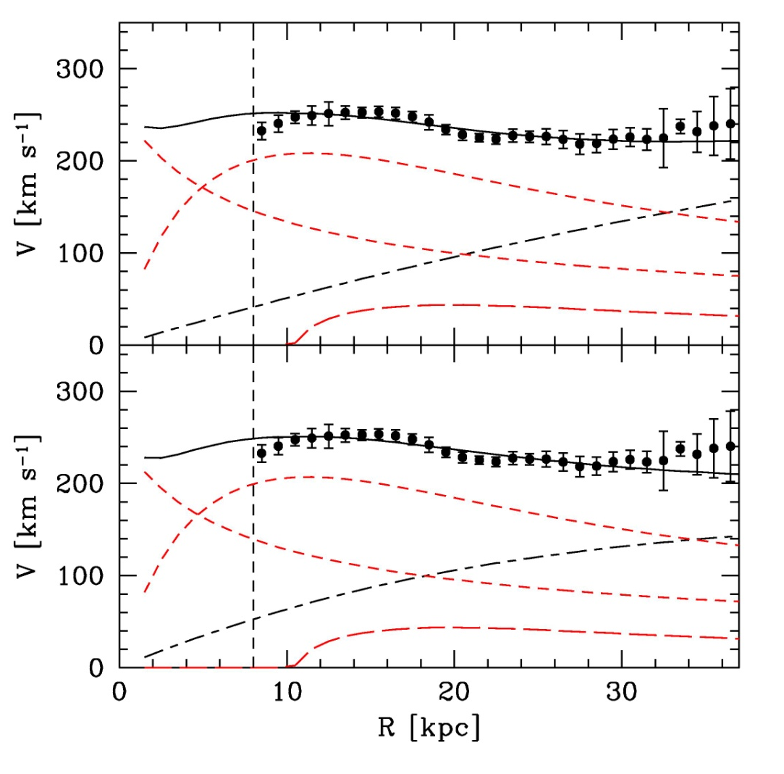
M 31
NO DM
BURKERT
MOND
NFW
MOND

Slide 21
A test case: ESO 116-G12
halo
stars
gas
Cored halos the best fits

Slide 22
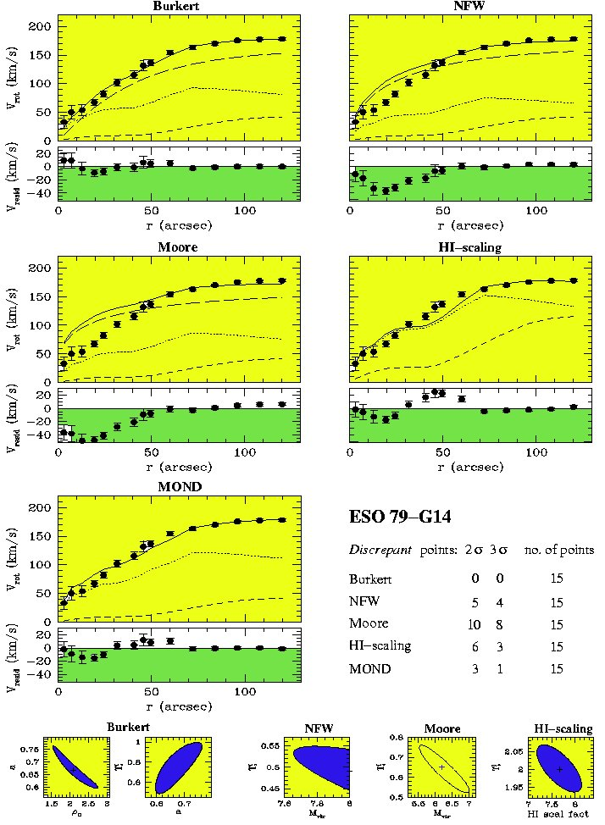
50 objects investigated
NFW inconsistent

Slide 23
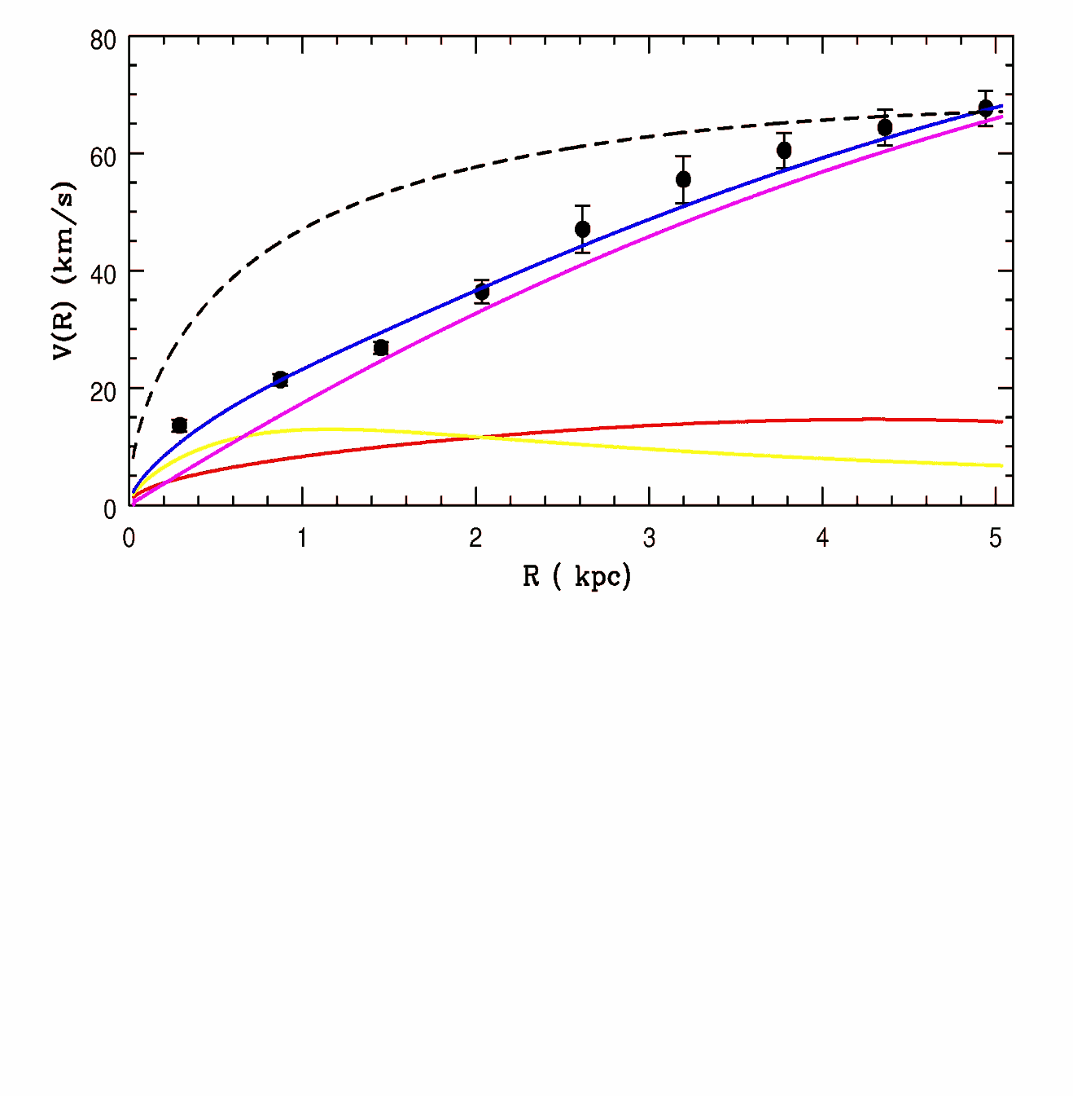
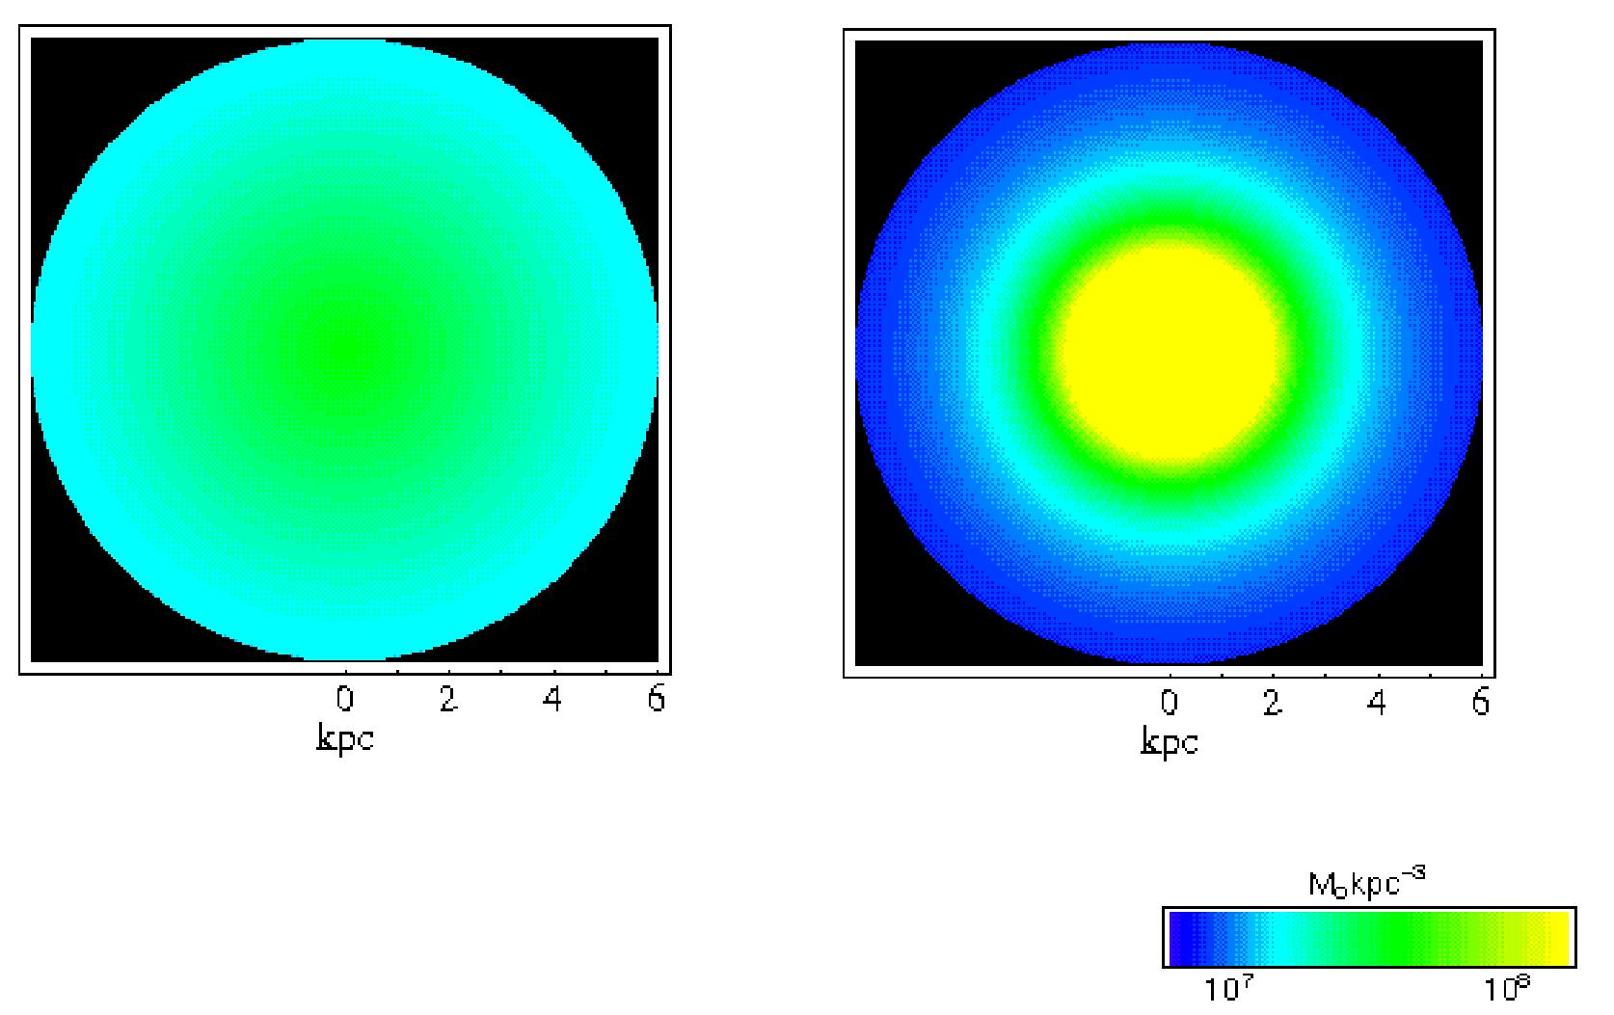
DDO 47
NFW
NFW HALOS
Fit badly the RCs
Unphysically too low stellar mass-to-light ratios
Unphysically too high halo masses
NFW
Theory Obis ssw
Obs Theory

Slide 24
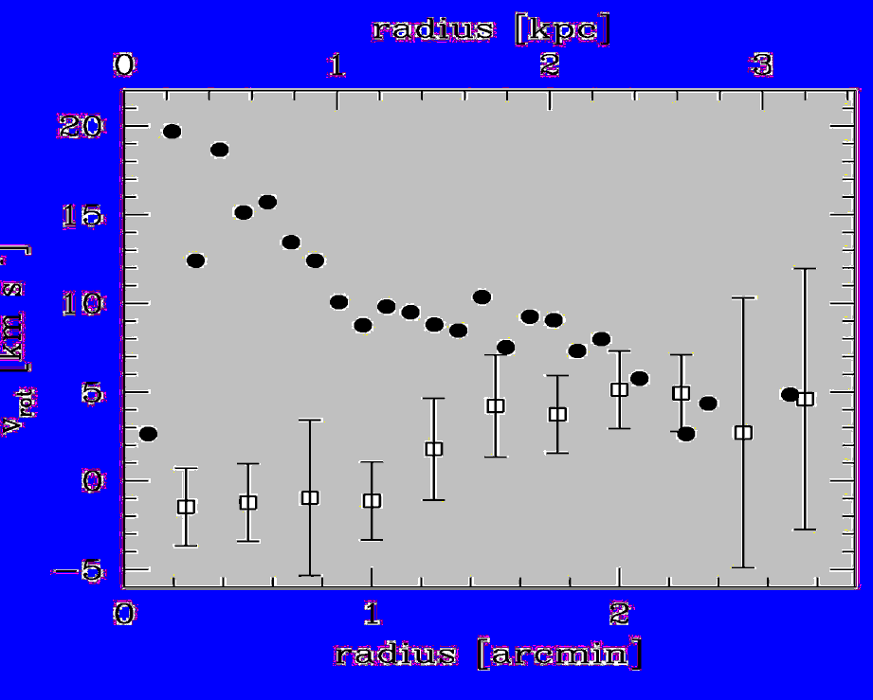
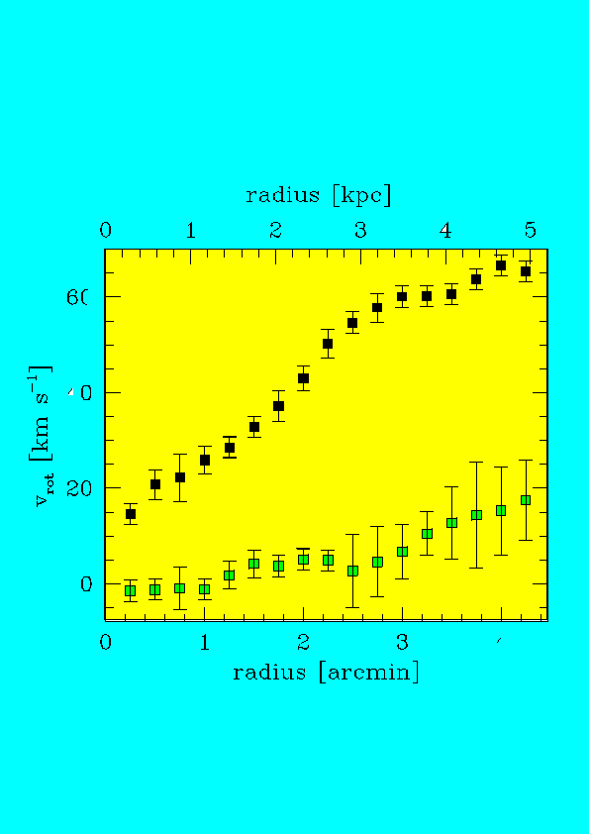
DDO 47: non circular motions ?
Triaxial halos predictions
V (minor axis)
R

Slide 25
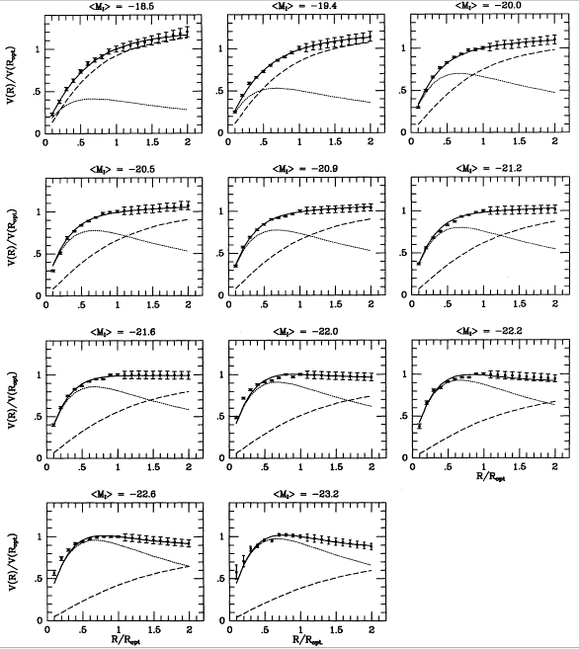
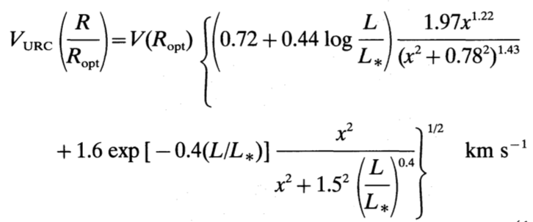
Modelling the Universal Rotation Curve
Rotation
velocity
Stellar contribution
Dark matter halo contribution
Stars
Dark matter

Slide 26
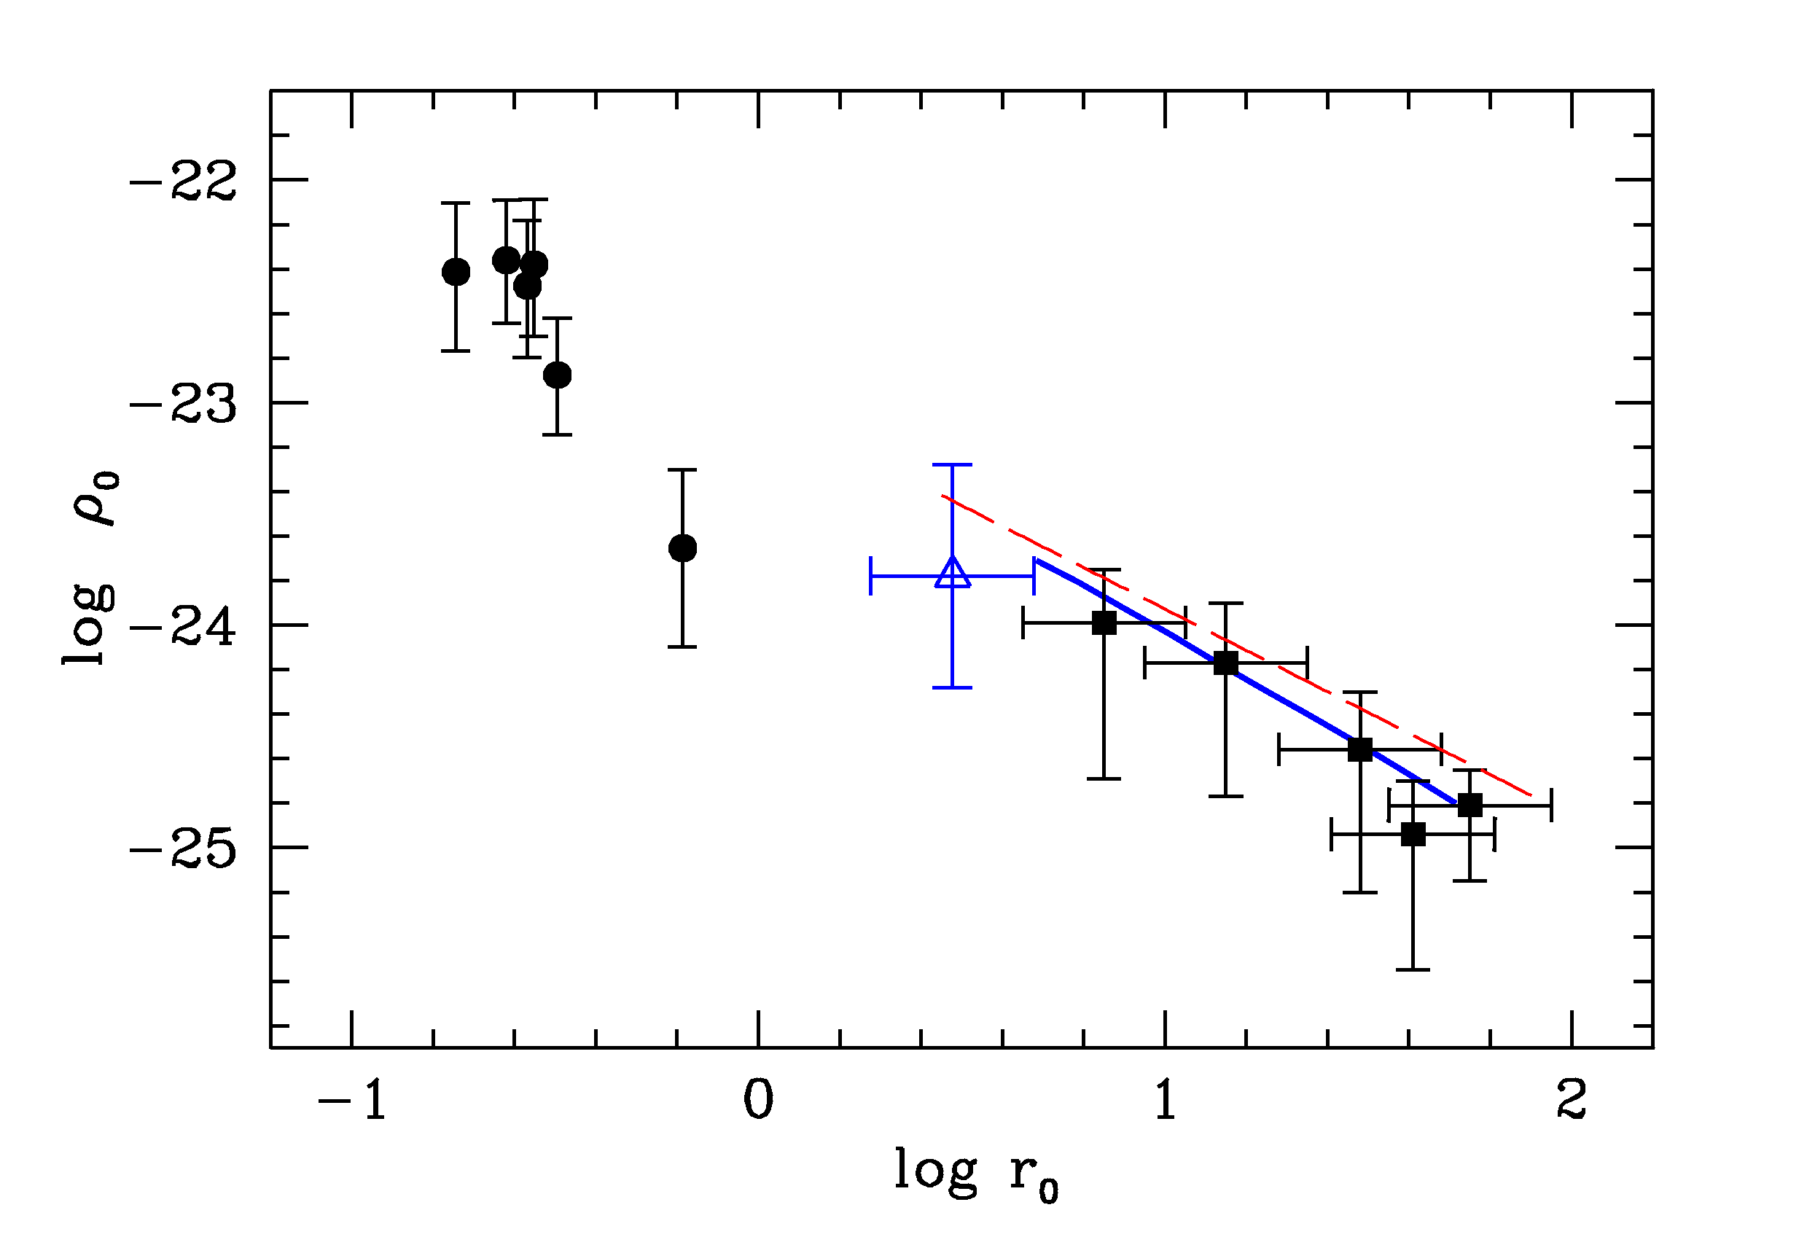
Halo central density vs core radius scaling r ₀ =10⁻²³ (r₀ /kpc)⁻¹ g/cm³ (WDM? De Vega et al 2010)
dSph
B
WL
URC

Slide 27
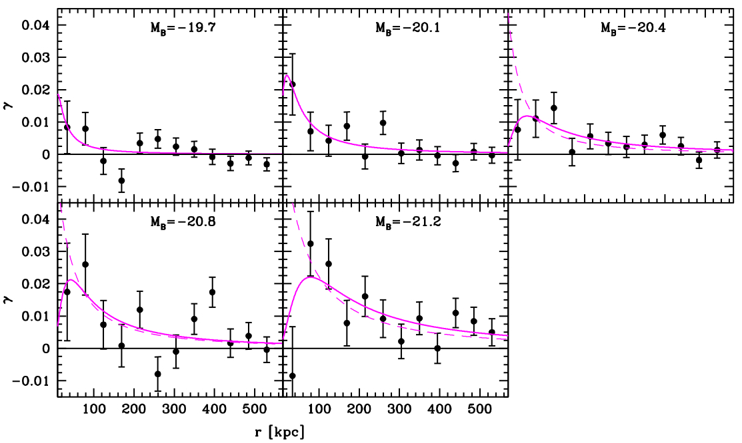
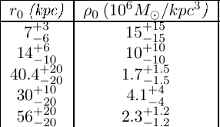

Weak lensing
With a density profile we model the tangential shear
Obtain the structural free parameters.
NFW
B
Same results as those obtained from RCs.
Burkert profile provides excellent fit, better than NFW.
Christiane Frigerio Martins

Slide 28
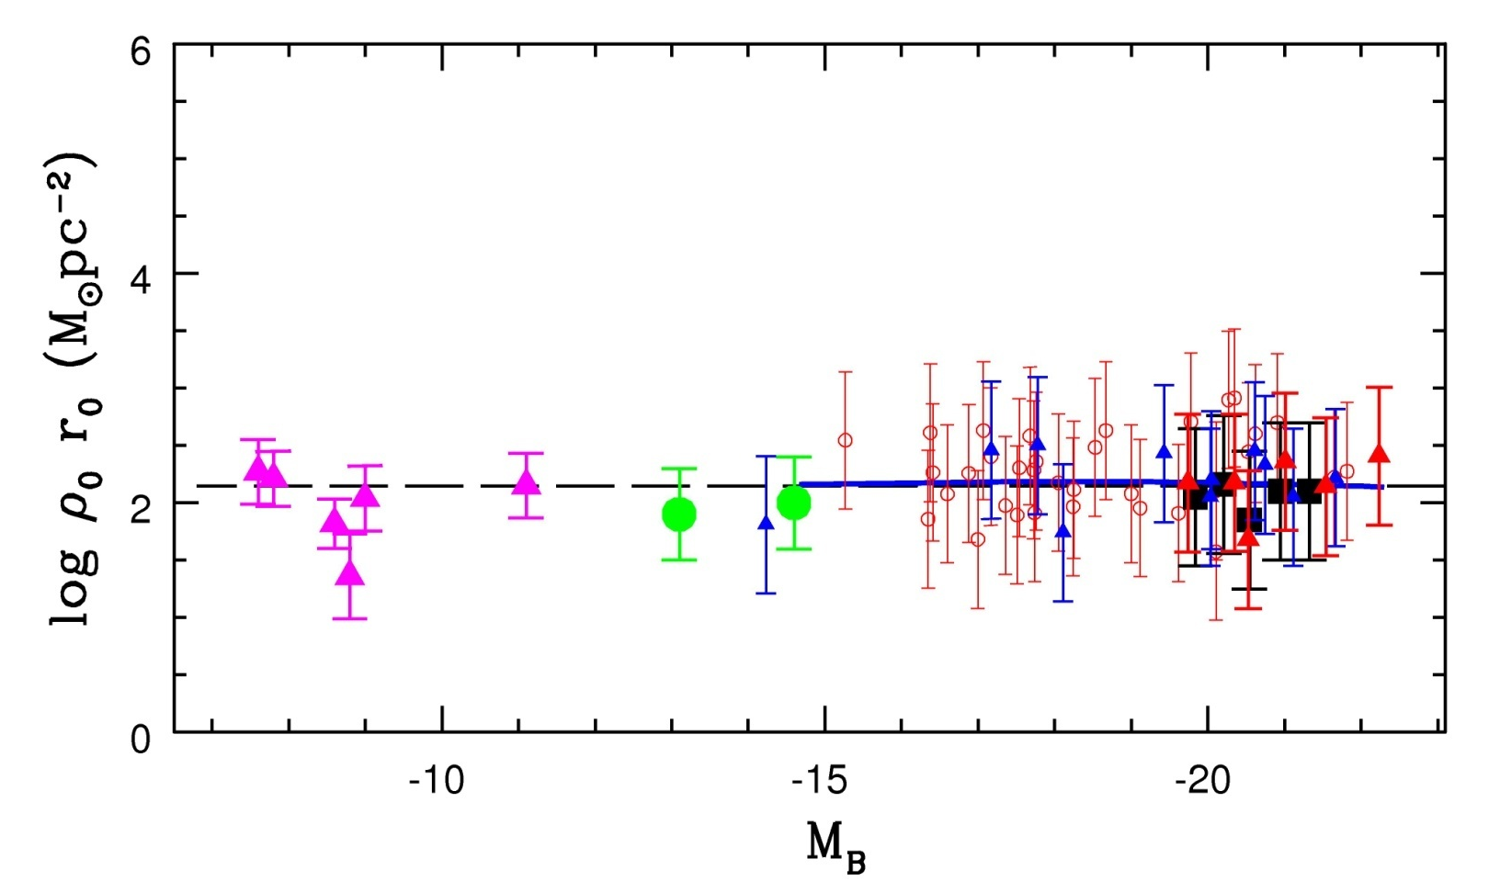
DM CENTRAL SURFACE DENSITY

Slide 29
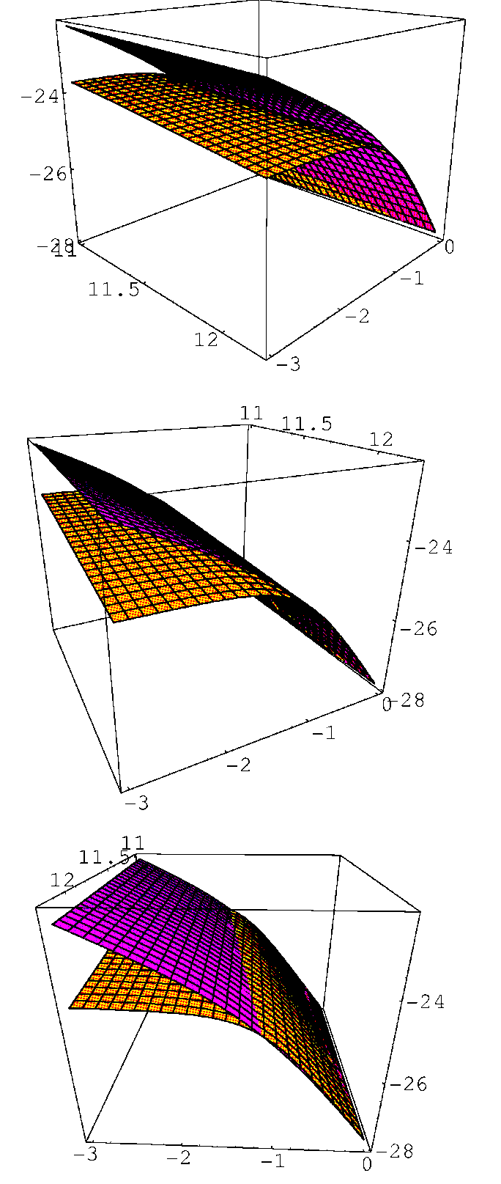
RESULTS
DM halo density: observations vs simulations

Slide 30
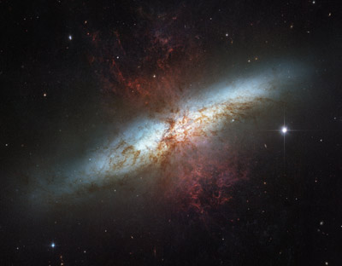
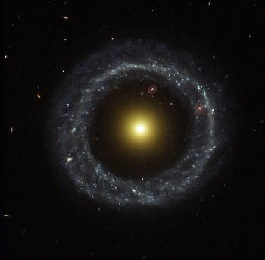
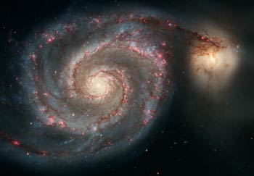
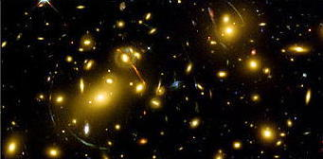
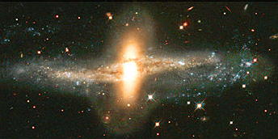
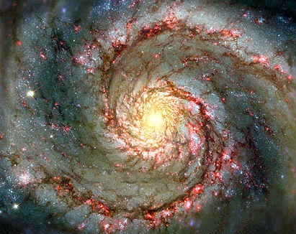
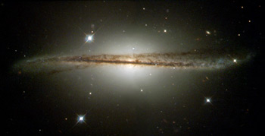
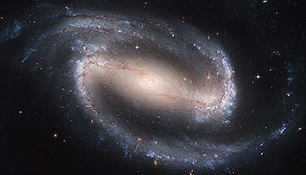
DARK MATTER IS PRESENT IN GALAXIES
IT IS STRONGLY RELATED TO THE LUMINOUS MATTER
THERE IS A SOLID EMPIRICAL SCENARIO

