Slide 1



Search for Point sources with the antares neutrino telescope
Juan de Dios Zornoza, IFIC (CSIC-UV)

Slide 2
Outline
The ANTARES telescope
Search methods
  Likelihood ratio (LLR)
  Expectation-Maximization (EM)
  (also a binned method, not discussed here)
Results

Slide 3
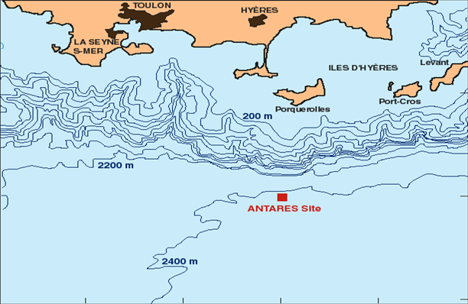
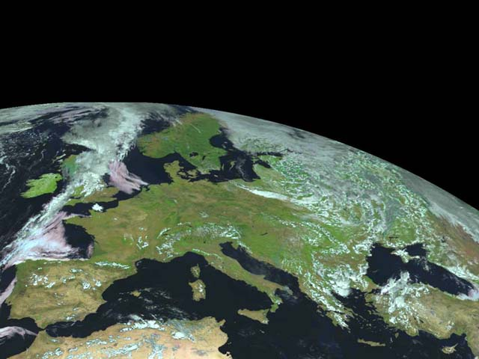
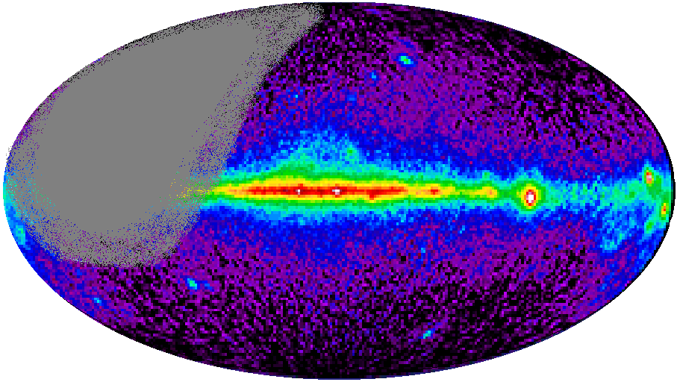
ANTARES detector
Shore station (La Seyne sur Mer)
The detector is located in the Mediterranean Sea (42º50’N, 6º10’E) at 2500 m depth, off the coast of Toulon (France).
It consists of 885 PMTs distributed along 12 lines anchored at the bottom of the sea.
Submarine Cable
2500 m
The ANTARES detector observes 3.5π sr (0.6π sr overlap with AMANDA/IceCube).
The Galactic Centre is observable 67% of the day.
Visibility
Mkn 501
RX J1713.7-39
CRAB
SS433
GX339-4
VELA
Galactic
Centre
Notes:
I will begin now the description of the ANTARES experiment, which is a collaboration of several European institutes. The detector will be located in the Mediterranean sea, near Toulon, in France, at 2500 deep. A submarine cable links the detector with the shore station, located at La Seyne-sur-Mer. From this location, ANTARES will observe 3.5π sr of the sky, with some overlapping with AMANDA and with the advantage in our case that the Galactic Center will be observable. This can be seen in this plot, where the ANTARES visibility (in Galactic coordinates) is shown. The Galactic Center is located here.

Slide 4
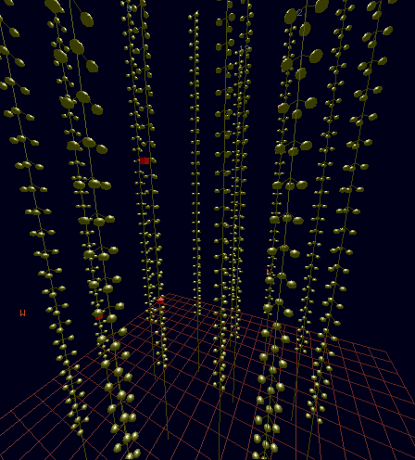
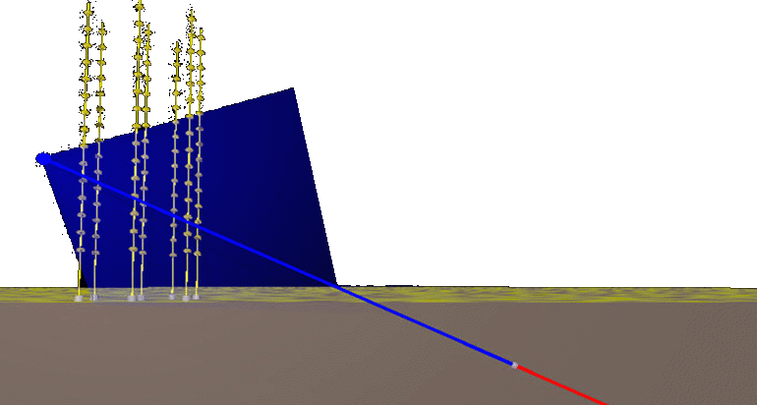
Detection principle
The neutrino is detected by the Cherenkov light emitted by the muon produced in a CC interaction.
ν_{μ}
μ
W
N
X
μ
ν_{μ}
1.2 TeV muon traversing ANTARES

Slide 5
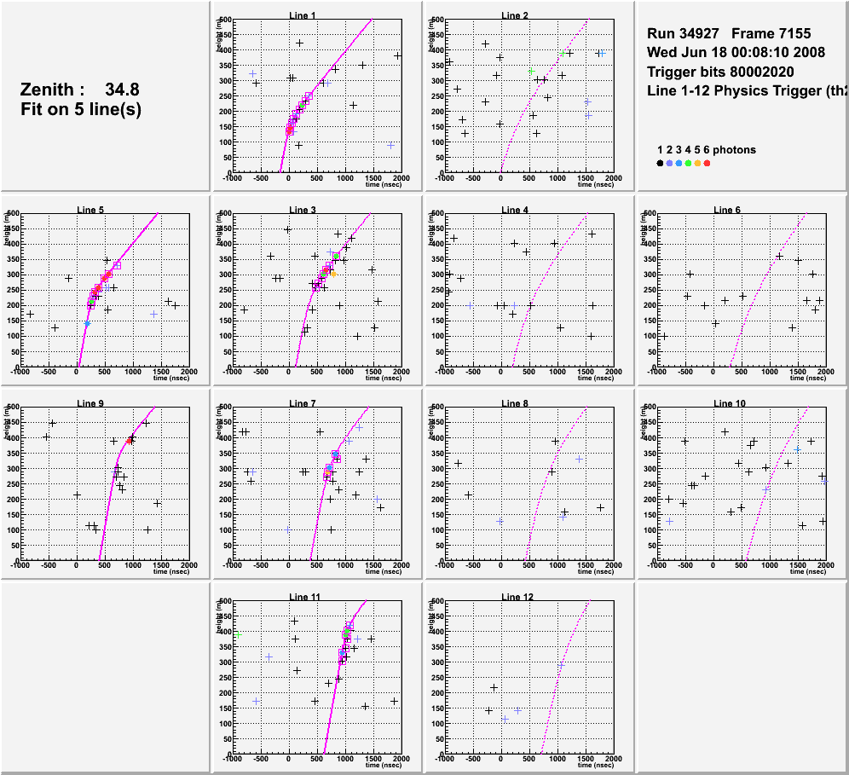
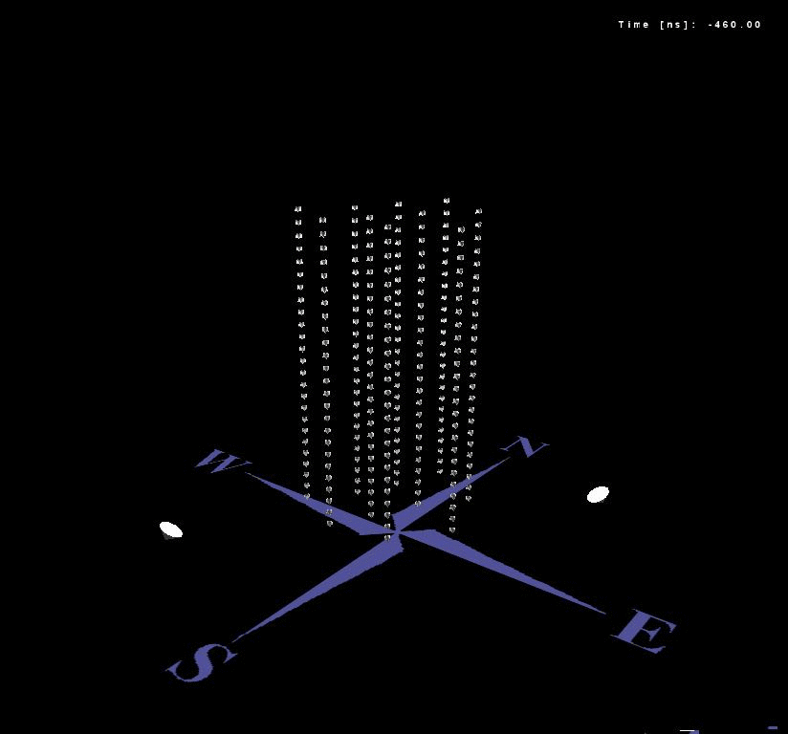
Neutrino candidate
Example of a reconstructed up-going muon (i.e. a neutrino candidate) detected in 6/12 detector lines:
height
time

Slide 6
Search for point sources
The search for point sources is based on algorithms looking for clusters of events over the background.
Three algorithms have been used:
  Likelihood ratio (unbinned)
  Expectation-Maximization (unbinned)
  Cone search (binned), not discussed here
The analysis presented here are based on the data of 2007, when 5 lines were installed (140 active days)

Slide 7
Likelihood ratio (LLR)
The method is an unbinned method based on a likelihood ratio maximization
Goal: search at a given point, called “Search-Point”, the number of signal events for a given BG model
The method has 2 steps:
Calculation of the angular distance between the Search-Point and all events in the Sky
Fit the distribution with the Signal and BG Probability Density Functions (PDFs) using the likelihood ratio maximization technique
Use the maximized likelihood ratio, λ, as a statistic test

Slide 8
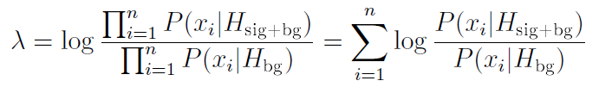
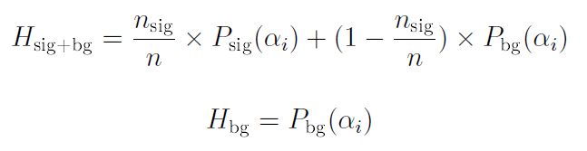
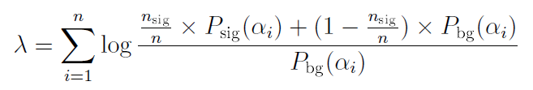
Statistic test λ
n_{sig} is the only free parameter

Slide 9
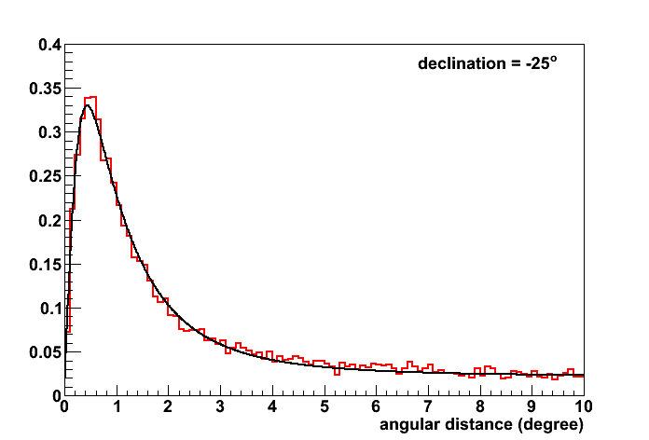
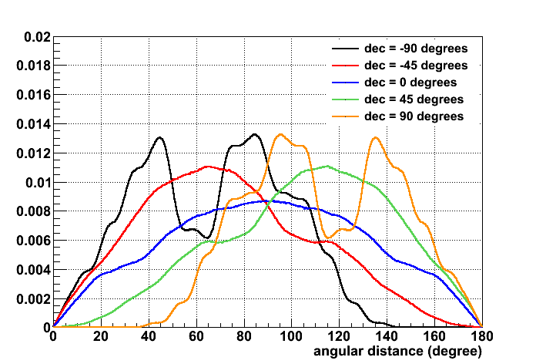
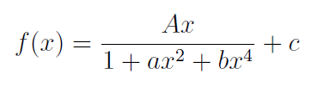
Probability Density Functions
μ (reconstructed)
ν (Monte-Carlo truth)
Signal PDF
BG PDF

Slide 10
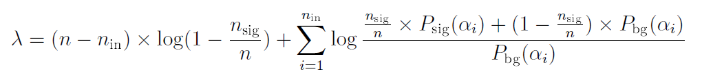
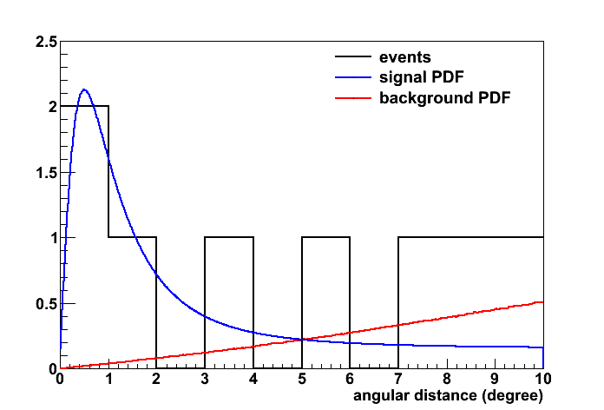
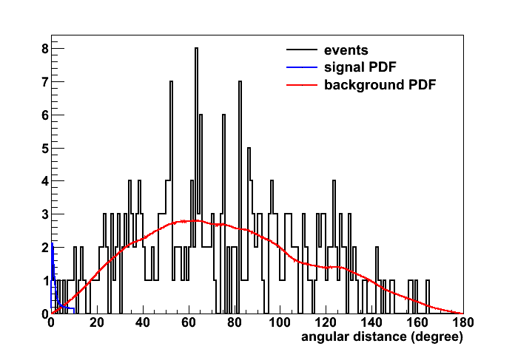
Fit

Slide 11
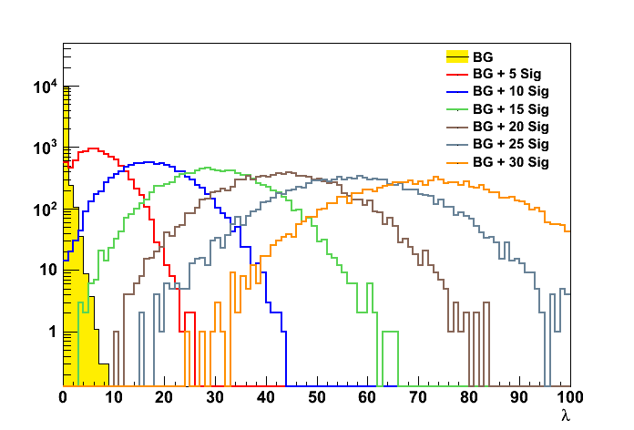
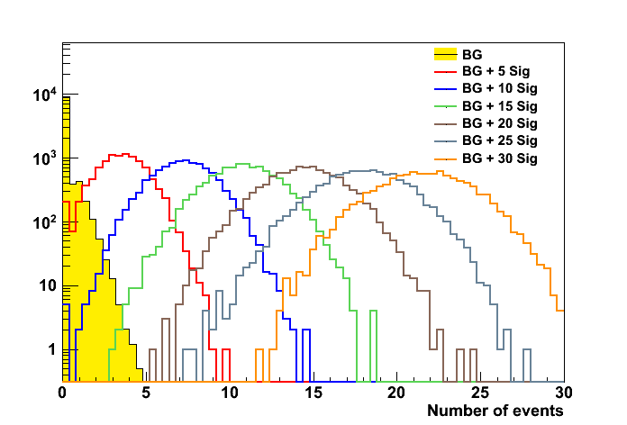
Algorithm output
Statistic test λ for different models
Fitted number of signal events

Slide 12
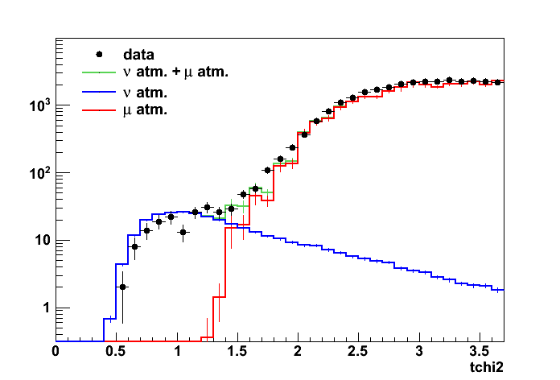
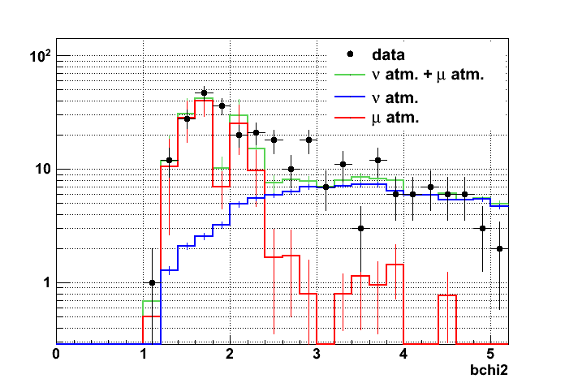
Selection cuts
Cuts are chosen to optimize sensitivity:
Nlines≥2
Nhits>5
Bchi2>2.2
Tchi2<1.8 if θrec<80º and tchi2<1.4 if 90º<θrec<80º
Fit to a line
Fit to a sphere
276 events are selected

Slide 13
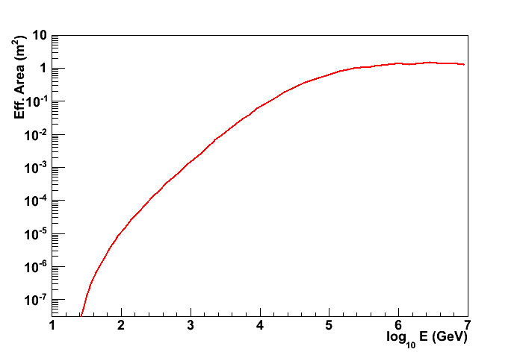
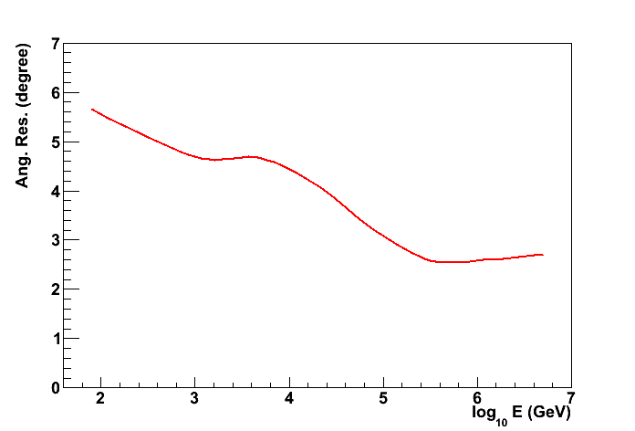
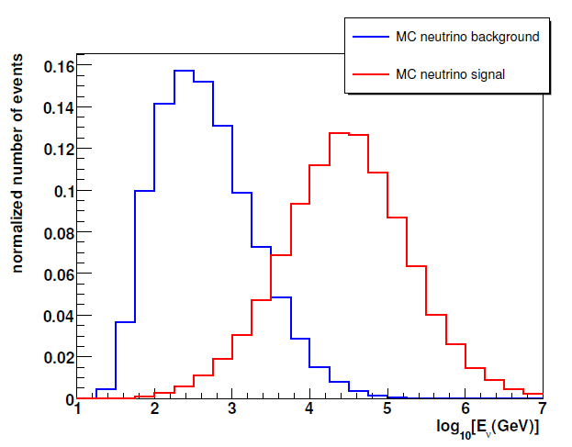
Performance of the detector
Effective area (E⁻²)
Angular resolution*
Event Rate = EffArea x Flux
*The best reconstruction (ang.res.~0.3deg) algorithm showed some data/MC discrepancies, which are now fixed
(→ 12 line data)

Slide 14
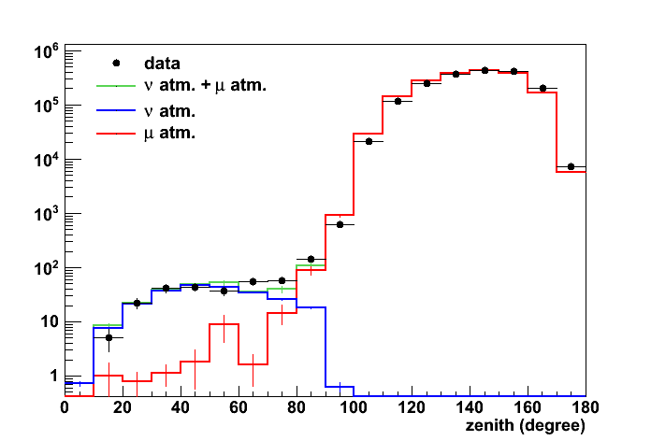
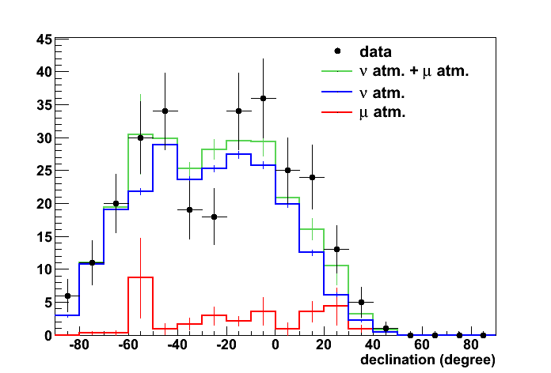
Data-MC comparisons
Zenith
(tchi2 ≤ 1.8 & bchi2 ≥ 2.2)
Declination
(optimized cuts)

Slide 15
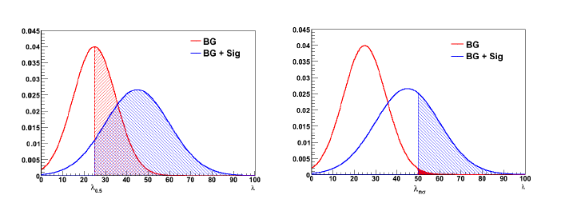
Limits and discovery power
Limit in the
number of events
Discovery power

Slide 16
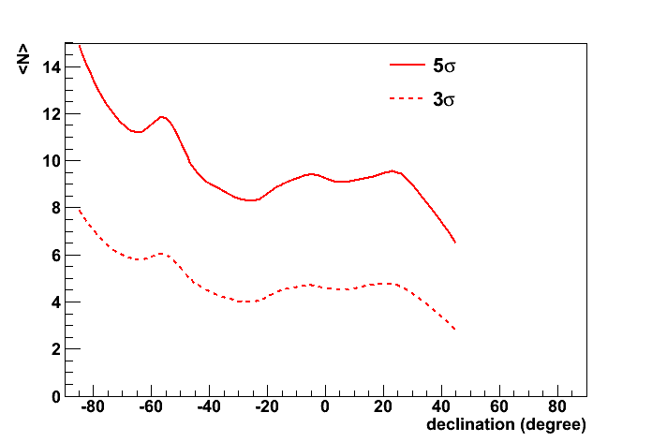
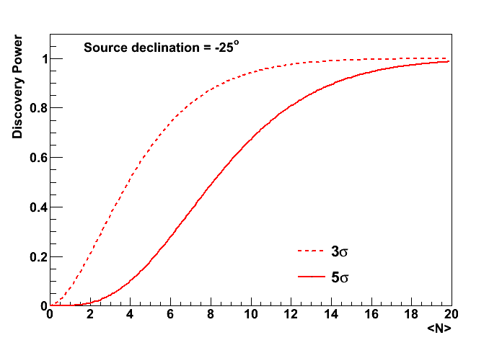
Discovery power and number limit
Number of events needed to have a 50% probability of having a a 3σ/ 5σ discovery as a function of declination
Probability of a a 3σ/ 5σ discovery as a function of the number of events

Slide 17
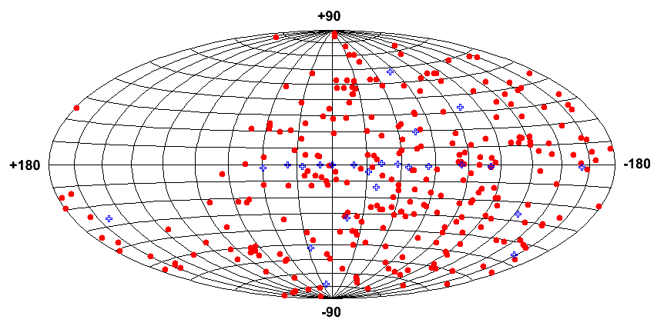
Skymap
Skymap (galactic coordinates) of the selected events (red points) and the candidate sources (blue crosses)

Slide 18
Results of for candidate sources (LLR)
Source | RA | δ | l | b | Visibility | p-value | Pretrial Sigma (1side)
HESS J0632+057 | 6^{h} 32^{m} 58^{s} | 5º 48’ 20’’ | 205.66 | -1.44 | 0.46 | 0.081 | 1.4
RX J0852.0-4622 | 8^{h} 52^{m} 00^{s} | -46º 22’ 00’’ | 266.28 | -1.24 | 0.91 | 0.007 | 2.5
HESS J1023-575 | 10^{h} 23^{m} 18^{s} | -57º 45’ 50’’ | 284.19 | -0.39 | 1.00 | 0.0014 | 3.0
PSR B1259-63 | 13^{h} 02^{m} 49^{s} | -63º 50’ 02’’ | 304.19 | -0.99 | 1.00 | - | -
RCW 86 | 14^{h} 42^{m} 43^{s} | -62º 29’ 00’’ | 315.79 | -1.46 | 1.00 | 0.182 | 0.9
Cir X-1 | 15^{h} 20^{m} 41^{s} | -57º 10’ 00.26’’ | 322.12 | 0.04 | 1.00 | - | -
HESS J1614-518 | 16^{h} 14^{m} 19^{s} | -51º 49’ 12’’ | 331.52 | 0.58 | 1.00 | - | -
GX 339 | 17^{h} 02^{m} 49^{s} | -48º 47’ 23’’ | 338.94 | -4.33 | 0.99 | - | -
RX J1713.7-3946 | 17^{h} 13^{m} 00^{s} | -39º 45’ 00’’ | 347.28 | -0.38 | 0.75 | - | -
Galactic Center | 17^{h} 45^{m} 41^{s} | -29º 00’ 22’’ | 359.95 | -0.05 | 0.66 | 0.048 | 1.7
W28 | 18^{h} 01^{m} 42^{s} | -23º 20’ 06’’ | 6.66 | -0.27 | 0.62 | - | -
LS 5039 | 18^{h} 26^{m} 15^{s} | -14º 49’ 30’’ | 16.90 | -1.28 | 0.57 | - | -
HESS J1837-069 | 18^{h} 37^{m} 38^{s} | -6º 57’ 00’’ | 25.18 | -0.12 | 0.52 | - | -
SS 433 | 19^{h} 11^{m} 50^{s} | 4º 58’ 58’’ | 39.69 | -2.24 | 0.48 | - | -
RGB J0152+017 | 1^{h} 52^{m} 40^{s} | 1º 47’ 19’’ | 152.38 | -26.61 | 0.49 | - | -
1ES 0347-121 | 3^{h} 49^{m} 23^{s} | -11º 59’ 27’’ | 201.93 | -45.71 | 0.55 | - | -
PKS 0548-322 | 5^{h} 50^{m} 40.6^{s} | -32º 16’ 16.4’’ | 237.56 | -26.14 | 0.69 | - | -
1ES 1101-232 | 11^{h} 03^{m} 38^{s} | -23º 29’ 31’’ | 273.19 | 33.08 | 0.62 | - | -
3C 279 | 12^{h} 56^{m} 11^{s} | -5º 47’ 21’’ | 305.10 | 57.06 | 0.51 | - | -
Centaurus A | 13^{h} 25^{m} 27.6^{s} | -43º 01’ 08.8’’ | 309.52 | 19.46 | 0.81 | - | -
ESO 139-G12 | 17^{h} 37^{m} 39.5^{s} | -59º 56’ 29’’ | 334.04 | -13.77 | 1.00 | - | -
PKS 2005-489 | 20^{h} 09^{m} 29^{s} | -48º 49’ 19’’ | 350.39 | -32.61 | 1.00 | 0.100 | 1.3
PKS 2155-304 | 21^{h} 58^{m} 53^{s} | -30º 13’ 18’’ | 17.74 | -52.25 | 0.67 | - | -
H 2356-309 | 23^{h} 59^{m} 08^{s} | -30º 37’ 39’’ | 12.84 | -78.04 | 0.67 | - | -

Slide 19
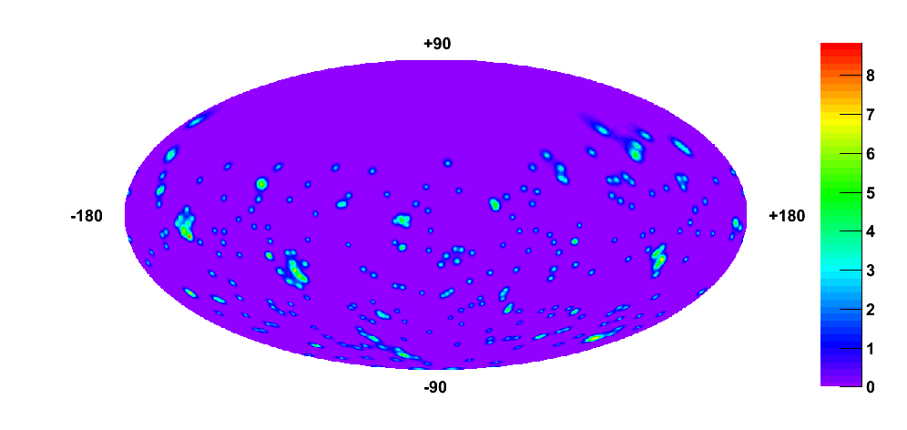
All sky search
Maximized likelihood ratio value in equatorial coordinates.
Brightest point: RA = 222.1º, δ = -9.5º, p-value = 0.31

Slide 20
Expectation Maximization
The EM method is a pattern recognition algorithm that maximizes the likelihood in finite mixture problems, which are described by different density components (pdf) as:
pdf
signal: RA, δ
bg: only δ
position of event
proportion of signal and background
The idea is to assume that the set of observations forms a set of incomplete data vectors. The unknown information is whether the observed event belongs to a component or another.
z_{i} is the probability that the event comes from the source

Slide 21
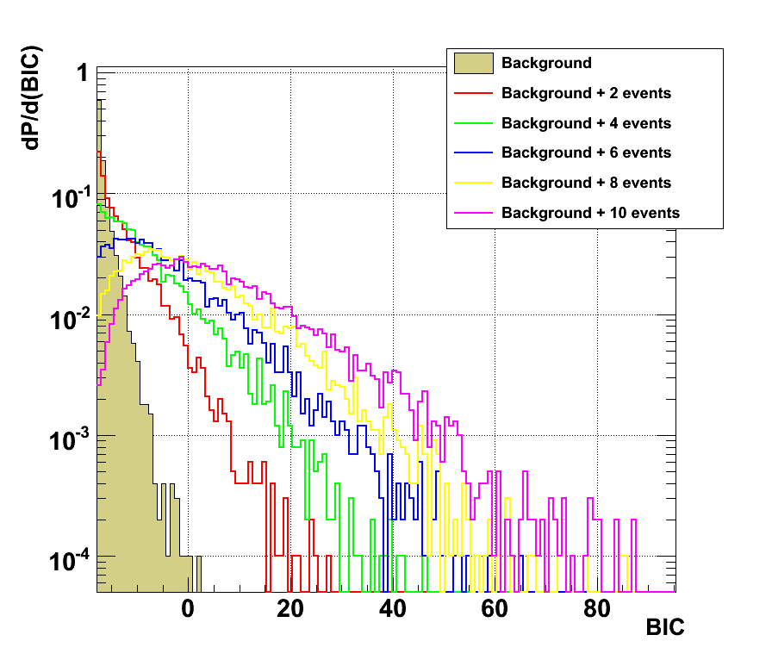
Model Selection in EM
The parameter used for discriminating signal versus background is the Bayesian Information Criterion, which is the maximum likelihood ratio with a penalty that takes into account the number of free parameters in the model weighed by the number of events in the data sample.
D: data set
θ₀: parameters of bg
θ₁: parameters of signal
M: model
ν_{k}: number of parameters to be estimated
BIC distribution for different number of sources events added (at δ=-80°), compared with only background

Slide 22
Results for list of candidates (EM)
Declination (deg) | RA (deg) | p-value | BIC (EM)
- 63.83 | 195.7 | - | -17.2482
- 62.48 | 220.68 | 0.3549 | -16.4863
-59.94 | 264.41 | - | -17.2482
-57.76 | 155.83 | 0.0032 | -5.6025
-57.17 | 230.17 | - | -17.2482
-51.82 | 243.58 | - | -17.2482
-48.82 | 302.37 | 0.145 | -14.5976
-48.79 | 255.70 | 0.3655 | -16.7197
-46.37 | 133 | 0.4466 | -17.0732
-43.02 | 201.37 | 0.4702 | -17.2021
-39.75 | 258.25 | - | -17.2482
-32.27 | 87.67 | - | -17.2482
-30.63 | 359.78 | 0.4233 | -17.1617
-30.22 | 329.72 | - | -17.2482
-29.01 | 266.42 | 0.0454 | -11.8406
-23.49 | 165.91 | - | -17.2482
-23.34 | 270.43 | 0.007 | -7.54282
-14.83 | 276.56 | 0.1563 | -14.8898
-11.99 | 57.35 | - | -17.2482
-6.95 | 279.41 | - | -17.2482
-5.79 | 194.05 | - | -17.2482
1.79 | 28.17 | 0.2563 | -16.1335
4.98 | 287.96 | - | -17.2482
5.81 | 98.24 | 0.0767 | -13.1885
Similar results than with LLR
The same cluster is found as the most significant one

Slide 23
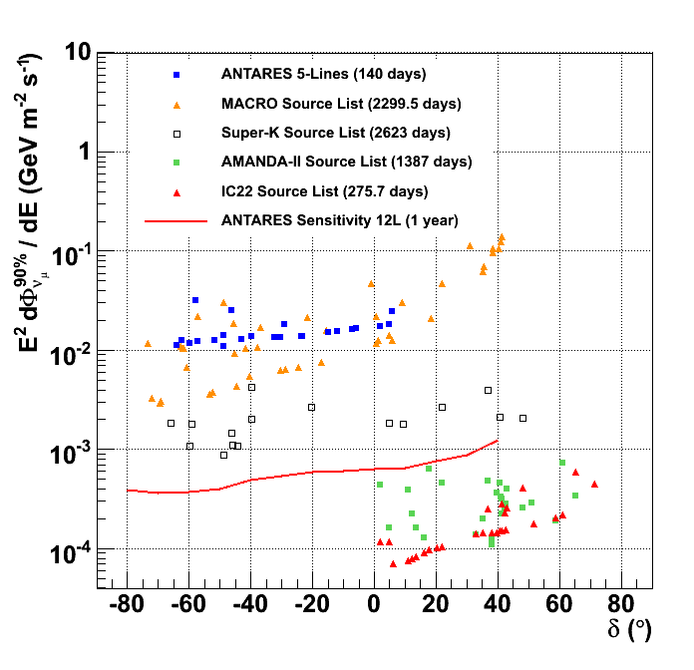
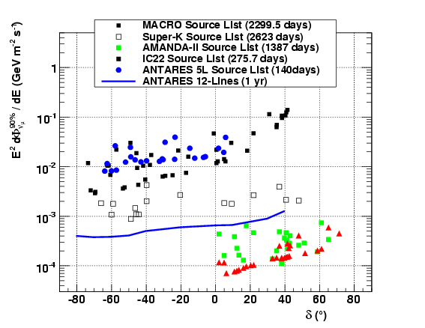
Flux limits
Both algorithms give similar results
Flux limits with 5 lines (140 active days) are close to those of MACRO
With 12 –lines and 2year data (already in disk!) the sensitivity is beyond any previous limit for the Southern Sky
Official result (LLR)
Alternative algortihm (EM)

Slide 24


Conclusions
first Spain’s point source
ANTARES has already been completed and is taking data for more than two years
It completes the coverage of the neutrino sky, with an unsurpassed angular resolution
Different algorithms have been used, showing similar performance
Two kinds of searches have been performed: over a list of 24 candidate sources and an all-sky scan.
First results with 2007 data show no evidence for neutrino point sources (most significant cluster has a post-trial P-value of 0.036 at HESS J1023-575)
Results with 2007-2008 data (and best reconstruction algorithm) soon available

Slide 25
Backup

Slide 26
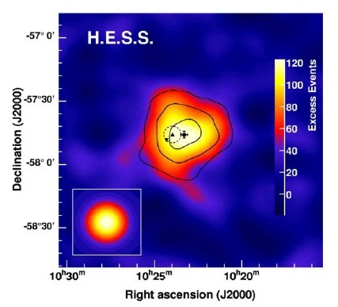
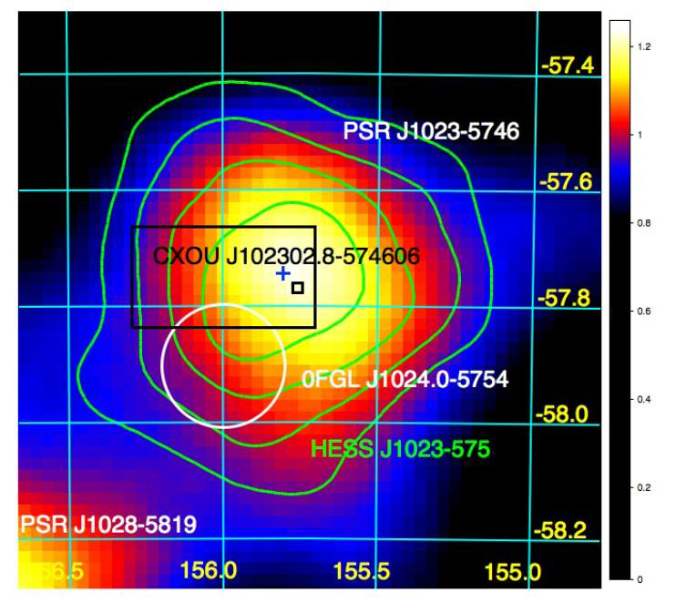
HESS J1023-575
Discovered by H.E.S.S. In 2007 by using 2006 data.
Extended source: 0.4x0.4 deg2 ( larger than H.E.S.S. Angular resolution).
Un-identified source → few possible source types inside, non of them has
been proved as TeV gamma source.
= -57° 45´ 50´´
α = 10^{h} 23^{m} 18^{s}
FERMI-LAT: pulsar PSR J1023-5746

Slide 27
Scientific scopes
Origin of cosmic rays
Hadronic vs. leptonic signatures
Detector size
Supernovae
Limitation at high energies:
Fast decreasing fluxes E⁻², E⁻³
Oscillations
Limitation at low energies:
-Short muon range
-Low light yield
-⁴⁰K (in water)
Dark matter (neutralinos)
Astrophysical neutrinos
GZK, Topological Defects
MeV
GeV
TeV
PeV
EeV
Detector density
Other physics: monopoles, etc...

