Slide 1
Why did i choose this subject
Mancardi Xavier (advisor : Patrice Verrecchia)
ENSICAEN – Université Paris-Sud
Subject covers every topic I approached during my studies : electronics, optical physics, nuclear physics, medical imaging
Instrumental thesis

Slide 2
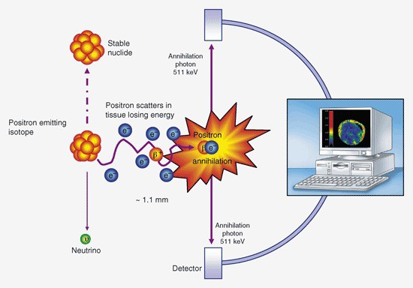
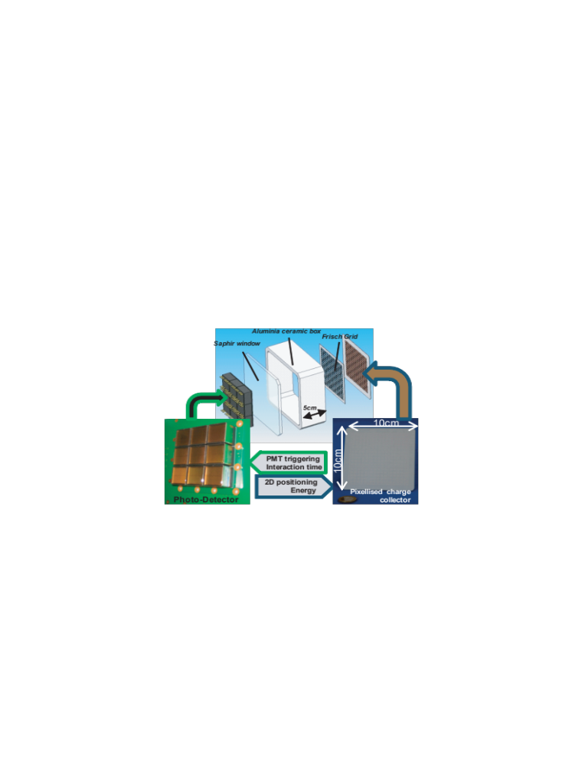
Thesis subject
Détecteur liquide multipixellisé pour l’imagerie médicale et préclinique
Conception and construction of the ionization part of the CaLIPSO detector for PET imaging modality : ultrapurification and caracterisation of the ionization parameters of the detection medium (TrimethylBismuth TMBi), electronic set up, Monte-Carlo simulation of the detector and performances analysis
Glossary : TrimethylBismuth, PET imaging modality, ultrapurification, electronics, simulation
CaLIPSO detector
PET principle

Slide 3
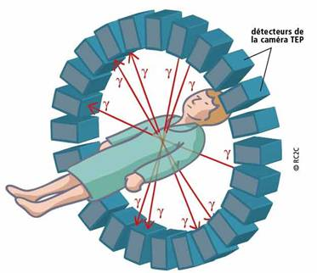
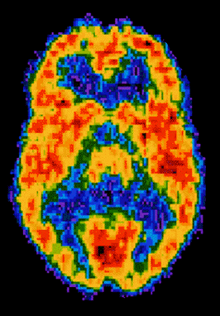
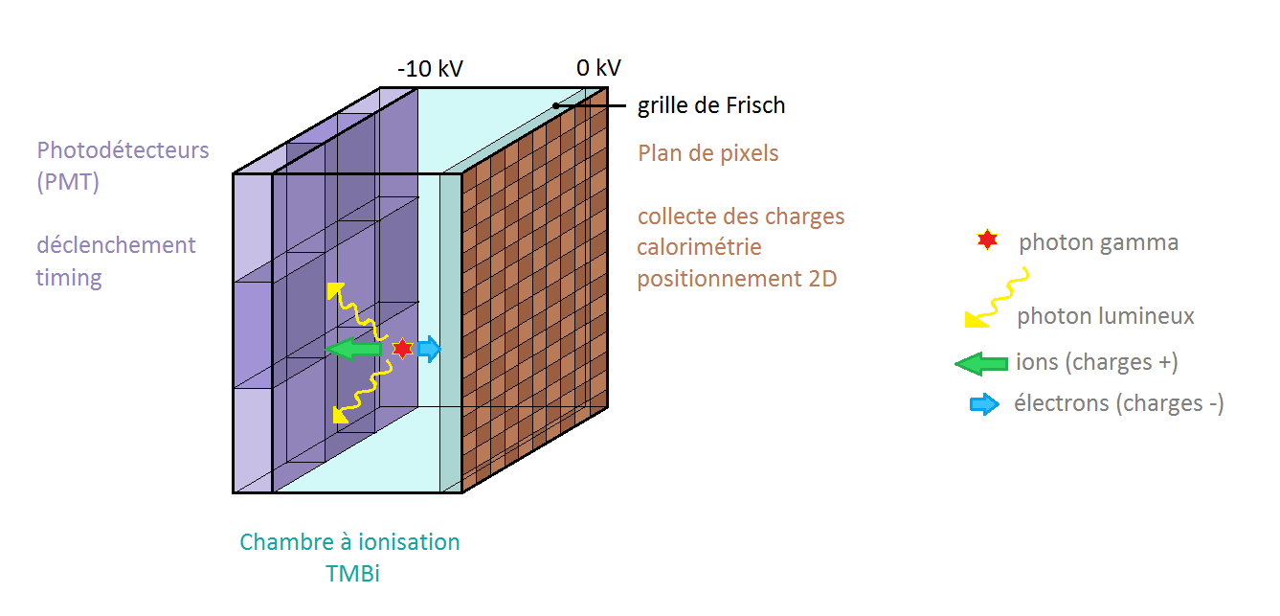
Plan
Physical principle
  TEP
  CaLIPSO
  PET detectors : state of the art
Ultrapurification
  Why
  Adsorption
  Molecular sieves
  Impurities analysis
  Ultrapurification station
Tvie cell tests
  Tvie cell - charge mode
  Tvie cell – Gfi mode
  Electronic noise optimisation
Measurements
  Expected muon signal
  Gfi measurement
  γ 511 keV measurement
Future
  Multipixellised detector
  Capacitive readout
Conclusion

Slide 4
I. PHYSICAL PRINCIPLE

Slide 5
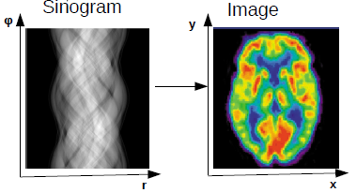
PET : Positron emission tomography
Functional imaging technique in nuclear medicine
  Oncology : small tumors and metastases imaging
  Neurology : exams of neurodegenerative diseases (Alzheimer, Parkinson)
Radioactive tracer (ex : FDG) is injected in the patient body and then chemically bounded in tissue
β+ decay
Annihilation with an electron of tissue → 2 511 keV γ are emitted back-to-back
2 γ detected in coincidence
Offline analysis and image reconstruction
PET principle
Important characteristics of PET detector
  Efficiency
  Spatial resolution
  Time resolution

Slide 6
CaLIPSO
But : Double detection of the 511 keV γ interaction in the TMBi
CH
CH
3
3
Organometallic liquid apolar and aprotic
Radiation length ~ 3 cm
Bi : Z = 83 highest Z non radioactive element
→ Photoelectric fraction R_{PE} = 47%
E_{PE} = 420 keV (K shell/ relativistic in TMBi)
→ Cerenkov emission (20 photons at 511 keV)
→ Cerenkov light detection (trigger / z positioning)
→ Optical detector operational
Drift of produced charges by the interaction of 511 keV γ
→ charge detection (calorimetry and xy positioning)
→ Ionization detector on study
Expected performances:
  → 3D positioning, 1 mm³
  → time resolution ~ 100 ps
Bi
CH
3
TrimethylBismuth
CaLIPSO detector

Slide 7
PET detector : state of the art
Properties Detector | Atten Length (cm) | Coinc . PhotElecE Eff.( %) | Timing Resolution (ps, FWHM) | Energy Resolution (% FWHM) | G Interac. Postion. (mm) | End user friendly
LSO/LYSO | 1.23 | 12 | 300 - 500 | 10 | 2 to 10 | YES
LaBr₃ | 2.3 | 1.9 | 100 - 300 | 3 | 4 to 10 | YES
CdTe/CZT | 2.0 | 2.2 | slow | 1- 3 | 0.1 | YES
CaLIPSO | 2.9 | 22 | ?150? - 380 | 10 | 0.15 | Will be !
LSO/LYSO : The reference detector
LaBr3 : Excellent timing, poor PE efficiency, fair positioning
  Only relevant for full body, Time of flight PET config
  CdTe/CZT : Excellent position recontruction, poor PE efficiency
  Only relevant for single mouse PET imaging
CaLIPSO* : Best PE efficiency, Excellent positioning, very good timing
→ Take the best of all technologies – Needed for high-res efficient Brain PET
* Inspired by the work done on liquid Xenon

Slide 8
II. ULTRAPURIFICATION

Slide 9
Why?
511 keV γ → 4500 electrons
Electronegative impurities contained in the liquid reduce the signal
→ ultrapurification needed
Commercial product obtained with a purity of 99,9995%
→ chemically pure but insufficient for our application
→ level of impurity required < 0,1 ppm oxygen equivalent
→ lifetime for the electrons > 10 µs
Efficient technique for such level of purification
→ molecular sieve

Slide 10
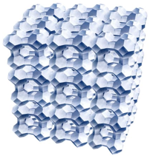
adsorption
Selective retention of one or several compounds of a mixture on a solid surface
Zéolite 4A
TMB +
Impurities (Adsorbate)
Adsorbant
TMB
Adsorption of molecules < micropore size
Most polar molecules adsorbed first
Adsorption favorised by high pressures and low temperatures
Electrostatic forces
physical
Van der Waals forces
Adsorption
chemical
Chemical bond created

Slide 11
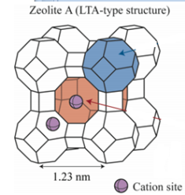
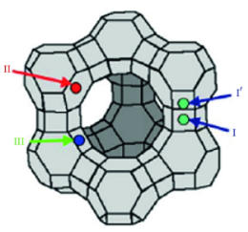
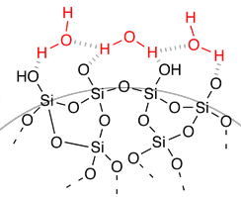

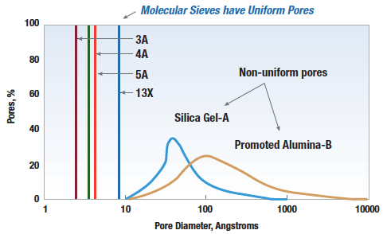
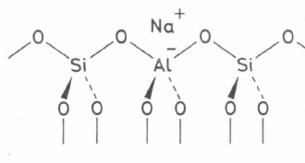
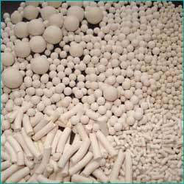
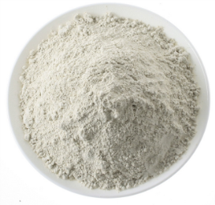
Molecular sieves
Molecular sieve | Zeolite A | Zeolite X | Silica gel | Activated alumina
Pore size | 3-5 Å | 10 Å | 20-200 Å | 20-500 Å
Structure
Metal aluminosilicates crystals
Product : monocrystals powder (particles ~ 10 µm)
Ionic structure
Negative charge Al- neutralised par Na+
Cation determinates pore size
Pore size distribution of several molecular sieves
Pellets
4A zeolite structure
Powder

Slide 12
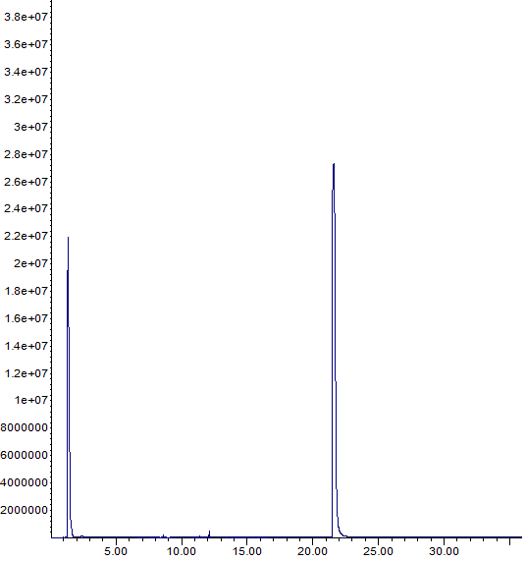
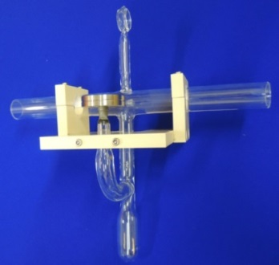
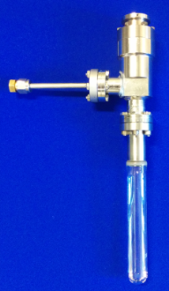

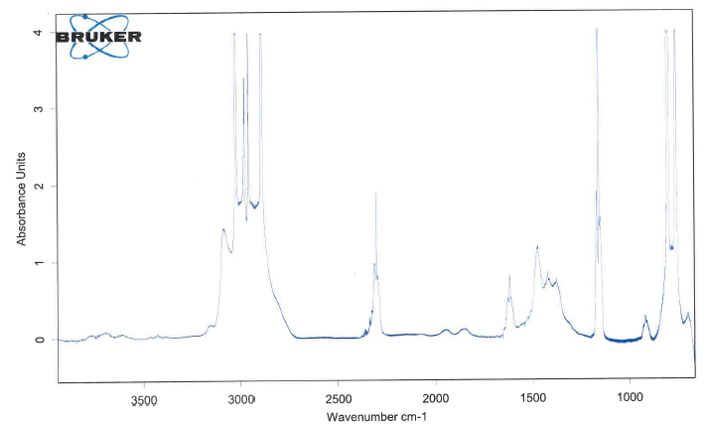
Impurities analysis
In collaboration with DEN (V. Dauvois et D. Doizi)
Analysis of impurities contained in TMBi
IR cell (left) et mass spectrometer cell (right)
TMBi chromatogram
Infrared spectrum
Mass spectrum

Slide 13
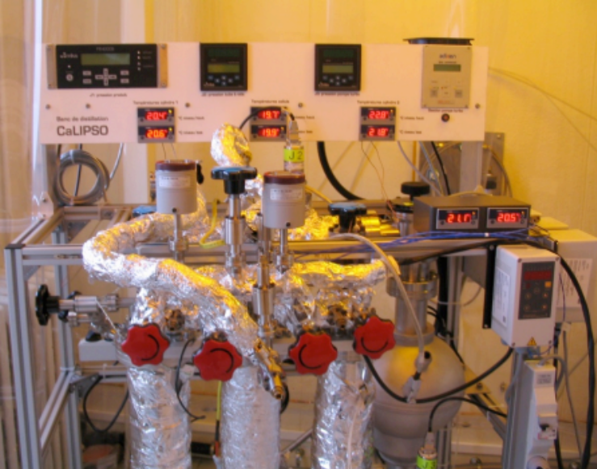
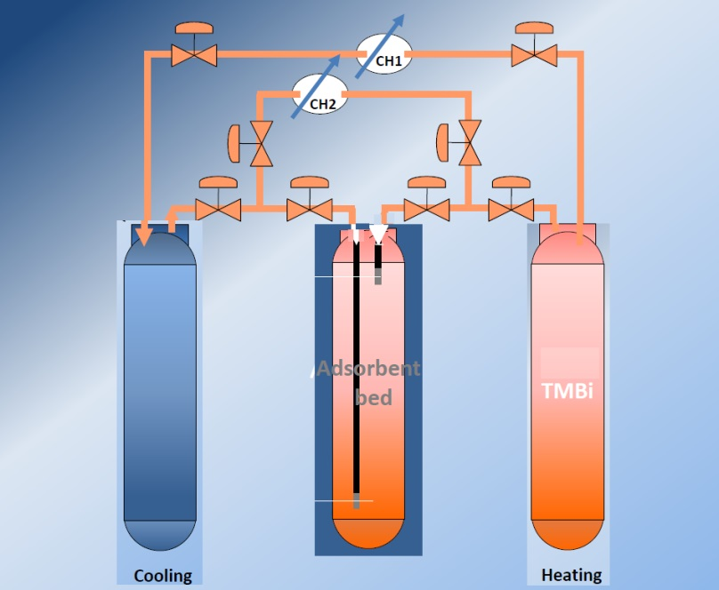
« DYNAMIc » ultrapurification station
TMBi in vapor phase passing on zeolites
Ultra high vacuum components (leak< 10⁻¹¹ mbar l/s)
Passing through 4A zeolites in pellet form inefficient → powder
Passing through activated alumina (Al₂O₃) → reaction with impurities contained inside the sieve → game over for Al₂O₃
Dynamic station
Dynamic station plan

Slide 14
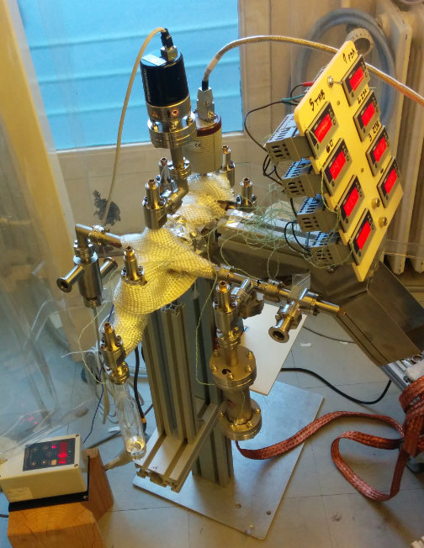
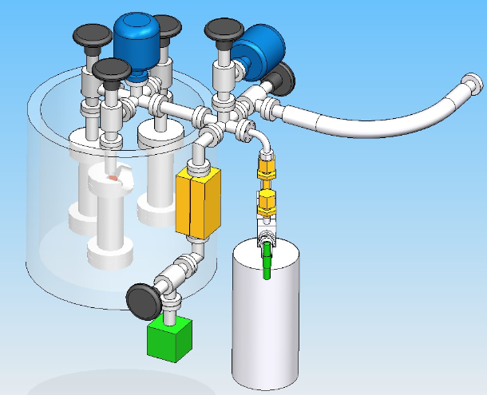
« static » ultrapurification station
Soaking of TMBi in liquid phase in zeolites
13X zeolites, Silica gel → TMBi goes inside the pores and react with the walls eventually → game over for large pores in static station
3A zeolites powder form → first ionization signal
4A and 5A zeolites in powder form → on going
Static station
Static station plan

Slide 15
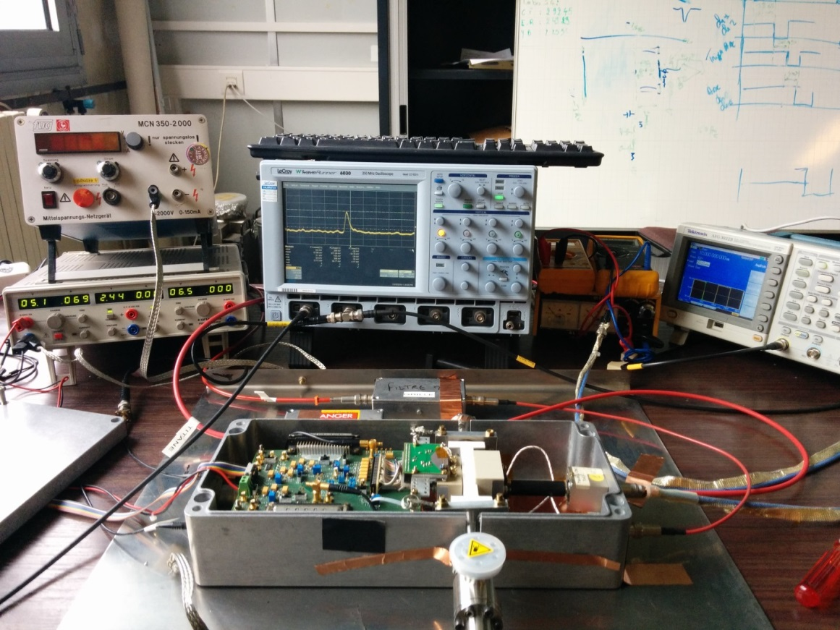
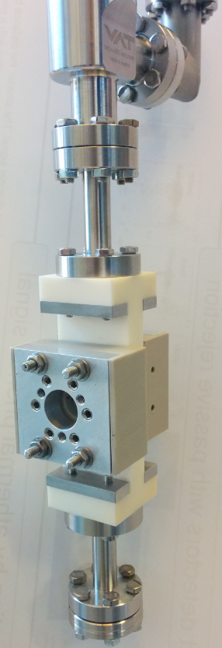
III. TVIE CELL TESTS
Tvie cell electronic readout
Tvie cell

Slide 16
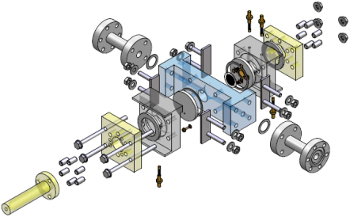
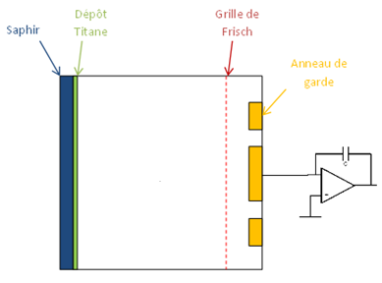
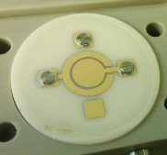
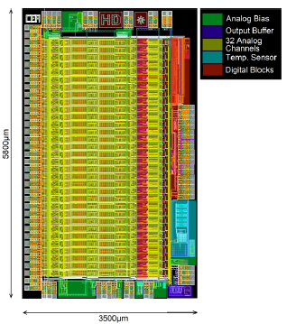
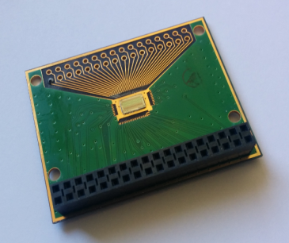
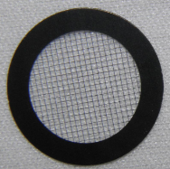
Tvie Cell - Charge MODE
  Charge impulsion readout
Measure of ionization yield, free electrons lifetime and mobility
Low-noise iDeF-X electronic developed at SEDI (O. Gevin et al.)
Frisch grid needed for :
→ signal to be independent of the interaction position in the detector
→ Collecting only electron charges
Tvie cell plan
Detector
Optical Demonstrator optimized
E₁
E₂
IDeF-X HD picture and layout
Frisch grid

Slide 17

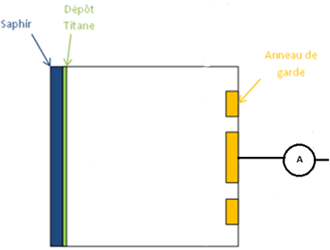
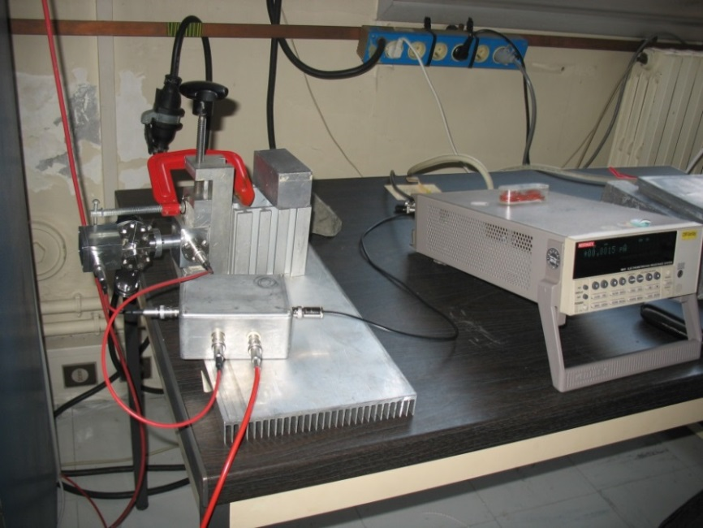
Tvie cell – gfi mode
  DC current readout
Gfi (number of free electrons created for 100 eV energy deposited)
Test cell for Gfi measurement and high voltage behaviour checking
Tvie cell plan
E
Ionisation chamber plan
Ionization current measurement

Slide 18
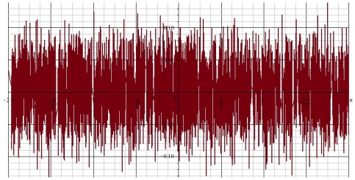
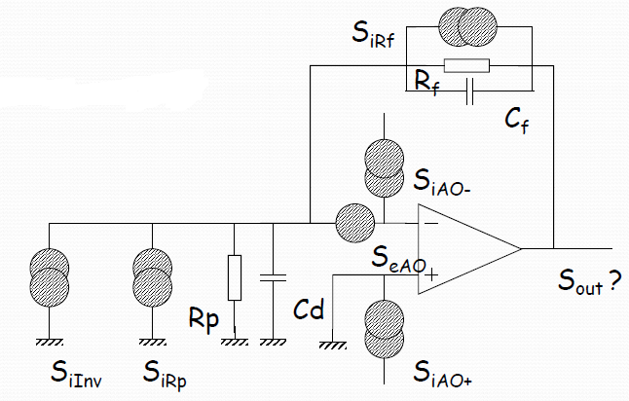
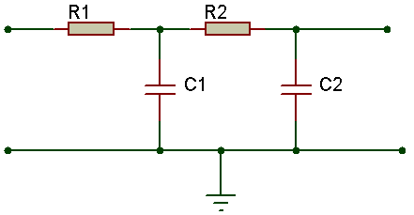
Electronic noise optimisation
Very weak signals (pA, fC)
Eliminate every noise sources
  Very low noise iDeF-X electronic
  Same ground for every electronic modules and detector
  High voltage filters
White noise
Charge preamplifier noise diagram
High voltage low-pass filter

Slide 19
IV. MEASUREMENTS

Slide 20
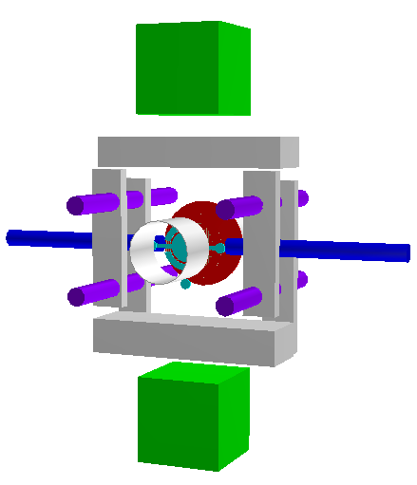
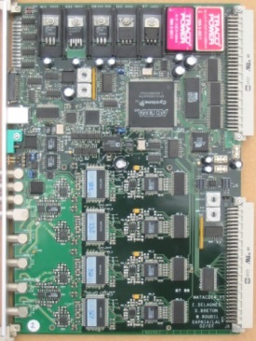
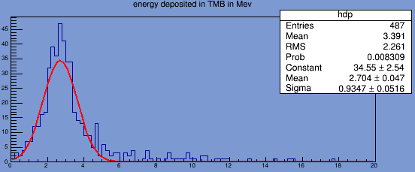
Expected muon signal
Detection in coincidence of a muon on two scintillators
Energy deposit at minimum ionizing
Ionization signal readout with IDeF-X
Acquisition on Matacq card developed at SEDI (E.Delagnes et al.)
2,7 MeV average energy deposit (σ = 0,93 MeV)
Matacq card
µ
Energie deposited by muons in TMBi in MeV
Energy loss regarding muon energy

Slide 21
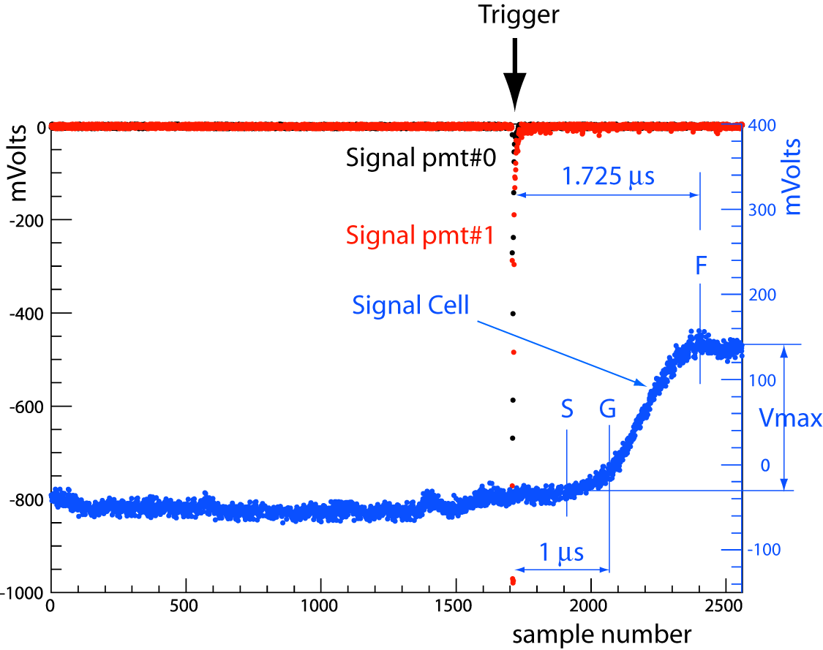
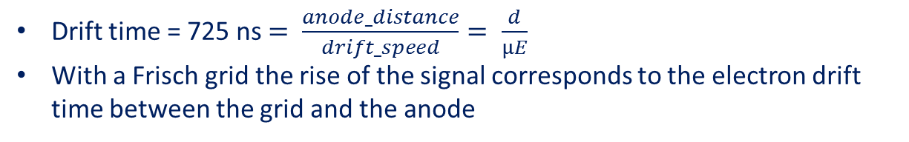
MUON signal (preliminary)
Drift time = 725 ns $= \frac{anode_distance}{drift_speed}= \frac{d}{µE}$
With a Frisch grid the rise of the signal corresponds to the electron drift time between the grid and the anode

Slide 22
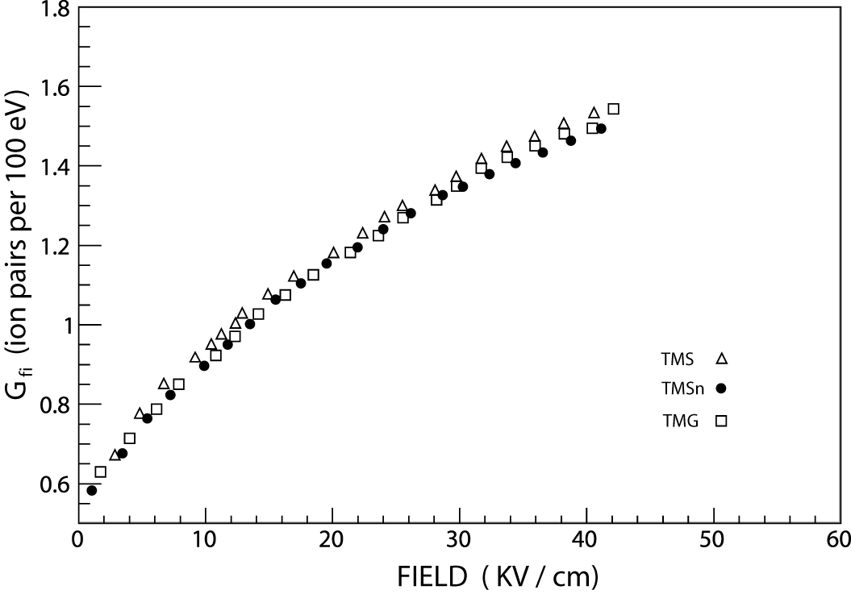
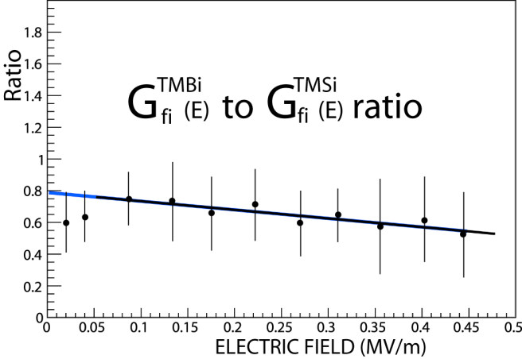
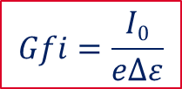
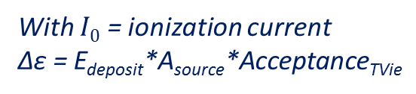
GFI measurements
  Readout of the ionization current produced by a ⁶⁰Co gamma rays source
Current measurements regarding HV
Cobalt 60 source
$$Gfi=\frac{I0}{e∆ε}$$
With $I0$ = ionization current
Δε = E_{deposit}*A_{source}*Acceptance_{TVie}
γ
Examples of Gfi curves
TMBi/TMSi Gfi ratios

Slide 23
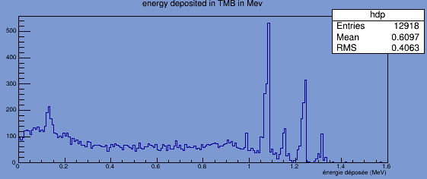
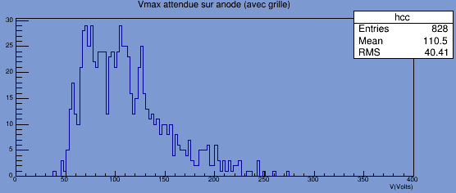
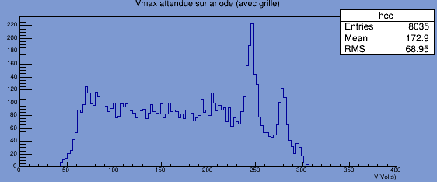
Modelisation : Impact of liquid purity
Energy deposited by Cobalt 60 in TMBi
TMBi brut (lifetime= 50 ns)
TMBi ultrapure (lifetime= 50 µs)
Pure TMBi needed for calorimetry
Minimum noise needed to get as close as possible to the real spectrum

Slide 24
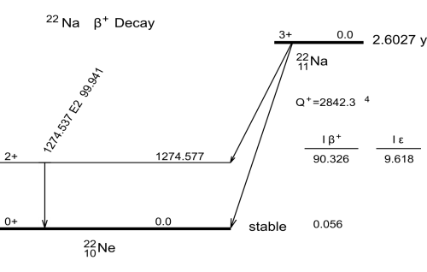
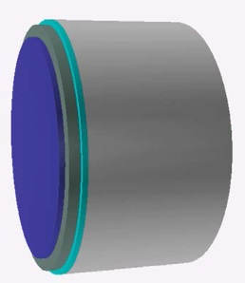
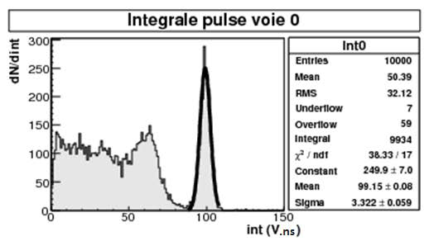

ModElisation : 511 kev signal
  Detection in coincidence of two 511 keV γ from a β⁻ ²²Na source
γ 511 keV
γ 511 keV
Ultrapure TMBi required for calorimetry
Final test for ultrapurification validation

Slide 25
V. FUTURE

Slide 26

Multipixellised detector
In order to localized the interaction position on the transverse plan we need to pixellise the charge collector with 1mm² pixels (at best)
Number of pixels
Compact readout electronics needed
Pixel size effect on signal collection
Diaphony effect/ capacitive coupling between pixels
Pixellised detector

Slide 27



Capacitive readout
In order to no longer need hermetic junctions for the signal readout on each pixel
→ resistive layer (alumine 300 µm) and pad readout by capacitive influence*
→ anode deposit tests on alumine performed by the CSNSM in Orsay (L. Dumoulin et L. Berge)
$$τ=RC=1GΩ²∗1pF=1ms$$
T_{peak} < 10 µs$→ok$
E₂
*D.Attié et al., Piggyback resistive Micromegas , ArXiv 1208.6525
Capacitive readout principle

Slide 28
VI. CONCLUSION

Slide 29
CALIPSO detector perspectives
Operational
  Optical detector
  Ionization electronic readout
  Tvie cell modelisation
  First ionization signal after purification on 3A zeolites in powder form
On going
  TMBi ultrapurification
  Tvie cell performance study
  Mecanical conception of final CaLIPSO detector with the bureau d’étude
  Physical modelisation of final detector

Slide 30
Thank you for your attention

