Slide 1
L’Étrange INCL
Jason HIRTZ
Café SPhN – 20/03/17

Slide 2
Contents
I. Introduction: what is the spallation?
II. The strange motivations
III. Strangeness implementation
IV. Preliminary results
V. Conclusion and outlook

Slide 3
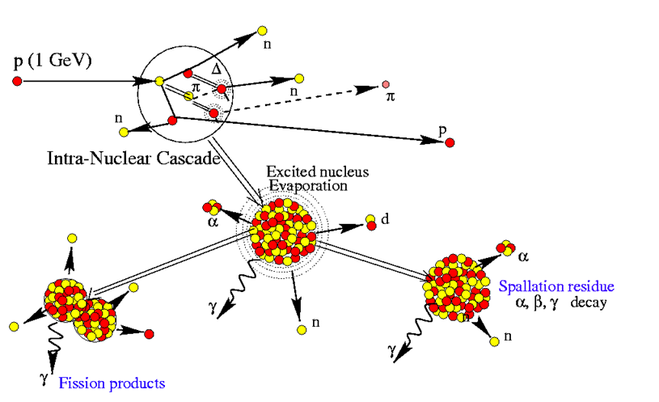
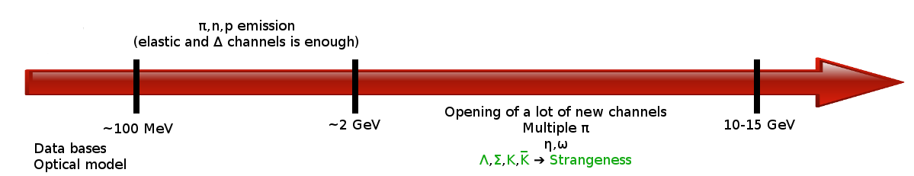
I. Spallation
Degree of freedom:
Hadrons
Initial energy range of validity:
100 MeV to 2 GeV
Time scale:
Cascade : 10⁻²²-10⁻²¹ s
De-excitation : 10⁻²⁰-10⁻¹⁵ s

Slide 4
II. Motivations
New possibilities of simulation:
  Hypernucleus physics and Kaon physics
(Collaboration with Yeleï, Alexandre and Anna)
Improving the description at “high” energies
(2 GeV to 10-15 GeV)
  Cosmic rays induced spallation
    (second part of my thesis)

Slide 5
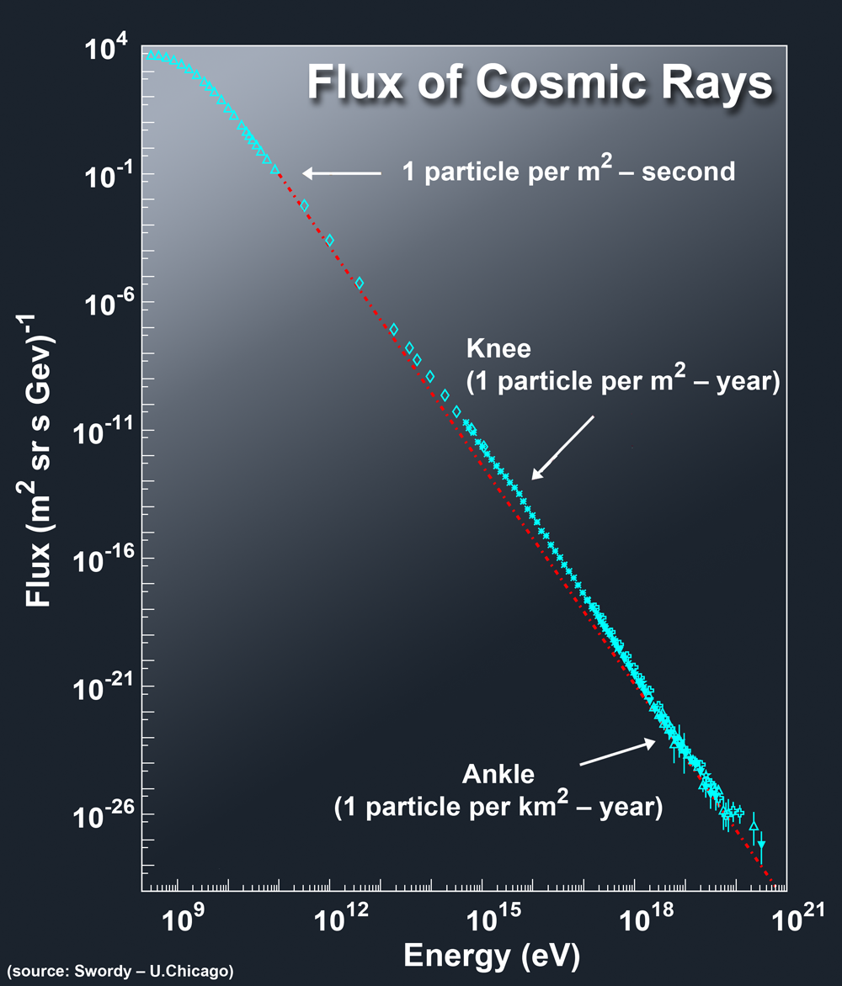
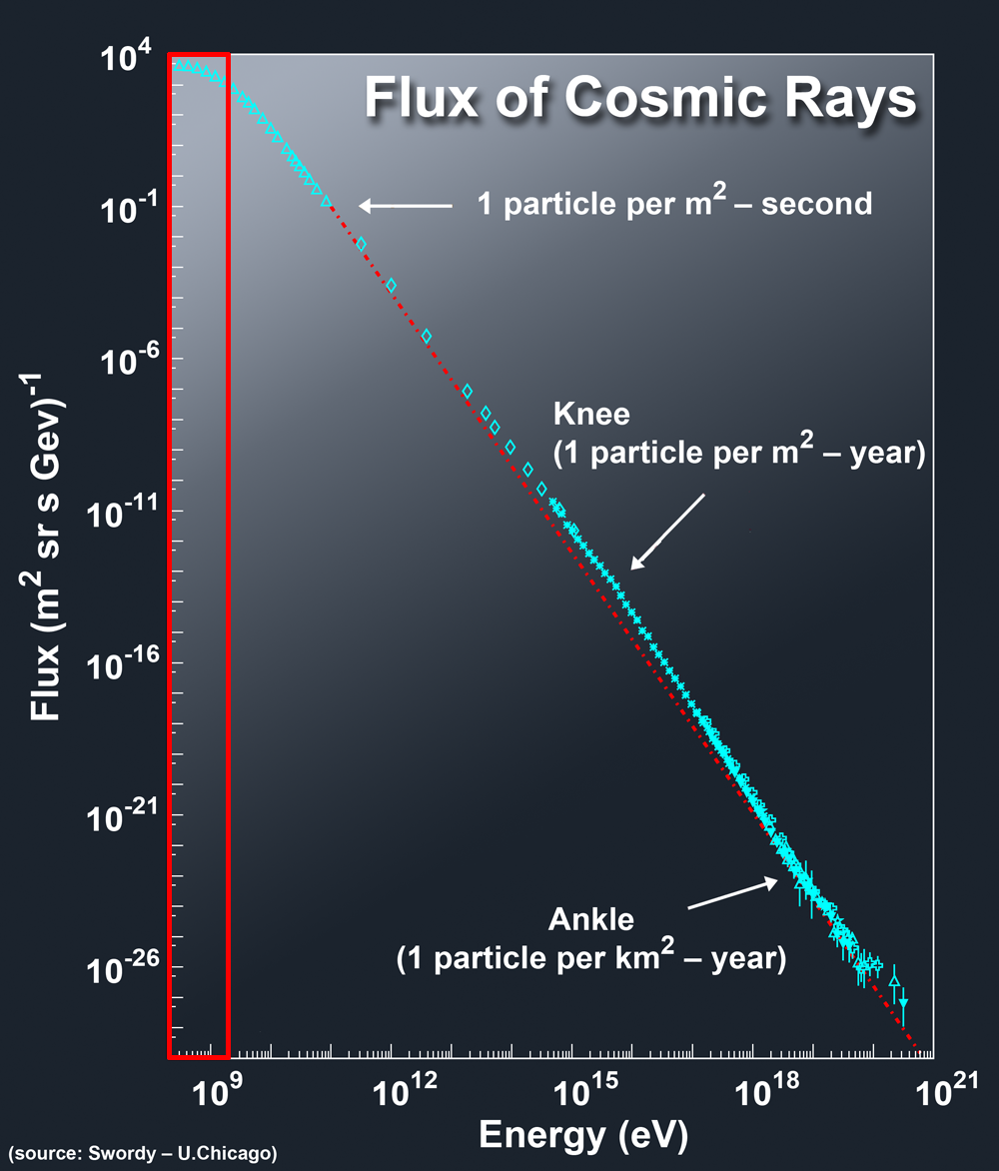

II. Motivations
Interest for the second part of my thesis
Energy range
100 MeV – 2 GeV
Energy range
100 MeV – 15 GeV

Slide 6
III. Strangeness implementation
Information origin:
Experimental Data
else
Symmetries
else
Models
else
???
Strangeness ➔ 8 New Particles ➔ 380 New channels
Λ Σ⁺ Σ⁰ Σ⁻ K⁺ K⁰ K̅⁰ K⁻
Channel
    Reaction cross section
    Angular distributions
Particle
    Mass, charge, ...
    Life-time
    Decay channels
    Potential in nucleus
ex : pp ➔ pΛK⁺

Slide 7
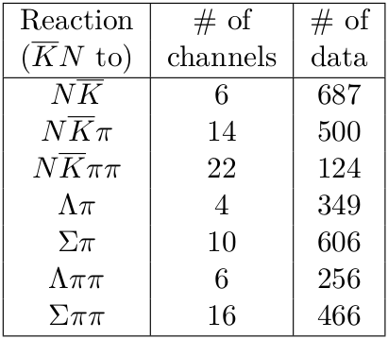
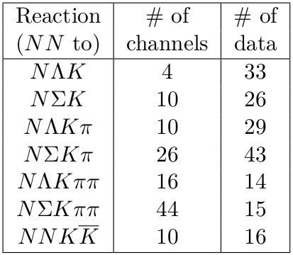
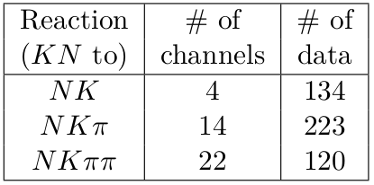
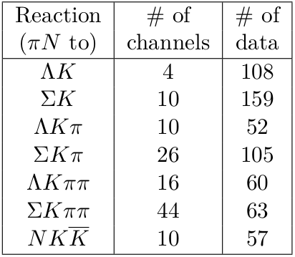
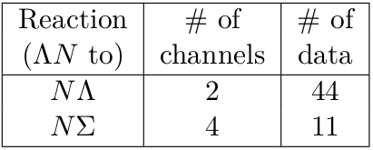
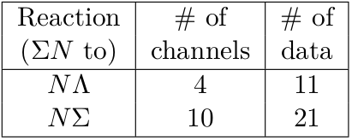
Cross sections availability
380 new channels
Exp. data for 64 channels
↓
~17 % of needed cross sections

Slide 8
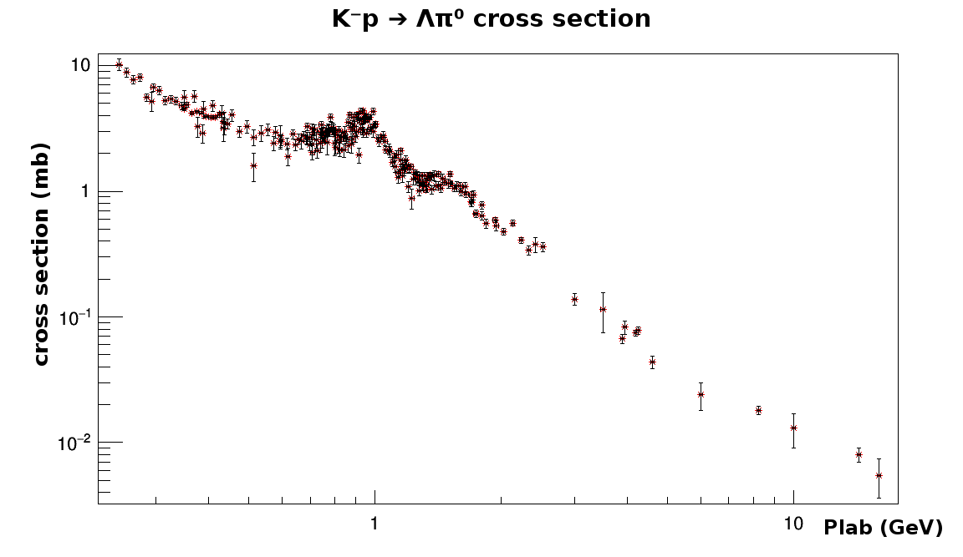
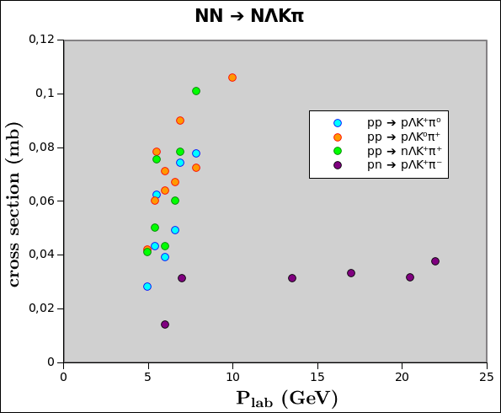
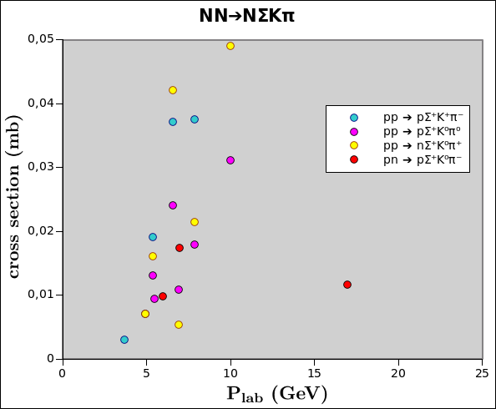
Cross sections availability
Some channel are well described...
Some others not.

Slide 9
III. Strangeness implementation
Problems:
  Data available
Solutions:
Isospin symmetry
  Bystricky Procedure
17%

Slide 10

Bystricky Procedure
Projection on isospin eigenstate
Link between cross section

Slide 11
III. Strangeness implementation
Problems:
  Data available
Solutions:
Isospin symmetry
  Bystricky Procedure
  17% ➔ 35%
17%
Hadron exchange model

Slide 12
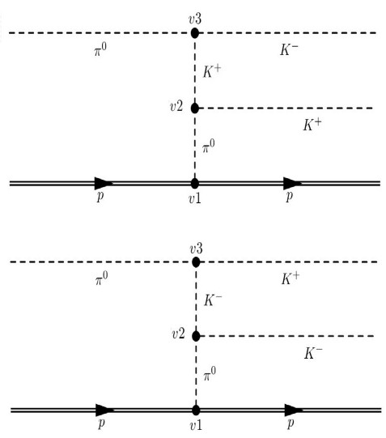
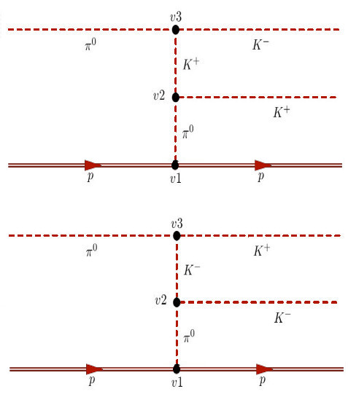
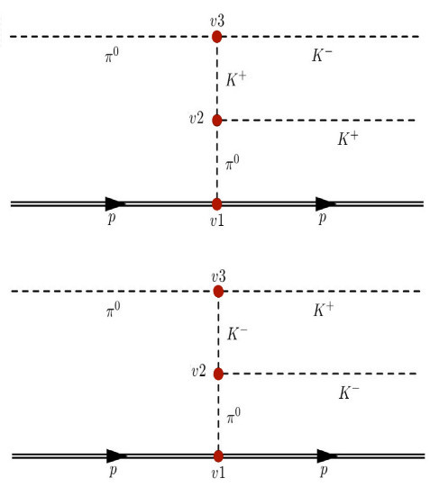
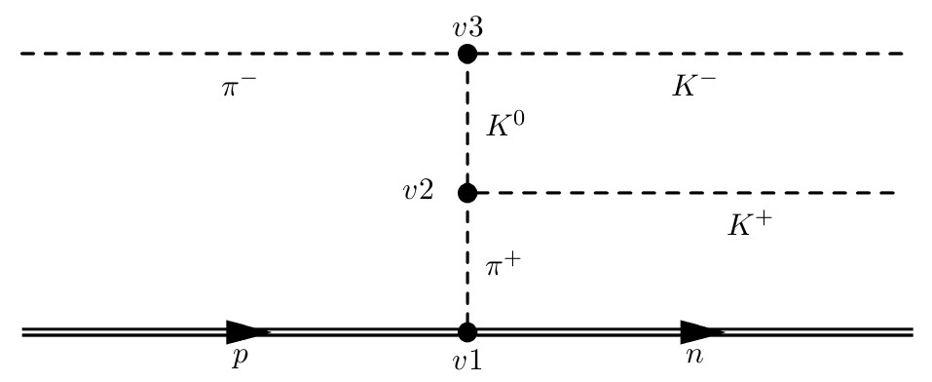
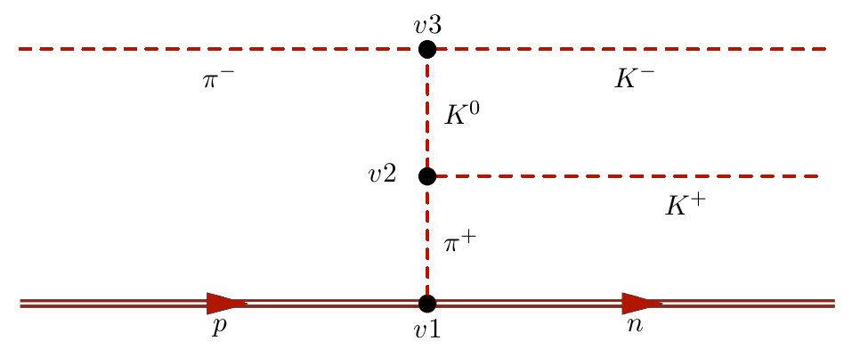
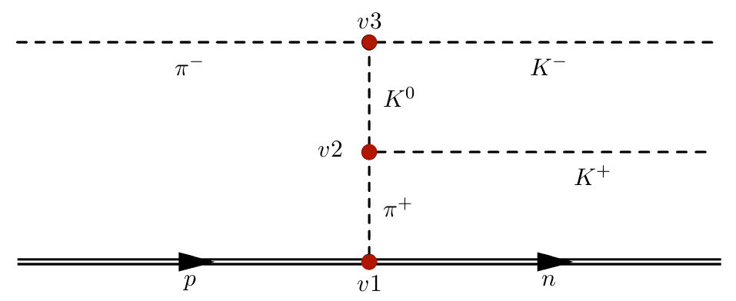
Hadron Exchange Model
Example:

Slide 13
Symmetries
Hadron Exchange Model

Slide 14
III. Strangeness implementation
Problems:
  Data available
Solutions:
Isospin symmetry
  Bystricky Procedure
  17% ➔ 35%
17%
Hadron exchange model
35% ➔ 72%

Slide 15
The 28 % missing cross sections
Models coming from other works:
Hypothesis: similarity with non strange
cross section:
100% ? ...

Slide 16
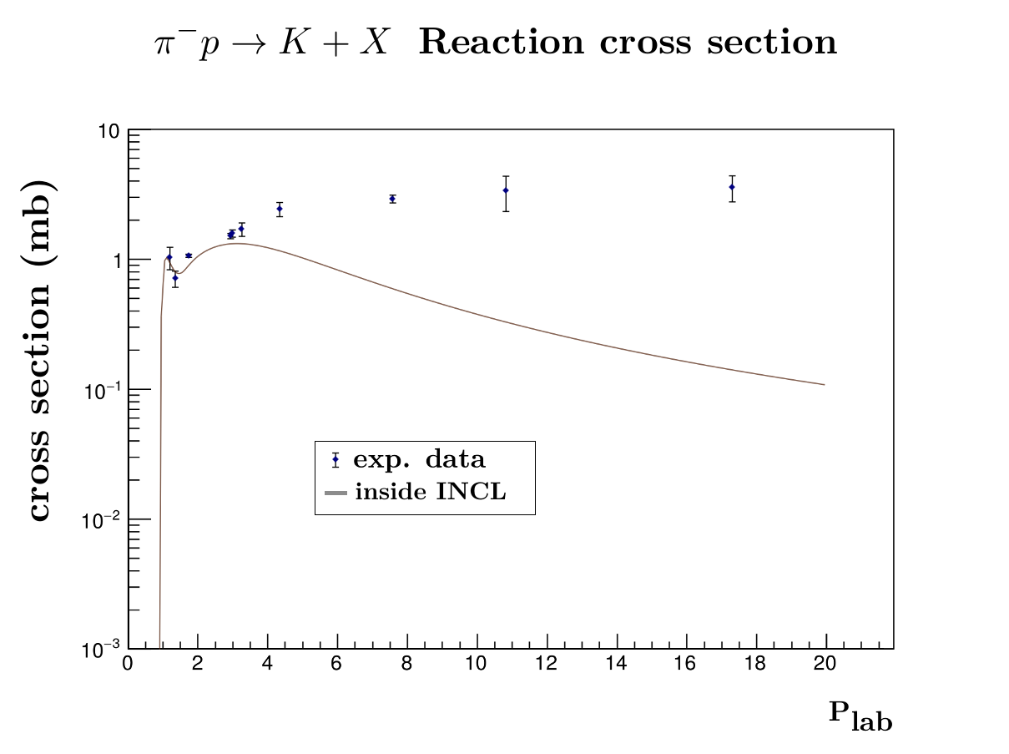
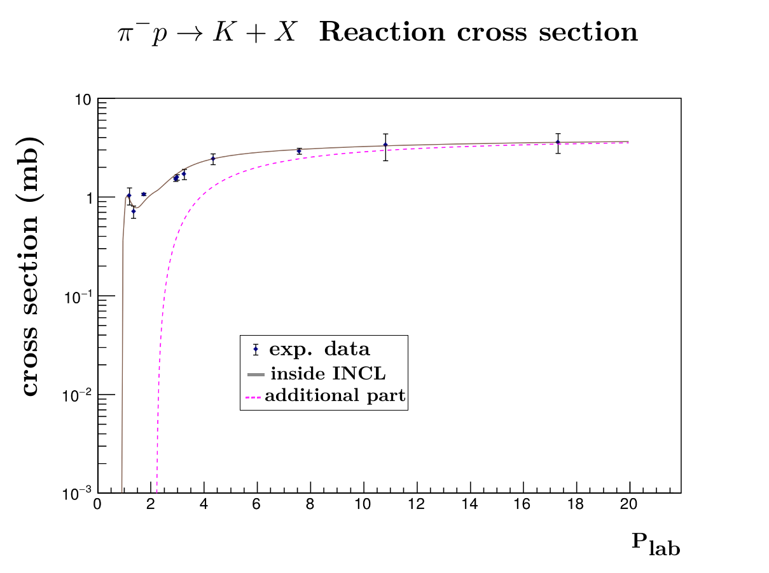
Missing part add in order to fit experimental inclusive cross section
Inclusive cross section not well described

Slide 17
Potential in the nucleus
Λ (-39 MeV)
K⁻(-60 MeV)
K⁺(25 MeV)
rather well known.
Σ badly known (maybe repulsive - 16 MeV?)
(Th.A. Rijken and H.-J. Schulze Eur. Phys.J.A. (2016) 52:21)
K⁰ and K̅⁰ unknown (not energy eigenstate)
➔ Potential of K⁰(K̅⁰) = potential of K⁺(K⁻) corrected be the charge. (Hypothesis)

Slide 18
Decay channel and other characteristics
Very well known: data from PDG.
Lifetime:
K⁺,K⁻ : 1.2380 10⁻⁸ s
K⁰s : 8.9564 10⁻¹¹ s
K⁰L : 5.116 10⁻⁸ s
Λ : 2.632 10⁻¹⁰ s
Σ⁺ : 8.018 10⁻¹¹ s
Σ⁰ : 7.4 10⁻²⁰ s
Σ⁻ : 1.479 10⁻¹⁰ s
Time scale:
Cascade : 10⁻²²-10⁻²¹ s
De-excitation : 10⁻²⁰ - 10⁻¹⁵ s
C. Patrignani et al.(Particle Data Group), Chin. Phys. C, 40, 100001 (2016).

Slide 19
Angular distributions
Phase space generator when no data available
2 dimensional fits of data for:
πN ➔ YK and K̅N ➔ Baryon Meson

Slide 20
Angular distributions
Phase space generation
Phase space
generator
Data
Isotropy ?

Slide 21
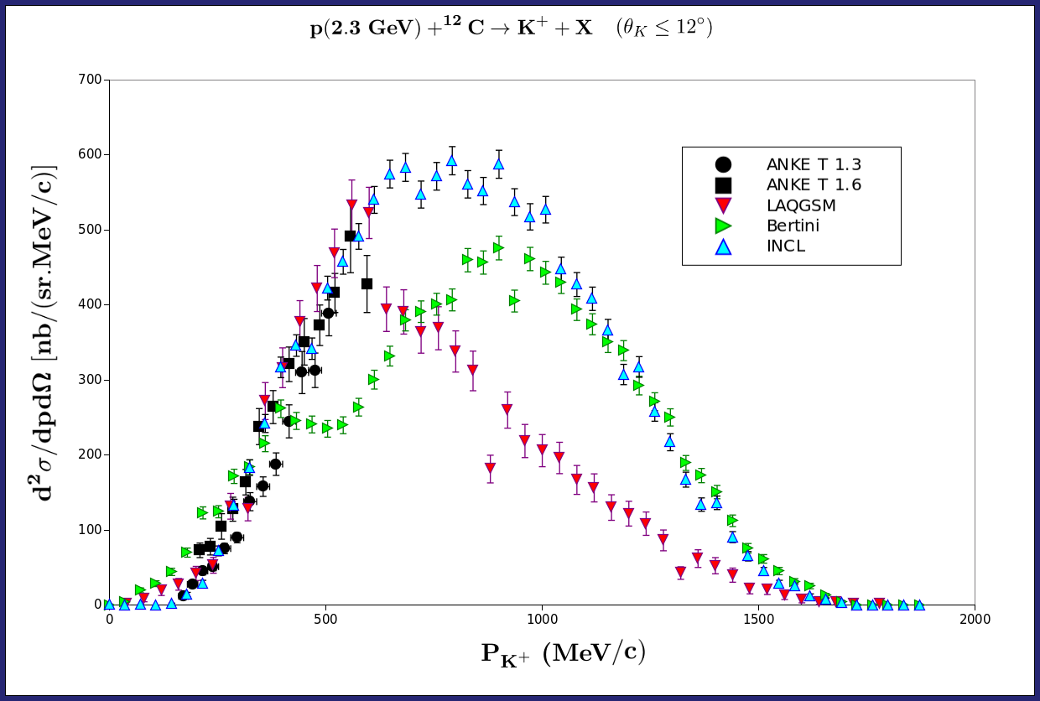
V. Preliminary Result
Comparison with other models

Slide 22
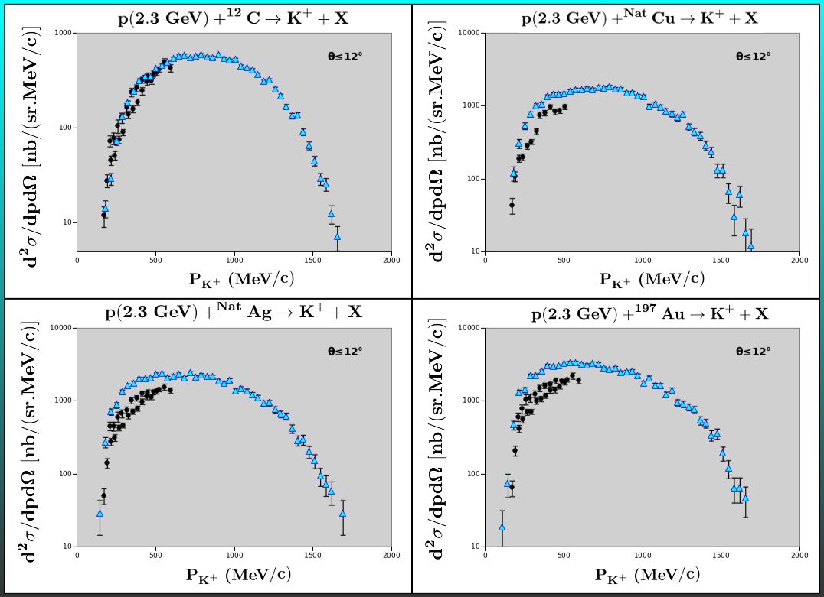
V. Preliminary Result

Slide 23
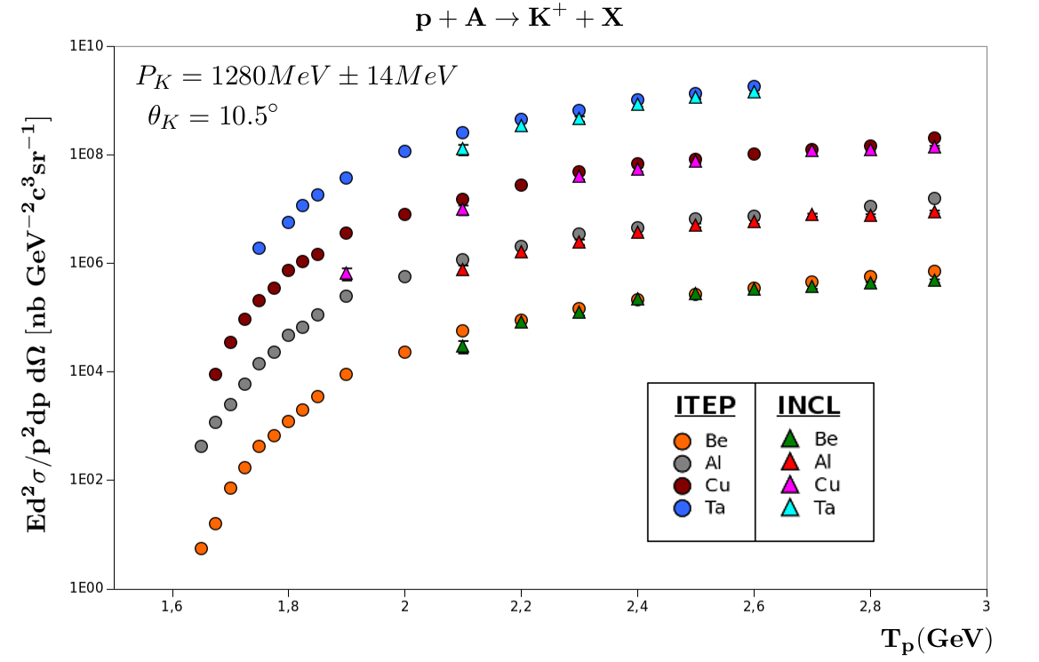
V. Preliminary Result

Slide 24
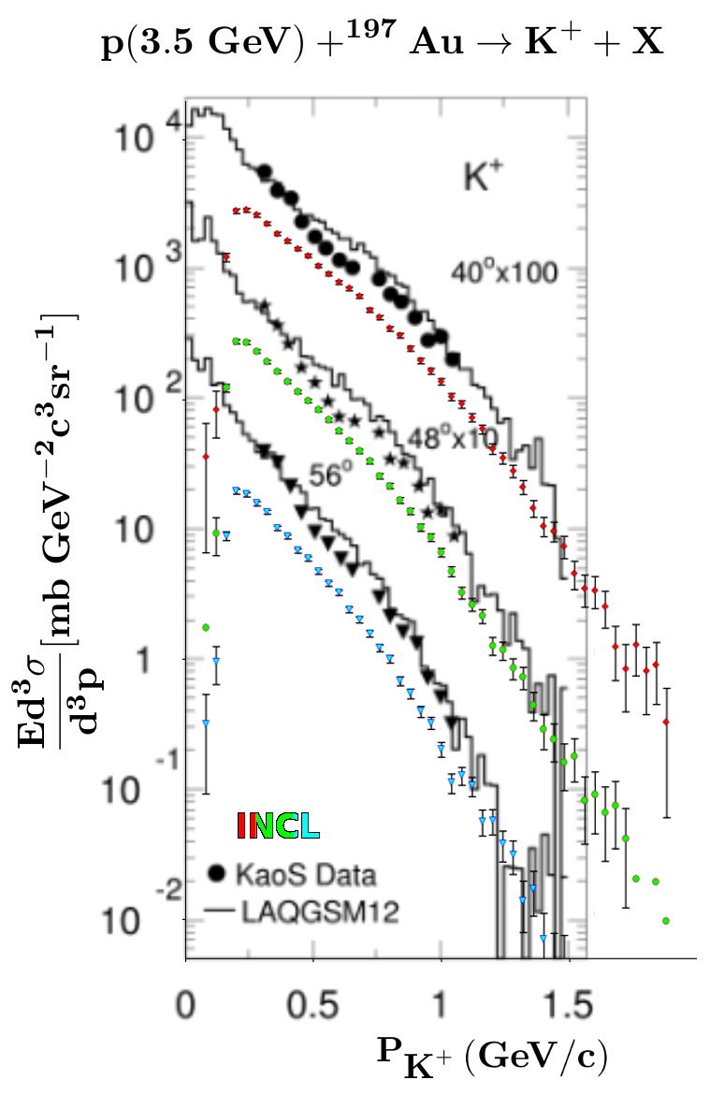
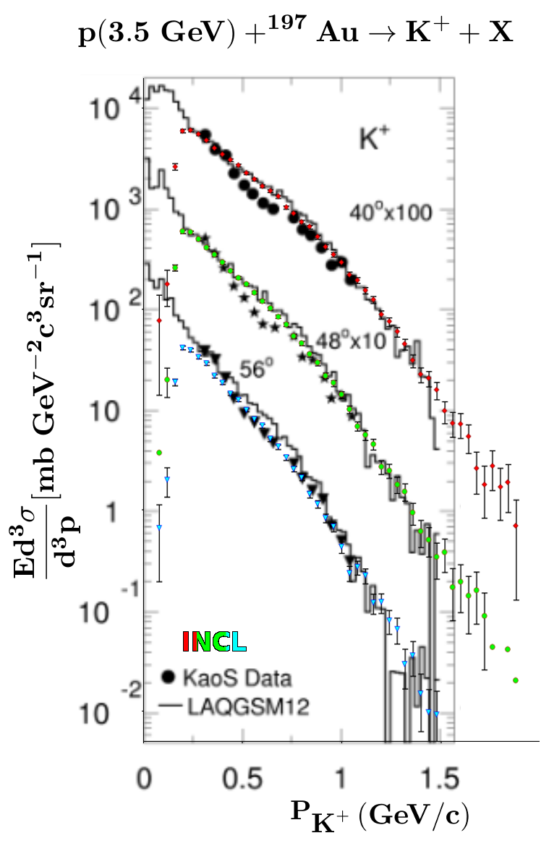
V. Preliminary Result
Real Prediction
Shape comparison
(Prediction x2)
Angular distribution

Slide 25
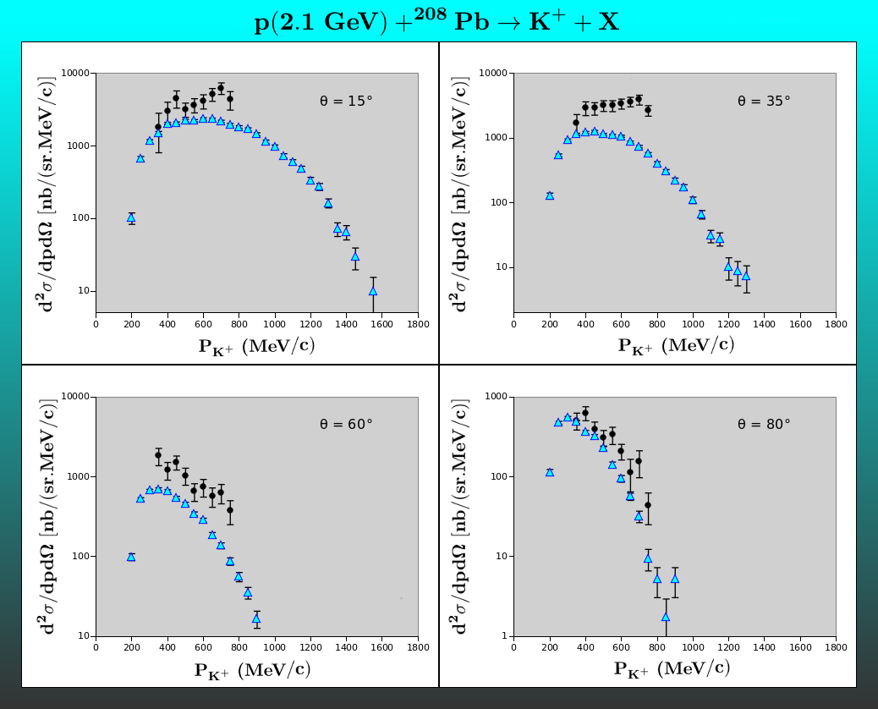
V. Preliminary Result

Slide 26
VI. Conclusion
Strangeness inside INCL
First results encouraging

Slide 27
VI. Next step
End of the CEA thesis part:
  Analysis of first results
  Biasing implementation
  Implementation in Geant4
  Coupling with a hypernuclei deexcitation code

Slide 28
VI. Next-next step
Second part of my thesis (University of Bern, Switzerland):
  Prediction of nuclei transmutation in meteorites and exoplanets high atmosphere under the influence of cosmic rays thanks to INCL
  Found life on an other planet?

Slide 29
Thanks for your attention

