Slide 1
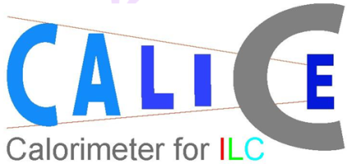
Spraying of Glass Plates for the DHCAL
José Repond
Argonne National Laboratory
RD51 Meeting, by phone, April 13, 2011

Slide 2
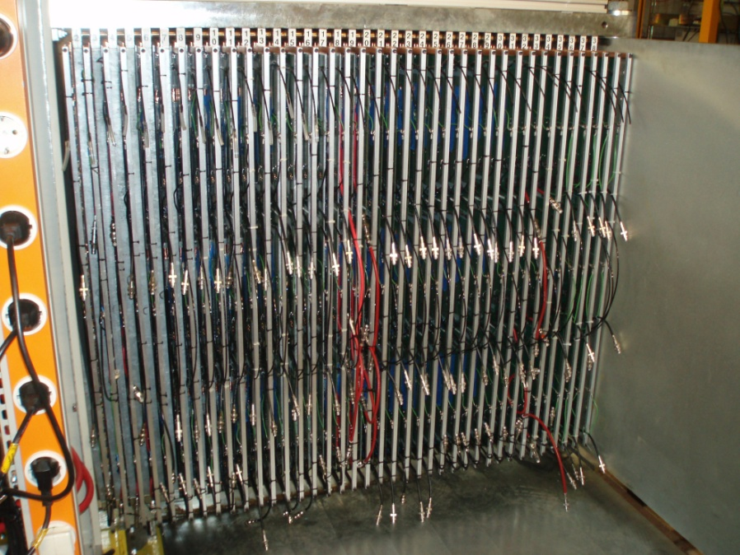
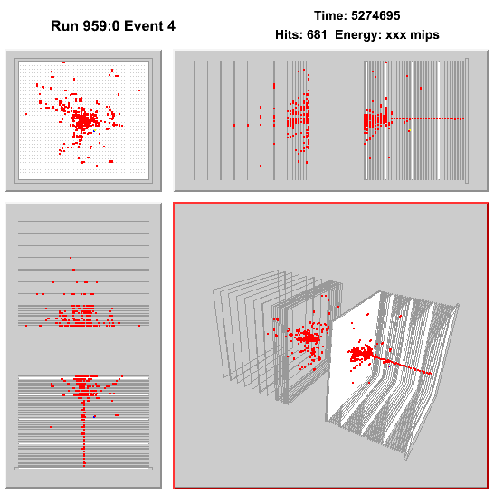
Digital Hadron Calorimeter: DHCAL
Hadron Calorimeter for PFA application
Resistive Plate Chambers as active elements
Extremely fine readout segmentation 1 x 1 cm²
1 – bit resolution per channel (digital readout)
Steel plates as absorber
The DHCAL in numbers
Each layer 96 x 95 cm²
38 layers in the DHCAL + 14 layers in the TCMT (tail catcher)
Each layer with 9,216 channels
Total number of channels 350,208 + 129,024 = 479,232
Status
Construction completed
Cassettes installed into the CALICE absorber structure at FNAL
2 successful test beam periods in October 2010 and January 2011
Currently taking data with the CALICE Silicon – Tungsten ECAL placed in front
Additional standalone runs in June and possibly later…

Slide 3
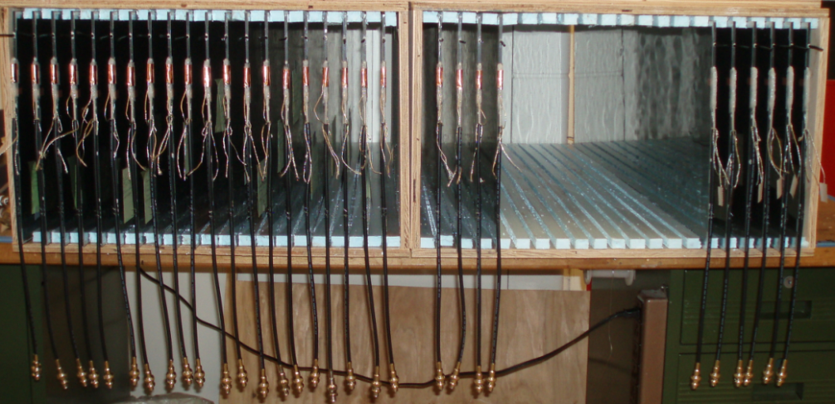
RPC design and construction
Design
Standard 2 plate design with glass as resistive plates
Readout on anode side
Outside of chamber coated with resistive paint to apply HV
Challenges
Maintain uniform gas gap (→ precision assembly fixtures)
Bring the HV out as far as possible to rim, w/out break downs
Provide uniform surface resistivity in the range on 1 – 5 MΩ/□
→ Higher resistivity impacts the rate capability
→ Lower resistivity increases the pad multiplicity
How to measure R□
G10 board
Signal pads
Mylar
Resistive paint
0.85mm glass
1.15mm gas gap
-HV
Resistive paint
1.05mm glass
Mylar
Aluminum foil

Slide 4
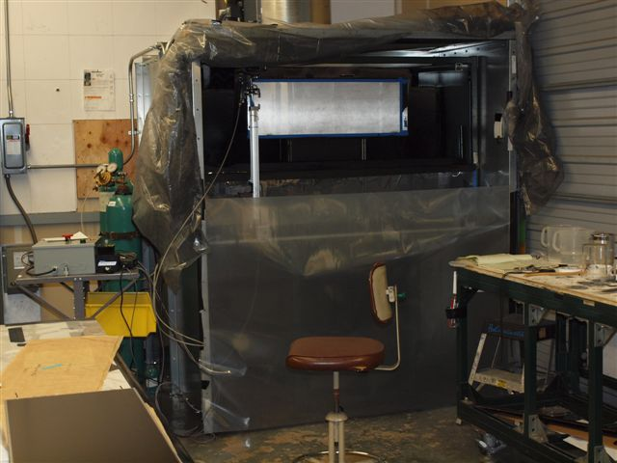
Spraying glass
Constraints on resistive paint
Surface resistivity in the range of 1 – 5 MΩ/□
Easily applicable
Resistivity not dependent on humidity (very important!!!)
Paint
Used commercial spray (LICRON) in the past, but new product not useful
Identified some 2-component ‘artist paint’ → satisfies constraints
Paint needs to be mixed appropriately and sprayed (with spraying gun)
Spraying booth
Built large booth to exhaust (non-toxic) fumes
Movement of spraying gun controlled with step motors (~ 2minutes/plate)
Spraying procedure
Significant preparation needed: cleaning of glass, masking off rims, mixing paint, cleaning tools
1-botton operation
Could spray up to 8 plates in one day

Slide 5
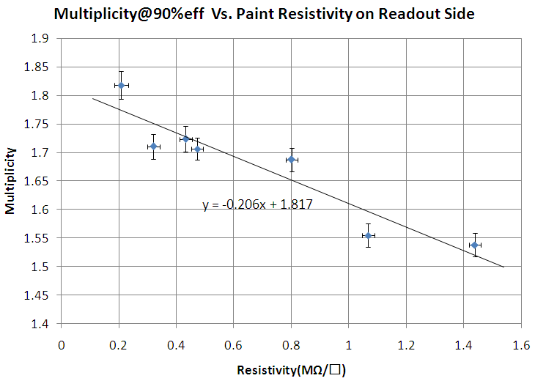
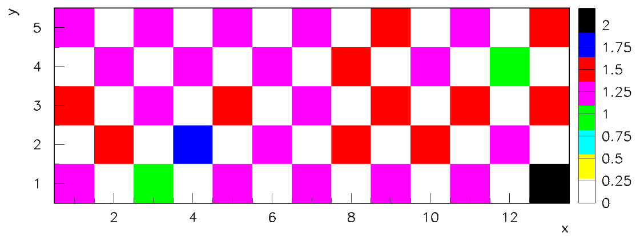
Results
Uniformity obtained by adjusting
- Speeds
- Distance to glass plate
- Order of spraying
- Air flow in booth
MΩ/□

Slide 6
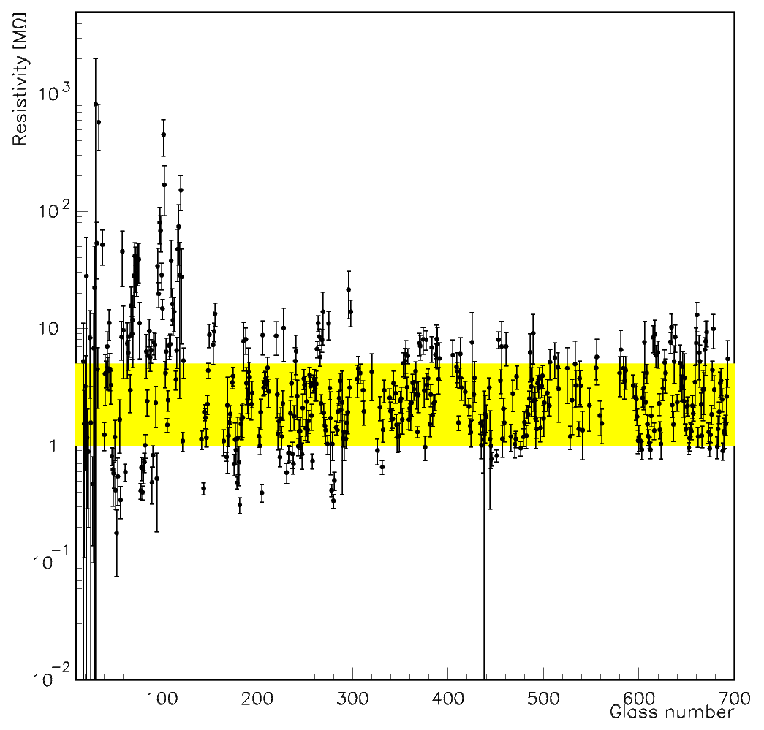
Overall values adjusted by
- Adding water to the mixture
- Modifying the ratio of the two components
For the DHCAL + TCMT + spares needed
~400 sheets of glass
Efficiency was poor ~ 60%
Not all values plotted
Environment (pressure, humidity,
temperature) was poorly controlled.
Better control needed for better
reliability

Slide 7
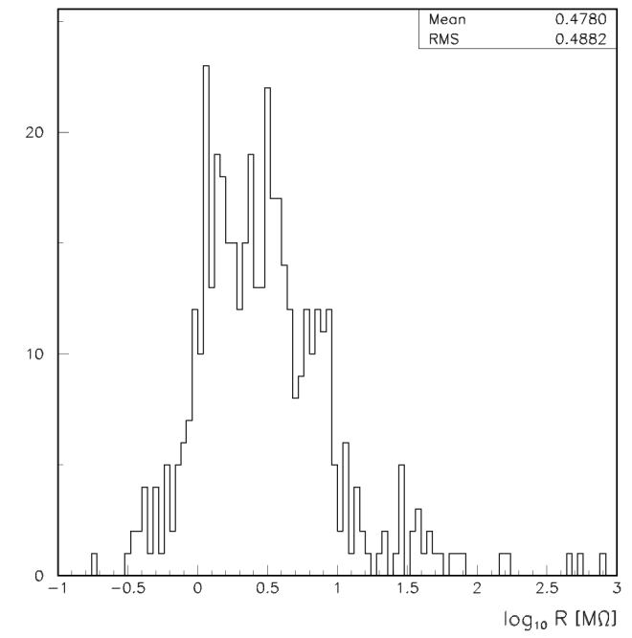
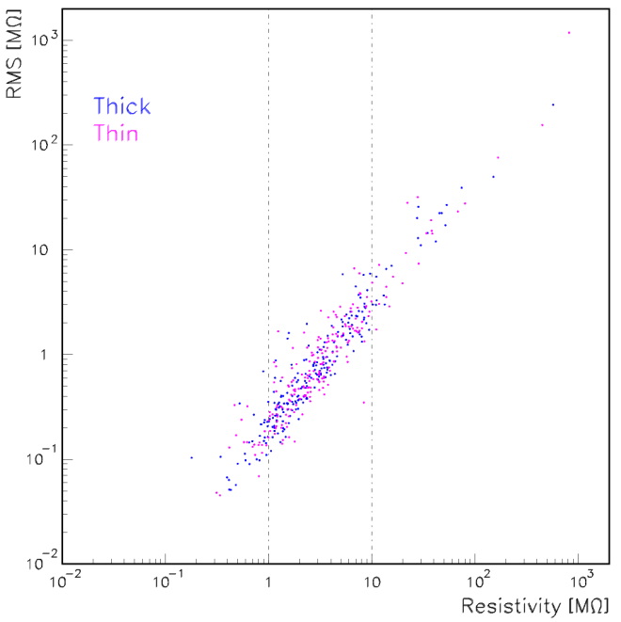
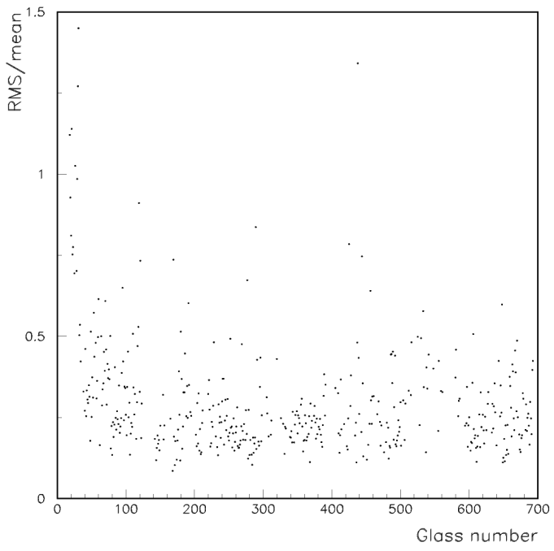
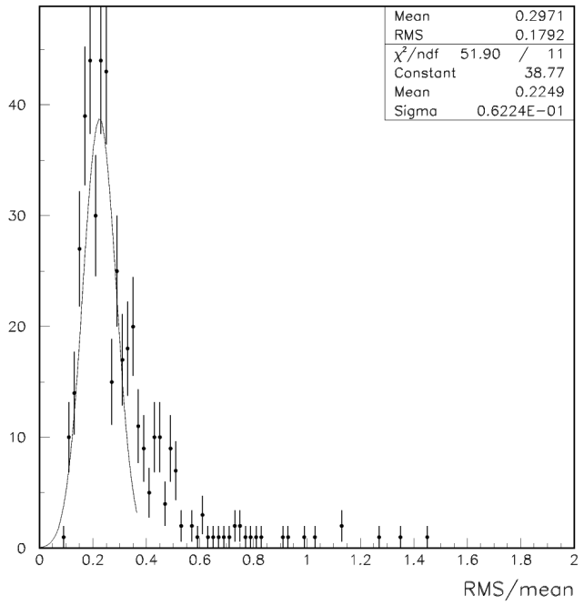
RMS related to
mean value
Note: not all plates
measured and included

Slide 8
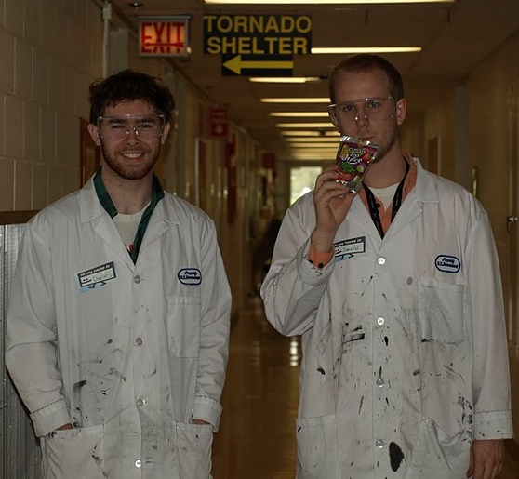
And who did all the work…
Daniel Trojand
ANL + McGill
Jacob Smith
ANL + UTA

Slide 9
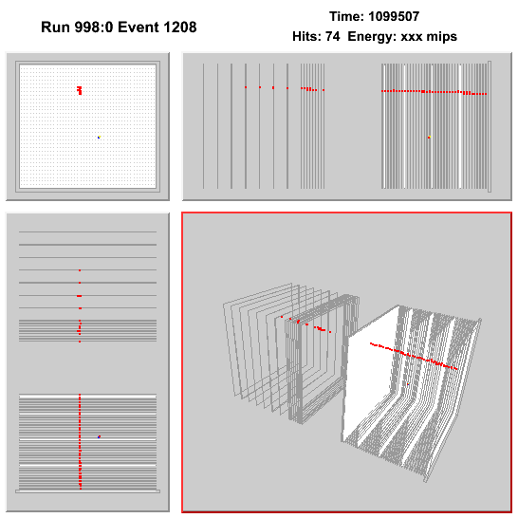
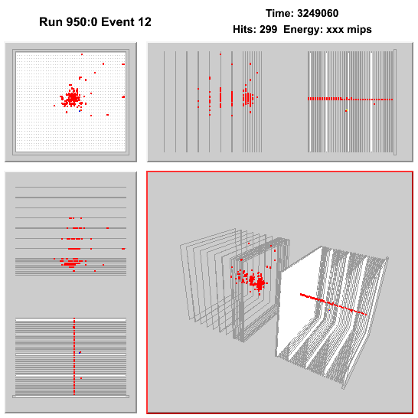
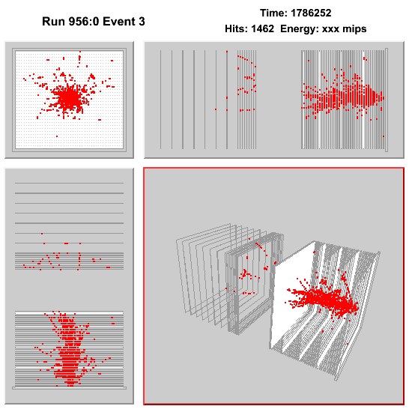
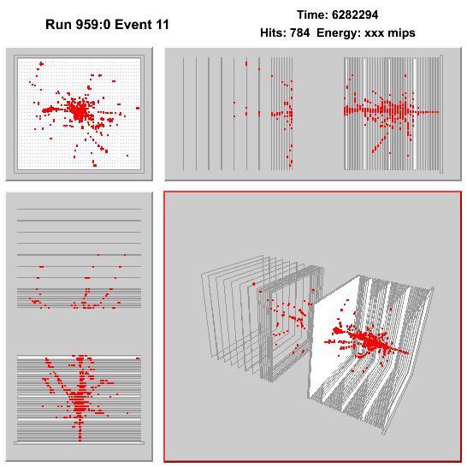
A few nice
events to
conclude…

