Slide 1
Experience with resistive coatings at Saclay
and Carleton, Nikhef, Neuchatel
P. Colas
Use of resistive coatings for:
Spreading the charge to improve resolution while limiting the number of electronic readout channels
Stabilizing Micromegas detectors (spark suppression)
Protecting integrated circuits
Numerous techniques tried since a decade
Characterization of coverlays : measurement of surface resistivity, bulk resistivity and thru-resistivity

Slide 2
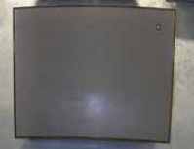
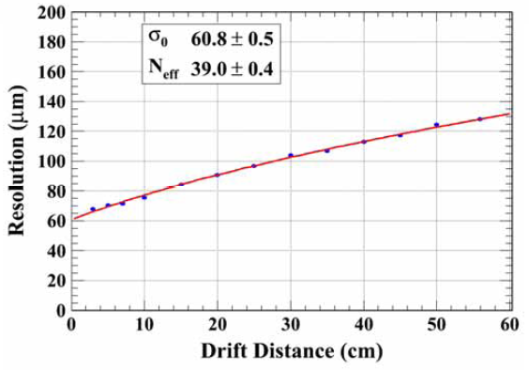
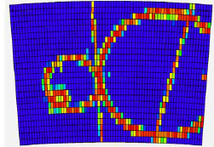
ILC-TPC : charge spreading
Resistive bulk Micromegas
Continuous RC circuit spreads the charge -> resolution improvement
60 µ resolution at 0 drift with 3 mm pads !

Slide 3
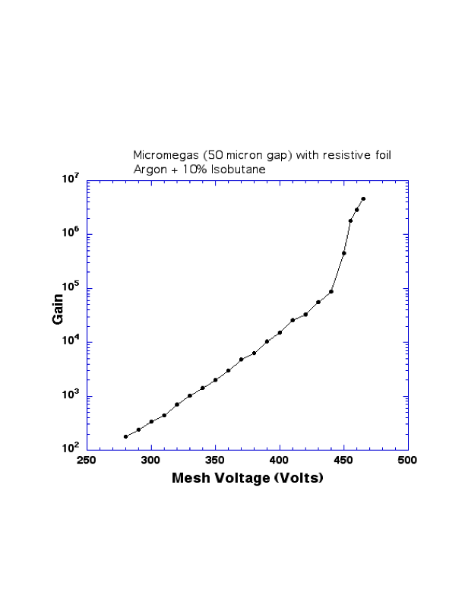
Also the resistive foil stabilizes Micromegas: no more breakdown, stable current
^{Argon/Isobutane 90/10}
Cr (SiO₂)_{n} cermet
P.C., M. Dixit, I. Giomataris
2005 LC workshop, Stanford

Slide 4
Standard Micromegas
Resistive Micromegas
MAMMA beam test, 15 kHz hadron beam, October 2009

Slide 5
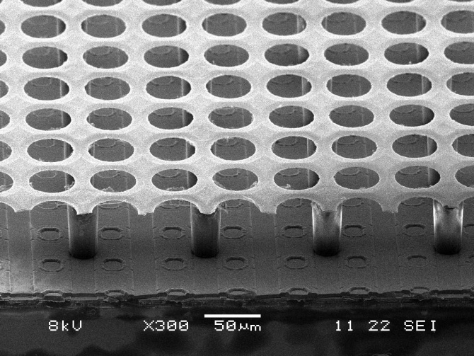
Resistive deposits also protect TimePix Chips from sparks
(10 microns of aSi:H, 4-7 microns of Si_{x}N_{y} (H. VdGraaf, N. Wyrsch)

Slide 6
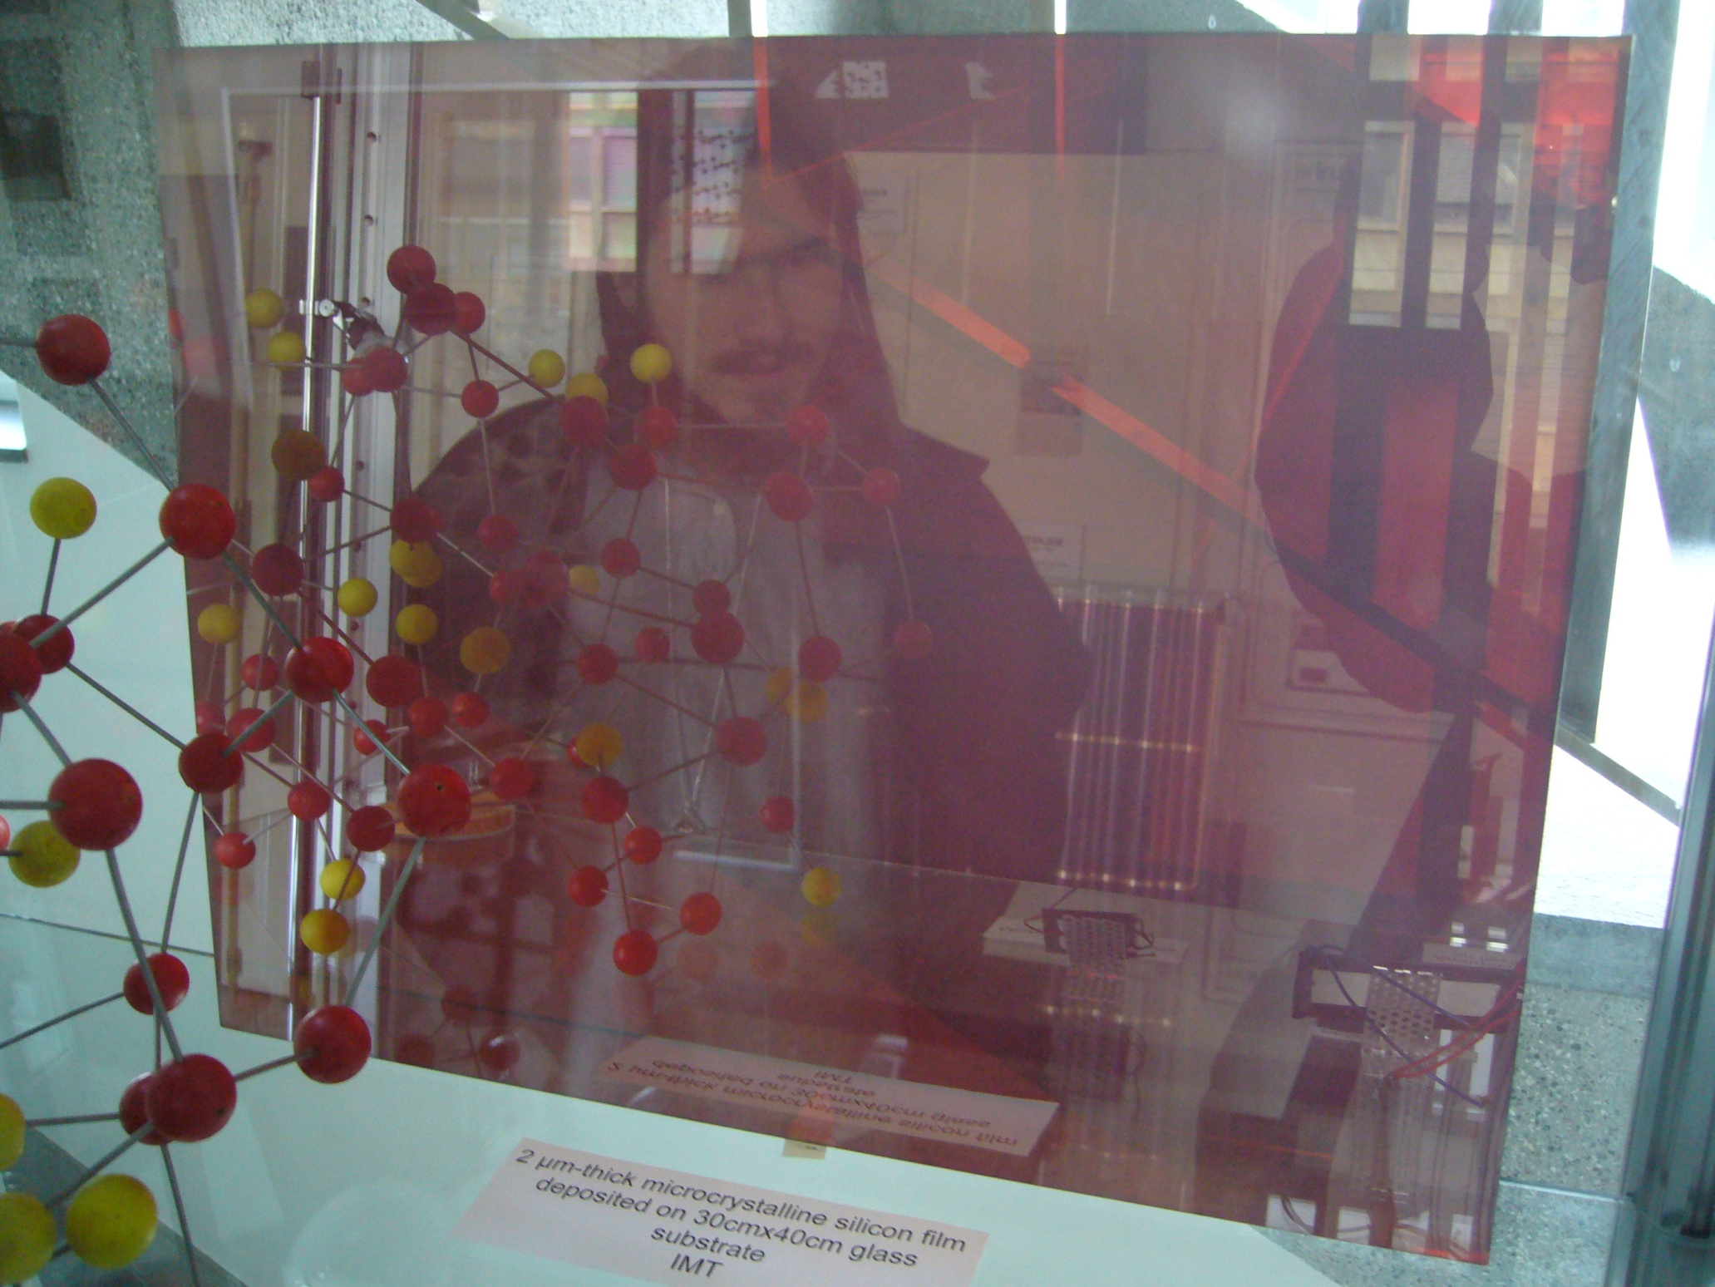

Slide 7
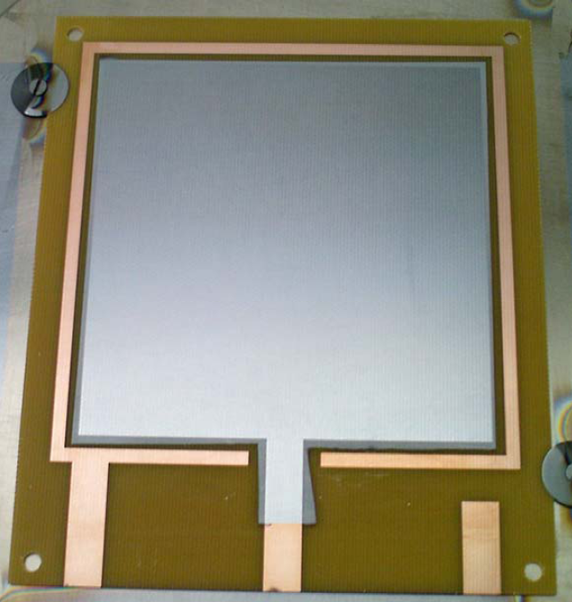
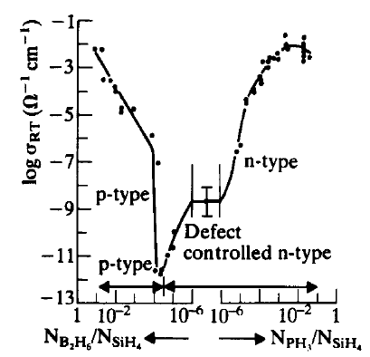
Deposition of thin layers (10 µ thick) of a-SiH (10¹³ Ω.cm)
Neuchatel, N. Wyrsch
Possibility to add a doped layer on top

Slide 8
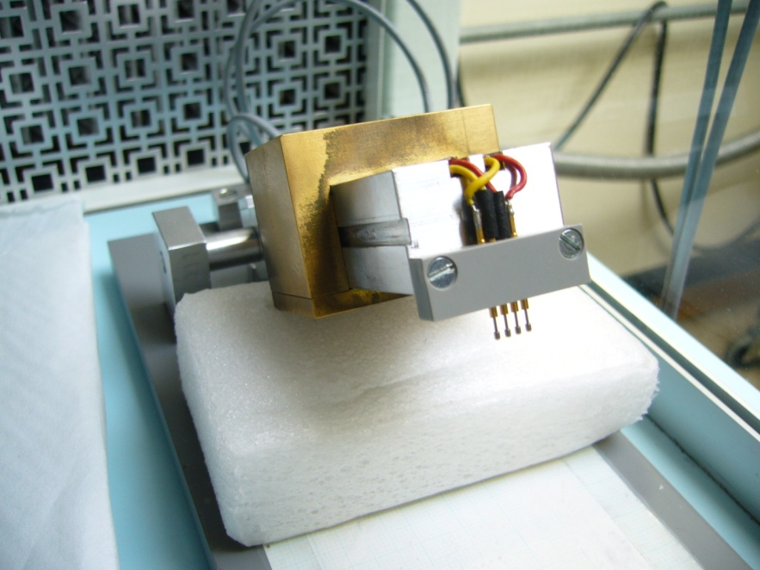
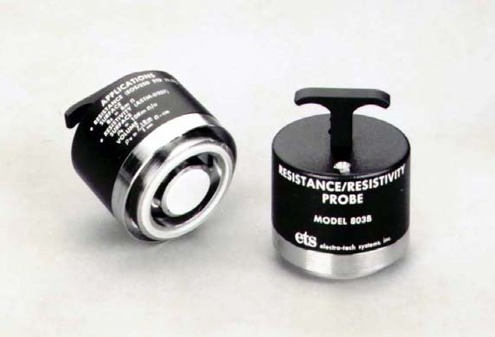
We used several techniques to measure resistivities.
May depend on voltage, pressure of the contact,…
Often see discrepancies, inhomogeneities, unstabilities
Thru-resistivity sometimes inconsistent with surface resistivity
4-point probe (Neuchatel)
Circular probe
Conducting tape, insulating substrate
lxL resistive sample = L/l ’squares’
Measure resistance, divide by number of squares

Slide 9
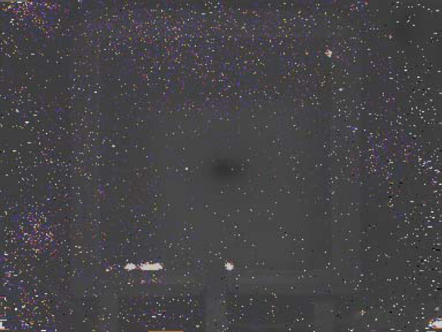

Diagnostic tools : thermal image of the prototype with a high-resistivity layer and a lower-resistivity layer on top (N. Wyrsch, EPFL, Neuchatel)
Hot spots due to leakage current

Slide 10
Type of coating | PROs | CONs
Cermet (Sheldal; M. Dixit et al.) | Tunable resistivity, homogeneous Stable once laminated | Fragile / scratchable
Carbon-Loaded polyimide (Dupont; M. Dixit et al.) | Accurate thickness (25 µ) Large surfaces easy
Thin layer deposition (H. VdGraaf, N. Wyrsch, EPFL) | Limited to few micron thickness | Limited to small surfaces (10x10cm2). Very clean substrate needed.
Sprays (G. Mikenberg, Tel Aviv, J. Répond, I.Laktineh) | Large surfaces. Needs tuning | 10-20% homogeneity
paints | Can be patterned. Large surfaces. | inhomogeneous

