Slide 1
RD51Collaboration meeting 13/04/2011
Resistors in Cern PCB worshop

Slide 2
Summary
Terminology
Materials and techniques
Structures made at CERN

Slide 3
Terminilogy
-A Resistor is define by:
-Value Ohms
-Precision %
-TCR ppm/Deg C
-max power W or W/m2
-breakdown voltage V
-Resistivity in Ohm*m
-Sheet resistance or surface resistivity in Ohm/sqr
-TCR: Temperature coefficient of the resistor
-Cermet: is a composite material composed of ceramic (cer) and metallic (met) materials.

Slide 4
Rs: Sheet resistance Ω/sq
Source: Wikipedia

Slide 5
Some examples
@ 300 K(Ω·m)
Silver 16·10⁻⁹ (Ω·m)
Ruthenium 71 10⁻⁹ (Ω·m)
Germanium 460·10⁻⁹ (Ω·m)
Ni/Cr 1000·10⁻⁹ (Ω·m)
Carbone 35 000·10⁻⁹ (Ω·m)

Slide 6
Resistor families
Thin-film :Vacuum deposited metals/oxides
Thick-film : (Cer-met)
Polymer (epoxy, phenolic, polyimide)

Slide 7
Thin film

Slide 8
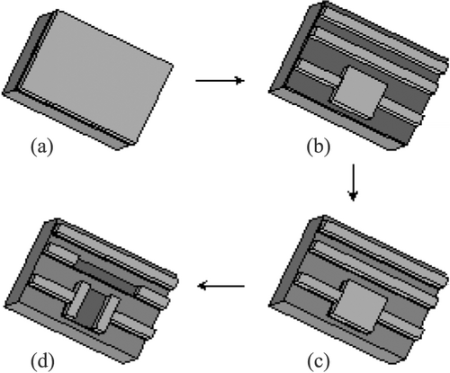
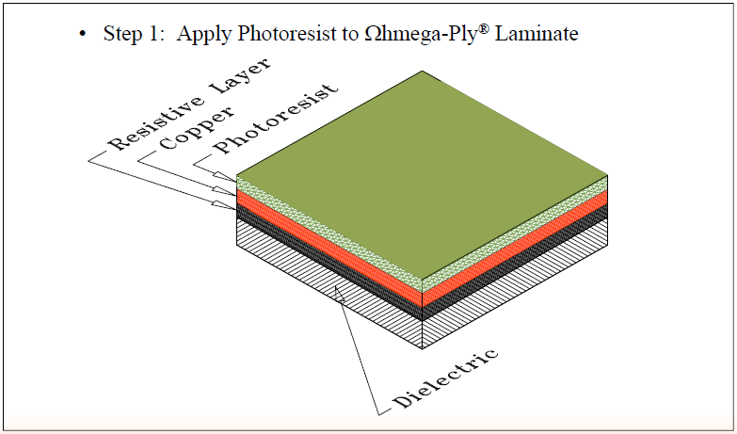
Thin film
WEB SITE: http://www.ohmega.com

Slide 9
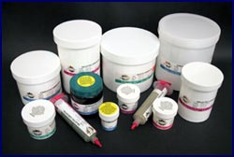
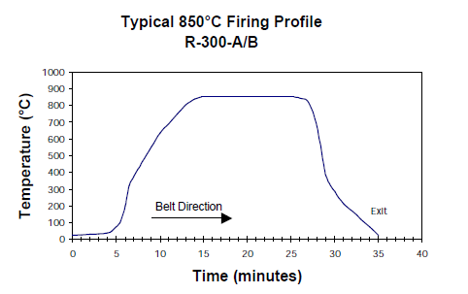
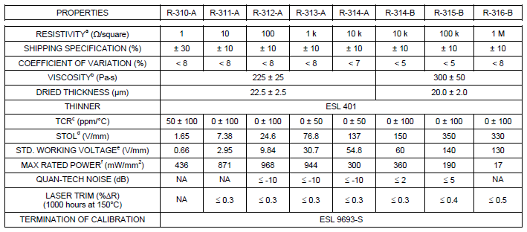
Thick film
Some supplier can build 100 Mohms/sqr pastes

Slide 10
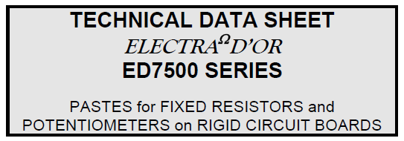
Polymer resistive pastes
1 Mohms/Sqr seems to be the limit for these polymers

Slide 11
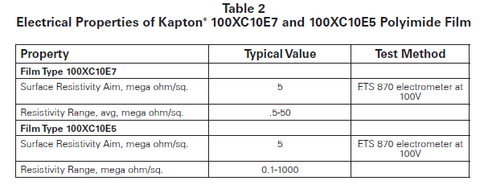
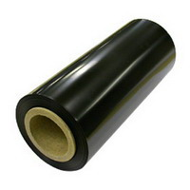
Polymer Resistive foils

Slide 12
Other products

Slide 13
Selection guide
Substrate
Thin film
Mineral materials: Ceramic, glass, silicon, metals
Polymers
Thick film
Mineral materials: Ceramic, glass, silicon, metals
Polymers
All type

Slide 14
Selection guide
-High values
Thick-film on ceramic (up to 1-10 GOhms/sqr)
Thin-film on polymer (antistatic material 10G-100GOhms/sqr)
Polymer patterned layers
-Precision
Thick film on ceramic (up to 1 GOhms/sqr)
Thin film low values (up to 100kOhms/sqr)
-Large size
Polymers
Thin-film on polymers

Slide 15
Full Resistive I
-Type:
Thin film
Thick film
Resistive polymer
-Deposit:
Vacuum deposit*
Painting
Screen printing
Spraying*
* Not made at CERN
Substrate PCB or Ceramic

Slide 16
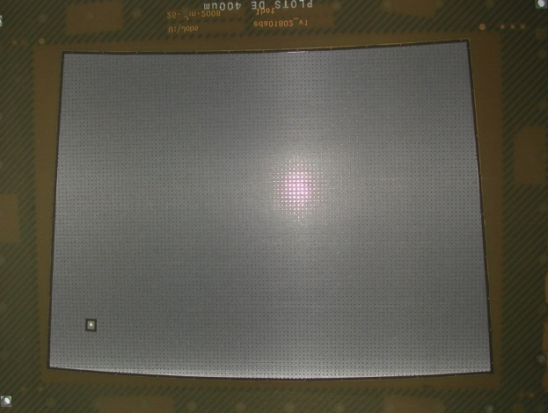
Full Resistive Ii
Copper
Dielectric: polymer or ceramic
PCB or ceramic
Resistive layer (all types)
200mm x 150mm
Bulk Micromegas with
Full Resistive layer
Pads for read out

Slide 17
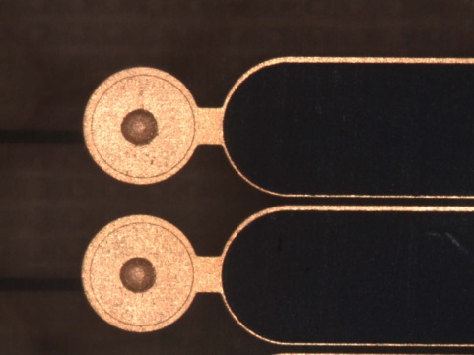
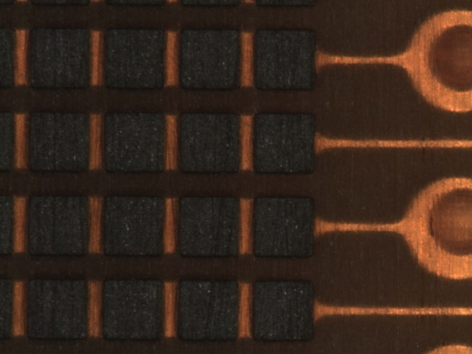
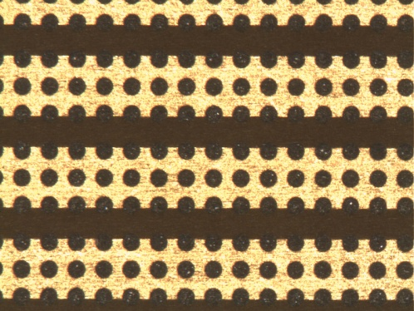
Patterned resistive layer
PCB
All resistor type but needs:
-photolithography
-and/or Wet etch
-and/or laser ablation
PCB
PCB
PCB

Slide 18
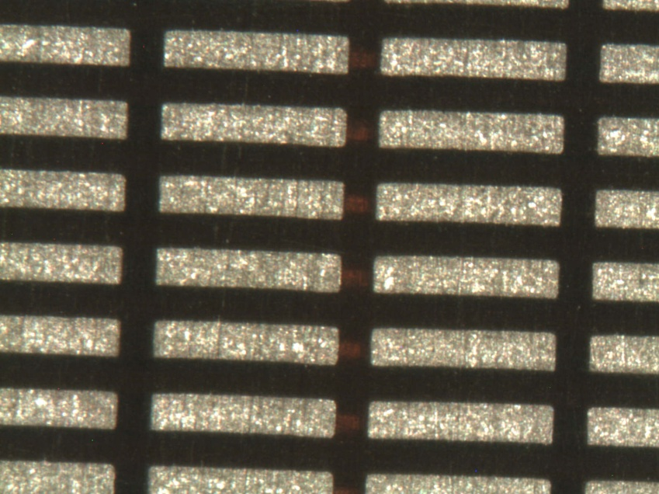
Thick and plated
Only Polymer resistors
-Thicknesses up to 200um
-Silver based glues for the top
PCB

Slide 19
Embedded
Pad
Microvia
75um
- All Resistors types
Resistor
Copper strip

Slide 20
Resistive strip I
PCB
All resistor type but needs:
-photolithography
-and/or Wet etch
-and/or laser ablation
PCB
PCB

Slide 21
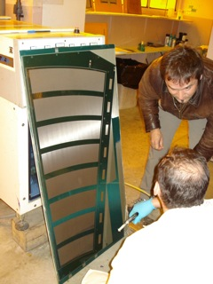
Resistive strip II
Cross section
PCB
Active area up to 1m
PCB
Dielectric 0.1mm
Resistive Strip
Copper Strip

Slide 22
Resistive strip III
Embedded resistor
PCB
GND
Resistive Strip
Copper Strip

Slide 23
Thank you

