Slide 1

A Micromegas TPC for the LC
P. Colas
D. Attié, P. Colas, I. Giomataris, W. Wang (Irfu)
M. Dixit, N. Shiell, P. Hayman (Carleton U.)
G. De Lentdecker (Brussels)

Slide 2
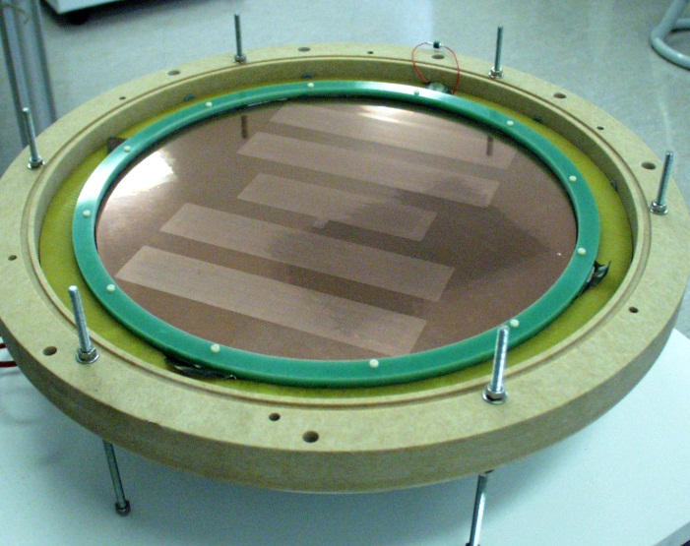
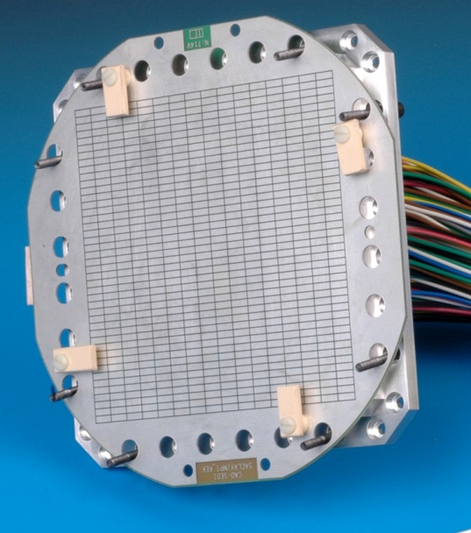
Some history
1992: TPC as a central tracker for a LC detector (Ron Settles, LCWS Garmisch)
1996: Micromegas as an option for readout (PC, Tesla Conceptual Design Report)
1998-2004: Berkeley-Orsay-Saclay TPC (V. Lepeltier, I. Giomataris, M. Ronan, E. Delagnes)
2005-2007: Collaboration with KEK, DESY (5T), Munich, etc…
Now: Large Prototype

Slide 3
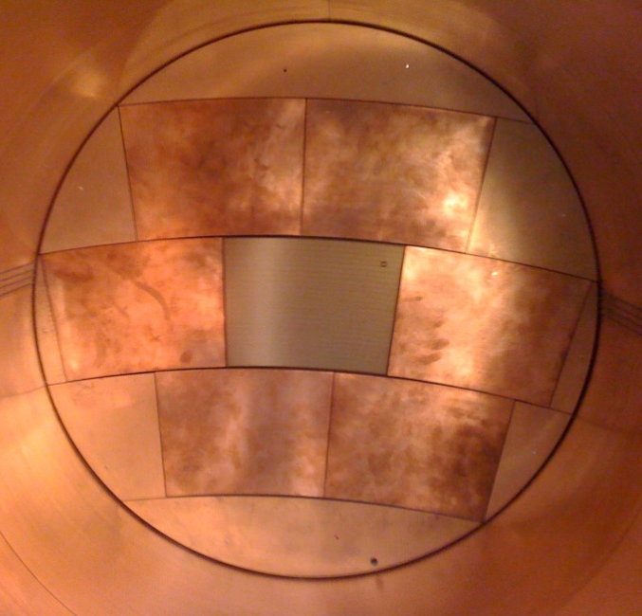
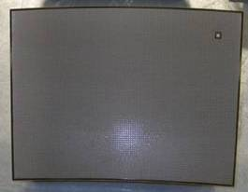
Strategy for Micromegas
The Micromegas option is studied within the same (EUDET) facility as the other options and also in hadrons beams at CERN (RD51)
Phase I: ‘Large Prototype’ Micromegas modules were built and tested in beam (2008-2011): 7 up to now with various resistive coatings, PCB routings and technology, electronic integration, etc…
Phase II (2011-2012): build 9 identical modules and address all integration issues, serial production and characterization, multimodule issues (alignment, distortions).
This talk: results from Phase I and status of Phase II.

Slide 4
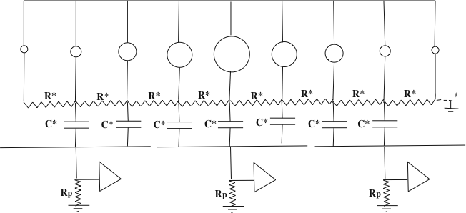
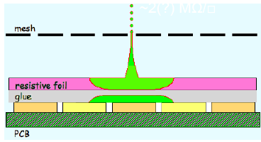
Charge spreading by resistive foil
Resistive coating on top of an insulator: Continuous RC network which spreads the charge: improves position sensitivity
M. Dixit, A. Rankin, NIM A 566 (2006) 28
Various resistive coatings have been tried: Carbon-loaded Kapton (CLK),
3 and 5 Mohm/square, resistive ink.
In addition the resistive foil suppresses sparks.

Slide 5
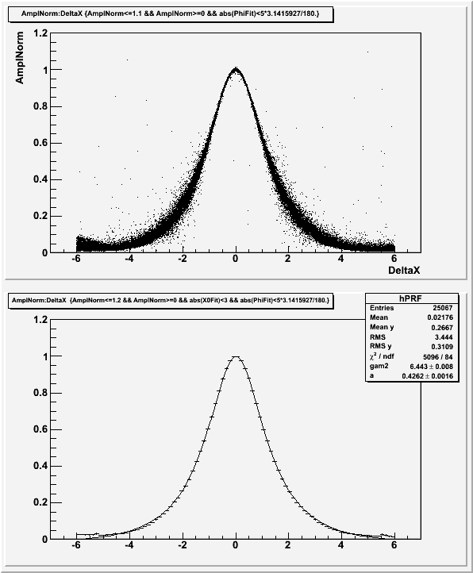
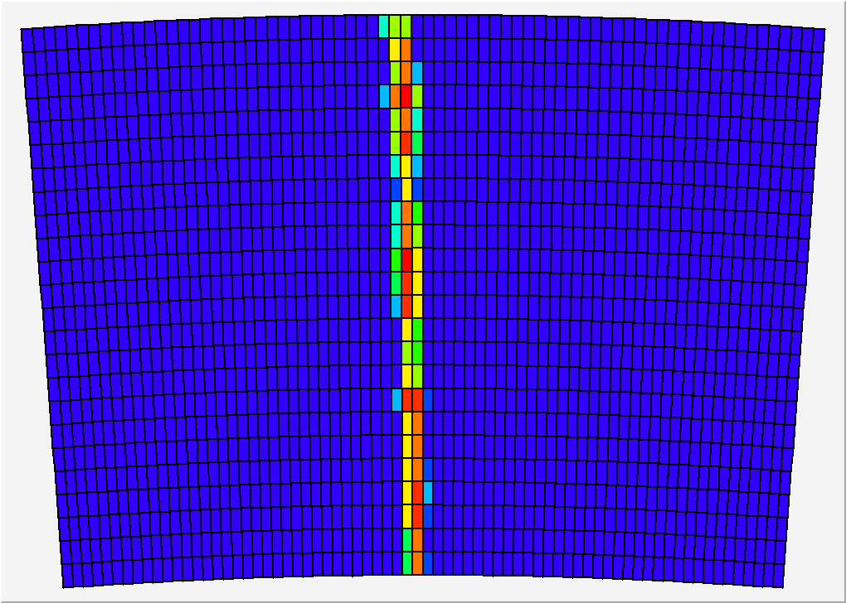
Pad response
Relative fraction of ‘charge’ seen by the pad, vs x(pad)-x(track)
Z=20cm, 200 ns shaping
24 rows x 72 columns of 3 x 6.8 mm² pads
x(pad) – x(track) (mm)

Slide 6
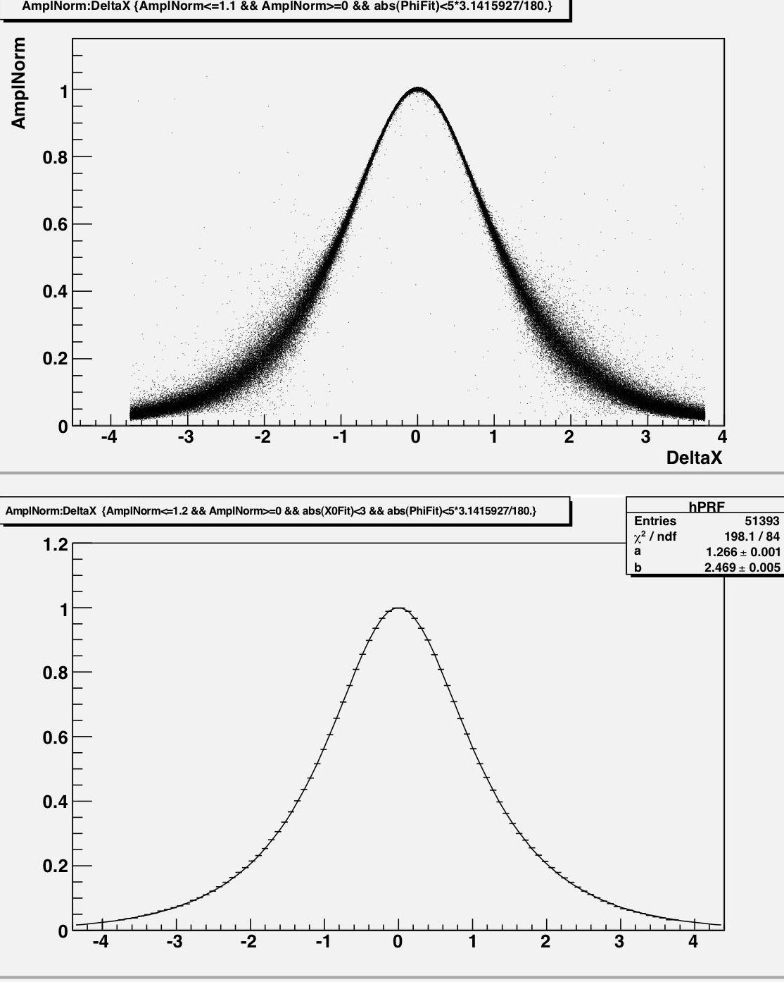
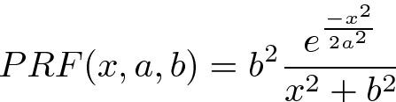
A new Pad Response Function (PRF)
Existing 4 parameter PRF (ratio of two symmetric quartics) replaced with a simpler one:
Only two parameters
Easier to work with
Better fits to data
(mm)

Slide 7
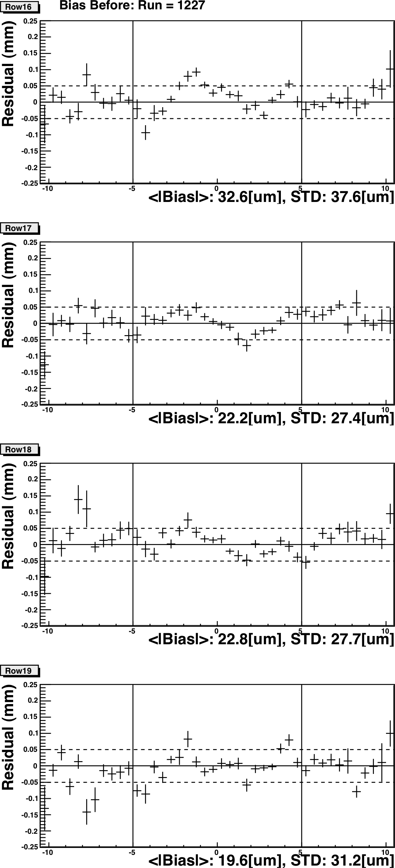
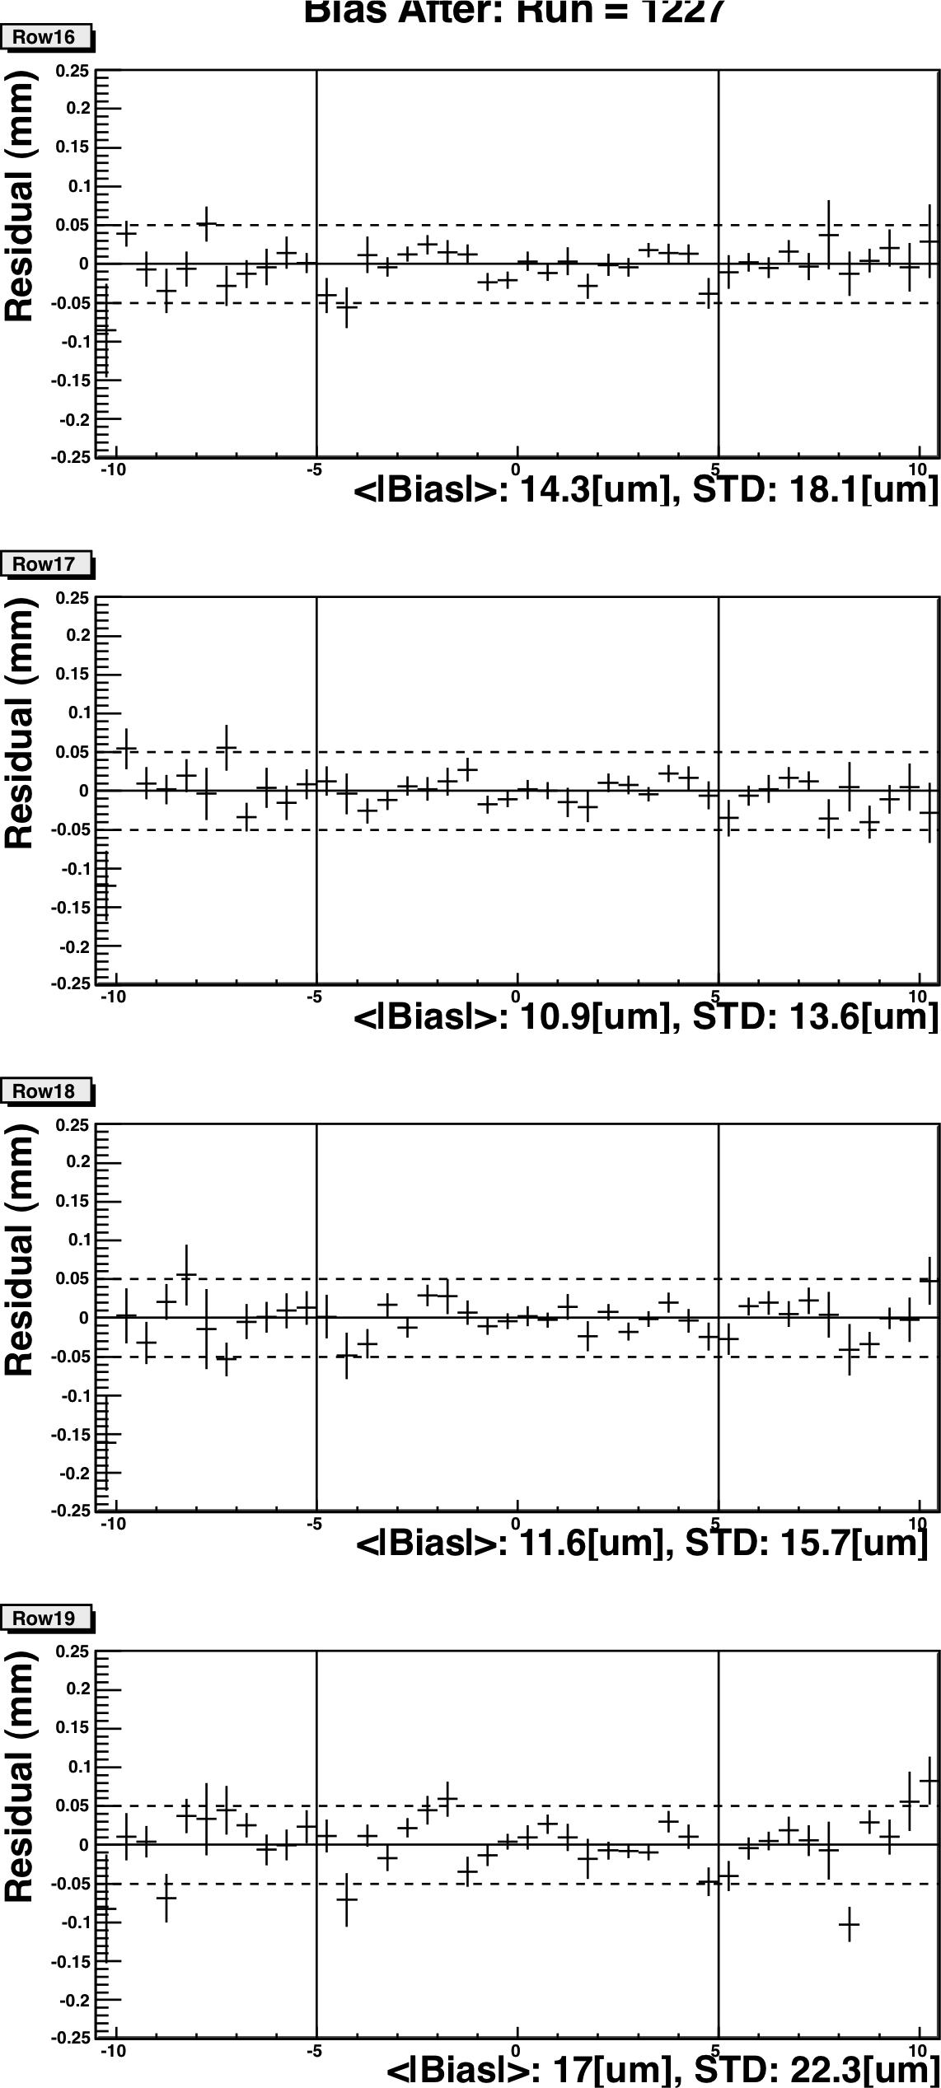
Bias before and after bias calibration
With no external silicon tracker information the accuracy of bias calibration, determined from internal consistency of TPC data, is statistically limited
Bias before
Bias after ~ 20 µm

Slide 8
Preliminary results of new module beam test (B=1T)
May 2011
Transverse resolution dependence on peaking time

Slide 9
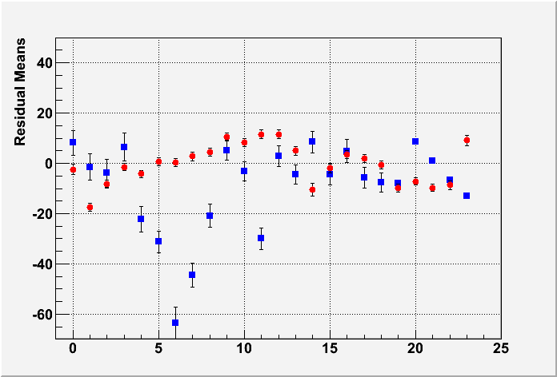
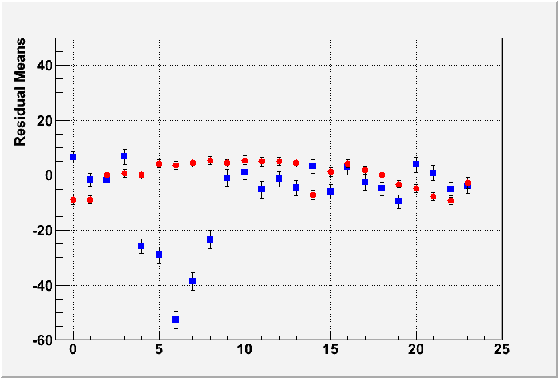
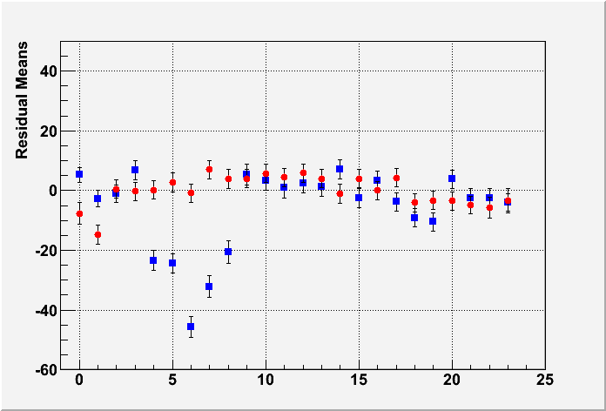
Uniformity (B=1T data)
MEAN RESIDUAL vs ROW number
Z-independent distortions
Distortions up to 50 microns for resistive ink (blue points)
Rms 7 microns for CLK film (red points)
-> select CLK
Z=5cm
Z=35cm
Z=50cm
Row number

Slide 10
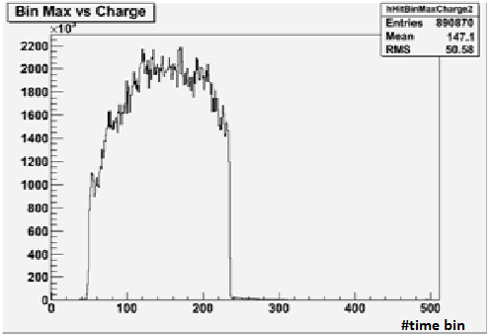
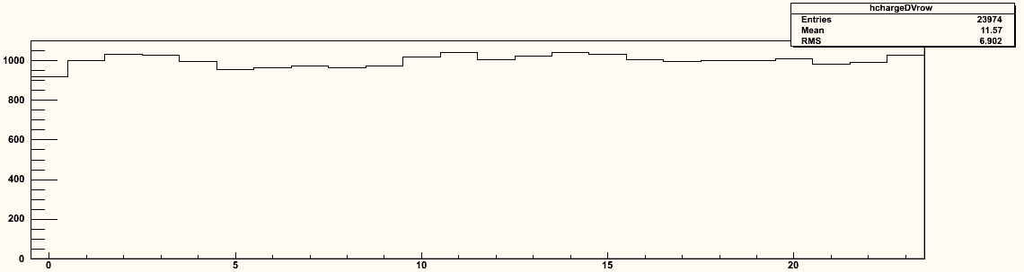
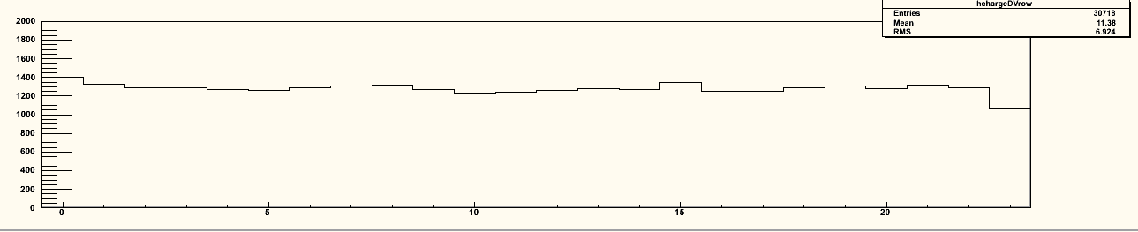
Uniformity
z distribution
Average charge by row
Average charge by row
Using cosmic-ray events
B=OT
Using 5 GeV e-
B=1T
0 5 10 15 20
0 5 10 15 20
Excellent uniformity up to the edge of the module, thanks to the ‘bulk’ technology.

Slide 11
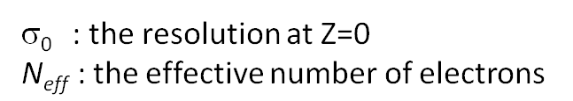
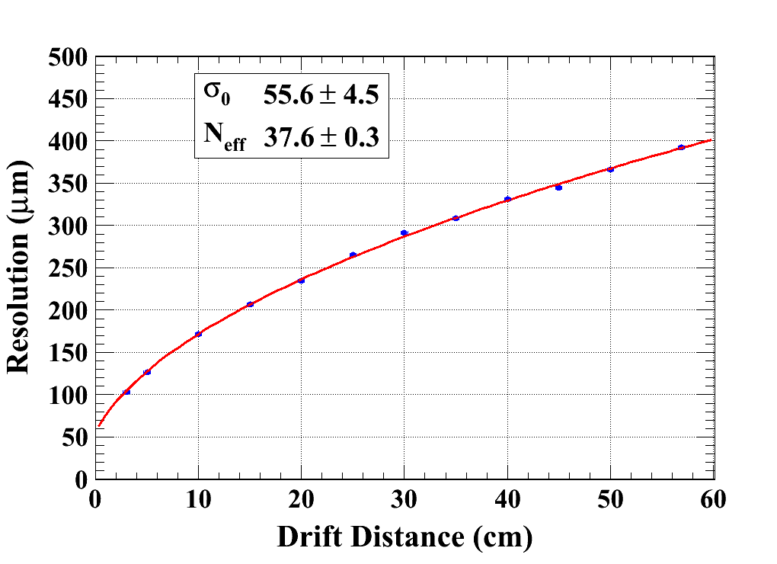
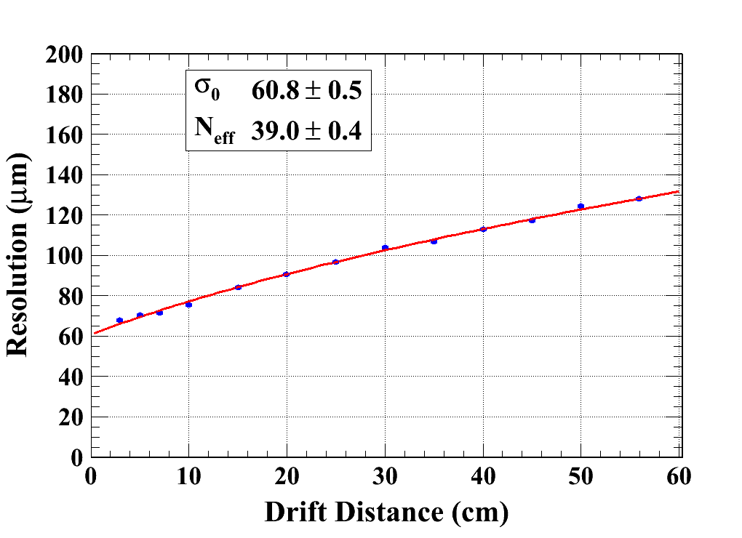
Data analysis results (B = 0T & 1T)
Carbon-loaded kapton resistive foil
Gas: Ar/CF4/Iso 95/3/2
C_{d} : diffusion constant
B=0 T C_{d} = 315.1 µm/√cm (Magboltz)
B=1 T C_{d} = 94.2 µm/√cm (Magboltz)
Module 4
χ² : 10.6
Ndf: 10
Module 3
χ² : 29.1
Ndf: 11

Slide 12
N_{eff} measurement with Micromegas
Averaging B=0T and B=1T data, modules 4, 5 and 3 (excluding ink module):
  N_{eff} = 38.0±0.2(stat) (systematics difficult to assess)
  σ₀= 59 ± 3 µm
  Note that 1/<1/N> = 47.1 from Heed for 5 Gev electrons on 6.84mm long pads.
  Thus N_{eff} has to be between 23.5 (for exponential gain fluctuations) and 47.1 if there are no gain fluctuations.
  1/<1/N> = 34.9 for 5.4 mm pads (GEM case).
D. Arogancia et al., NIM A 602 (2009) 403

Slide 13
Dependence of resolution with peaking time
Z=5cm
CLK 5 MΩ/sq
Optimum resolution for 500 ns peaking time -> try to lower resistivity to lower this peaking time (faster charge spreading)

Slide 14
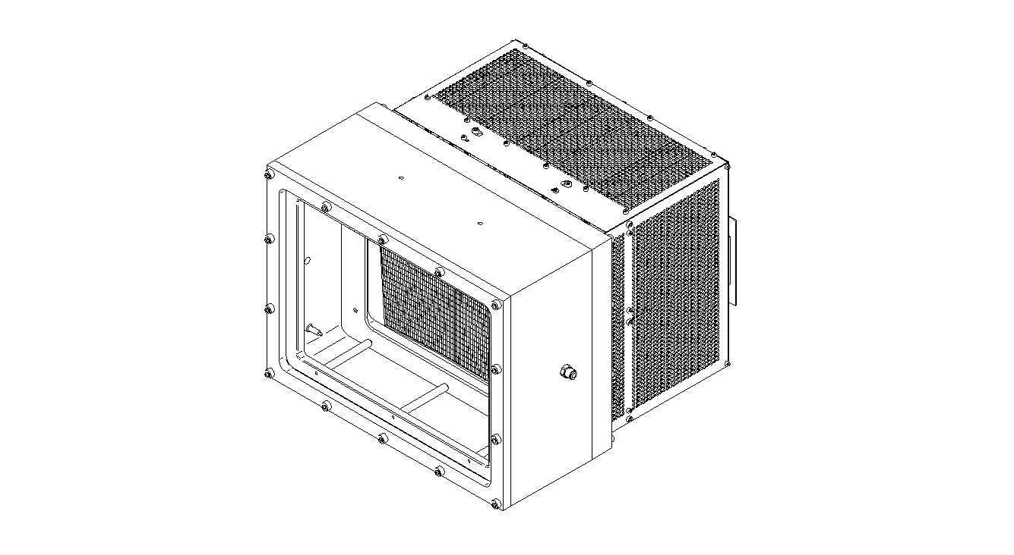
Test in a high intensity π beam
Top
40 cm
B field
11 cm
27 cm
35cm
Bottom

Slide 15
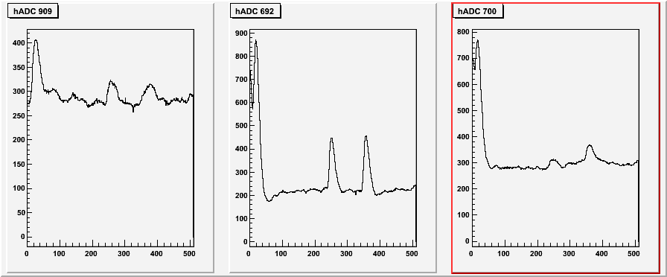
Test at CERN (July 2010) at 180 kHz (5 x 2 cm² beam) showed no charging up and stable operation
Peaking time of 200 ns is enough to obtain the best resolution -> 300 ns suffice to distinguish 2 tracks on the same pad
4µs
Time (in 40 ns bins)

Slide 16
7 Module project
D. Attié, D. Calvet, E. Delagnes, S. Lhénoret, I. Mandjavidze, A. Le Coguie, M. Riallot, E. Zonca
Test bench @ CERN
D. Attié, S. Herlant, A. Delbart

Slide 17
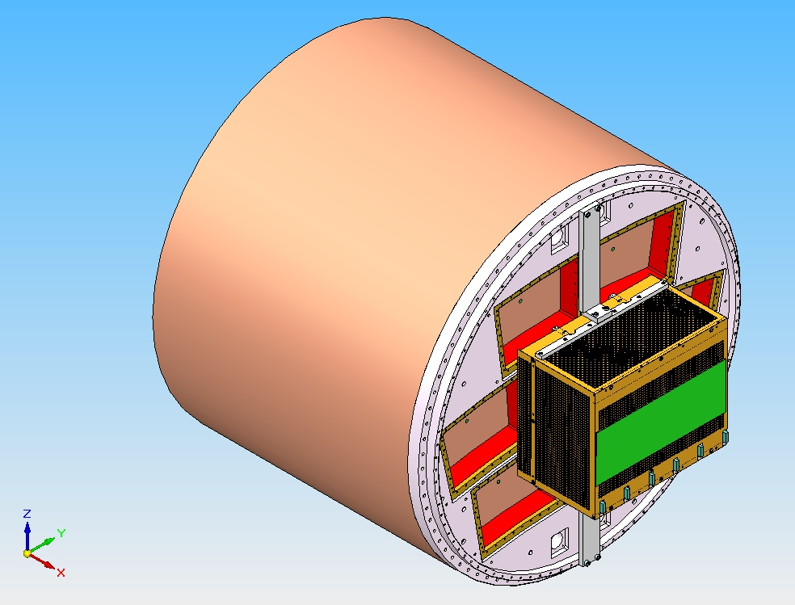
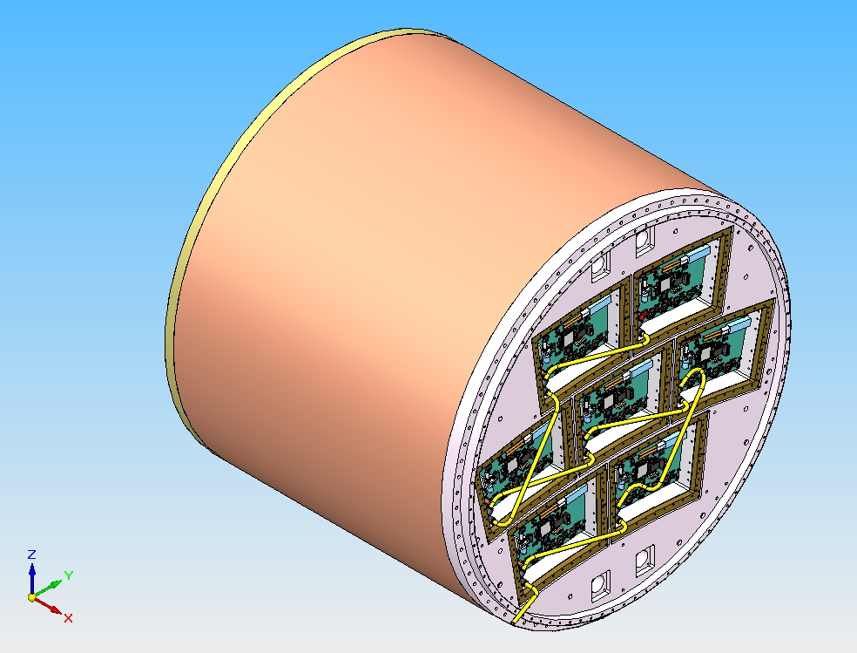
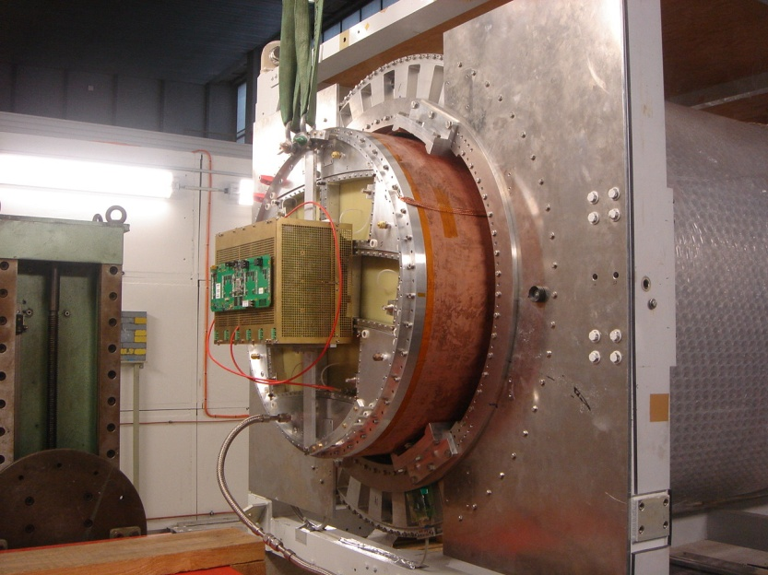
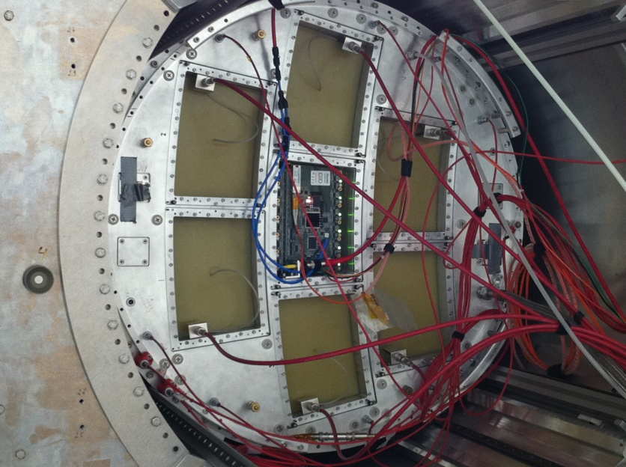
Towards Phase II: 7 module project – electronic integration

Slide 18
May 2011: beam test of a new module with fully integrated electronics
New detector : new routing to adapt to new connectors, lower anode resistivity (3 MΩ/sq), new res. foil grounding on the edge of the PCB.
New 300 points flat connectors
New front end: keep naked AFTER chips and remove double diodes (count on resistive foil to protect against sparks)
New Front End Mezzanine (FEMI)
New backend ready for up to 12 modules
New DAQ, 7-module ready and more compact format
New trigger discriminator and logic (FPGA).

Slide 19
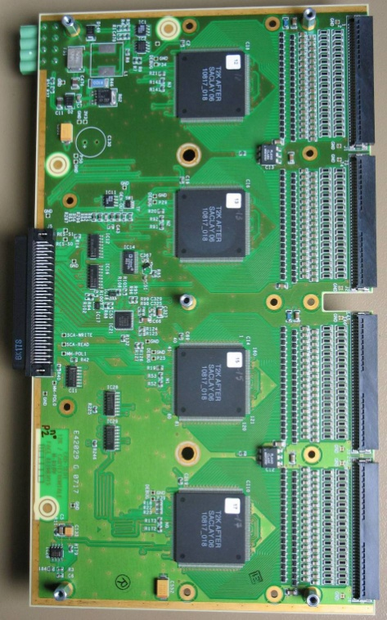
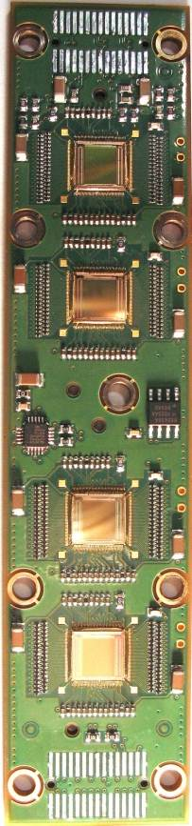
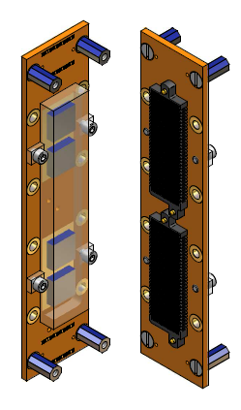
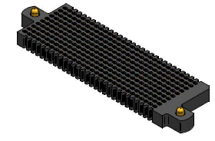
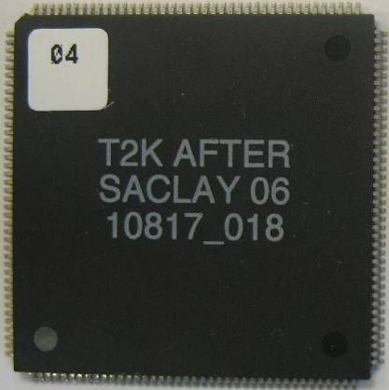
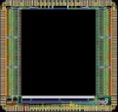
Integrated electronics for 7-module project
Remove packaging and protection diodes
Wire –bond AFTER chips
Use 2 × 300 pins connector
Use tiniest resistors (1 mm × 0.5 mm) from O to 10Ω
FEC
25 cm
4,5 cm
12,5 cm
14 cm
3,5 cm
2,8 cm
3,5 cm
0,78 cm
Chip
0,74 cm
after 2 weeks of operation: no ASIC lost:
  The resistive foil protects against sparks

Slide 20
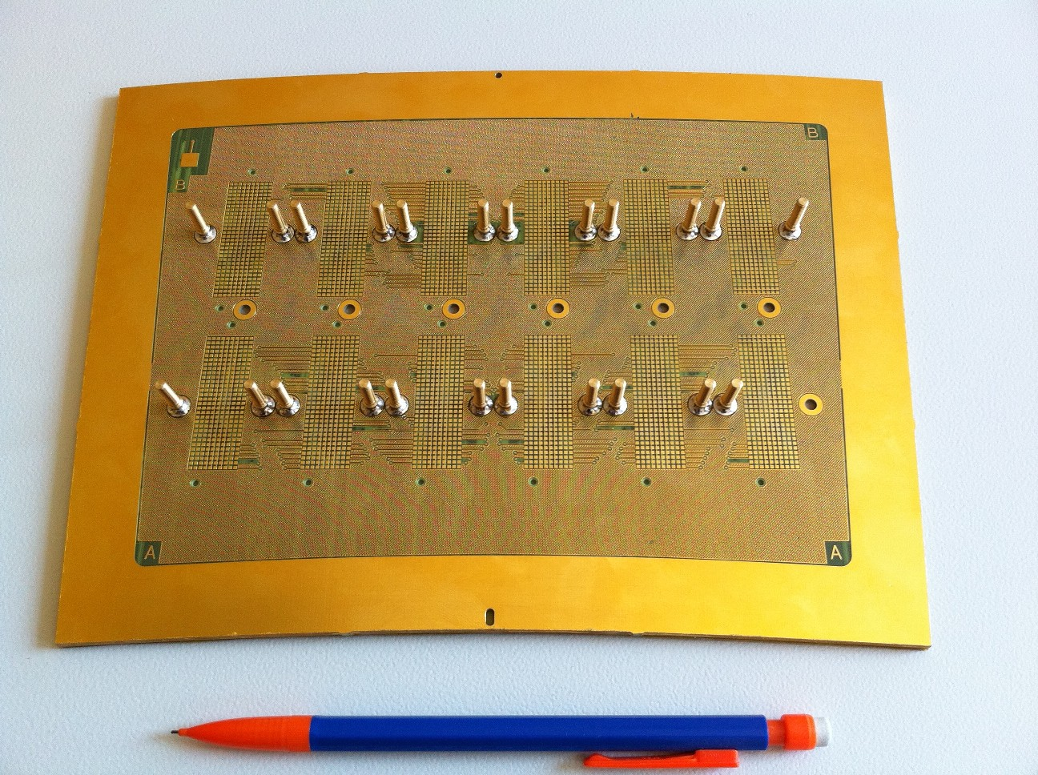
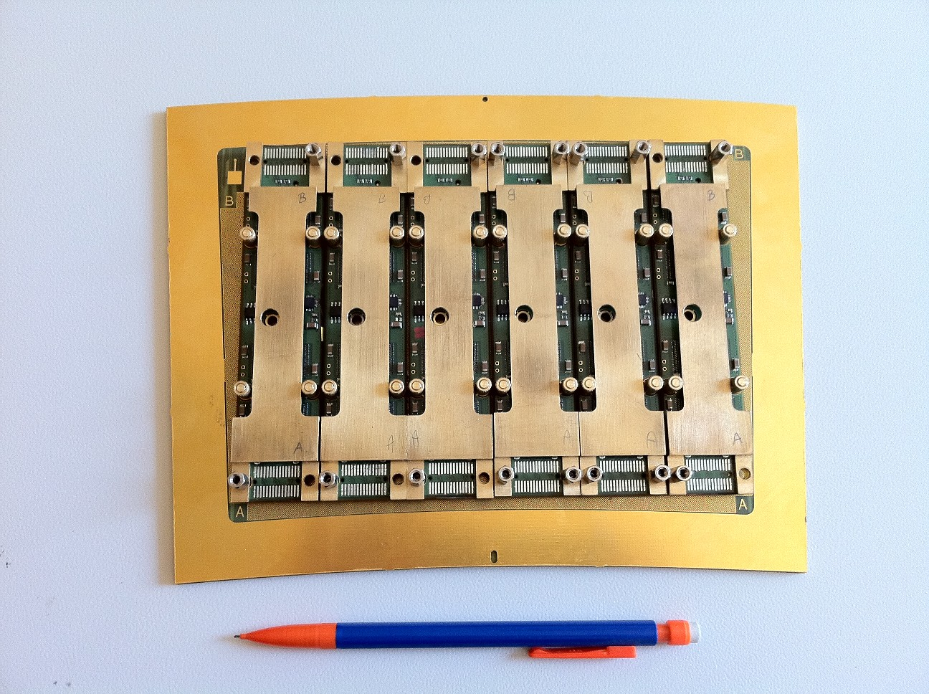
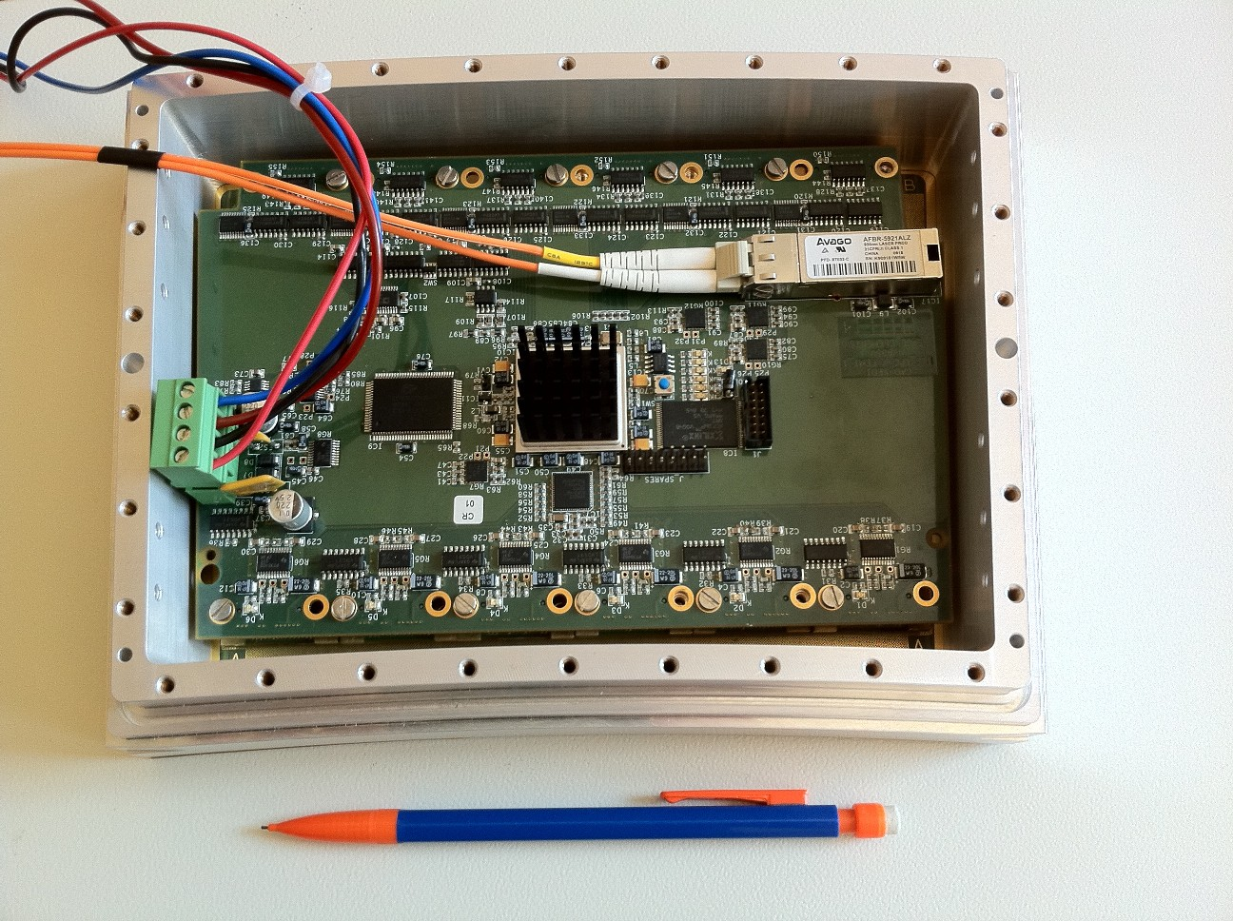
First prototype of the electronics

Slide 21
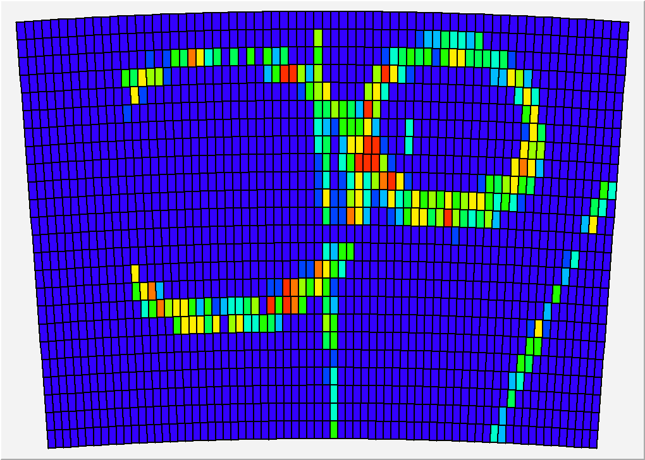

Slide 22
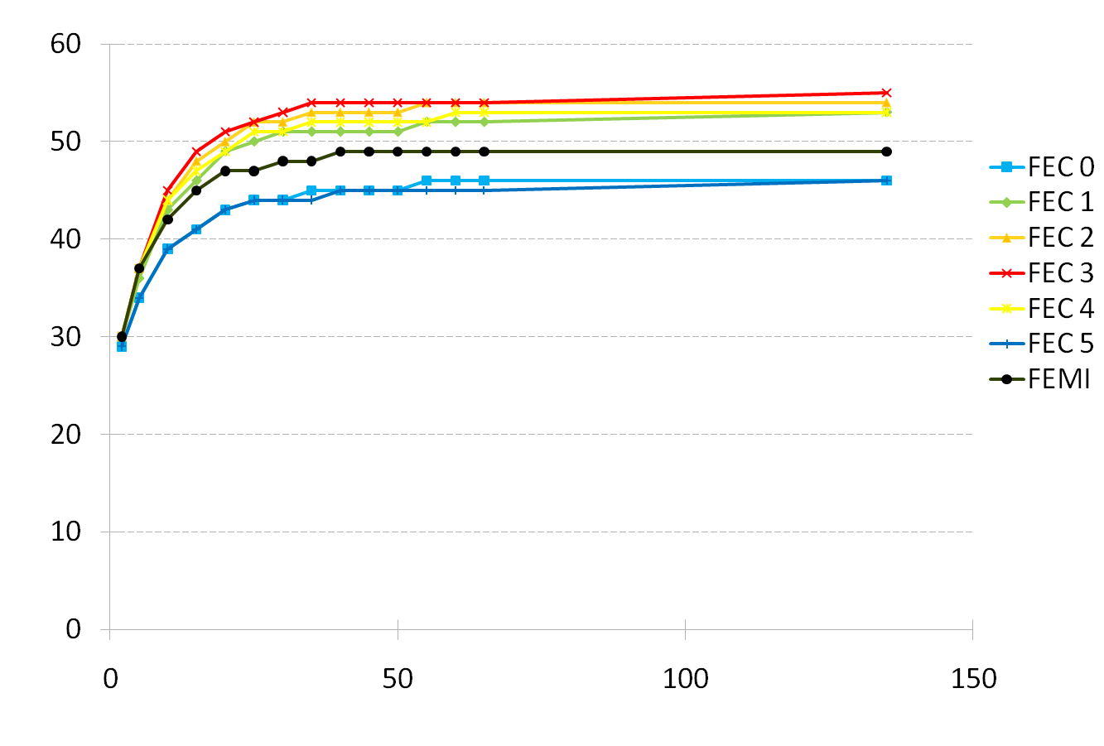
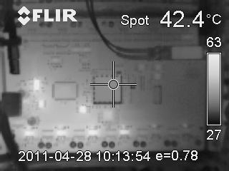
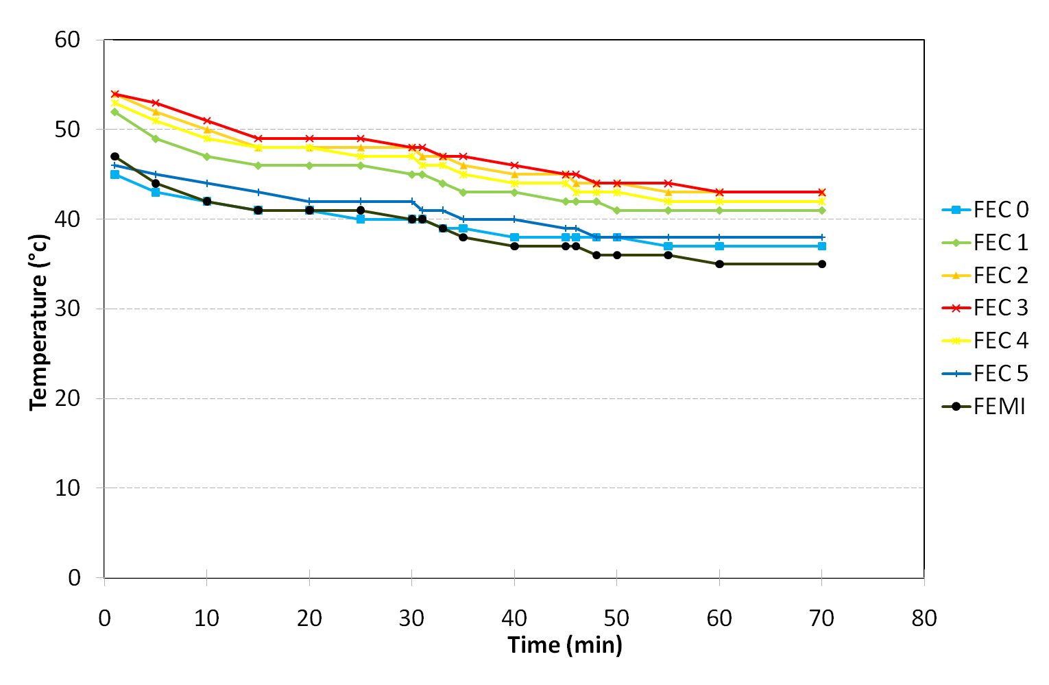
Thermal studies. IR camera shows hot spots (regulators, ADC). T-probes on every component.
2-phase CO2 cooling under study (KEK, Nikhef)
Onset of the electronics
Nitrogen cooling

Slide 23
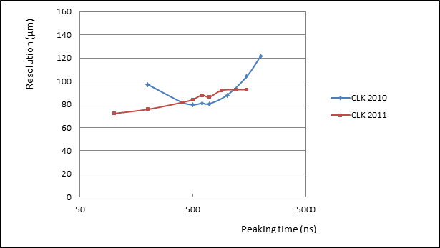
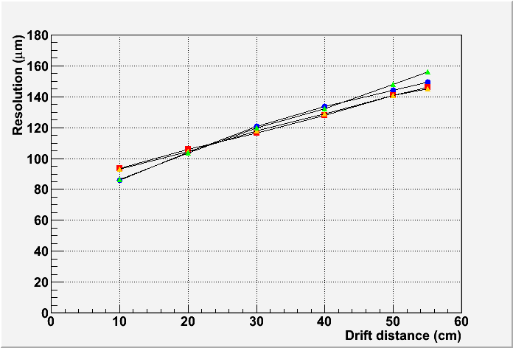
Preliminary results : resolution (B=1T data)
Tends to confirm previous measurements
(excluding lines with ASICs in bad contact).
Optimum resolution now obtained for peaking time below 200 ns
Resolution vs z for various peaking times.

Slide 24
CONCLUSIONS
A baseline Micromegas module for ILC TPC is now well defined, with very high performances : 60 µ resolution for 3mm-wide pads, N_{eff} = 38.
A module with fully integrated electronics has been tested in a beam and showed similar performance
A serial production and characterization will be carried out in 2012. A test bench at CERN will be used to study the uniformity and thermal properties.

Slide 25
Collaboration with Saha, India and Carleton
Design and construction of a detector for power-pulsing studies (segmented mesh and many pads, fitted to a 5T magnet in DESY). Later also study distortions.
AIDA
Improvement of the PCMAG magnet (DESY-KEK-Toshiba)
Readout Electronics for TimePix and for standard pads.
TimePix
Single electron studies, 8-chip prototype
More protection layer and InGrid studies

