Slide 1






Beam test of Linear Collider TPC Micromegas module with fully integrated electronics
Madhu Dixit
Carleton University & TRIUMF
On behalf of LC TPC collaboration Micromegas group*
* D. Attié, A. Bellerive, P. Colas, E. Delagnes, M. Dixit, I. Giamatoris, P. Hayman, J.-P. Martin, M. Riallot, N. Shiell, Y-H Shin and W. Wang
(Saclay, Carleton, Montreal, TRIUMF)
Tracking & Vertexing 27 Sept 2011, LCWS11 Granada

Slide 2
Outline
The Time Projection Chamber for the Linear Collider
Micro Pattern Gas Detector options for ILD TPC readout:
  Standard GEM readout
  Micromegas with charge dispersion, a new MPGD readout concept
1 meter Large Prototype TPC (LP TPC) development & tests at DESY to establish the design parameters for the ILD-TPC
Summary of LP TPC tests with a single Micromegas module (2008-2010) to measure single hit transverse resolution, TPC readout electronics adapted from T2K TPCs
LP TPC first results with the first of 7+2 (spare) Micromegas modules:
  To measure & demonstrate momentum resolution performance
  To address integration issues, serial production and characterization, multimodule issues (alignment, distortions)
Summary

Slide 3
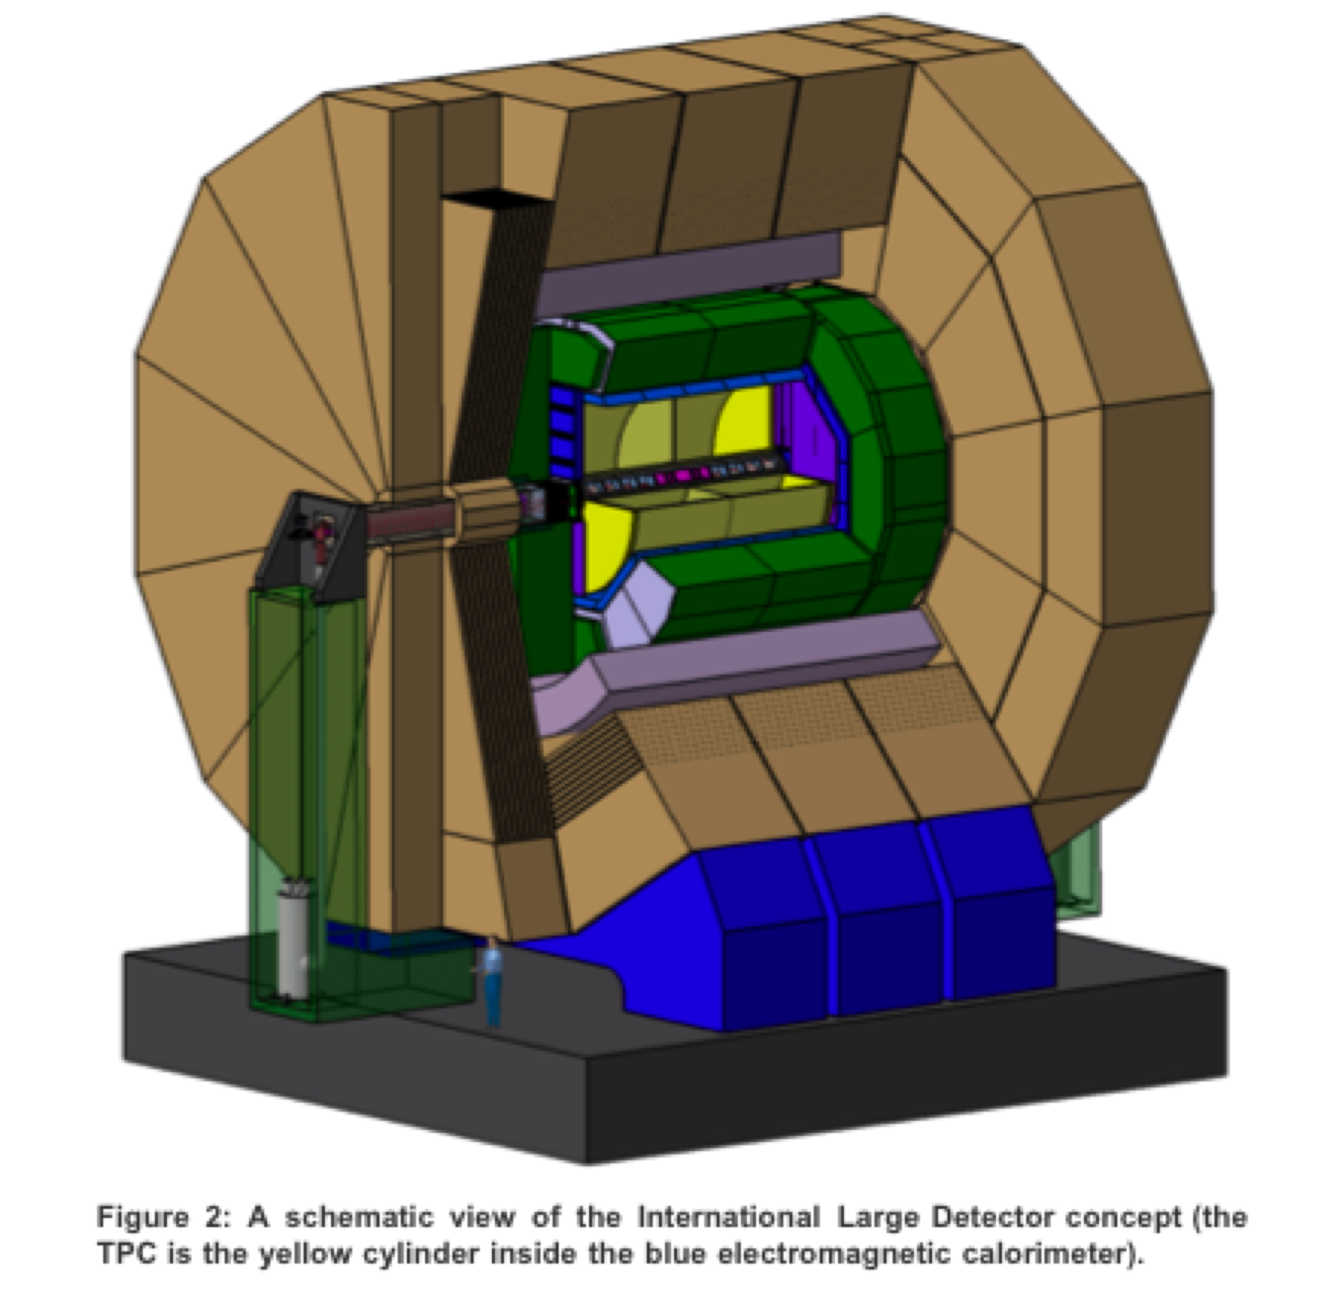
The TPC central tracker for the Linear Collider
The ILD detector concept plans to use a ~2.2 meter drift TPC read out with Micro Pattern Gas Detectors
Unprecedented transverse resolution goals driven by model independent Higgs measurements limited only by the precision of collision energy
Measure 200 track points
σ_{r, ϕ} ≤ 100 μm (stiff radial tracks, full drift distance)
σ_{z} ≈ 500 - 1500 μm (zero to full drift)
Double hit resolution:
≈ 2mm in (r,ϕ)
≈ 6 mm in z
dE/dx ~ 5%
Conventional wire/pad TPC limited by intrinsic ExB effects

Slide 4
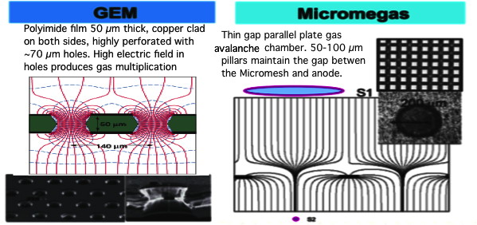
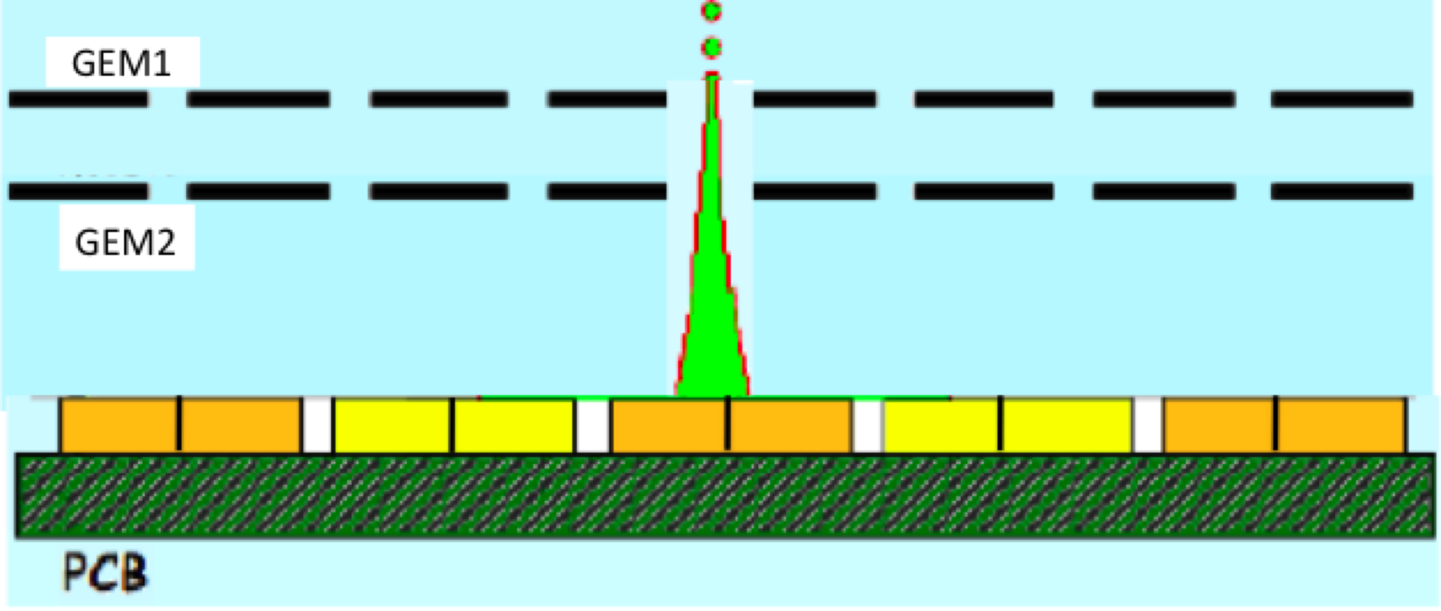
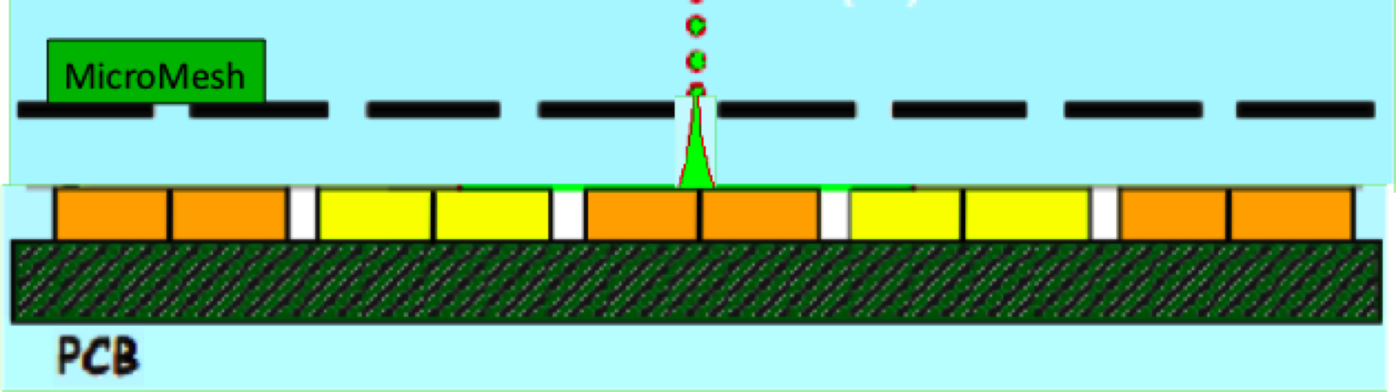
Micro-Pattern Gas Detector (MPGD) readout for Linear Collider TPC
GEM resolution ok ~ 1 mm wide pads
Signal too narrow for conventional Micromegas for good resolution with 1 mm wide pads
3-5 mm
~ 100 µm

Slide 5
Micro-Pattern Gas Detector Options for ILD TPC Readout
MPGDs have no preferred track angle & negligible ExB effect
For the GEM, increased transverse diffusion in the transfer & induction gaps provides a natural mechanism to disperse avalanche charge facilitating pad centroid determination from charge sharing
The conventional GEM readout would use narrow ~1 mm wide pads to achieve the 100 µm ILD TPC resolution goal
The Micromegas exploits the concept of charge dispersion in Micro Pattern Gas Detectors with a resistive anode and can use wider pads to achieve the ILD resolution goal
A resolution of 50 µm at zero drift distance has been achieved with ~3 mm wide pads for the charge dispersion Micromegas TPC readout option

Slide 6
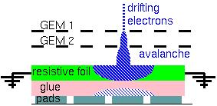
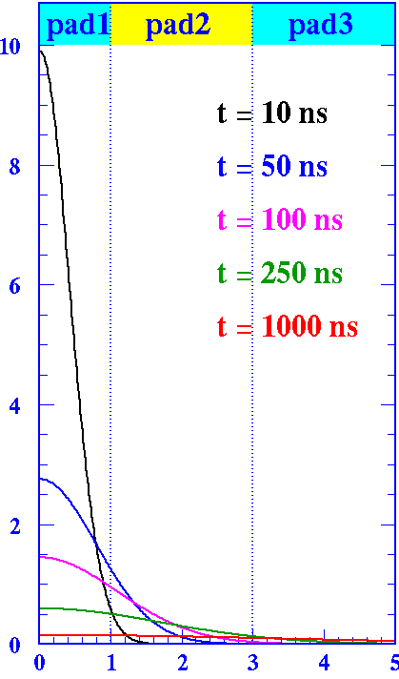
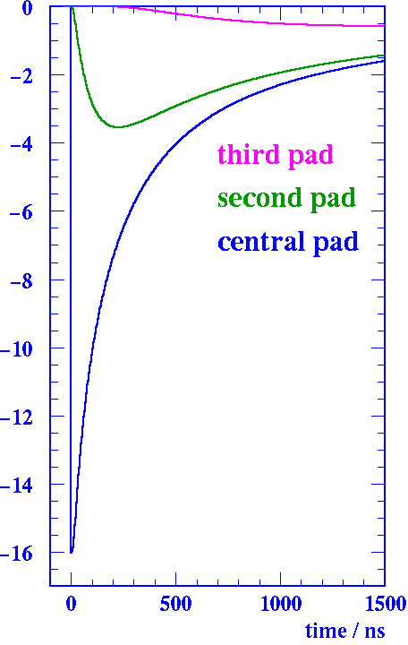
Charge dispersion in a MPGD with a resistive anode
Concept first proven for the GEM. Modified anode with a high resistivity film bonded to a readout plane with an insulating spacer.
2-dimensional continuous
RC network defined by material properties & geometry.
Point charge at r=0 & t=0 disperses with time.
Time dependent charge dispersion on anode facilitates precision pad centroid determination.
Equation for anode surface charge density function on the 2D continuous RC network:
ρ(r)
Q
ρ(r,t) integral over pads
mm
r / mm
ns

Slide 7
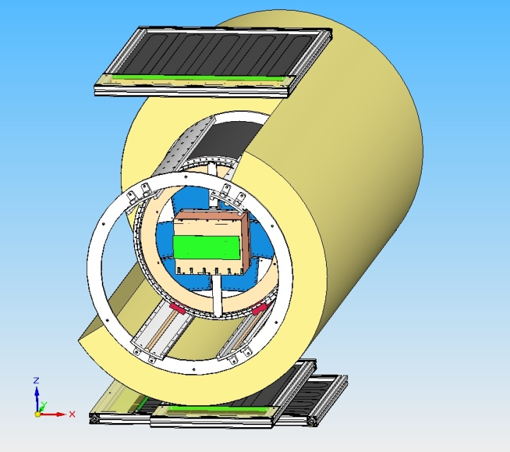
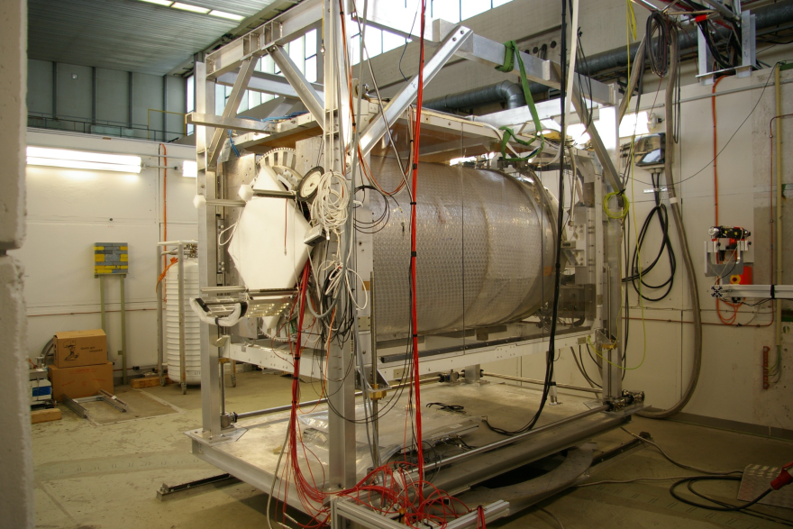
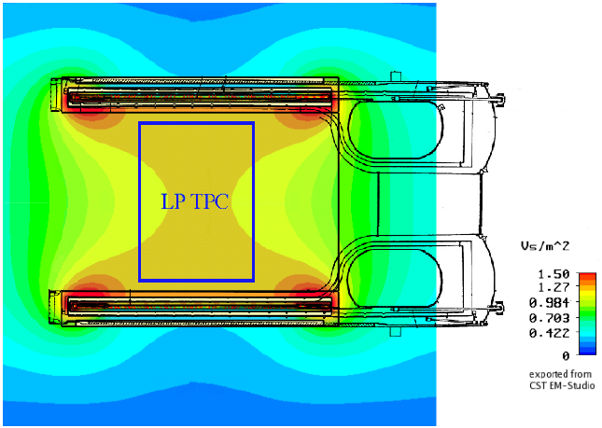
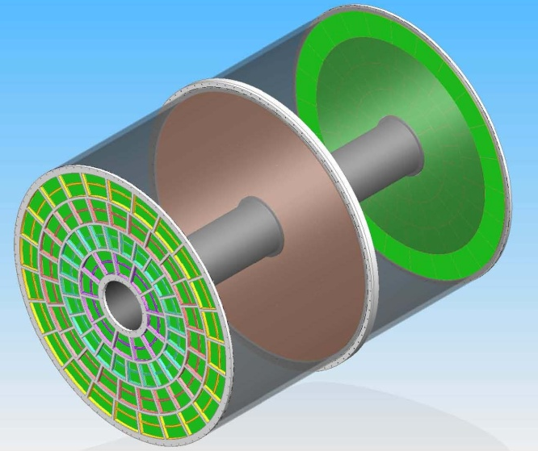
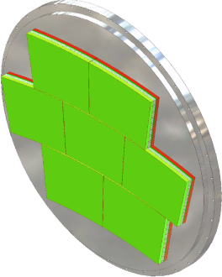
Large Prototype LP TPC - EUDET Test Facility at DESY
PCMAG: superconducting solenoid, B = 1.2T
e⁻ test beam at DESY
(1GeV/c<p<6GeV/c)
SiPM Cosmic
Trigger Setup
Translation stage
LP : part of a
TPC endplate

Slide 8
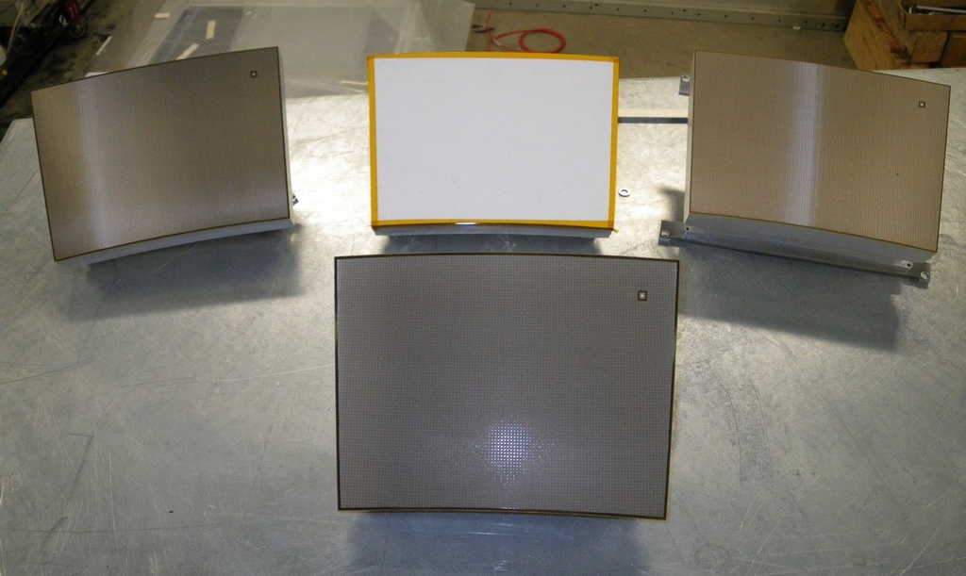
LP TPC tests with a single Micromegas module (2008-10)
Resistive Kapton
~5 MΩ/□
Resistive Kapton
~3 MΩ/□
Standard
Bulk Micromegas: pillars hold the mesh on the whole surface: no need for frame
Resistive ink
~3 MΩ/□
Resistive bulk: continuous 2D RC network to disperse the charge
The LP TPC was outfitted & tested with different Micromegas modules (one at a time) to compare performance

Slide 9
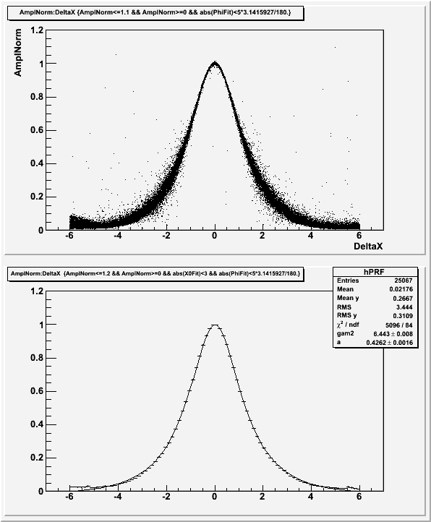
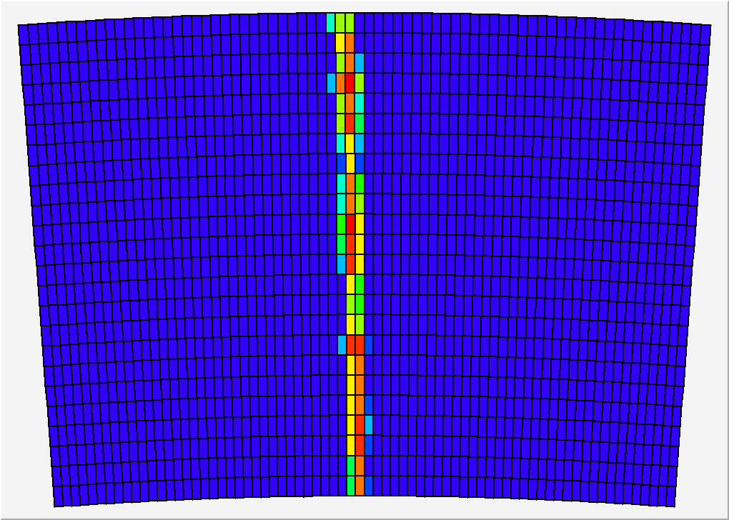
Micromegas LP TPC readout module pad layout
Relative fraction of ‘charge’ seen by the pad, vs x(pad)-x(track)
Z=20cm, 200 ns shaping
24 rows x 72 columns 3 x 6.8 mm² pads
0

Slide 10
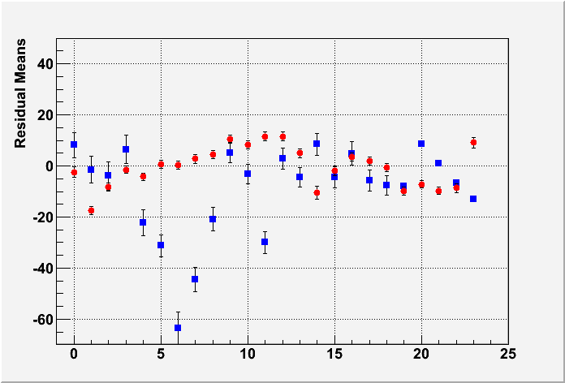
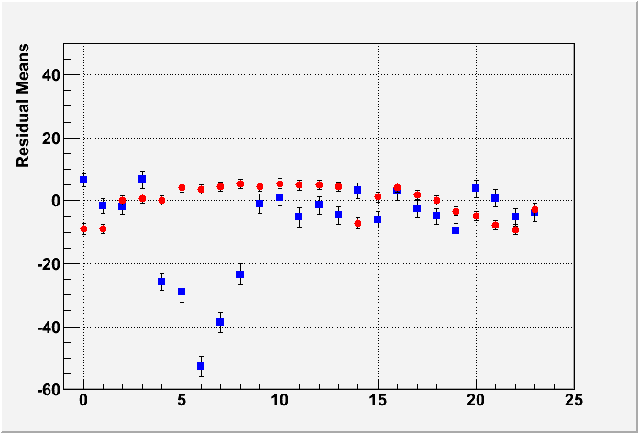
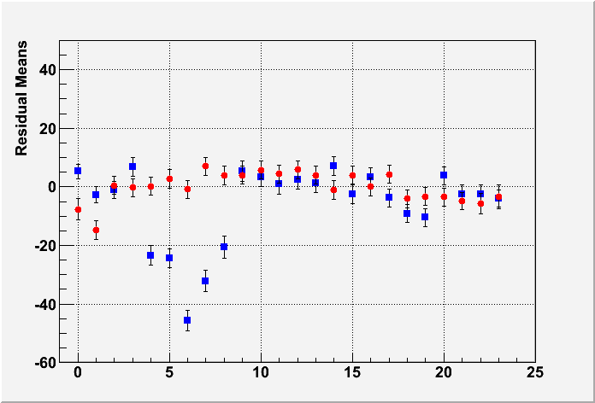
Track position dependent bias due to non-uniformities
in anode film resistivity and readout structure assembly
MEAN RESIDUAL vs ROW number
Z-independent distortions
Distortions up to 50 microns for resistive ink (blue points)
RMS 7 microns for CLK film (red points)
Z=5cm
Z=35cm
Z=50cm
Carbon loaded Kapton is much more uniform than resistive ink

Slide 11
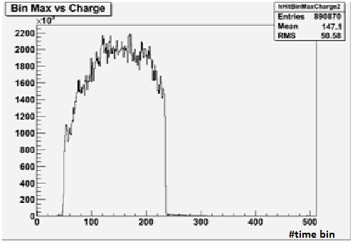
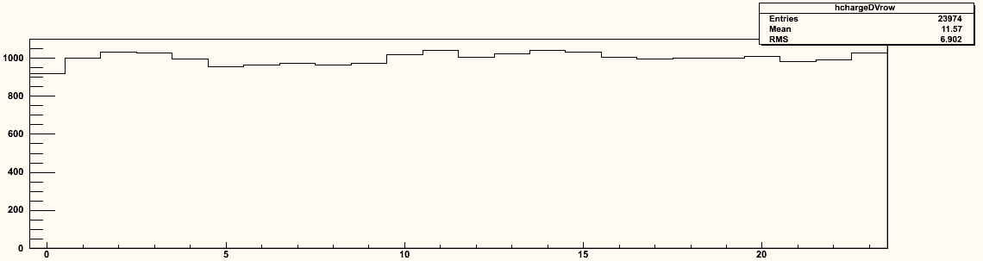
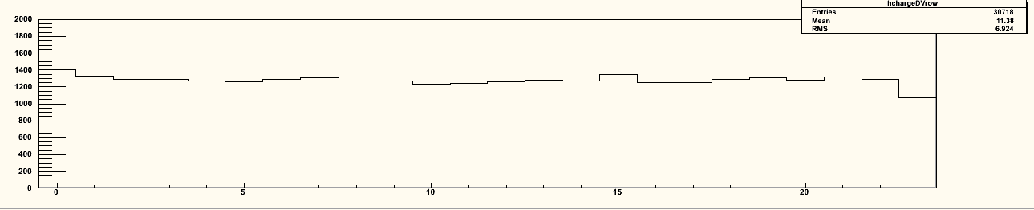
Response to cosmic rays & beam particles
z distribution
Average charge by row
Average charge by row
Using cosmic-ray events
B=OT
Using 5 GeV electrons
B=1T
0 5 10 15 20
0 5 10 15 20
Excellent uniformity up to the edge of the readout module for the ‘bulk’ Micromegas technology.

Slide 12
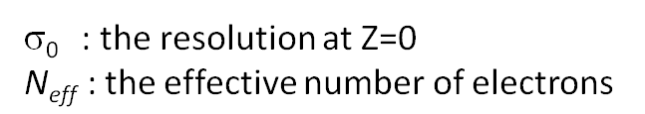
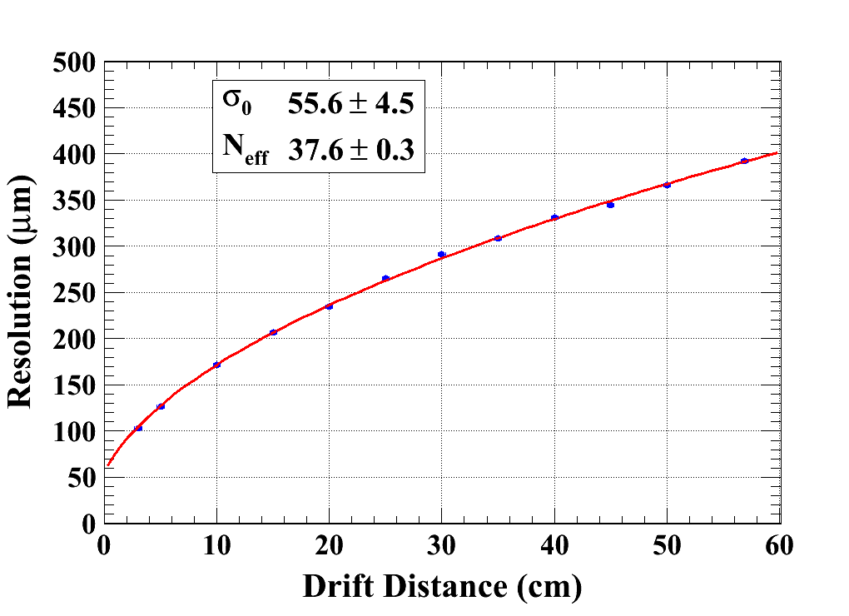
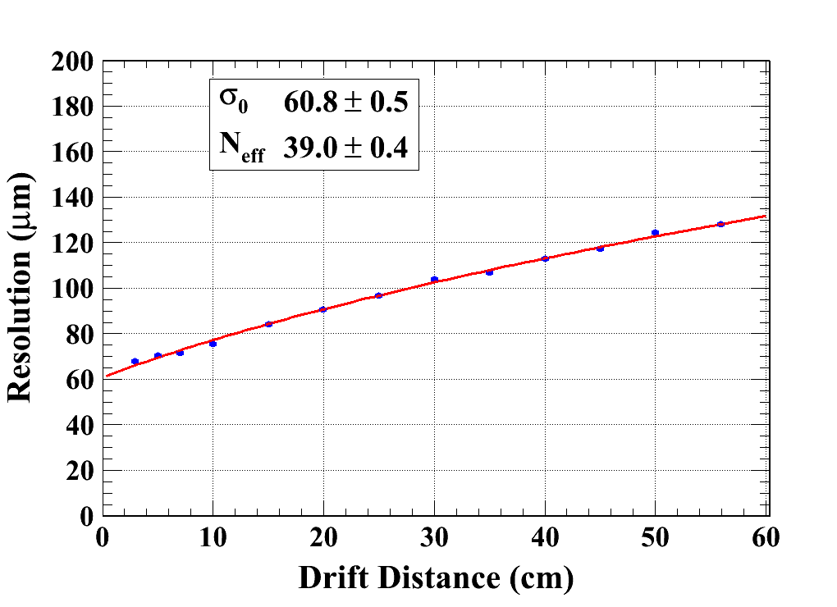
Single hit transverse resolution measurement
(B = 0T & 1T)
Carbon-loaded Kapton (~5 MΩ/□)
B=0 T C_{d} = 315.1 µm/√cm (Magboltz)
B=1 T C_{d} = 94.2 µm/√cm (Magboltz)
χ²/Ndof = 10.6/10
χ²/Ndof = 29.1/11
Module 4
Module 3
Average of B=0T data and B=1T data
  N_{eff} = 38.0±0.2(stat) ±0.8 (C_{d} syst)
  σ₀= 59 ± 3 µm

Slide 13
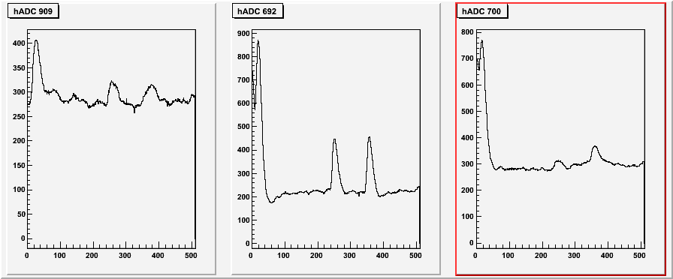
Test in a high intensity pion beam at CERN (July 2010)
180 kHz (5 x 2 cm² beam) showed no charging effects and stable operation
Peaking time ~300 ns sufficient to distinguish 2 tracks on the same pad
4µs
Time (in 40 ns bins)

Slide 14
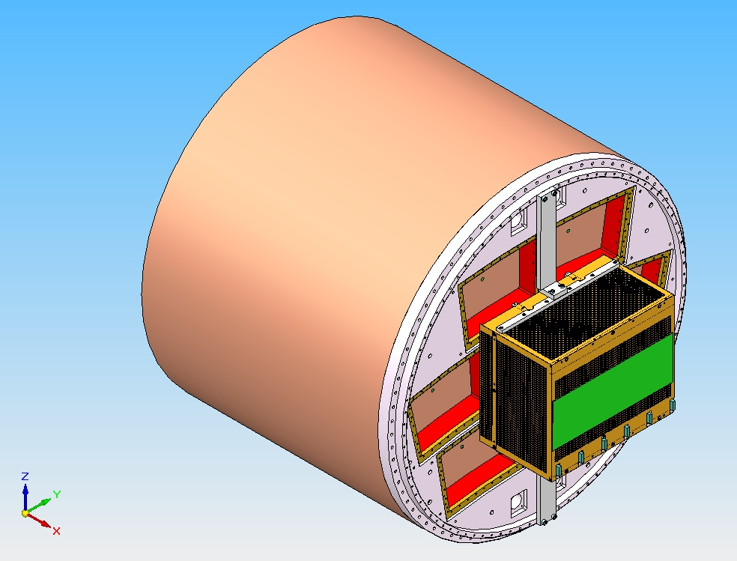
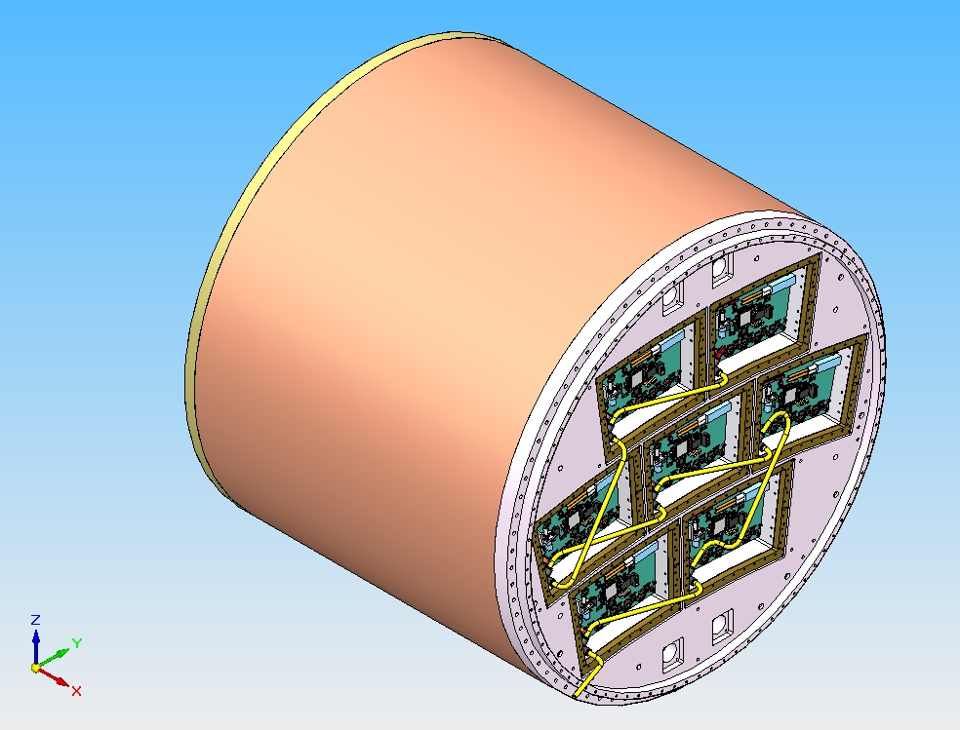
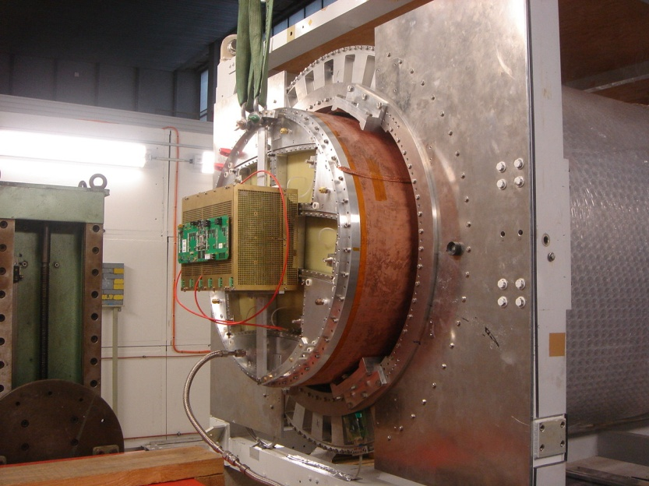
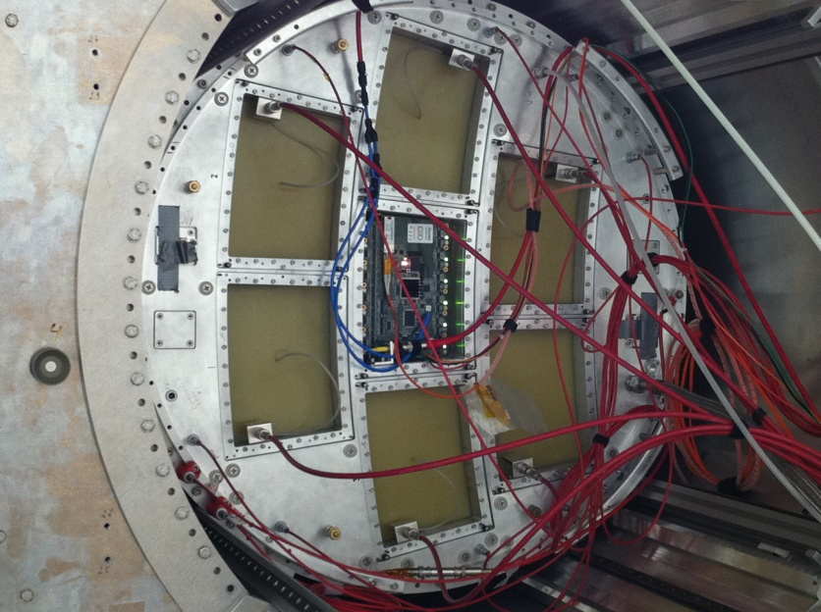
Toward 7+2 module project and electronics integration

Slide 15
Beam test of first Micromegas module with integrated electronics - May 2011
New detector: new routing to adapt to new connectors, lower anode resistivity (3 MΩ/□), new resistive film, grounding on the edge of the PCB.
New 300 points flat connectors
New front end: keep naked AFTER chips and remove double diodes (depend on resistive film to protect against sparks)
New Front End Mezzanine (FEM)
New backend ready for up to 12 modules
New DAQ, 7-module ready and more compact format
New trigger discriminator and logic (FPGA)

Slide 16
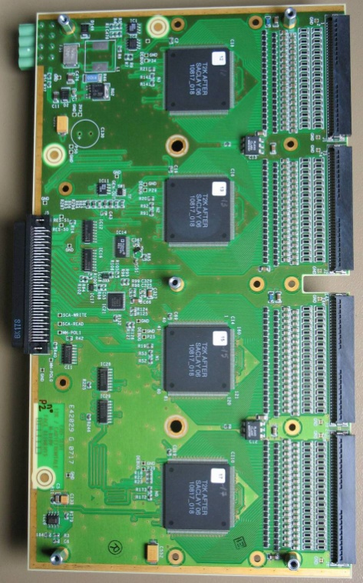
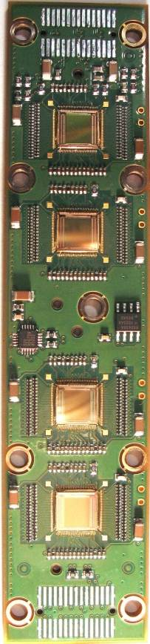
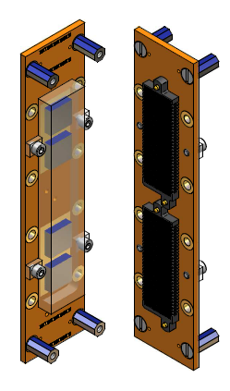
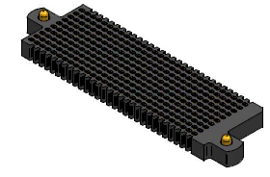
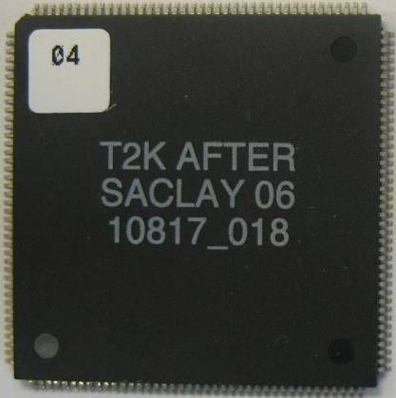
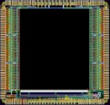
Integrated electronics for 7-module project
Remove packaging and protection diodes
Wire –bond AFTER chips
Use 2 × 300 pins connector
Use tiniest resistors (1 mm × 0.5 mm) from O to 10Ω
FEC
25 cm
4,5 cm
12,5 cm
14 cm
3,5 cm
2,8 cm
3,5 cm
0,78 cm
Chip
0,74 cm
After 2 weeks of operation: no ASIC lost. The resistive film protects against sparks.

Slide 17
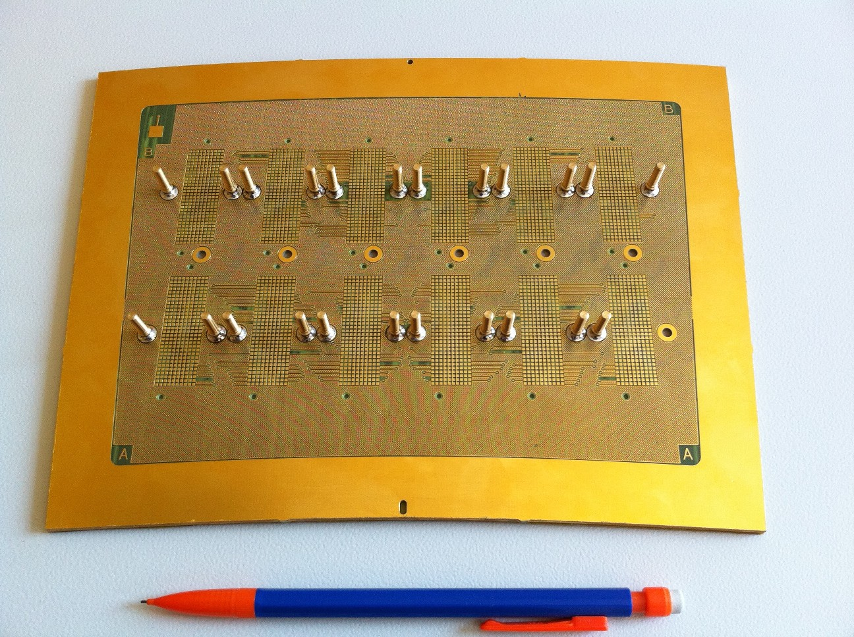
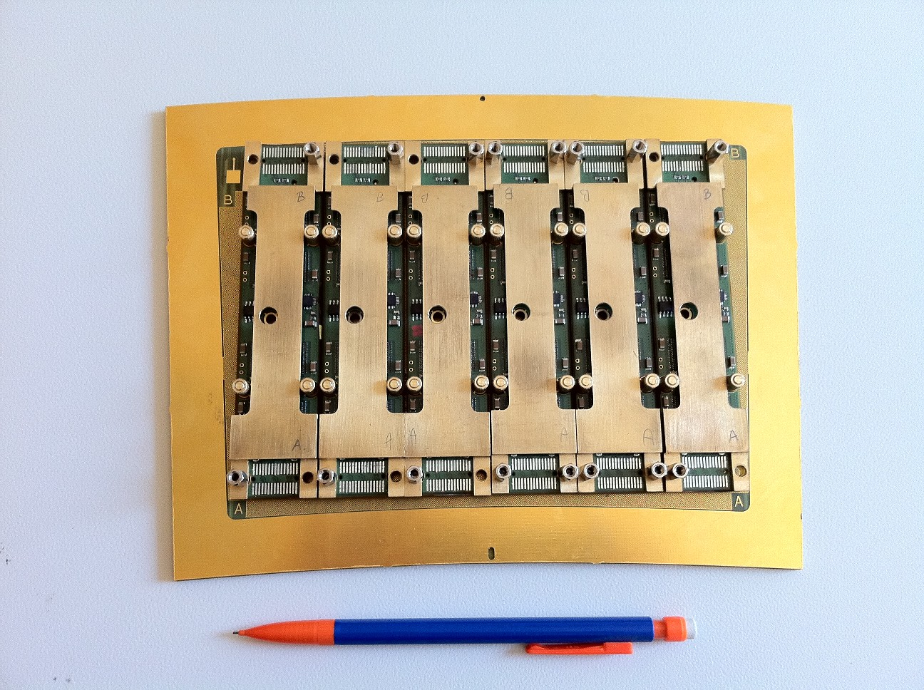
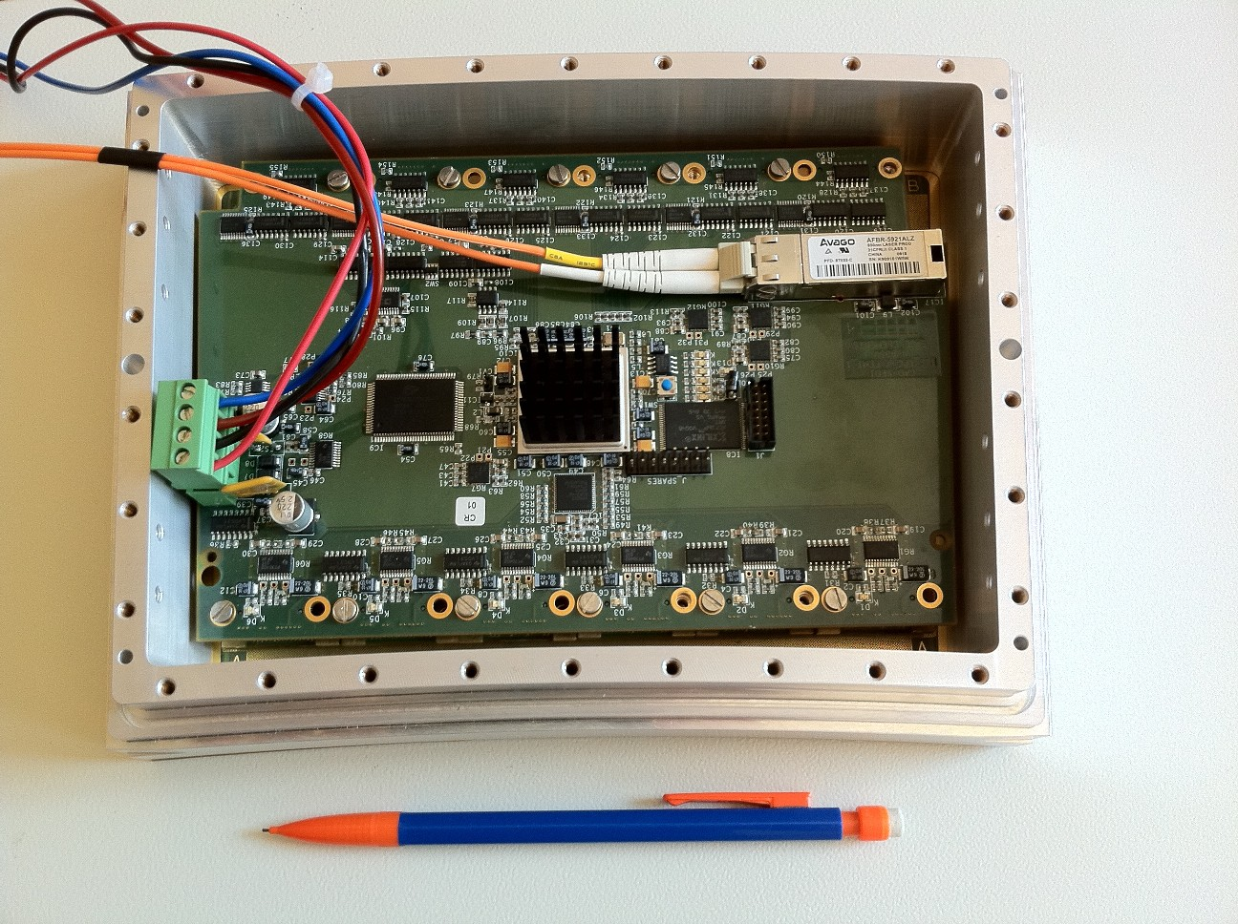
First prototype of electronics readout board

Slide 18
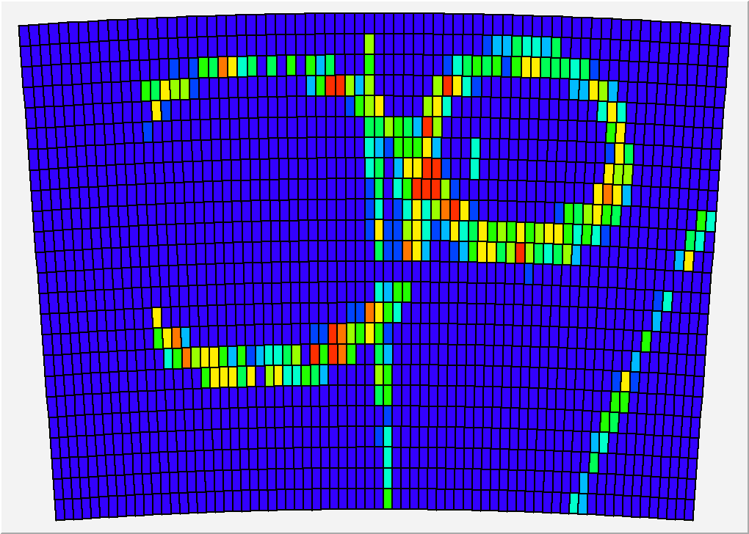
New Micromegas module with integrated electronics

Slide 19
Toward 7 Module Analysis with Marlin Integration
Existing single module software was ported from Fortran and is incompatible with Marlin
Progress to date:
Converted most anonymous namespaces to classes (named remaining namespaces)
Ensured classes have only relevant functions
Moved main function out of library
Turned separate PRF, BIAS, & DD analysis code into proper subclasses selected based on command-line user input
Removed all errors revealed by compiling with -Wall
Organized files into proper “include” and “source” files
Begin to implement proper C++ coding practices
Further work to be done:
    Marlin consistent co-ordinate system
    Multihit capability
    Implement version control (SVN)
    Check for any classes/functions that are already implemented in Marlin
    Modify front end of code to be consistent with Marlin “Processes”
    Apply Marlin coding standards (including cmake)

Slide 20
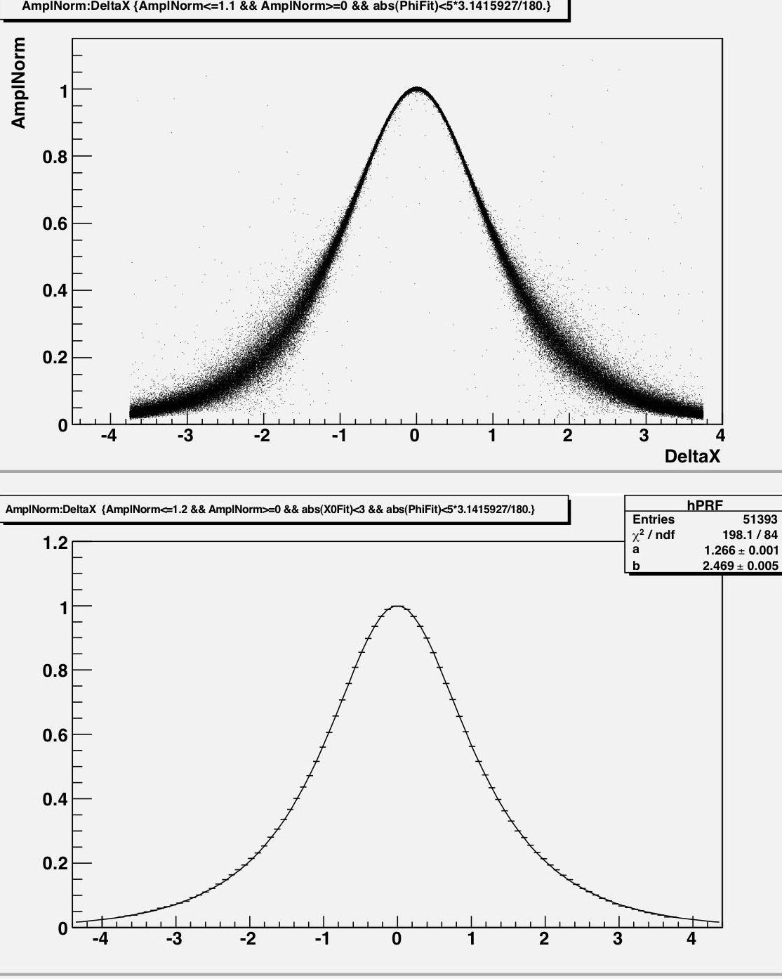
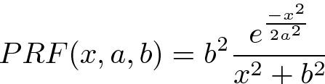
A new Pad Response Function (PRF)
Existing 4 parameter PRF (ratio of two symmetric quartics) replaced with a simpler one:
Only two parameters
Easier to work with
Better fits to data
(mm)

Slide 21
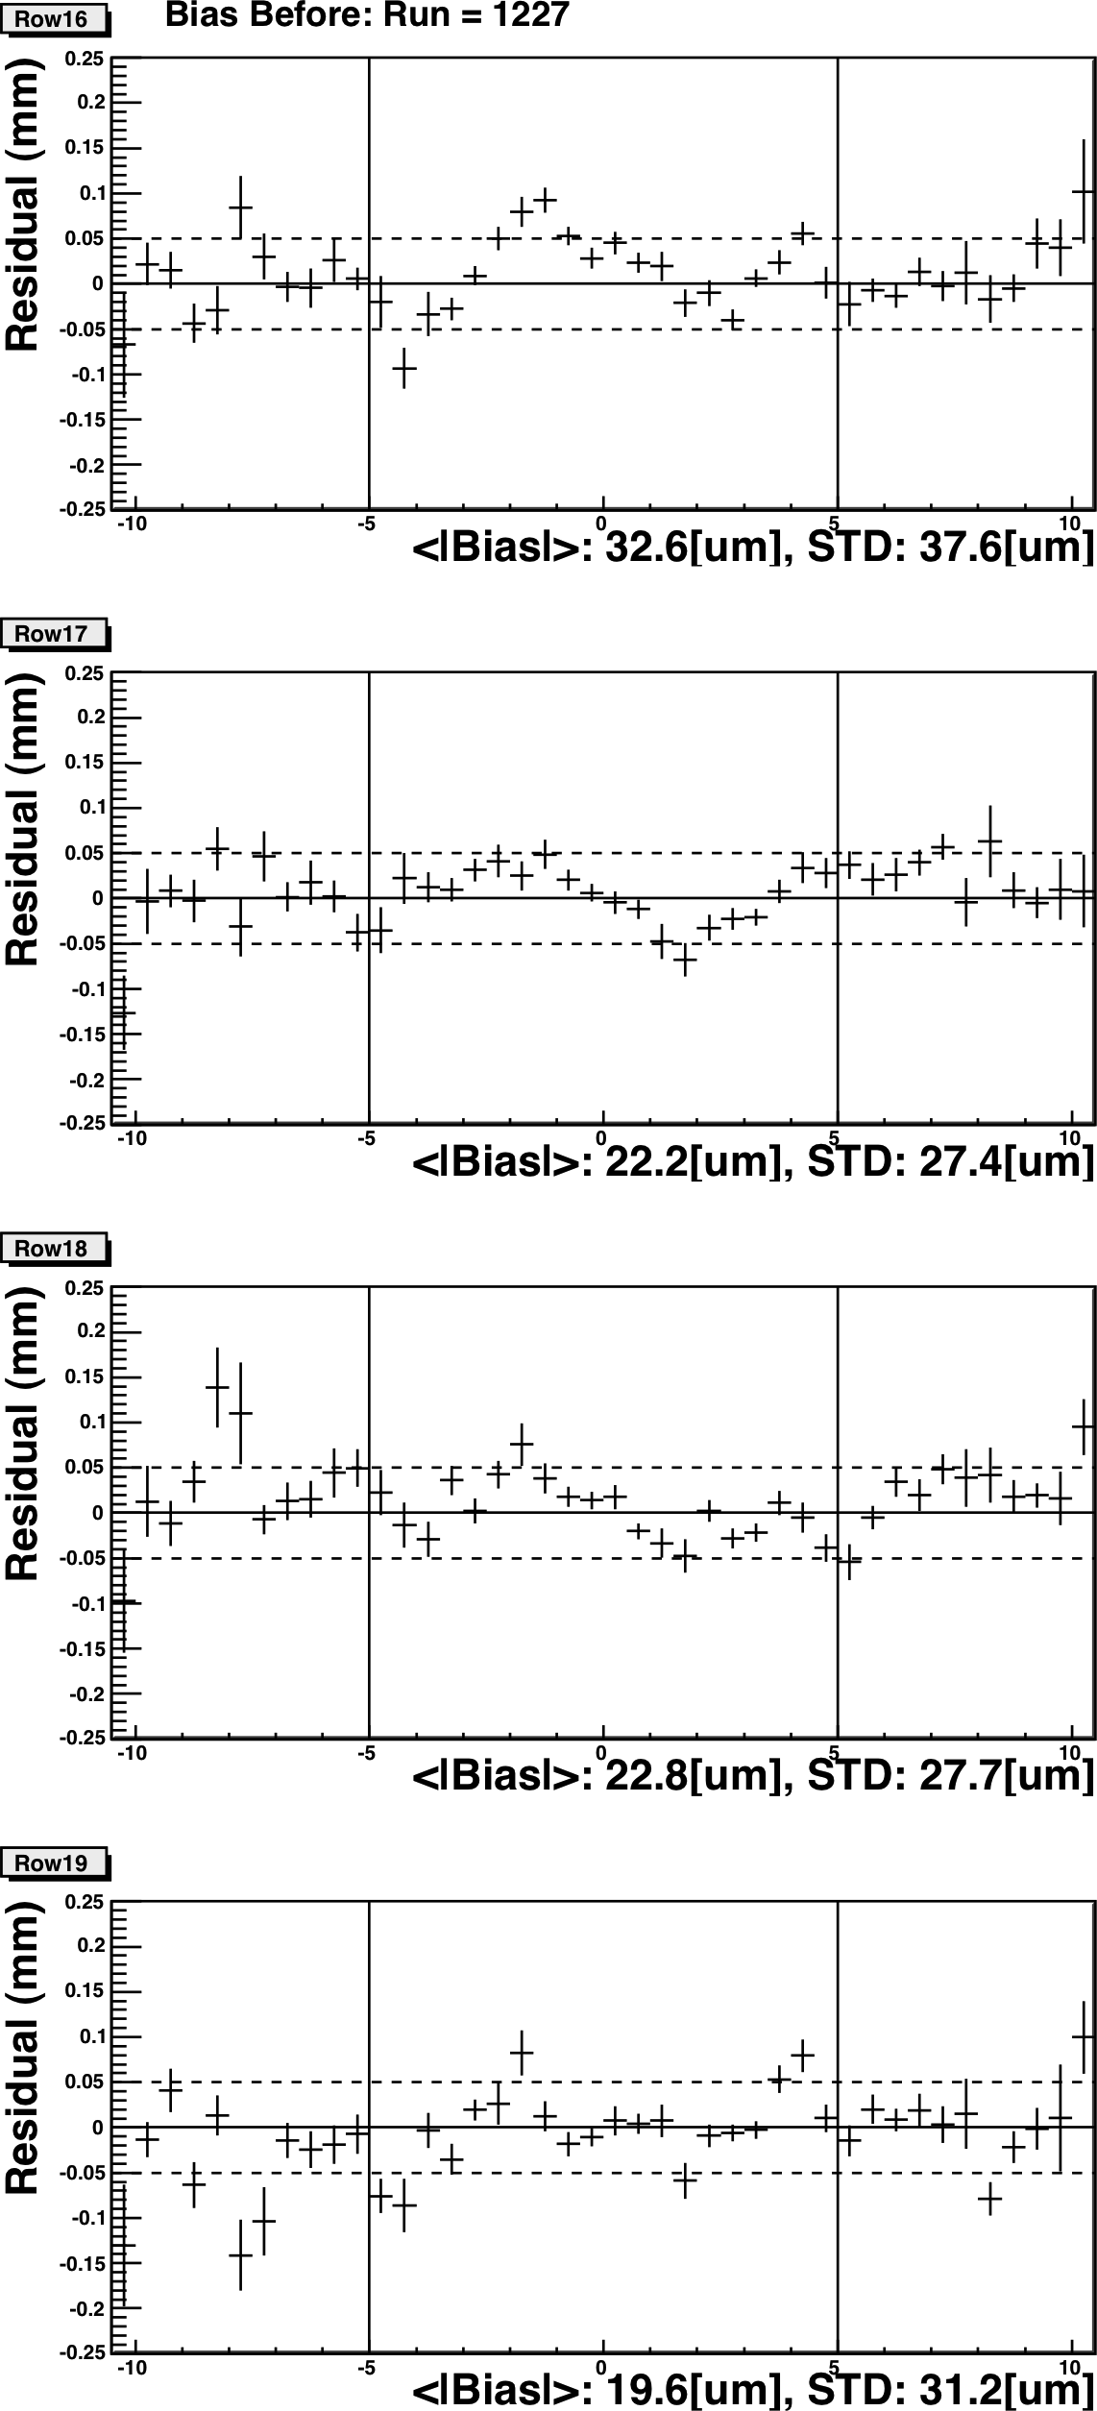
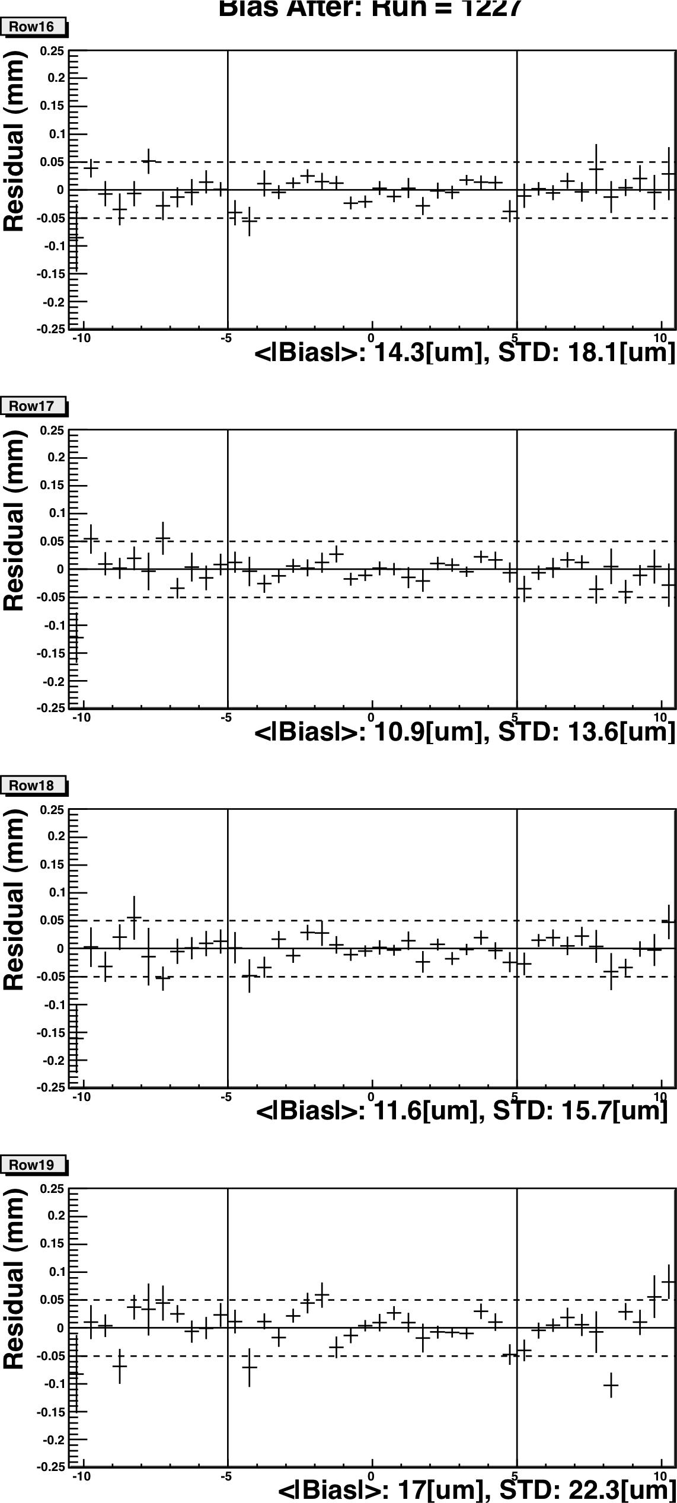
Bias before and after bias calibration
With no external silicon tracker information the accuracy of bias calibration, determined from internal consistency of TPC data, is statistically limited
Bias before
Bias after ~ 20 µm

Slide 22
Preliminary results of new module beam test (B=1T)
May 2011
Transverse resolution dependence on peaking time

Slide 23
Short peaking time preferable for timing & two track resolution
However, we get:=>
Small Z => Better resolution for shorter peaking time
Large Z => Better resolution for longer peaking time
Work in progress: Reintegrate short peaking time signal for good resolution at all Z

Slide 24
SUMMARY
A baseline Micromegas module for LP TPC is now well defined
A module with fully integrated electronics has been tested in a beam. Resolution ~ 50µm for 3mm wide pads
Seven module analysis software development in progress
A serial production and characterization will be carried out in 2012. A test bench at CERN will be used to study the uniformity and thermal properties

Slide 25
Spare slides

Slide 26
Abstract
The Micromegas option for the ILD TPC readout exploits the new concept of charge dispersion in Micro Pattern Gas Detectors with a resistive anode. The Large Prototype TPC (LP TPC) beam tests done so far with a single Micromegas module have demonstrated that the requisite single hit transverse resolution can be achieved. Toward demonstrating the ILD TPC momentum resolution goal, the LP TPC was outfitted and tested earlier this year at DESY with the first of seven Micromegas modules to be built with on-board integrated electronics. The present status of development & results from the beam test will be presented.

Slide 27
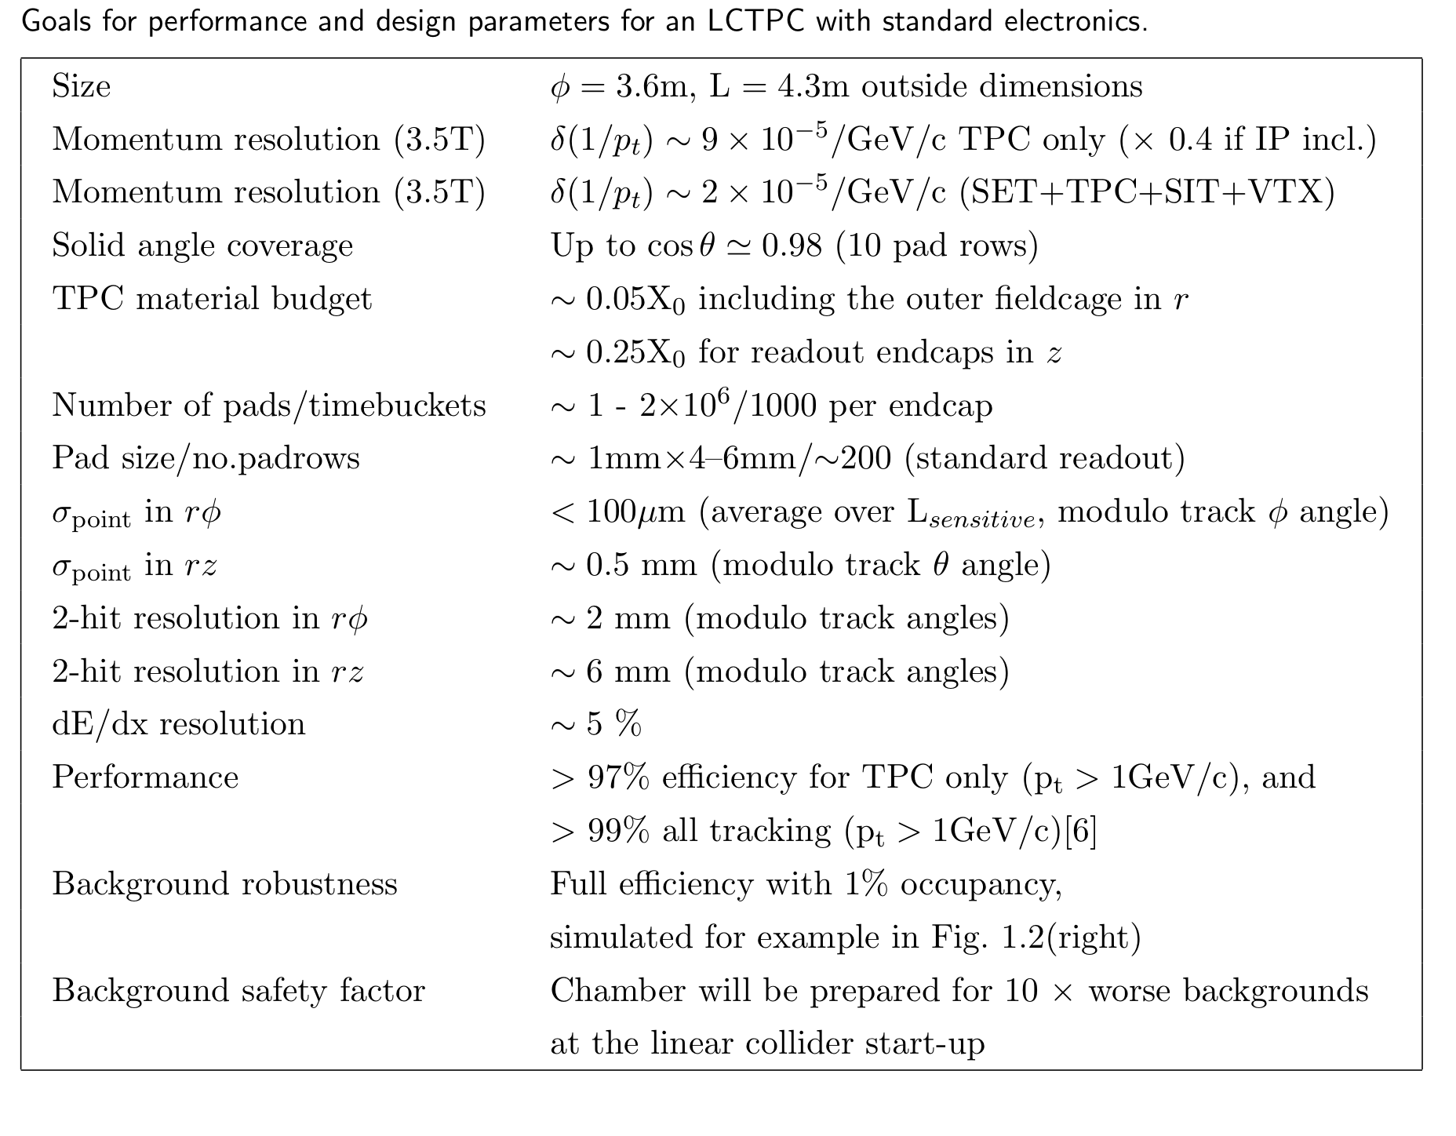

Slide 28

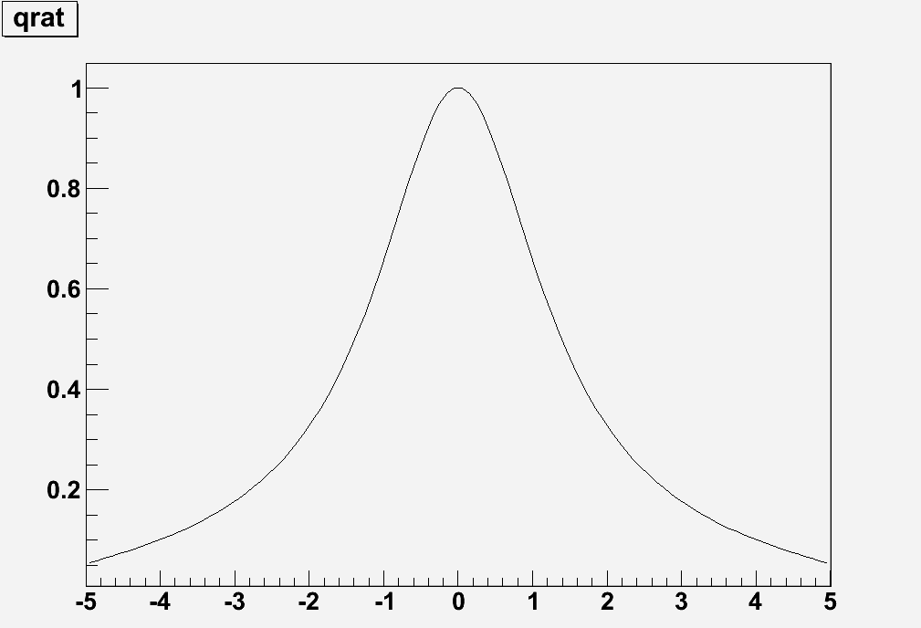
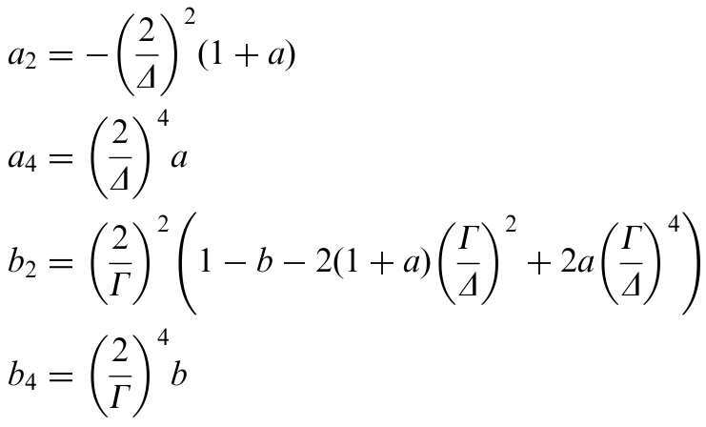
Old PRF – Ratio of two symmetric quartics

