Slide 1



R&D of a Fast-Neutron Imaging Detector Based on Bulk-Micromegas TPC
L. An², D. Attié¹, Y. Chen², P. Colas¹, M. Riallot¹, H. Shen²,
W. Wang^{1,2}, X. Wang², C. Zhang², X. Zhang², Y. Zhang²
2011 Nuclear Science Symposium
and Medical Imaging Conference
October 27th, 2011 – Valencia, Spain
(1)
(2)
Notes:
I’m here to present a TPC review

Slide 2
Overview
Introduction: idea of Fast Neutron Imaging detector
Micromegas TPC for neutron imaging
Description of T2K electronics and the detector
Data analysis and results
Conclusion

Slide 3
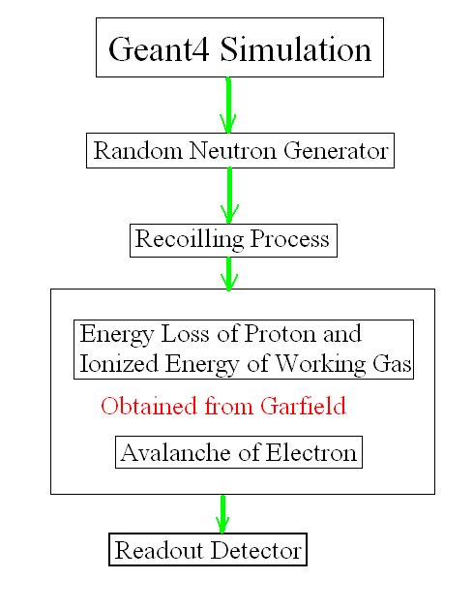
Characteristics and simulation of FNI detector
Characteristics expected of Fast Neutron Imaging detector based on TPC:
High spatial resolution: <100 µm
high quality imaging from Micro-Pattern Gas Detector
as Micro-Mesh Gaseous Structure (Micromegas)
  Low efficiency: ~ 0.01-1%,
  subject to thickness and kind of converter
  suitable for beam monitor/profile
  imaging in very high flux
Simulation tools:
  Geant4 (physics processes)
  Garfield (gas processes):
    ionization energy
    electron drift velocity
    electron avalanche

Slide 4
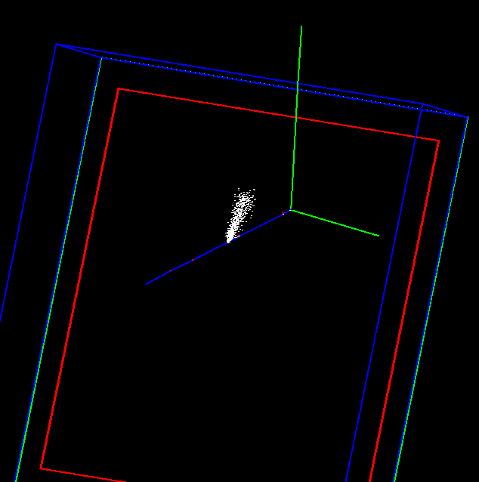
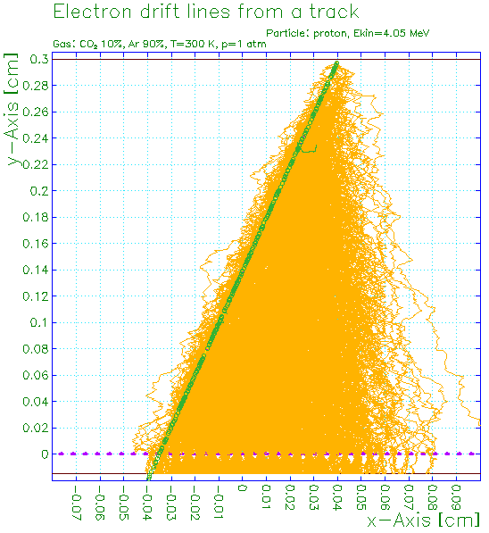
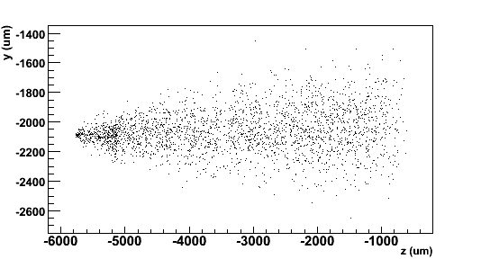
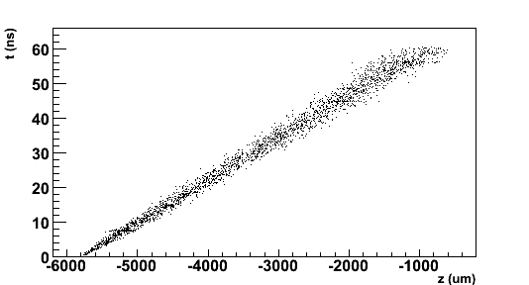
Simulation by Geant4 + Garfield
n
Garfield
Drift lines from primary ionization e-
Proton track
p
e- avalanche
Neutron event interacting
with polyethylene foil
and knocking out a proton
Avalanches
Data reconstruction method:
  identify cluster (track)
  extract hit position where the time is maximum t_{max} → interaction point
  integrate all events → image
p
Drift time
Avalanche drift time
σ = 91.9 µm
y-z readout plane
X-Y readout plan

Slide 5
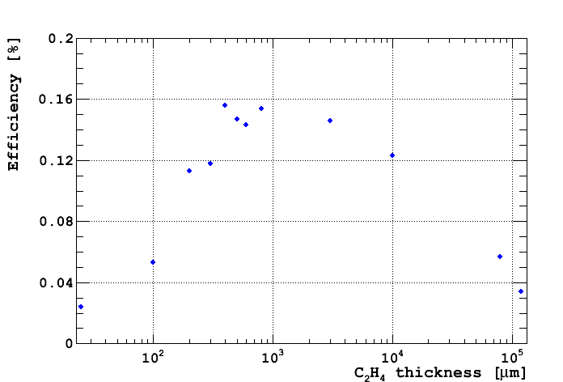
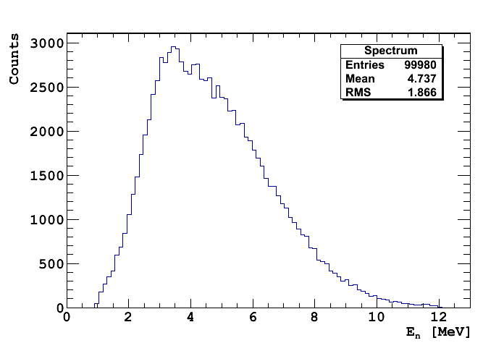
Geant4 simulation for converter efficiency
Neutron→proton scattering efficiency in a polyethylene [C₂H₄]_{n} layer
coming from ²⁴¹Am-⁹Be source
For 100 000 events in the neutron spectrum:
CH2
gas
Incident neutron spectrum
10 cm
n
n, p
6 cm
25 µm – 20 cm
1 cm

Slide 6
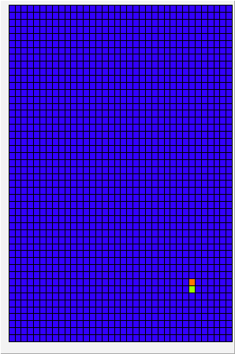
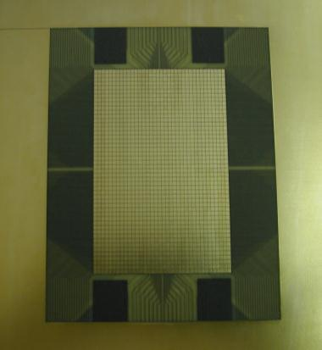
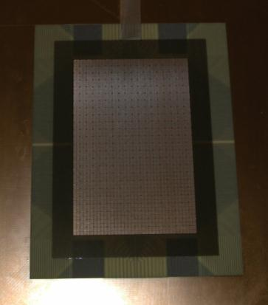
Micromegas TPC for neutron imaging
Detector layout: 1728 (36 ×48) pads of 1.75 mm × 1.50 mm
+ bulk Micromegas
Gas mixture: Argon + 5% Isobutane
Elastic scattering on hydrogen n → p
+ masks (Pb, paraffin wax)
n
Pb
Aluminized polyethylene 25 µm
between 2 layers (0.5 µm) of Al
Wax
gas
HV_{drift}
10 mm
p
E_{drift} ~ 200 V/cm
128 µm
HV_{mesh}
57.4 mm
E_{amp} ~ 30 kV/cm
88.6 mm
(x, y, t)
Cosmics
PCB
Micromegas

Slide 7
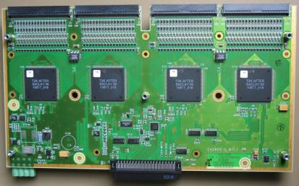
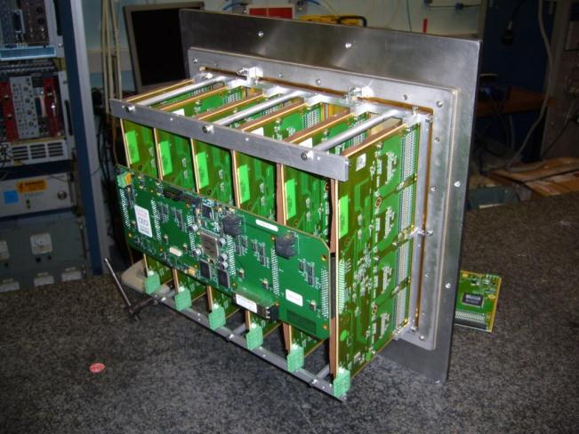
Description of T2K electronics
Electronics designed at CEA/Irfu for the T2K TPC
AFTER-based electronics (72 channels/chip):
  low-noise (700 e-) pre-amplifier-shaper
  100 ns to 2 µs tunable peaking time
  full wave sampling by SCA
  frequency tunable from 1 to 100 MHz (most data at 25 MHz)
  12 bit ADC (rms pedestals 4 to 6 channels)
  full-scale gain from 120 fC to 600 fC
  zero-suppression capability
6 Front-End Cards (FEC) read out by a
Front-End Mezzanine (FEM)
Trigger signal needed
Spark protection
FEC with 4 AFTER chips

Slide 8
Detector + electronics setup
Window for x-rays source
Shielding
FEC
Trigger from
Micromegas signal
FEM

Slide 9
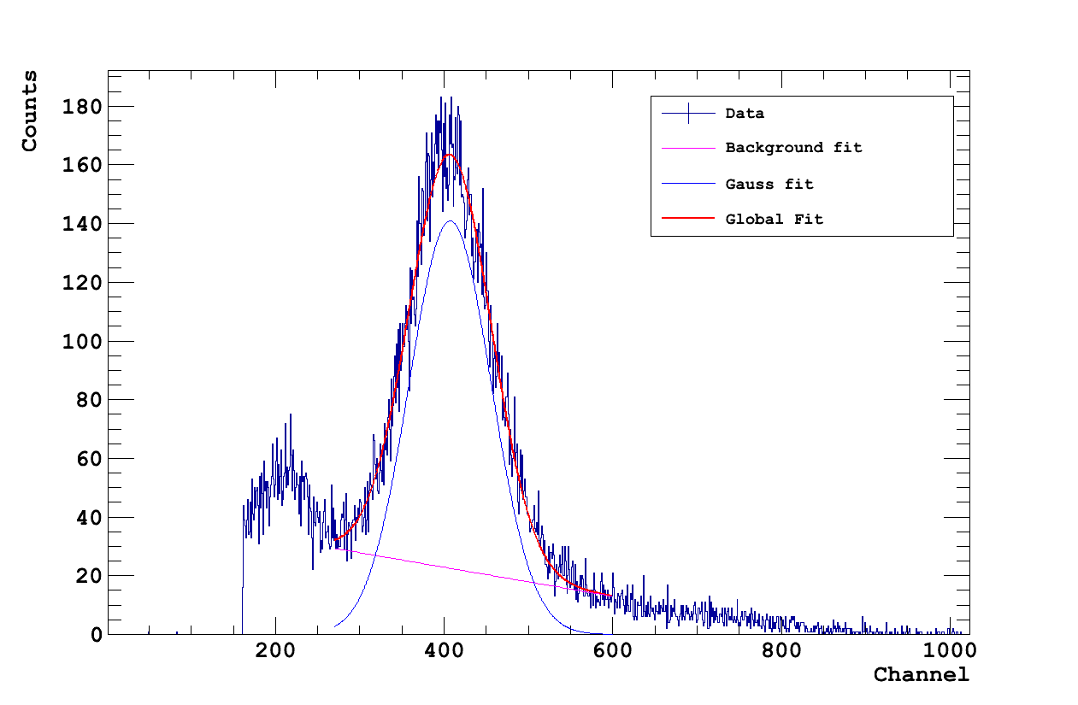
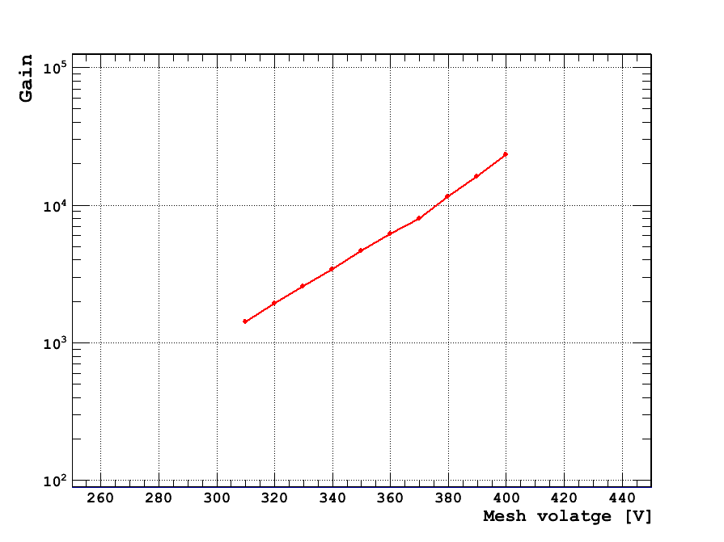
Performances of the Micromegas detector
Gain curve measured from 5.9 keV line using ⁵⁵Fe source. Signals read out on the mesh in Ar/Isobutane 5%: G~10³ @ 300 V
Energy resolution of σ~12 % due to detector capacitance and noise
best energy resolution measured for a bulk Micromegas (~7 %)
Operating gas gain < 1500 and electronics full-scale gain set ≥ 360 fC
in order to cut the gamma-rays and cosmics events
σ = 12 %

Slide 10
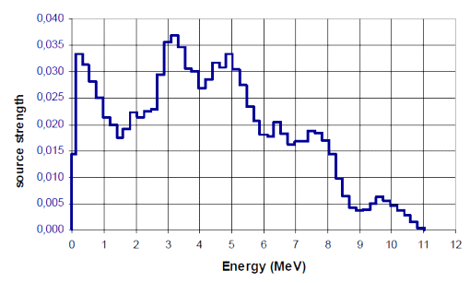
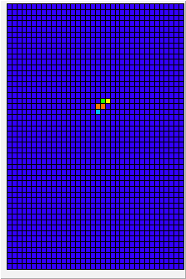
²⁴¹Am–⁹Be source
Located in Yuzhong (near Lanzhou city), data taking in July 2011
Intensity: ~6 ×10⁶ Hz (4π)
Neutron energy spectrum, according to ISO 8529 (reference radiations for calibrating neutron-measuring devices)
Mean energy ~4.5 MeV, up to 11 MeV
Data sample from source
Source strength
48
Energy (MeV)
36

Slide 11
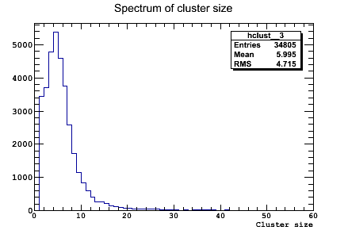
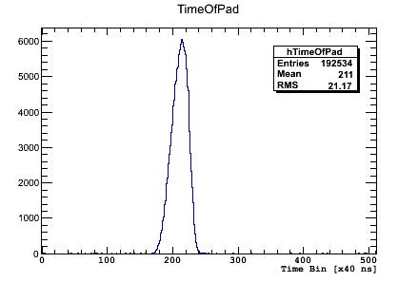
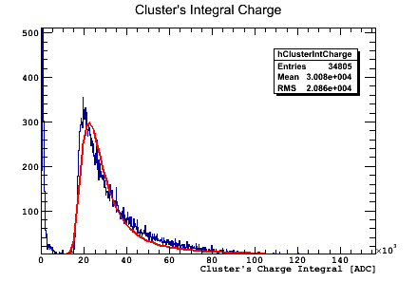
Proton/gamma-ray discrimination
~ 20 cm of paraffin in front of the detector
Cluster size is maximum at ~4
Equivalent charge: Landau MPV at ~40 keV
Uniform time spectrum
→ 60 keV (²⁴¹Am) + γ from neutron ?
Cluster size
Time spectrum
Cluster charge

Slide 12
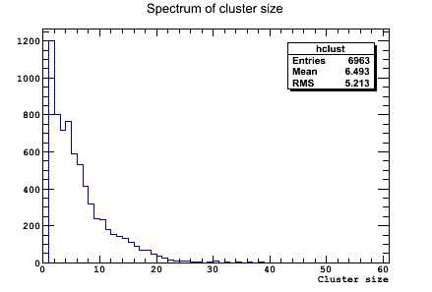
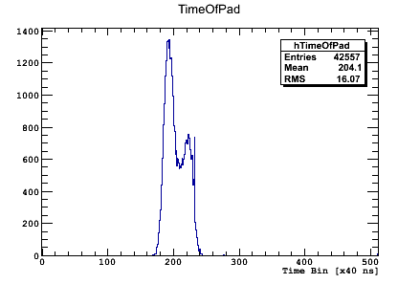
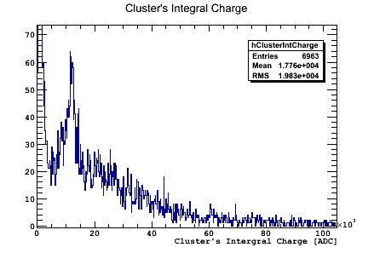
Proton/gamma-ray discrimination
6 mm of Pb in front of 8 cm of paraffin
before detector
Smaller cluster size
Equivalent charge: peak at ~110 keV
+ continuum up to 1 MeV
Doublet in time structure
→ neutron signature ?
Cluster size
Time spectrum
Cluster charge

Slide 13
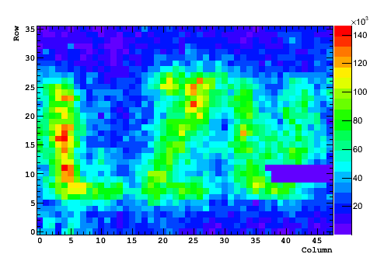
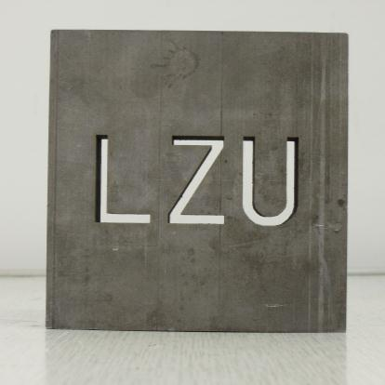
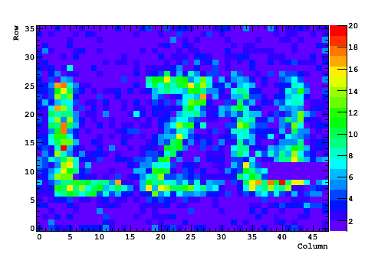
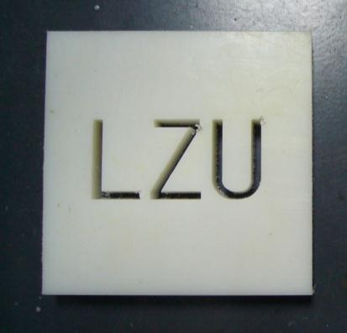
Imaging with Lanzhou mask
Thickness: 17 mm
3 mm
Counting
mode
Pb
+
Imaging
Tracking +cuts in time & charge
Paraffin

Slide 14
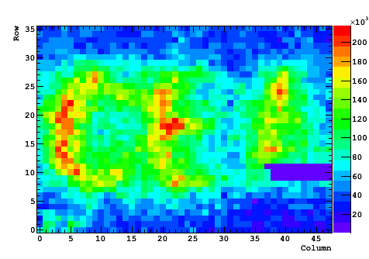
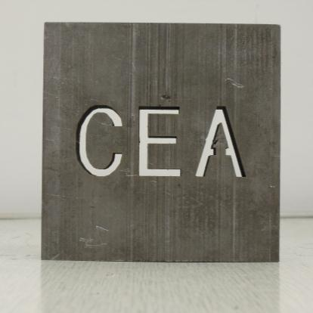
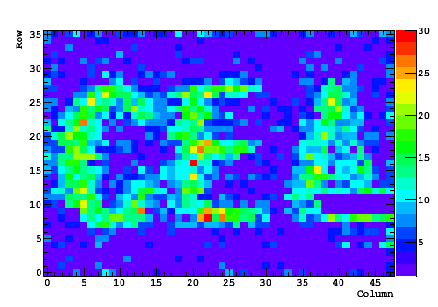
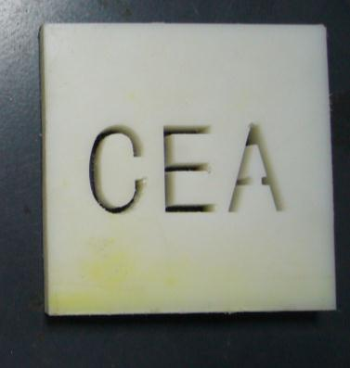
Imaging with CEA mask
Thickness: 17 mm
3 mm
Counting
mode
Pb
+
Imaging
Tracking +cuts in time & charge
Paraffin

Slide 15
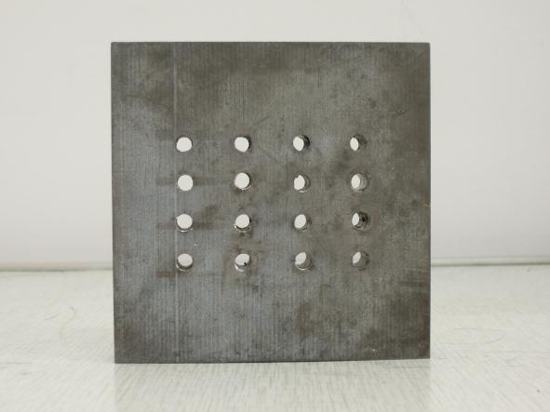
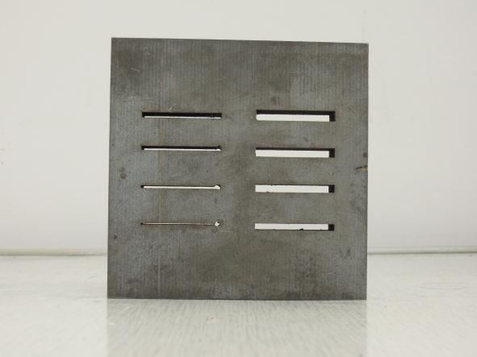
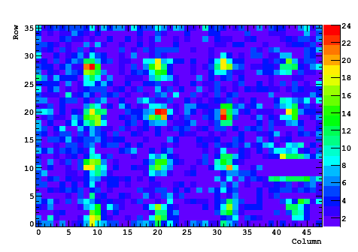
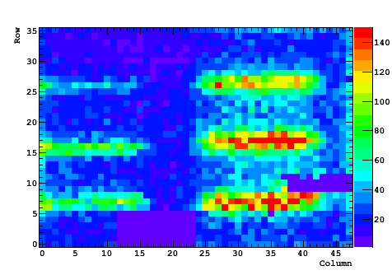
Imaging using others masks
Thickness: 17 mm
3 mm
5 mm
1.5 mm
3.5 mm
∅2.5 mm

Slide 16
Conclusion
Since July 2011, the detector is ready for neutron imaging data taking
Still need to optimize the converter and the drift space
Find and use a high flux of fast neutron beam (D-T source) to avoid gamma-ray from source
Proton/gamma-ray discrimination should be improved by taking data with better neutron and gamma-ray stoppers

