Slide 1
News from Saclay
7 modules construction
Benchmark at CERN
Soft with Carleton, Brussels
Cooling

Slide 2
7 module production
Backend to be brought to Saclay and to CERN (Ralf Diener? Travel W3-4 2012?)
FEM cards received and tested. One soldering fault solved.
FECs PCBs ordered (CIBEL company)
FECs soldering at the commercial department
Detectors ready to be ordered at CERN (PCBs subcontracted to ELTOS)

Slide 3
Software
New version of the standalone analysis program from Carleton
Plans for software work in the next 2 weeks (with Indians from SINP, Brussels and Madhu et al.)
Plans to integrate the software into Marlin in the first 2 weeks of January (KEK, Chinese)

Slide 4
Cooling
2 options: air and 2PCO2.
Air sufficient for the present prototype
2PCO2 probably the right option for future

Slide 5
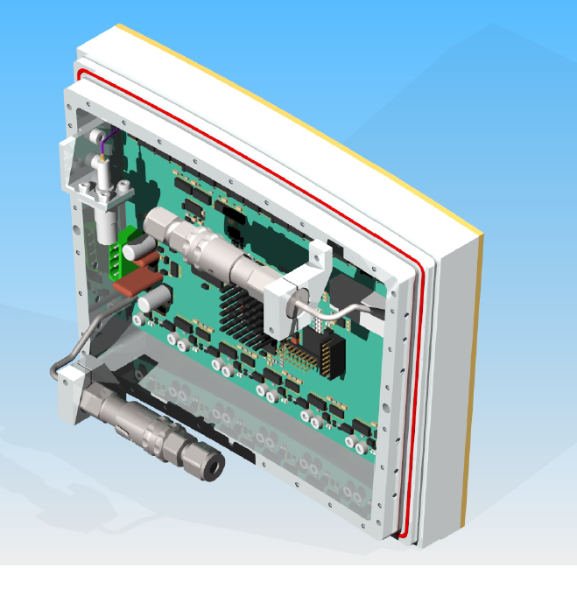

Slide 6
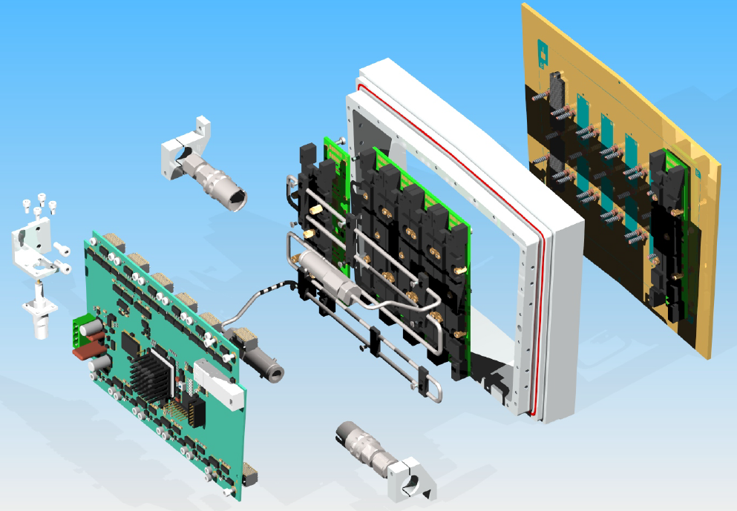

Slide 7
