Slide 1
Kalman Filter in MarlinTPC
G. De Lentdecker
Université Libre de Bruxelles

Slide 2
MarlinTPC installation
MarlinTPC is based on the Marlin framework:
Based on LCIO data format
Usage of successive « processors »
One .xml file with the running parameters of each processor to steer Marlin
Marlin provides interfaces to GEAR (geometry description) and LCCD (conditions data)
Uses RAIDA (AIDA + ROOT) for histogramming
+ need additional packages: MySQL, CLHEP, Java, QT, etc.
You need to install a lot of things.
Fortunately the developers provide an installation python script: ilcinstall
Despite this script it took me a while to find the right recipe to compile and link everything together:
32 vs 64bits,
SL4 vs SL5
special ROOT versions used by CMS (my other experiment).
Also helpful : https://znwiki3.ifh.de/MarlinTPC/HowToInstallMarlinTPC
Eventually I found the correct combination to work on CERN lxplus

Slide 3
Installation of Kalman Filter
KalTest and KalDet are not installed by ilcinstall
Fortunatelly it is well documented in
https://znwiki3.ifh.de/MarlinTPC/HowToInstallMarlinTPC
MarlinTPC/reconstruction/README
KalTest/README
And so it is rather straightforward to install (once you have installed all the rest, of course)

Slide 4
Modifications to be done
Note : the code has been developed by our Japanese colleagues and therefore it has been mostly tested with GEM modules => so a few numbers are hardcoded; examples :
The number of rows in the class HelicalTrack.cc
The algorithm to find pulses looks behind pad #72 in TopoFinder.cc

Slide 5
Before you run, you need:
gear_ilc_lp_micromegas_single_module.xml
Describes the geometry of a single micromegas module in LP
TPCChannelMapping.slcio
Provides the mapping in pad row and column
Files provided by Jason Abernathy
Old geometry (not for TB with new electronics)

Slide 6
Sequence:
<execute>
<!-- "manager processors" -->
<processor name="MyAIDAProcessor"/>
<processor name="MyConditionsProcessor"/>
<!-- "reconstruction processors" -->
<processor name="MyAFTERRawDataConverterProcessor"/>
<processor name="MyPedestalSubtractor"/>
<processor name="MyPulseFinder"/>
<processor name="MyChannelMapperProcessor"/>
<!-- "For KalmanFilter" -->
<processor name="MyHitTrackFinderTopoProcessor"/>
<processor name="MyTrackMakingKalmanFilterProcessor"/>
<!-- "validation processors" -->
<processor name="MyChargeOnPadsVisualisationProcessor"/>
<processor name="MyDumpResidualsProcessor"/>
<!-- "output processors" -->
<processor name="MyLCIOOutputProcessor"/>
</execute>
// Find the pulses in detector
// Do the mapping to (col,row)
//make TrackHit from pulses
//perform KF & produce
LCIO Tracks
// processors for x-checks &
histograms

Slide 7
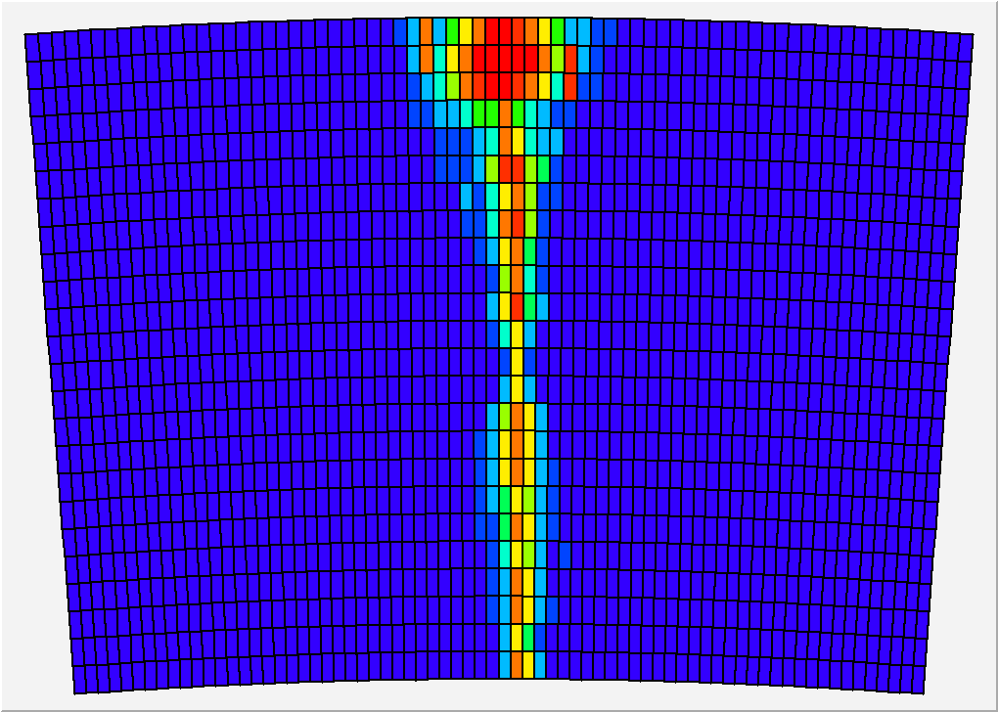
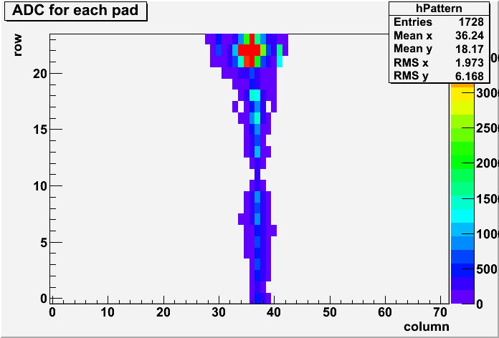
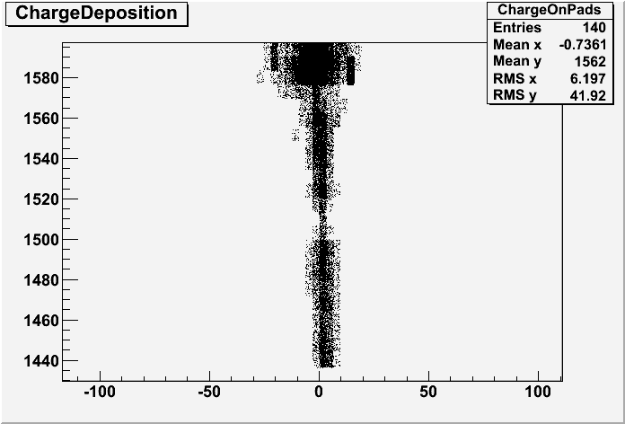
Comparison event by event
Compared some pulses between LPMon and MarlinTPC
Pulse height and time looked in agreement although not exactly identical by a few ADC counts
One « event display »:
RUN01007
1st event (Resistive Ink)
Y
LPDisplay
X
MarlinTPC
Y (mm)
X (mm)

Slide 8
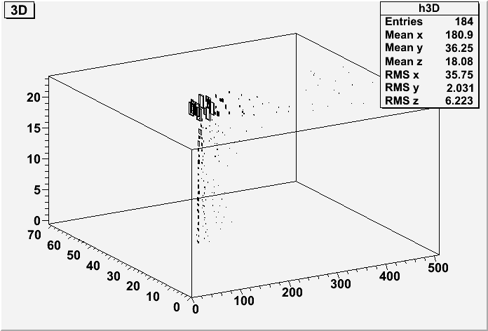
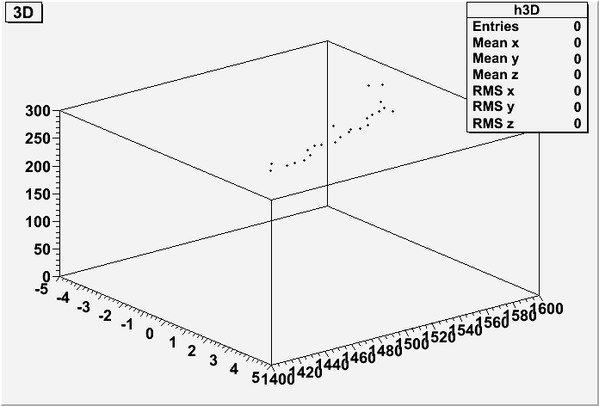
Comparison
LPDisplay
Y
RUN01007 1st event (Resistive Ink)
Hits included in track reconstructed
by Kalman Filter
X
Time
MarlinTPC
Time
Y
X
Y
X

Slide 9
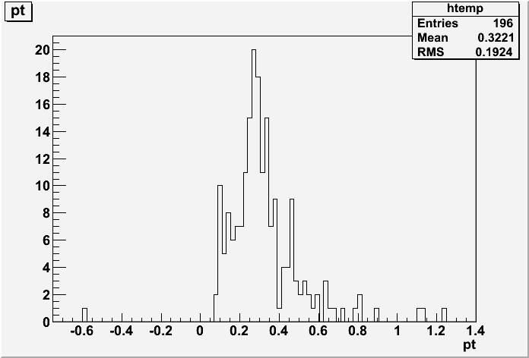
Kalman Filter
Kalman filter seems to work:
Tracks are reconstructed
However pt values obtained are not correct (bad B field setting ?)
(GeV/c)

Slide 10
Conclusions
The most difficult (for me) was to install Marlin & ILCSOFT
Once this done, installation of KalTest and KalDet is easy
Except few hardcoded values, Kalman Filters runs:
Tracks are reconstructed
BUT values returned by the fit doesn’t look right… investigating

