Slide 1
LP TPC Analysis Code and Results
The progress at the Carleton University

Slide 3
Amplitude of Pad
Fit Point Max:
Amp = Maximum Pulse Height
T0 = Time of bin with maximum signal
Quadratic Fit:
Amp = Max Pt. of fit
T0 = Time of Max Pt.

Slide 4
PRF – Pad Response Function

Slide 9
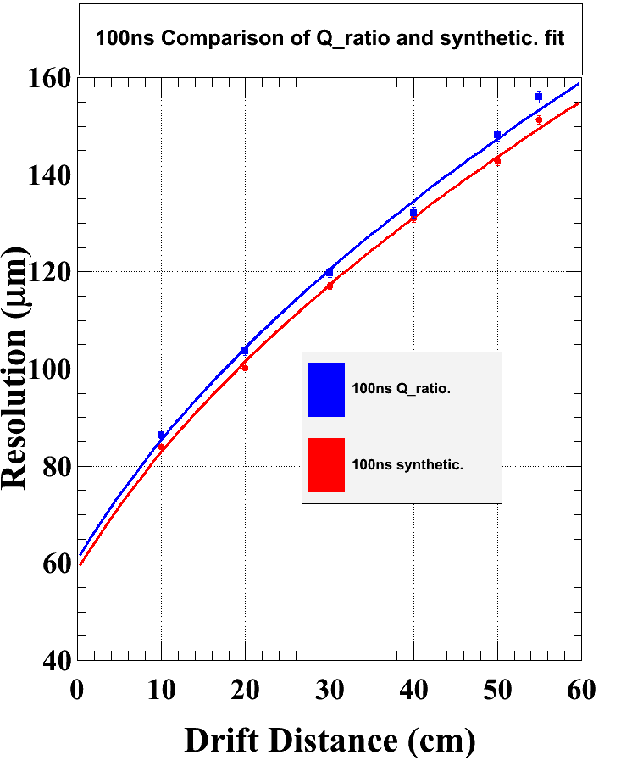
100 ns peaking time
Using half rows
Maximume Amplitude
PRF fitting: - Q_ratio
- Synthetic

