Slide 1


Beam tests of Fast Neutron Imaging in China
L. An², D. Attié¹, Y. Chen², P. Colas¹, M. Riallot¹, H. Shen²,
W. Wang^{1,2}, X. Wang², C. Zhang², X. Zhang², Y. Zhang²
Workshop MPGD at Saclay, 2011
(1)
(2)

Slide 2
The Helium-3 Shortage:
Supply, Demand, and Options for Congress
The demand was small enough that a substantial stockpile of helium-3 accumulated. After the terrorist attacks of September 11, 2001, the federal government began deploying neutron detectors at the U.S. border to help secure the nation against smuggled nuclear and radiological material. The deployment of this equipment created new demand for helium-3. Use of the polarized helium-3 medical imaging technique also increased. As a result, the size of the stockpile shrank. After several years of demand exceeding supply, a call for large quantities of helium-3 spurred federal officials to realize that insufficient helium-3 was available to meet the likely future demand.
Until 2001, helium-3 production by the weapons program exceeded demand, and the program accumulated a stockpile. To recoup some of the cost of purifying recycled tritium, the program transferred helium-3 from the stockpile to the DOE Office of Isotope Production and Research for sale at auction. Despite these sales, the helium-3 stockpile grew from roughly 140,000 liters in 1990 to roughly 235,000 liters in 2001. Since 2001, however, helium-3 demand has exceeded production. By 2010, the increased demand had reduced the stockpile to roughly 50,000 liters.
Actions to reduce demand:
• Fund or encourage the development of alternative technologies.
• Require or provide incentives for the use of alternative technologies.

Slide 3
Overview
Introduction: idea of Fast Neutron Imaging detector
Simulation of Micromegas as a neutron detector
Description of the detector
Data analysis and results
Conclusion and Next step

Slide 4
Characteristics and simulation of FNI detector
Characteristics expected of Fast Neutron Imaging detector based on TPC:
High spatial resolution: <100 µm
high quality imaging from Micro-Pattern Gas Detector
as Micro-Mesh Gaseous Structure (Micromegas)
  Low efficiency: ~ 0.01-1%,
  subject to thickness and kind of converter
  suitable for beam monitor/profile
  imaging in very high flux
Simulation tools:
  Garfield (gas processes):
    ionization energy
    electron drift velocity
    electron avalanche
  Geant4 (physics processes)

Slide 5
Monte-Carlo simulation
Garfield
Geant4
Ionization of charged
particle in drift gap
Incident 14MeV
neutron flux
Transportation of
electron in gas
Charged particle (proton)
in converter
Average ionization energy
Energy loss
Drifting velocity
Diffusion coefficient
Multiplication coefficient
Initial electron
Transportation function
Induced signal

Slide 6
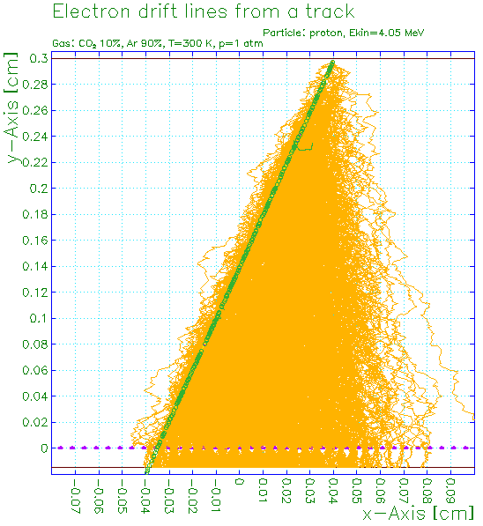
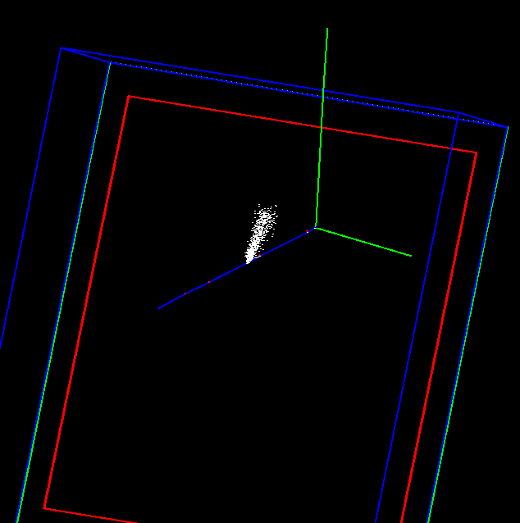
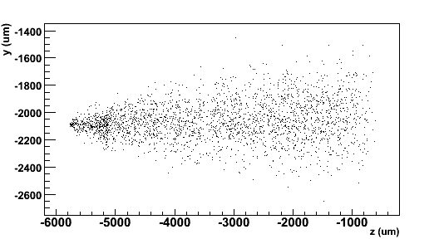
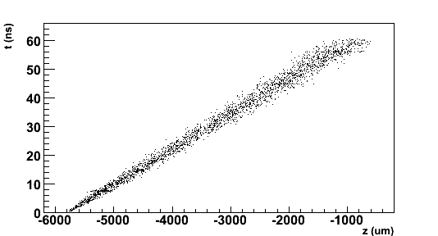
Monte-Carlo simulation
n
Garfield
Drift lines from primary ionization e-
Proton track
p
e- avalanche
Neutron event interacting
with polyethylene foil
and knocking out a proton
Avalanches
Data reconstruction method:
  identify cluster (track)
  extract hit position where the time is maximum t_{max} → interaction point
  integrate all events → image
p
Drift time
Avalanche drift time
σ = 91.9 µm
y-z readout plane
X-Y readout plan

Slide 7
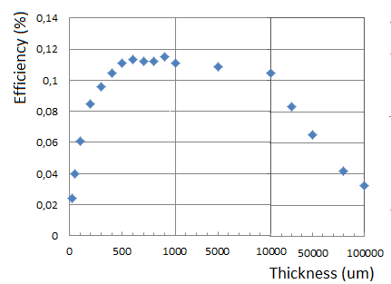
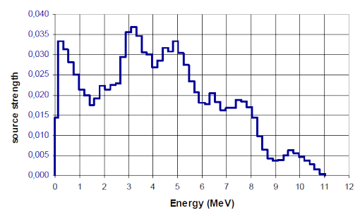
Geant4 simulation for converter efficiency
Neutron→proton recoiling efficiency in a polyethylene [C₂H₄]_{n} layer coming from ²⁴¹Am-⁹Be source
CH2
gas
Incident neutron spectrum
10 cm
n
n, p
6 cm
According to ISO 8529^{(*)}
25 µm ~ 20 cm
1 cm
* INTERNATIONAL STANDARD ISO 8529. Reference neutron radiations – Part 1: Characteristic and methods of productions. International Standard ISO 8529-1 (2001).
07.12.2011
W.Wang_Beam tests of Fast Neutron Imaging in China
7

Slide 8
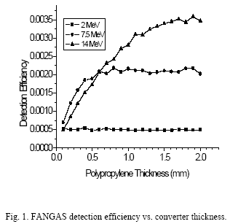
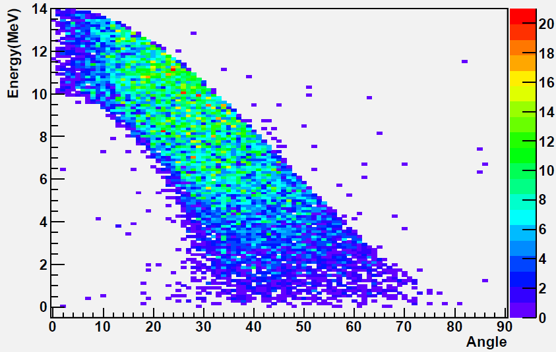
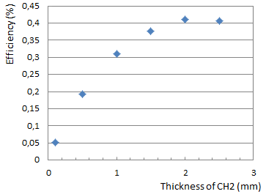
Geant4 simulation for converter efficiency
Neutron→proton recoiling efficiency in a polyethylene [C₂H₄]_{n} layer coming from 14MeV neutron
*
* D. Vartsky et al, Nucl. Intsr. and Meth. A 376 (1996) 29.
07.12.2011
W.Wang_Beam tests of Fast Neutron Imaging in China
8

Slide 9
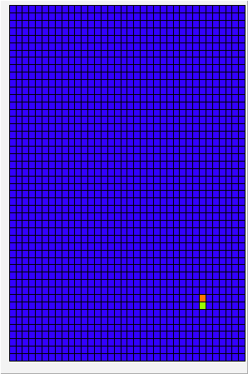
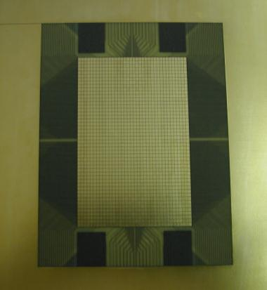
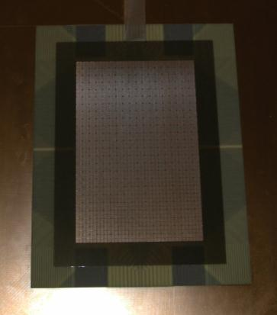
Micromegas TPC for neutron imaging
Detector layout: 1728 (36 ×48) pads of 1.75 mm × 1.50 mm
+ bulk Micromegas
Gas mixture: Argon + 5% Isobutane
Elastic scattering on hydrogen n → p
+ masks (Pb, paraffin wax)
n
Pb
Aluminized polyethylene 25 µm
between 2 layers (0.5 µm) of Al
Wax
gas
HV_{drift}
10 mm
p
E_{drift} ~ 200 V/cm
128 µm
HV_{mesh}
57.4 mm
E_{amp} ~ 30 kV/cm
88.6 mm
(x, y, t)
Cosmics
PCB
Micromegas

Slide 10
Detector + electronics setup

Slide 11
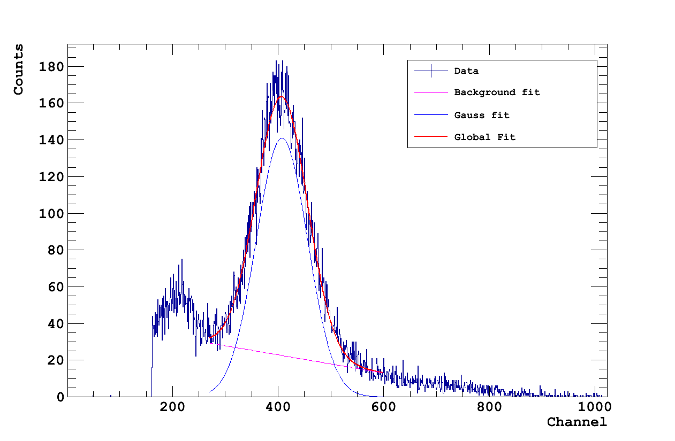
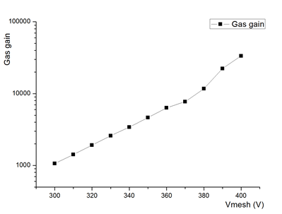
Performances of the Micromegas detector
Gain curve measured from 5.9 keV line using ⁵⁵Fe source. Signals read out on the mesh in Ar/Isobutane 5%: G~10³ @ 300 V
Energy resolution of σ~12 % due to detector capacitance and noise
best energy resolution measured for a bulk Micromegas (~7 %)

Slide 12
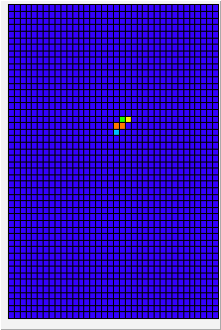
²⁴¹Am–⁹Be source
Located in Lanzhou University, data taking in July 2011
Intensity: ~6 ×10⁶ Hz (4π)
Neutron energy spectrum, according to ISO 8529 (reference radiations for calibrating neutron-measuring devices)
Mean energy ~4.5 MeV, up to 11 MeV
Data sample from source
48
36

Slide 13
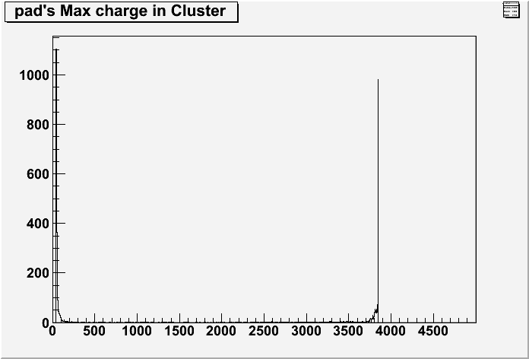
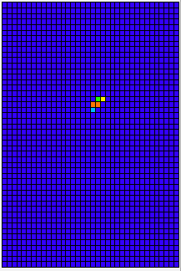
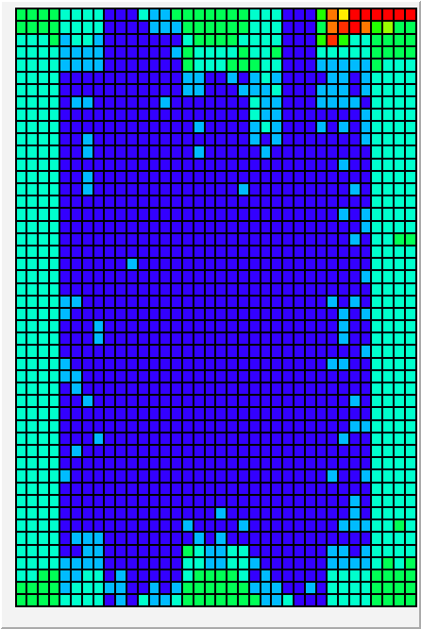
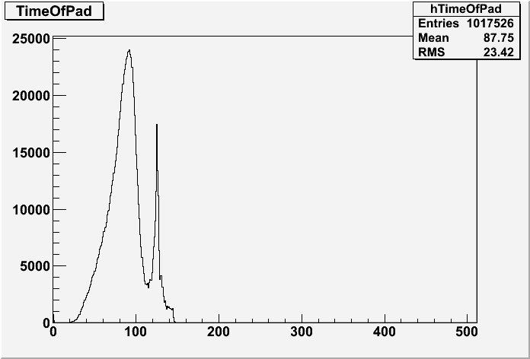
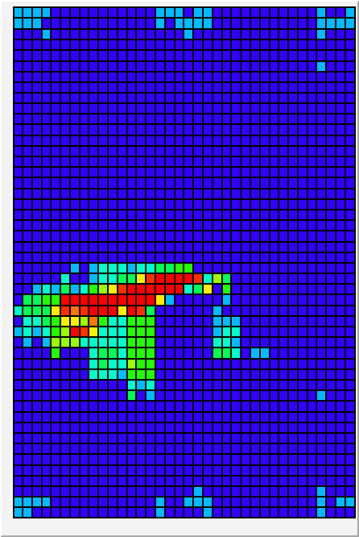
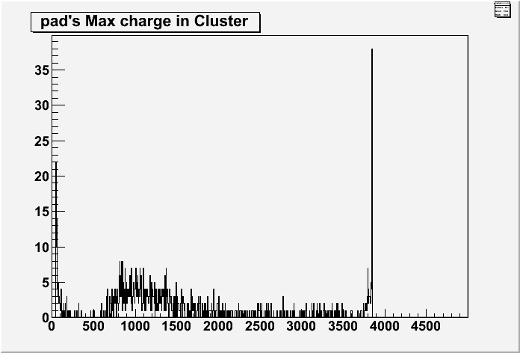
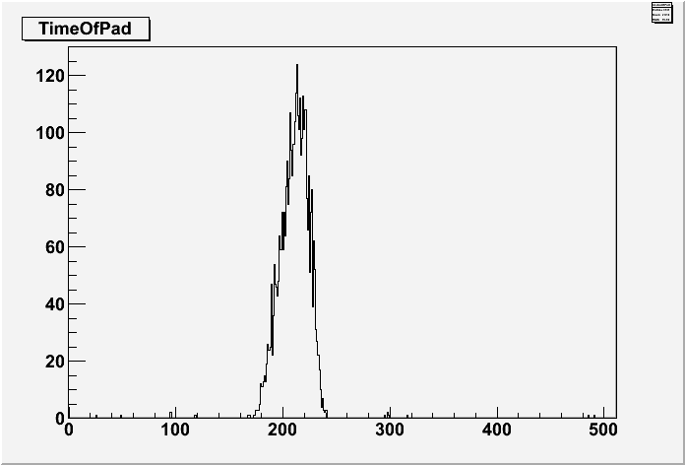
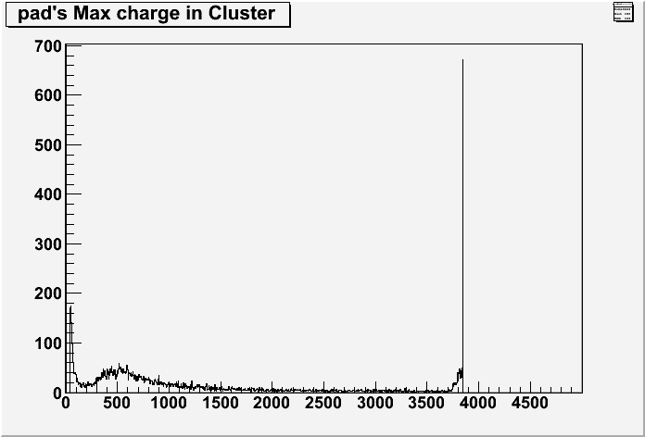
Data analysis and results
Electronic Gain = 120 fc
Vmesh = 300V
Operating gas gain < 1500 and electronics full-scale gain set ≥ 360 fC in order to cut the gamma-rays and cosmics events
Electronic Gain = 120 fc
Vmesh = 350V
Electronic Gain = 360 fc
Vmesh = 300V
Electronic Gain = 360 fc
Vmesh = 300V
Electronic Gain = 600 fc
Vmesh = 320V

Slide 14
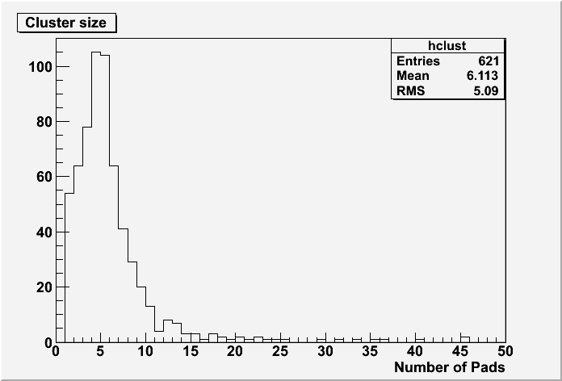
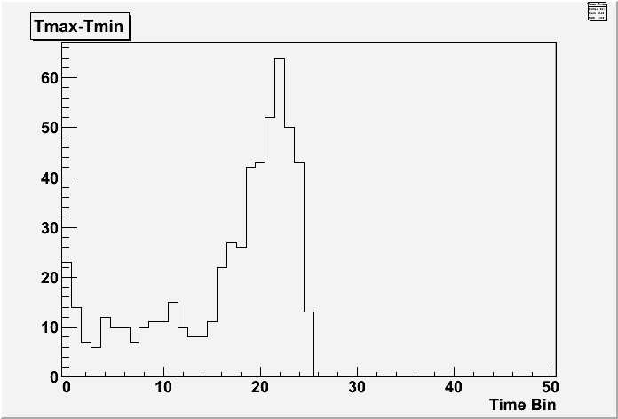
Data analysis and results
64mm plastic(polyethylene) in front of the detector
Vmesh = 300V Electronic Gain = 360
Cluster size is maximum at ~5
Uniform time spectrum

Slide 15
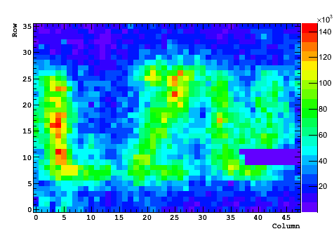
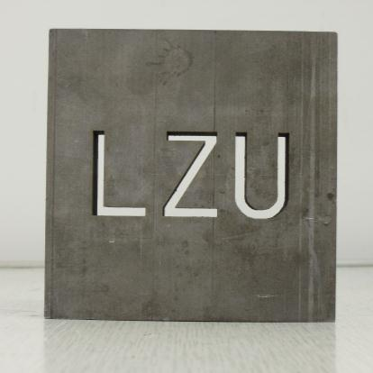
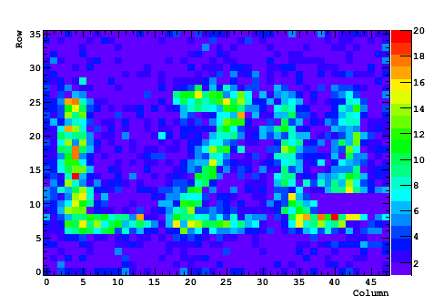
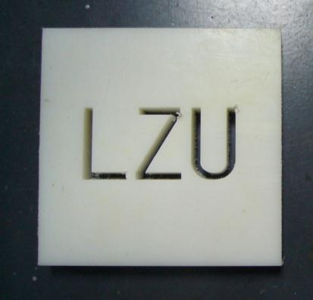
Imaging with Lanzhou mask
Thickness: 17 mm
3 mm
Counting
mode
Pb
+
Imaging
Tracking +cuts in time & charge
Paraffin

Slide 16
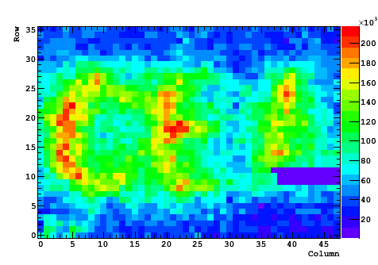
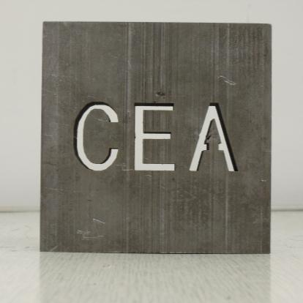
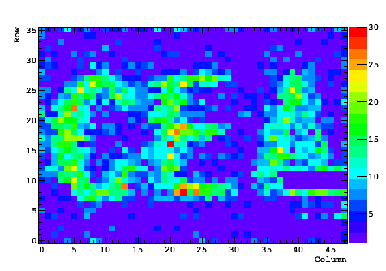
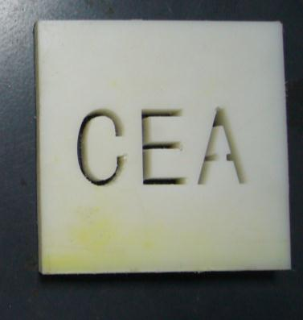
Imaging with CEA mask
Thickness: 17 mm
3 mm
Counting
mode
Pb
+
Imaging
Tracking +cuts in time & charge
Paraffin

Slide 17
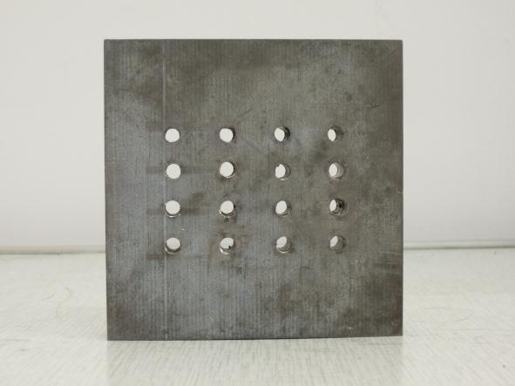
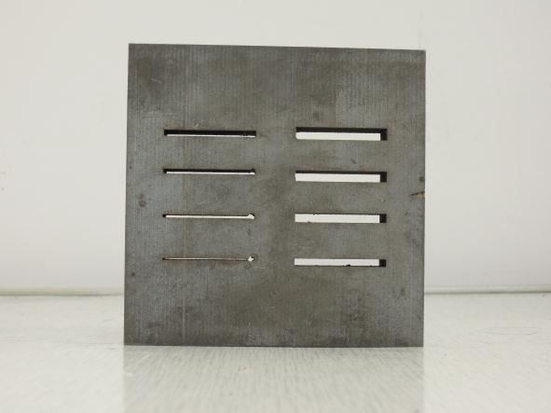
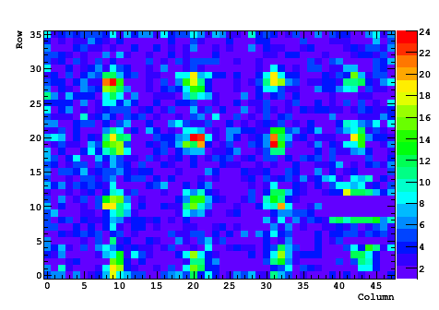
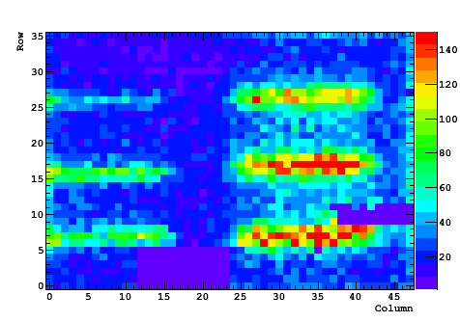
Imaging using others masks
Thickness: 17 mm
3 mm
5 mm
1.5 mm
3.5 mm
∅2.5 mm

Slide 18
Conclusion and Next step
Since July 2011, the detector is ready for neutron imaging data taking
The Characteristics were studied using ⁵⁵Fe and ²⁴¹Am+Be
Still need to optimize the converter and the drift space
- Using 1mm polyethylene as converter layer
- Using thin drift gap (1mm) to reduce the inaccuracy
- Using thick drift gap (3cm) to get good proton track

Slide 19
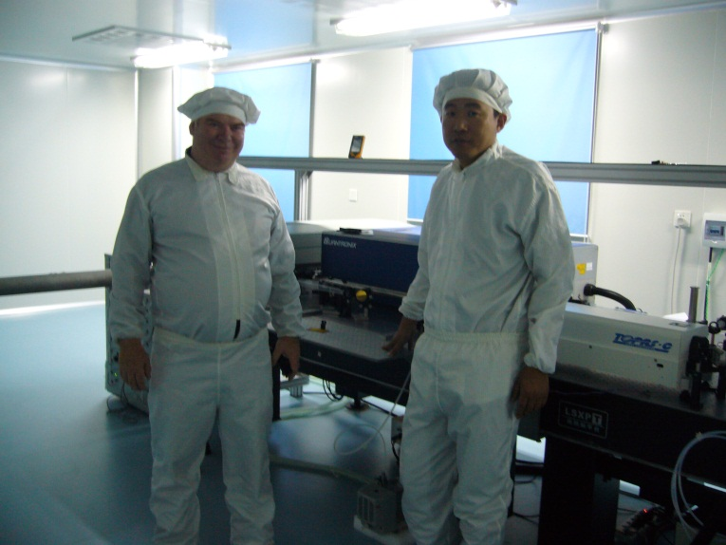
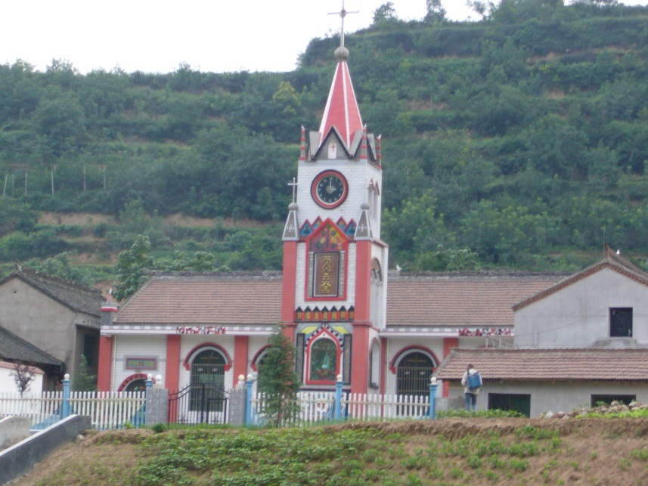
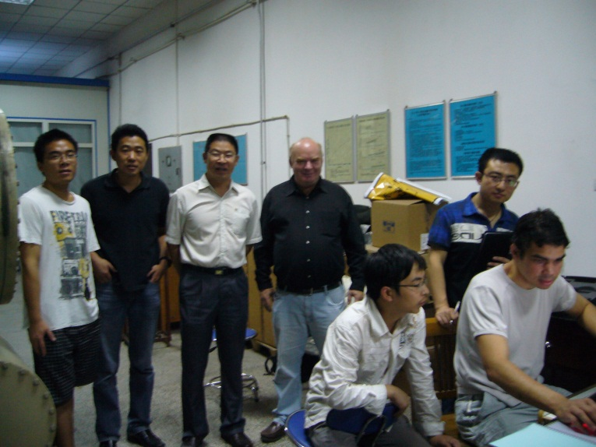
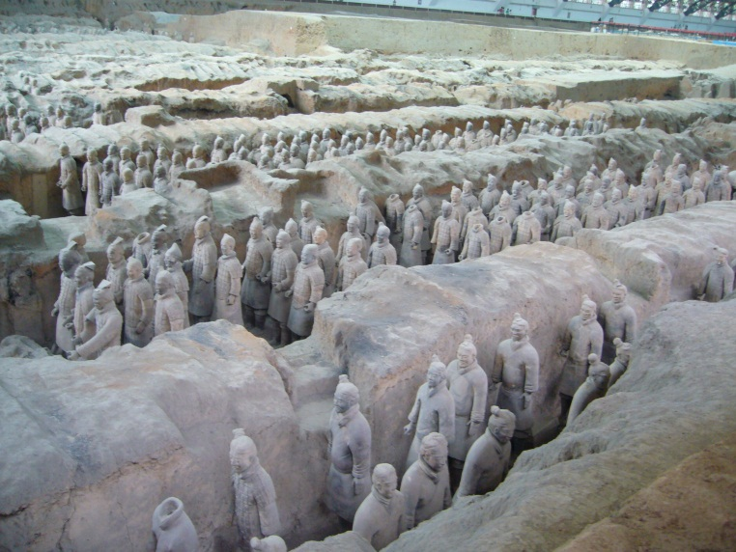
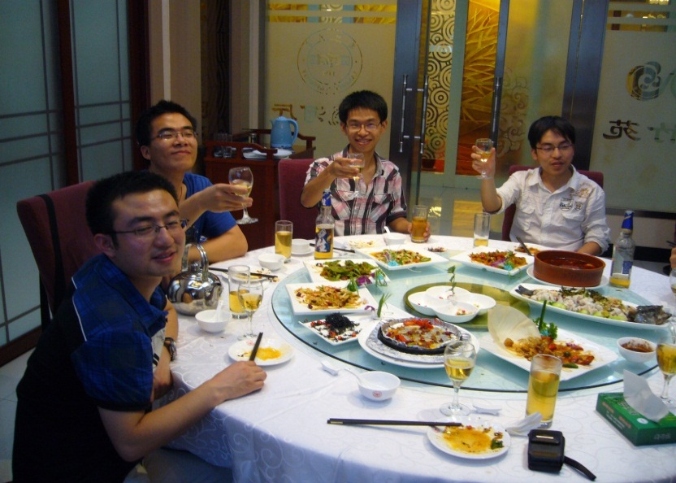
Clean room
Church
Terracotta soldier

Slide 20
Thank you!

