Slide 1
R&D in
micropixel detectors
at Irfu
D. Attié, A. Chaus, P. Colas, X. Coppolani,
E. Delagnes, M. Riallot, M. Titov
Saclay, December 8th, 2011
Notes:
I’m here to present a TPC review

Slide 2
Outline
Timepix: a readout chip designed for gaseous detectors
Historical overview of this activity
Applications using single electron efficiency:
  single chip:
    polarimetry
    study of gas properties
  ‘Octopuce’:
    tracking tools
    data analysis framework
InGrid production: status and plans
R&D relating to chip protection
Conclusions and perspectives

Slide 3
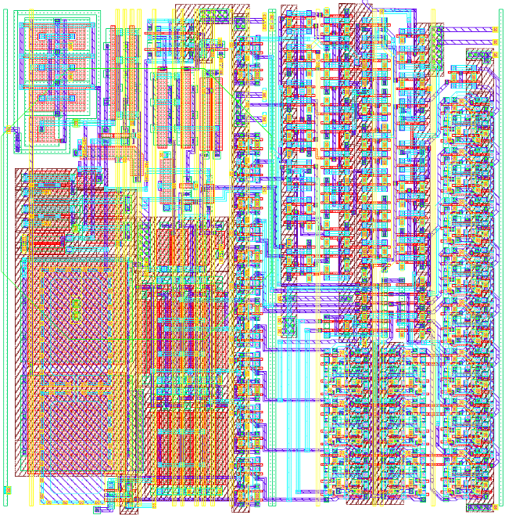
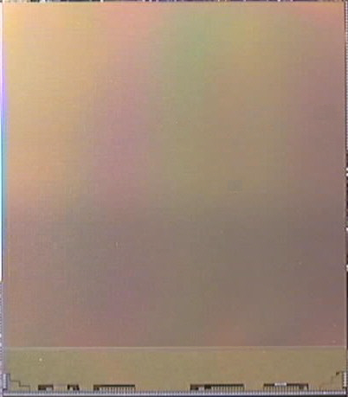
The Timepix chip
Chip (CMOS ASIC) upgraded in the EUDET framework from the Medipix chip developed first for medical applications → candidate for LC-TPC readout
IBM technology 0.25 μm
Characteristics:
  surface: 1.4 x 1.6 cm²
  matrix of 256 x 256
  pixel size: 55 x 55 μm²
For each pixel:
  preamp/shaper
  threshold discriminator
  register for configuration
  TimePix synchronization logic
  14-bit counter
Noise: ~ 650 e-
  C_{in} ~ 15 fF
Pixel
55 μm
Synchronization Logic
Interface
14080 μm (pixel array)
16120 μm
m
μ
55
4
4
55 μm
Preamp/shaper
Configuration latches
Counter
THL disc.
2
14111 μm
2
3
1
3
1
5
5
55
μ
m

Slide 4
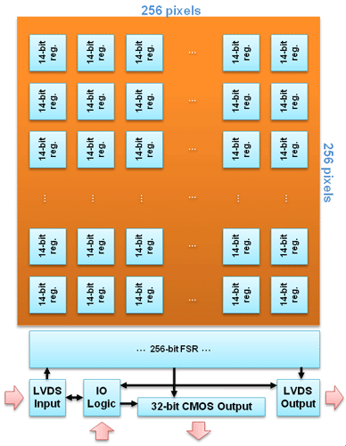
From Medipix2 to TimePix
Based on MediPix2 design:
  Same dimensions and readout protocol
  Replace a 14-bit hit counter by TDC
  Only low threshold
  Fast pixels count clock pulses at 100 MHz
  Noise threshold ~ 500 e-
Counting modes per pixel (can be mixed):
  “Time-Over-Threshold” → Charge information
  “Common stop” → Time information
Characteristics:
  Dynamic range: 160 µs @ 100 MHz
  Integration time: 200 ns
  Analog Power: 440mW
  Digital Power (Ref_Clk=50MHz): 220mW
  Serial readout (@100MHz): 9.17 ms
  Parallel readout (@100MHz): 287 µs
  > 36M Transistors

Slide 5
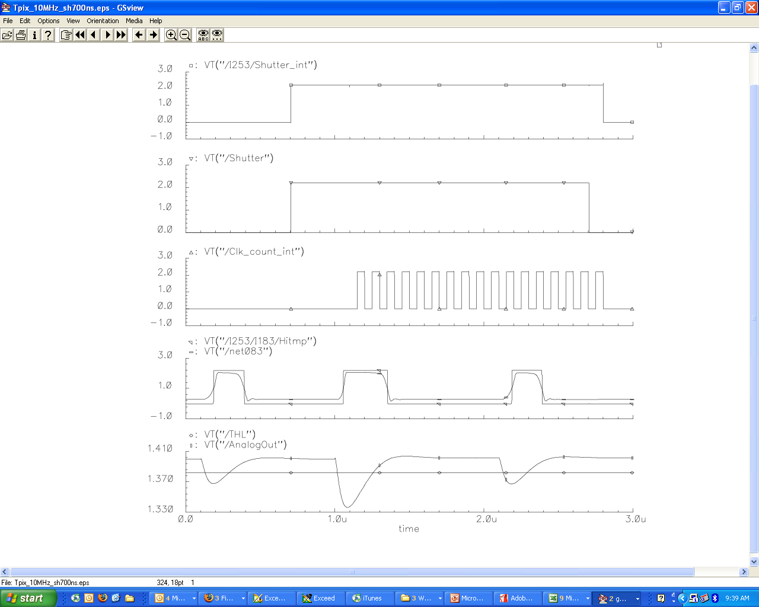
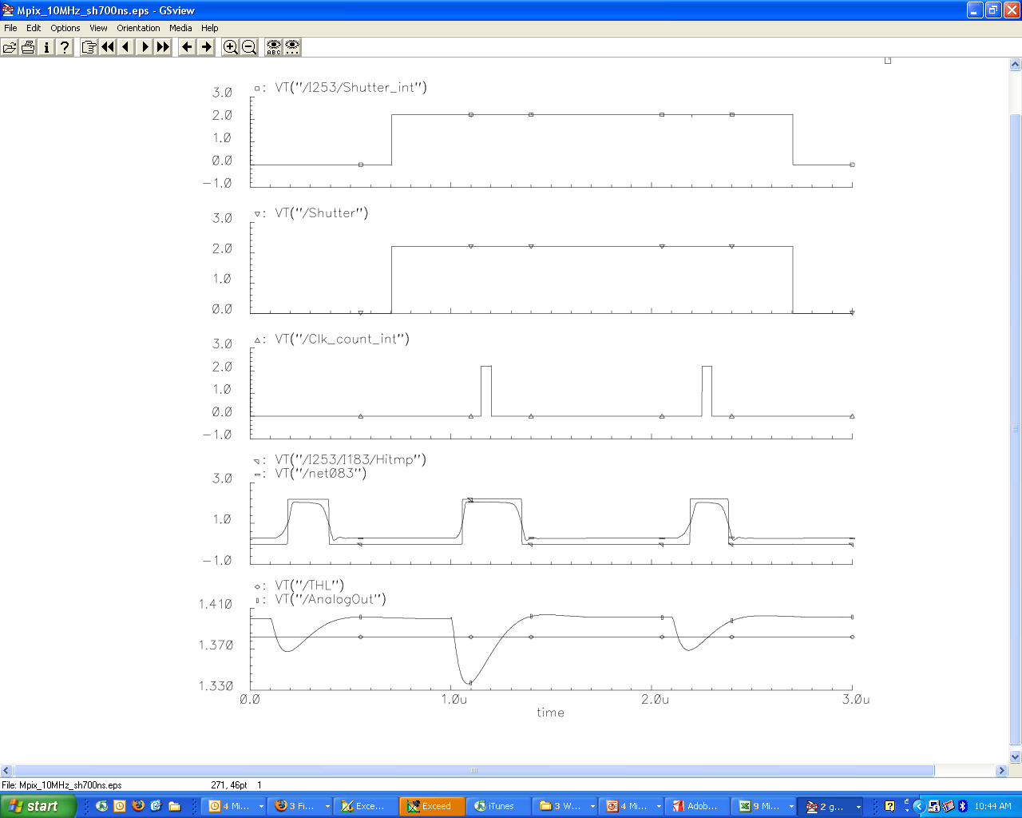
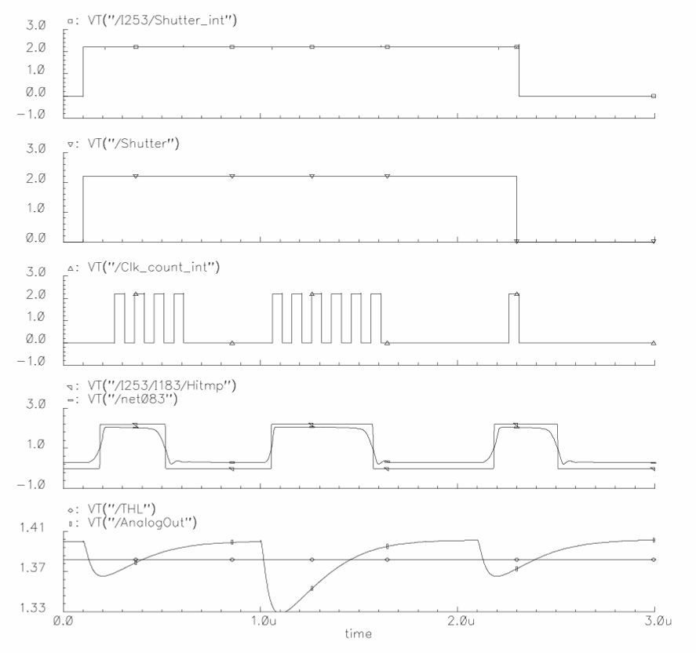
TimePix Synchronization Logic (TSL) control
Timepix Mode
Medipix Mode
Each pixel can be configured independently in 5 different modes
Internal clock up to 100 MHz
TOT Mode
100 MHz
Internal Shutter
Shutter
Mask | P1 | P0 | Mode
0 | 0 | 0 | Masked
0 | 0 | 1 | Masked
0 | 1 | 0 | Masked
0 | 1 | 1 | Masked
1 | 0 | 0 | Medipix
1 | 0 | 1 | TOT
1 | 1 | 0 | Timepix-1hit
1 | 1 | 1 | Timepix
Internal Clock
Digital signal
Analogic signal
not detected
detected
Charge summed

Slide 6
Detectors using Medipix/Timepix chip
Solid detector
Gas detector
x, y, F(x, y)
Drift grid
x, y, z(t), E(x,y)
X-ray source
Ionizing
particle
Gas volume
+
-
Semiconductor
sensor
Flip-chip
bump bonding
connections
Single pixel
readout cell
+
Amplification System (MPGD)
+
-
-
Medipix2 chip
Medipix2/TimePix chip

Slide 7
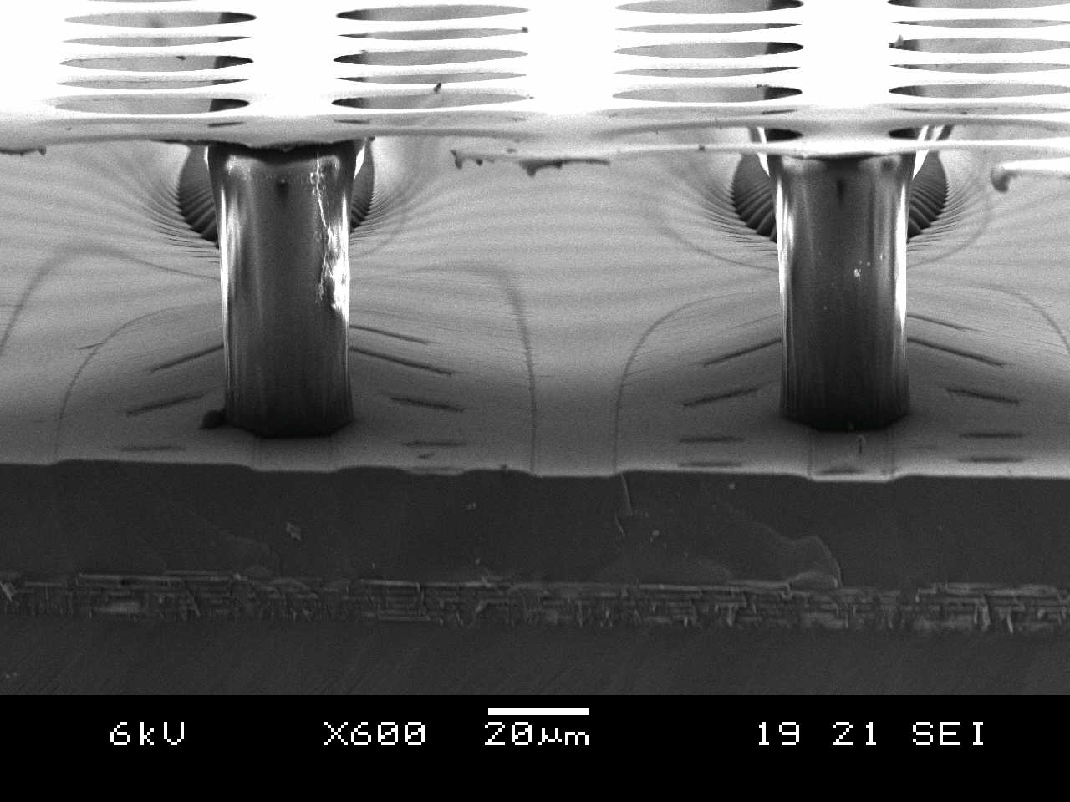
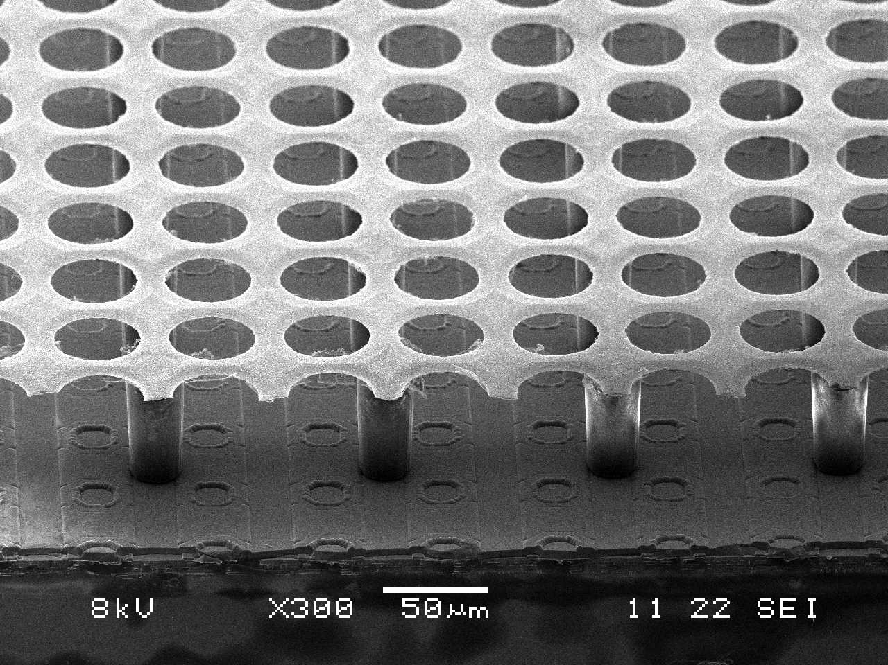
InGrid: building process
Integrate a GEM or Micromegas detector directly on a chip …
… using wafer post-processing :
The substrate could be:
  naked or patterned wafer of Si
  readout chip
photo-resist
substrate
Deposit photo-resist & UV exposure
  define the amplification gap (tens of μm)
  define the grid support (pillars/walls)
Deposit metal & pattern
  define the grid geometry
Develop unexposed photo-resist
  cleaning
Resistive layer for protection
NIKHEF
(MESA+, Univ. Twente)

Slide 8
The historical overview
2006 | EUDET contribution for Timepix wafers + postdoc
2006-2007 | Demonstrator: µTPC Micromegas Ingrid produced on naked wafer or only for Nikhef
2008 | Demonstrator for x-rays polarimetry; SiProt for protection
2007-2009 | Ion feedback measurement using raw Ingrids (M. Chefdeville)
2009 | First prototype of 8 Timepix chips board
2009-2010 | First Ingrids in Saclay (~12) gas properties measurements using single chip Octopuce board
End 2010 | ‘Octopuce’ data taking in 5 GeV electron beam at Desy
2006-2008 | Postdoc EUDET
2009-2010 | Master student (9 months): M. Lupeberger
2010 | ANR 3DLAMI Irfu/LAL rejected
2011 | P2IO proposal submitted
2012 | Participation in ANR ‘jeune’ for DM physics (CAST)?
2011-2014 | PhD student: A. Chaus

Slide 9
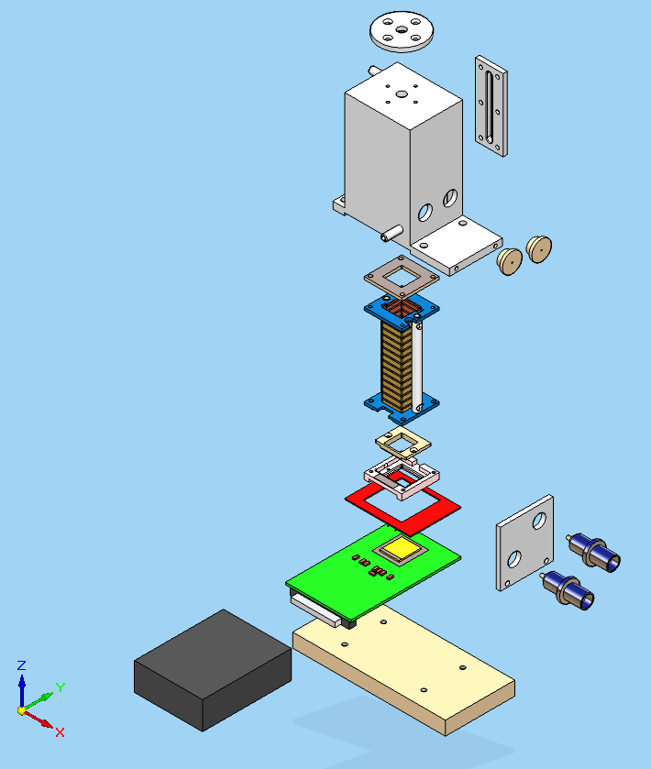
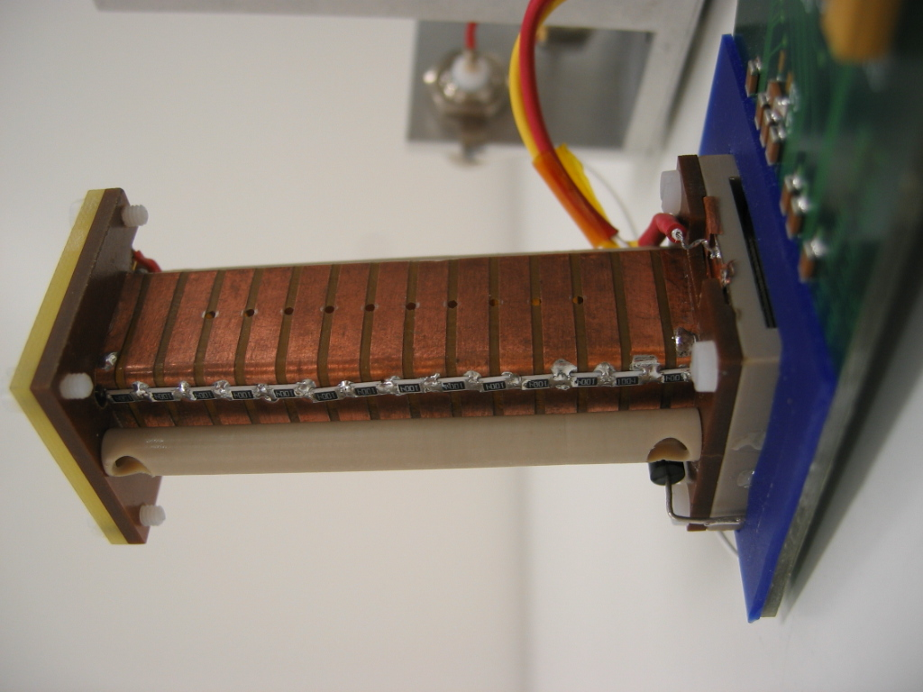
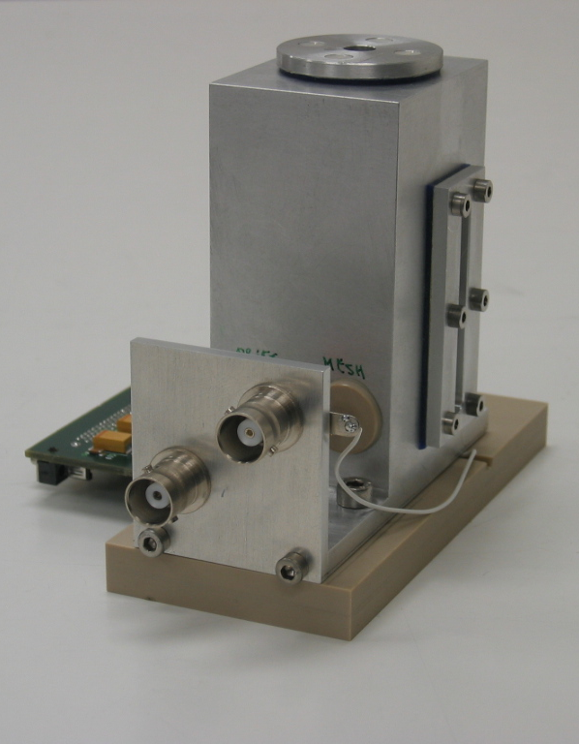
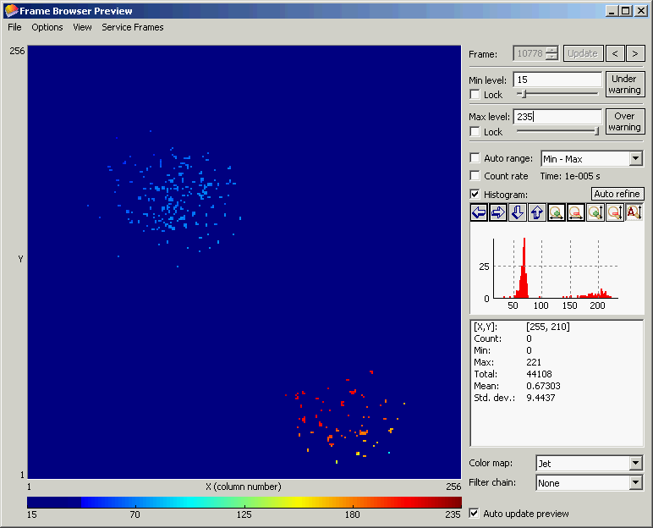
Micro-TPC using TimePix/Micromegas
Micro-TPC with a 6 cm height field cage
Size : 4 cm × 5 cm × 8 cm
Windows for X-ray sources
Cover
6 cm
Windows for
β sources
Field cage
TimePix chip
+ SiProt 20 μm
+ Micromegas
⁵⁵Fe source
Ar/Iso (95:5)
Time mode
z = 25 mm
V_{mesh} = -340 V
t_{shutter} = 283 μs
Micromegas
mesh
Medipix2/TimePix chip

Slide 10
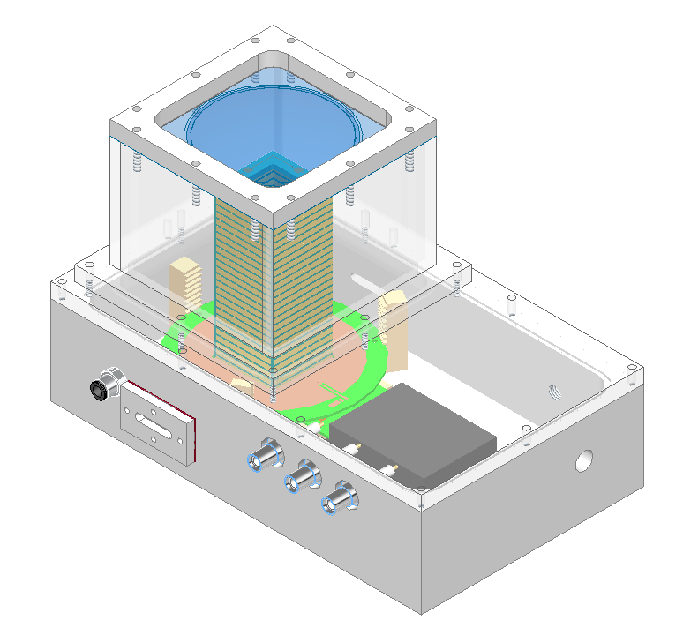
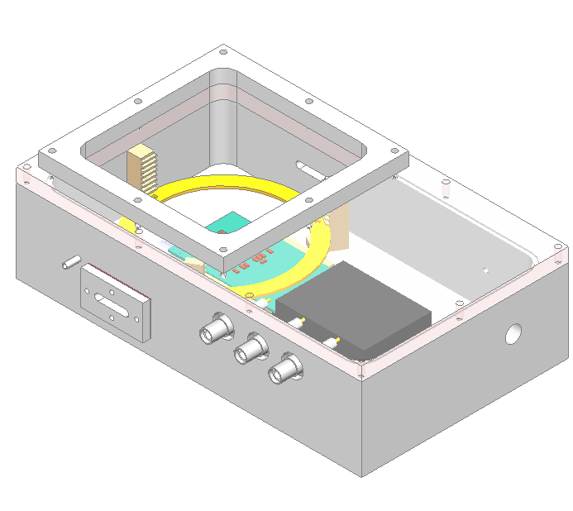
TimePix box
Two specific boxes have been built
Size : 25 cm × 10 cm × 5 cm
Use many times to test bulk, µbulk, etc.

Slide 11
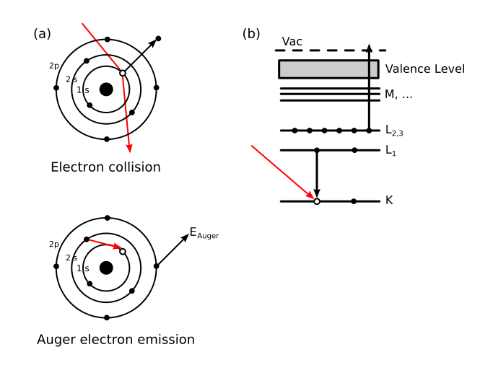
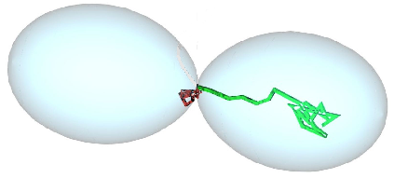
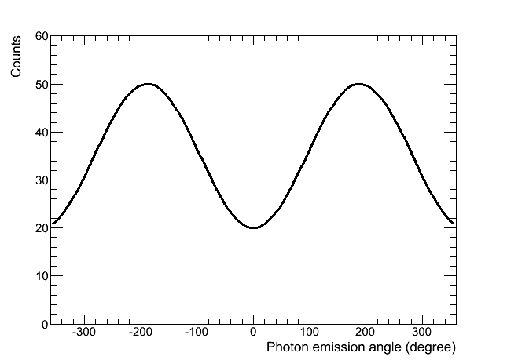
Polarimetry using photoelectric absorption
Ideal polarimeter is a track imager with:
anode segmentation < mean free path of photoelectron
E
X-ray
Photoelectron
Differential photoelectron cross-section emitted
from the atomic s-orbital in non relativist limit:
θ polar angle, φ azimutal angle
Emission angles are modulated by the polarization P
Auger
electron
θ
φ
maximum in the plane ⊥ x-ray direction
N_{max}
N_{min}

Slide 12
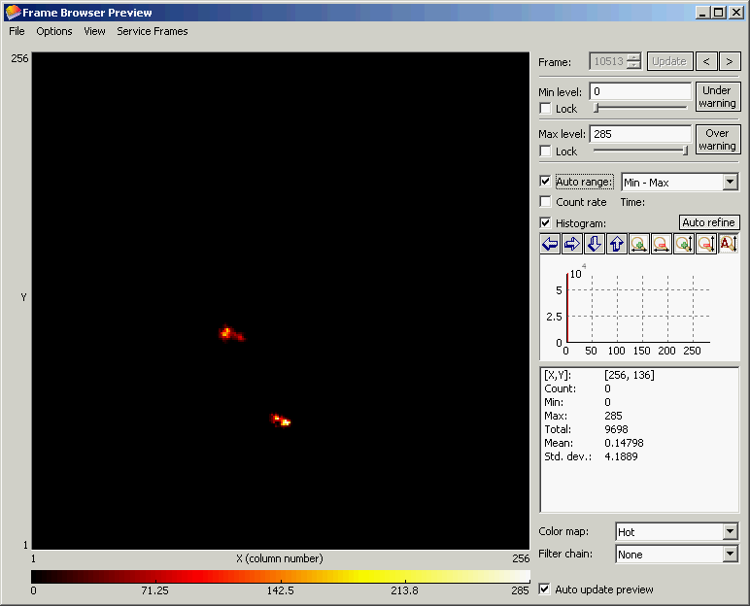
Polarimeter prototype using TimePix/Micromegas
TimePix chip
+ SiProt 20 μm
+ Micromegas
⁵⁵Fe source
Ne/Iso (90:10)
TOT mode
z < 5 mm
V_{mesh} = -450 V
t_{shutter} = 0.2 s

Slide 13
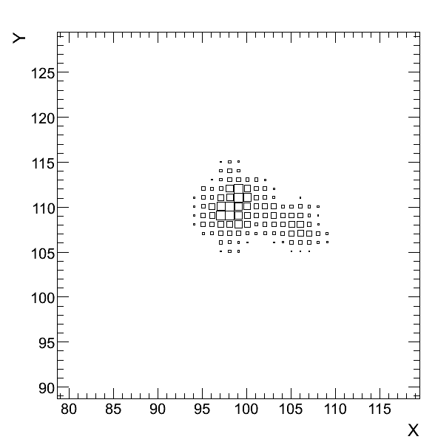
Polarimeter prototype using TimePix/Micromegas
Identify the cluster
Photoelection + e_{auger} track in Neon+10 Isobutane
TimePix chip
+ SiProt 20 μm
+ Micromegas
⁵⁵Fe source
Ne/Iso (90:10)
TOT mode
z < 5 mm
V_{mesh} = -450 V
t_{shutter} = 0.2 s
Determination of the polarization
Barycentre
Principal axis
Reconstructed absorption point
Reconstructed photoemission
direction with identification
of the absorption point and the
removal of the final part
of the track
φ
φ photoemission angle
Low E_{k-edge} of Neon → e_{auger} are
isotropically emitted with a small
fraction of the photon energy
In low Z gas mixture tracks are
longer so angular reconstruction is easier
Attié et al., NIMA 610 (2009) p. 178

Slide 14
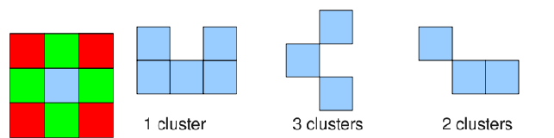
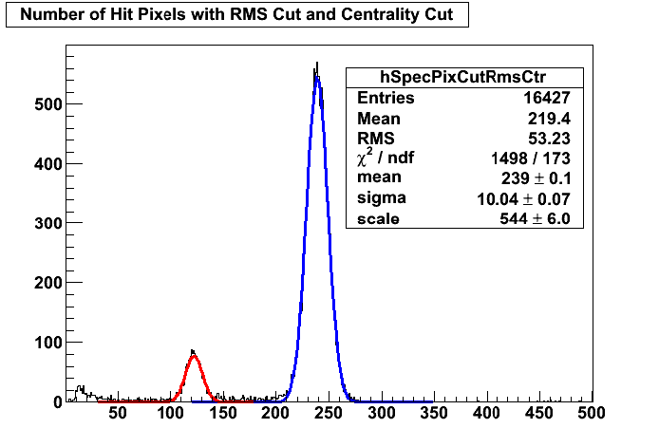
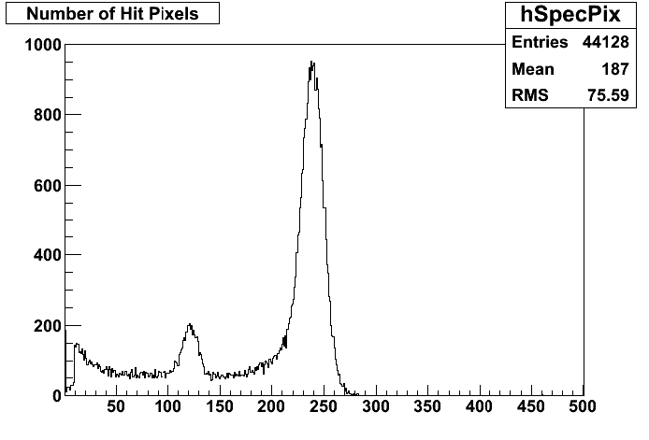
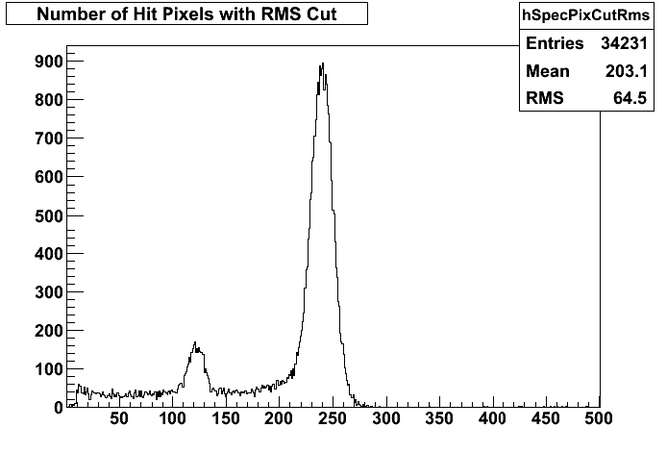
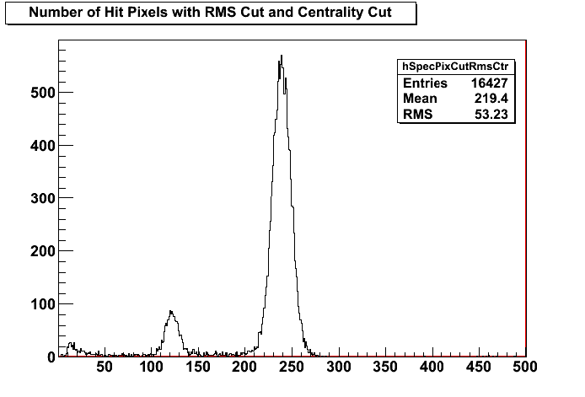
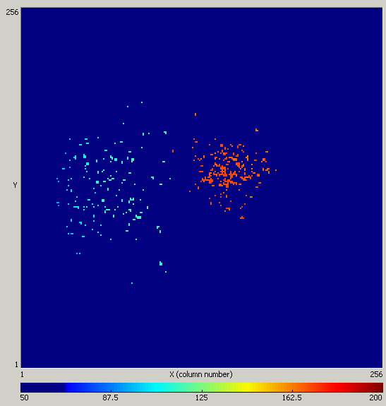
InGrid: Measurements of primary statistics in gases
Diffusion σ_{t} should be big enough to separate e-: cluster[1]=83.8% ; cluster[2]= 11.4%
Study of primary electrons and Fano factor F using σ_{RMS}
Gain fluctuation of avalanche statistics accessible
TimePix+Ingrid+15 μm SiProt in Argon + 5% Isobutane
Kβ-filtered spectrum with Cr foil
σ_{FWHM} = 10 %

Slide 15
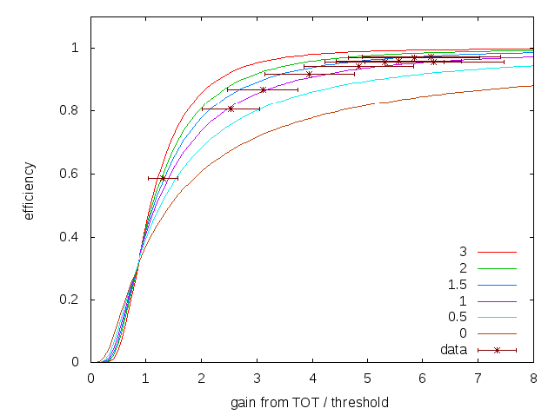
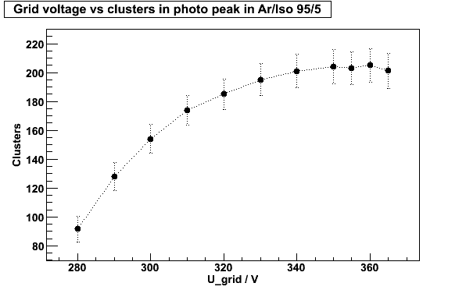
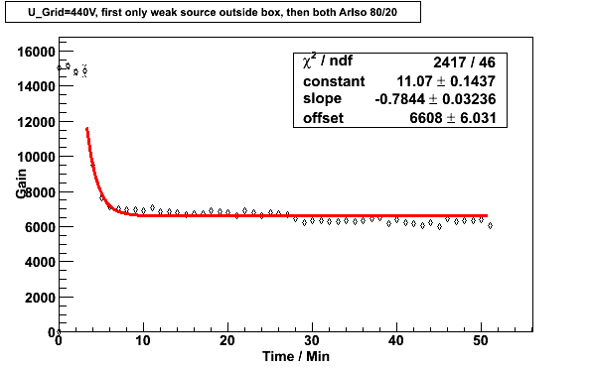
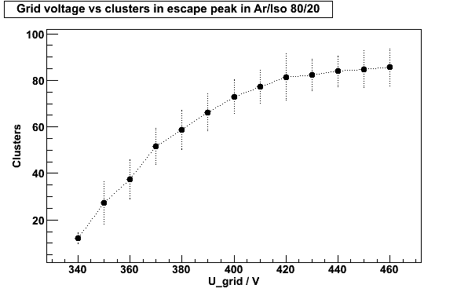
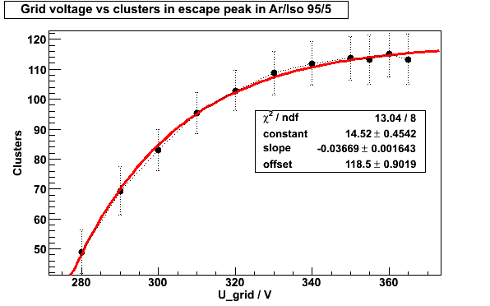
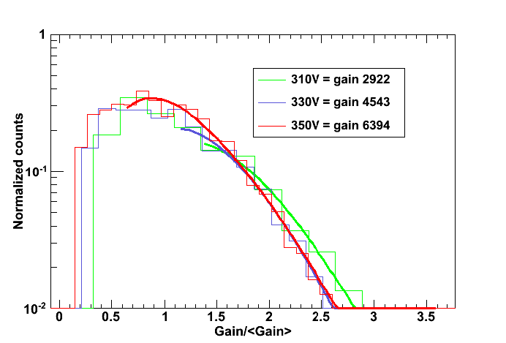
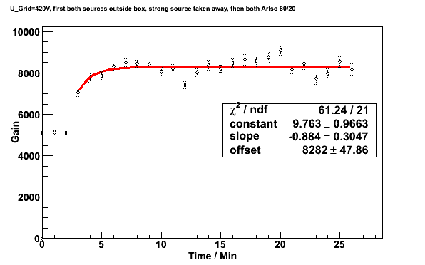
Measurements of gas properties
M. Lupberger, Diploma thesis, 2010

Slide 16
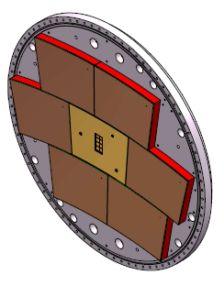
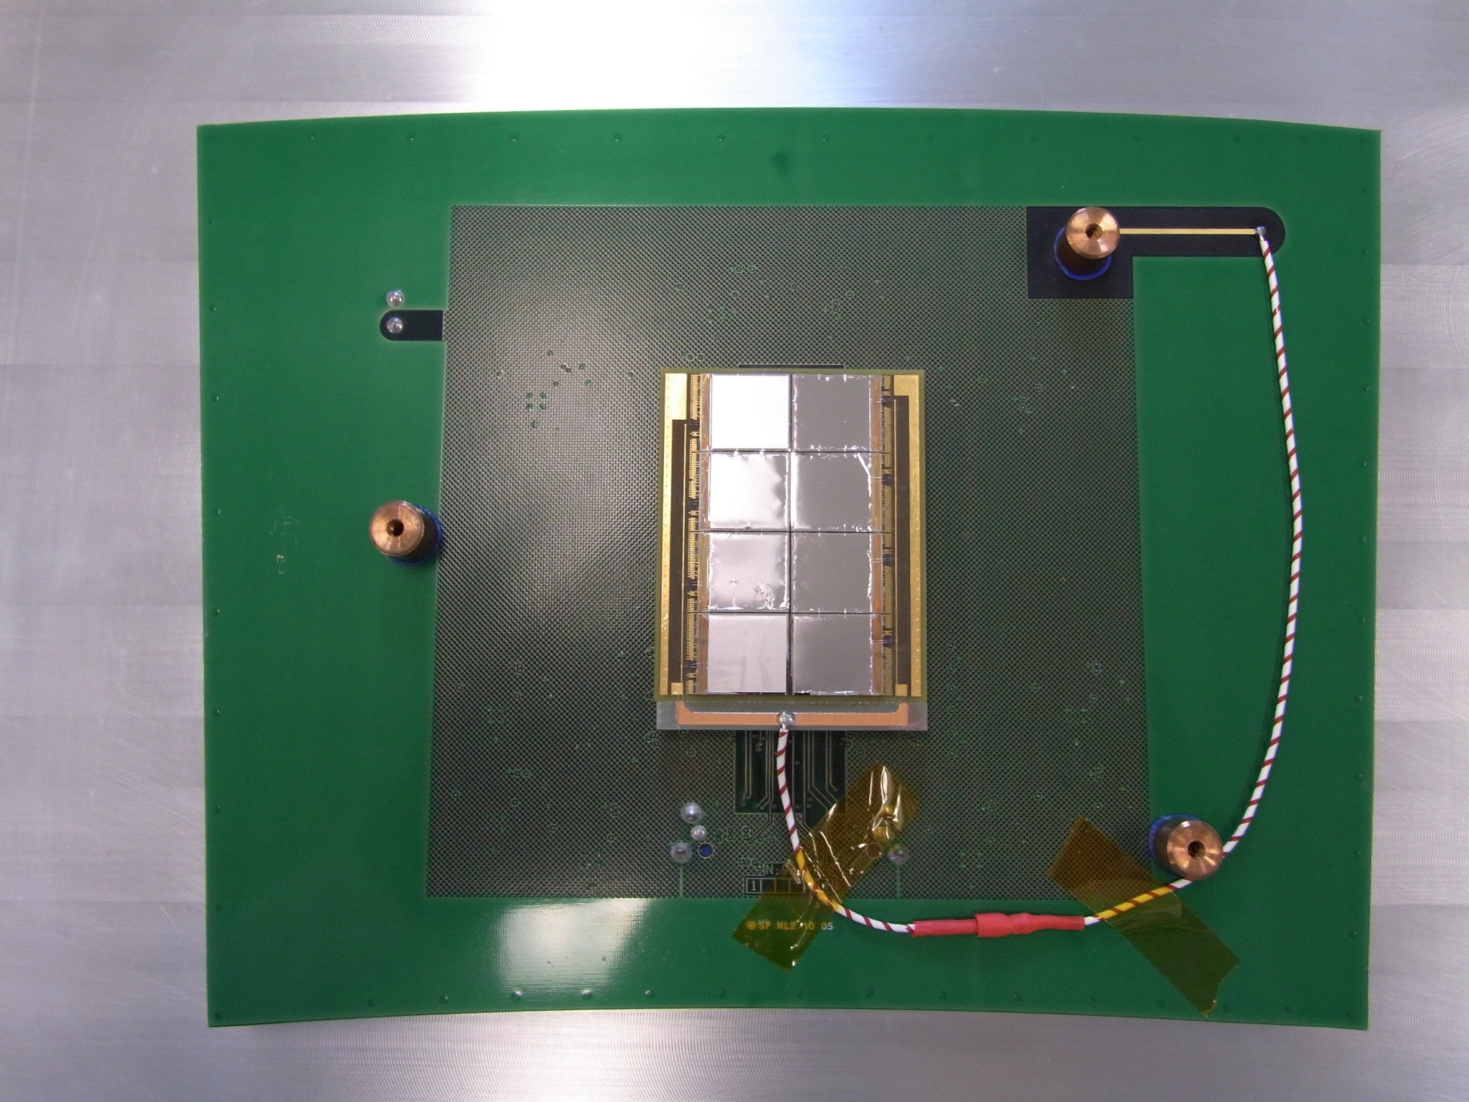
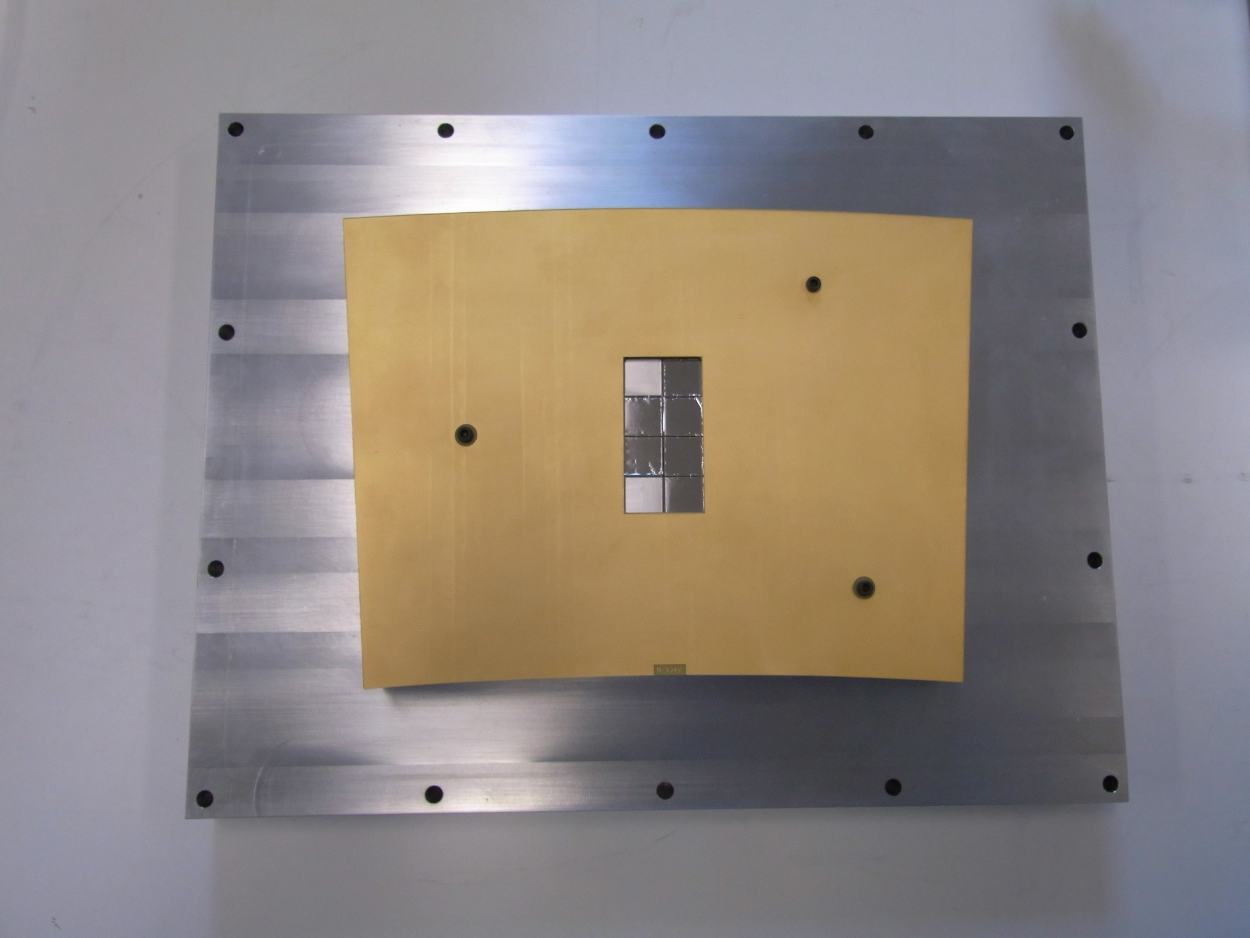
The ‘Octopuce’
Chips on a mezzanine board making wire bonding easier
Large Prototype compatible
Heat dissipator
Guard ring
Mother board
Mezzanine board
Timepix pane for Large Prototype TPC

Slide 17

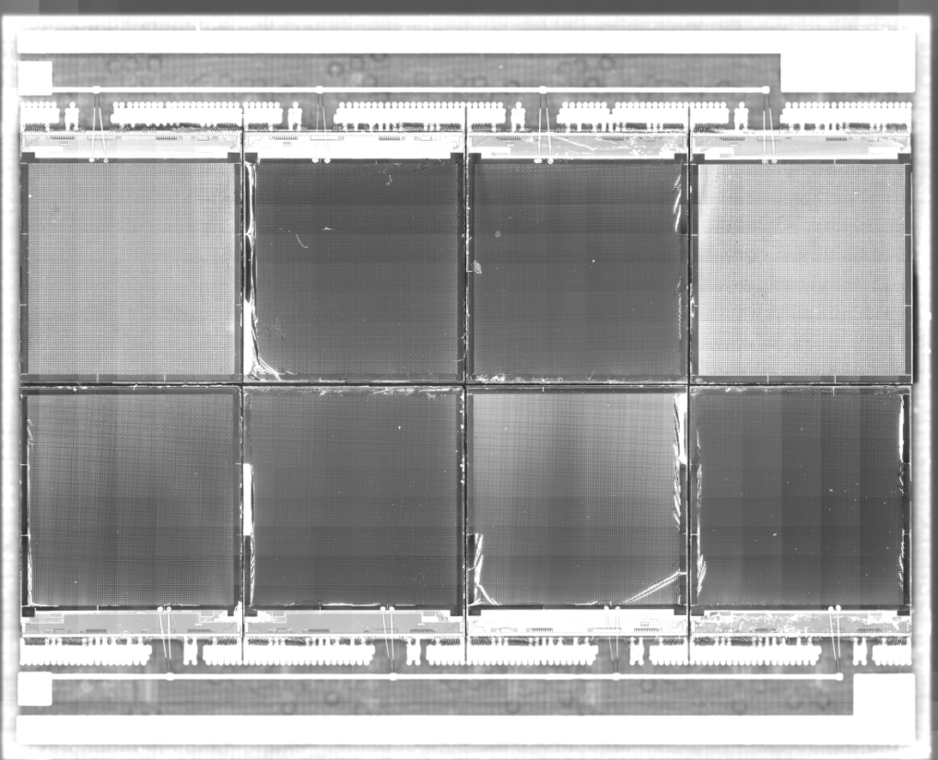
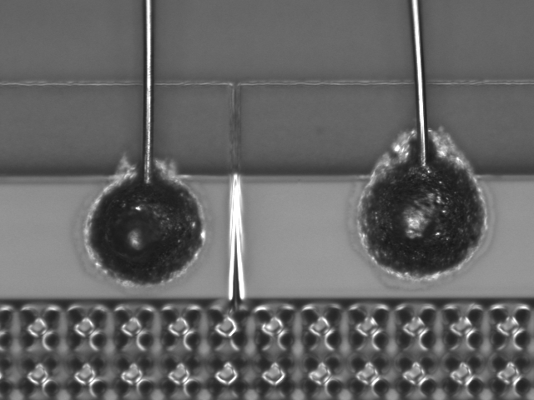
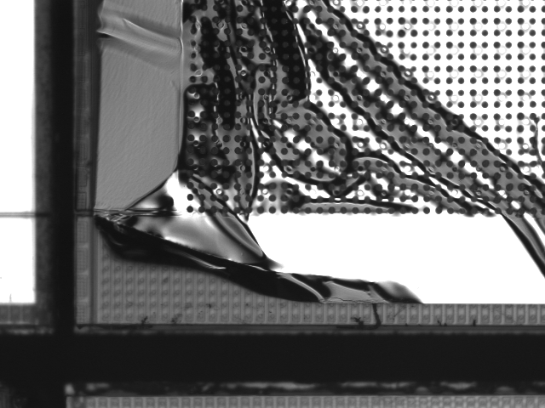
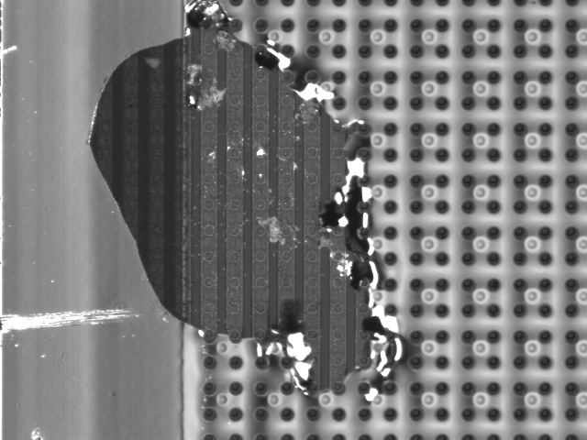
The ‘Octopuce’

Slide 18
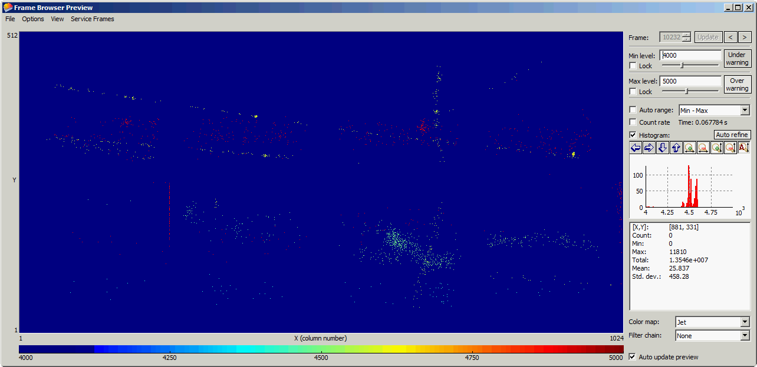
Octopuce in the Large prototype TPC at 0T
He/Iso 80/20
V_{mesh} = 380V
Time mode
Shutter Time: 100 us, start given by beam trigger

Slide 19
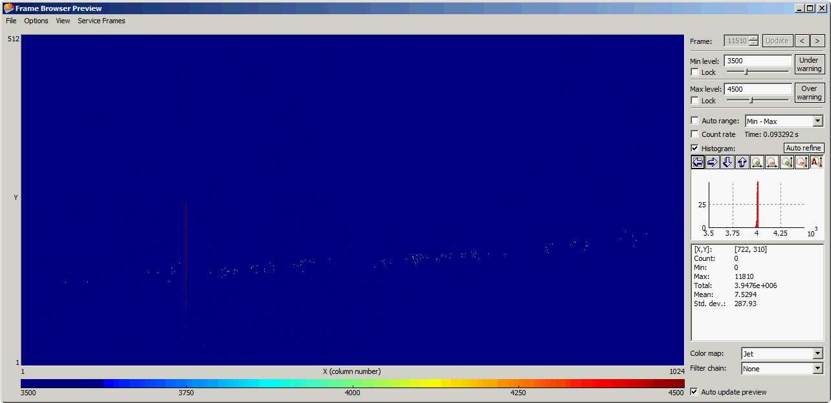
Octopuce in the Large prototype TPC at 1T
He/Iso 80/20
V_{mesh} = 380V
Time mode
Shutter Time: 100 us, start given by beam trigger

Slide 20
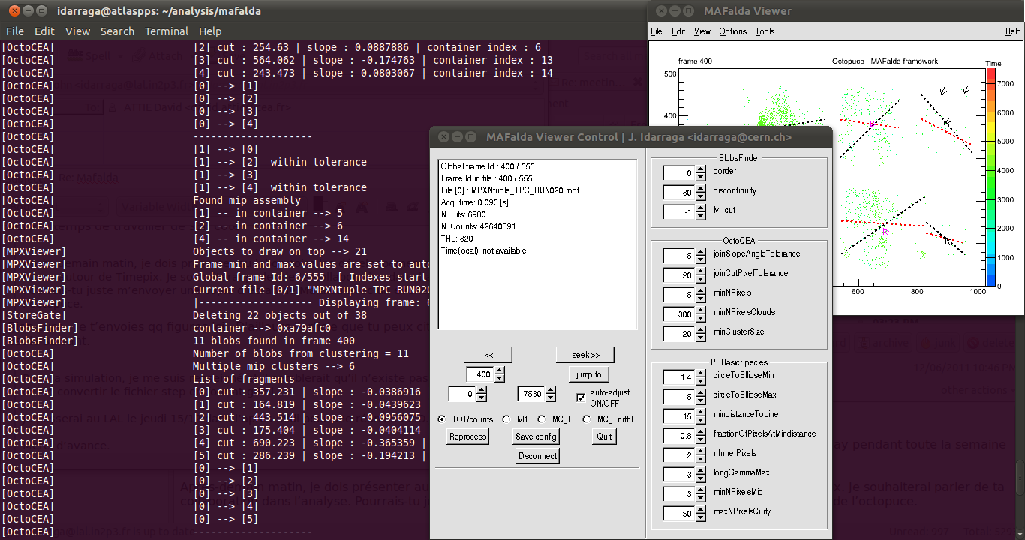
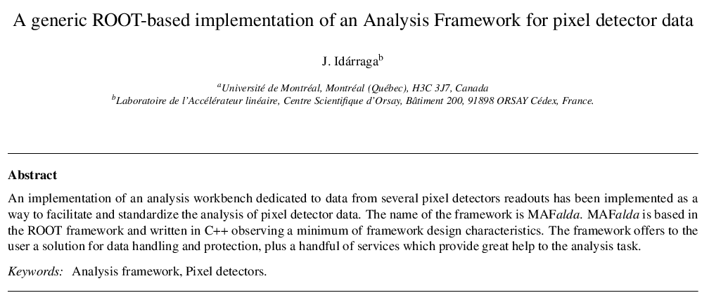
MAFalda: Medipix Analysis Framework
ROOT based analysis package developed by John Idarraga (LAL)
C++ classes including processors:
  OctoCEA (define in a few minutes)
  Pattern recognition of tracks for low energy threshold

Slide 21
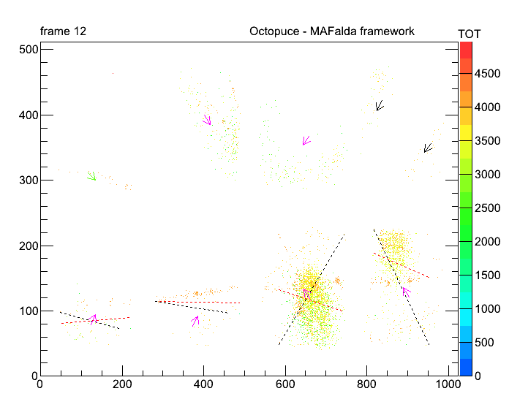
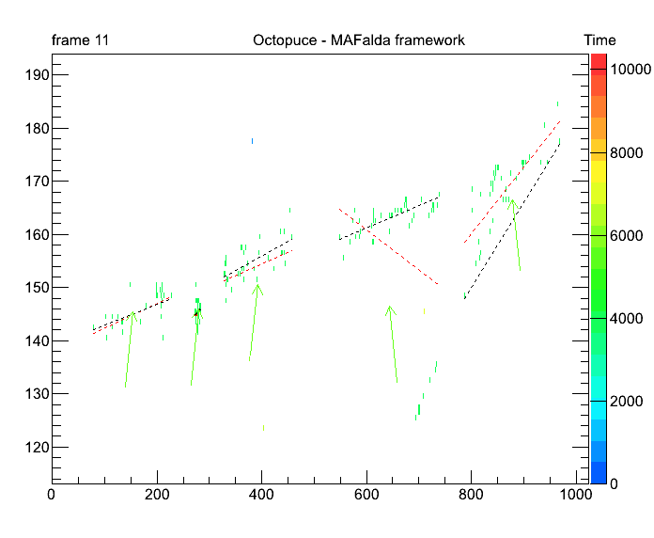
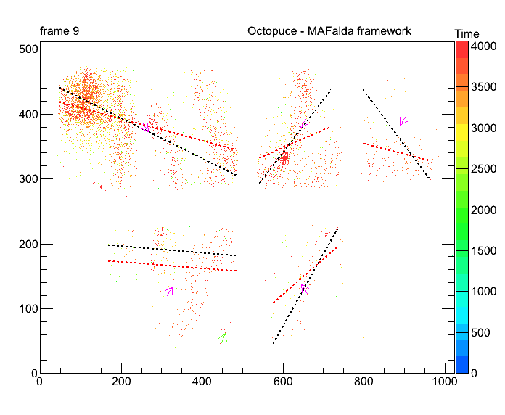
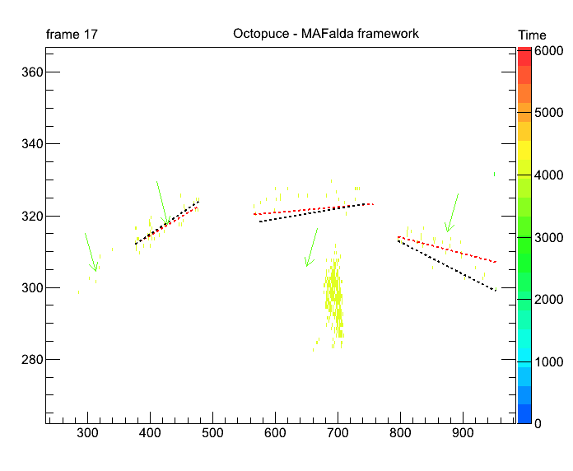
MAFalda: first try
Thanks to John Idarraga

Slide 22
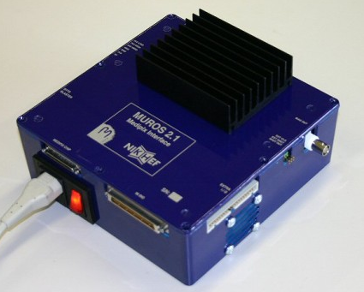
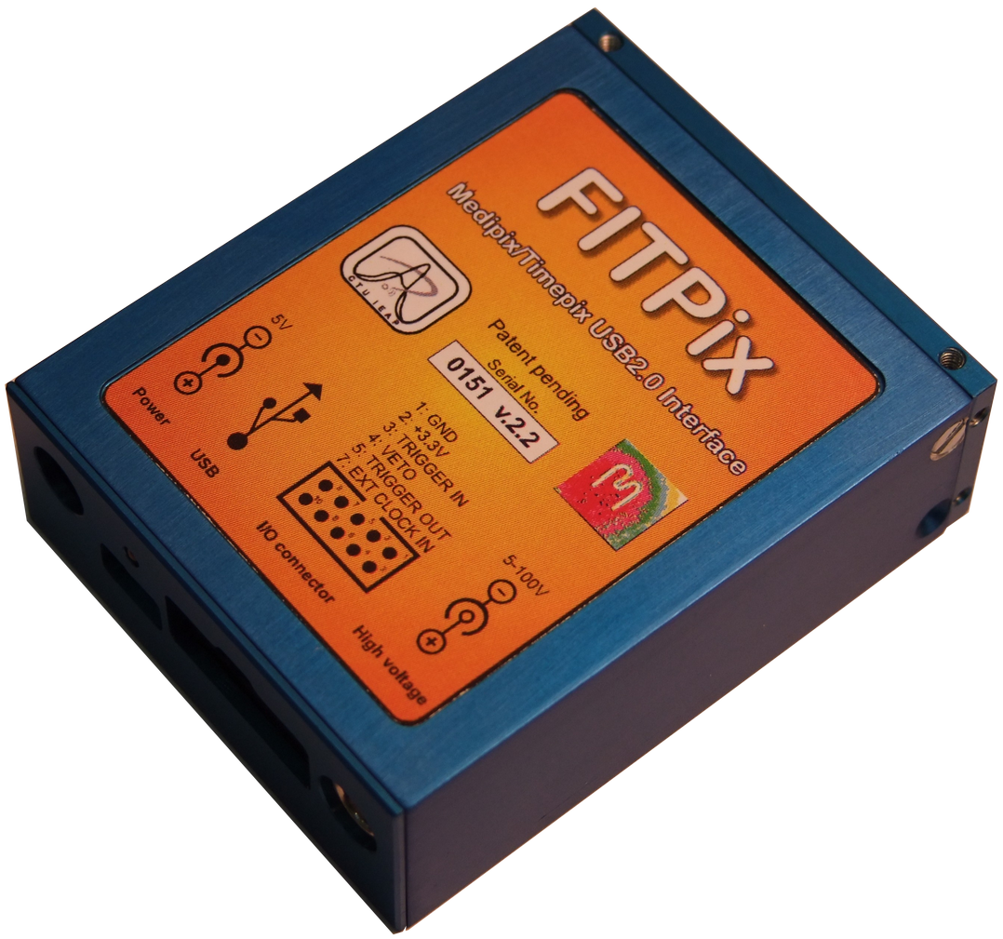
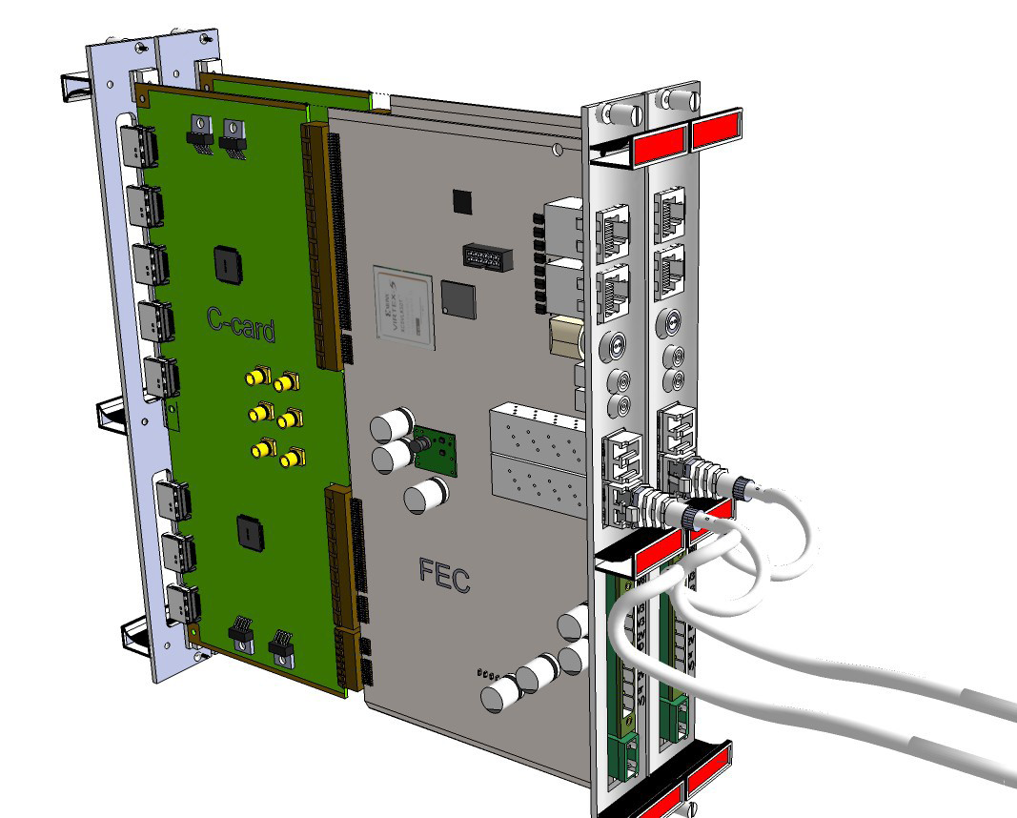
Readout interface for Medipix/Timepix
Interface | Lab | Description | Status
MUROS | Nikhef | The first interface, NI card needed, 8 chips max | No longer supported
USB V1.1 | IEAP (CZ) | First version distributed to Medipix2 users. Supports all versions of Medipix2. TimePix support is just partial. | Available
USB V1.2 |  | Slightly improved version: Power voltage recovery implemented. | Abandoned
USB V1.22 |  | Currently distributed version. Full support of TimePix with selectable clock frequency (10, 20, 40 and 80 MHz), spectroscopic module integrated. | Available
USB Lite Ver. 1.3 |  | Very compact size of 60 x 15 mm.. The interface (ver. 1.2) and Medipix2 (MXR) chip share the same PCB. | First batch being manufactured
USB RUIN Ver. 2.0 |  | DSP driven. Equipped with 128 MB memory DDR2, USB2.0 interface and 1 Gbps Ethernet adapter. Supports all chips and communication modes (serial and parallel) at highest frequencies supported by chip itself. Prototype is fully tested. | Preparation phase
USB FITPix Ver. 1.0 |  | FPGA driven, USB2.0 interface. Supports all chips (Medipix2, Timepix, Medipix3). Uses serial interface allowing 90 frames per second (for single chip). | Available
FPGA based | Bonn Univ. | FPGA based on Virtex 5 → 6, must be adaptable to SRS | In progress
USB

Slide 23



Status of the production in IZM (Bonn)
First InGrid produced in August 2011 after one year:
- wire bonding pads covered with SiNi film
- InGrid peel-off at edges (due to unfortunate last
correction treatment…..!)

Slide 24
Timepix3 scope
Several groups in the Medipix3 collaboration have shown interested in a new version of the Timepix → Timepix3 ( ≡Timepix v2)
Large range of applications (HEP and non-HEP):
  X-ray radiography, X-ray polarimetry, low energy electron microscopy
  Radiation and beam monitors, dosimetry
  3D gas detectors, neutrons, fission products
  Gas detector, Compton camera, gamma polarization camera, fast neutron camera, ion/MIP telescope, nuclear fission, astrophysics
  Imaging in neutron activation analysis, gamma polarization imaging based on Compton effect
  Neutrino physics
Reuse many building blocks from Medipix3 chip (2009)
Main Linear Collider application: pixelized TPC readout
Timepix3 is an approved project by the Medipix3 collaboration with an assigned budget (2-engineering runs)
Design groups: NIKHEF, BONN, CERN

Slide 25
Timepix3 Main Requirements
Matrix layout: 256x256 pixels (Pixel size 55x55 µm)
Time stamp and TOT recorded simultaneously
  8-10 bit Energy Measurement (TOT)
    Standard Resolution 25ns (@40MHz)
    Energy Dynamic range from 6.4 µs to 25.6 µs (@40MHz)
  10-12 bits Slow time-stamp
    Resolution 25ns (@40MHz)
    Dynamic range 25.6 µs (10 bit) to 102.4 µs (12 bit)
  4 bits Fast time-stamp
    resolution ~1.5ns (if using on-pixel oscillator running at 640MHz)
    Dynamic range 25ns
Sparse Readout
Technology choice: IBM 130nm DM 3-2-3 or 4-1

Slide 26

The Timepix3 chip
110 µm
Readout Chip | TIMEPIX3 (beginning of 2012)
Pixel size | 55 x 55 µm²
Pixel arrangement | 256 x 256 (2x4 superpixels)
Sparse readout | YES
PC, TOA or TOT recorded simultaneously | YES (2 at a time) ~40 bit/Hit
Minimum threshold | > 500 e- (1.8keV)
TOA resolution | > 1.5ns
Peaking time | < 25 ns
TOT resolution | < 5% channel to channel spread
Technology | IBM 130nm DM 3-2-3
Power consumption ON | <700 mW (~20 μW/pixel) @1.2 V
Power consumption OFF | <10 mW (*)
Target floorplan | 3 sides buttable and minimum periphery
TSVs possibility | YES. Multi-dicing scheme as Medipix3
Count Rate | ~0.2 x 10⁶ x-rays/mm²/s
This chip will be
220 µm

Slide 27


R&D on chip protection
Bulk on ceramic (300 µm) → Piggyback
First test in Argon/Iso 5%
No signal observed on TimePix chip

Slide 28

Micromegas using induction signal
TOP
150
Pad mirrored through a resistor to ground
Has to be tested with specific electronic
⁵⁵Fe spectrum read out on the mesh
in Ar/Iso 5% using plain anode to ground
25
Mesh+photoresist
Top pad
0,5 mm
C-Loaded Kapton 25 µm
150
1 mm
Ø4.2
Kapton 25 µm
60
2 mm
15
15
60
25
SIDE
BOTTOM
150
380 V
400 V
150
Ø4.2
420 V
440 V
450 V
15
E. Delagnes, R. De Oliveira, D. Attié

Slide 29
Conclusions and perpectives
InGrid+Timepix chip is no more in the competition for the readout of the LC-TPC, (large area, production, …)
Excellent candidate for X-ray polarimetry
Nevertheless, it is an excellent tool for gas properties characterization
Need to find new way to build InGrid (LAAS), cheaper and more robust (ceramic, etc.)
Unfortunately, this R&D activity is surviving depending of time and money

Slide 30





The TimePix collaboration
NIKHEF H. van der Graaf
J. Timmermans
J. Visschers
Saclay CEA/DAPNIA D. Attié
        A. Chaus
P. Colas
M. Riallot
M. Titov
Univ. Twente/Mesa+ J. Schmitz
Univ. Bonn
K. Desch
J. Kaminski
CERN E. Heijne
X. Llopart
Medipix Consortium
β⁻ from ⁹⁰Sr source in He/Isobutane 80:20

Slide 31


