Slide 1
Status of the R&D in
micropixel detectors
at Irfu
D. Attié, A. Chaus, P. Colas, X. Coppolani,
E. Delagnes, M. Riallot, M. Titov
Saclay, January 5th, 2012
Notes:
I’m here to present a TPC review

Slide 2
Outline
Timepix: a readout chip designed for gaseous detectors
Historical overview of this activity
Applications using single electron efficiency:
  single chip:
    polarimetry
    study of gas properties
  ‘Octopuce’:
    tracking tools
    data analysis framework
InGrid production: status and plans
R&D relating to chip protection
Conclusions and perspectives

Slide 3
The historical overview
2006 | EUDET contribution for Timepix wafers + postdoc
2006-2007 | Demonstrator: µTPC Micromegas Ingrid produced on naked wafer or only for Nikhef
2008 | Demonstrator for x-rays polarimetry; SiProt for protection
2007-2009 | Ion feedback measurement using raw Ingrids (M. Chefdeville)
2009 | First prototype of 8 Timepix chips board
2009-2010 | First Ingrids in Saclay (~12) gas properties measurements using single chip Octopuce board
End 2010 | ‘Octopuce’ data taking in 5 GeV electron beam at Desy
2006-2008 | Postdoc EUDET
2009-2010 | Master student (9 months): M. Lupeberger
2010 | ANR 3DLAMI Irfu/LAL rejected
2011 | P2IO proposal submitted
2012 | Participation in ANR ‘jeune’ for DM physics (CAST)?
2011-2014 | PhD student: A. Chaus

Slide 4
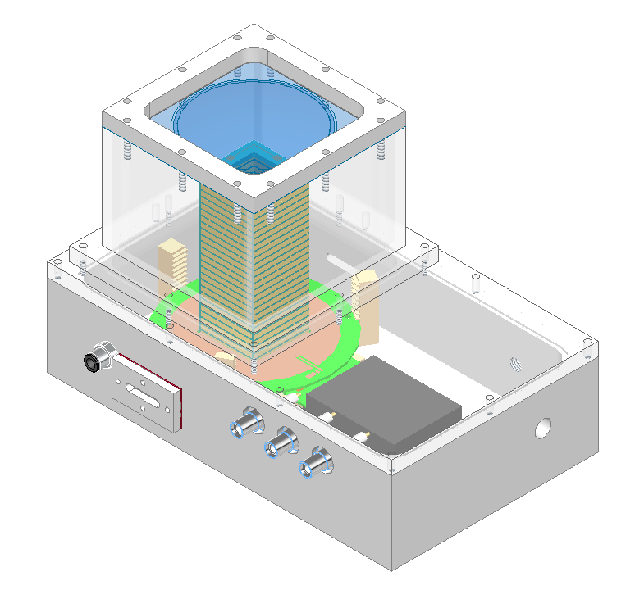
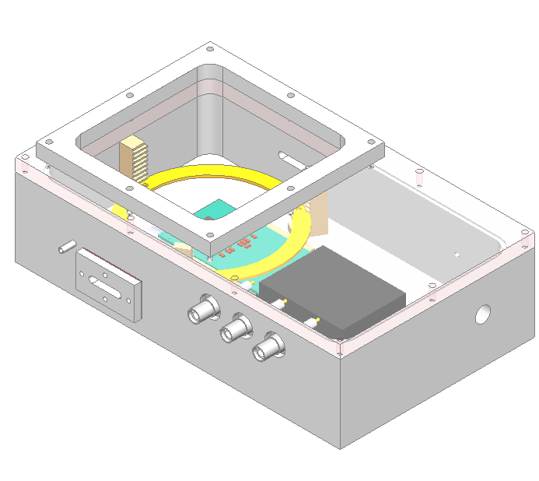
TimePix box
Two specific boxes have been built
Size : 25 cm × 10 cm × 5 cm
Use many times to test bulk, µbulk, etc.

Slide 5
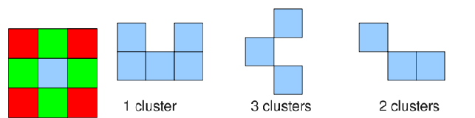
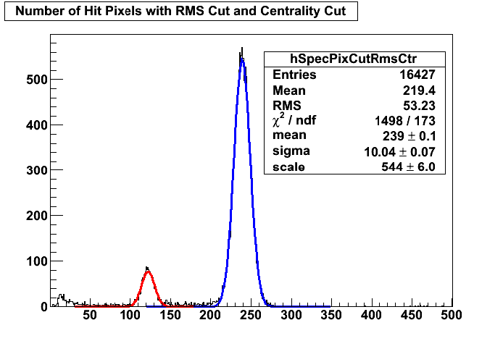
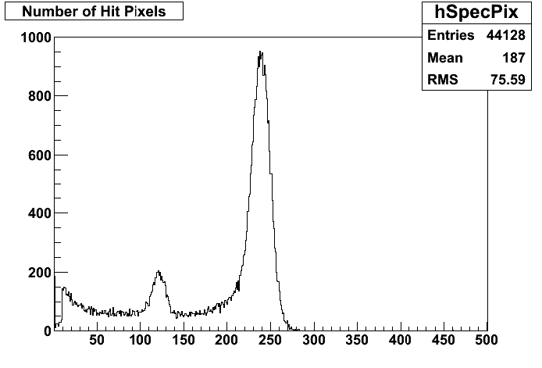
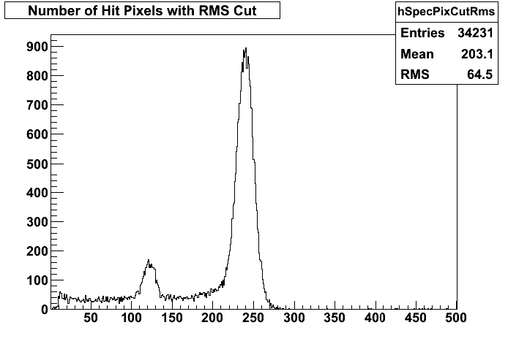
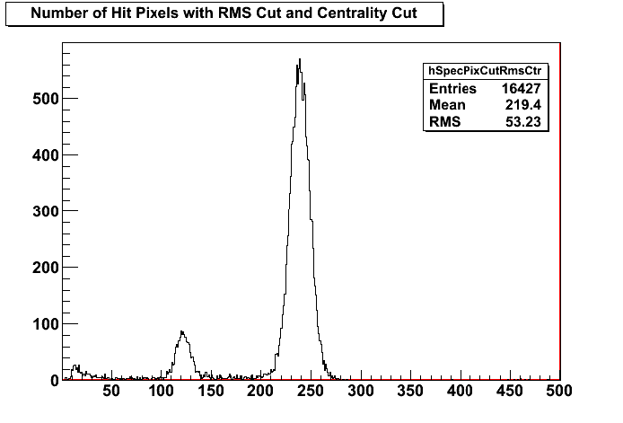
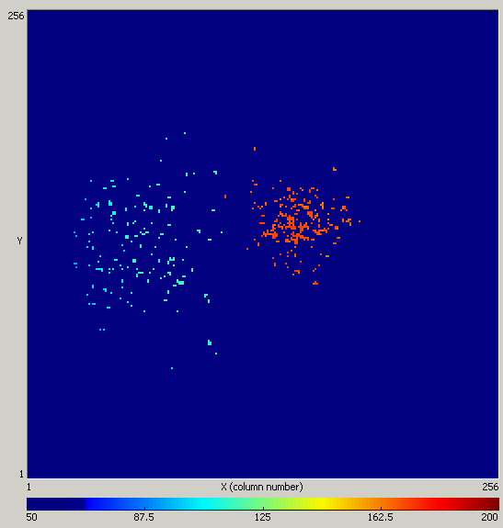
InGrid: Measurements of primary statistics in gases
Diffusion σ_{t} should be big enough to separate e-: cluster[1]=83.8% ; cluster[2]= 11.4%
Study of primary electrons and Fano factor F using σ_{RMS}
Gain fluctuation of avalanche statistics accessible
TimePix+Ingrid+15 μm SiProt in Argon + 5% Isobutane
Kβ-filtered spectrum with Cr foil
σ_{FWHM} = 10 %

Slide 6
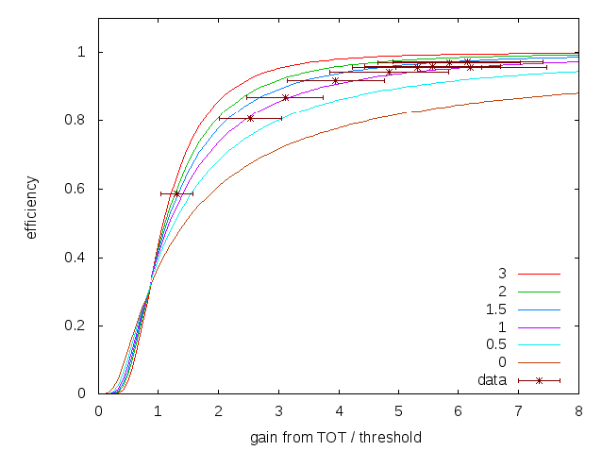
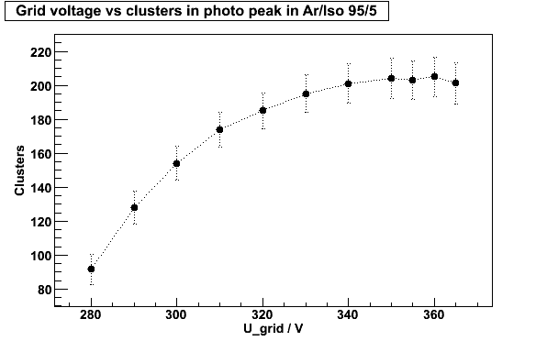
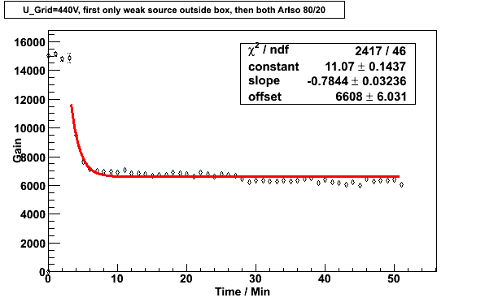
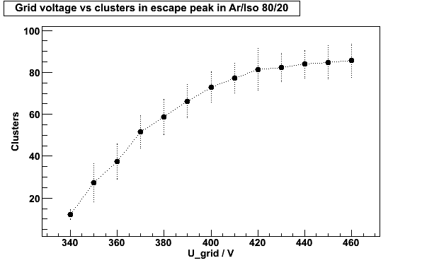
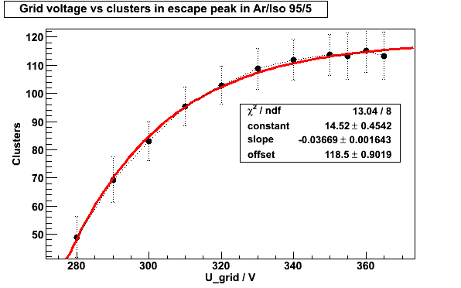
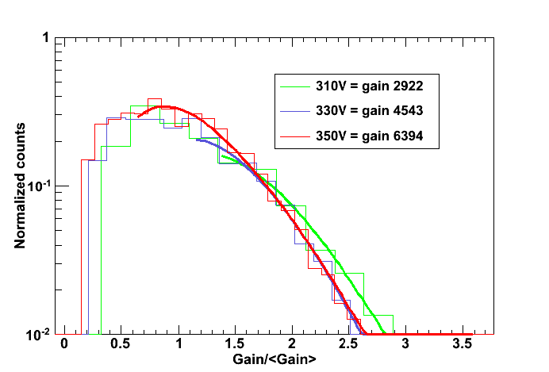
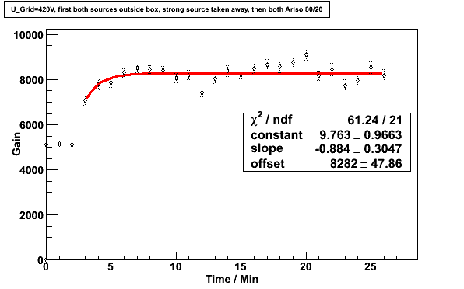
Measurements of gas properties
M. Lupberger, Diploma thesis, 2010

Slide 7
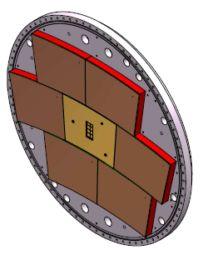
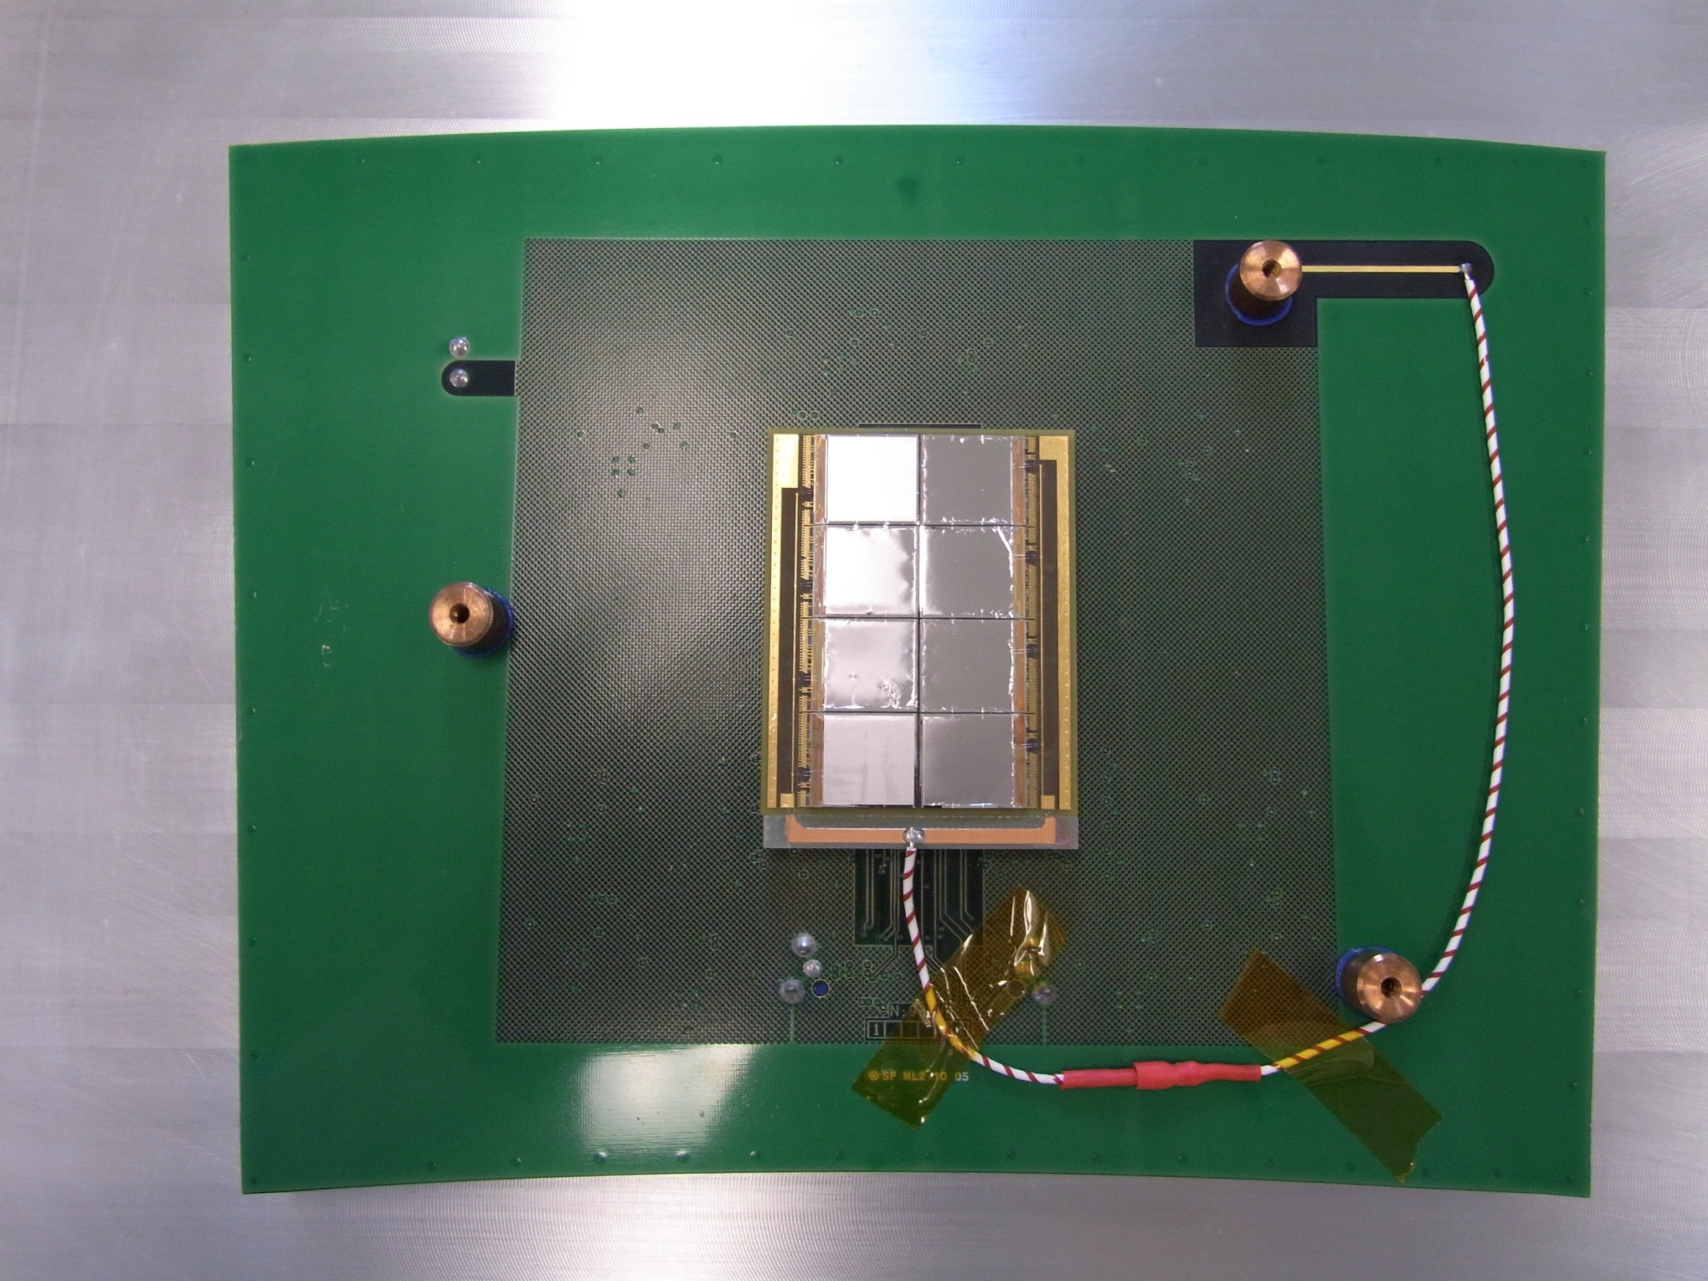
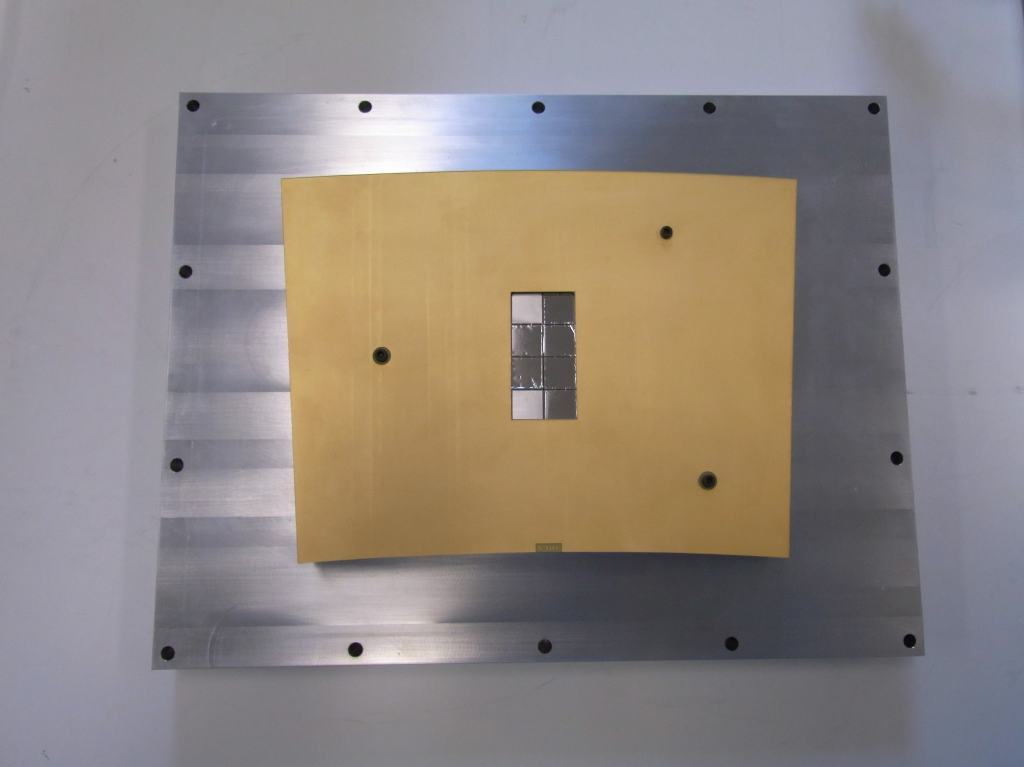
The ‘Octopuce’
Chips on a mezzanine board making wire bonding easier
Large Prototype compatible
Heat dissipator
Guard ring
Mother board
Mezzanine board
Timepix pane for Large Prototype TPC

Slide 8

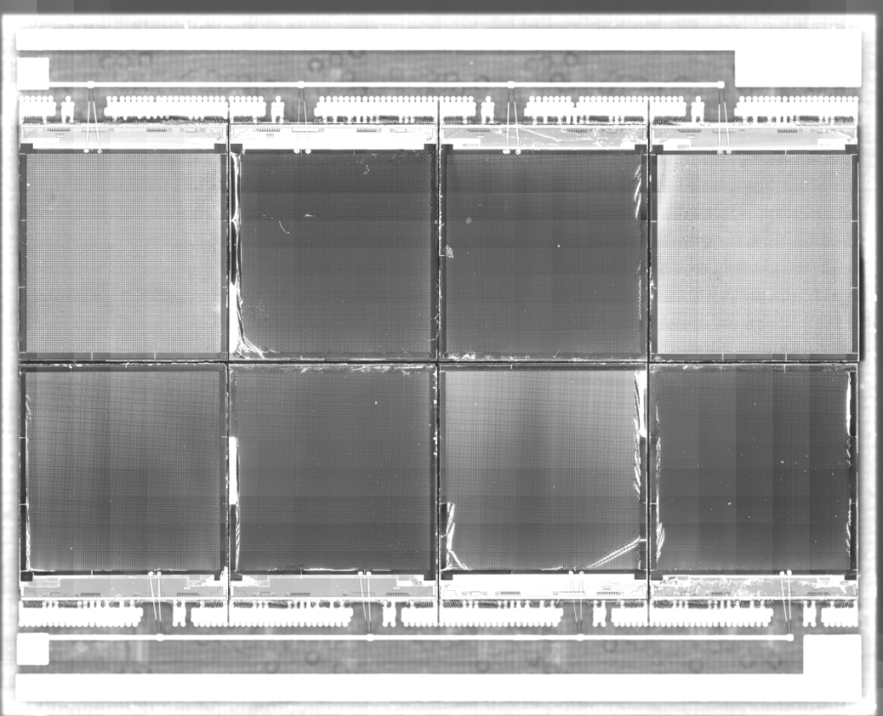
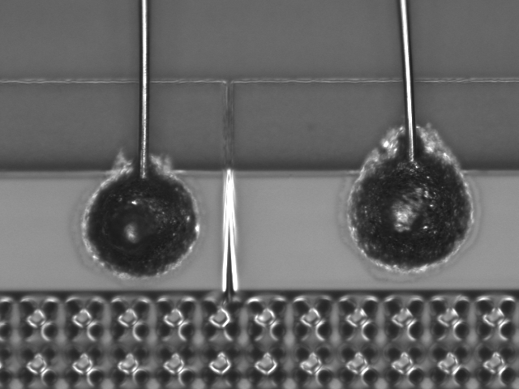
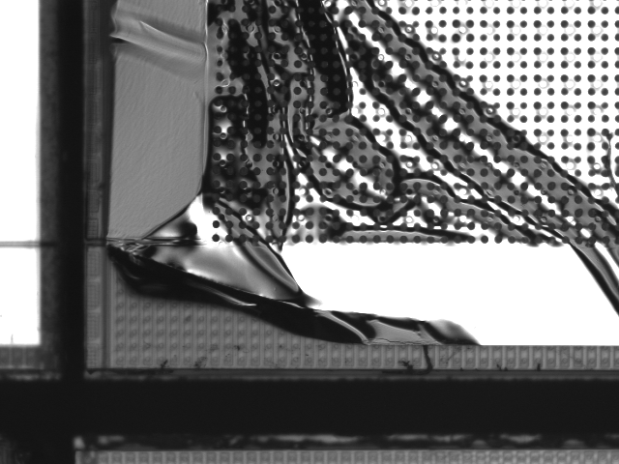
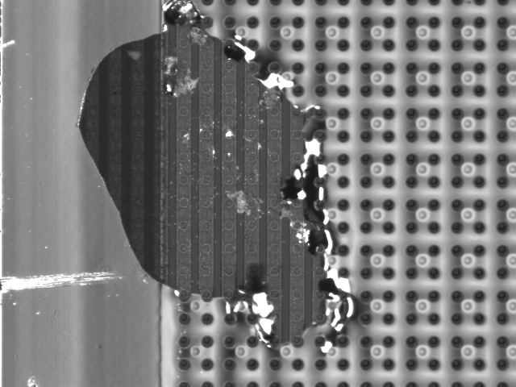
The ‘Octopuce’

Slide 9
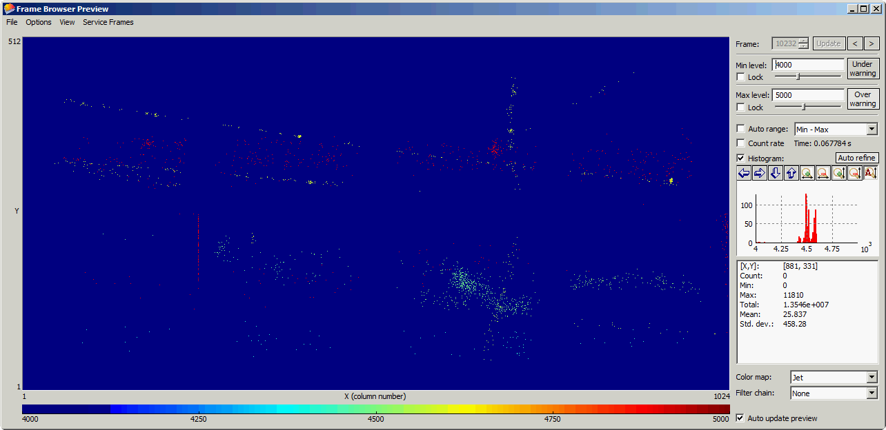
Octopuce in the Large prototype TPC at 0T
He/Iso 80/20
V_{mesh} = 380V
Time mode
Shutter Time: 100 us, start given by beam trigger

Slide 10
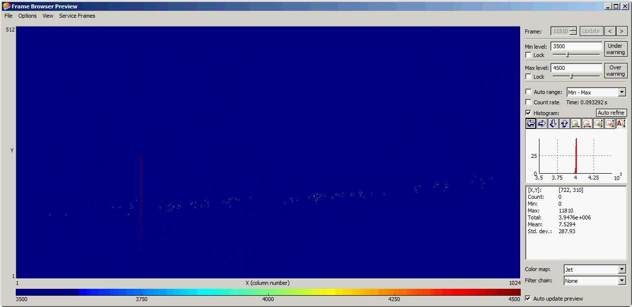
Octopuce in the Large prototype TPC at 1T
He/Iso 80/20
V_{mesh} = 380V
Time mode
Shutter Time: 100 us, start given by beam trigger

Slide 11
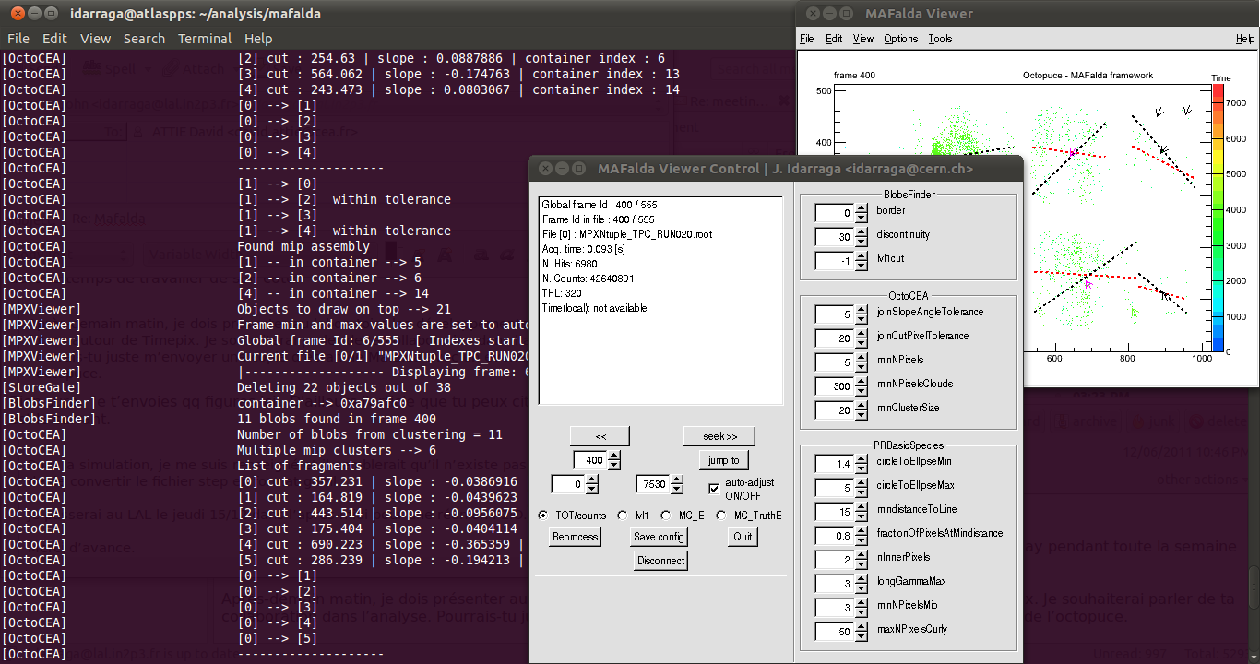
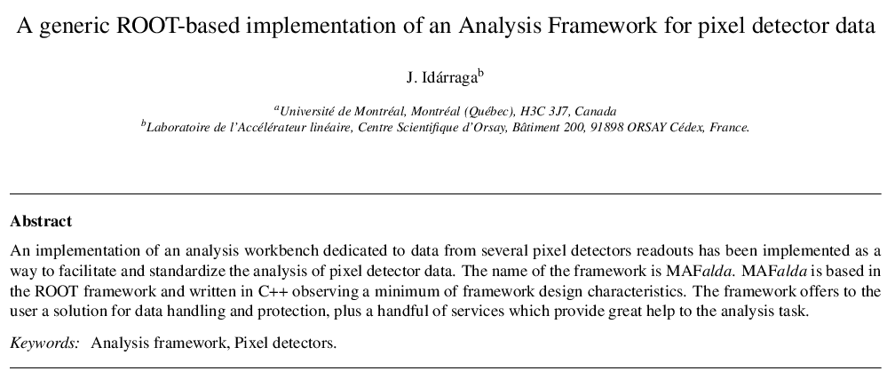
MAFalda: Medipix Analysis Framework
ROOT based analysis package developed by John Idarraga (LAL)
C++ classes including processors:
  OctoCEA (define in a few minutes)
  Pattern recognition of tracks for low energy threshold

Slide 12
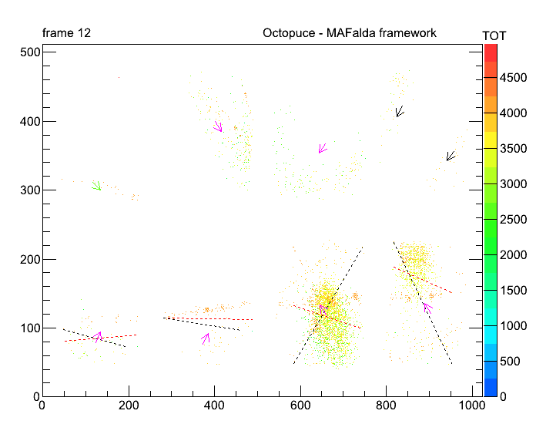
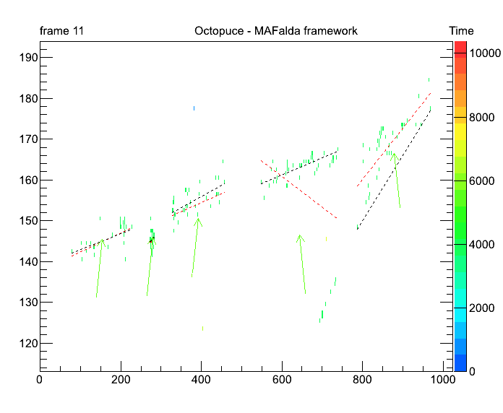
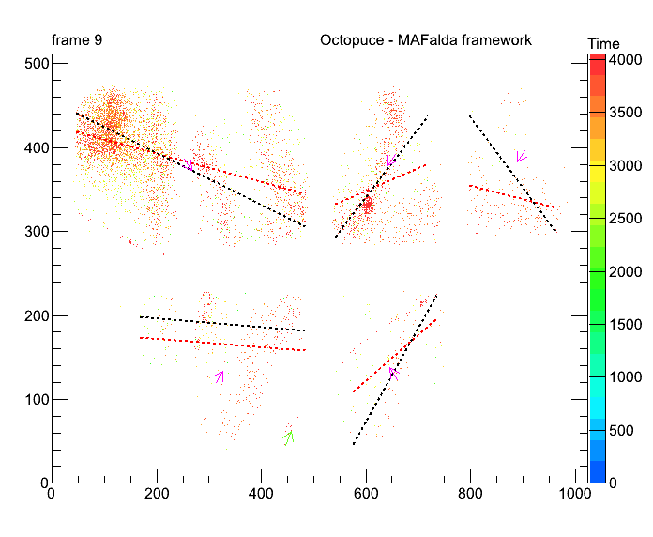
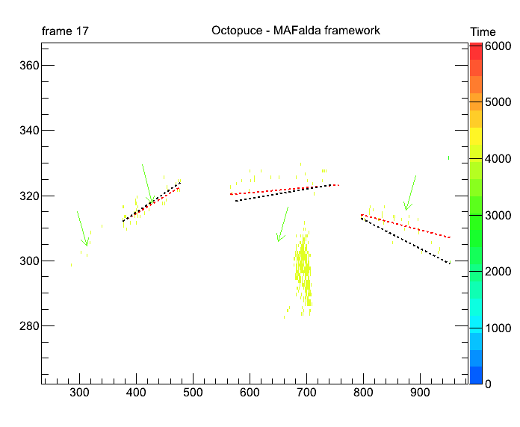
MAFalda: first try
Thanks to John Idarraga

Slide 13
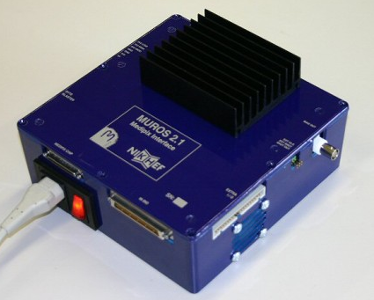
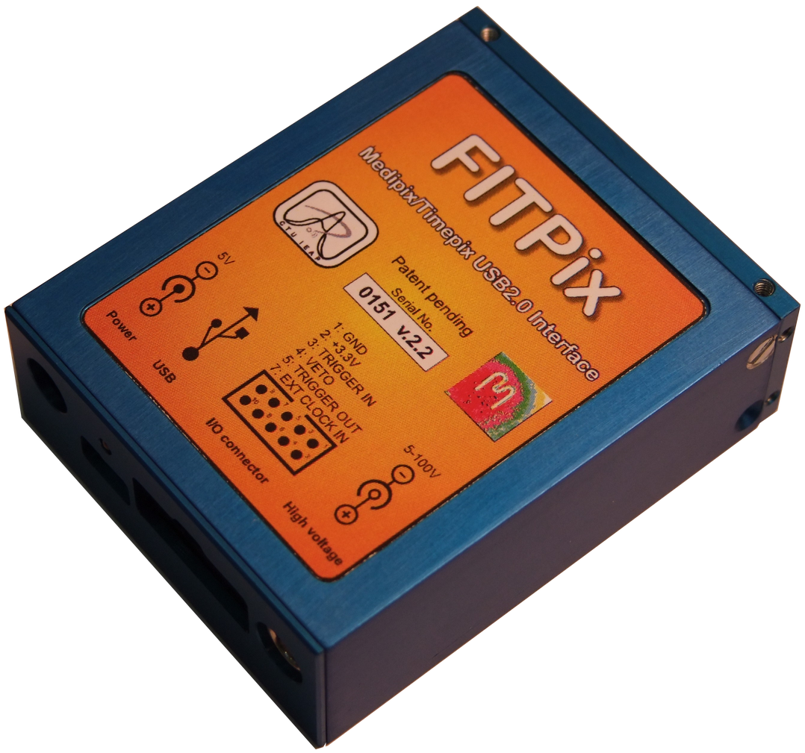
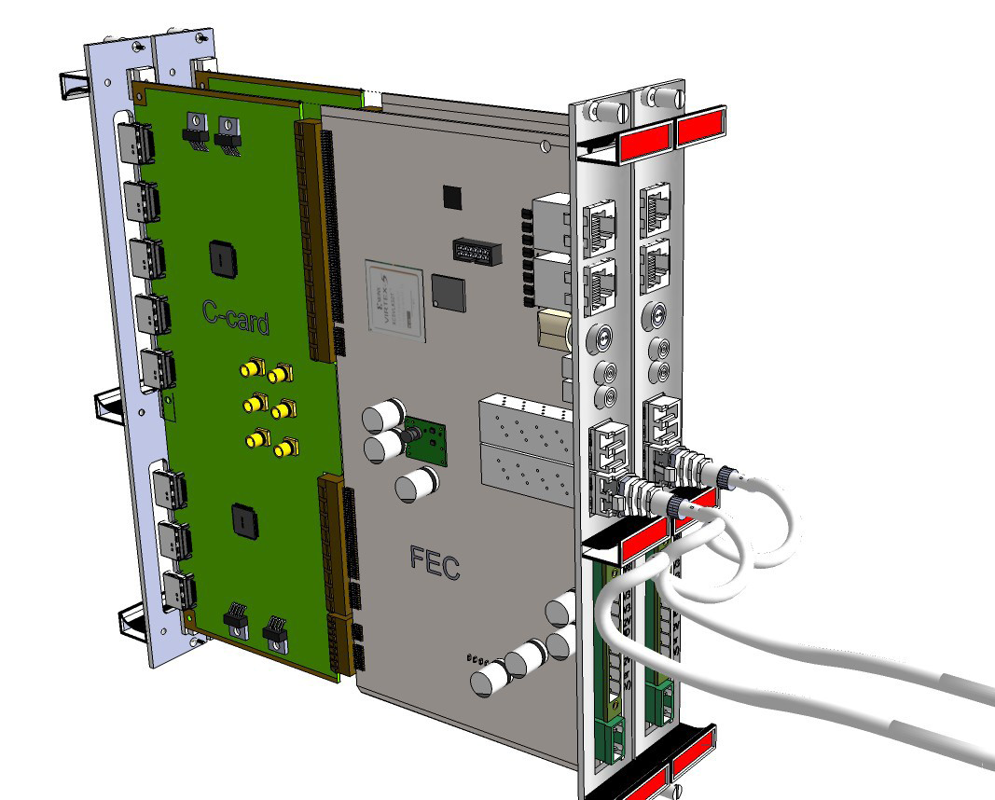
Readout interface for Medipix/Timepix
Interface | Lab | Description | Status
MUROS | Nikhef | The first interface, NI card needed, 8 chips max | No longer supported
USB V1.1 | IEAP (CZ) | First version distributed to Medipix2 users. Supports all versions of Medipix2. TimePix support is just partial. | Available
USB V1.2 |  | Slightly improved version: Power voltage recovery implemented. | Abandoned
USB V1.22 |  | Currently distributed version. Full support of TimePix with selectable clock frequency (10, 20, 40 and 80 MHz), spectroscopic module integrated. | Available
USB Lite Ver. 1.3 |  | Very compact size of 60 x 15 mm.. The interface (ver. 1.2) and Medipix2 (MXR) chip share the same PCB. | First batch being manufactured
USB RUIN Ver. 2.0 |  | DSP driven. Equipped with 128 MB memory DDR2, USB2.0 interface and 1 Gbps Ethernet adapter. Supports all chips and communication modes (serial and parallel) at highest frequencies supported by chip itself. Prototype is fully tested. | Preparation phase
USB FITPix Ver. 1.0 |  | FPGA driven, USB2.0 interface. Supports all chips (Medipix2, Timepix, Medipix3). Uses serial interface allowing 90 frames per second (for single chip). | Available
FPGA based | Bonn Univ. | FPGA based on Virtex 5 → 6, must be adaptable to SRS | In progress
USB

Slide 14
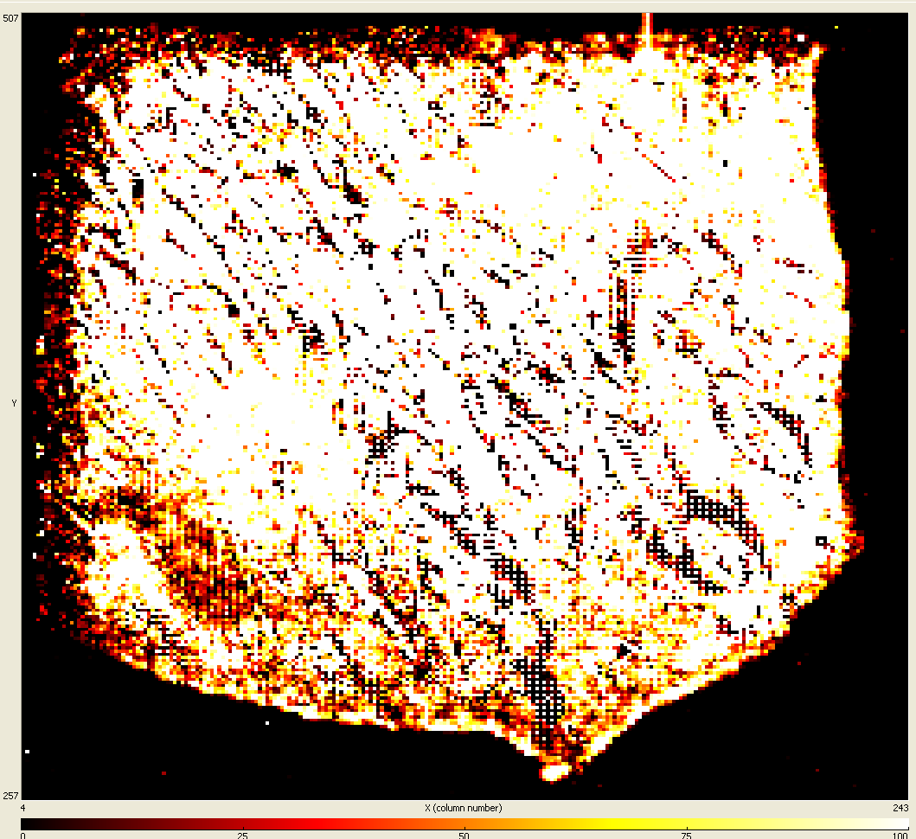
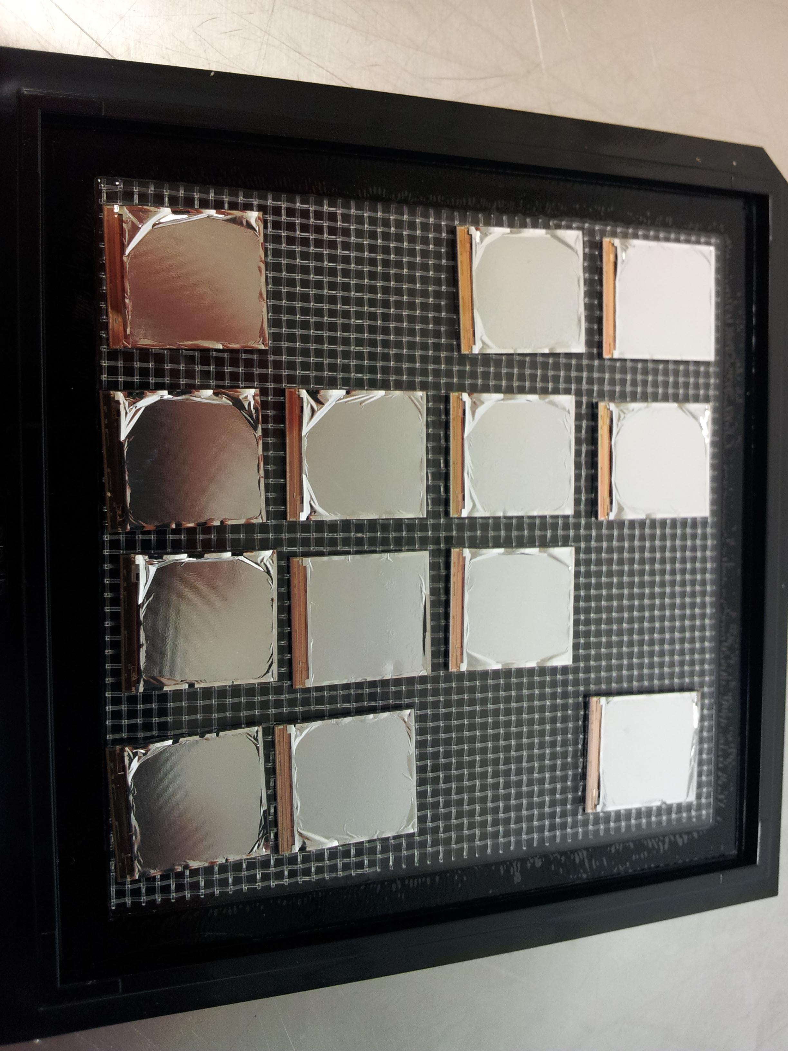
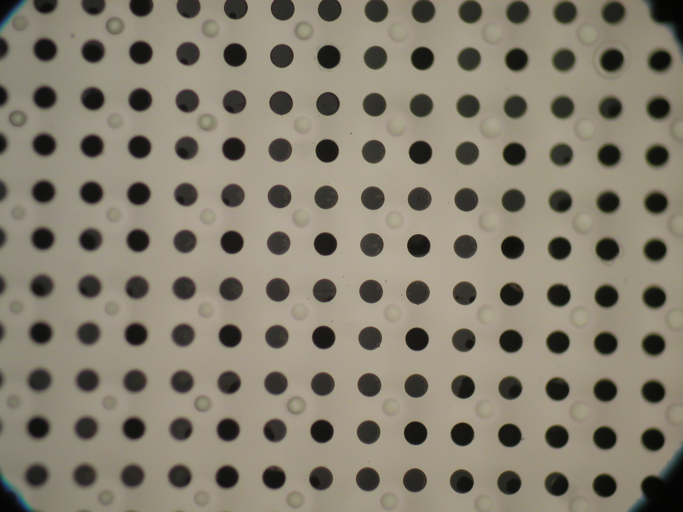
Status of the production in IZM (Bonn)
First InGrid produced in August 2011 after one year:
- wire bonding pads covered with SiNi film
- InGrid peel-off at edges (due to unfortunate last
correction treatment…..!)

Slide 15

GridPix workshop

Slide 16
Test of new GridPix detector, made by Yevgen Bilevych et al.
Nikhef, Dec 19-21, 2011
protection layer (SRN) made on 8” TPX wafer at MESA+
InGrid made on 8” TPX wafer at IZM-Fraunhofer Berlin
Gas: DME/CO2 50/50 @ atm. press.
Drift gap: 2.5 mm
HV grid: 620 - 670 V, HV cathode1160 V
No discharges, no noise. TimePix Class A. Homogeneous response. Sharp fiducial surface due to W, N & E dykes.
Gain lower than expected: precise value of avalanche gap not known.

Slide 17
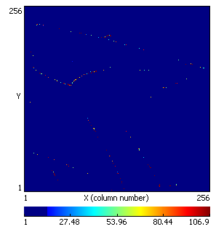
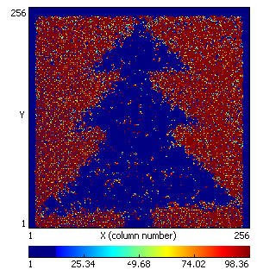
Test of new GridPix detector, made by Yevgen Bilevych et al.
TimePix in ToT mode. Irradiated with 90Sr.
GridHV = 670 V, CathHV = 1100 V
B // E = ~ 0.07 T
MIP in top section has nice δ-ray. Above middle,left: lower-momenta tracks,
Irradiated with 55Fe with Cu shadow mask. This GridPix is perfectly homogeneous, within statistics.
GridHV = 620 V

Slide 18
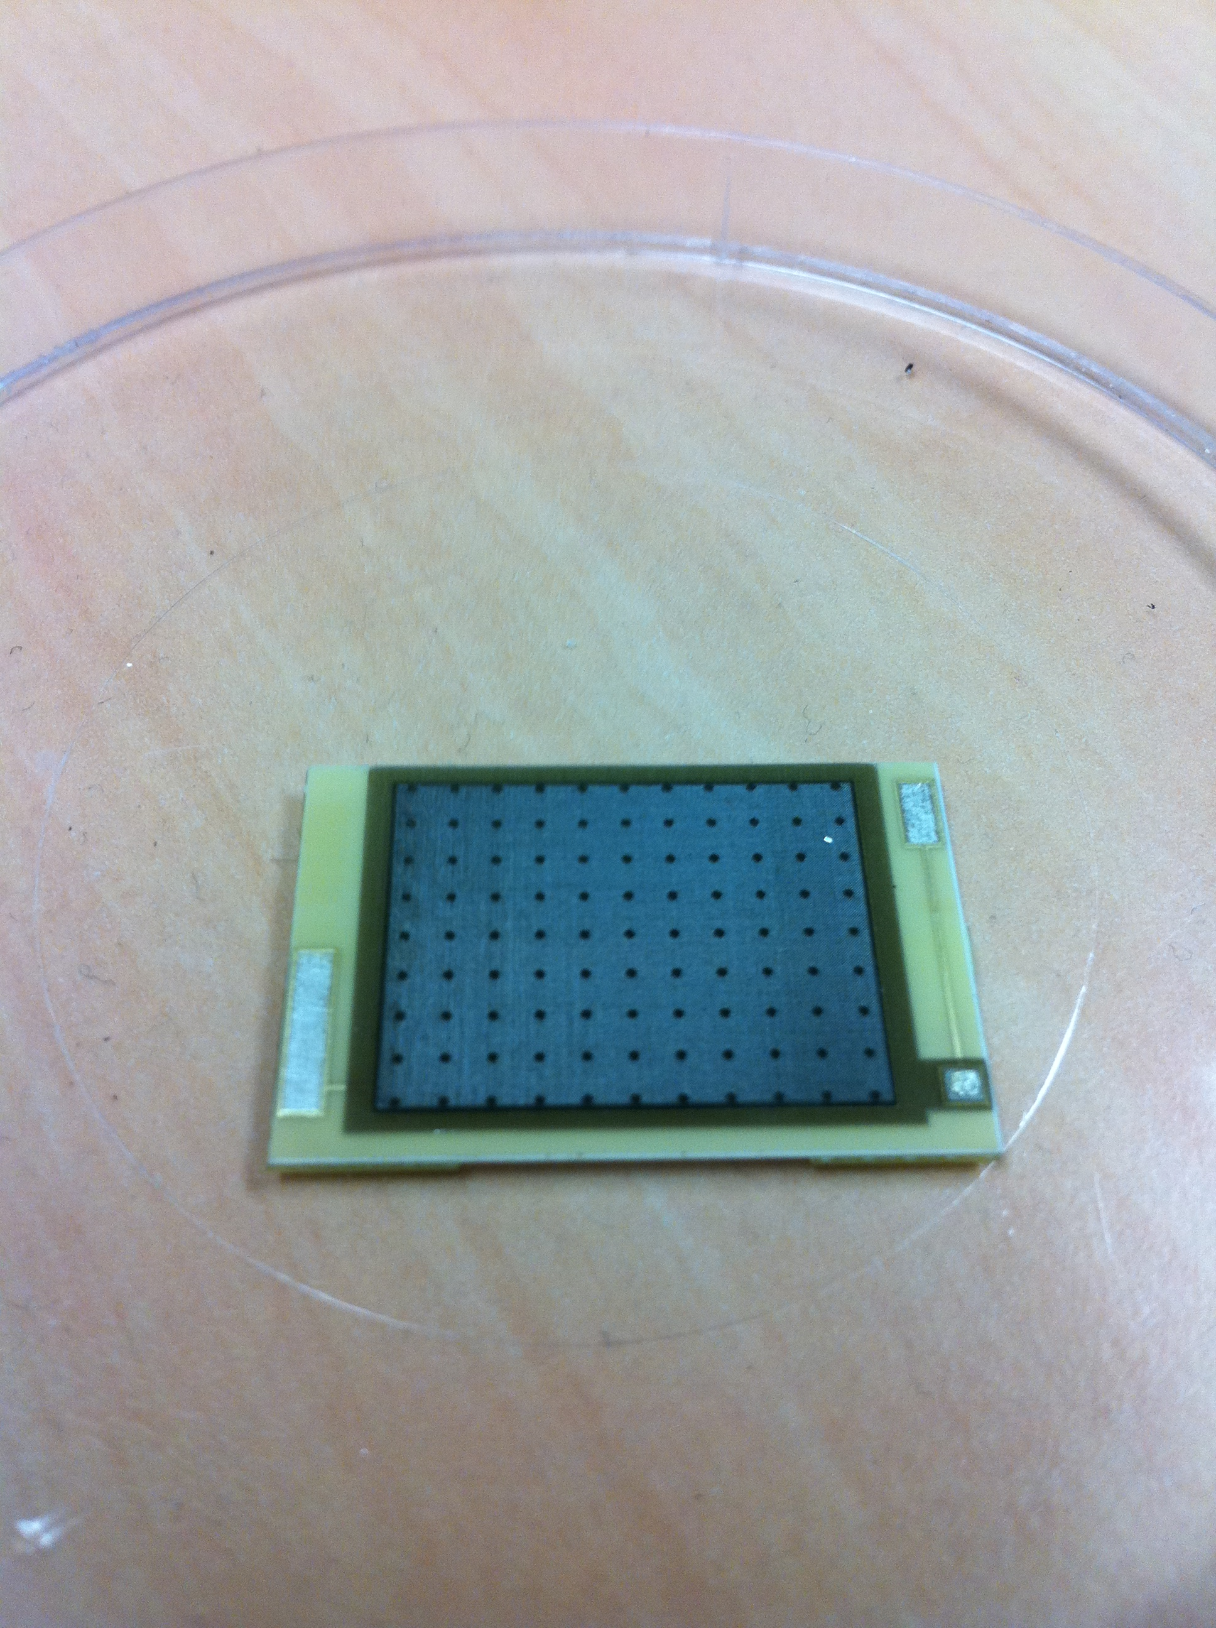
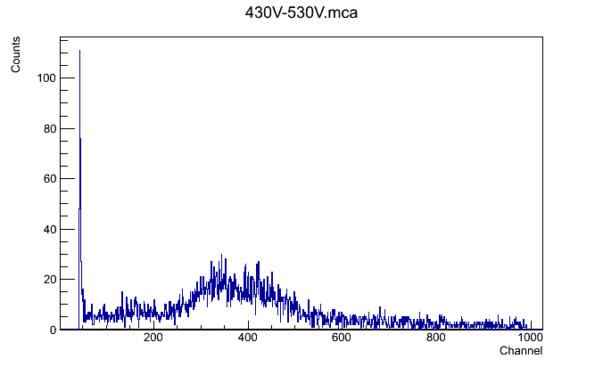
R&D on chip protection
Bulk on ceramic (300 µm) → Piggyback
First test in Argon/Iso 5%
No signal observed on TimePix chip

Slide 19
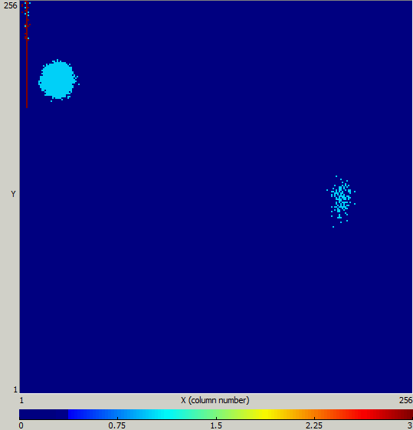
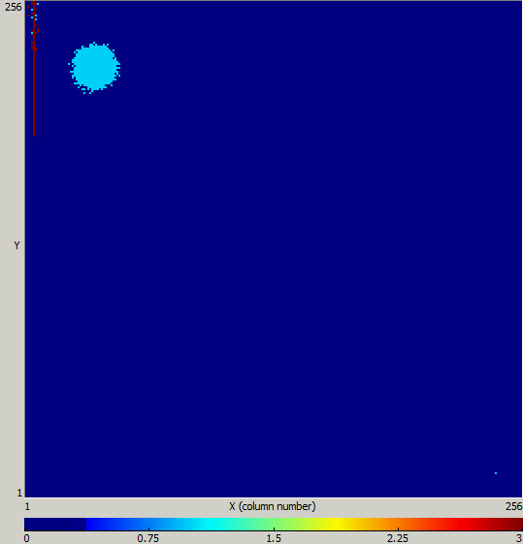
R&D on chip protection
Medipix + Bulk on ceramic
⁵⁵Fe source
Medipix + Bulk on ceramic
²⁴¹Am source

