Slide 1
Micromegas LP module matter
D. Attié, P. Colas, W. Wang

Slide 2
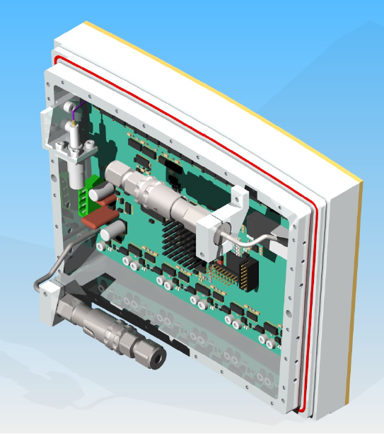
Surface 374 cm²
Weight:
Backframe 938 g (take 300g) Al
Mounting Bracket 120 g
Frame+detector 1390 g
6 FECS (incl. Radiator)+ screws : 294 g
FEMI 170g
Air cooling 140g
Total 1476 g
4 g/cm² = 40 kg/m²
For Si Rad.Length =21.8 g/cm²
For Al : 24 g/cm²
Thus pannel thickness is about
20 % X°
This is an upper limit, as no effort was done to reduce it

Slide 3
