Slide 1


TPC for ILC and application to Fast Neutron Imaging
L. An², D. Attié¹, Y. Chen², P. Colas¹, M. Riallot¹, H. Shen²,
W. Wang^{1,2}, X. Wang², C. Zhang², X. Zhang², Y. Zhang²
5th FCPPL workshop Orsay-Saclay, France
21-23 March 2012
(1)
(2)

Slide 2
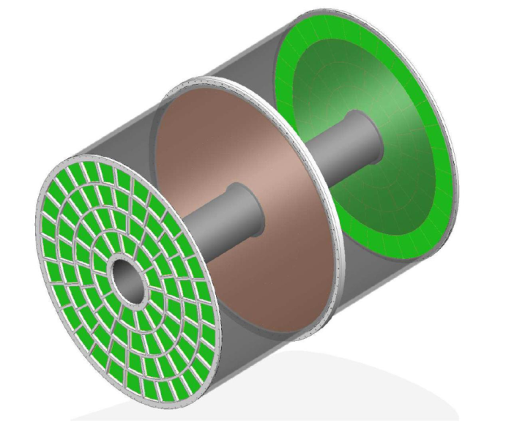
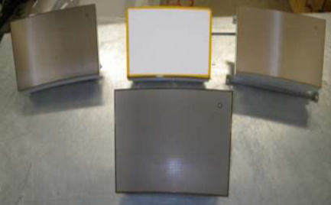
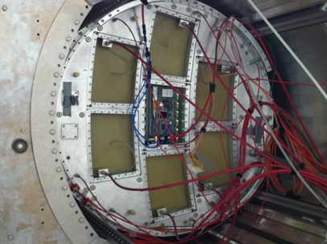
Micromegazs TPC for ILC
A TPC for ILC:
2008-2011: 7 different modules have been tested at DESY, one at a time
2012: 7 fully integrated modules will be tested at DESY

Slide 3
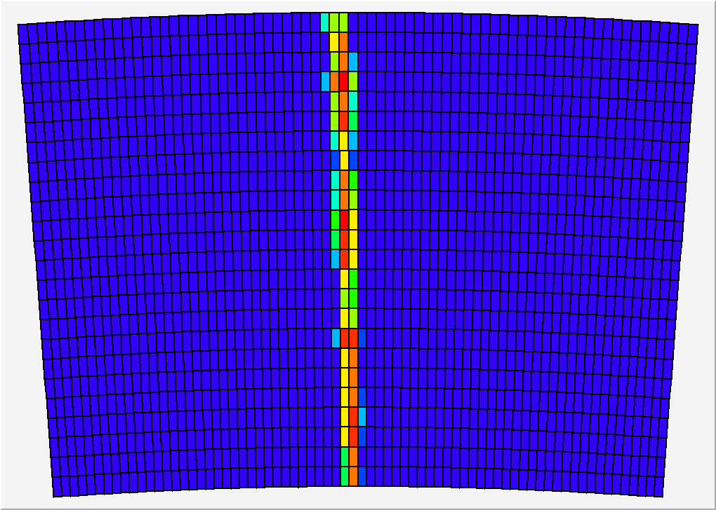
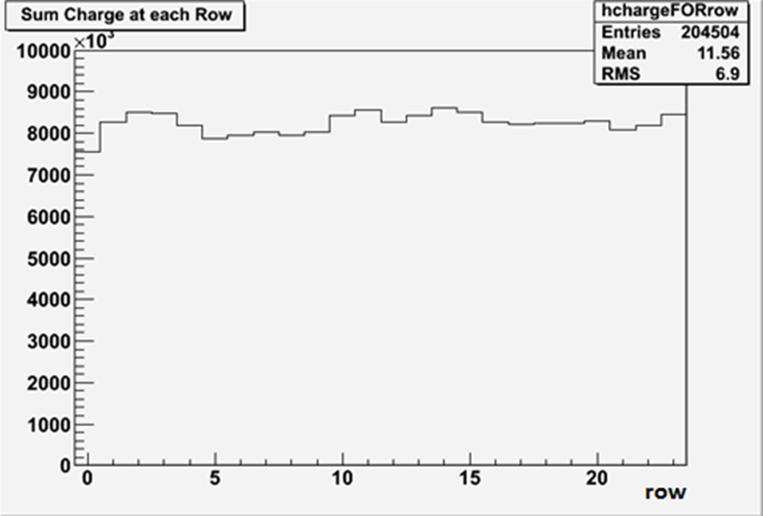
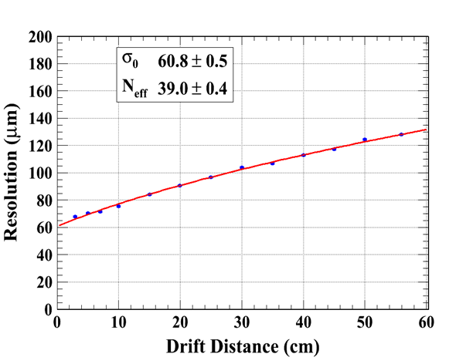
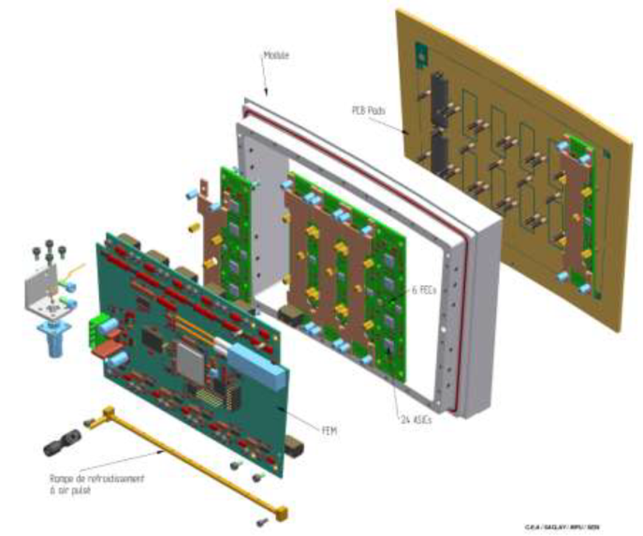
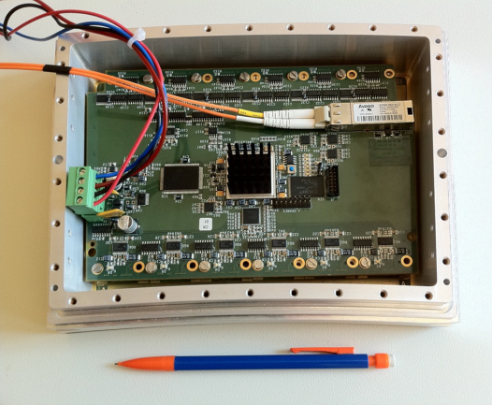
Micromegas TPC for ILC
Uniformity (B = 0T)
Average charge by row using cosmic-ray events
The av. thickness is less than 0.2 X_{o}
Resolution as a function of drift distance (B=1T)

Slide 4
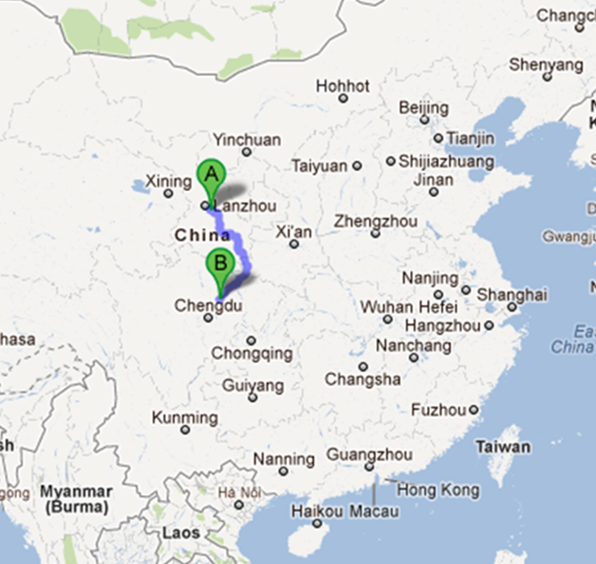
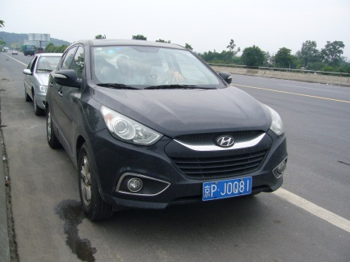
Fast Neutron Imaging
Within FCPPL:
application to Fast Neutron Imaging with Lanzhou University
Distance: 800km
Data taking:
²⁴¹Am-⁹Be source
14MeV Neutron beam
Lanzhou
Sichuan
1. R&D of Fast Neutron Imaging detector based on Bulk-Micromegas Mini-TPC , Huaya Shen, 4th FCPPL, Shandong
2. R&D of a Fast-Neutron Imaging Detector Based on Bulk-Micromegas TPC, David Attié, 2011 IEEE Nuclear Science Symposium and Medical Imaging Conference

Slide 5
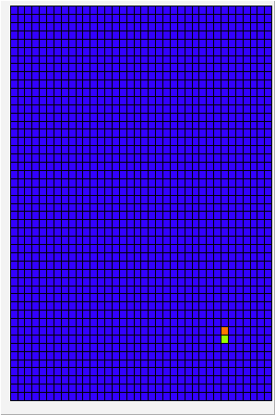
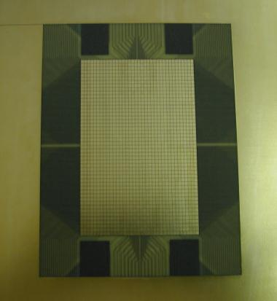
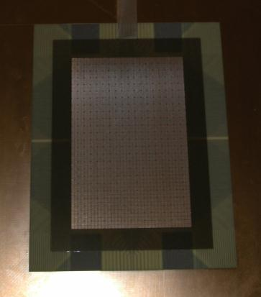
Micromegas TPC for neutron imaging
Detector layout: 1728 (36 ×48) pads of 1.75 mm × 1.50 mm
+ bulk Micromegas
Gas mixture: Argon + 5% Isobutane
Elastic scattering on hydrogen n → p
+ masks (Pb, paraffin wax)
n
Pb
Aluminized polyethylene 25 µm
between 2 layers (0.5 µm) of Al
Wax
gas
HV_{drift}
10 mm
p
E_{drift} ~ 200 V/cm
128 µm
HV_{mesh}
57.4 mm
E_{amp} ~ 30 kV/cm
88.6 mm
(x, y, t)
Cosmics
PCB
Micromegas

Slide 6
Characteristics and simulation of FNI detector
Expected characteristics of Fast Neutron Imaging detector based on TPC:
High spatial resolution: <100 µm
high quality imaging from Micro-Pattern Gas Detector
as Micro-Mesh Gaseous Structure (Micromegas)
  Low efficiency: ~ 0.01-1%,
  subject to thickness and kind of converter
  suitable for beam monitor/profile
  imaging in very high flux
Simulation tools:
  Garfield (electric fields and gas properties)
  Geant4 (physics processes)

Slide 7
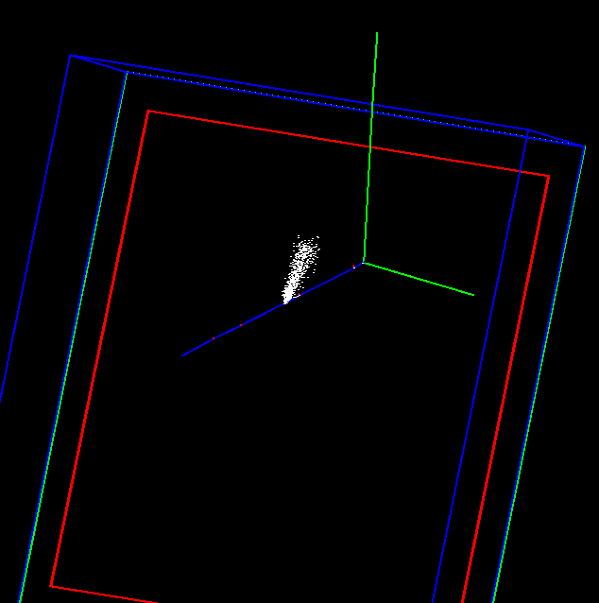
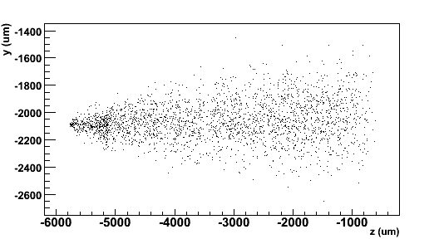
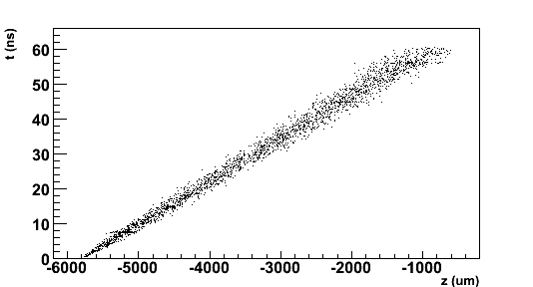
Monte-Carlo simulation
n
Garfield
Proton track
p
e- avalanche
Neutron event interacting
with polyethylene foil
and knocking out a proton
Avalanches
Data reconstruction method:
  identify cluster (track)
  extract hit position where the time is maximum t_{max} → interaction point
  integrate all events → image
p
Drift time
Avalanche drift time
σ = 91.9 µm
y-z readout plane
X-Y readout plan

Slide 8
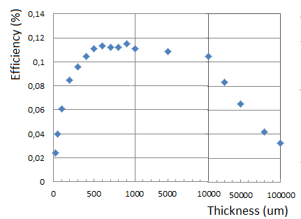
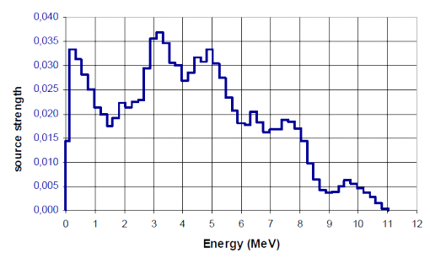
Geant4 simulation for converter efficiency
Neutron→proton recoiling efficiency in a polyethylene [C₂H₄]_{n} layer coming from ²⁴¹Am-⁹Be source
Incident neutron spectrum
According to ISO 8529^{(*)}
* INTERNATIONAL STANDARD ISO 8529. Reference neutron radiations – Part 1: Characteristic and methods of productions. International Standard ISO 8529-1 (2001).
21-23 March 2012
W.Wang_5th FCPPL workshop Orsay-Saclay,France
8

Slide 9
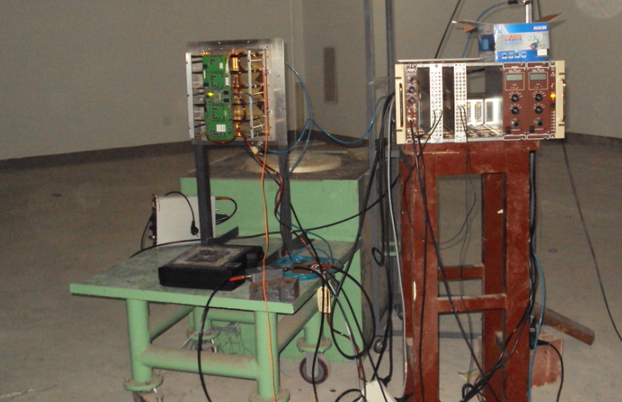
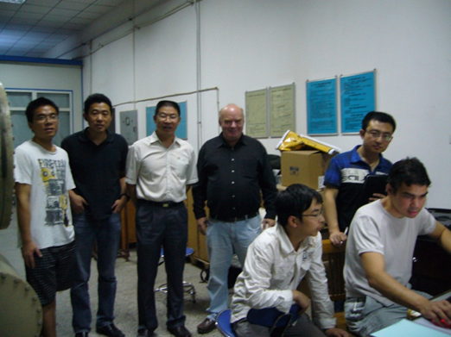
Assembled FNI detector
Readout electronics:
The AFTER-based electronics

Slide 10
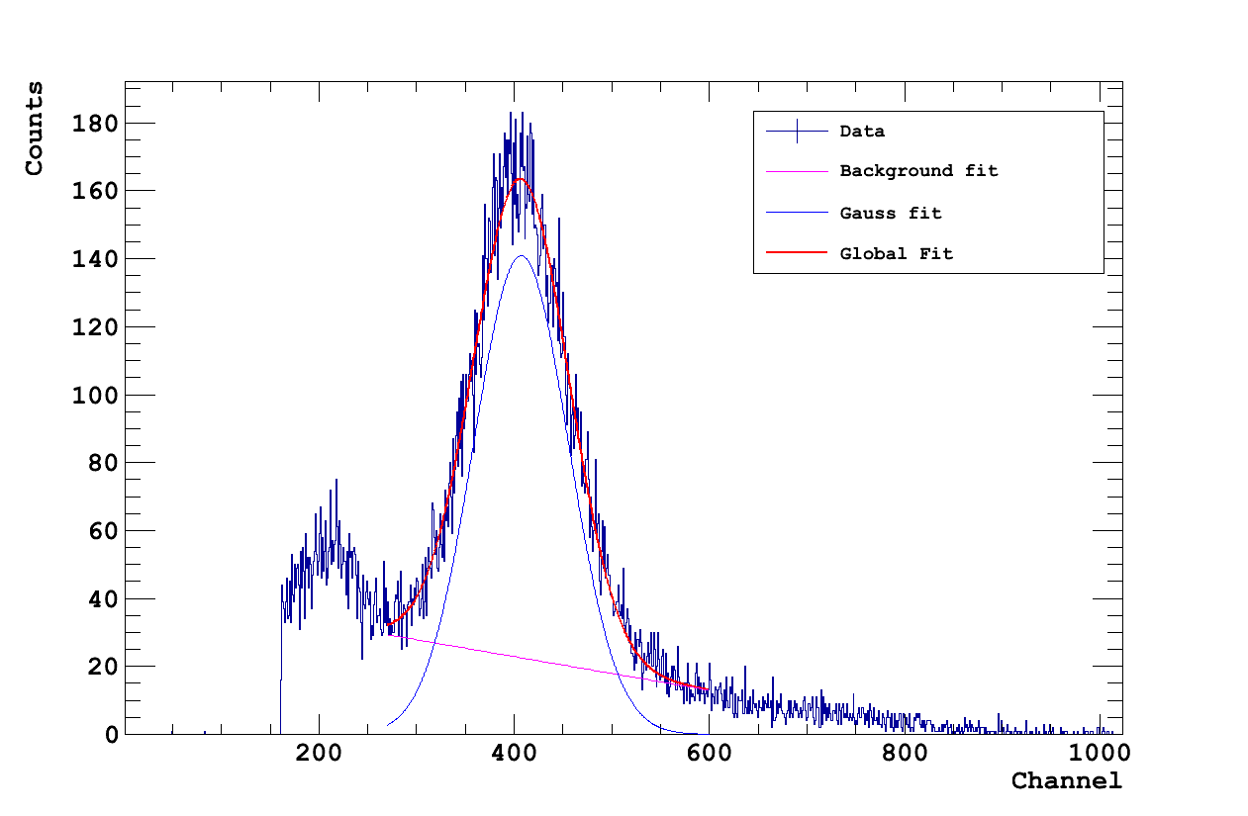
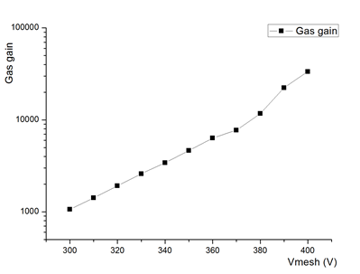
Performances of the Micromegas detector
Gain curve measured from 5.9 keV line using ⁵⁵Fe source. Signals read out on the mesh in Ar/Isobutane 5%: G~10³ @ 300 V
Energy resolution of σ~12 % due to detector capacitance and noise
best energy resolution measured for a bulk Micromegas (~7 %)

Slide 11
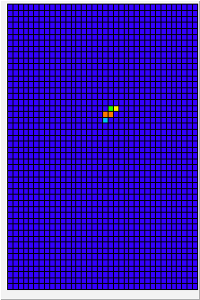
²⁴¹Am–⁹Be source
Located in Lanzhou University, data taking in July 2011
Intensity: ~6 ×10⁶ Hz (4π)
Neutron energy spectrum, according to ISO 8529 (reference radiations for calibrating neutron-measuring devices)
Mean energy ~4.5 MeV, up to 11 MeV
Data sample from source
48
36

Slide 12
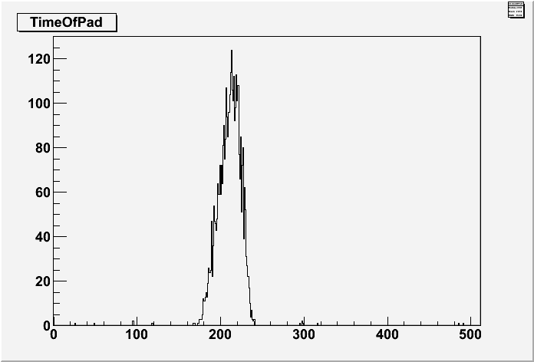
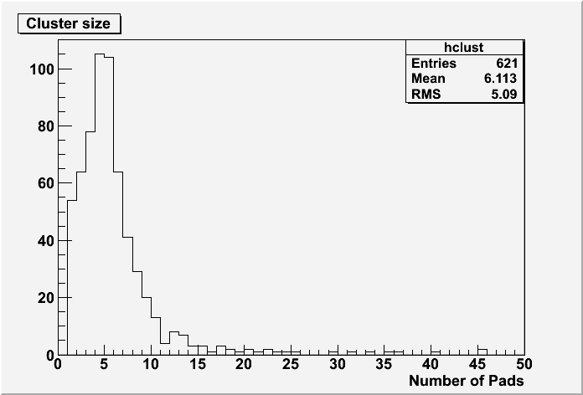
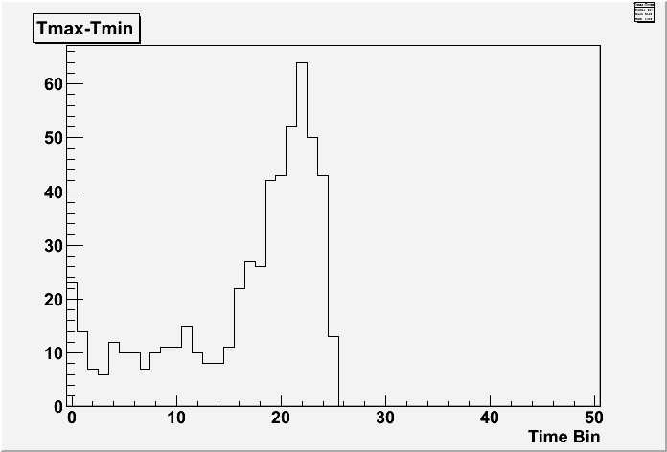
Data analysis and results
64mm plastic in front of the detector
Vmesh = 300V Electronic Gain = 360
Cluster size is maximum at ~5
Uniform time spectrum

Slide 13
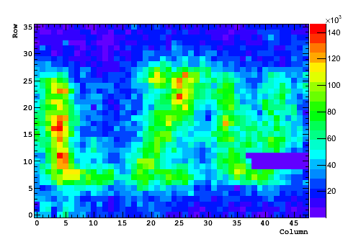
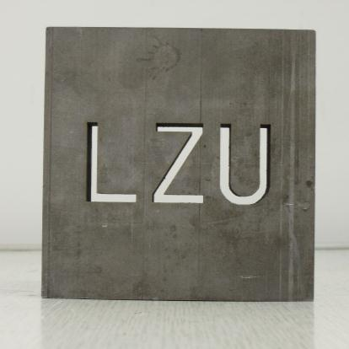
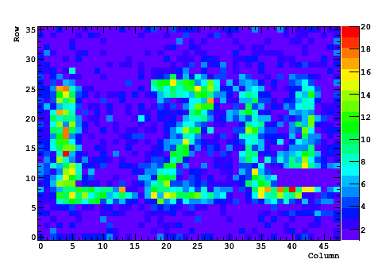
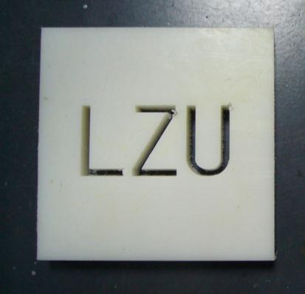
Imaging with Lanzhou mask
Thickness: 17 mm
3 mm
Counting
mode
Pb
+
Imaging
Tracking +cuts in time & charge
Paraffin

Slide 14
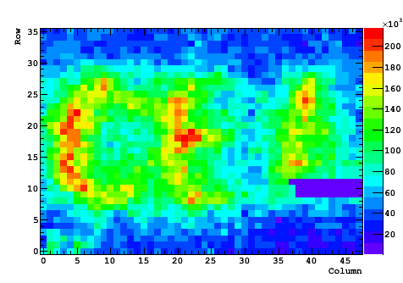
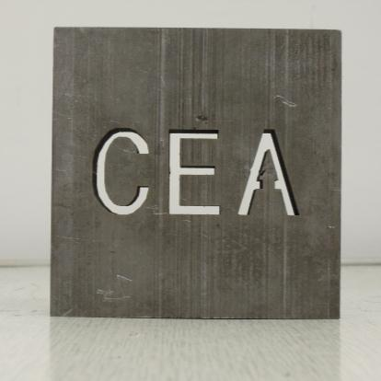
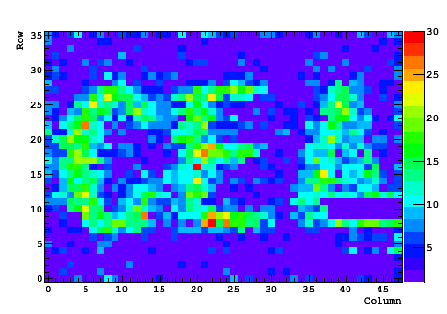
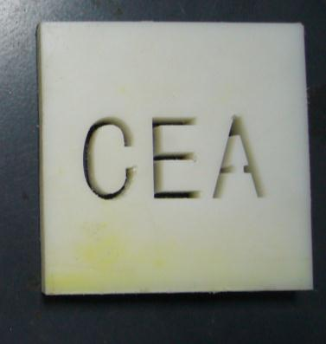
Imaging with CEA mask
Thickness: 17 mm
3 mm
Counting
mode
Pb
+
Imaging
Tracking +cuts in time & charge
Paraffin

Slide 15
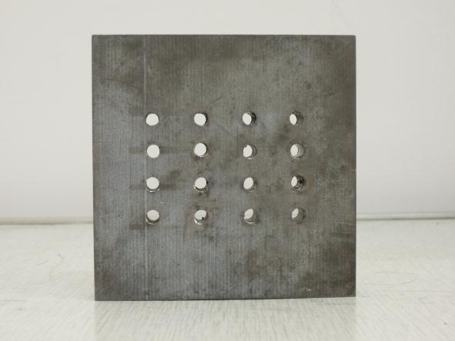
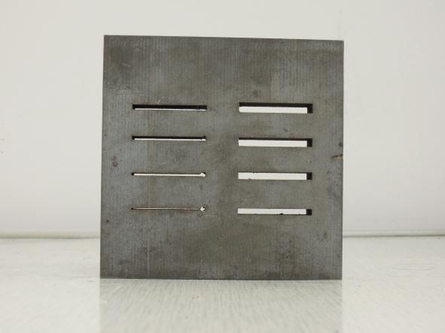
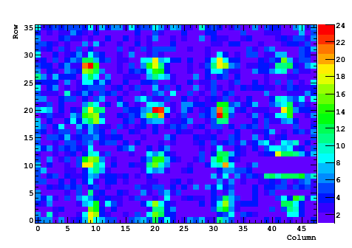
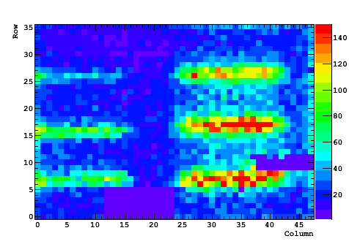
Imaging using others masks
Thickness: 17 mm
3 mm
5 mm
1.5 mm
3.5 mm
∅2.5 mm

Slide 16
Conclusion and Next step
Since July 2011, the detector is ready for neutron imaging data taking
The Characteristics were studied using ⁵⁵Fe and ²⁴¹Am+Be
Still need to optimize the converter and the drift space
- Using 1mm polyethylene as converter layer
- Using thin drift gap (1mm) to reduce the inaccuracy
Or Using thick drift gap (3cm) to get good proton track

Slide 17
Thank you!
IN CHINA this work is supported by the National Science Foundation of China,Grant No.:10875054 and 10605011 and by the Fundamental Research Funds for Central University, Grant No.lzu jbky-2010-24
IN FRANCE this work is supported by the FCPPL

