Slide 1
A TPC for the Linear Collider
Frontier detectors for frontier physics
12 th Pisa meeting on advanced detectors
Isola d’Elba, 20-26 May 2012
P. Colas
on behalf of LCTPC

Slide 2
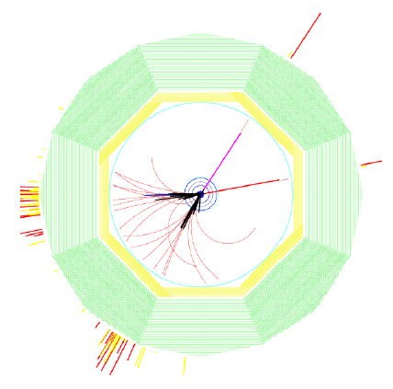
2 detector concepts : ILD and SiD
Both based on the ‘particle flow’ paradigm
SiD: all-silicon
ILD: TPC for the central tracking
Benchmark process: e+e- -> HZ, Z->µµ
Requirements:
Momentum resolution
δ(1/p_{T}) <2.10⁻⁵ GeV/c with vertex constraint
δ(1/p_{T}) <9.10⁻⁵ GeV/c TPC only
(200 points with 100 µ resolution in Rφ)
2-track separation: 2 mm in Rφ and 6 mm in z in a high density background
Material budget: <5% X₀ in the barrel region, <25% X₀ in the endcap region
B=3.5 T

Slide 3
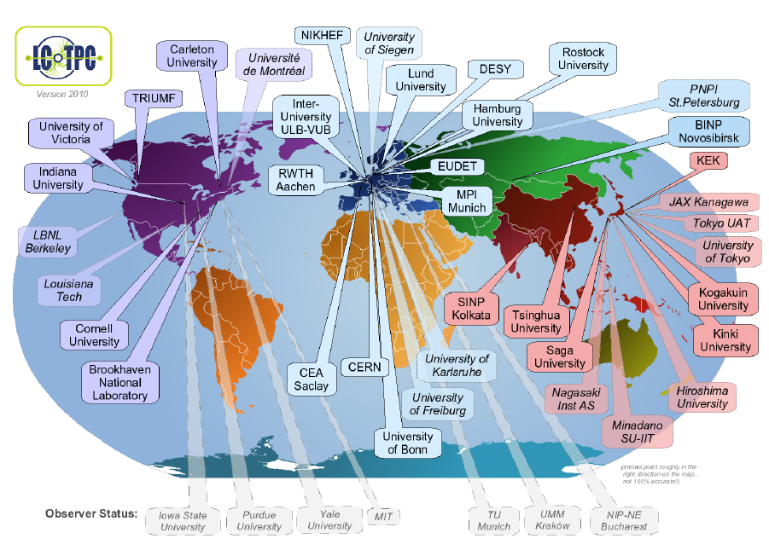
All the R&D is gathered in LCTPC
38(*) member + 7 observer institutes from 12 countries
(*) 25 signed the MOA
www.lctpc.org

Slide 4
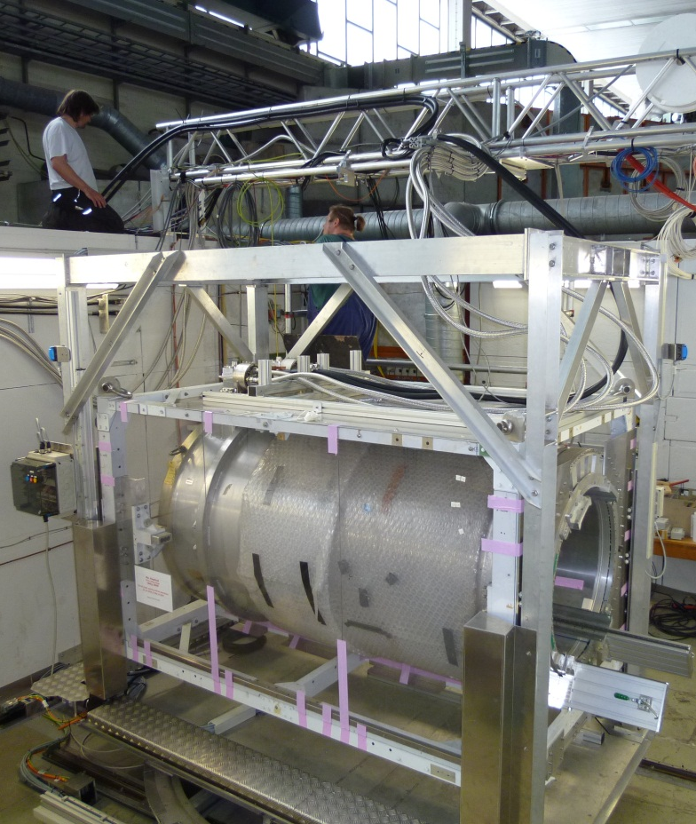
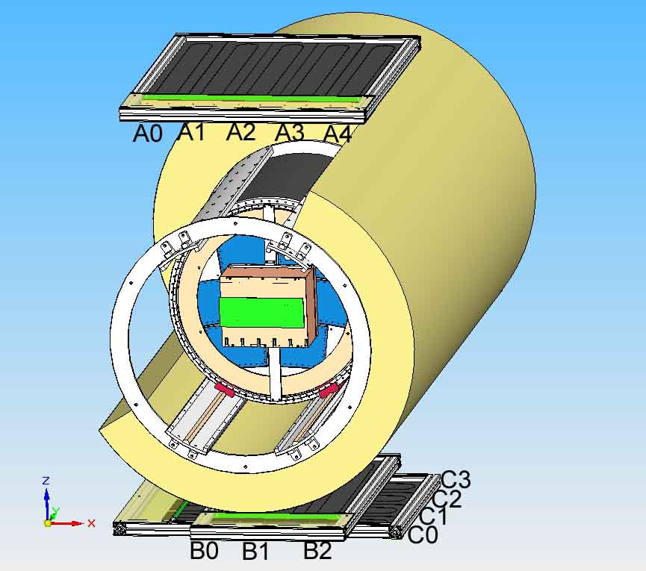
The EUDET test setup at DESY
The EUDET (FP6) setup at DESY is operational since 2008
Just upgraded within AIDA (FP7): autonomous magnet with 2 cryo-coolers
SiPM trigger
Field cage

Slide 5
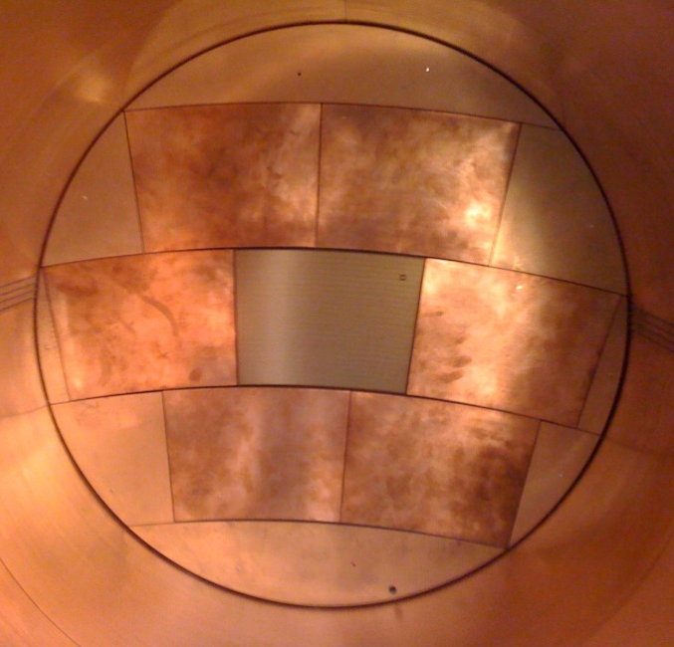
Beam tests at DESY : 5 technologies
Laser-etched Double GEMs 100 µ thick (‘Asian GEMs’)
Micromegas with charge disper-sion by resistive anode
GEM + pixel readout
InGrid (integrated Micromegas grid with pixel readout)
Wet-etched triple GEMs (‘European GEMs’)

Slide 6
Advantages of MPGDs over wires
Reduction of ExB effect (improves spatial resolution)
Less mechanical tension
Less ageing than wires
Fast signal O(few ten ns), fast and efficient ion collection
Natural or tunable suppression of ion backflow
Discharge probability and consequences can be mastered (use of resistive coatings, several step amplification, segmentation)

Slide 7
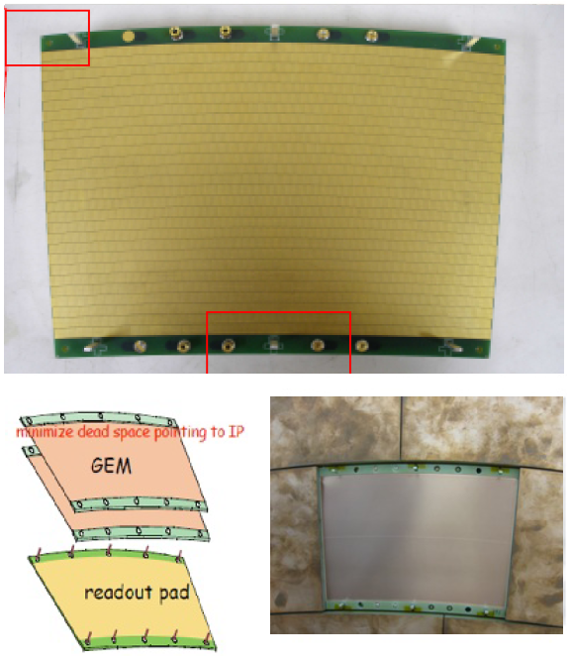
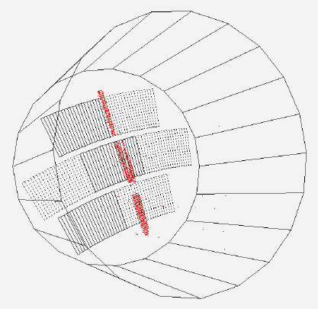
Double GEM Modules (Asian GEMs)
Laser-etched Liquid Crystal Polymer 100 µm thick, by SciEnergy, Japan
28 staggered rows of 176-192 pads
1.2 x 5.4 mm²

Slide 8
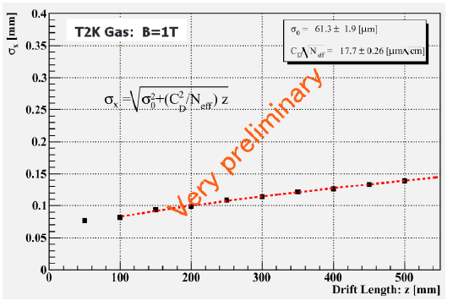
Performance of Double GEMs
rφ resolution at zero drift: 60 microns
Behavior consistent with expectation from diffusion.
Distortions due to HV setting on the frame : corrected offline

Slide 9
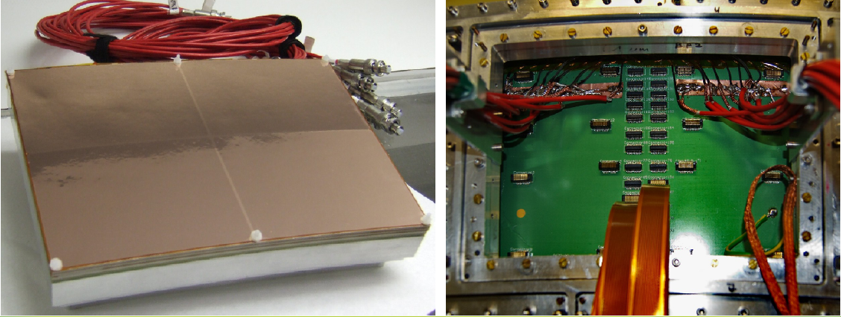
Tripple GEM Module (‘European GEMs ’)
3 standard CERN GEMs mounted on a light ceramic frame (1 mm) and segmented in 4 to reduce stored energy.
Partially equipped (1000 pads, 1.26 x 5.85 mm²)
5000 pad version being built

Slide 10
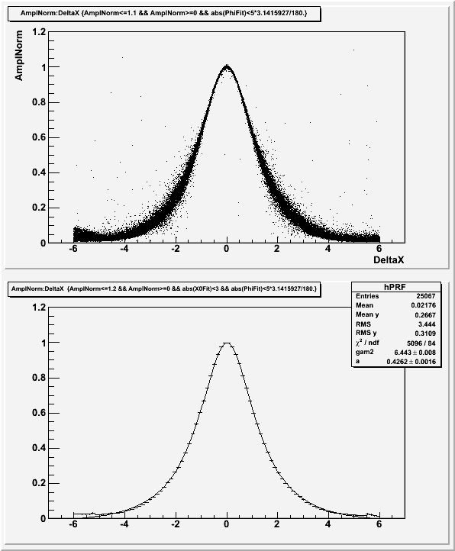
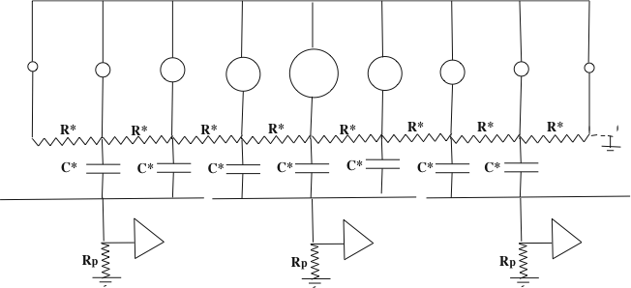
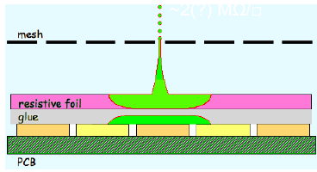
Charge spreading by resistive foil
PAD RESPONSE: Relative fraction of ‘charge’ seen by the pad, vs x(pad)-x(track)
Z=20cm, 200 ns shaping
Resistive coating on top of an insulator: Continuous RC network which spreads the charge from σ(avalanche)~15µ to mm: matching pad width improves position sensitivity
M. Dixit, A. Rankin, NIM A 566 (2006) 28
x(pad) – x(track) (mm)

Slide 11
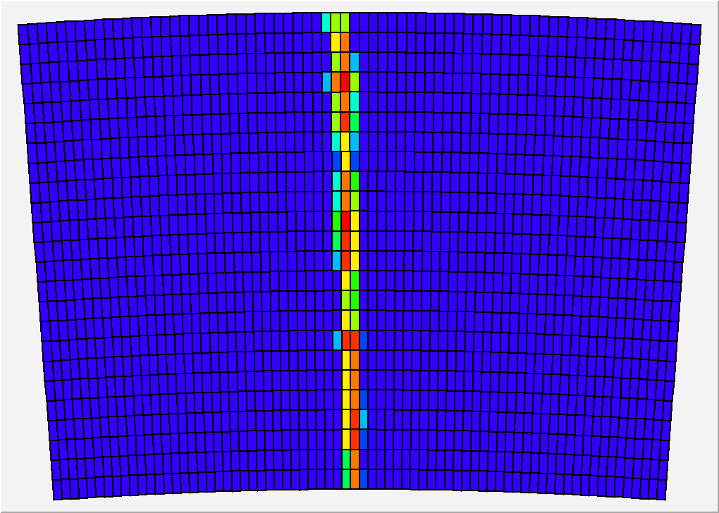
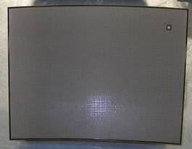
Micromegas Modules with resistive coating
24 rows x 72 columns of 3 x 6.8 mm² pads
Various resistive coatings have been tried: Carbon-loaded Kapton (CLK),
3 and 5 Mohm/square, resistive ink.

Slide 12
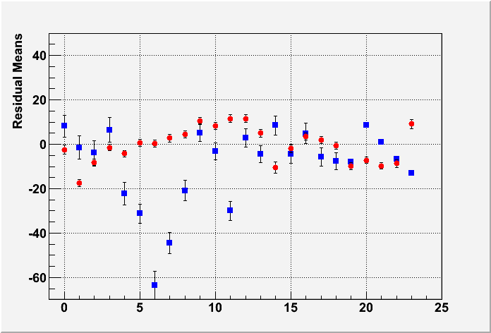
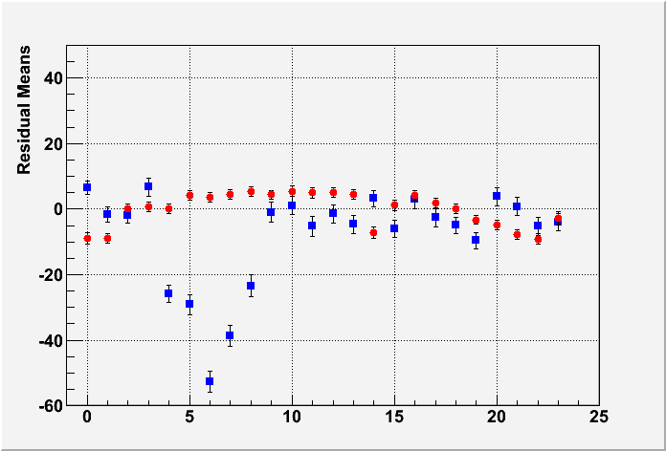
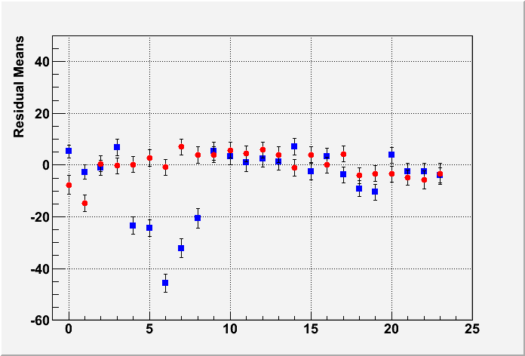
Uniformity (B=1T data)
MEAN RESIDUAL vs ROW number
Z-independent distortions
Distortions up to 50 microns for resistive ink (blue points)
Rms 7 microns for CLK film (red points)
-> select CLK
Z=5cm
Z=35cm
Z=50cm
Row number

Slide 13
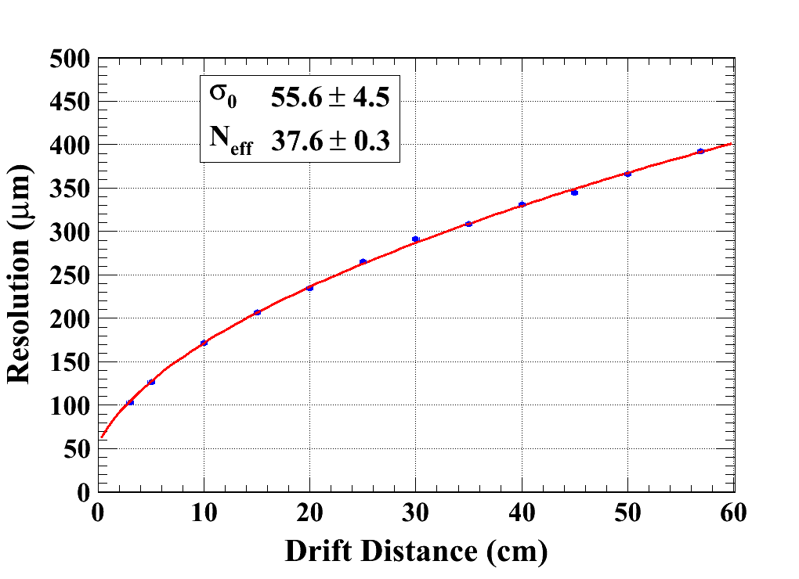
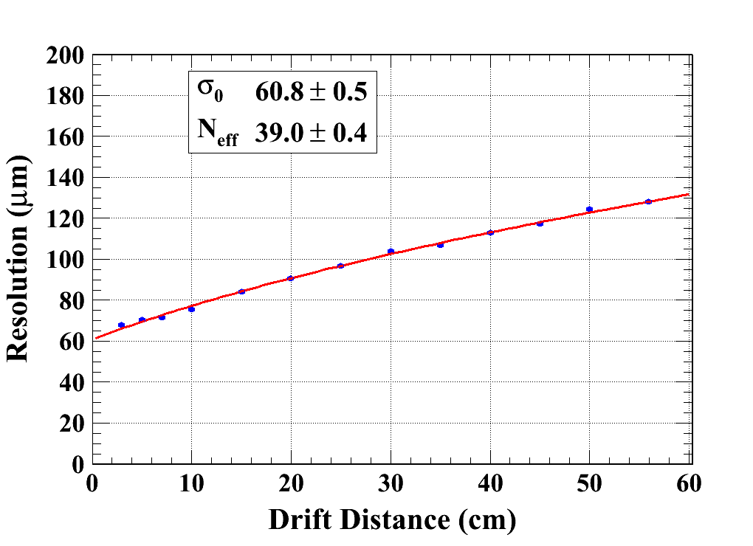
Micromegas results (B = 0T & 1T)
Carbon-loaded kapton resistive foil
Gas: Ar/CF4/Iso 95/3/2
C_{d} : diffusion constant
B=0 T C_{d} = 315.1 µm/√cm (Magboltz)
B=1 T C_{d} = 94.2 µm/√cm (Magboltz)
Module 4
χ² : 10.6
Ndf: 10
Module 3
χ² : 29.1
Ndf: 11

Slide 14
Micromegas results (B = 0T & 1T)
Carbon-loaded kapton resistive foil
Gas: Ar/CF4/Iso 95/3/2
C_{d} : diffusion constant
B=0 T C_{d} = 315.1 µm/√cm (Magboltz)
B=1 T C_{d} = 94.2 µm/√cm (Magboltz)
Extrapolates to <100 µm at 2.3 m in B=3.5 T
Module 4
χ² : 10.6
Ndf: 10
Module 3
χ² : 29.1
Ndf: 11

Slide 15
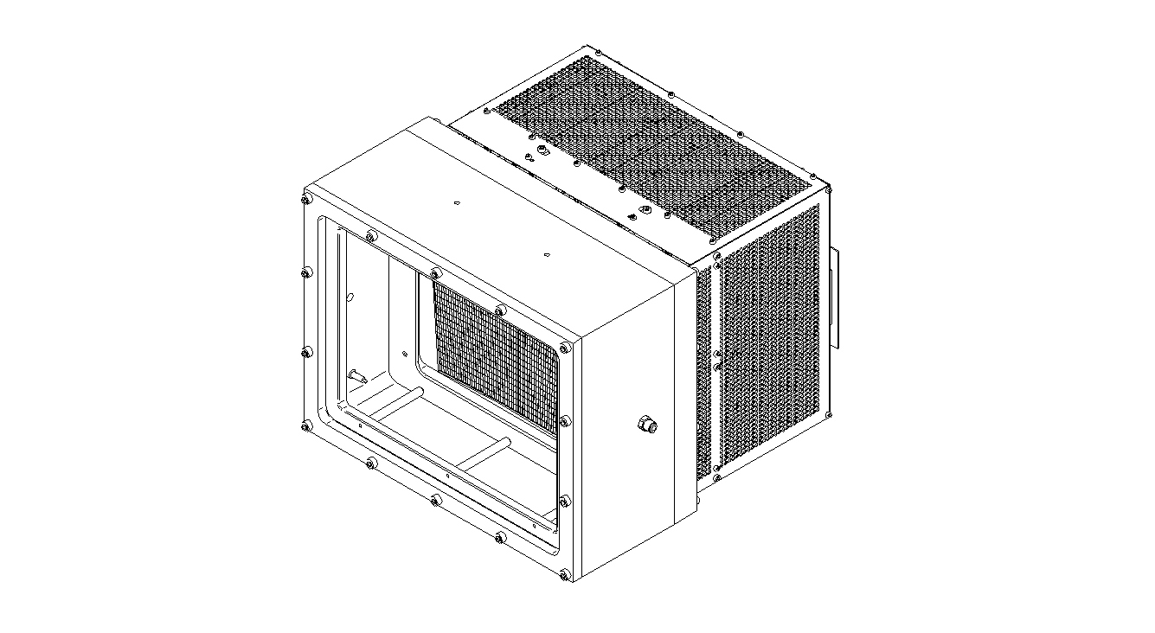
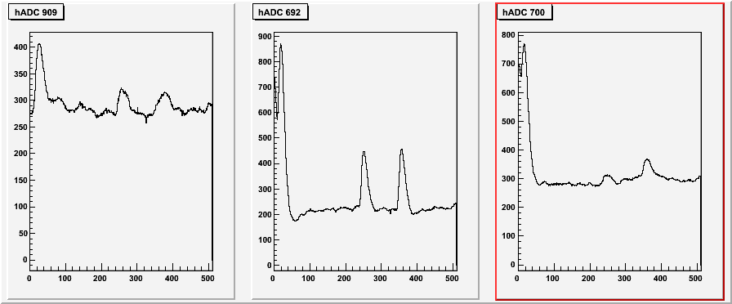
Test in a high intensity π beam
Test at CERN (July 2010) at 180 kHz (5 x 2 cm² beam) showed no charging up and stable operation

Slide 16
See T. Krautscheid’s talk, this session

Slide 17
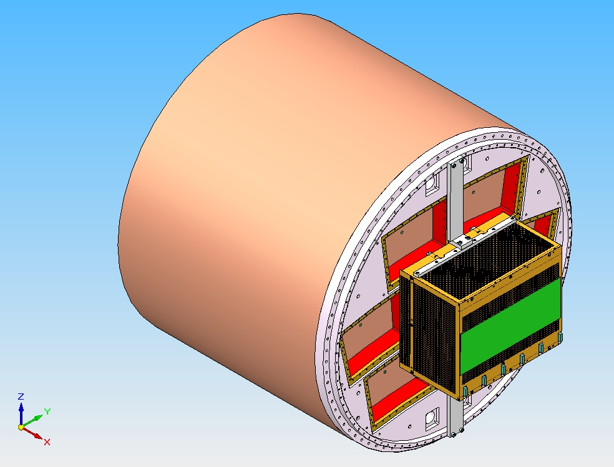
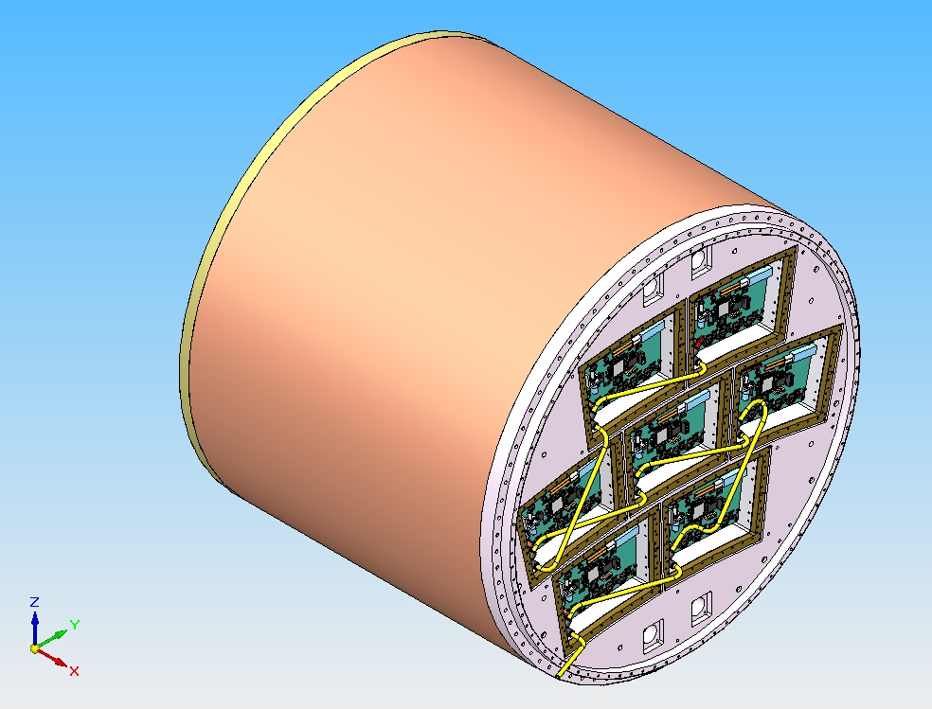
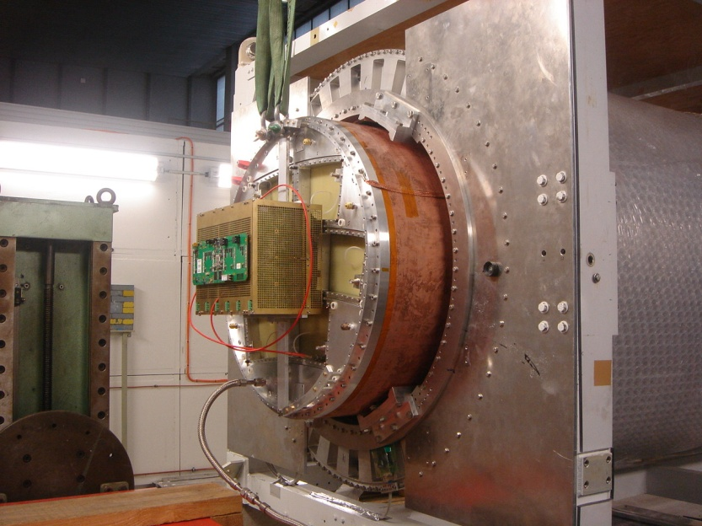
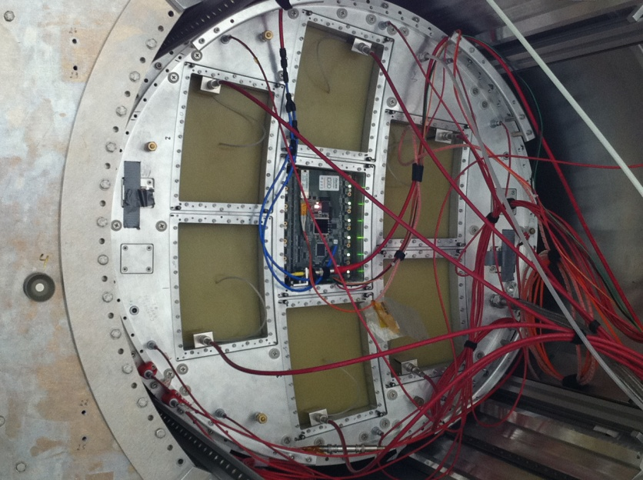
7 module project – Micromegas electronic integration

Slide 18
Integration of the T2K electronics
New detector : new routing to adapt to new connectors, lower anode resistivity (3 MΩ/sq), new res. foil grounding on the edge of the PCB.
New 300 points flat connectors (zero extraction force)
New front end: keep naked AFTER chips and remove double diodes (count on resistive foil to protect against sparks)
New Front End Mezzanine (FEMI)
New back-end for up to 12 modules
New DAQ, 7-module ready and more compact format
New trigger discriminator and logic (FPGA).

Slide 19
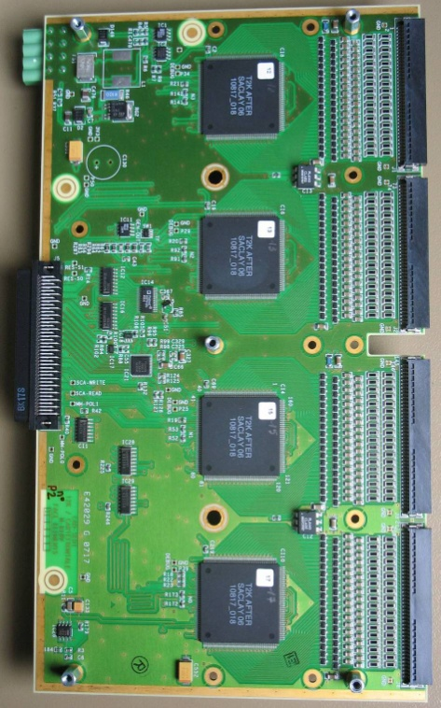
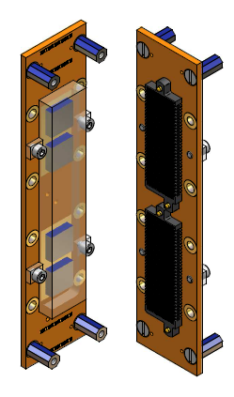
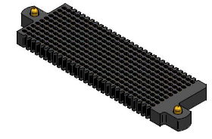
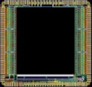
Integrated electronics for 7-module project
Remove packaging and protection diodes
Wire –bond AFTER chips
Use 2 × 300 pins connector
FEC
25 cm
4,5 cm
12,5 cm
14 cm
3,5 cm
2,8 cm
3,5 cm
0,78 cm
Chip
0,74 cm
after 2 weeks of operation: no ASIC lost:
The resistive foil protects against sparks

Slide 20
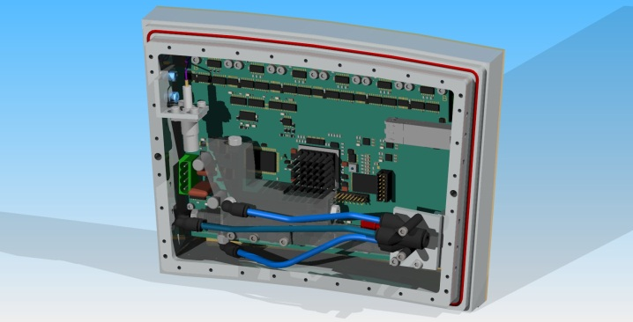
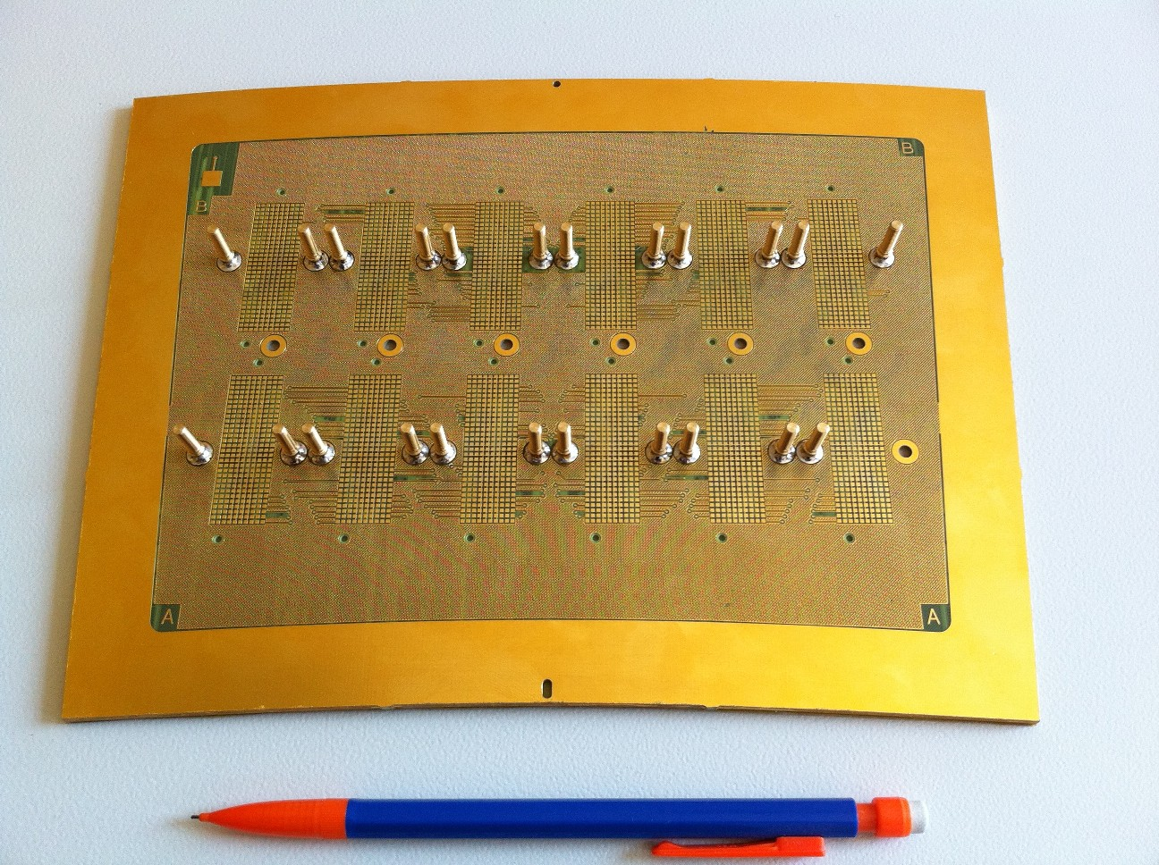
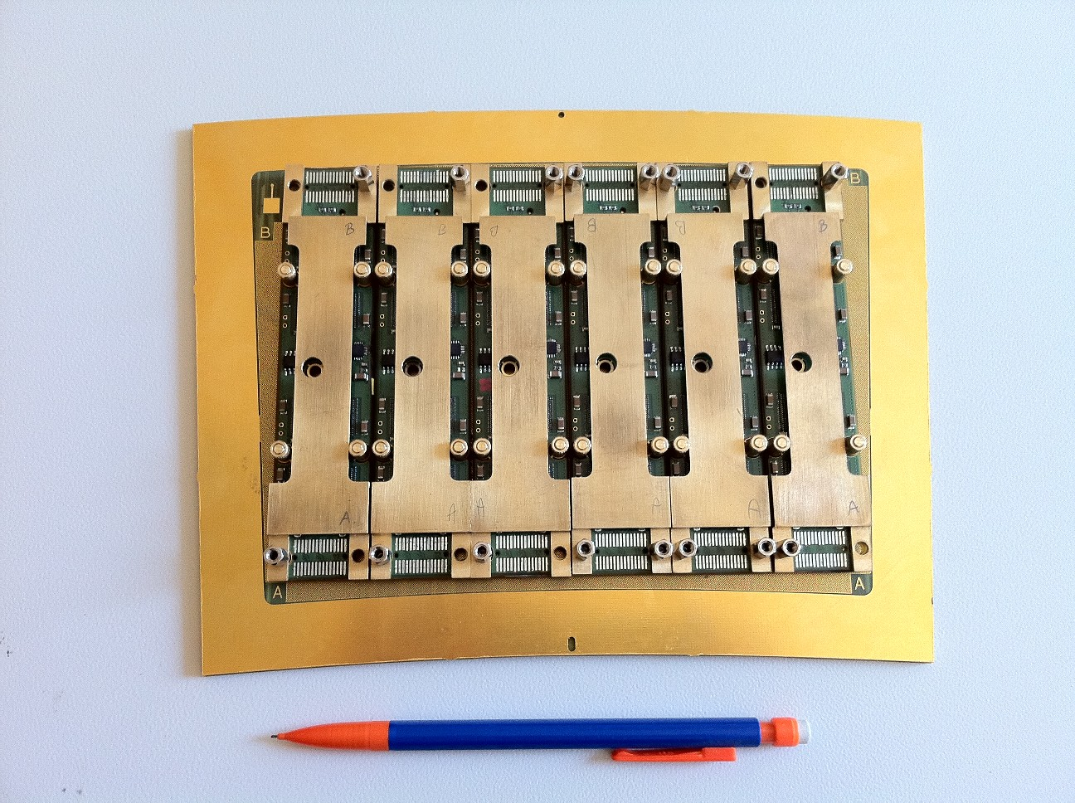
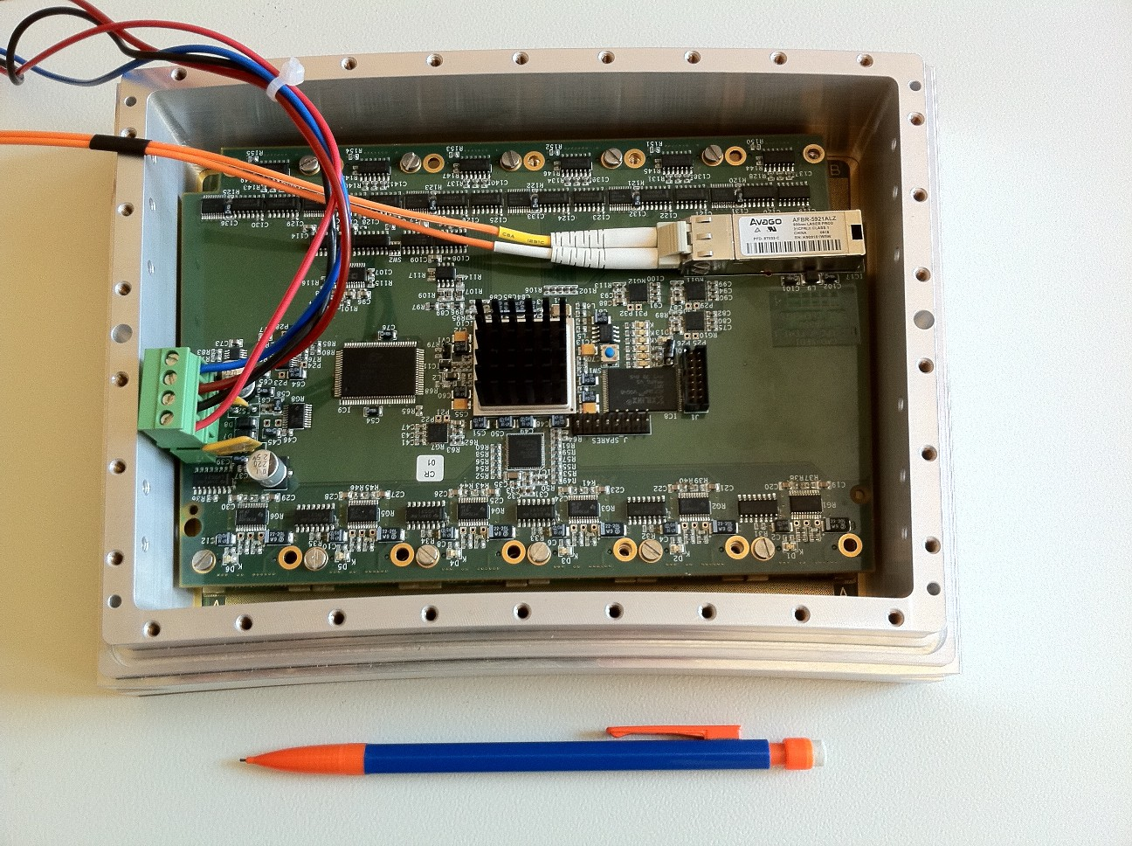
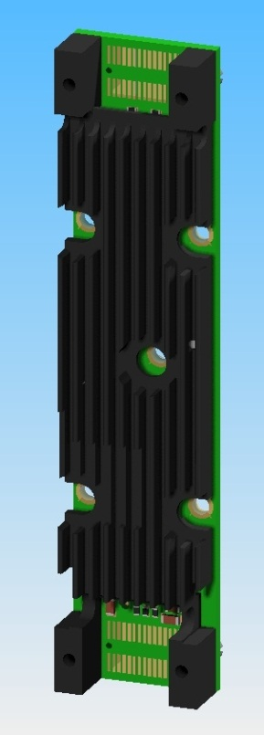
The goal of < 25% X0 is attained
radiator
Goals:
-test of full integration
-test of quasi industrial production, with characterization and qality procedures

Slide 21
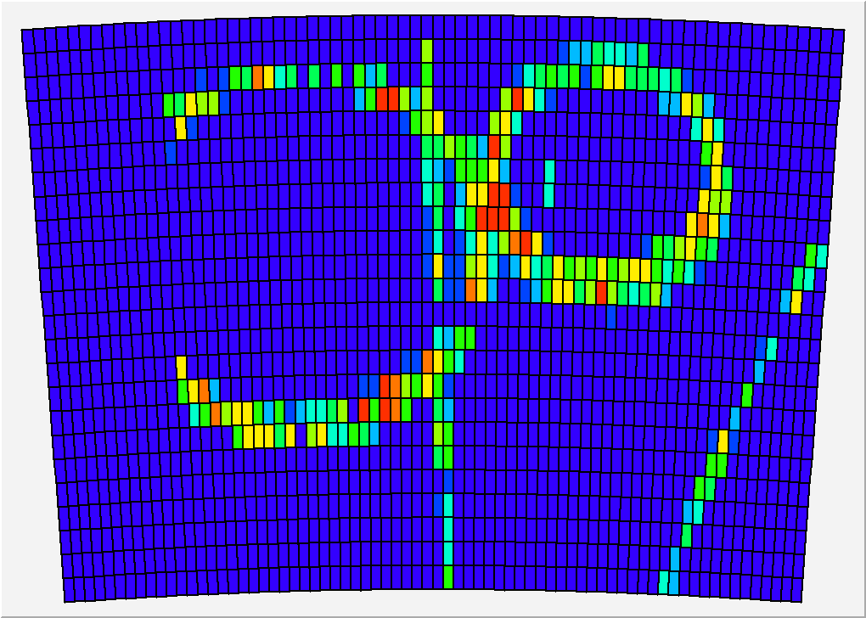

Slide 22
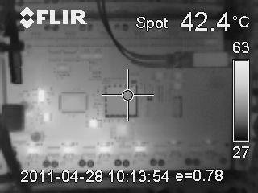
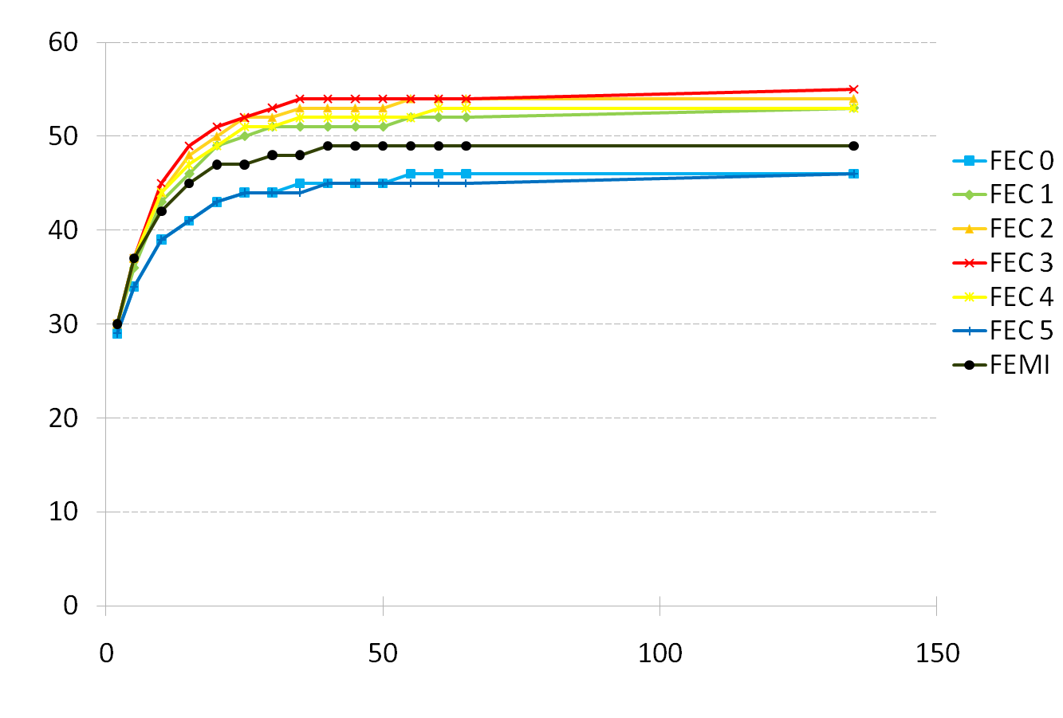
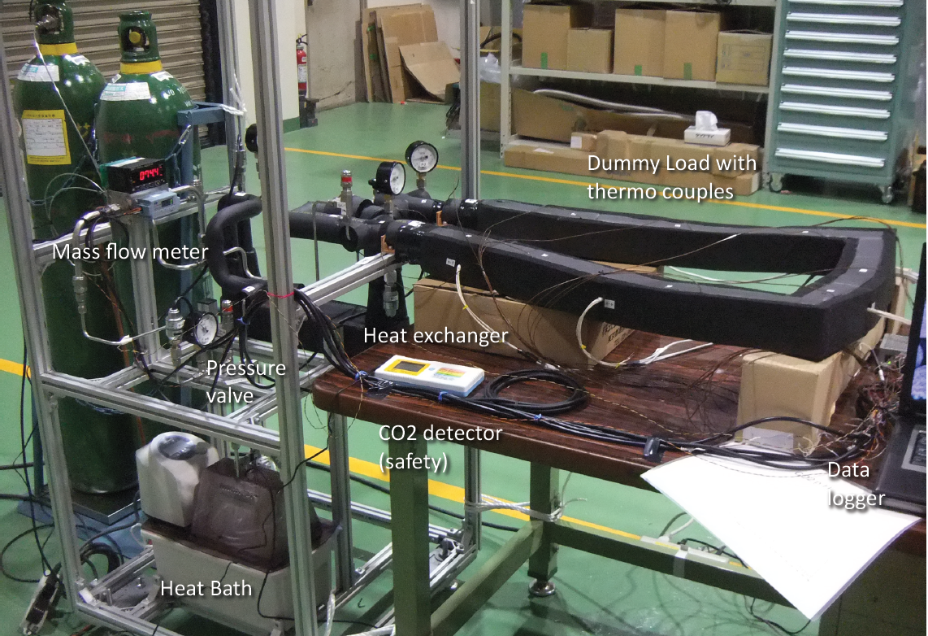
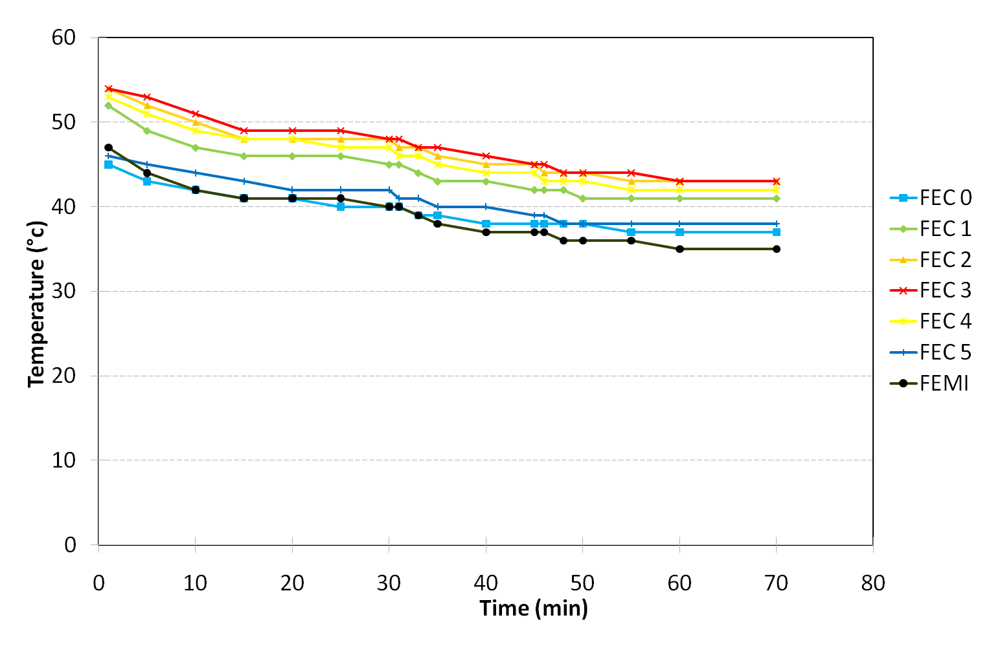
Thermal studies. IR camera shows hot spots (regulators, ADC). T-probes on every component.
2-phase CO2 cooling under study (KEK, Nikhef)
Onset of the electronics
Nitrogen cooling

Slide 23
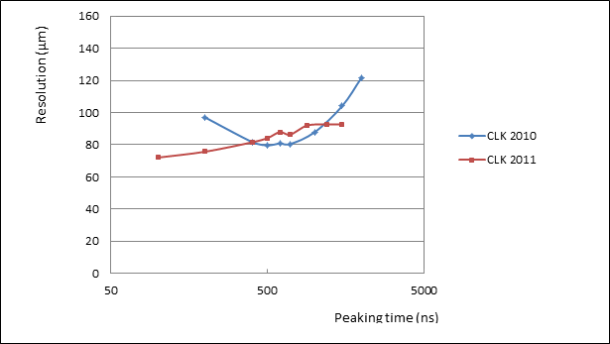
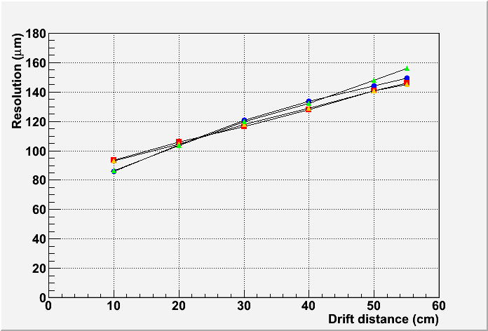
Preliminary results (May 2011) : resolution (B=1T data)
Confirms previous measurements (excl. rows with ASICs in bad contact).
Optimum resolution now obtained for peaking time below 200 ns : good for 2-track separation
Resolution vs z for various peaking times.

Slide 25
Ion disk and gating
During 1 ms every 200 ms, bunch crossings produce ionization in the gas: positive ions drift very slowly to the cathode. Ions produced in the avalanches near the anode drift all the way back to the cathode, resulting in a slowly moving ion sheet.
Background evts have been simulated and charge density and resulting electric field estimated. Preliminary results :
Primary ionization gives up to 8.5 µm distortions (can be tolerated)
‘ion sheet’ effect results in 60 µ distortions (not acceptable)
With a gating grid near the anode, this can be reduced to a negligible amount.
-> gating is necessary between train crossings

Slide 26
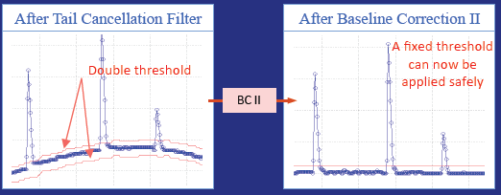
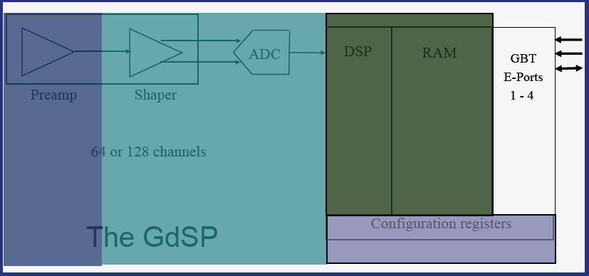
Preparation for future electronics
Design and optimization work in progress for a new chip GdSP, evolution from SALTRO16:
64 or 128 channels
130 nm technology
Very low noise
Integrated ADC
Low power consumption (all-inclusive 7-8 mW/ch)
6 different power regions for power cycling
High level filtering (baseline subtraction, spike removal)
Gaseous detector Signal Processor, P. Aspell et al.

Slide 27
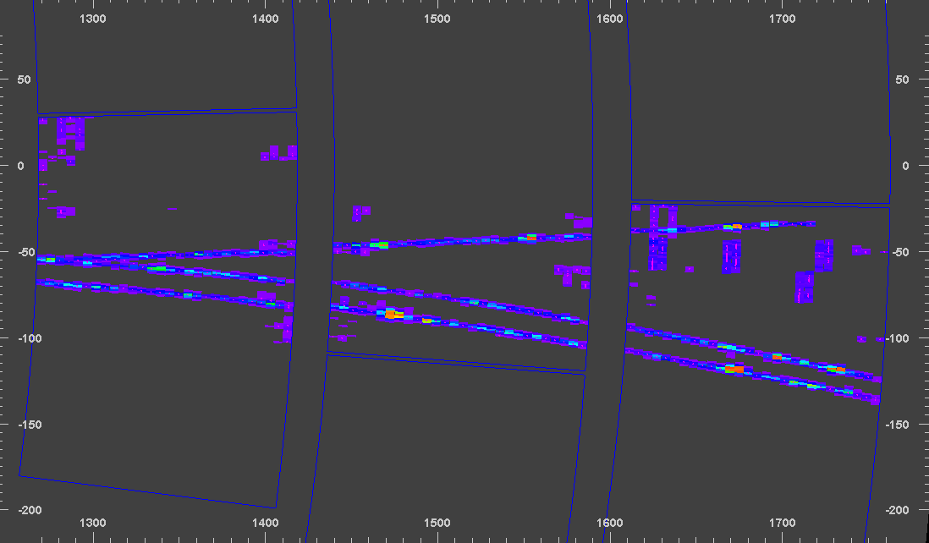
Software : track reconstruction and fitting
Going from various programs for track reconstruction to one (Marlin TPC) within LC framework
Can serve for all beam test prototypes and for ILD simulation data
Allow multi-module alignment
Kalman filter track finding and fitting

Slide 28
CONCLUSIONS
MPGDs have been shown to fulfill the requirements for the readout of a TPC for the LC.
Pixel readout needs more development to gain in reliability and operability in large surfaces.
Integration work (electronics and cooling) is going on, and practical production issues are addressed for the pad readout.
All aspects/limitations are being addressed to be included in the ‘Detector Baseline Document’

Slide 29
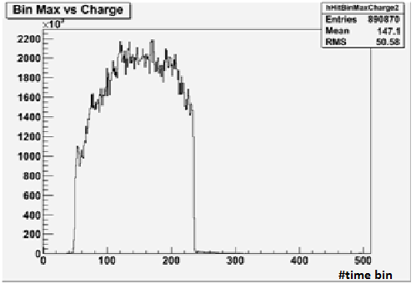
Uniformity
z distribution
Average charge by row
Average charge by row
Using cosmic-ray events
B=OT
Using 5 GeV e-
B=1T
0 5 10 15 20
0 5 10 15 20
Excellent uniformity up to the edge of the module, thanks to the ‘bulk’ technology.

Slide 30
N_{eff} measurement with Micromegas
Averaging B=0T and B=1T data, modules 4, 5 and 3 (excluding ink module):
N_{eff} = 38.0±0.2(stat) (systematics difficult to assess)
σ₀= 59 ± 3 µm
Note that 1/<1/N> = 47.1 from Heed for 5 Gev electrons on 6.84mm long pads.
Thus N_{eff} has to be between 23.5 (for exponential gain fluctuations) and 47.1 if there are no gain fluctuations.
1/<1/N> = 34.9 for 5.4 mm pads (GEM case).
D. Arogancia et al., NIM A 602 (2009) 403

