Slide 1
Construction and tests of a TPC endplate prototype for the ILC
P.Colas D.Attié, W.Wang, I.Giomataris
CEA/Saclay, France
K.Fujii T.Fusayasu, K.Kato, M. Kobayashi,
T. Matsuda, O. Nitoh, A Sugiyama, T. Watanabe
KEK/IPNS, Nagasaki U., Kinki U., TUAT, Saga U., Kogakuin U., Sokendai, Japan

Slide 2
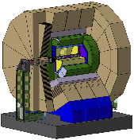
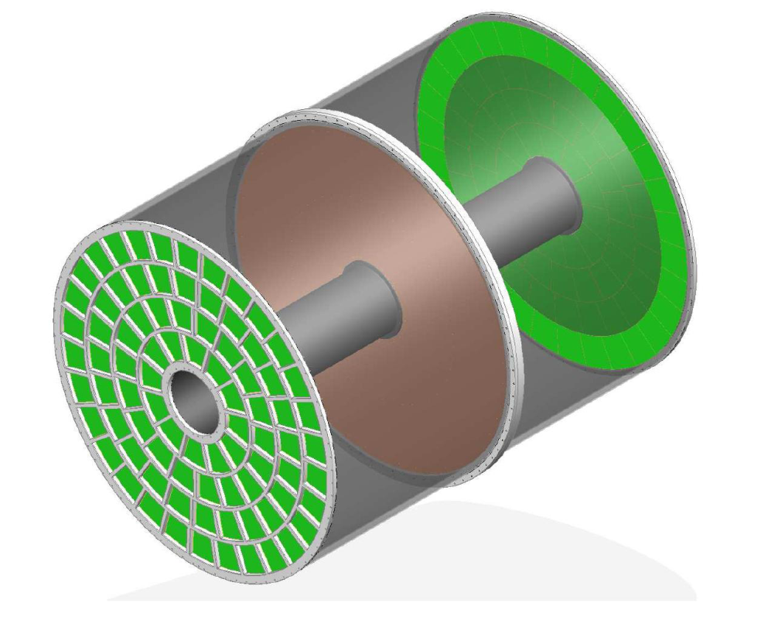
ILD &TPC
ILD detector concept
Design for an ILD TPC in progress 2x80 modules with 8000 pads each
Spatial Resolution δ(x) ~ 100 μm in a 3.5T
for the full 2.3 m drift
ILC-TPC Large Prototype
Seven Micromegas modules will be tested simultaneously in June 2012 with new integrated electronics.
New GEM modules and SALTRO16 chips are being prepared for the momentum resolution measurements in 2012.

Slide 3
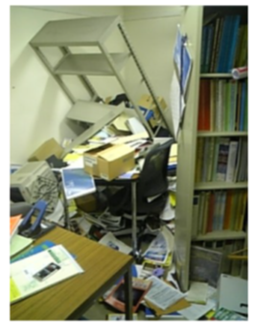
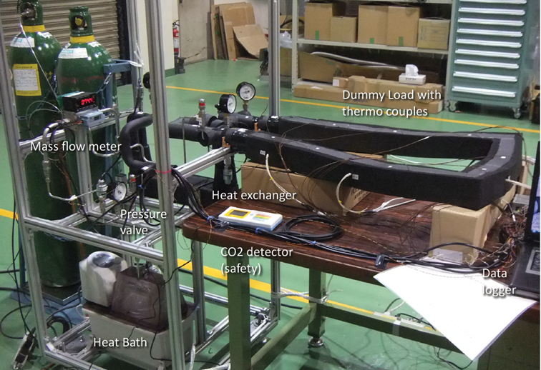
FJPPL Report
In May last year, despite the earthquake, P. Colas’s travel, planned well in advance, took place, and most of the Japanese team was present during this week of collaborative work.
A 2-phase CO₂ circulation cooling system was built and will be installed at DESY.
Ion backflow studies were started.
The test-beam analysis software is being developed under the MarlinTPC framework. The Kalman filter implementation of track finding and fitting is used in the ILC software.
Akiya Miyamoto’s office after the big earthquake

Slide 4
FJPPL Report from 4/2011 to 3/2012
Spending on French Funds
Description | €/unit | Nb of units | Total (€) | Provided by:¹
P. Colas, 9 days in KEK (May 18-27) | 80 | 9 | 720 | CEA/Irfu
Travel | 1200 | 1 | 1200 | CEA/Irfu
W. Wang, 7 days in Kobe (August 28 – Sep 4) for MPGD/RD51 conference | 150 | 10 | 1500 | CEA/Irfu
Travel | 1200 | 1 | 1200 | CEA/Irfu
I Giomataris, 4 days in KEK | (150) | 4 | (600) | (KEK)
Kamioka to Tsukuba travel (IG) | (200) |  | (200) | (KEK)
Total |  |  | 4940
Spending on KEK Fund
Description | k¥/Unit | Nb of units | Total (k¥)
K. Fujii, 8 days at Saclay, Jan 4-11 | 20 | 8 | 160
T. Matsuda | 20 | 3 | 60
Travel | 150 | 2 | 300
Total |  |  | 520

Slide 5
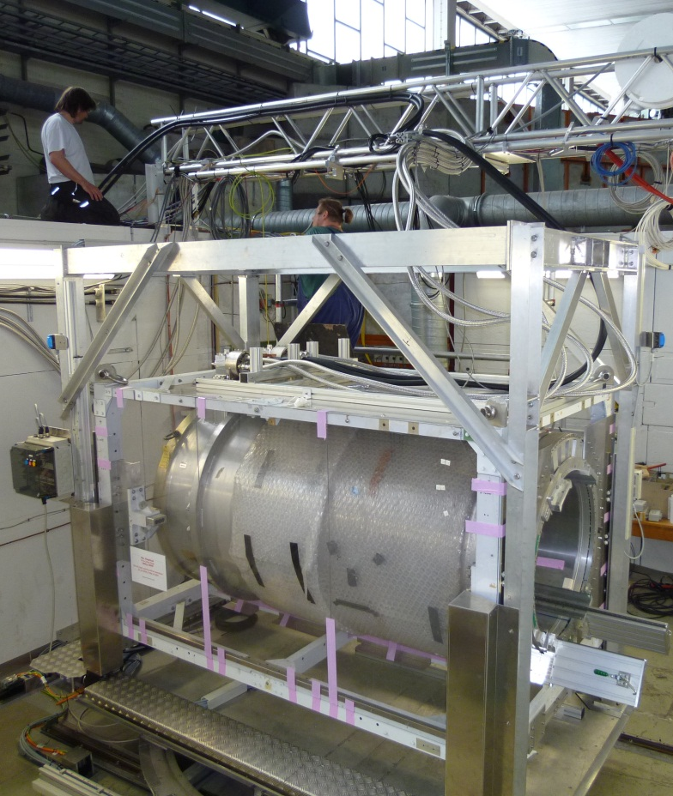
Large prototype at DESY
Modification:
Add cryo-coolers at 4 and 10K.
PCMAG is based on the conduction cooling of the thin superconducting coil from the reservoir tank filled with Liq. He. It is rather easy to switch to the cooling by cryo-coolers (actually to cool the reservoir tank).
Advantages in the operation after the modification:
Simply switch-on the cryo-coolers to start cooling PCMAG.
No Liq. He fillings, no recovery of He gas, and no pre-cooling.
Safe operation without Liq. He.
Long-period, unattended-operations possible.
May 2012 at DESY after upgrade
at Toshiba company (July,2011- March 2012)

Slide 6
Several type of readout modules are studied.
LP Modules
Readout | Pads (width:1~3mm) | Timepix (pixel: 55µm ×55µm)
MPGDs | Double GEMs (Laser-etched) Japanese team
 | Triple GEMs (wet-etched) | Triple GEMs
 | Micromegas (Resistive anode) French team | Ingrid (Micromegas)

Slide 7
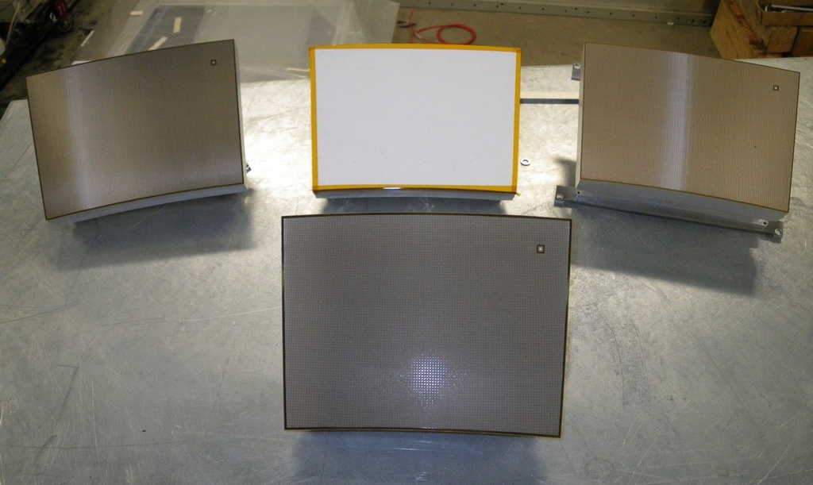
Micromegas modules (@ Saclay)
2 Resistive Kapton
~3 MΩ/□
Resistive Kapton
~5 MΩ/□
Standard
Resistive ink
~2(?) MΩ/□

Slide 8
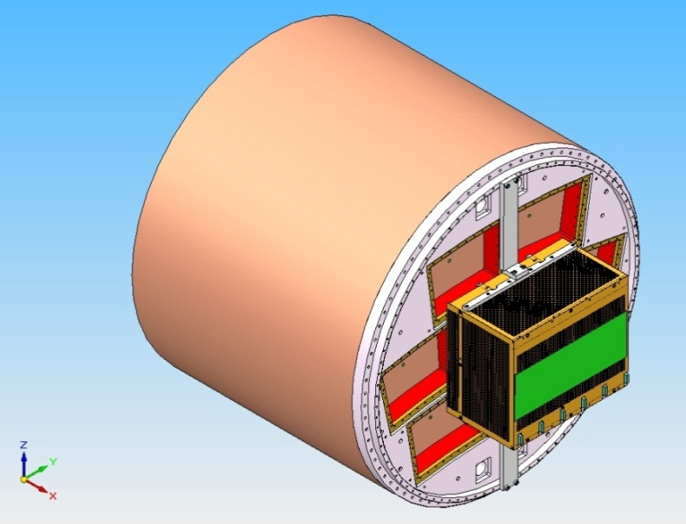
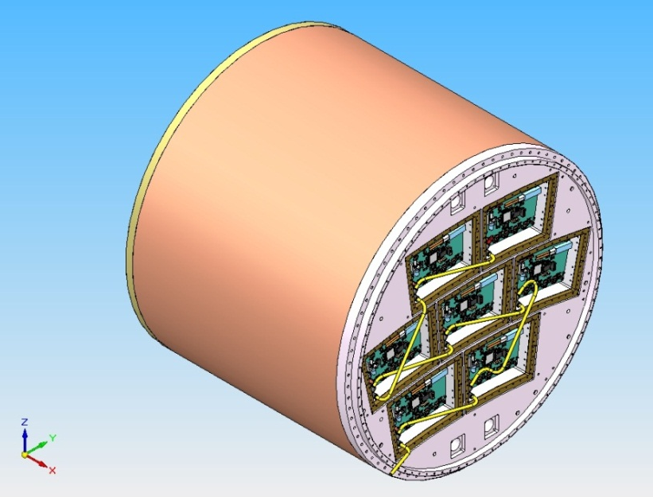
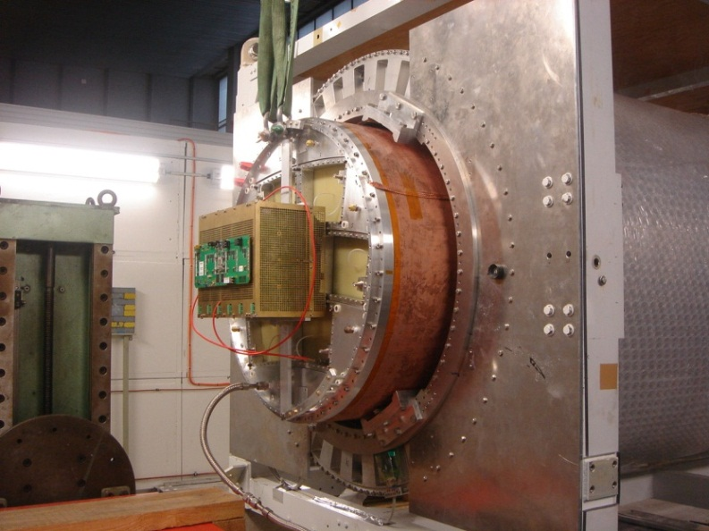
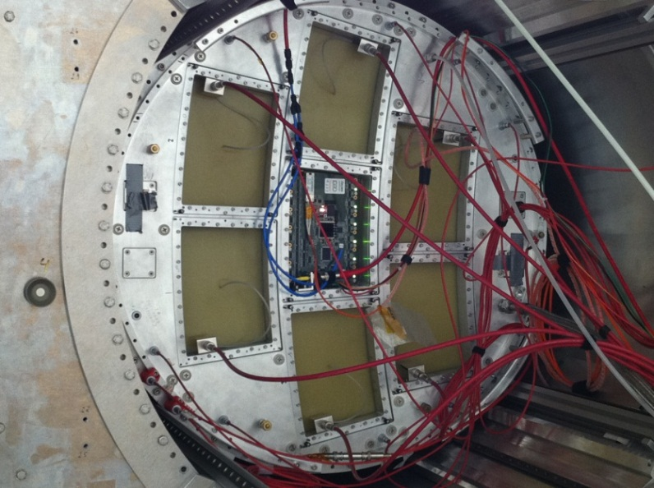
7 Micromegas modules with electronic integration

Slide 9
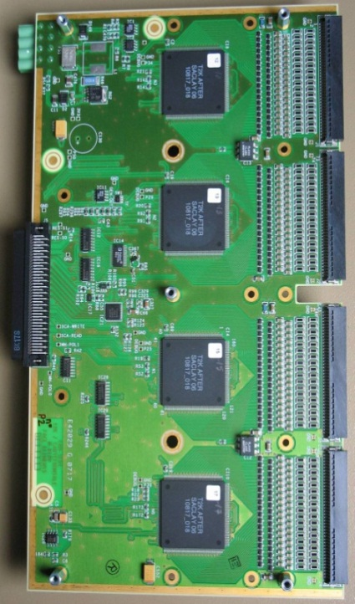
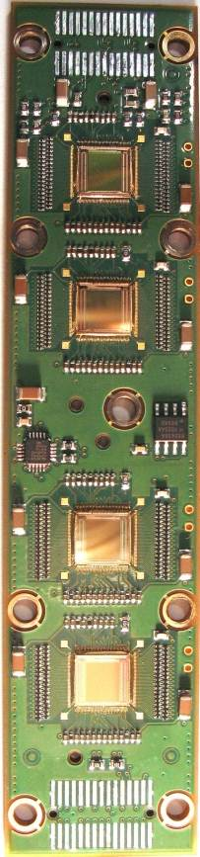
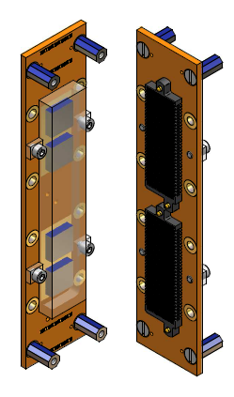
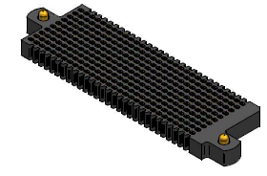
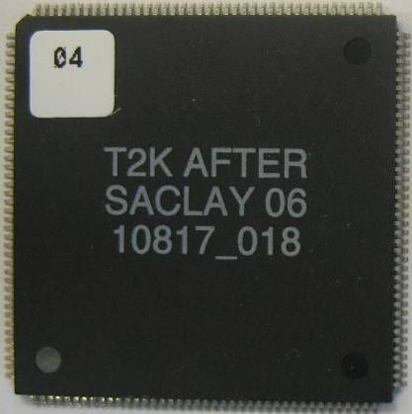
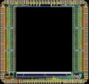
integrate electronic
Remove packaging and protection diodes
Wire-bond AFTER chips
Use 2 × 300 point connector
FEC
25 cm
4,5 cm
12,5 cm
14 cm
3,5 cm
2,8 cm
3,5 cm
0,78 cm
Chip
0,74 cm
after 2 weeks of operation: no ASIC lost:
  The resistive foil protects against sparks

Slide 10
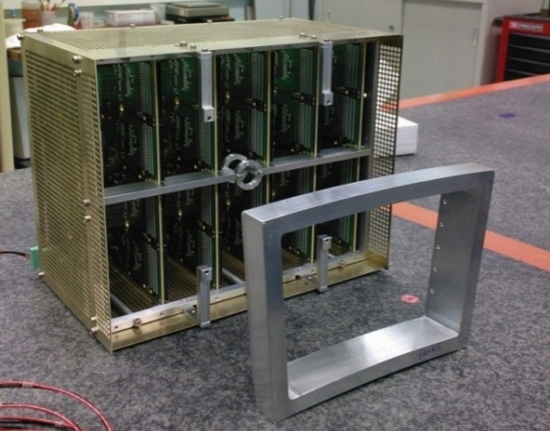
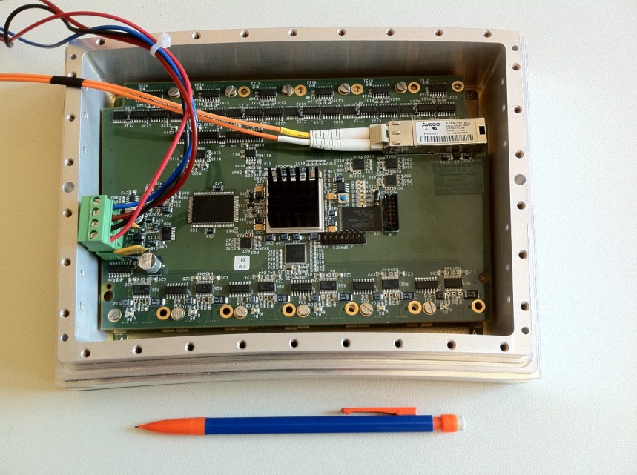
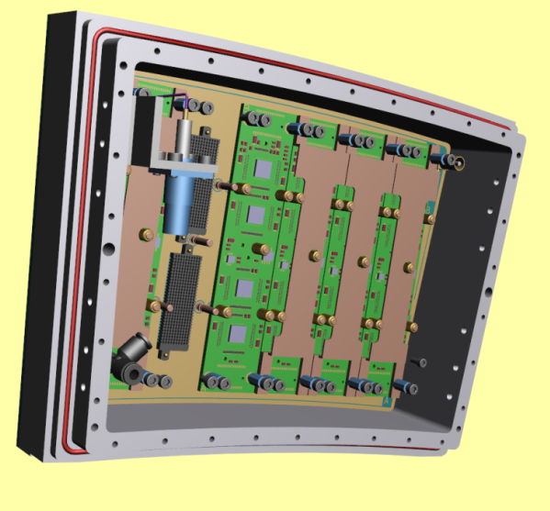
New T2K Electronics
FEC
Module frame
FEM

Slide 11
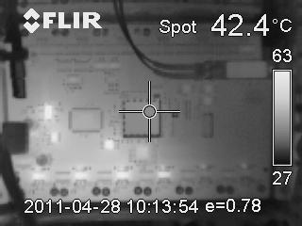
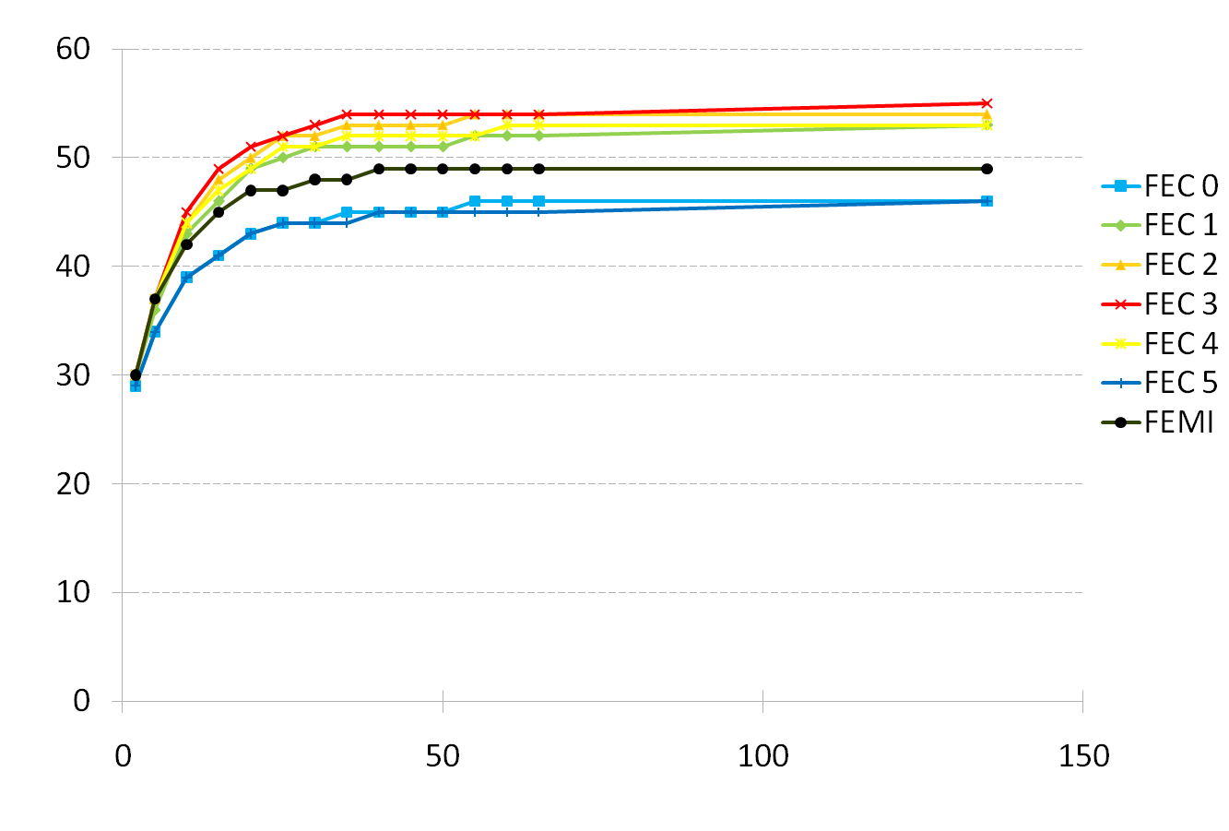
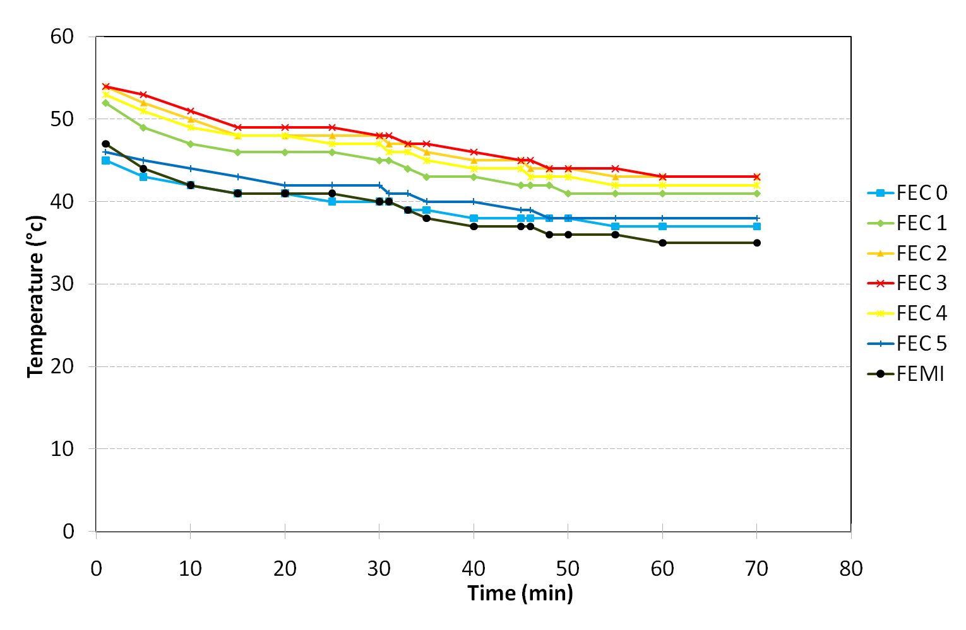
Electronics thermal studies
Temperature during switching on
Temperature after cooling (Nitrogen cooling)

Slide 12
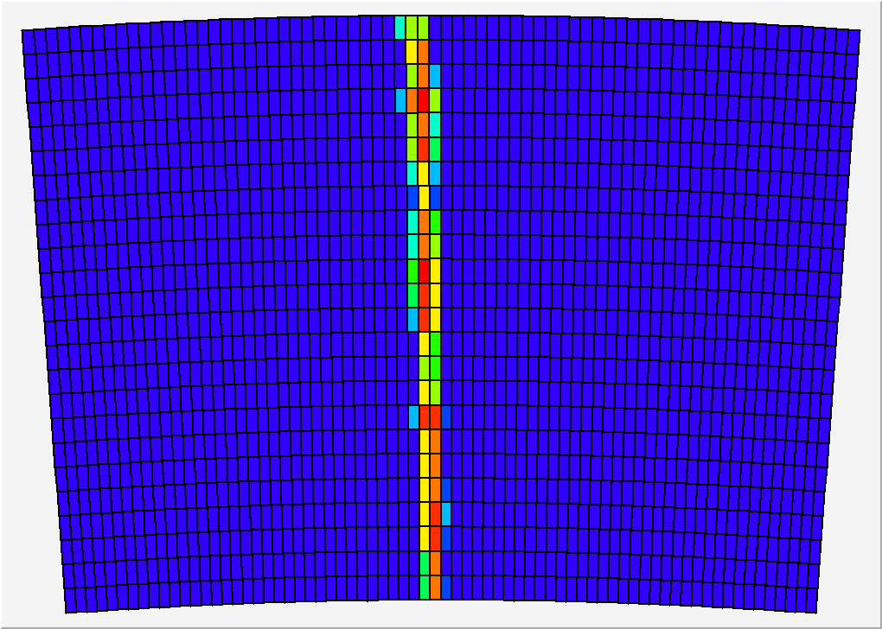
Events display
24 rows x 72 columns of 3 x 6.8 mm² pads

Slide 13
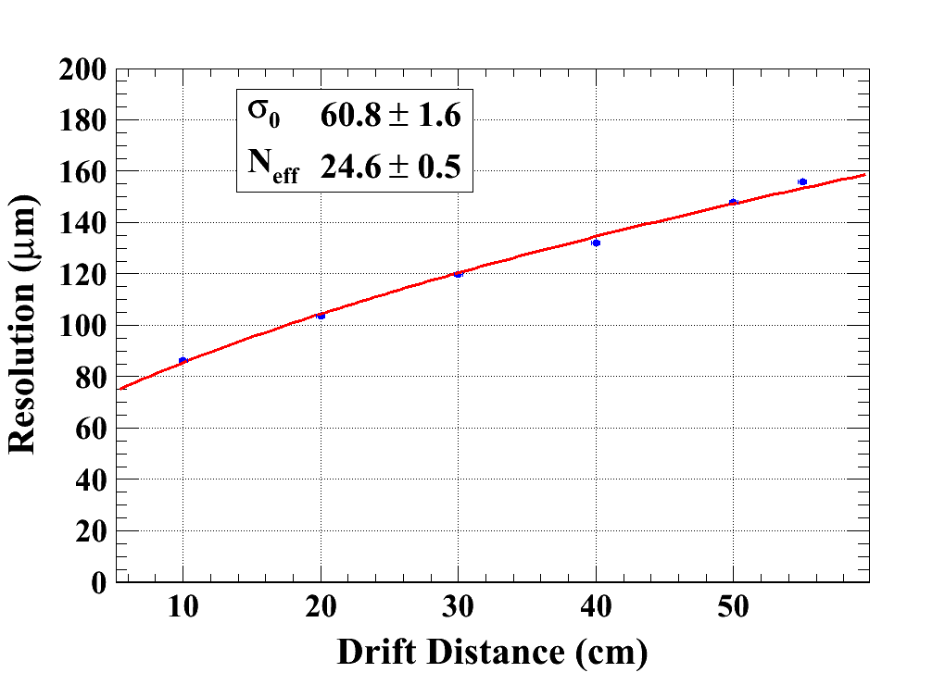
Resolution of the detector (B=1T)
σ₀ : the resolution at Z=0
N_{eff} : the effective number of electrons

Slide 14
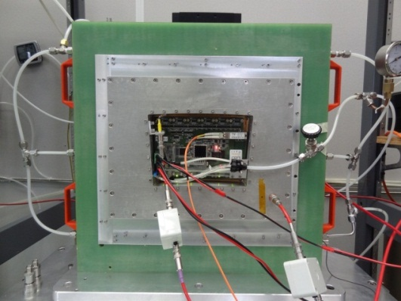
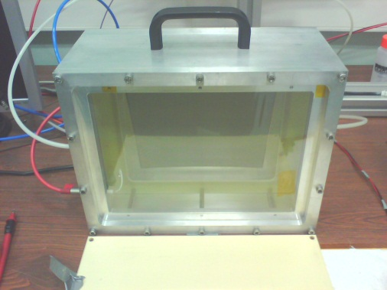
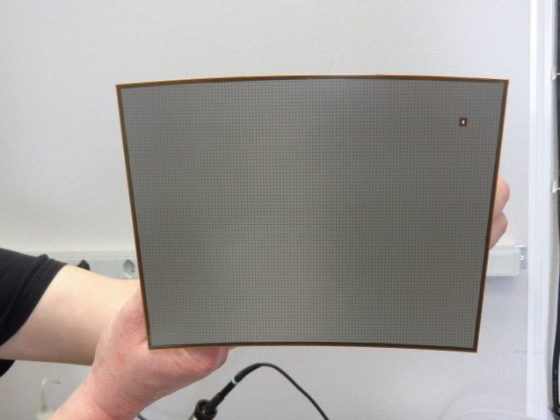
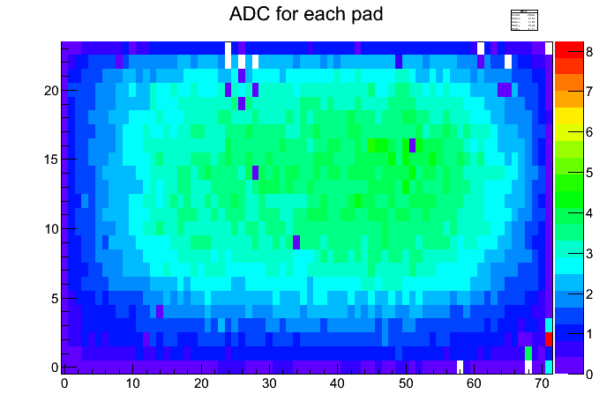
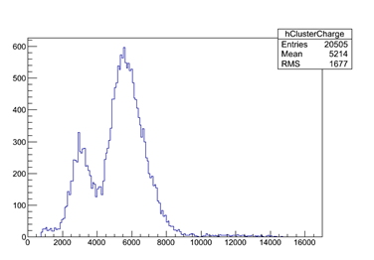
Bench test using ⁵⁵Fe
Tested at CERN
Tested at Saclay
Preliminary
⁵⁵Fe spectrum

Slide 15
Marlin TPC and Kalman filter
MarlinTPC
Marlin based simulation, digitization, reconstruction and analysis code for the TPC.
see: http://ilcsoft.desy.de/portal/software_packages/marlintpc/
KalTest: (installed in Marlin)
A ROOT-based Kalman Filter Package.
- Minimum number of user-implemented classes
MeasLayer : measurement layer
KalDetector : an array containing MeasLayers
You can put different kinds of MeasLayers
Hit : coordinate vector as defined by the MeasLayer

Slide 16
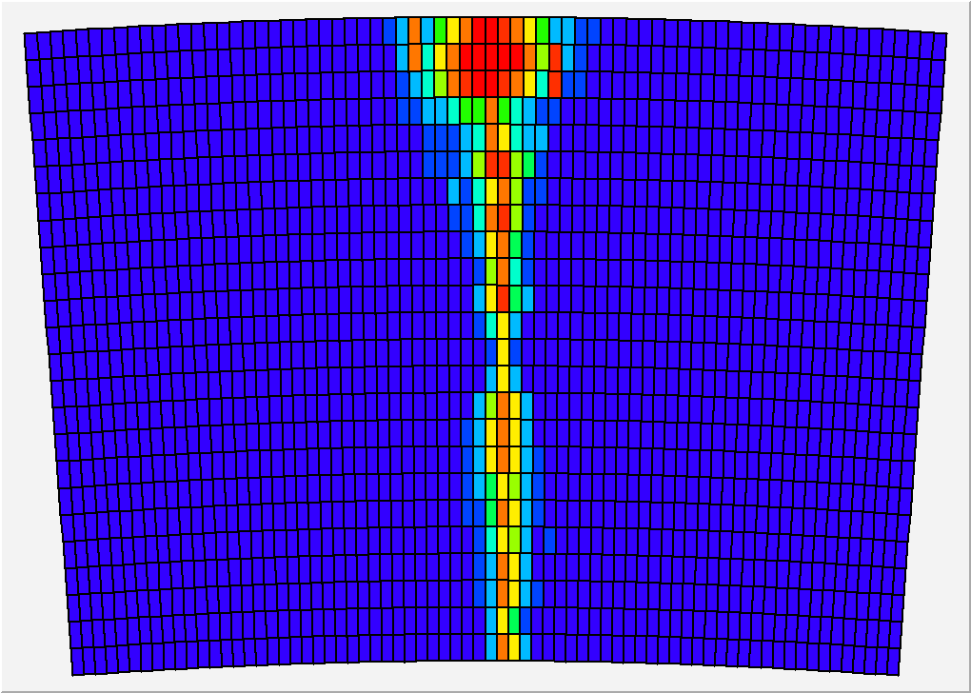
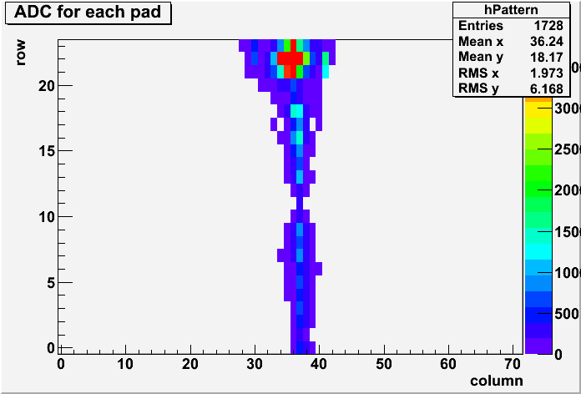
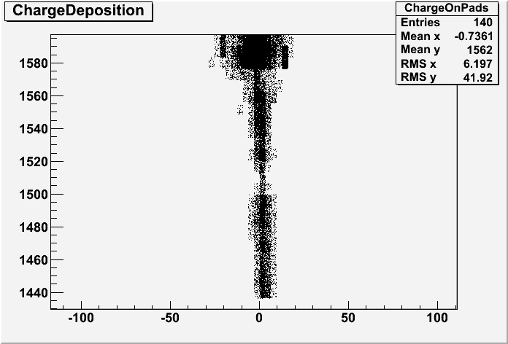
Events display
Compared some pulses between LPMon online display programme and MarlinTPC (ILC framework)
One « event display »:
Y
X
LPDisplay
MarlinTPC

Slide 17
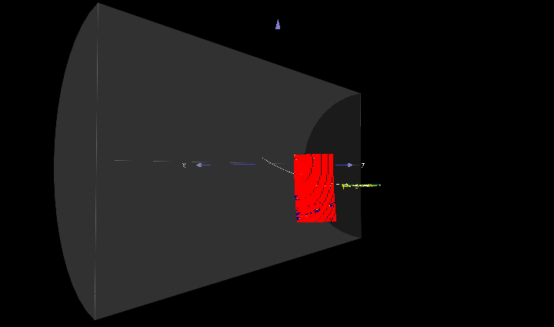
CED Viewer

Slide 18
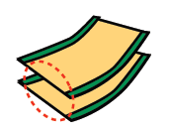
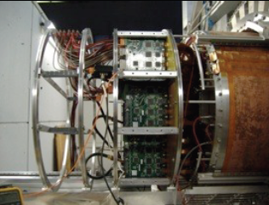
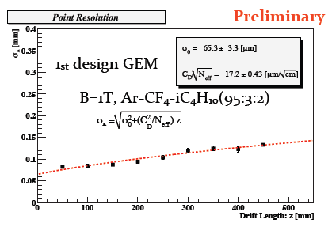
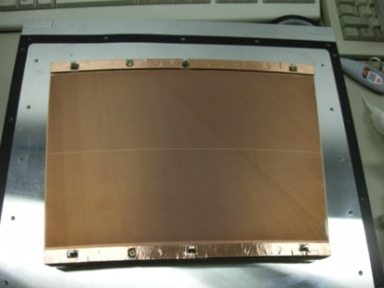
Double GEM (@ KEK)

Slide 19
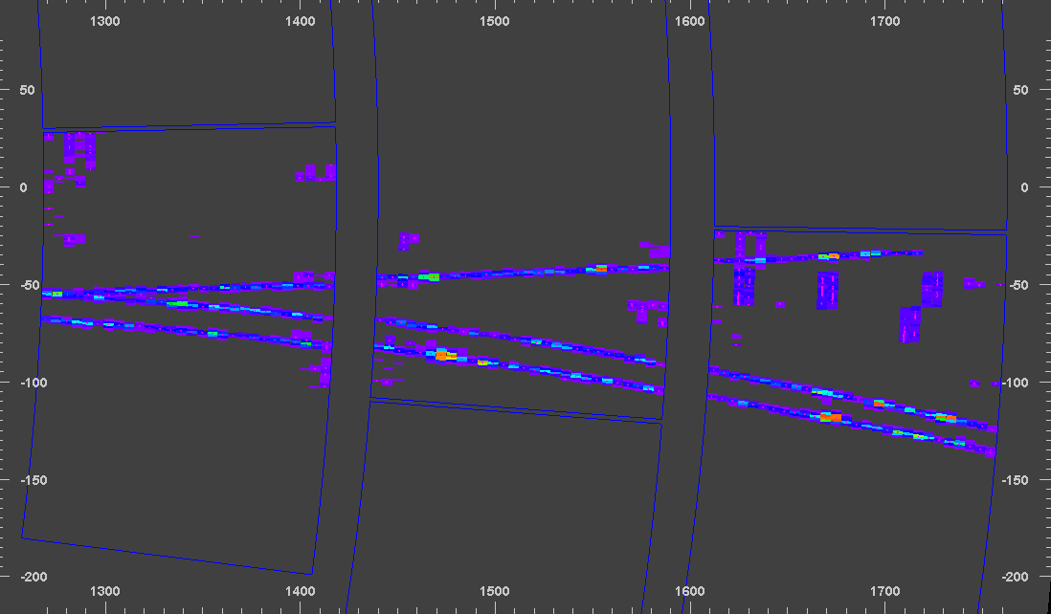
GEM events in Marlin TPC

Slide 20
Conclusion
Several type of readout modules(Micromegas and GEM) have been studied and the resolutions of both seem to fulfill the requirements for the readout of a TPC for the ILC.
Integration work (electronics and cooling) is going on.
A 2-phase CO₂ circulation cooling system was built at KEK and will be installed at DESY
Software is being developed under the MarlinTPC framework.
Plan for this year is to continue collaborative analysis of GEM and Micromegas data, and develop common software. Request 8000 € for France and 1250 k¥ for Japan(4 travels for each side).

Slide 21
Thank you!

