Slide 1

Beam test
July 2012
D. Attié, P. Colas, M. Dixit, P. Hayman, T. Maerschalk, A. Robichaud, J. Timmermans , W. Wang
LCTPC WP Phone meeting 154
July 19, 2012

Slide 2
Thanks to our DESY colleagues of Ties’s team for their support at T24.
Jan, Thierry, Carleton team and Saclay team participated in this beam test.
Everything went well during data taking.

Slide 3
We finally mounted six modules on the endplate (5 just manufactured and one from 2011).
The whole detector works smoothly. We took cosmic-ray and beam events with 1T magnet.
Data analysis is on-going using MarlinTPC.

Slide 4
Data taking summary
Z Scan (2.5cm-57cm)
Drift Field Scan(Standard field:230V/cm and low field:140V/cm)
Gain Scan
X Scan (upper and lower crack)
Phi Scan (angle: 0-15)
Peaking Time Scan (100ns-700ns)
Cosmics and beam, B=0 and 1T

Slide 5
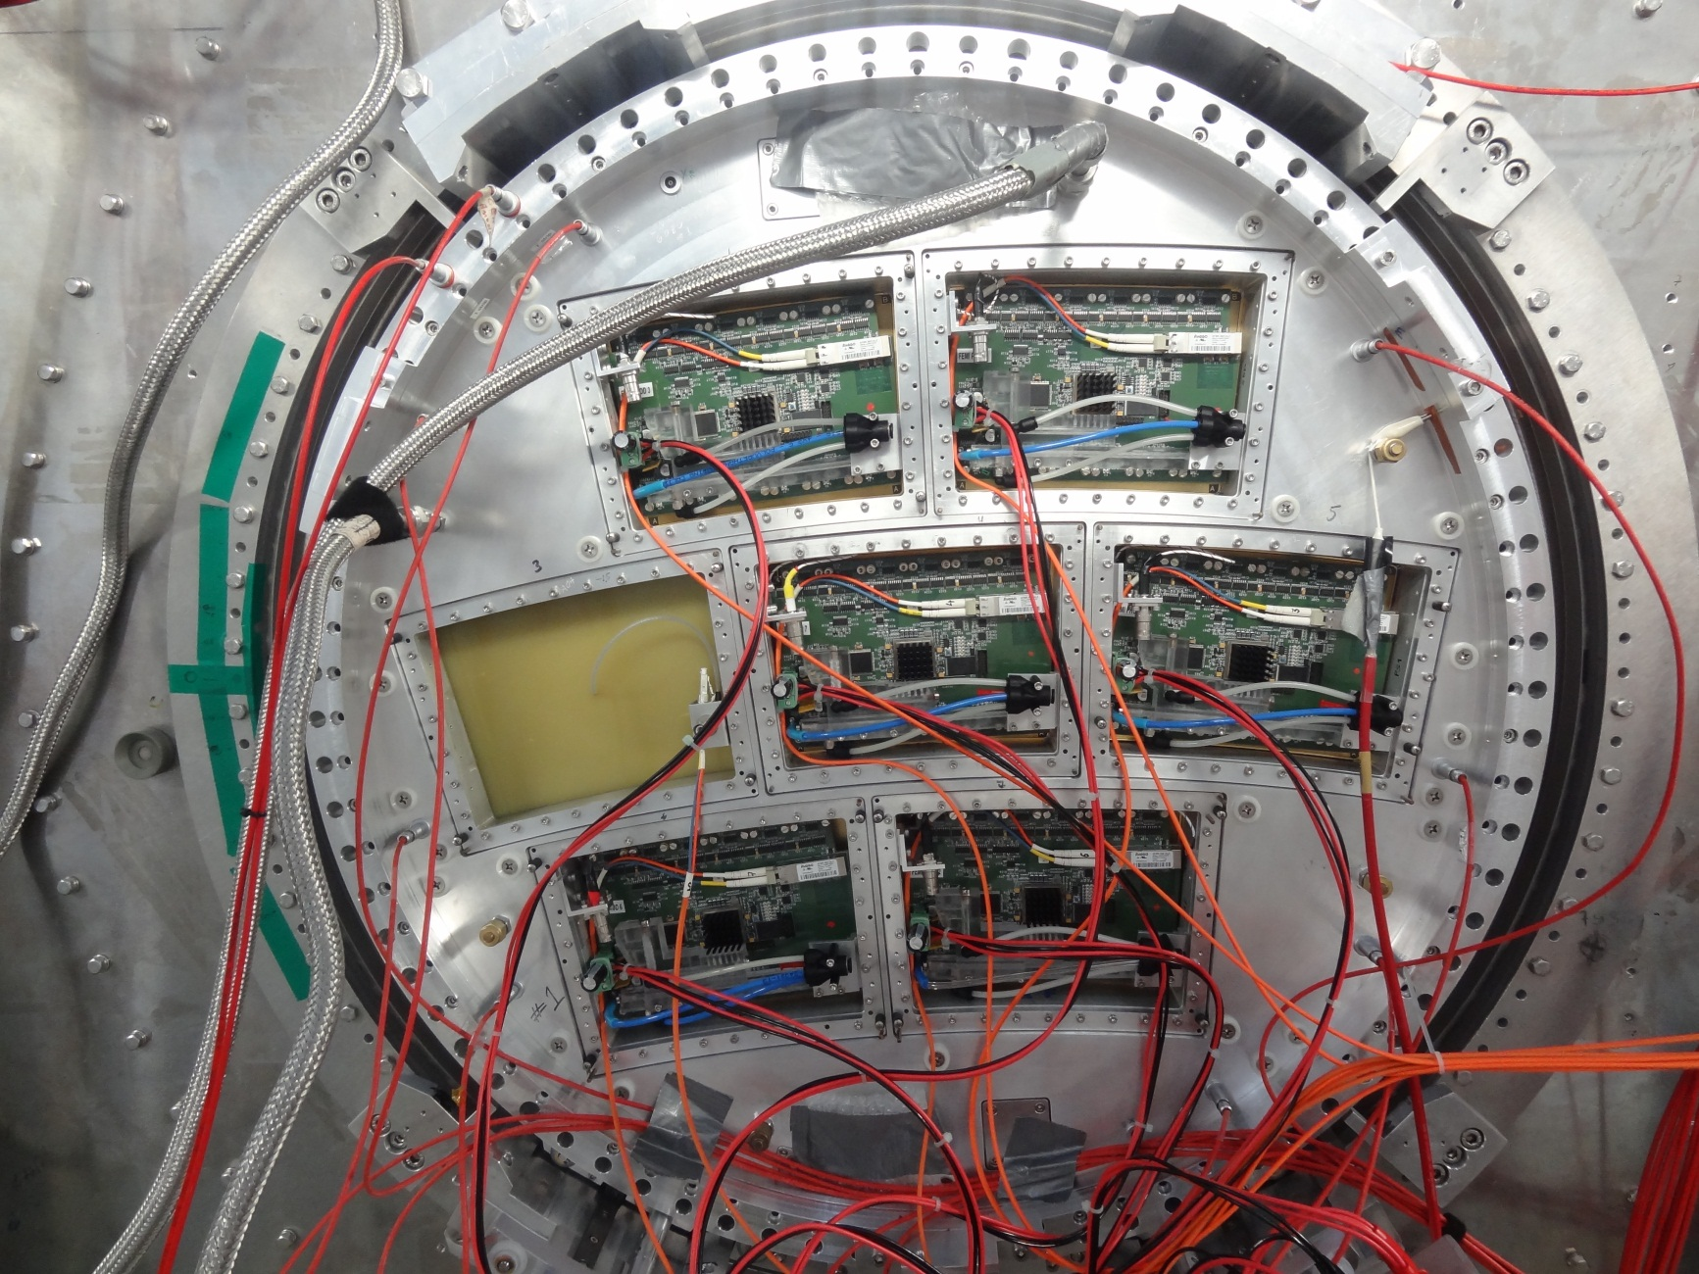

Slide 6
