Slide 1
Status of Micromegas TPC Analysis very preliminary
P.Colas, D.Attie, W.Wang @Saclay
P.Hayman et al @Carleton
With the help of Martin Killenberg, Li Bo

Slide 2
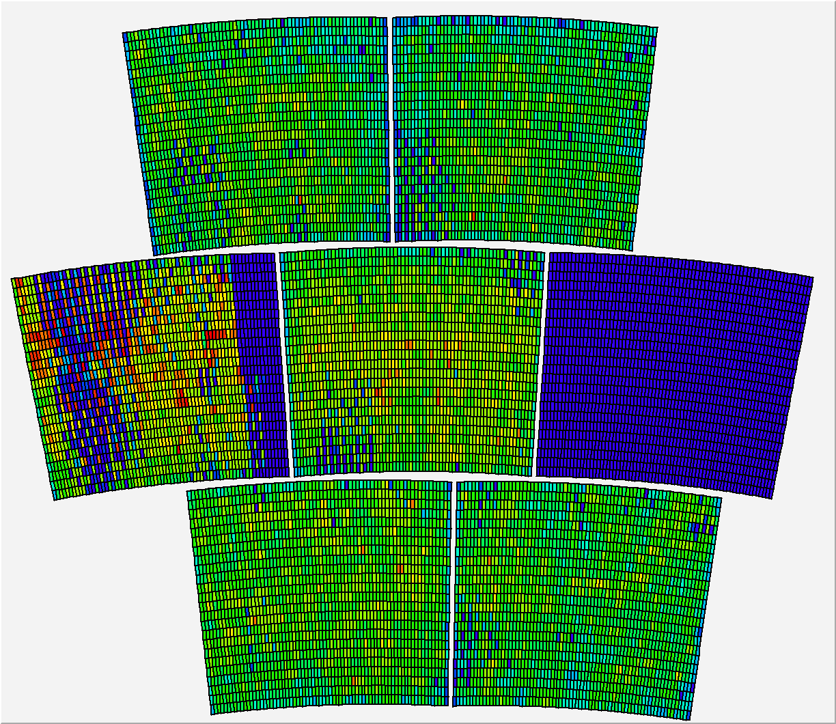
Integrate all events using cosmics data

Slide 3
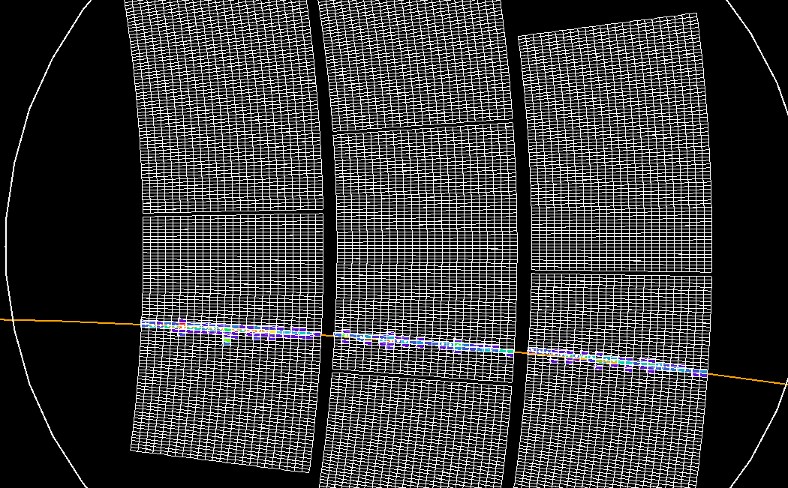
Track fit

Slide 4
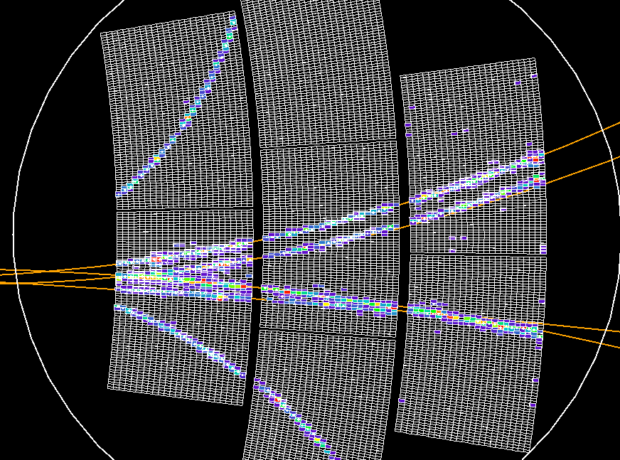

Slide 5
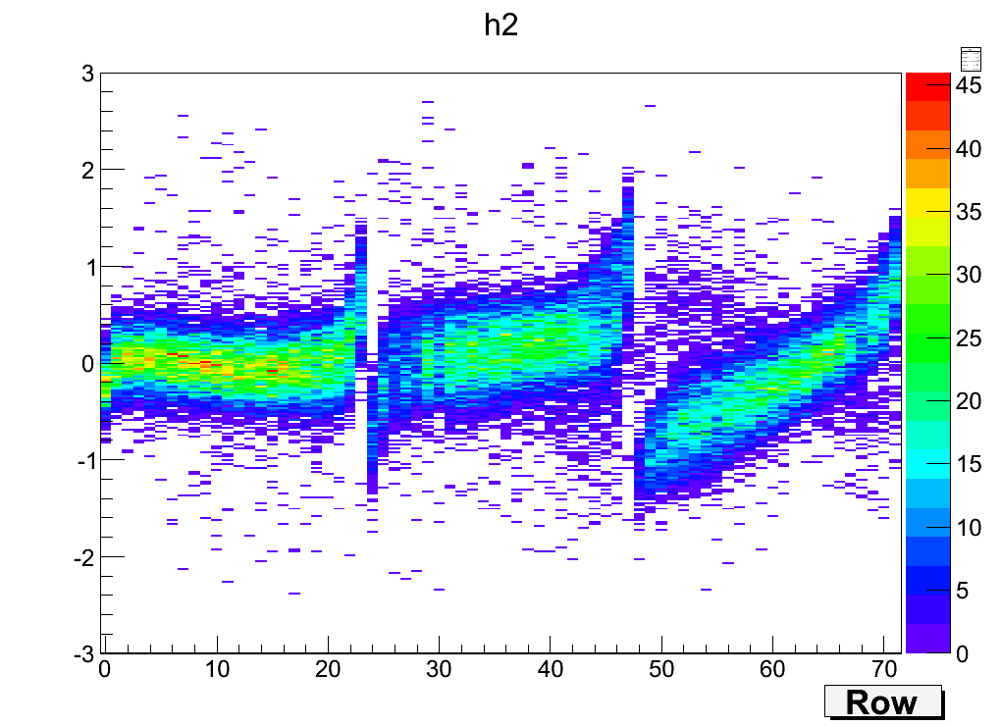
Residual

