Slide 1
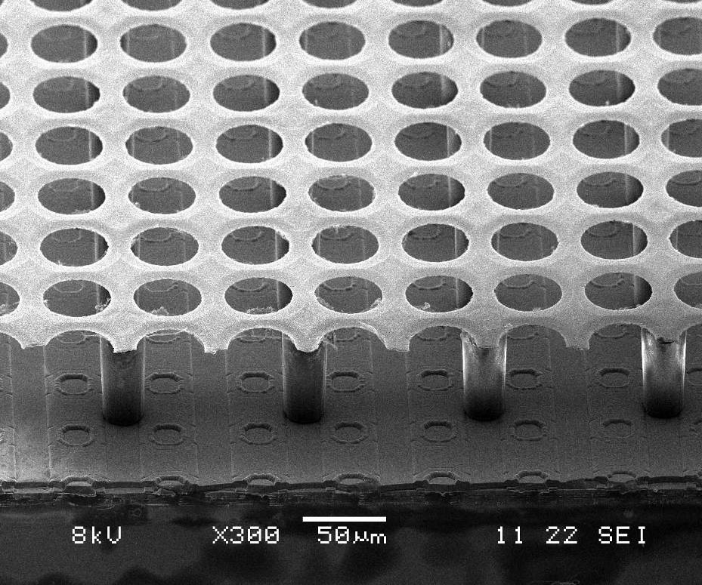
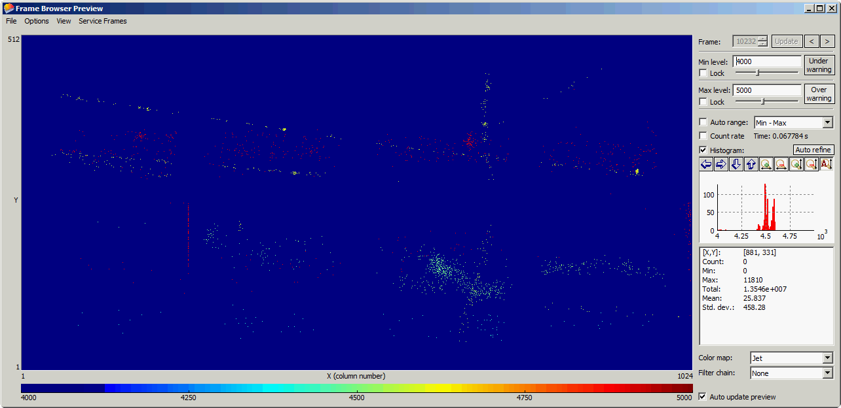
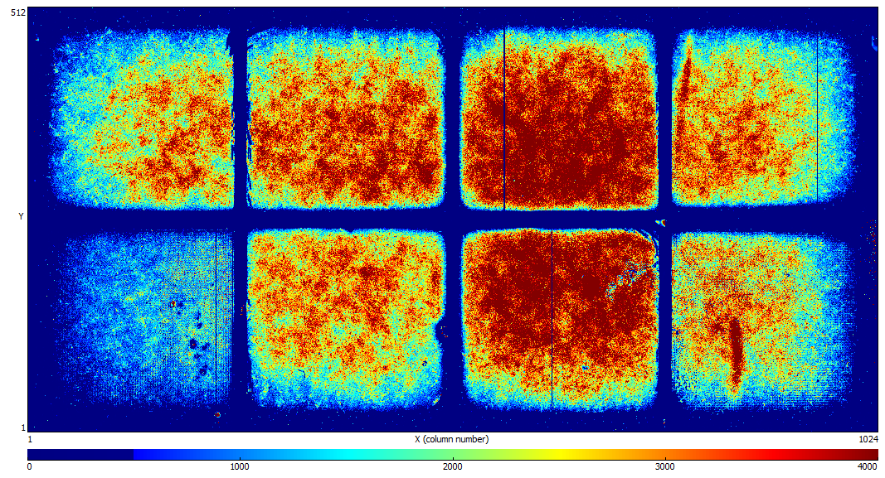
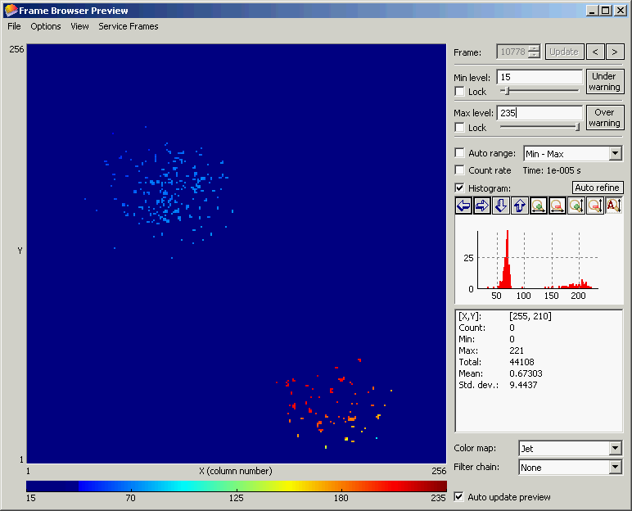

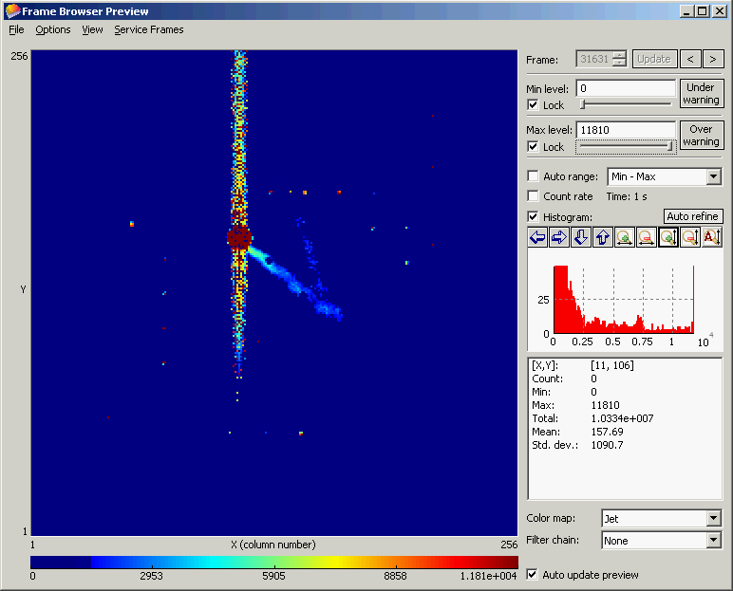
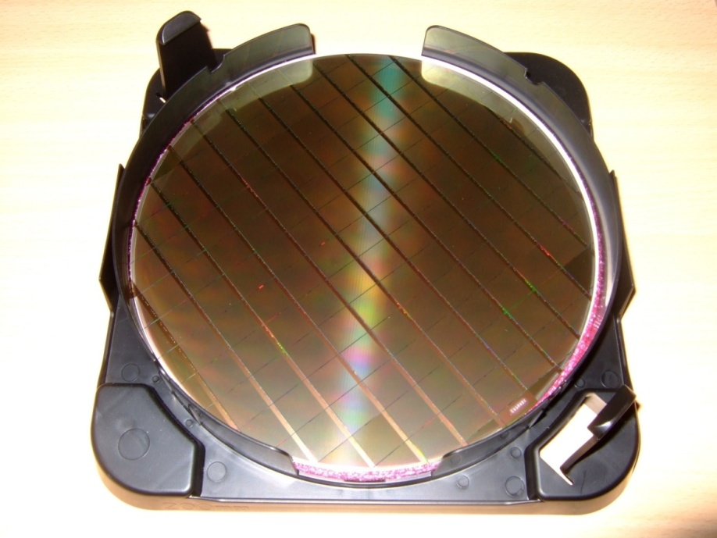
Ingrid
Recent Ingrid Studies and DESY Test-Beam
Results with Octopuce
A. Chaus, D. Attie, P. Colas, M. Titov
CEA Saclay, Irfu/SPP, France
OUTLINE:
“Octopuce” Uniformity Studies in the Laboratory
DESY Test-Beam Track Reconstruction with Octopuce
Tests of IZM-3 InGrids
Future InGrid Tests using Low Energy Electrons from PHIL at LAL
International Workshop on Future Linear Colliders
University of Texas at Arlington, October 22-26, 2012

Slide 2
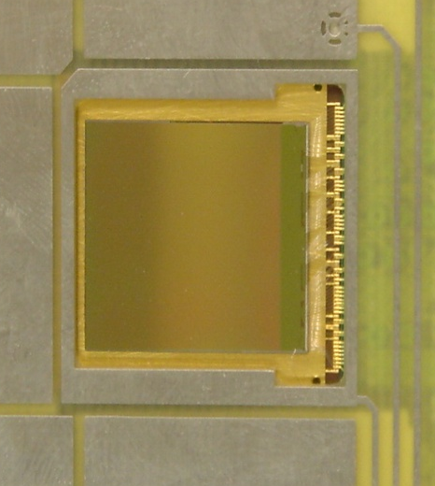
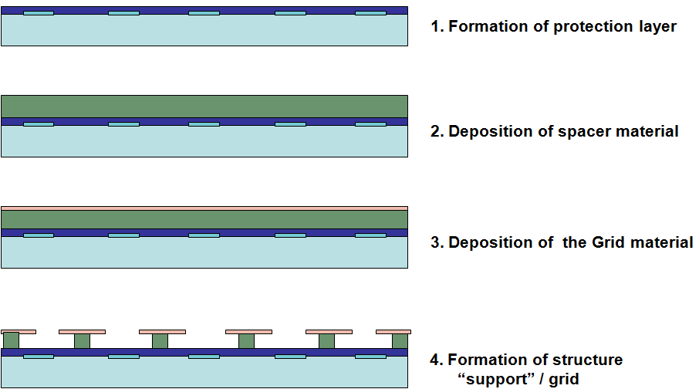
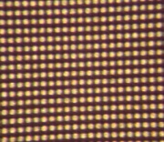
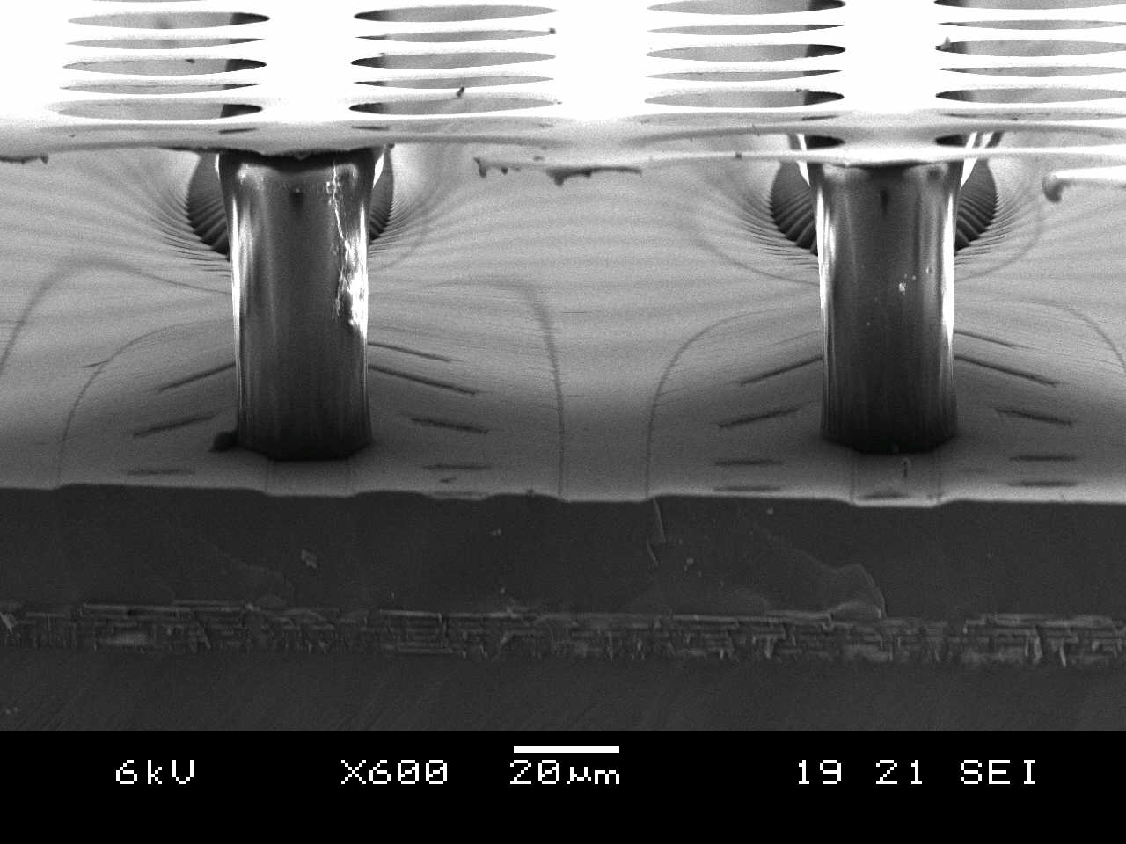

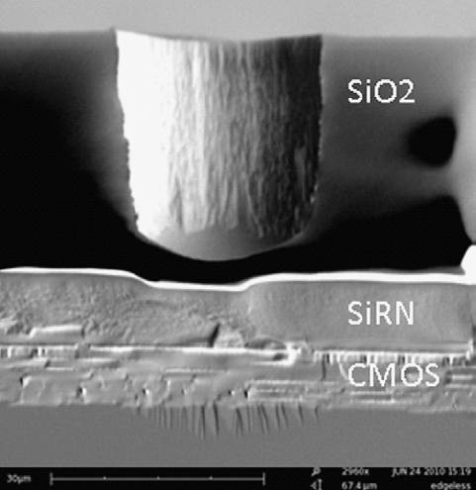
Integrated Electronics: Pixel Readout of Micro-Pattern Gas Detectors
3D Gaseous Pixel Detector → 2D (CMOS pixel chip readout) x 1D (drift time)
Through POST-PROCESSING INTEGRATE
MICROMEGAS directly on top of CMOS chip
Bump bond pads for Si-pixel
Detectors - Timepix or
Medipix2 (256 × 256 pixels
of size 55 × 55 μm2) serve
as charge collection pads.
(e.g. Si3N4)
(e.g. SU8)
Each pixel can be set to:
● TOT ≈ integrated charge
● TIME = Time between hit and shutter end
“InGrid” Concept:
50 - 80 μm
Protection Layer (few μm)

Slide 3
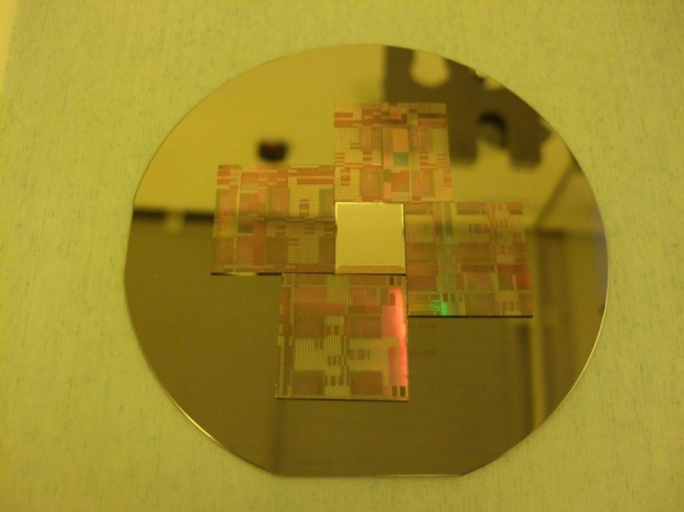
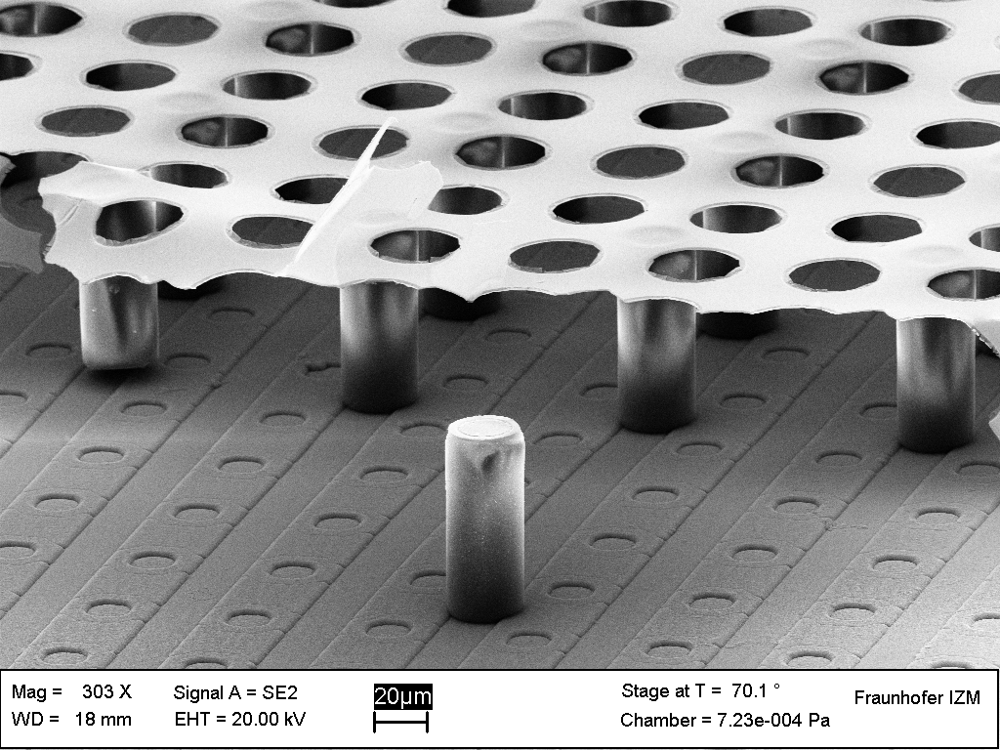
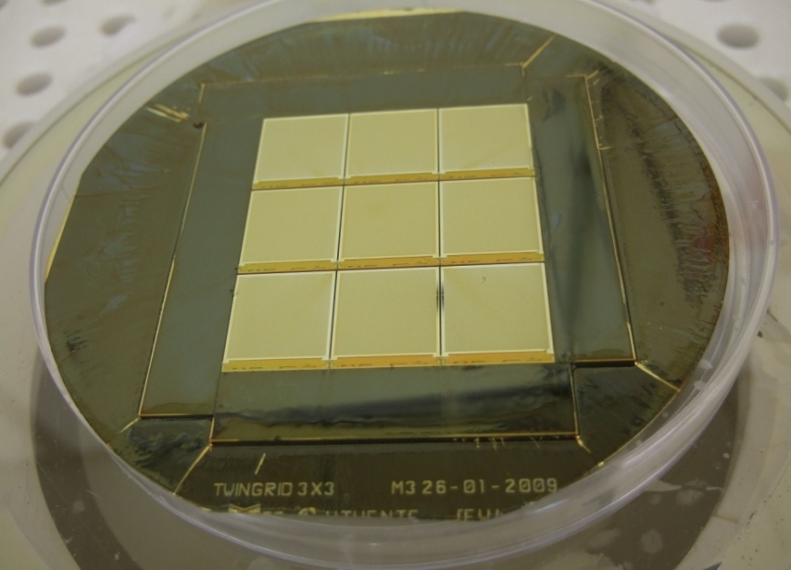
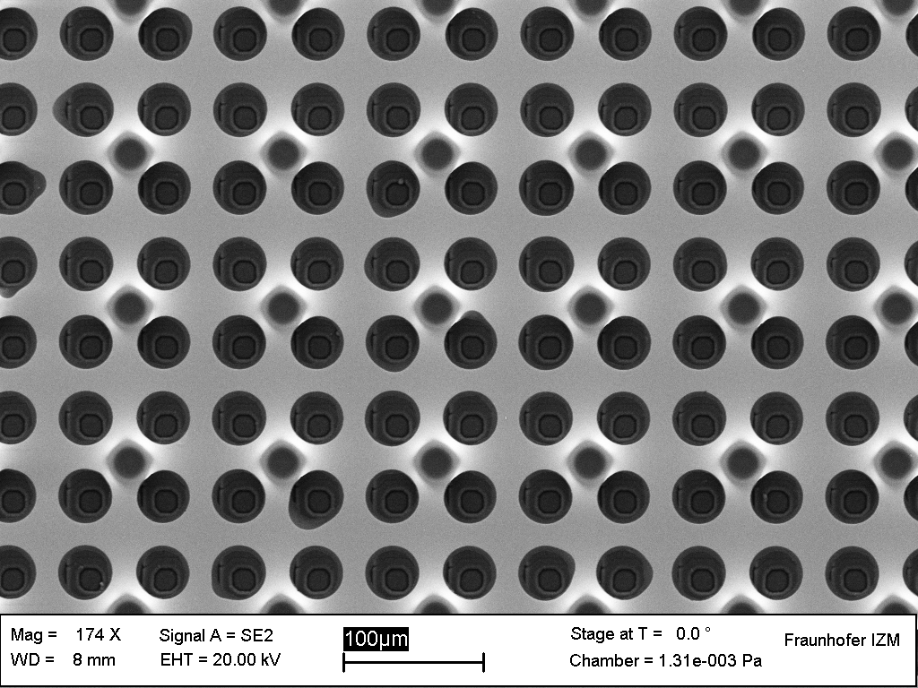
“InGrid’ Technology and “Driving” Developments
2005: Single “InGrid” Production
2011: Major Step Forward →
InGrid Production on a wafer level (107 chips)
2009: “InGrid” Production on a
3 x 3 Timepix Matrix

Slide 4

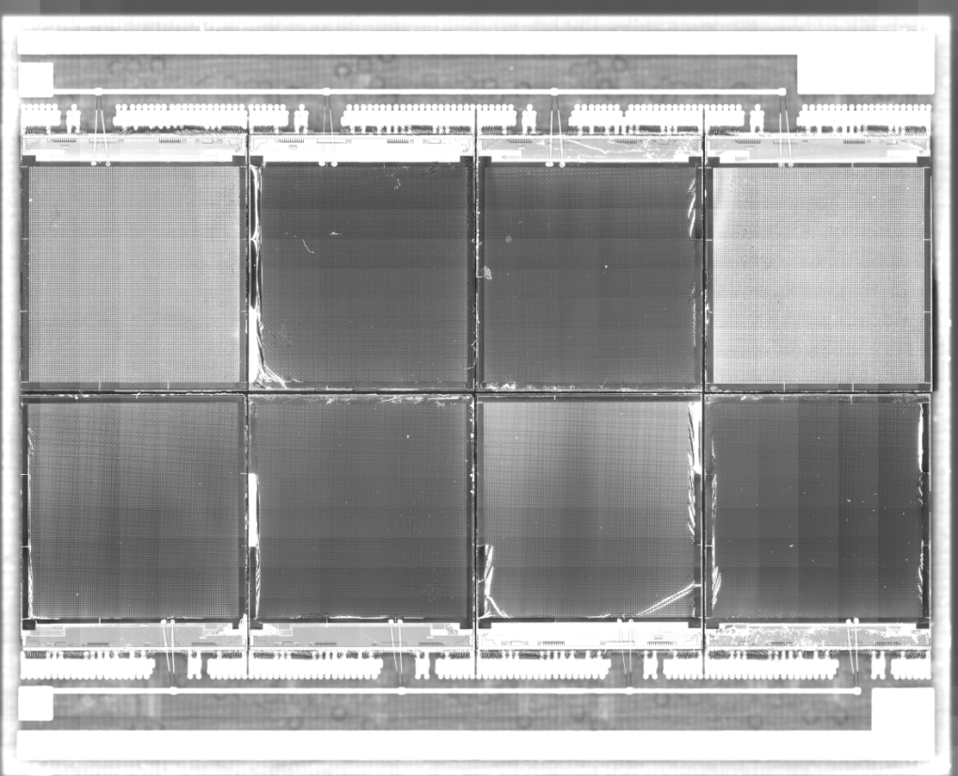
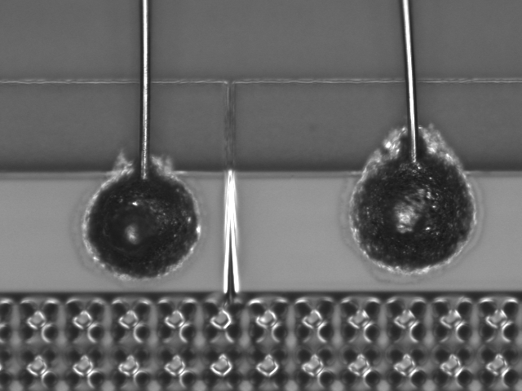
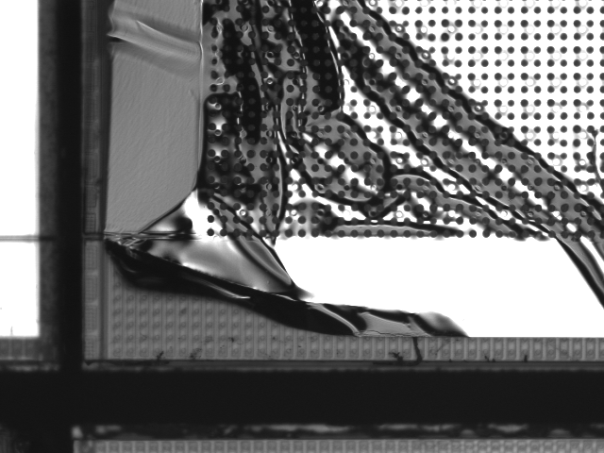
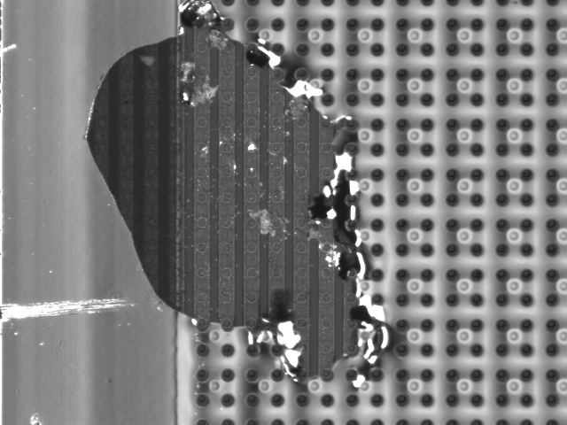
The “Octopuce” (2009)
chip 4
chip 1
chip 5
chip 8
Non homogeneous area on the mesh of different chips
HV connections
“Grid irragularities”

Slide 5
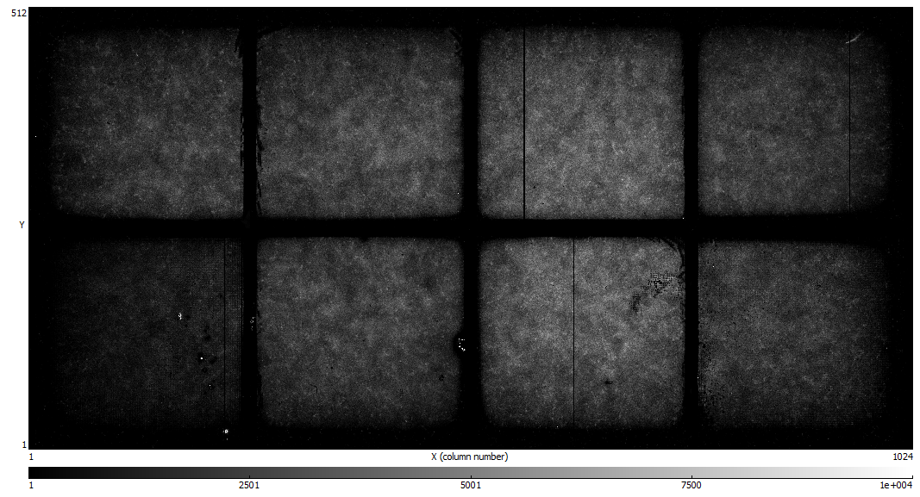
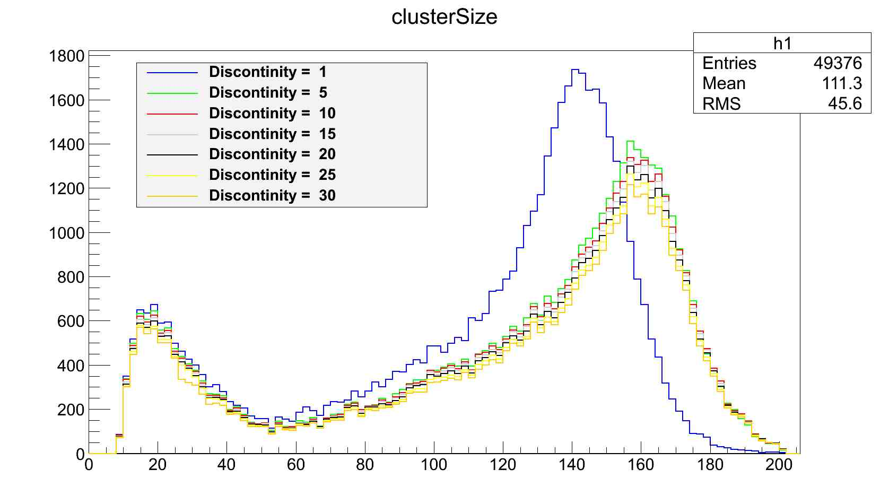
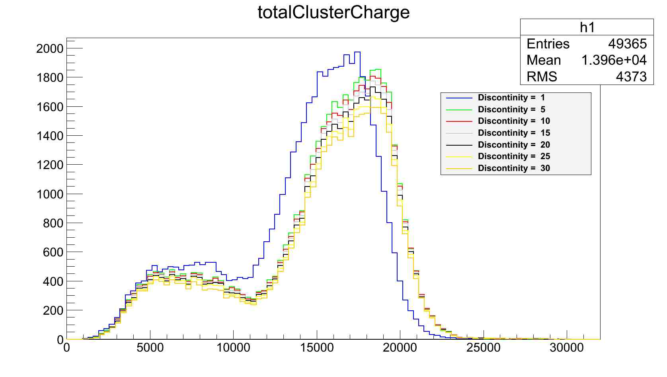
Octopuce Studies & Fe55: Homogeneous Irradiation
Fe⁵⁵ Studies (26/07/2012):
He/Iso 80/20
Vmesh=390 V
Vdrift =3000 V
Chip 8
Chip 5
“Hot spots”
Chip 4
Integrated picture for all 8 chips:
(discontinuity = distance
between pixels in the cluster)
Chip 1
(pixels)
(sum of
pixels TOT)
5

Slide 6
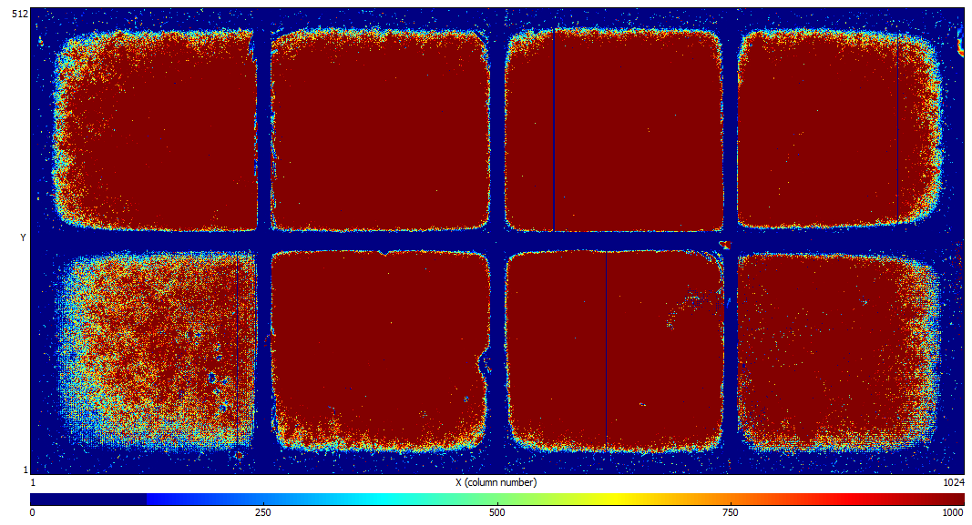
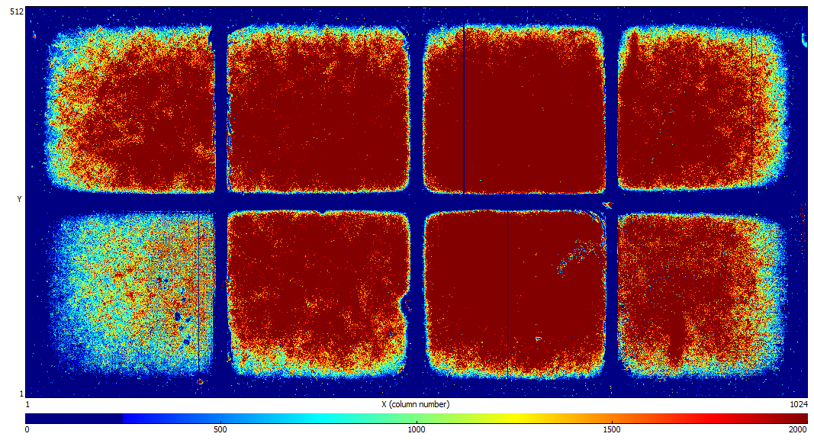
Octopuce: Uniformity of the Response (I)
THRESHOLD = 1000 COUNTS
THRESHOLD = 2000 COUNTS
Chip 8
Chip 5
Chip 1
Chip 4
THRESHOLD = 4000 COUNTS
Non-sensitive (~ 1.5 mm)
areas between chips
Fe⁵⁵ Studies (26/07/2012):
He/Iso 80/20
Vmesh=390 V
Vdrift =3000 V

Slide 7
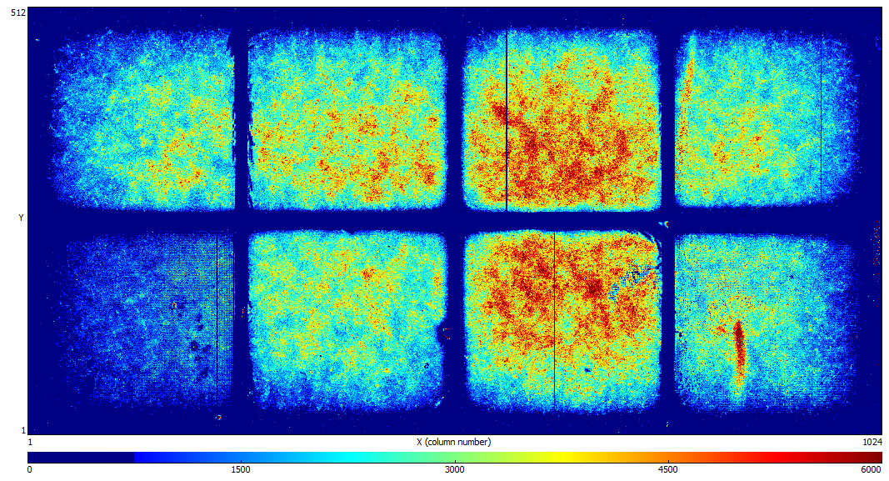
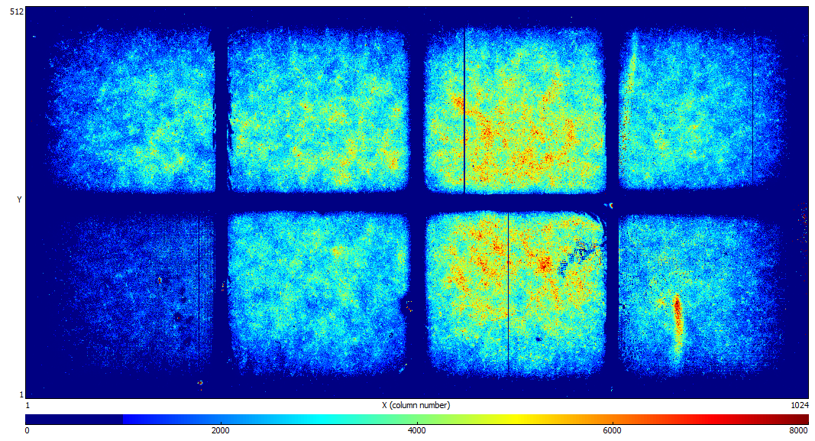
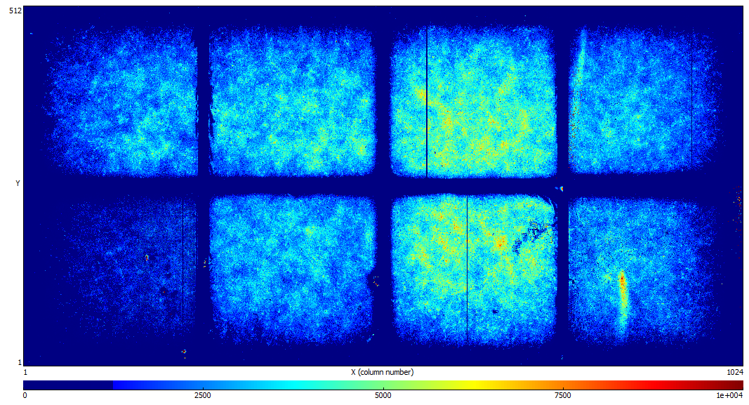
Octopuce: Uniformity of the Response (II)
THRESHOLD = 6000 COUNTS
THRESHOLD = 8000 COUNTS
THRESHOLD = 10000 COUNTS
Non-sensitive (~ 1.5 mm)
areas between chips:
More studies required to understand:
if “dead” areas between chips decreases
with increased drift field;
“dead” area on the outer edge as a
function of the guard voltage

Slide 8
Octopuce: Cluster Size Distribution
Single electron sensitivity is very high for all (but 1 and 4) chips
Expected number of primary electrons in He/Iso (80/20) ~ 165

Slide 9
Octopuce: Total Cluster Charge
Chips 1 and 4 have a lower response (same trend as for the cluster size distribution) →
Difference in amplification gap
Difference in threshold (too big to explain differences between 1 &4 and others)
After equalization:
Chip number | Threshold level
1 | 337
2 | 335
3 | 340
4 | 335
5 | 330
6 | 327
7 | 330
8 | 320
Some differences in amplification gaps between different chips are seen by microscope
(studies are not conclusive, might come from different thickness of the glue under the chips)

Slide 10
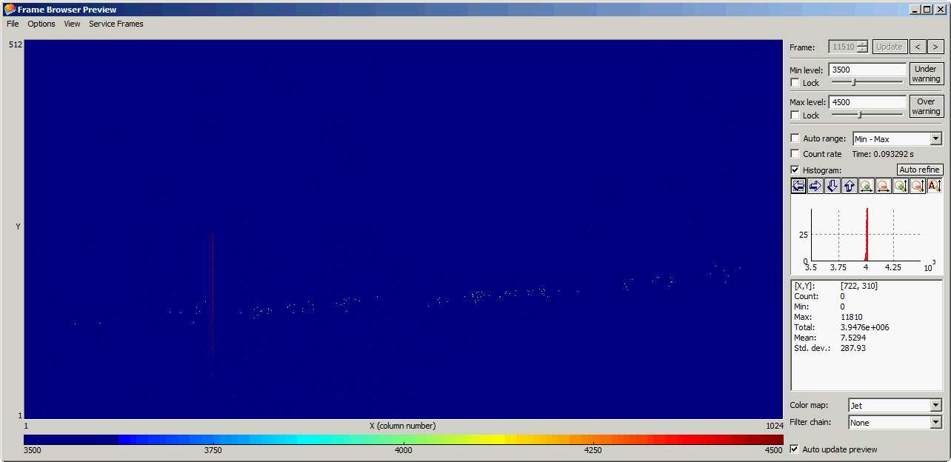
B = 0 T
He/iC₄H₁₀(80:20)
4 chips
DESY Test-Beam with Octopuce & Large Prototype TPC (December 2010)
2 chips
B = 1T
He/iC₄H₁₀(80:20)

Slide 11
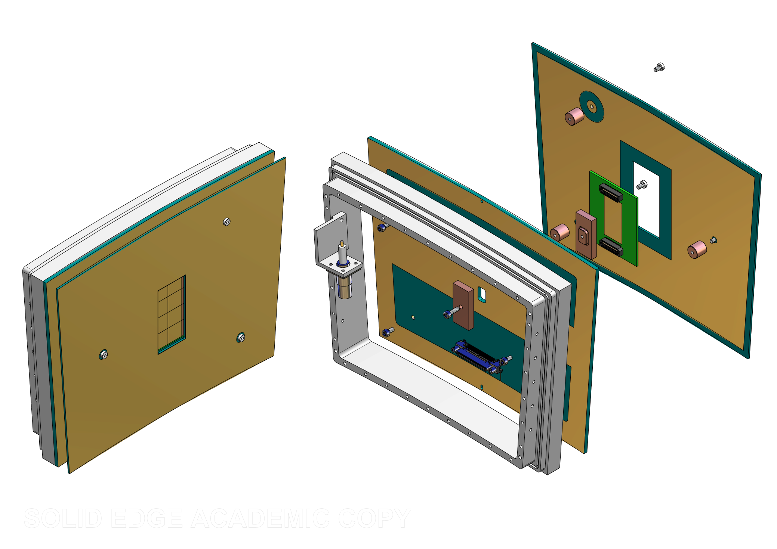
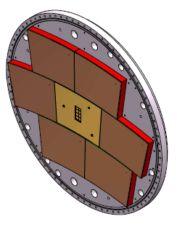
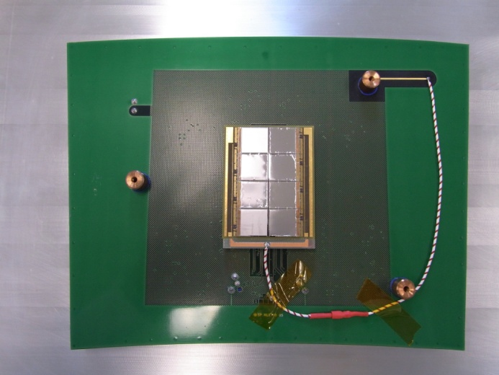
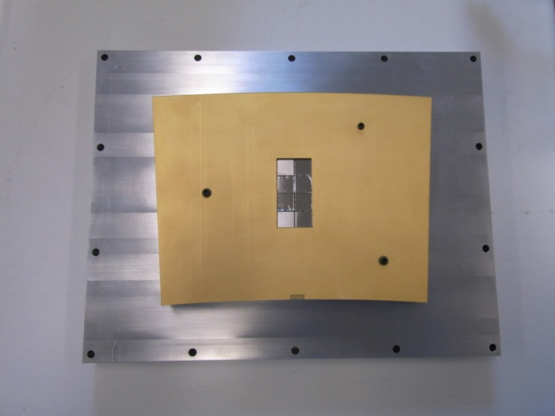
“The Octopuce” in the Large Prototype TPC
Chips on a mezzanine board making wire bonding easier
Large Prototype compatible
Heat dissipator
Guard ring
Mother board
Mezzanine board
Timepix pane for Large Prototype TPC

Slide 12
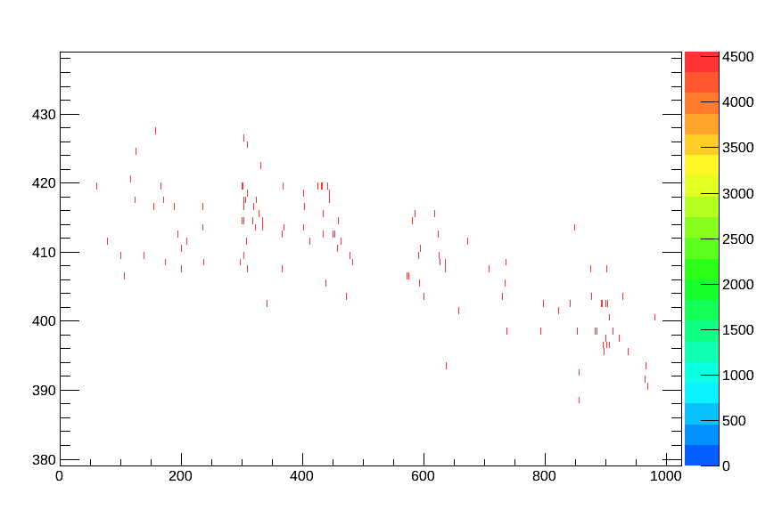
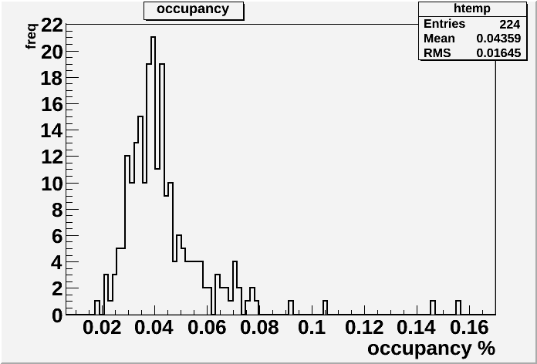
Octopuce in the Large Prototype TPC at 0 T
He/Iso 80/20
V_{mesh} = 380V
Time mode
Shutter Time: 100 μs, start given by beam trigger
Example of a typical event:
Occupancy is very low:
< 0.1 % (no noisy frames)

Slide 13
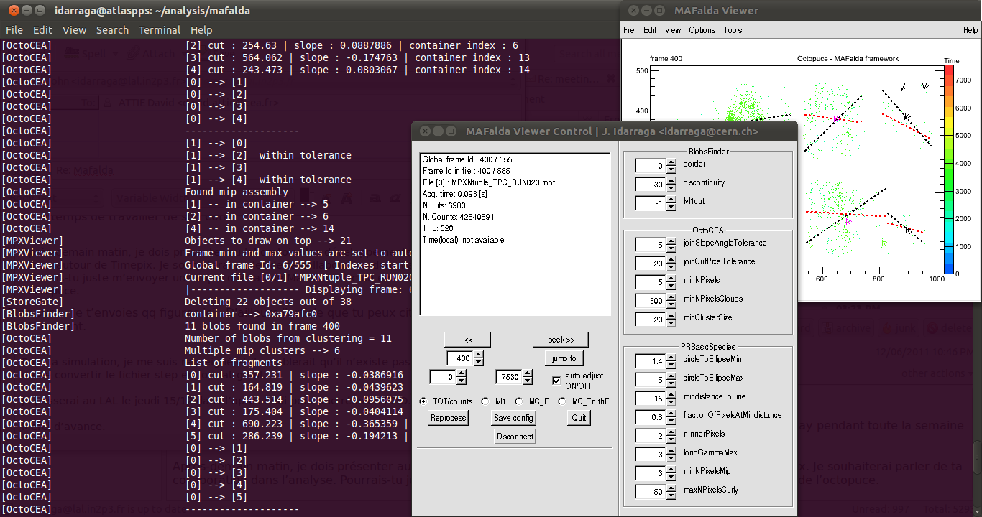
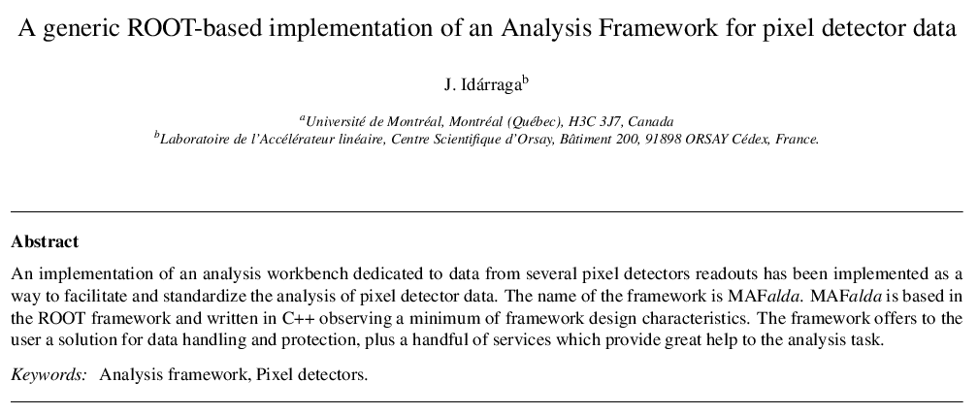
MAFalda: Medipix Analysis Framework
ROOT based analysis package developed by John Idarraga (LAL)
C++ classes including processors:
  OctoCEA (define in a few minutes)
  Pattern recognition of tracks for low threshold
Use MAFalda as the first step → implement reconstruction algorithm in Marlin TPC

Slide 14
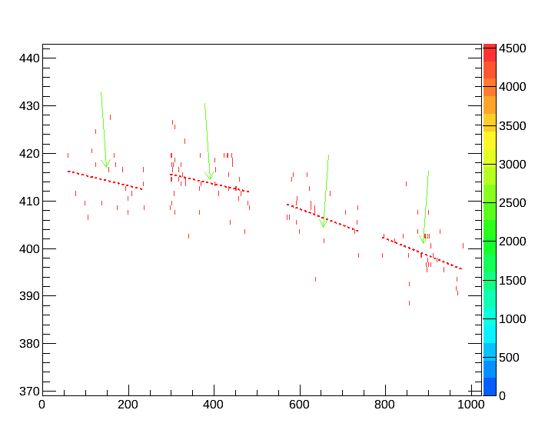
MAFalda: Cluster Finding and Track Segments (I)
Form cluster from the pixels with “discontinuity” < 40 pixels (each cluster
should contain > 12 pixels)
Calculate the linear regression with all points in the cluster (red dotted line)
Calculate residuals from the red line to each point (if > 80 % the points are within 20 pixels – this is the “track segment” !

Slide 15
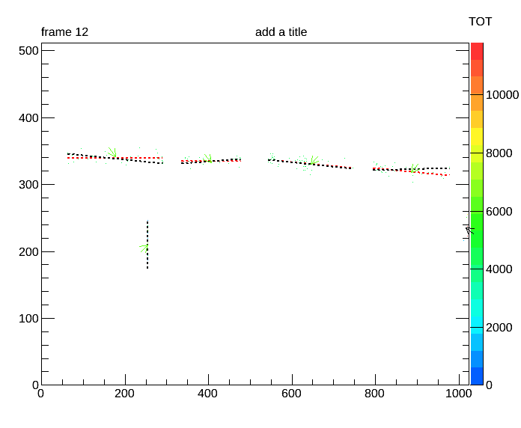
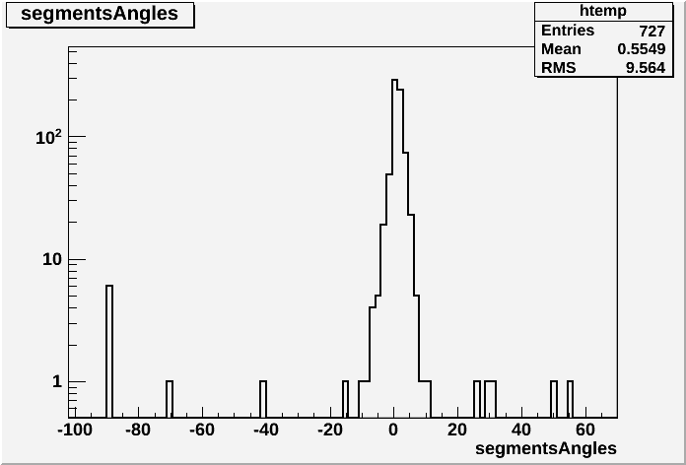
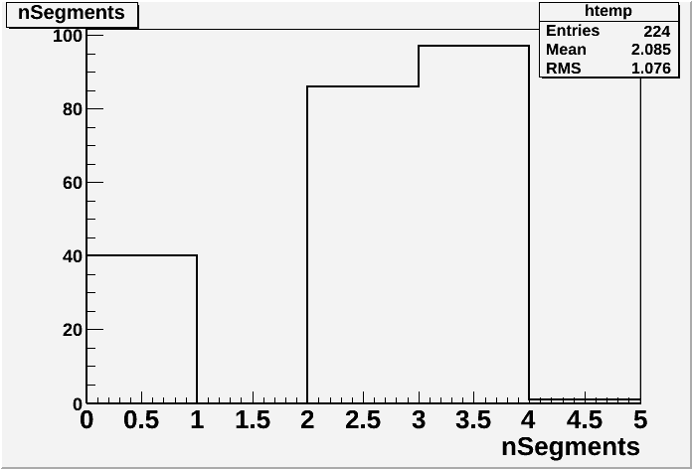
MAFalda: Cluster Finding and Track Segments (II)
Check incident angles of track segments
→ Take segments within +/-10 degrees
(electron beam is in the horizontal direction)
Number of segments
per reconstructed track
(most tracks consists of
2-3 segments):

Slide 16
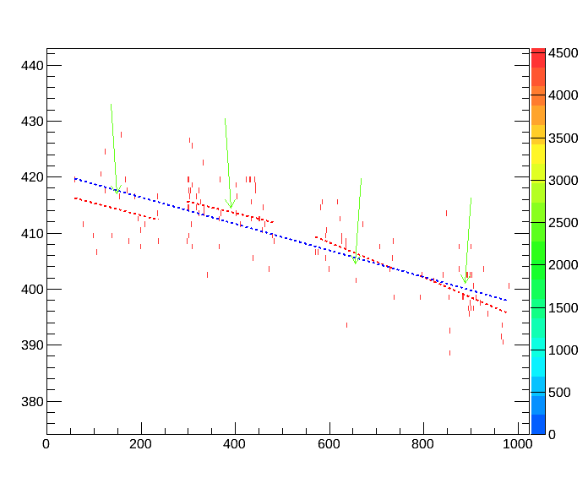
Track Reconstruction
Reconstruct track from track segments (if more than 2 segments):
Apply data quality cuts to make sure all segments correspond to a given track
Perform a linear regression for all pixels on a track → reconstructed track (blue dotted line)
Y = ax +b
b : 417.558 | a : -0.021984
b : 421.54 | a : -0.0199386
b : 428.789 | a : -0.0341787
b : 431.063 | a : -0.0362019

Slide 17
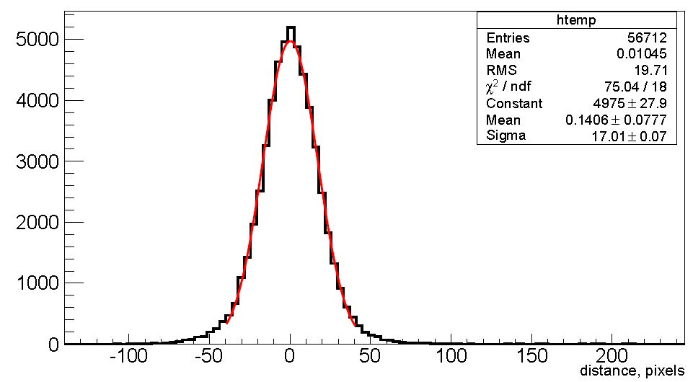
Track Reconstruction: Residuals
An unbiased estimate of the single point resolution: σ = Sqrt(σ1 * σ2):
Perform fit to all pixels and calculate the distance between each pixel and the position
of the point of closest approach along the fitted track:
σ1 = Gaussian fit, when all pixels are included in the track fit
σ2 = Gaussian fit, omitting pixel under consideration from the track fit
in number
of pixels

Slide 18
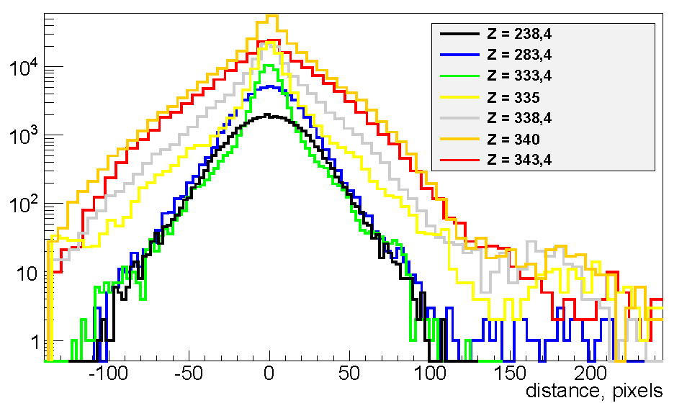
DESY Test-Beam: Track Residuals
Summary of residuals (σ = sqrt(σ1*σ2)) for different Z-coordinates:
(corresponds to the different positions of electron beam
passing through the Large Prototype TPC)

Slide 19
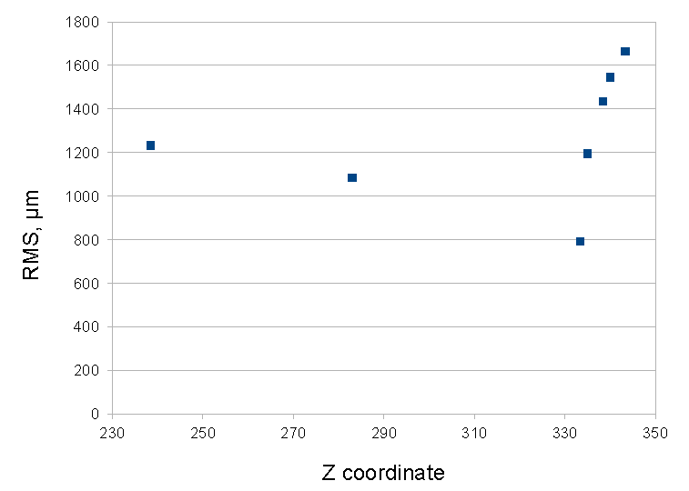
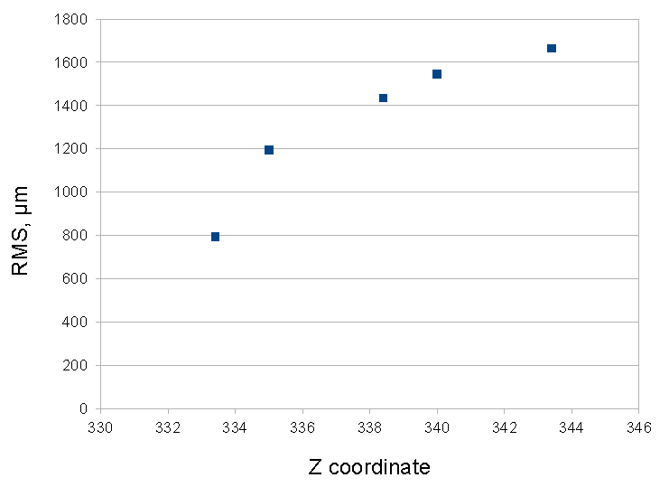
DESY Test-Beam: Track Residuals as a function of Z
(Large Prototype TPC)
PRELIMINARY:
PRELIMINARY:
Very low statistics, behavior needs to be understood

Slide 20
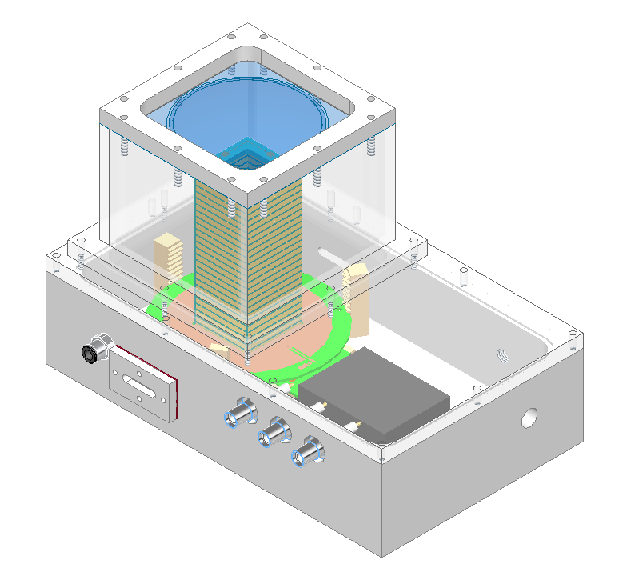
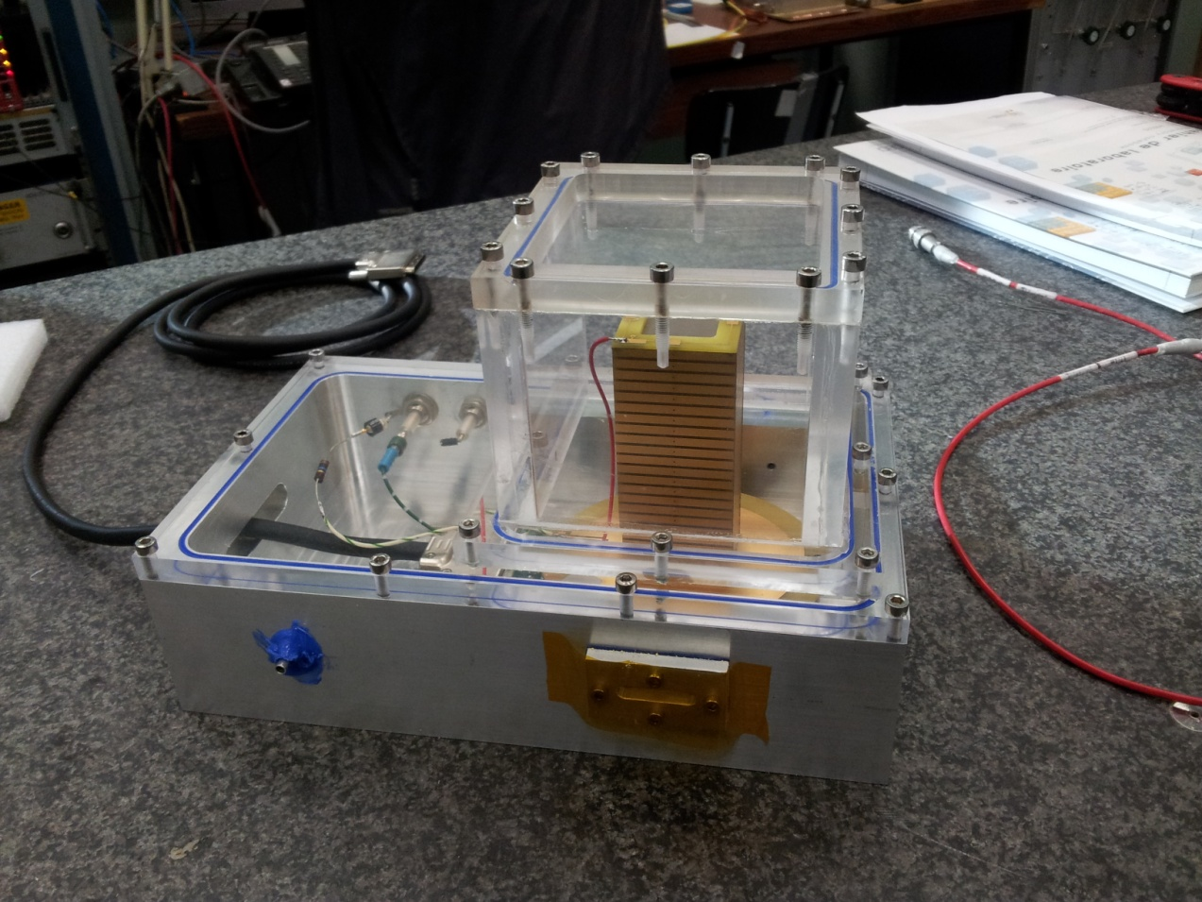
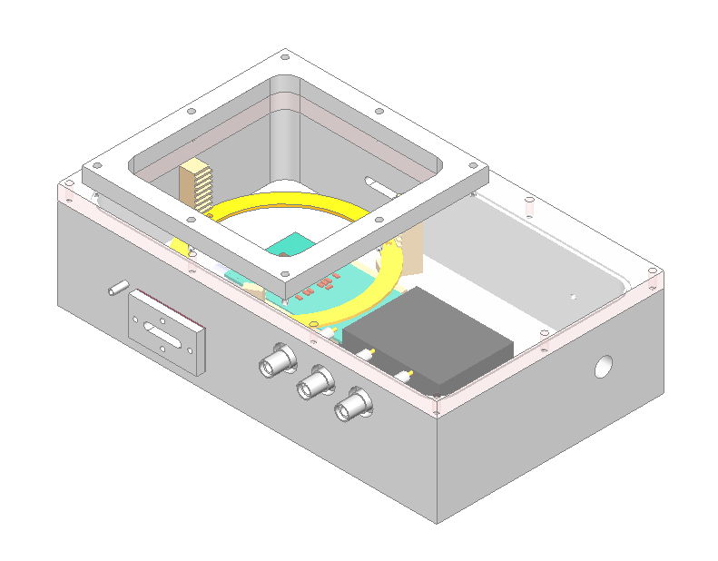
Saclay Micro-TPC with Timepix
Two micro-TPC boxes have been built
Drift distance in micro-TPC (~ 10 cm)
is large enough to allow study of single
electron response from Fe⁵⁵ source
Fe⁵⁵
Micro-TPC
TIMEPIX

Slide 21
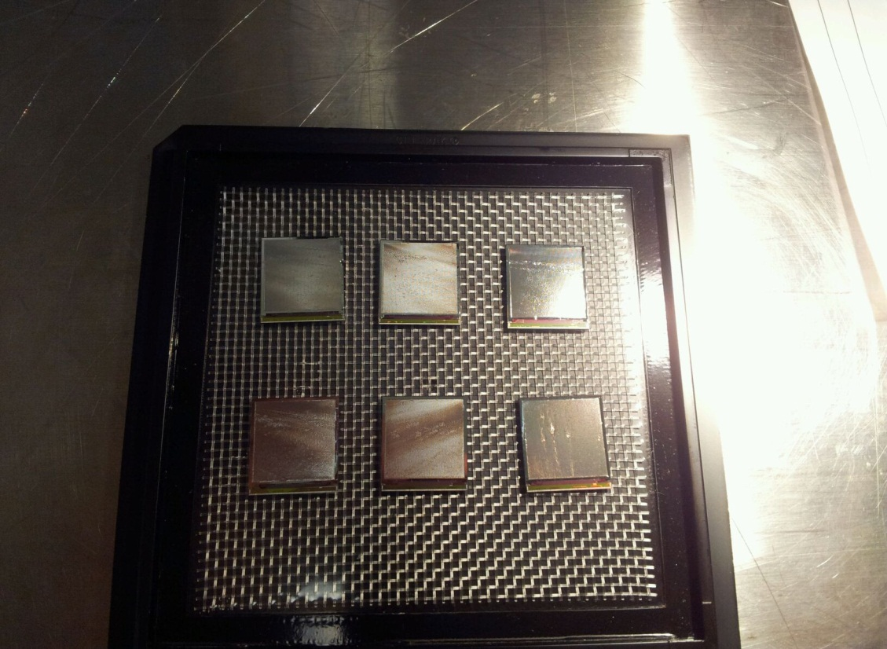
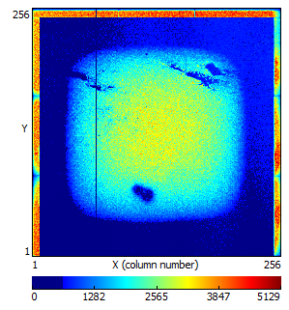

Studies of new IZM-3 InGrids in the Saclay micro-TPC
2011: Major Step Forward → InGrid Production on a wafer level
2013: 3rd IZM production run to post-process Timepix chips on a wafer level
Received 6 IZM-3 InGrids in Saclay (earlier studies
with IZM-3 InGrids have been performed in Bonn,
NIKHEF)
Four chips are mounted on PCB (one does not work)
One InGrid is tested →
in general, good behavior
Guard ring problem
in micro-TPC
Some noise and/or
discharges
Some local grid
issues

Slide 22
Proposal of a Flexible Detector Setup
using Low Energy Electrons from PHIL at LAL
PHIL provides electrons with momentum 5 MeV/c and 10⁹ particles per bunch
Goal: obtain samples of “monochromatic” electrons
with energy between 1 and 5 MeV and energy spread of better than 10%
with adjustable intensity down to 10⁴ electrons per bunch
Study dE/dx by cluster counting using InGrid detectors
the electron range 1-5 MeV
(earlier simulation results by M. Hauschild & NIKHEF
experimental studies)
Joint proposal LAL & IRFU
LAL contribution from S. Barsuk, L. Burmistrov, H. Monard, A. Variola

Slide 23

Spectrometer to sample “monochromatic” low energy electrons
Setup idea:
Use electrons from PHIL
Reduce energy/intensity using Al plug
Select unique direction for electrons passing the plug with collimator 1
Select required energy by half-turn of electron in the magnetic field (position of collimator 2)
Adjust intensity/energy spread using collimator 2, positioned in front of tested detector

Slide 24



Momentum and angular spectra of electrons passing through the Al plug, depending
on the plug thickness : Geant4 simulation
5 MeV/c electron
Aluminum plug
θ

