Slide 1
Results of a beam test of a Large Micromegas TPC prototype with 6 modules
LCWS12 Arlington
October 22-26, 2012
D. Attié, P. Colas, M. Dixit, P. Hayman, T. Maerschalk, A. Robichaud, J. Timmermans, W. Wang

Slide 2
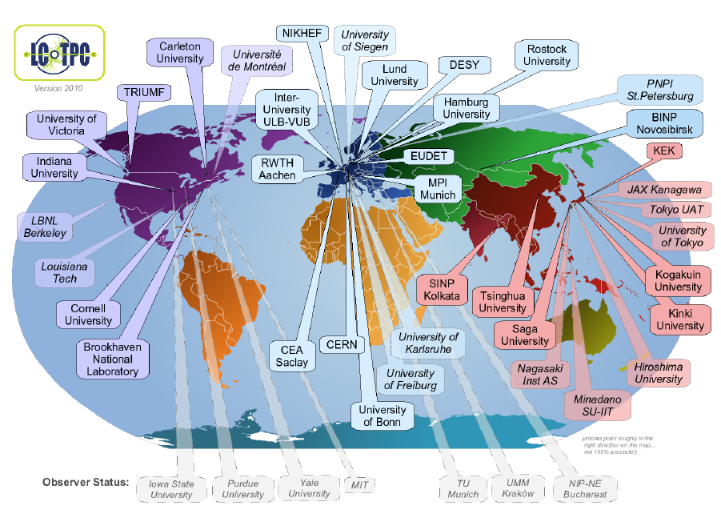
All the R&D is gathered in LCTPC
38(*) member + 7 observer institutes from 12 countries
(*) 25 signed the MOA
www.lctpc.org

Slide 3
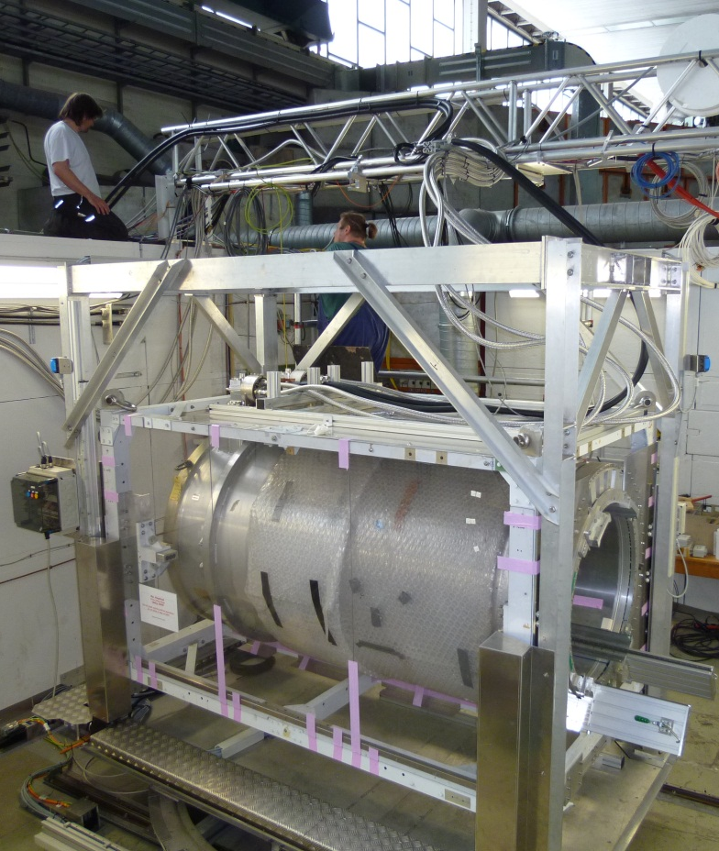
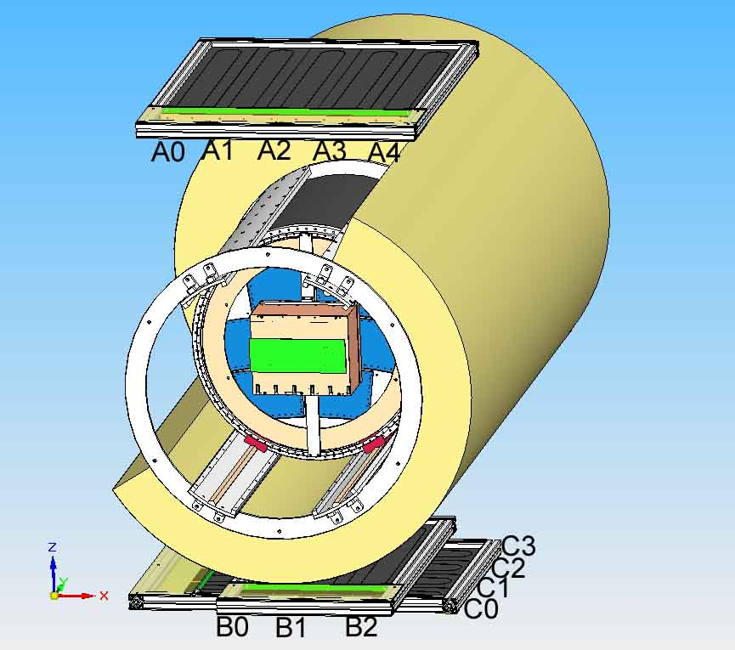
The EUDET test setup at DESY
The EUDET (FP6) setup at DESY is operational since 2008
Upgraded within AIDA (FP7): autonomous magnet with 2 cryo-coolers since July
SiPM trigger
Field cage

Slide 4
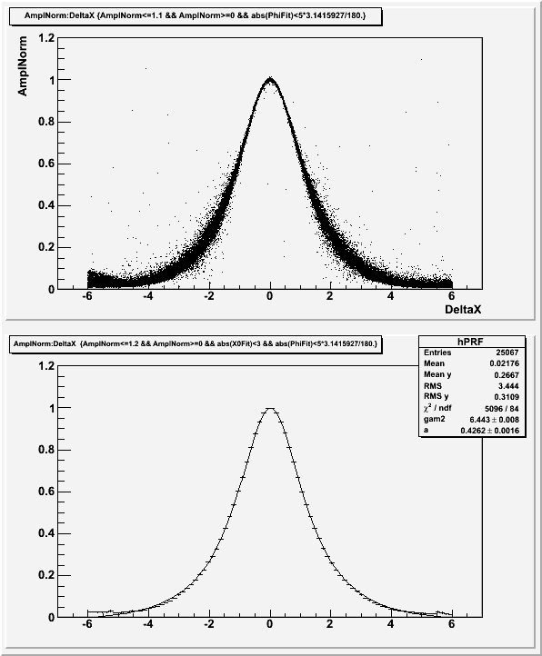
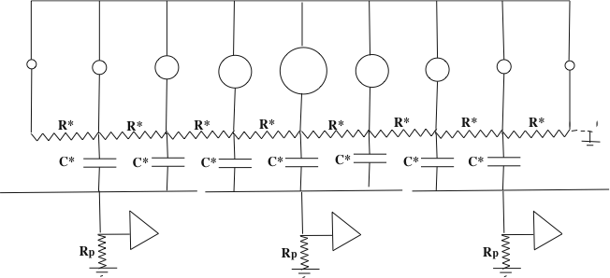
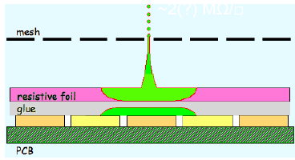
Charge spreading by resistive foil
PAD RESPONSE: Relative fraction of ‘charge’ seen by the pad, vs x(pad)-x(track)
Resistive coating on top of an insulator: Continuous RC network which spreads the charge from σ(avalanche)~15µ to mm: matching pad width improves position sensitivity
Z=20cm, 200 ns shaping
M. Dixit, A. Rankin, NIM A 566 (2006) 28
x(pad) – x(track) (mm)

Slide 5
Integrated electronics
D. Calvet et al., IEEE Real Time 2012
New detector : new routing to adapt to new connectors, lower anode resistivity (3 MΩ/sq), new res. foil grounding on the edge of the PCB.
New 300 points flat connectors (zero extraction force)
New front end: keep naked AFTER chips and remove double diodes (count on resistive foil to protect against sparks)
New Front End Mezzanine (FEMI)
New back-end for up to 12 modules
New DAQ, 7-module and more compact format
New trigger discriminator and logic (FPGA).

Slide 6
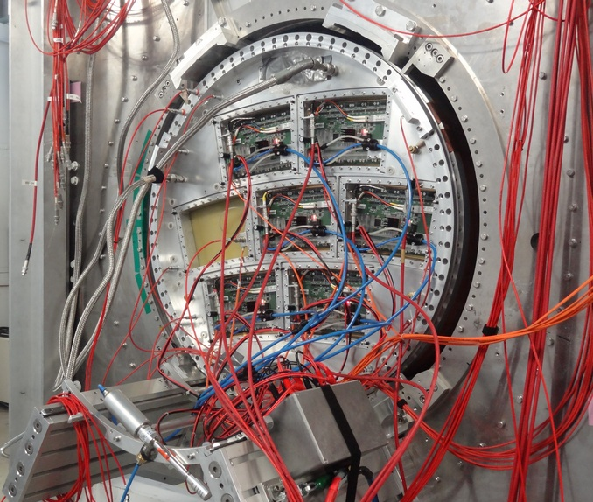
The multi-module configuration allows new studies :
Performance in cracks
Module misalignment
distortions

Slide 7
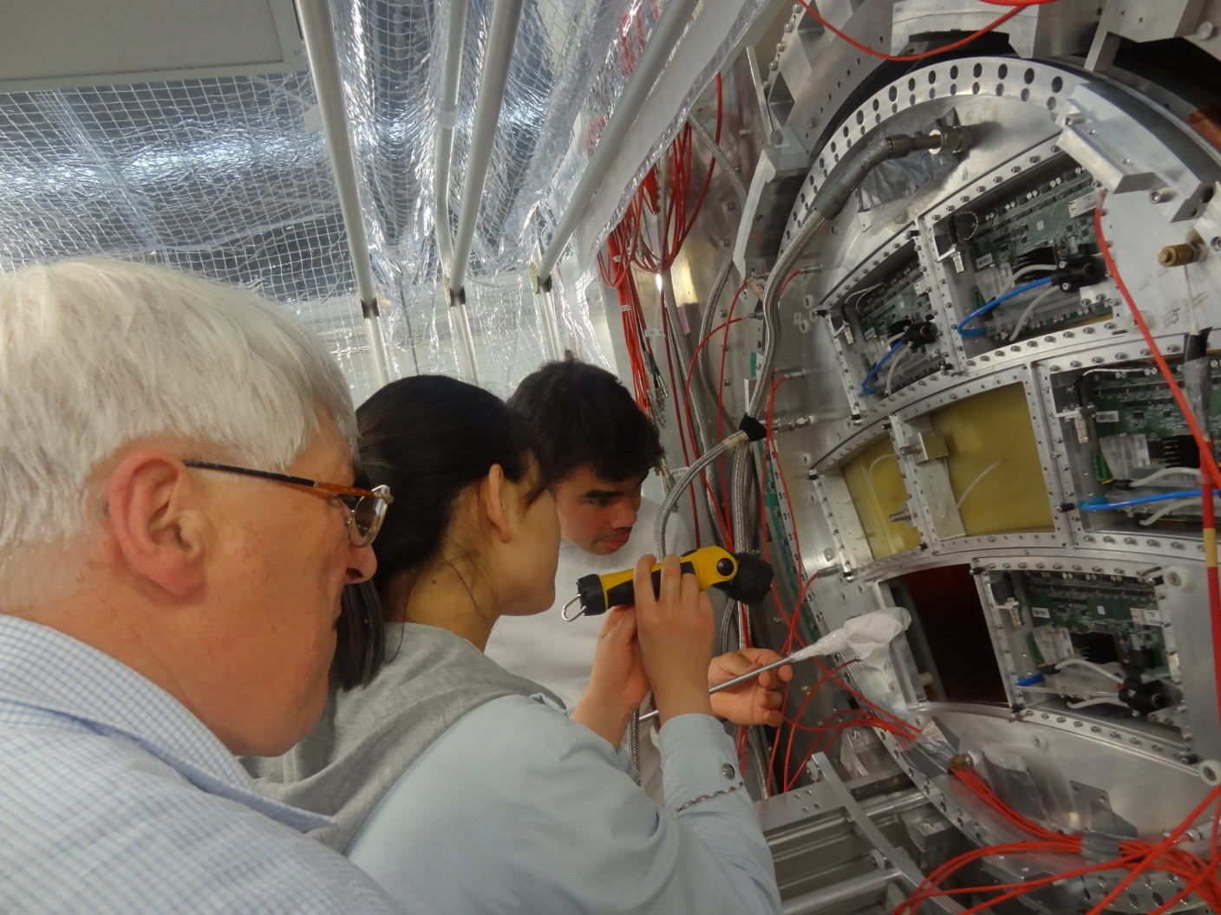
Smooth data taking in July, with over 1 000 000 evts. Air cooling and temperature control. However 6 modules only, 2 of them prototype or pre-serie, imperfect contacts

Slide 8
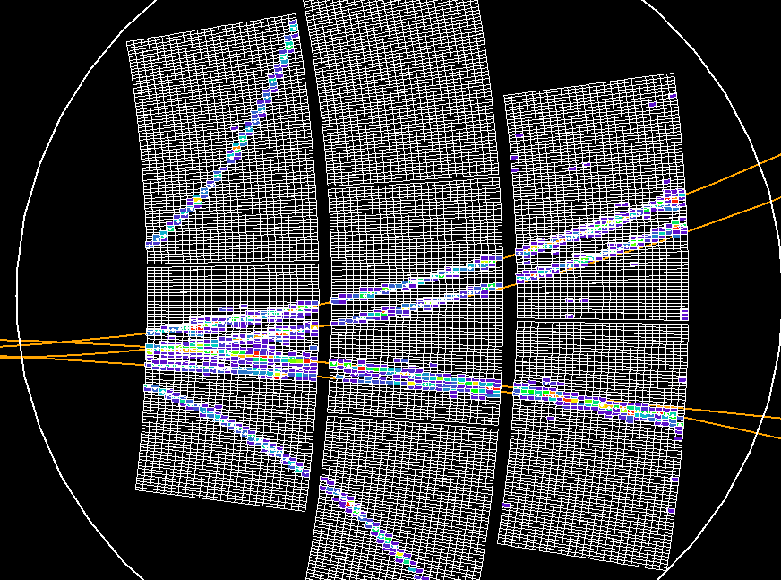
Thanks to Bo Li, Keisuke Fujii, Gilles de Lentdecker, M. Killenberg,…

Slide 9
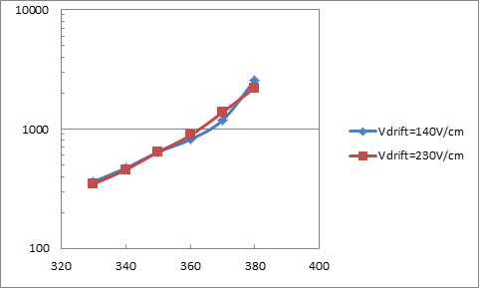
Effective gain vs mesh voltage is measured by using the fitted MPV of the (Landau) distribution of the measured charge. It compares well with direct gain measurements with a 55Fe source on a detector without resistive foil (x2 lower)

Slide 10
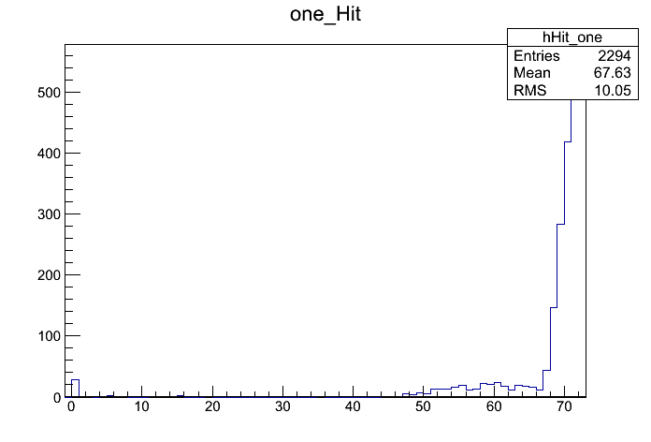
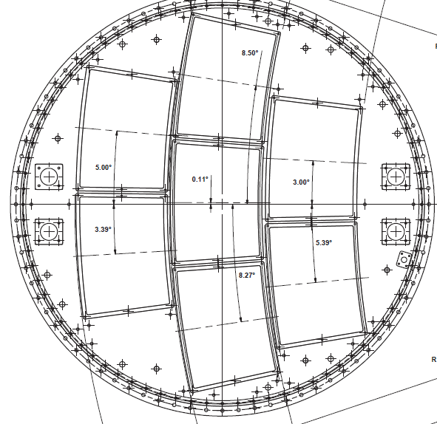
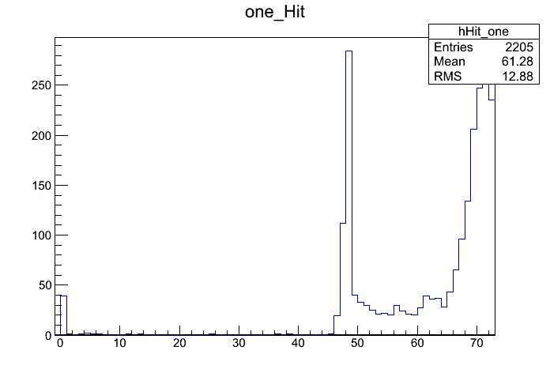
Crack scan
Outside crack
Study the hit reconstruction efficiency at or near the crack: take data with beam, moving by steps of 2mm
In crack
Beam direction
Padrow number (3x24=72)
Upper crack
Lower crack
Hits with ADC>150, 1-track evts

Slide 11
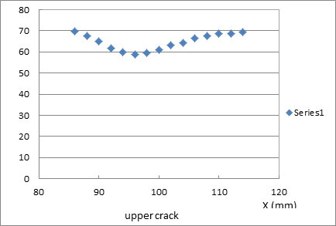
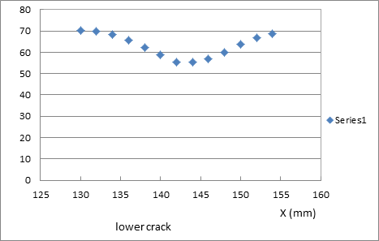
Crack scan
Number of hits vs x
Effect of cracks is felt in an area ~1cm around.
In the worst case, 50% of the hits are lost

Slide 12
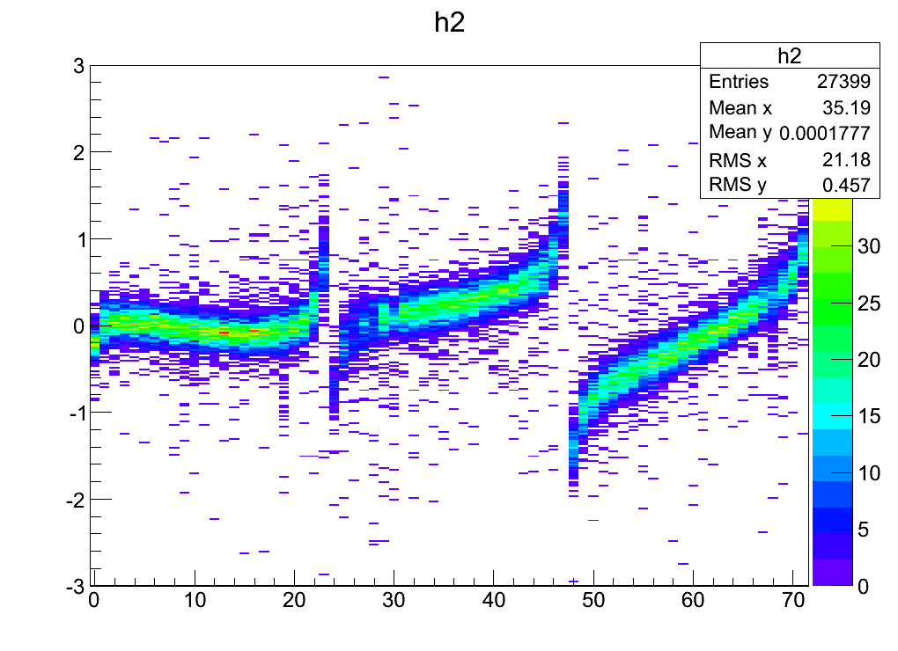
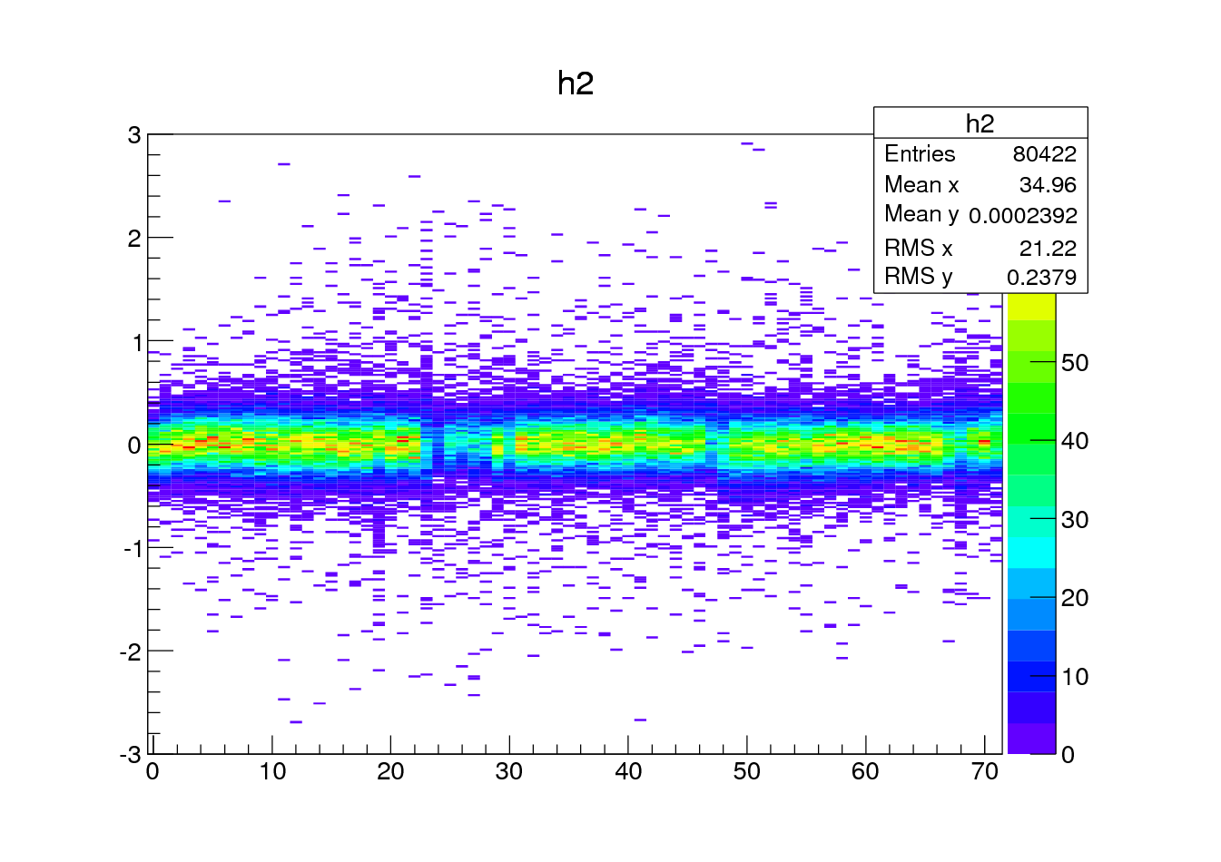
Brute force alignment
ROW NUMBER : 3x24 = 72
Displacement in mm

Slide 13
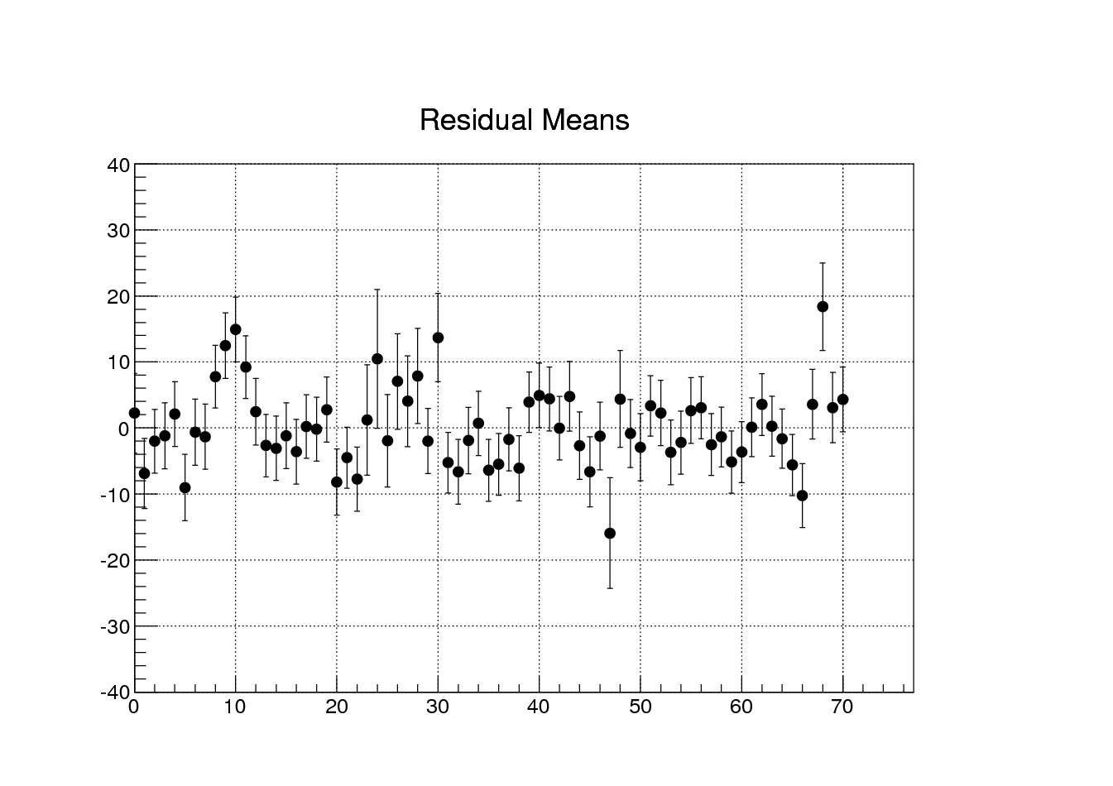

Slide 14
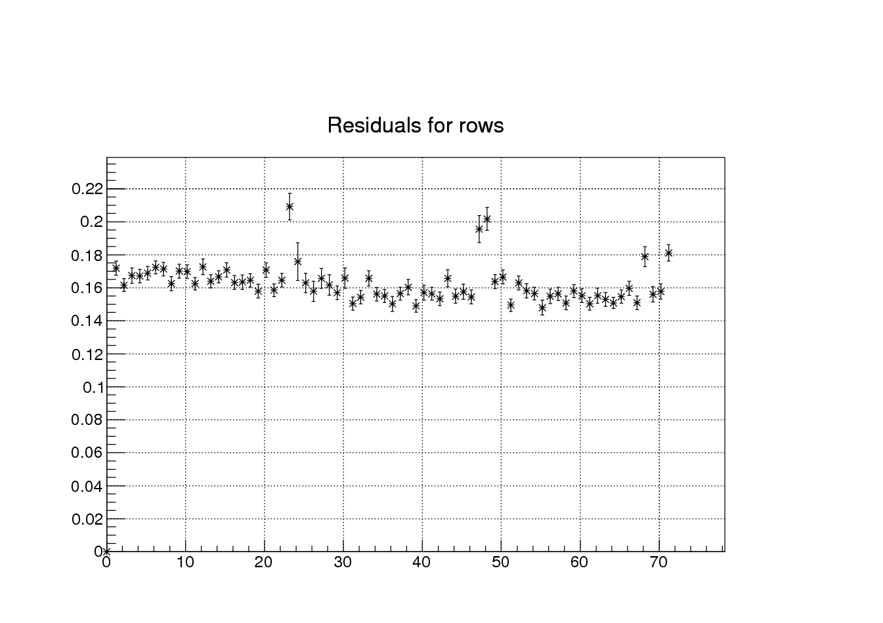

Slide 15
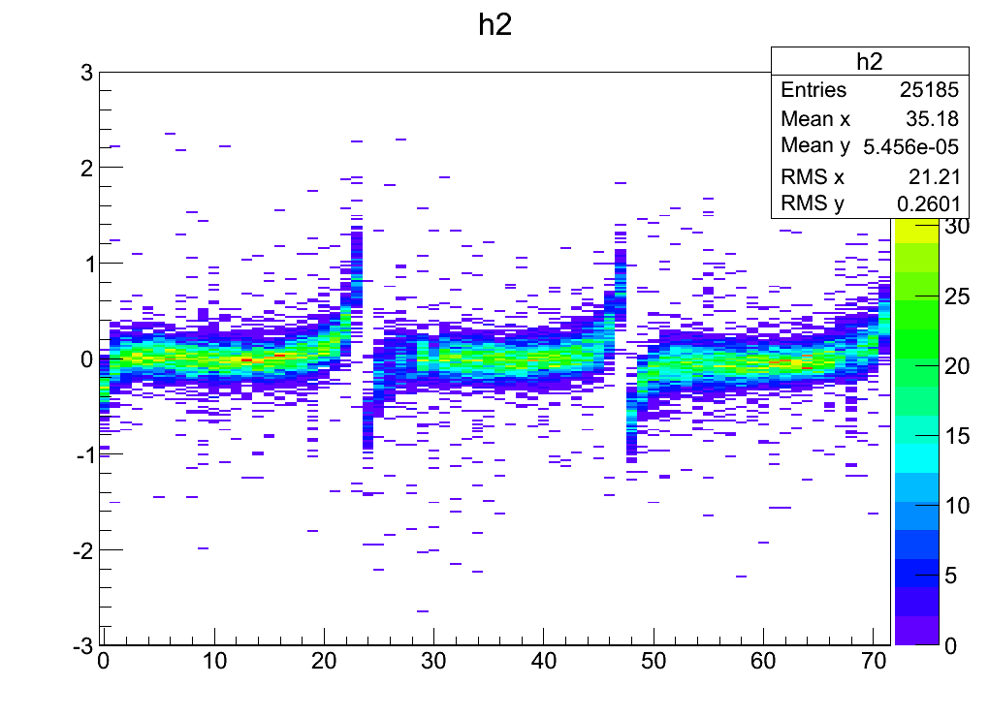
Alignment
Z=10cm
Fitted displacement :
Rotation :
δφ = -1.7 mrad, 3.7 mrad and 8.4 mrad
Translation:
δx = -54 µm, 180 µm and 278 µm
After alignment : only distortions remain (probably ExB effect)
Maximum effect of distortions 400µm

Slide 16
On-going electronics developments
GdSP : gaseous detector signal processing (or Go digital as Soon as Possible)
CERN-based collaboration lead by Paul Aspell, including Saclay: F. Guilloux and E. Delagnes, continuing S-ALTRO evolution.
Common development for CMS GEM µ-chambers and LC TPC. Recently considering ALICE upgrade (GEM TPC and µ chambers).
Main developments : 130 nm technology, 64 or 128 channels, low noise and ultra-low consumption, many power domains to ease power switching
First Si test to be submitted in February 2013 (AIDA)
Goals for the FE: for 10 pF detector capacitance and 100 ns peaking time ENC<900 e- and power < 1mW/ch

Slide 17
Front End specifications
Parameter | VFAT2 (IBM 0.25) | SALTRO (IBM 0.13) | VFAT3 / GdSP (IBM 0.13)
Linear range | +- 12fC | 150fC | Max 200fC
Input capacitance (pF) | 20 | 0-20 | 5 – 10 – 30 – 60
Noise | ~500e- ⊕ 40-60e-/pF @ 25ns | ~ 650e- ⊕ 15e-/pF @ 120ns | < SAltro /VFAT
From Paul Aspell
Starting from data measured on ABCN (130nm design by Jan Kaplon for ATLAS SCT):
* 800 e- @ 5pF, tp=22ns, 100µW
* assuming serie noise only + strong inversion for the input transistor
➔ we can hope 530 e- @10pF, tp= 100ns, 200µW
➔ Ultra Low power low noise design seems feasible (cf slide 6)
Parameter | VFAT2 | SALTRO | VFAT3 / GdSP
Power (mW/channel) | 1.5 (IBM 250nm) (incl. comparator) | 10 | << 1

Slide 18
Proposal for CFE
Groups involved
CEA-IRFU
INFN-BARI
Output
Buffer
Calib.
CSA 1/2/3
PZ 1/2
Shaper
x6
Sallen Key
CSA 1/2
PZ 1
MUX 9➔1
DDF
MUX 3➔1
x2
Bypass
Bypass
Calib.
CSA 2
PZ 2
DDF
x8
Calib.
CSA 2
PZ 2
DDF
Slow Control
(SPI)
Registers
Bias
Regulator
DAC
CERN

Slide 19
Summary
Successful test of 6 modules at a time
Most integration questions addressed
Improvements needed in contacts of the flat connectors
Multi-modules aspects addressed: alignment, reconstruction
Next step: 7 modules high quality test, full calibration on the test bench, detailed analysis in 2013-2014
R&D projects: thinner meshes, other charge dispersion devices (ceramic with ruthenium oxide).
Then a larger module with smaller pads for the inner wheel.
Thanks to our DESY colleagues, especially Ralf Diener, Christophe Rosemann and Felix Müller

