Slide 1


Study of the Micromegas-TPC Modules for an ILC Detector
Wenxin Wang
On behalf of LCTPC
2012 Nuclear Science Symposium, Medical Imaging Conference
& workshop on Room-Temperature Semiconductor X-Ray and Gamma-Ray Detectors
Oct. 29-Nov. 3, 2012, Anaheim, California

Slide 2
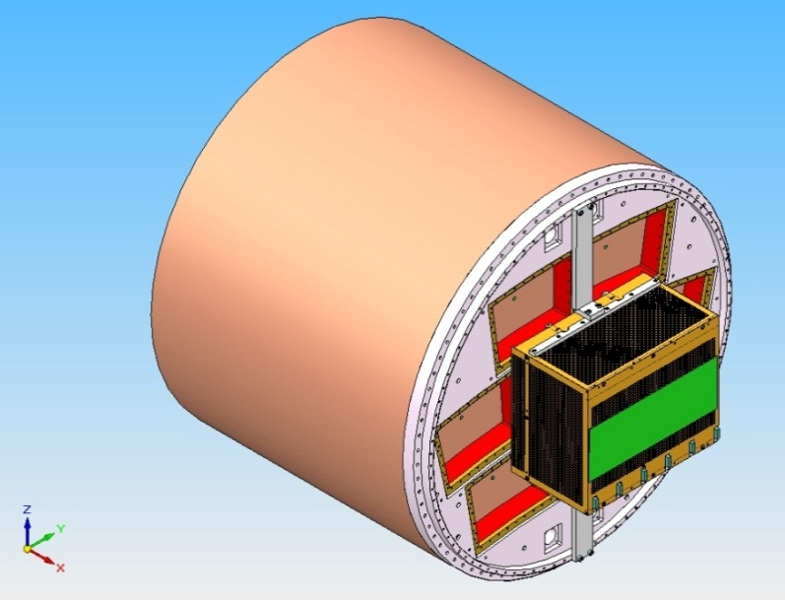
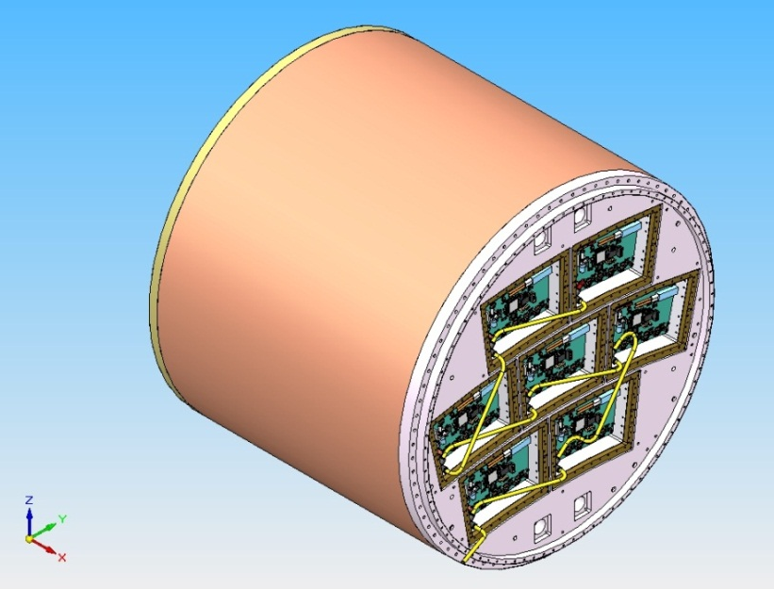
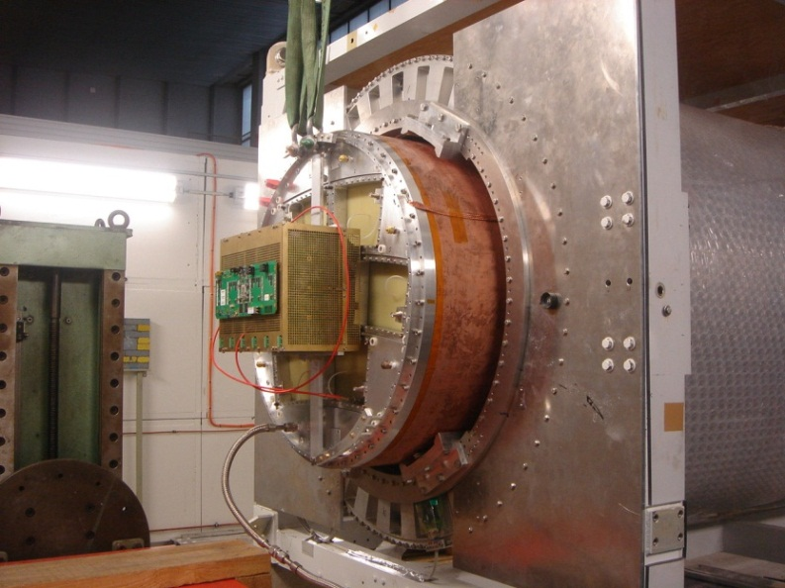
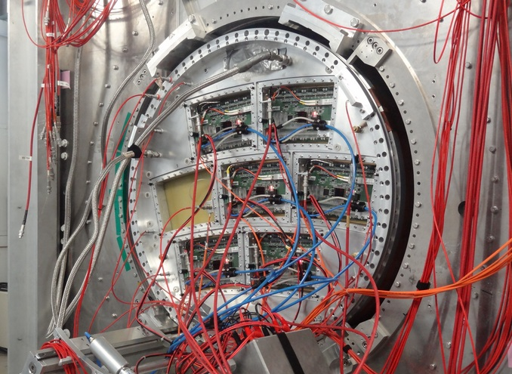
7 Micromegas modules with integration of electronics
2008-2011
2012-

Slide 3
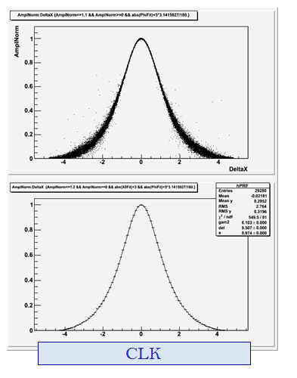
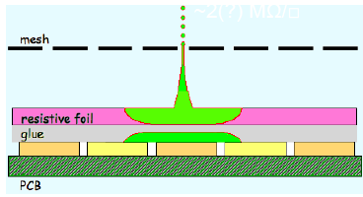
Bulk Micromegas with charge spreading
Resistive bulk : continuous RC circuit to spread the charge to improve resolution
M. Dixit, A. Rankin, NIM A 566 (2006) 28
x(pad) – x(track) (mm)
PRF(Pad Response Functions) fits, z ~ 5 cm

Slide 4
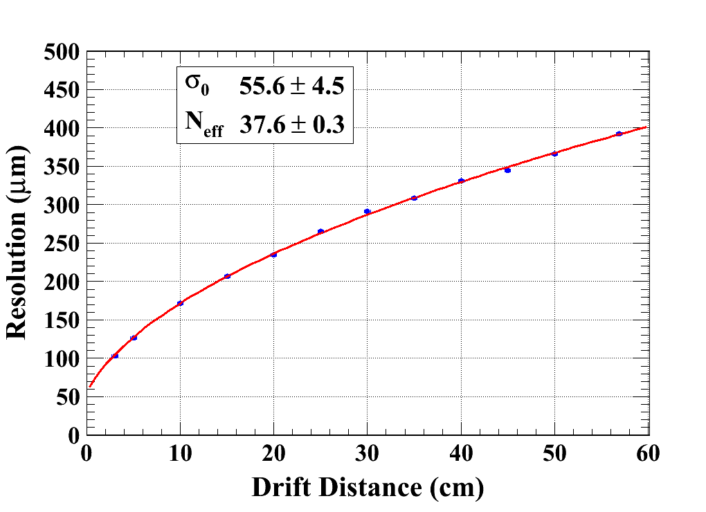
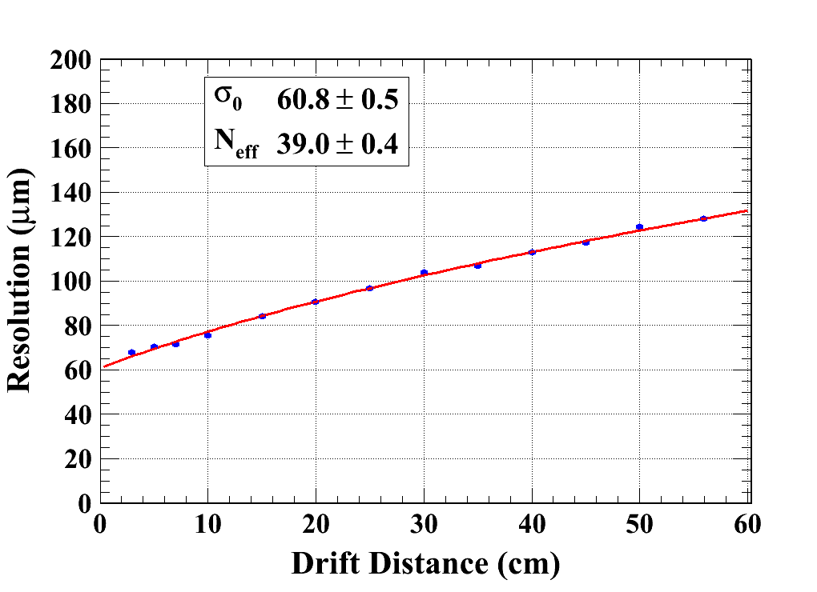
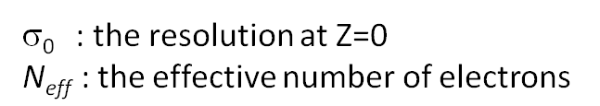
Data analysis results (B = 0T & 1T)
(One module installed at the end plane of TPC with old electronics)
B=0 T C_{d} =315.1 µm/√cm (Magboltz)
B=1 T C_{d} = 94.2 µm/√cm (Magboltz)
60 µm Resolution at z=0
z drift dependence agrees with diffusion, with large Neff
Extrapolates to better than 100 microns at 2.3 m in B=3.5T

Slide 5
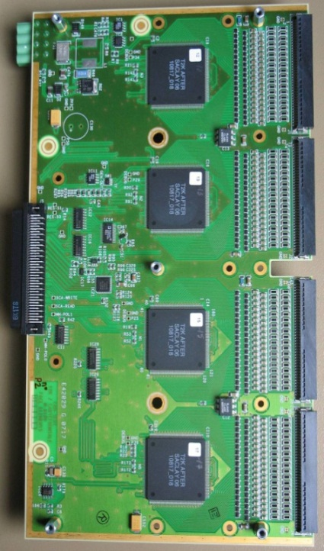
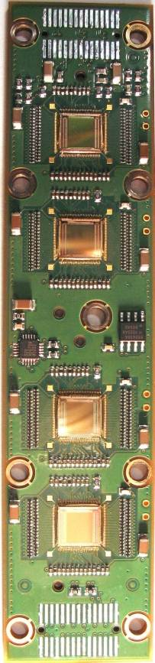
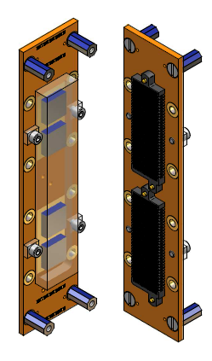
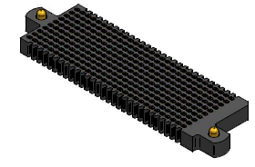
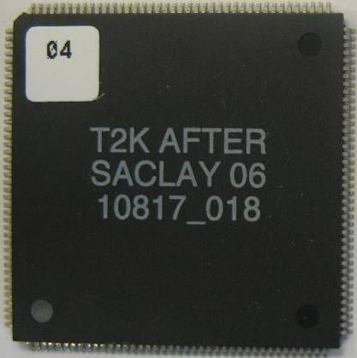
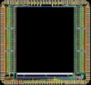
Electronics integration
(See D. Calvet et al. Real time 2012)
Remove packaging and protection diodes
Wire-bond AFTER chips
Use 2 × 300 point connector
FEC
25 cm
4,5 cm
12,5 cm
14 cm
3,5 cm
2,8 cm
3,5 cm
0,78 cm
Chip
0,74 cm
The resistive foil protects against sparks

Slide 6
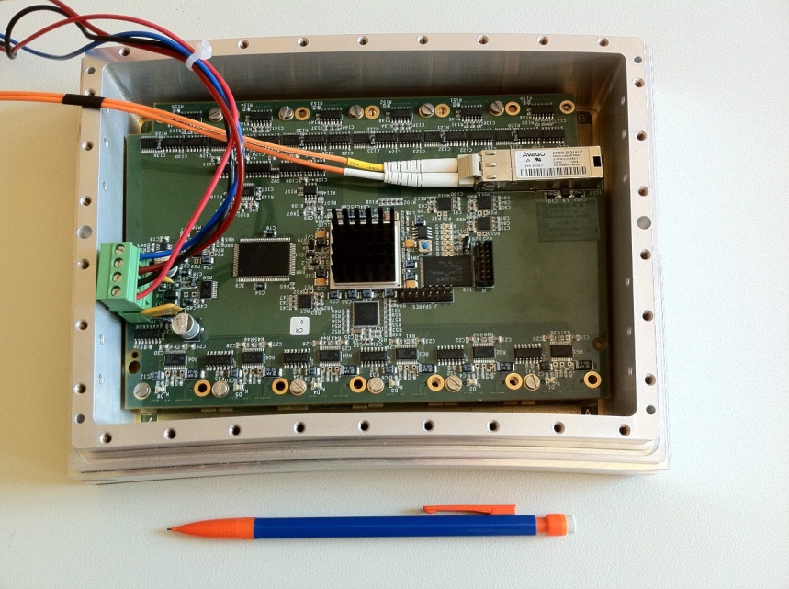
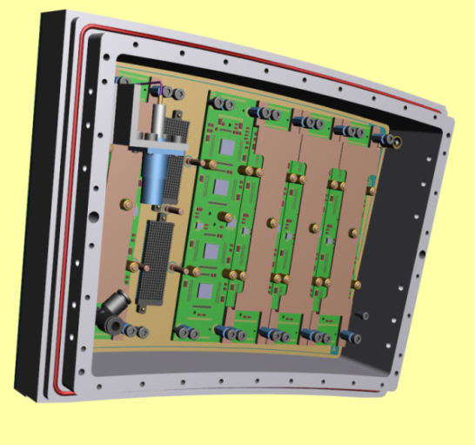
New T2K Electronics
FEC
FEM
Every module will be calibrated with a source on a test bench
The av. thickness is less than 0.2 X_{o}
all included (det., FECs, Mezzanine, connectors, cooling, shielding)

Slide 7
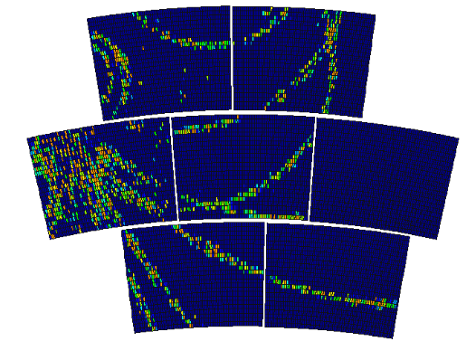

6 Modules Test
In July 2012, 6 modules were installed on the endplate of LP-TPC at DESY and tested at the same time. Data were taken with cosmic rays and 5 GeV e- beam.
Cosmic event
Notes:
77

Slide 8
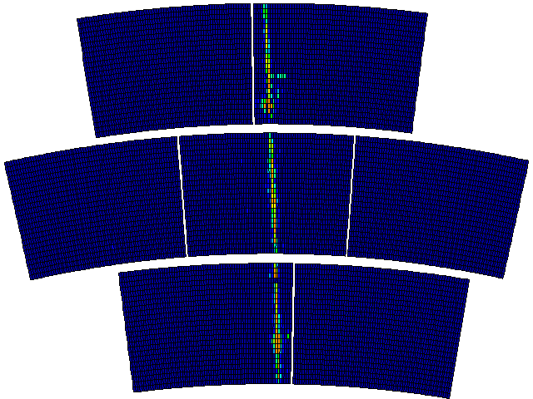
Event display (the first 100 triggers of a good run)

Slide 9
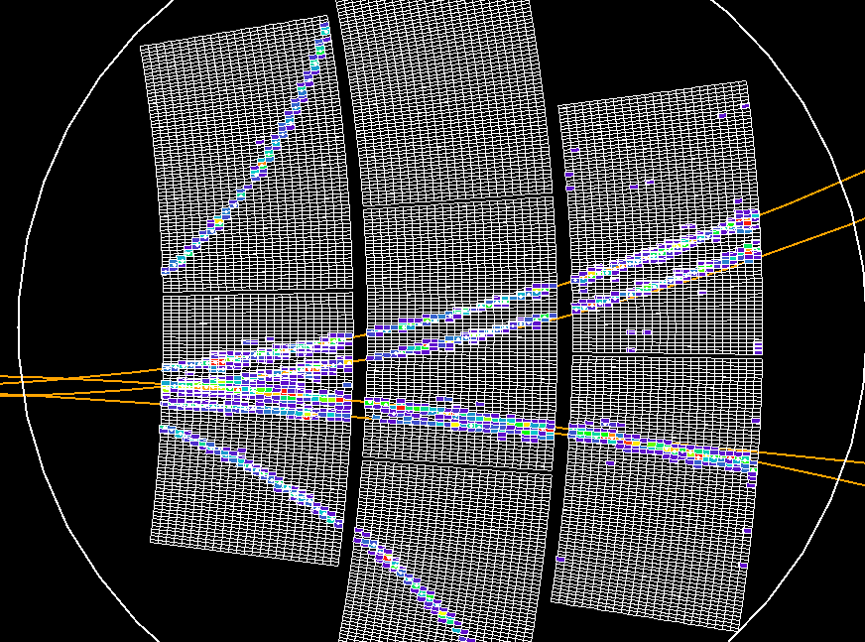
Track reconstruction

Slide 10
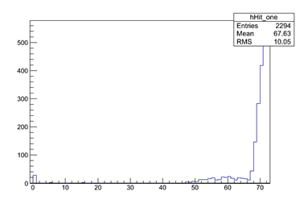
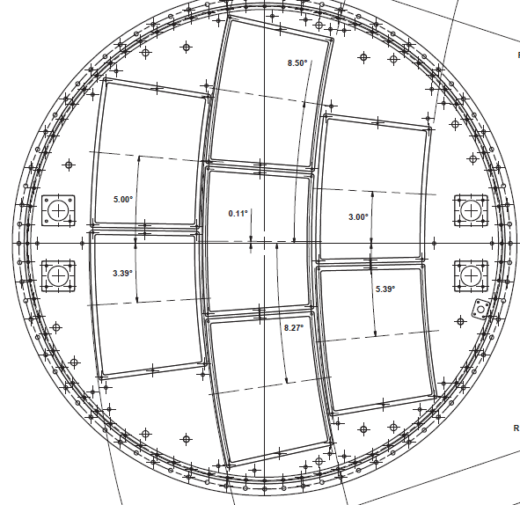
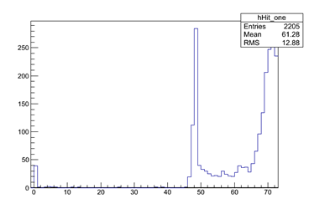
Crack scan
Outside crack
x
5 GeV
e- Beam
In crack
Upper crack
Lower crack
Padrow number (3x24=72)

Slide 11
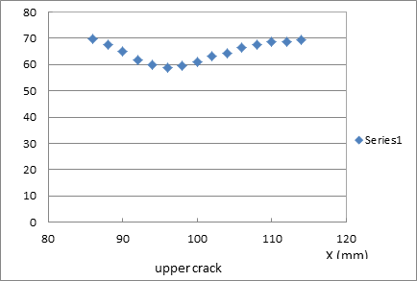
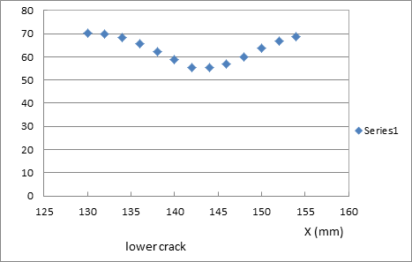
Crack scan
Number of hits vs x (72 pad-rows)
Study the hit reconstruction efficiency at or near the crack: take data with beam, moving by steps of 2mm

Slide 12
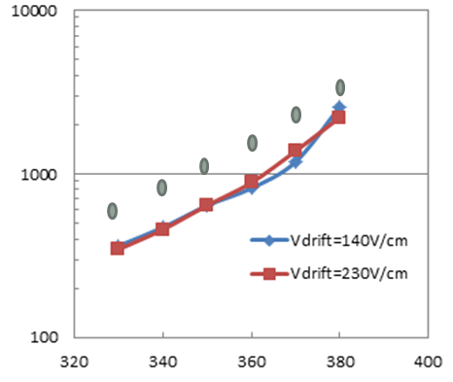
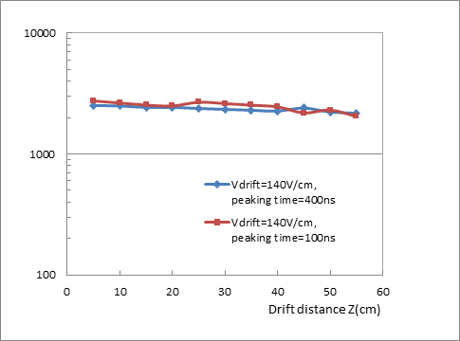
Gain study
Using the fitted MPV of the (Landau) distribution of the measured charge
Effective gain vs mesh voltage
(compared with the direct gain measurements using ⁵⁵Fe source on a bulk detector without resistive foil)
Effective gain vs drift distance
(Vmesh=380V, Vdrift=140V/cm, peaking time 100 ns and 400 ns)

Slide 13
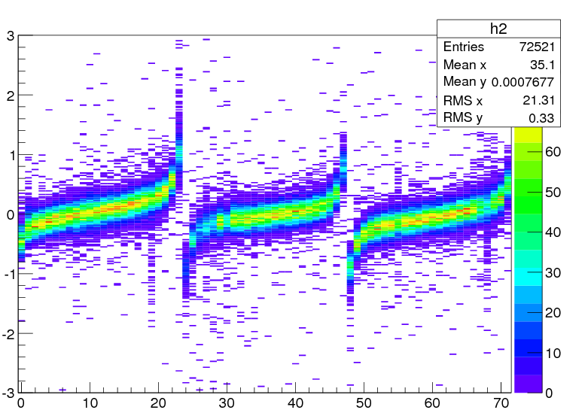
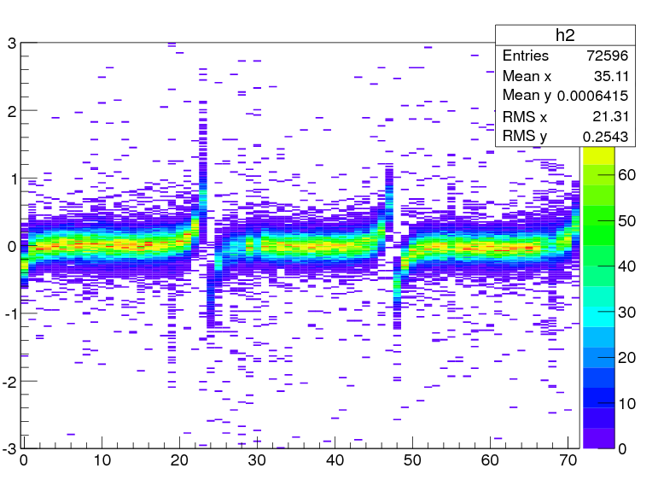
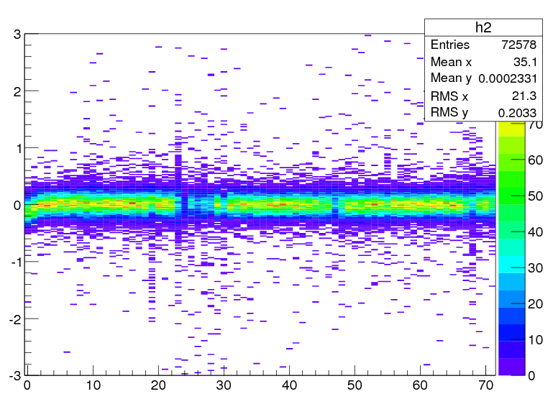
Data analysis results (B = 1T)
Residuals by padrow
(a)
(b)
δx (mm)
δx (mm)
Row Number: 3 x 24 = 72
Displacement in mm
(a): Before alignment
(b): After alignment
δφ= 3.3 , 2.2 and 3.1 mrad
δx = 55 µm, -36 µm and 63 µm
(c): After ‘brute force’ correction (i.e. average subtraction and refit)
(c)
δx (mm)

Slide 14
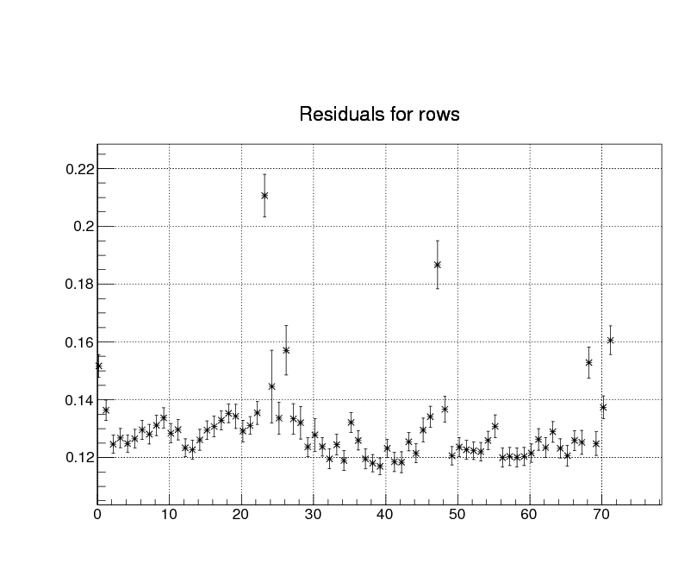
Data analysis results (B = 1T)
drift distance 30cm
Residual rms (mm)
Effects of approximate geometry
Row number

Slide 15
Summary
A lot of experience has been gained in building and operating Micromegas TPC panels. The measured resolution of one module is about 60 microns at zero drift distance with 3 mm wide pads. This meets LC needs.
Successful test of 6 modules simultaneously with full integration of the electronics flat behind the panels. The analysis work is on-going.
Next step: 7 modules high quality test, full calibration on the test bench
The analysis work is under the cooperation with Carleton colleagues. Thanks to our DESY colleagues, Japanese colleagues.

Slide 16
Thank you!

