Slide 1
Preliminary analysis results of Micromegas beam test

Slide 2
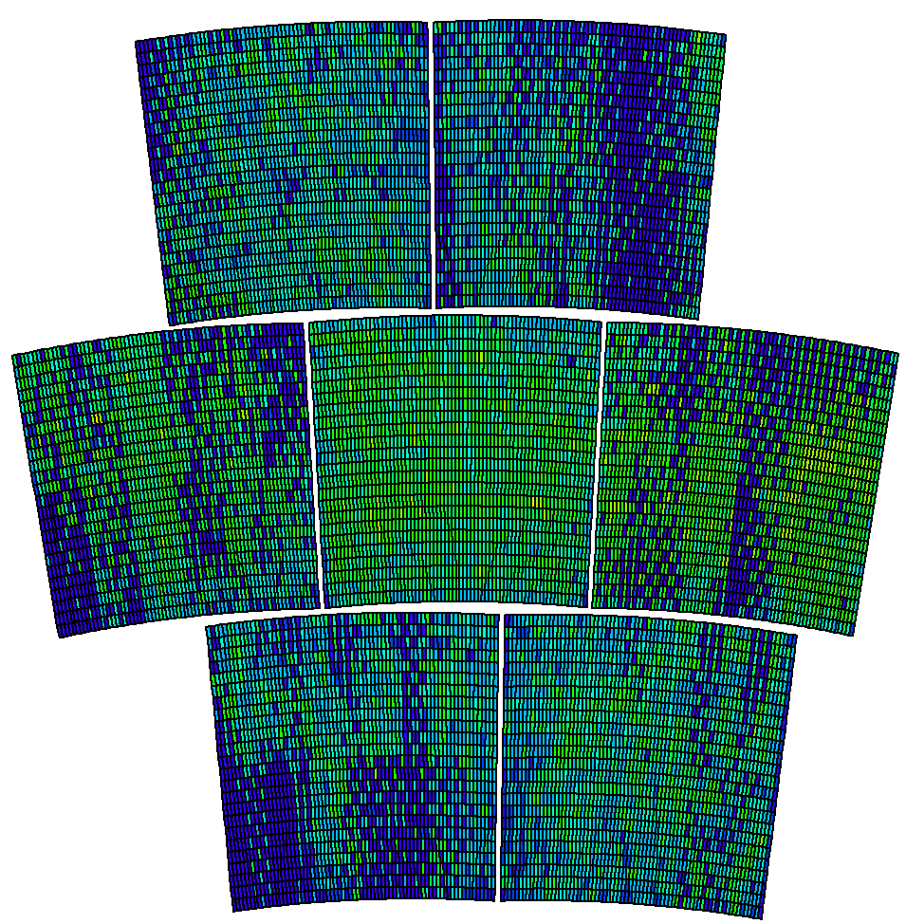
Missing pads

Slide 3
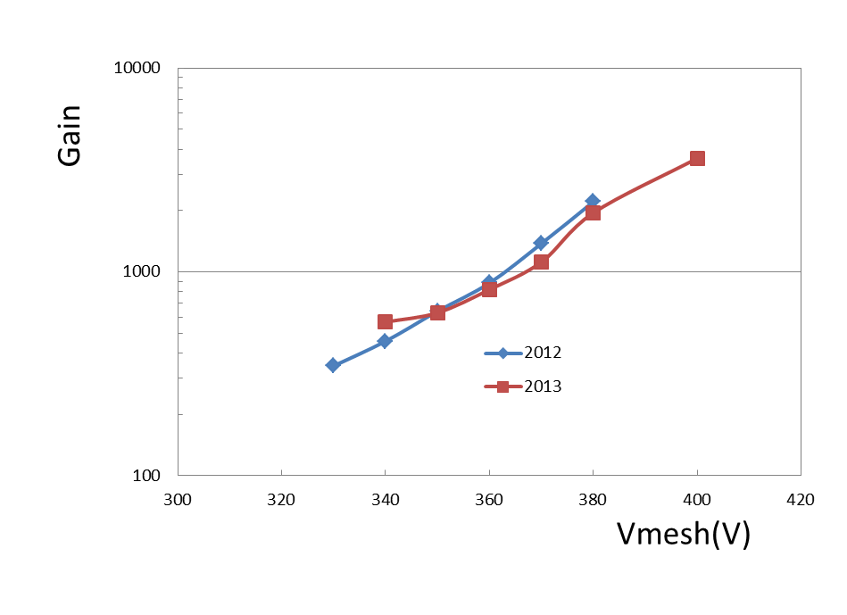
Gain (B=1T)
2012: Sum of the charge in each row
2013: Each hit’s charge using MarlinTPC

Slide 4
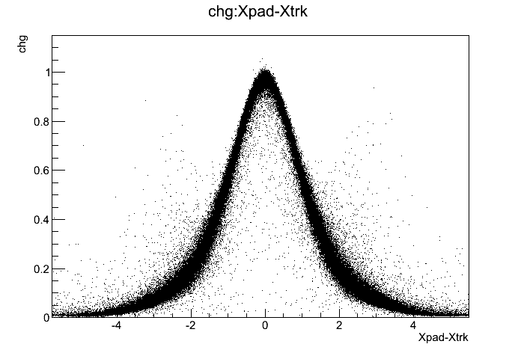
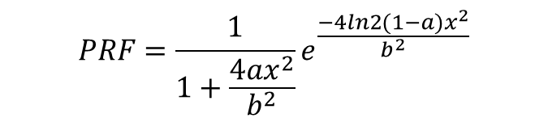
PRF
Fitting row by row to get PRF parameter a &b
$$PRF=\frac{1}{1+\frac{4ax^{2}}{b^{2}}}e^{\frac{−4ln2(1−a)x^{2}}{b^{2}}}$$

Slide 5
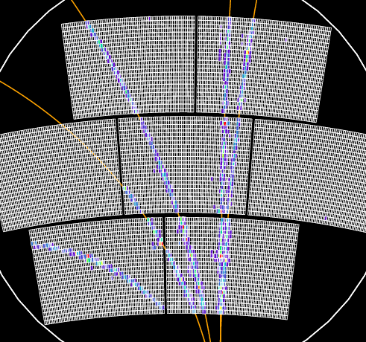
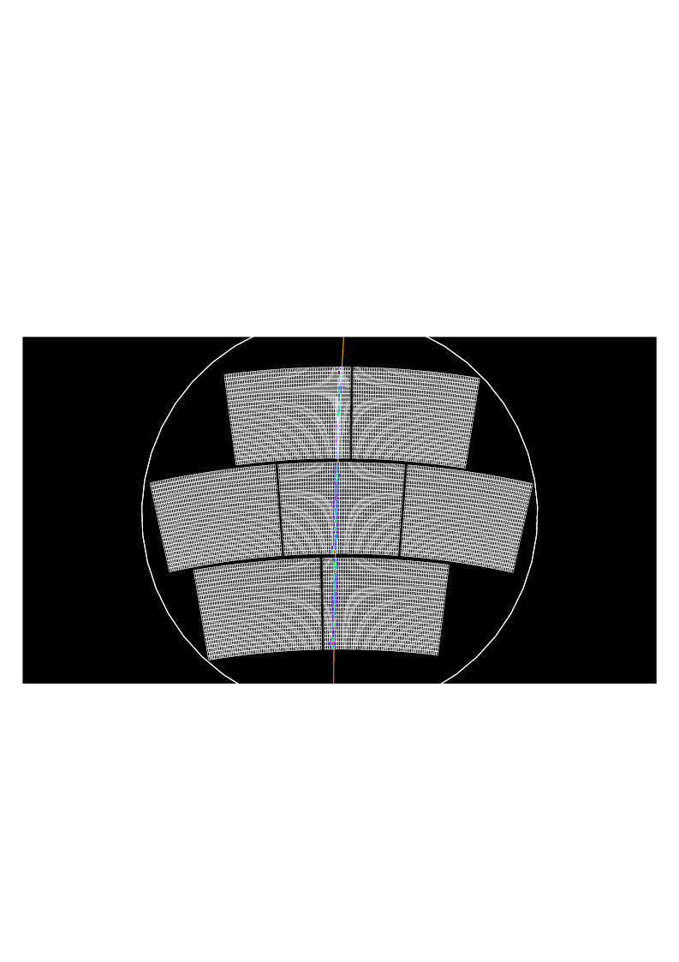
Event & track selection
Throw multi-tracks events
Keep the event with only one track which has 10 hits at least
After track selection, only central module used in analysis

Slide 6
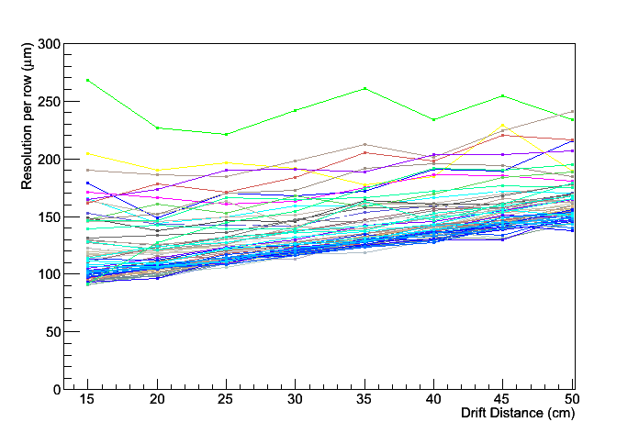
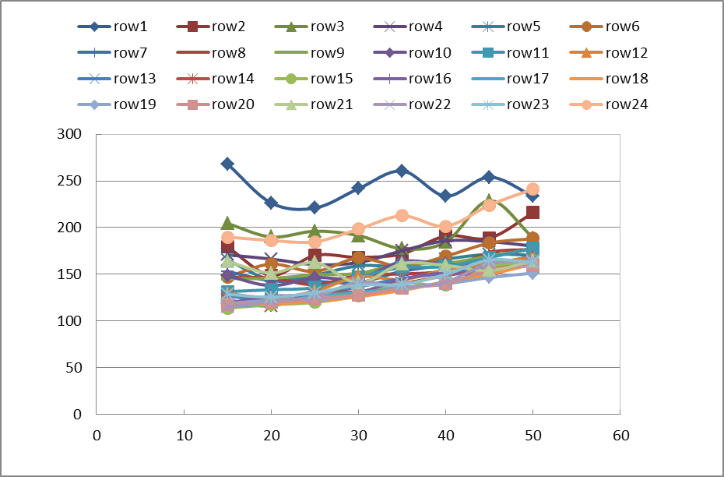
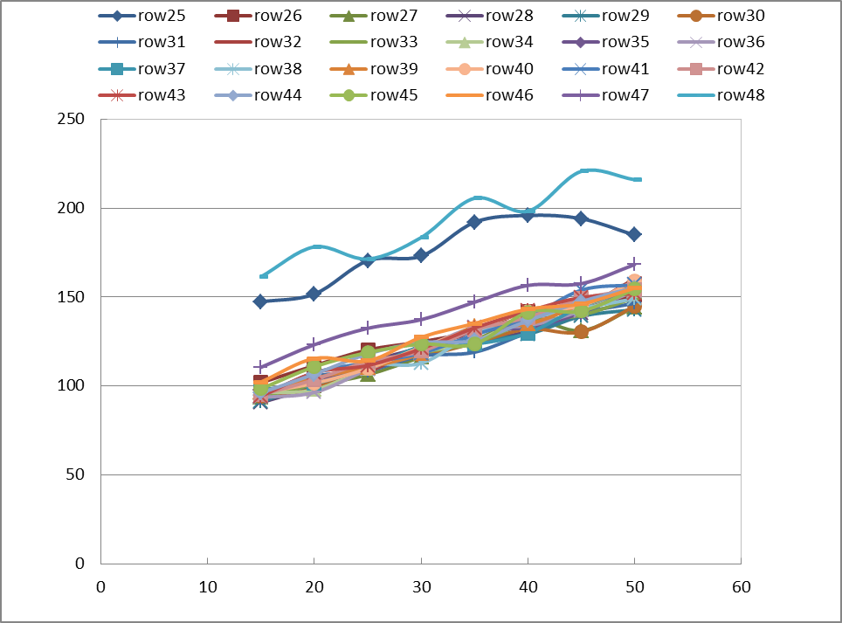
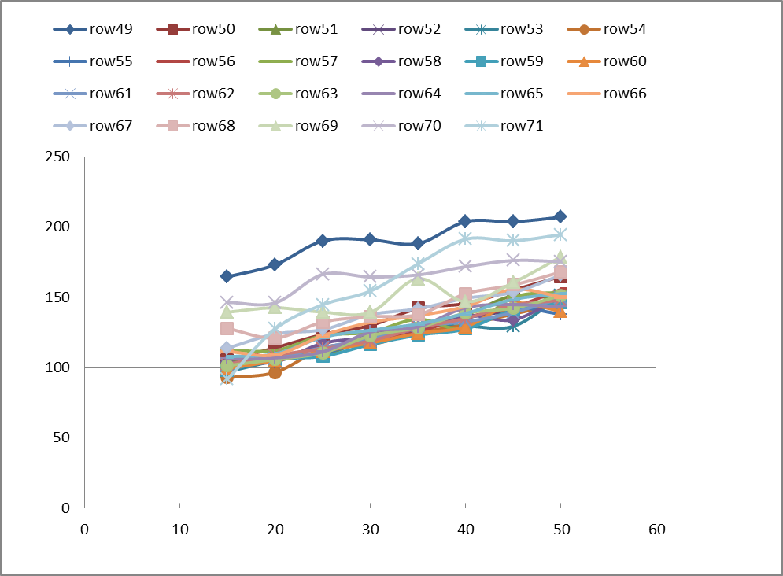
Resolution for each row
72 rows

Slide 7
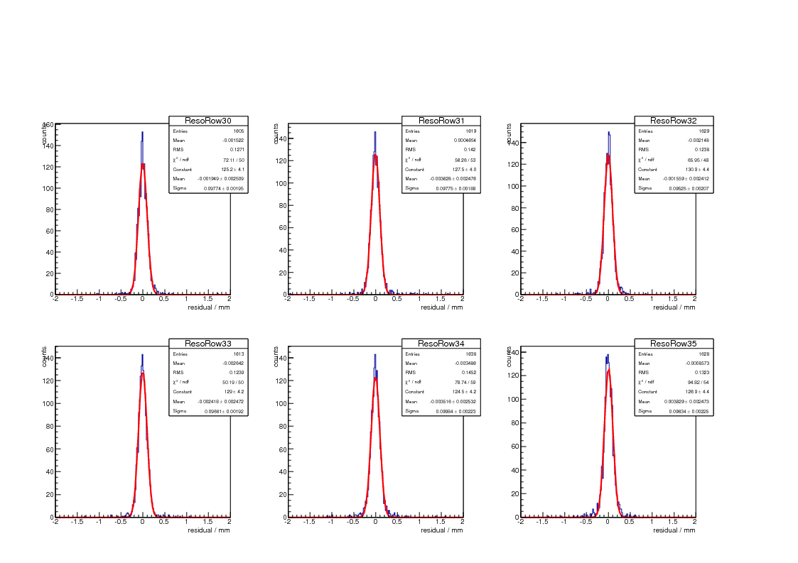
Residuals for rows (middle module)

Slide 8
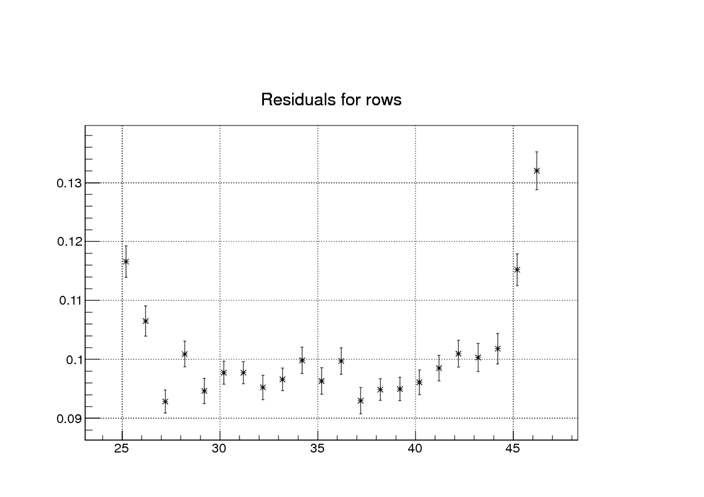
Residuals for rows (middle module)

Slide 9
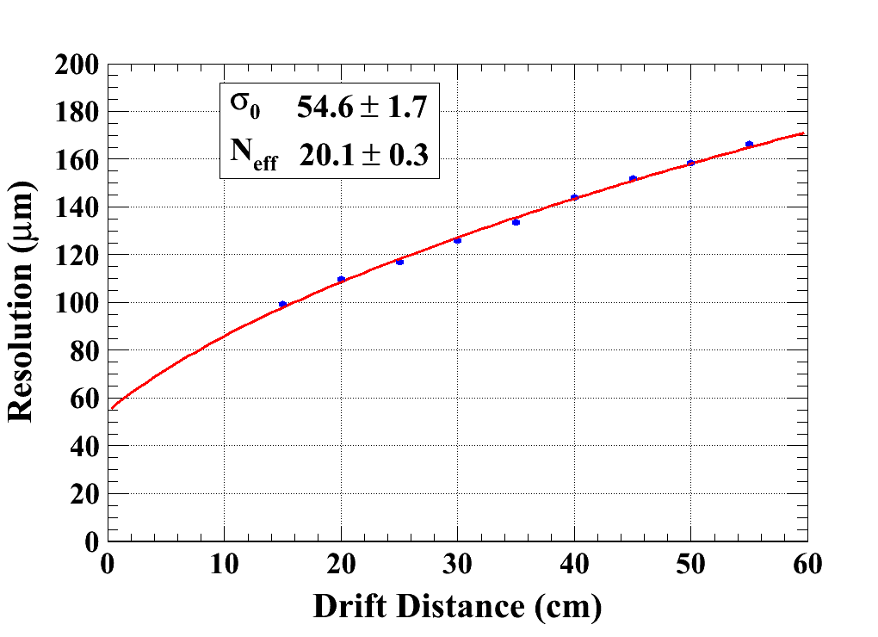
Resolution (middle module)
B=1T, Vmesh=380V, Ed=230V/cm, Peaking time 100ns

Slide 10
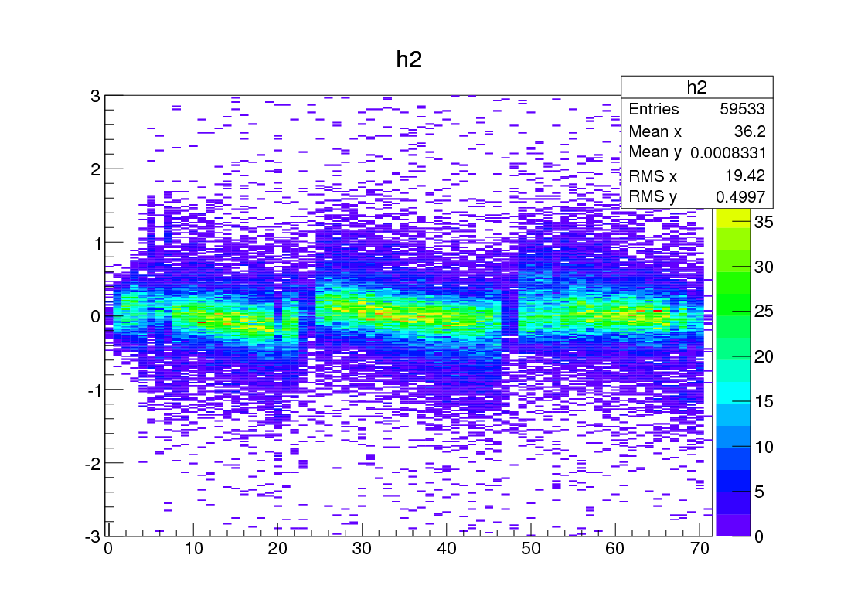
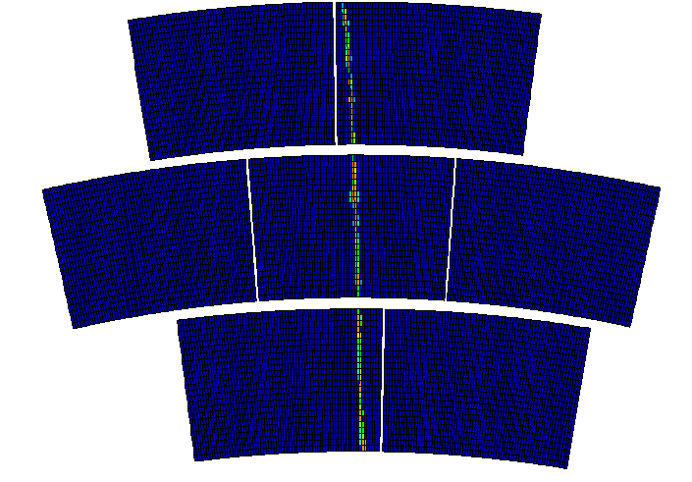
Residual (B=0T, Phi=0º)

Slide 11
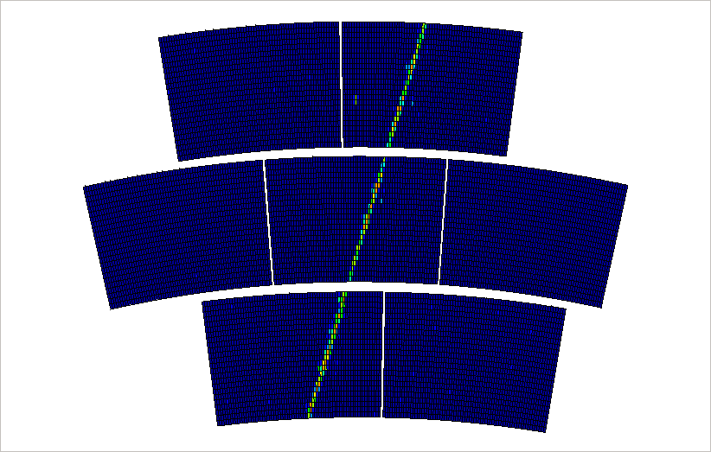
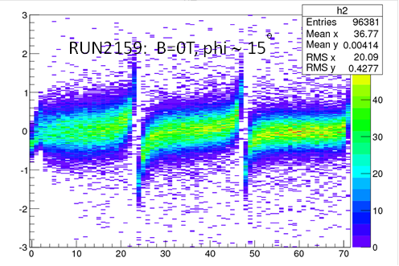
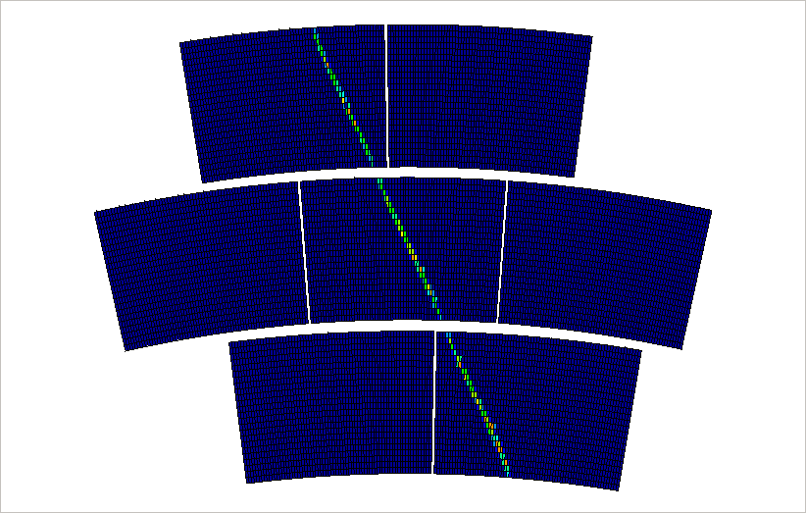
Distortions

Slide 12

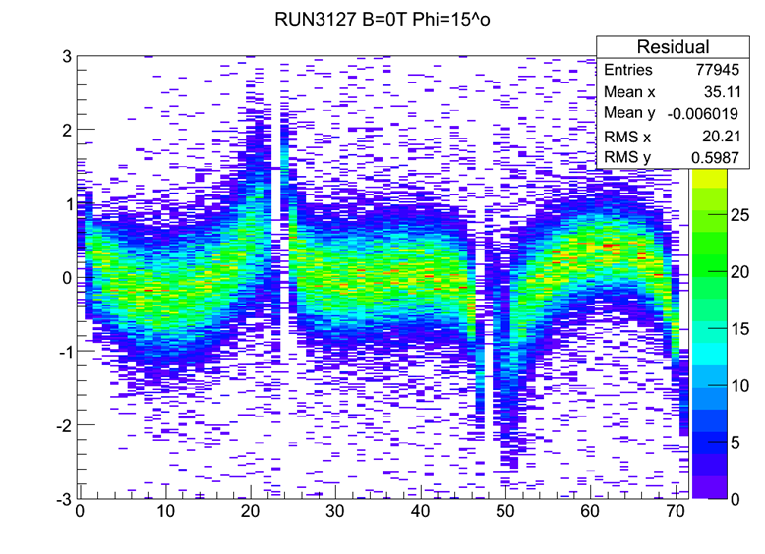
Distortions

Slide 13
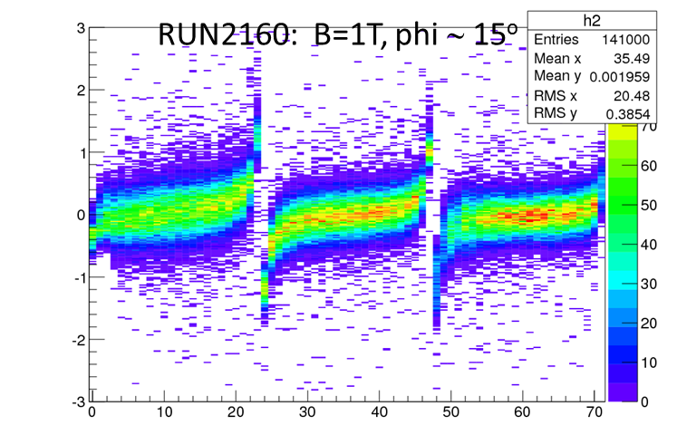

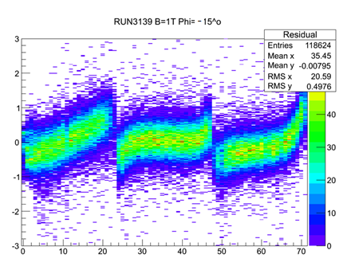

Distortions

