Slide 1
Micromegas Analysis

Slide 2
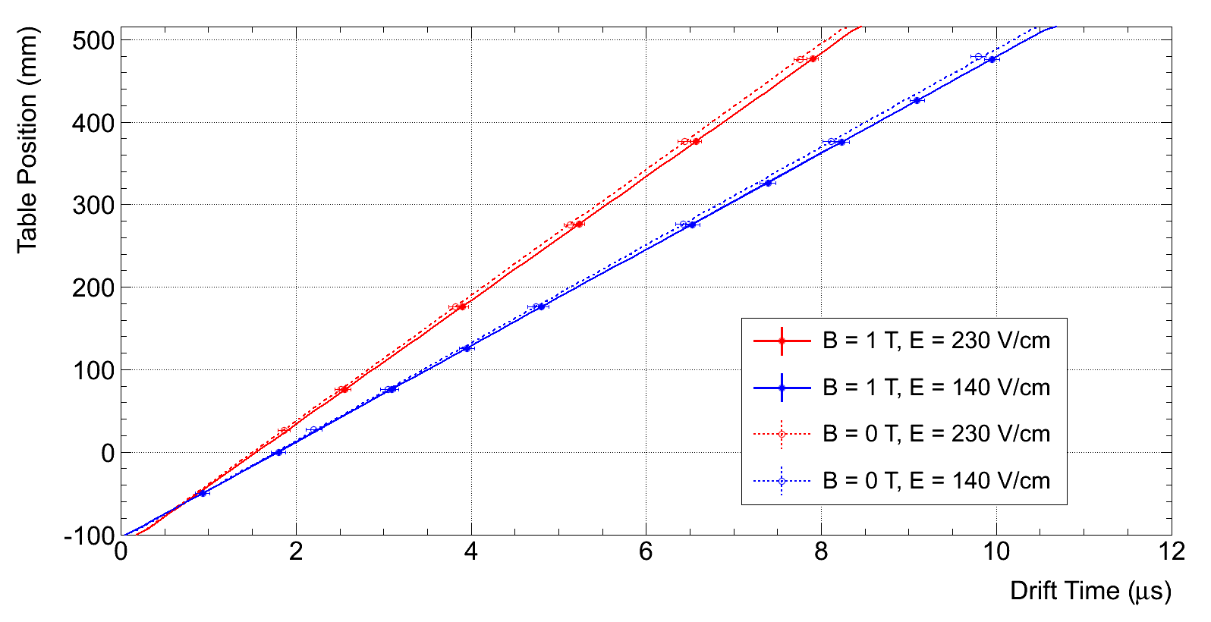
Drift Velocity
B_{field} (T) | E_{drift} (V/cm) | Drift Velocity (cm/μs)
 |  | Measured | Simulated
1 | 230 | 7.50±0.07 | 7,6
1 | 140 | 5.83±0.03 | 5,91
0 | 230 | 7.63±0.04 | 7,6
0 | 140 | 5.94±0.04 | 5,91
David Attie VCI talk (Feb 2013)

Slide 3
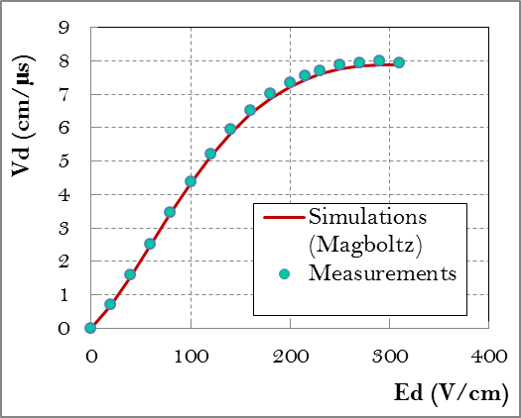
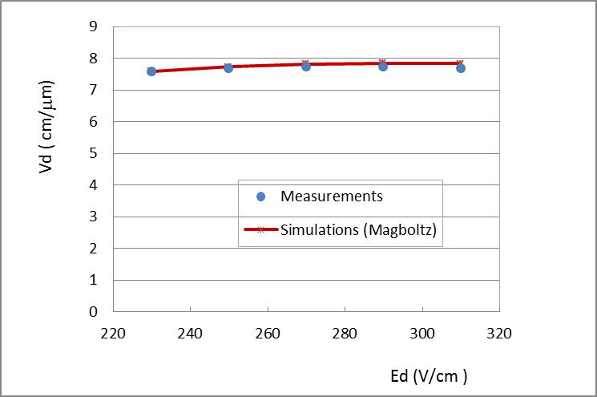
Drift Velocity
2009
B=0T T=19ºC H2O:35ppm
2013
B=1T T=16,5ºC H2O:99ppm
270V/cm: 7.947 cm/μs(2009 Meas.)
7.725cm/μs(2013 Meas.) 7.817cm/μs(Sim.)

Slide 4
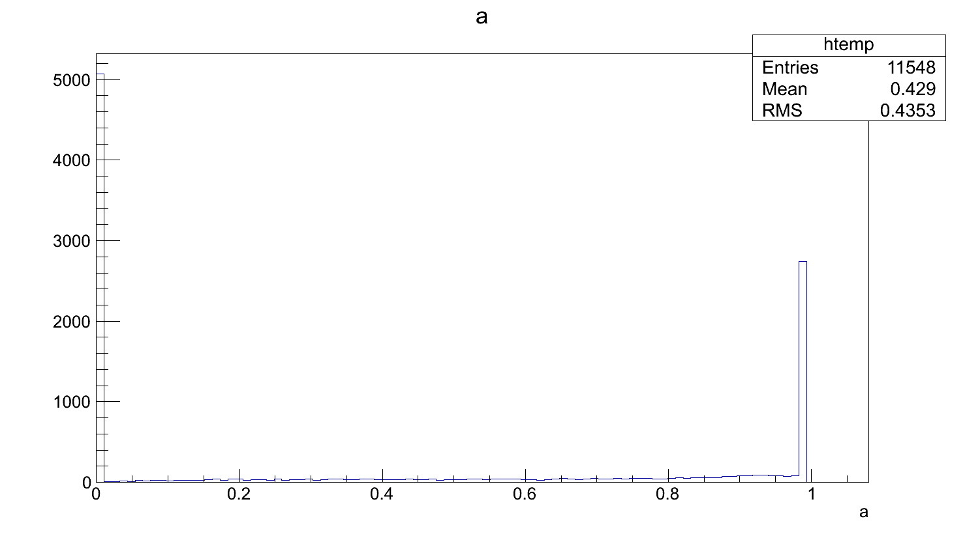
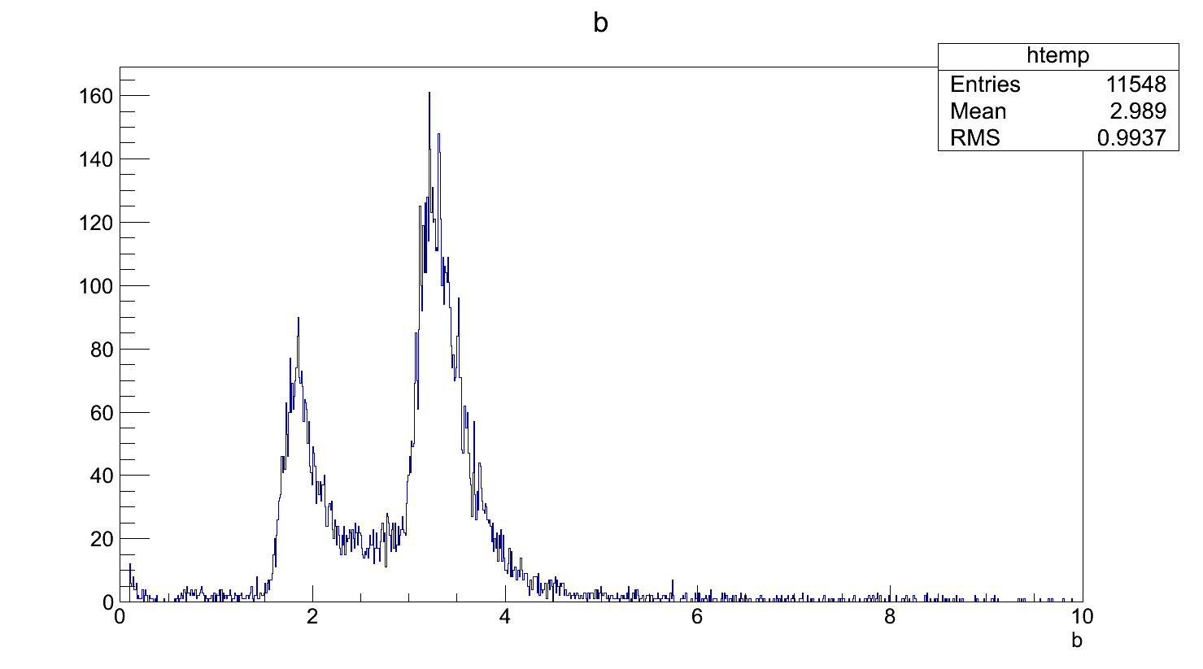
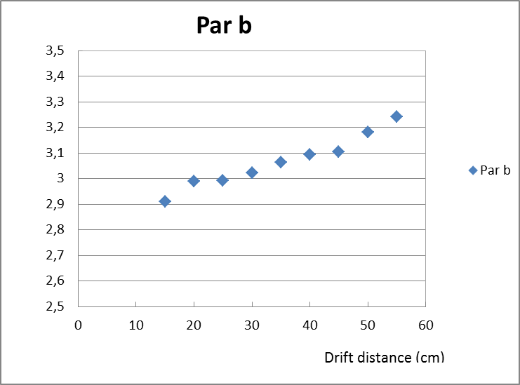
PRF
$$PRF=\frac{1}{1+\frac{4ax^{2}}{b^{2}}}e^{\frac{−4ln2(1−a)x^{2}}{b^{2}}}$$
For a=1, b is the FWHM of a Lorentzian
For a=0, b is the FWHM of a Gaussian
B=1T

Slide 5
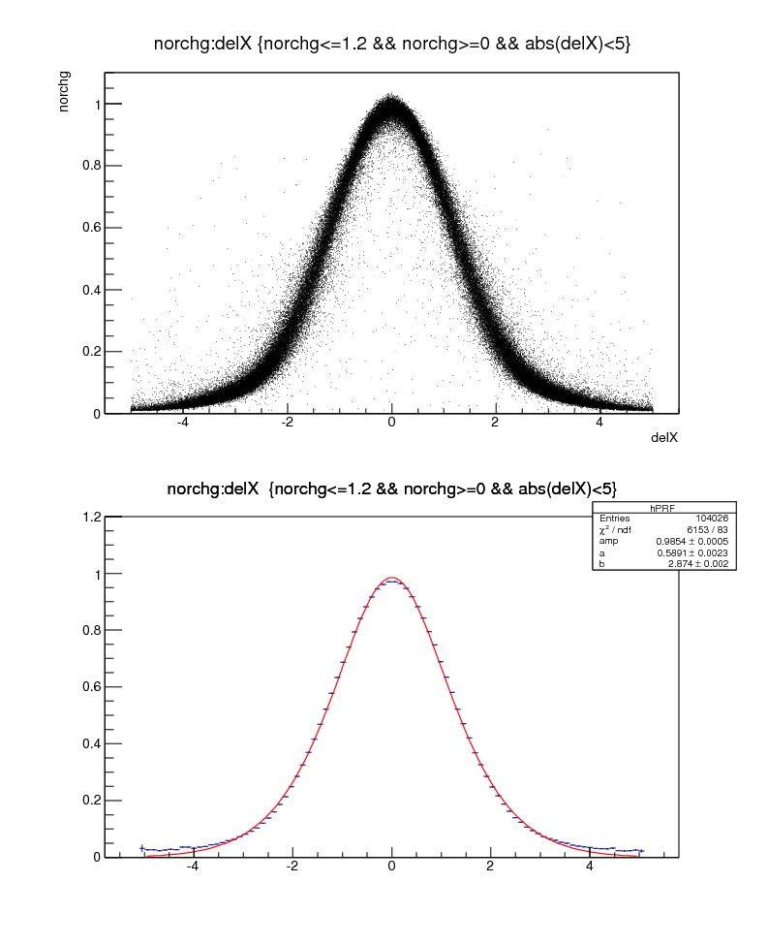
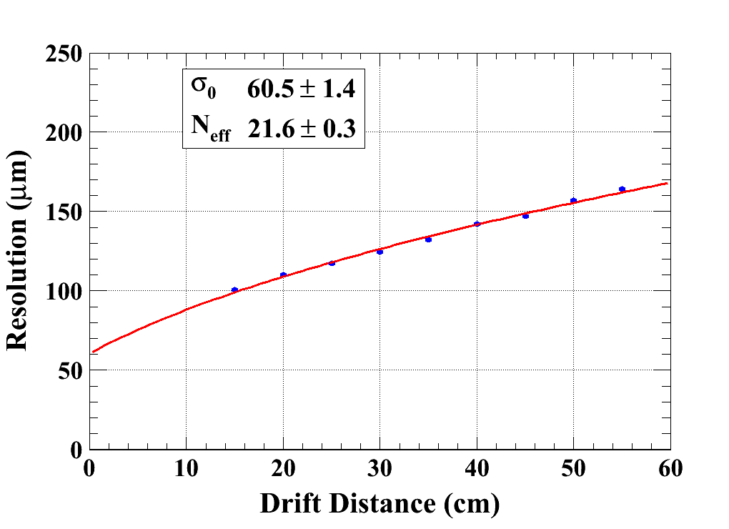
Z Scan (B=1T)
Z=15cm

Slide 6
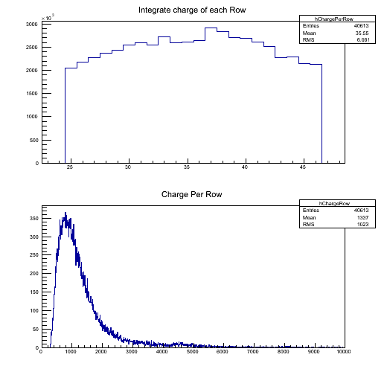
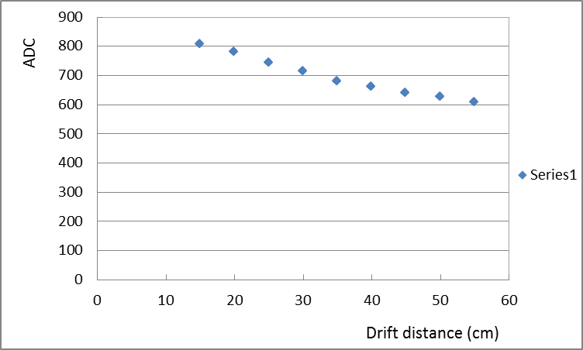
Z Scan (B=1T)

Slide 7
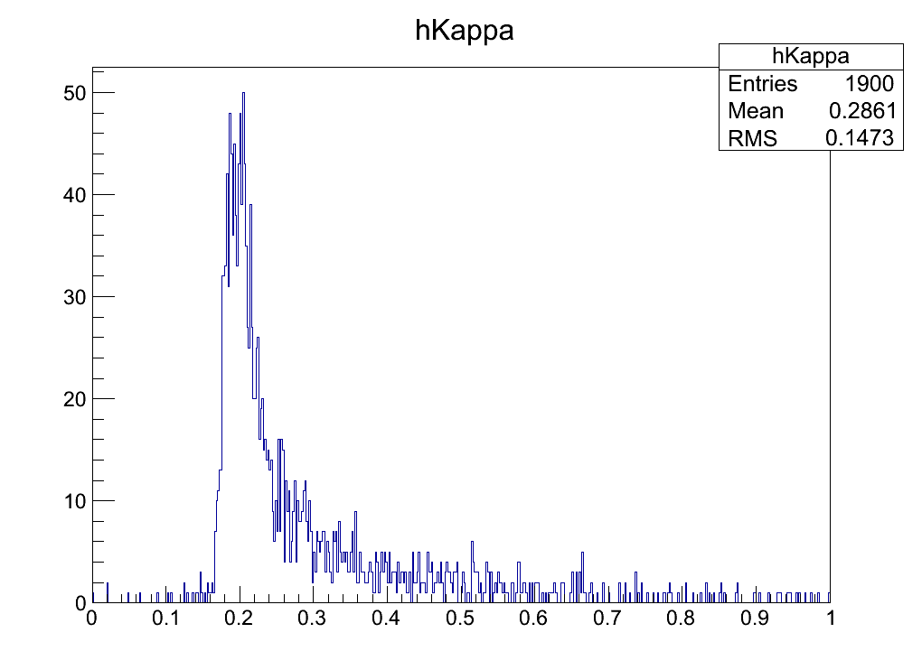
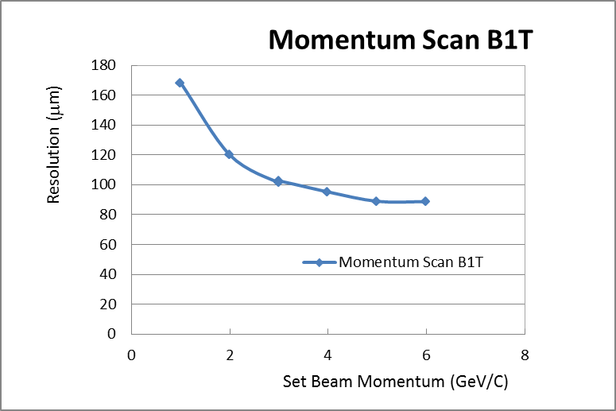
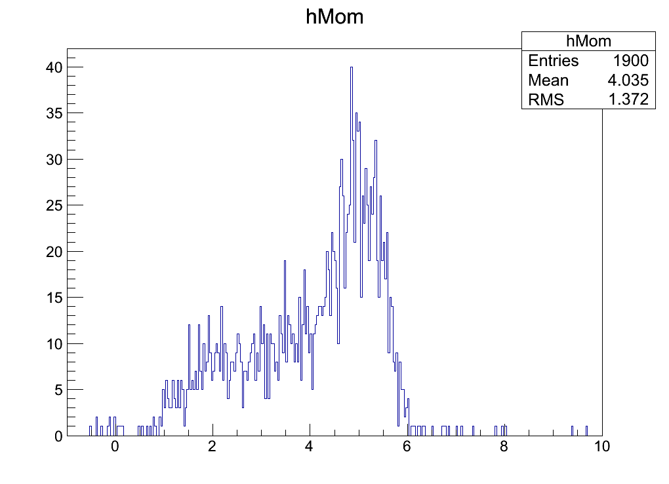
Momentum Scan (B=1T)
Set Beam Mom. = 5GeV

Slide 8
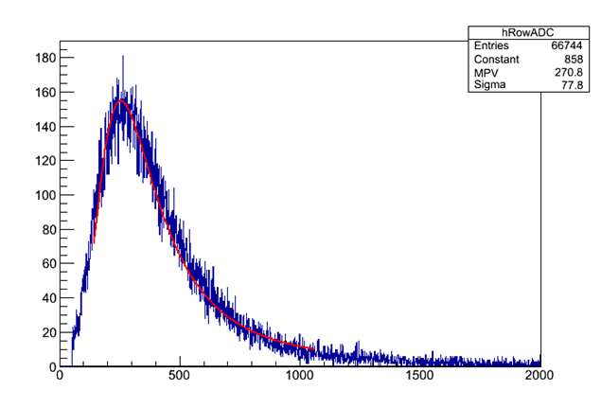
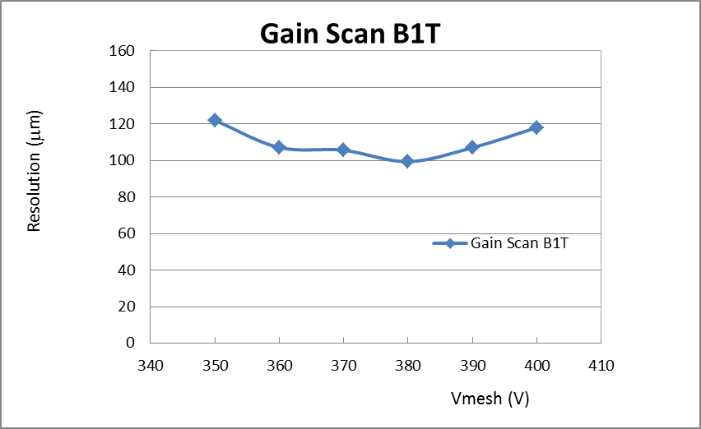
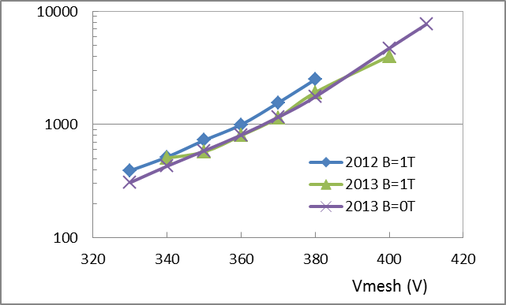
Gain Scan
For pitch 6.84 mm 5 GeV e-Expectations for Ntot: 61.9
( P. Colas - FJPPL-FCPPL-LCTPC Analysis meeting talk in 2010)

Slide 9
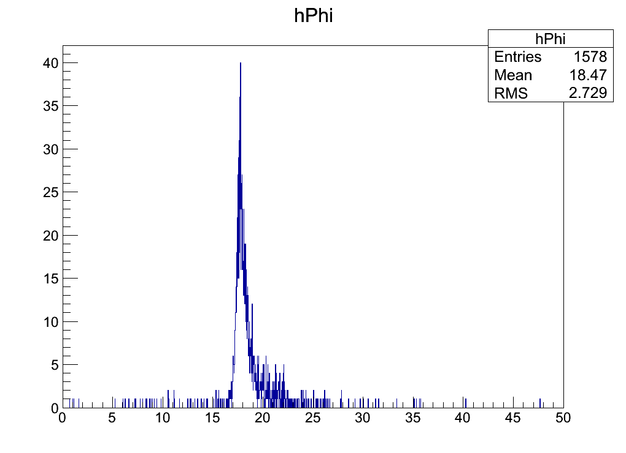
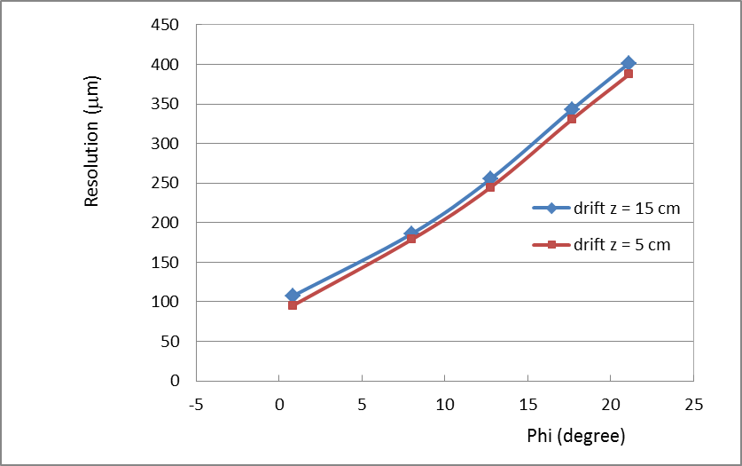
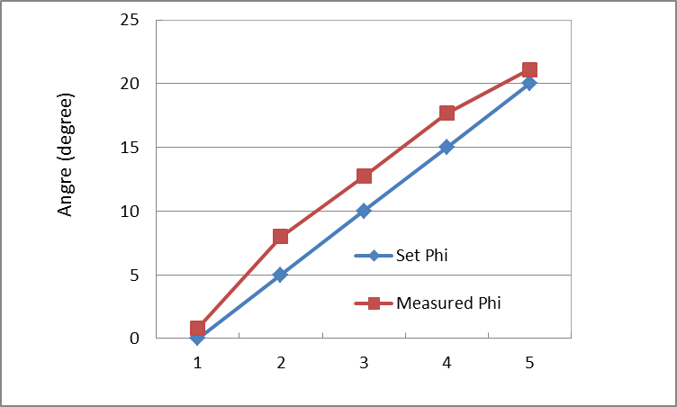
Phi Scan (B=1T)

