Slide 1
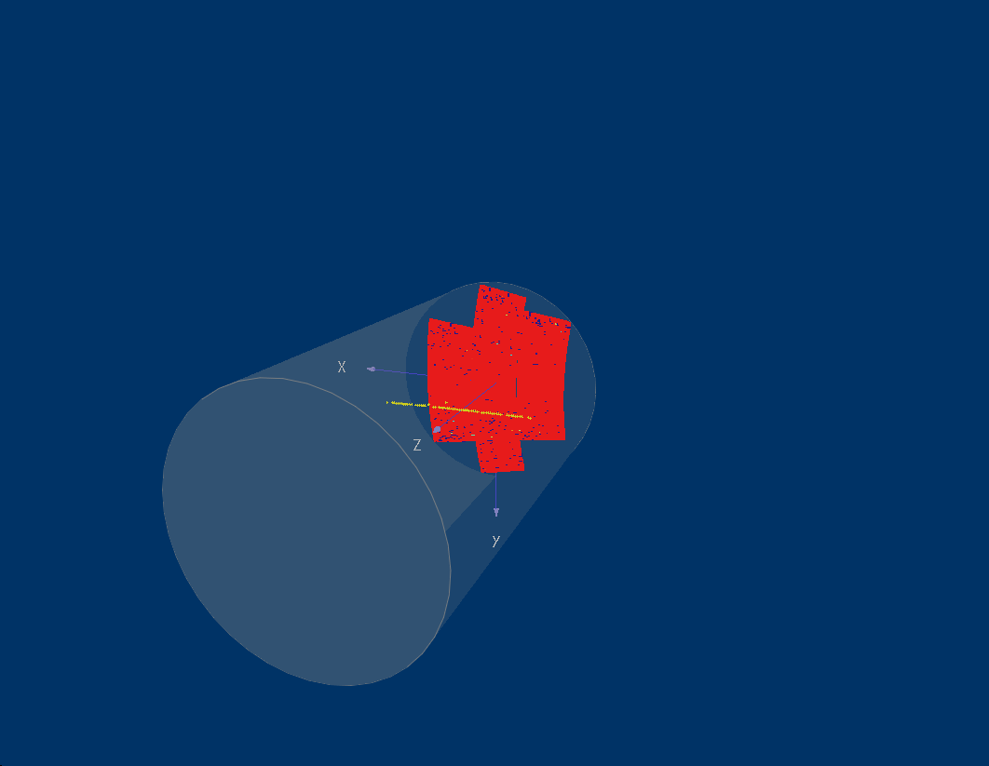
A Micromegas TPC for the ILC
Wenxin Wang

Slide 2
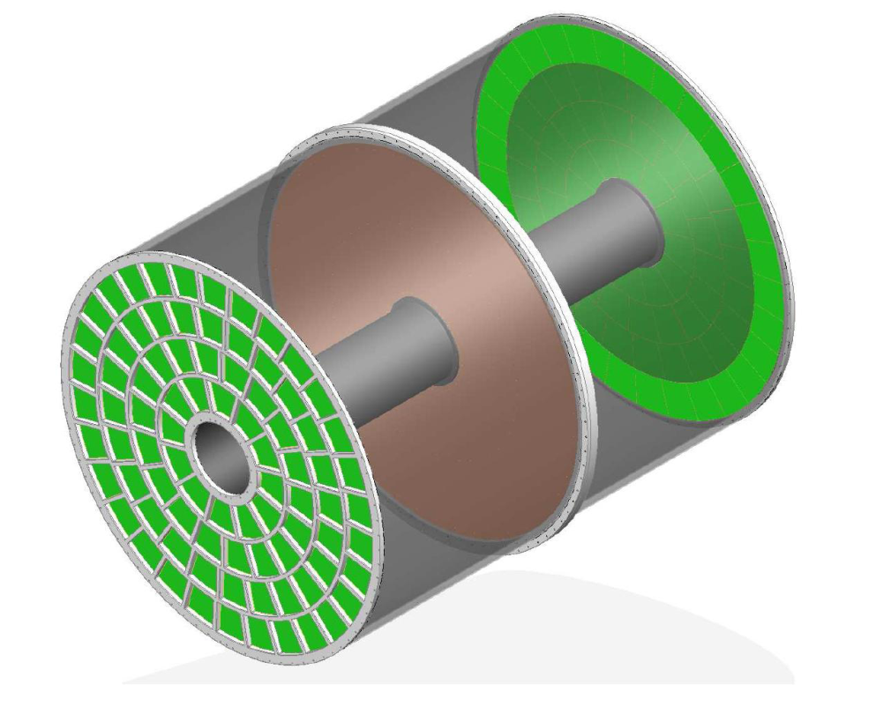
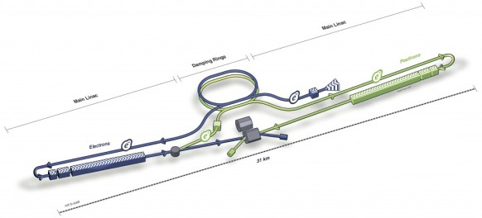
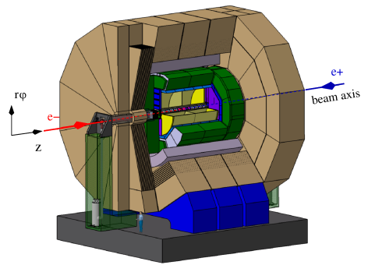
ILD-TPC for ILC
L: 4.7m
Design for an ILD TPC in progress:
Each endplate: 80 modules with 8000 pads
Spatial Resolution (in a B=3.5T magnetic field):
δ(x) ~ 100 μm for the full 2.3 m drift
φ: 3.6m
ILD

Slide 3
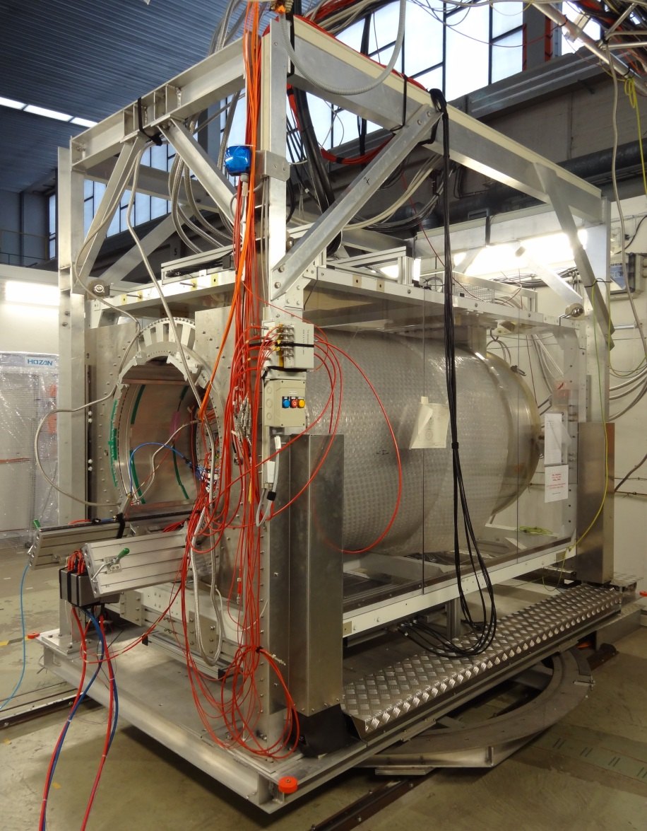
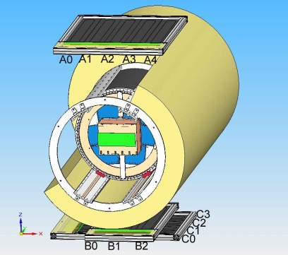
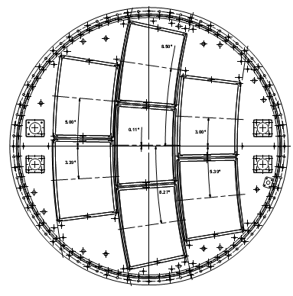
Large Prototype-TPC (LP-TPC)
Magnet up to 1.2T
Field cage: 61 cm length and 72 cm diameter
7 interchangeable modules with keystone shape

Slide 4
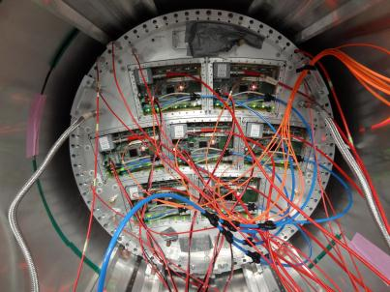
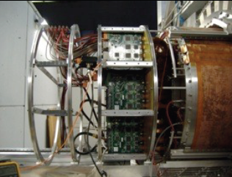
MPGD: Micromegas & GEM
Several types of readout modules are studied
Readout |  | Pad Size | Electronics | Groups
MPGDs | Double GEMs (Laser-etched) | (~ 1 × 6 mm² Pad) | ALTRO | Asia
 | Triple GEMs (wet-etched) |  |  | Desy
 | Micromegas (Resistive anode) | (~ 3 × 7 mm² Pad) | AFTER | Saclay-Carleton
GEM
(test with 3 modules)
Micromegas
(test with 7 modules)

Slide 5


Micromegas with Resistive Anode
Pad width limits MPGD TPC resolution
Charge dispersion technique with a resistive anode so that wide pads can be used for centroid determination
: pad width
σ₀ : resolution at Z=0 without diffusion
mesh
mesh
B
B
E
E
resistive foil
glue
pads
pads
Direct signal readout technique

Slide 6
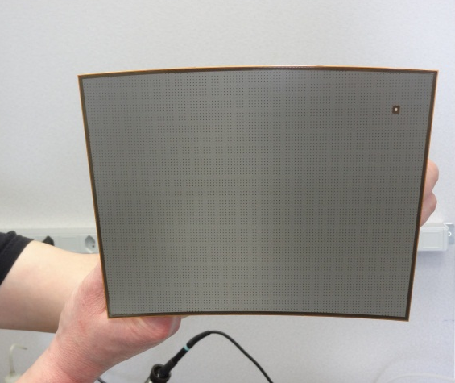
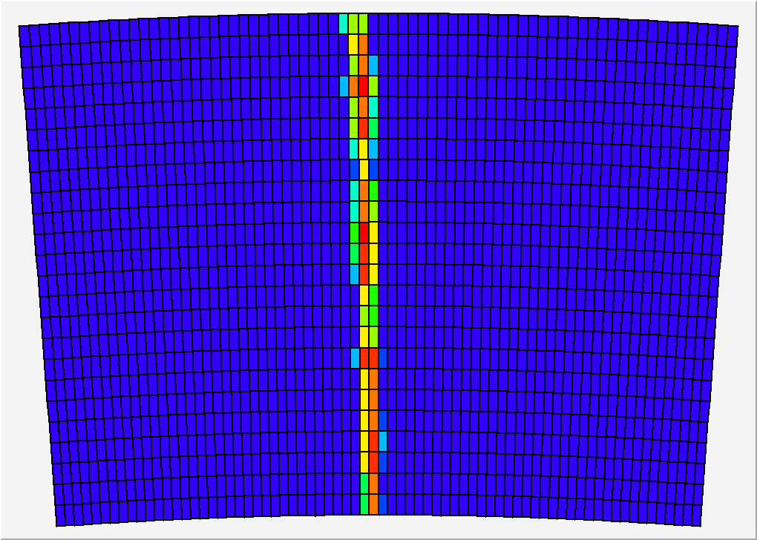
Micromegas module
Module size: 23 cm × 17 cm
24 rows × 72 columns
Readout: 1726 Pads
Pad size: ~3 mm × 7 mm

Slide 7
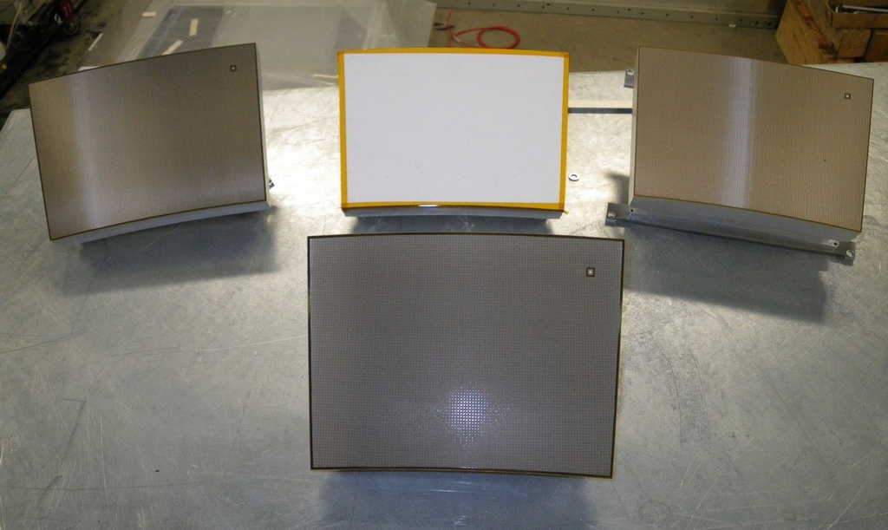
Micromegas modules
Resistive Kapton
~3 MΩ/□
Resistive Kapton
~5 MΩ/□
Standard
Resistive ink
~3 MΩ/□

Slide 8
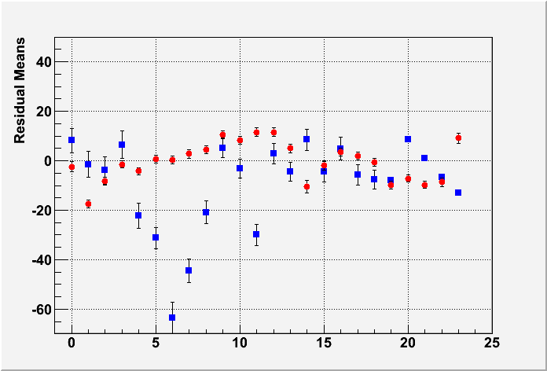
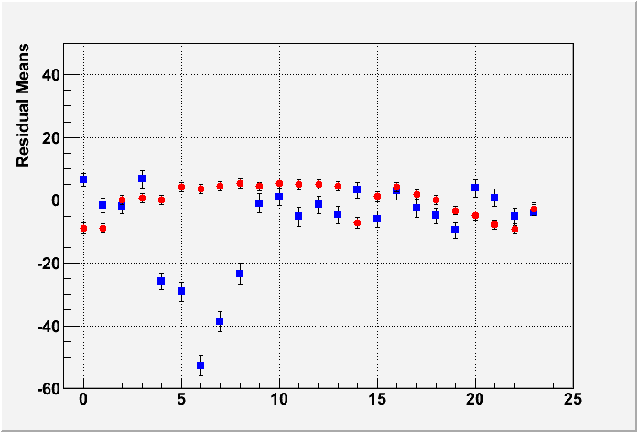
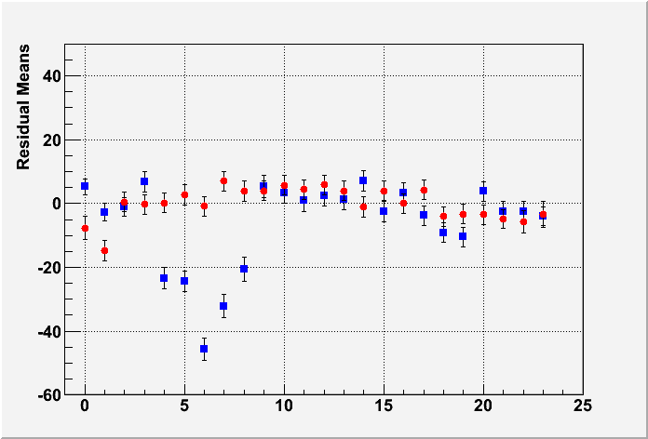
Uniformity
Mean Residual vs Row Number
Z-independent distortions
Distortions up to 50 microns for resistive ink (blue points)
Rms 7 microns for CLK film
(red points)
Z=5cm
Z=35cm
Z=50cm
Row Number

Slide 9
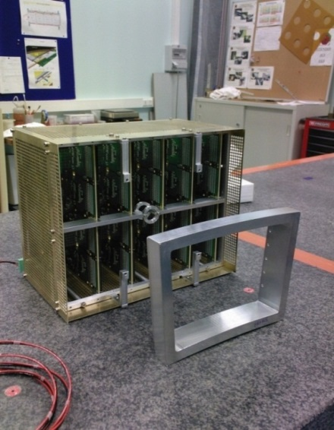
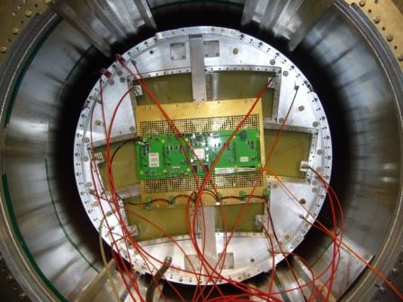
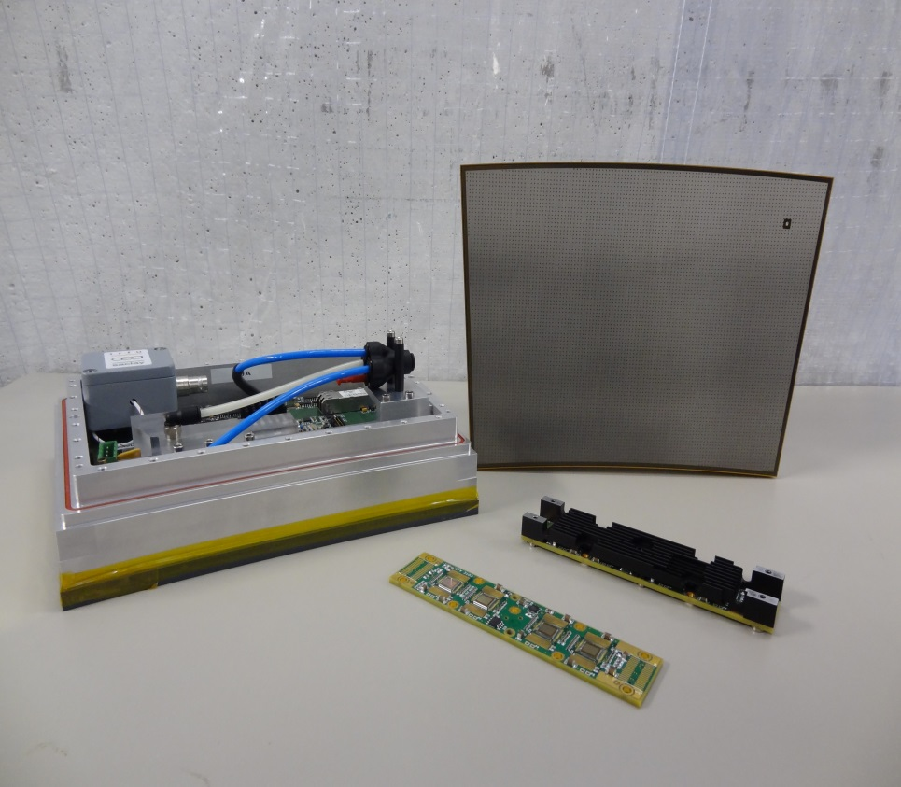
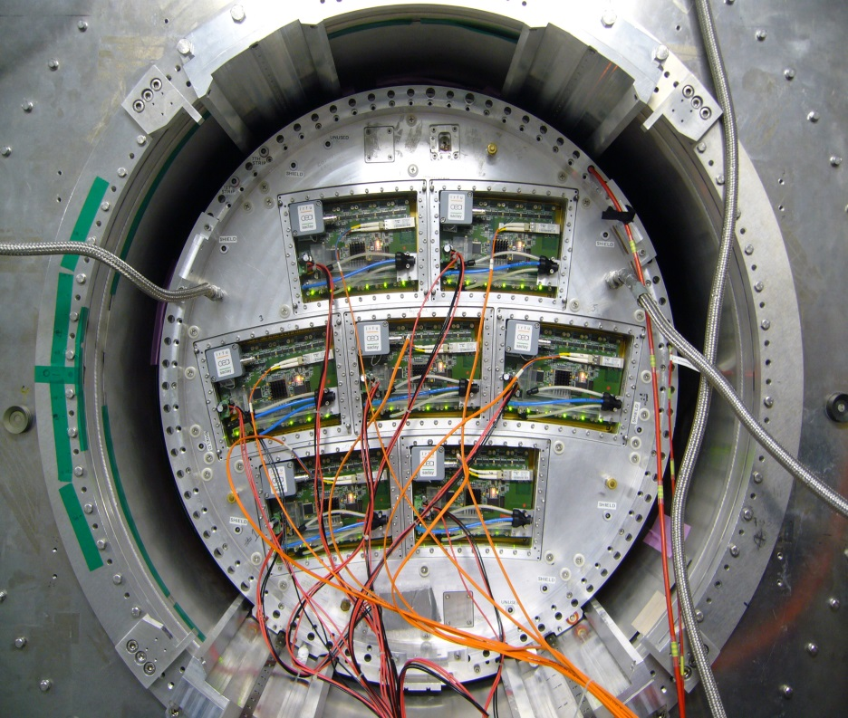
Beam test
2008~2011:
Test with one module
T2K electronics
(32cm × 25cm × 14cm )
2012~2013:
Test with
multi-modules
Integrated electronics ( 23cm × 17cm × 5cm )
Resistive Micromegas Detector
FEM
Fully integrated Module
FEC

Slide 10
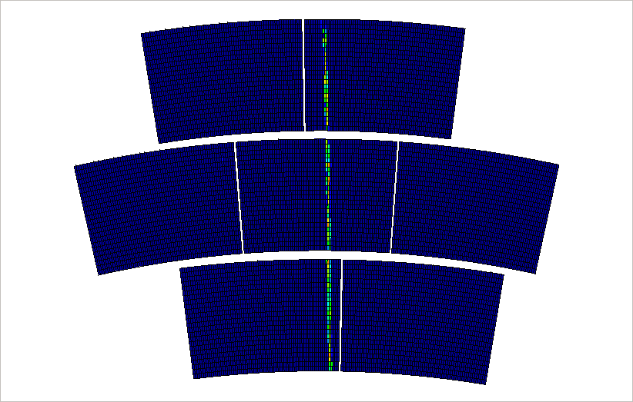
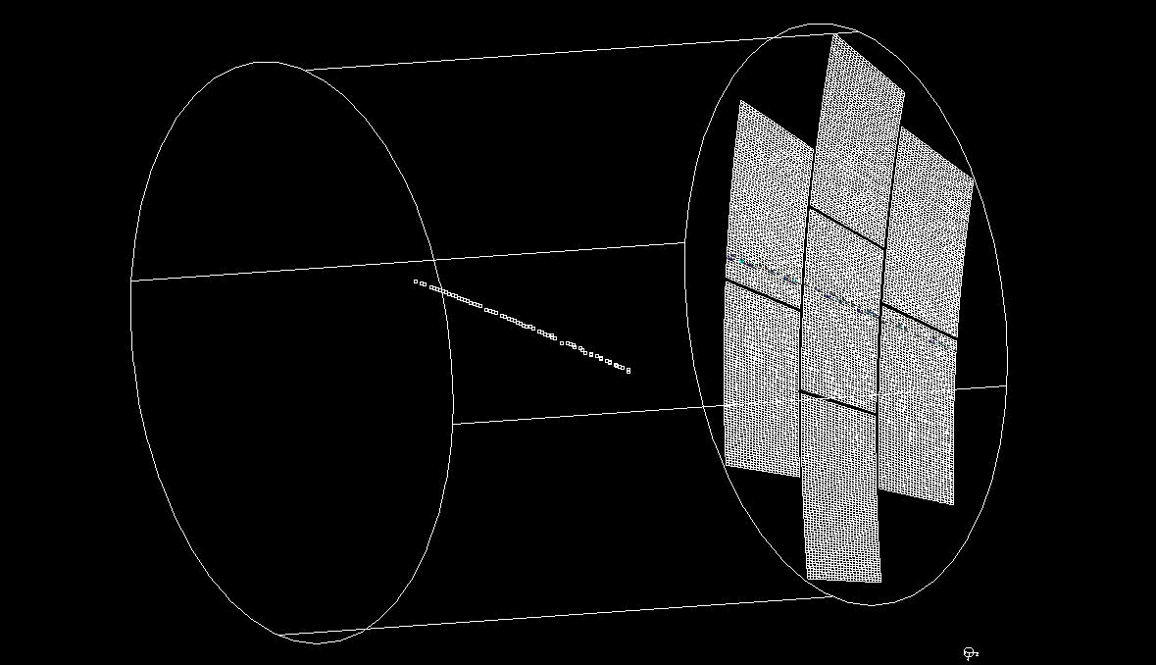
Event display
Online monitor
2D or 3D display software available
Offline monitor

Slide 11
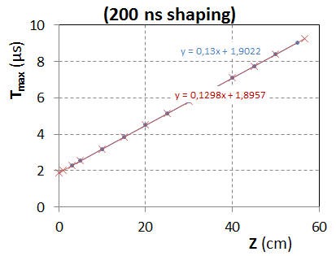
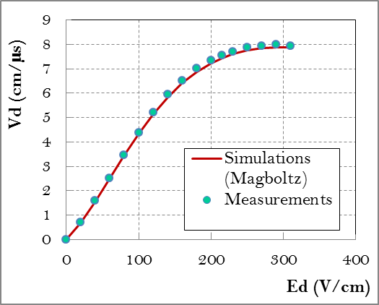
Drift Velocity
Test in 2009 (B=0T):
T2K gas: Ar:CF4:iso=95:3:2
T=19ºC - P = 1035hPa
H2O:35ppm
At E=230 V/cm :
V_{drift} = 7.698 +- 0.040 cm/µs (Magboltz : 7.583+-0.025(gas comp.))
The difference is 1.5+-0.6 %

Slide 12
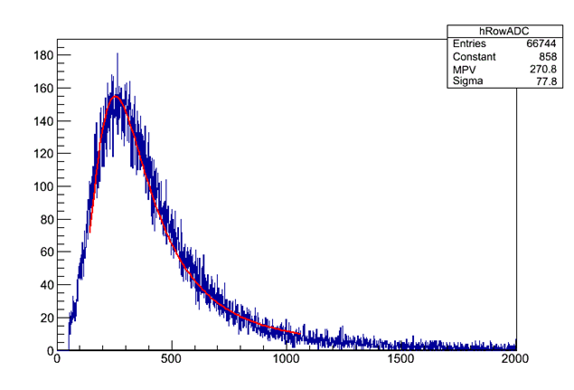
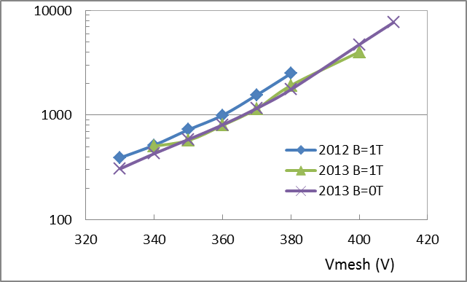
Gain Study
Gain
ADC
For 6.84 mm pitch and 5 GeV e-
Expectations for Ntot: 61.9
(from HEED simulation)

Slide 13
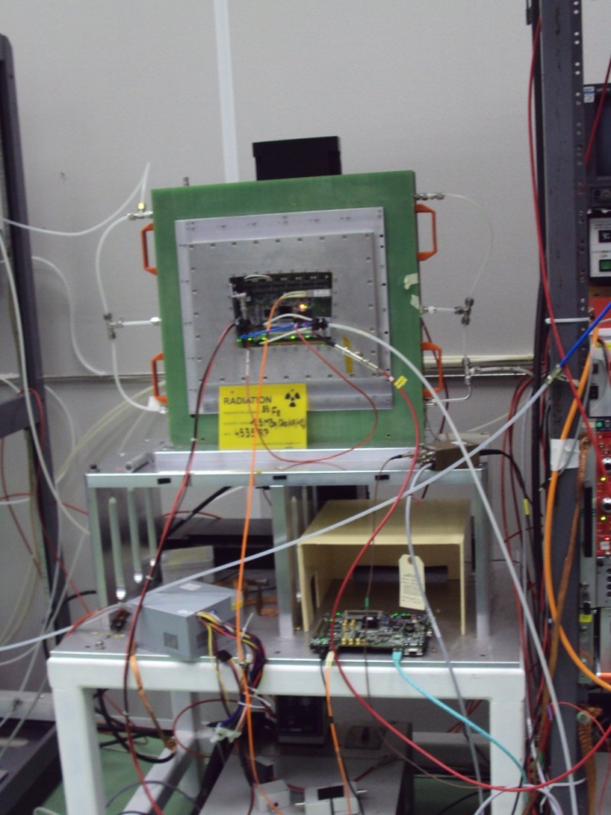
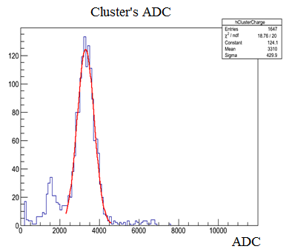
Test bench
Energy Resolution :~13% rms
Gain ~2600
(using collimated source, Vmesh=380V)
The ⁵⁵Fe source is put in an aluminum collimation tube and fixed on a set of two mechanical arms (X-Y).

Slide 14
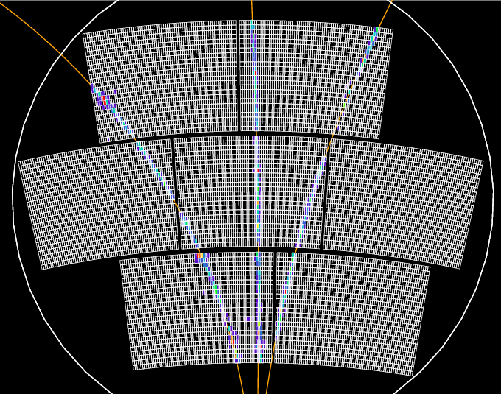
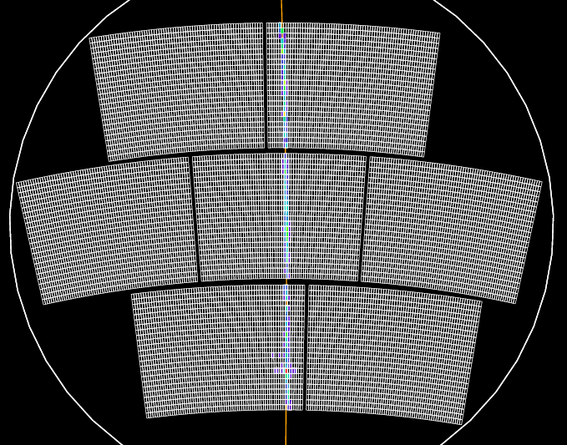
Spatial resolution
Event selection

Slide 15
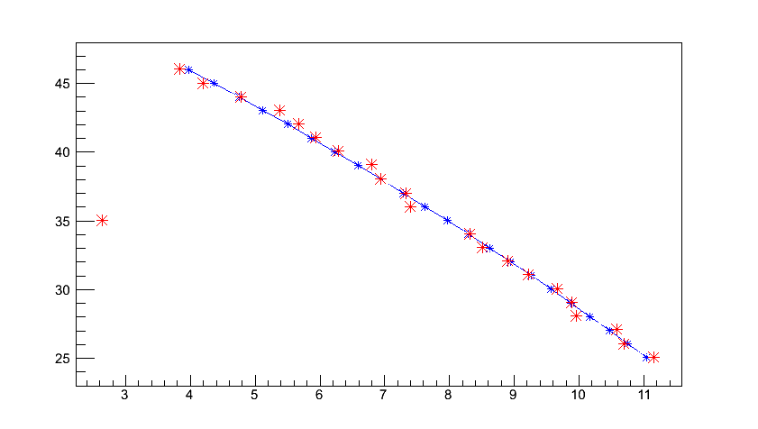
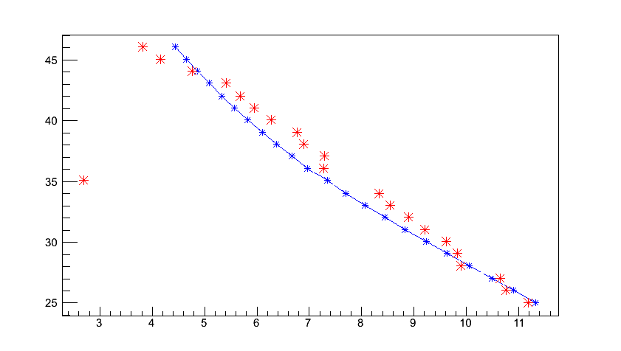
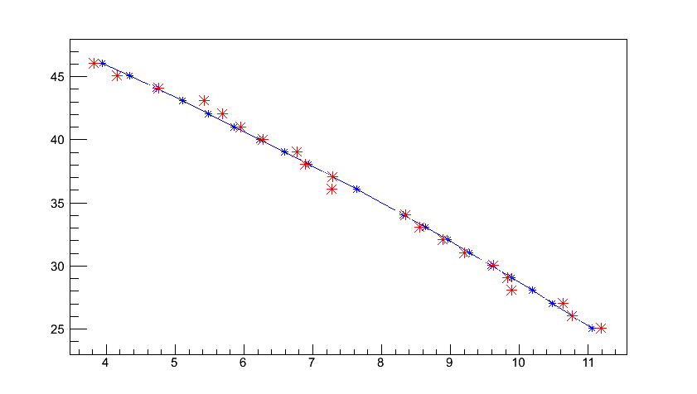
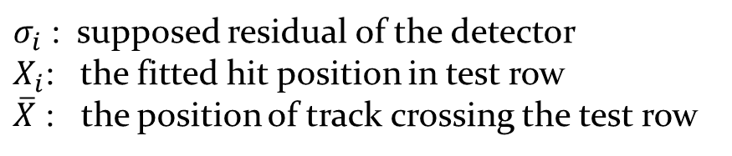
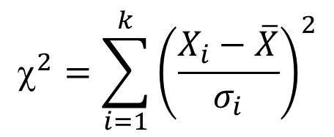
Spatial resolution
Hits selection
(c) Fit track after selection hits (row 35)
Row number
(b) Fit track without using hit in row 35
Row number
(a) Fit track with all rows
X (mm)
X (mm)
$$^{2}=\sum_{i=1}^{k}{{\left(\frac{X_{i}−\overline{X}}{σ_{i}}\right)}^{2}}$$
$σ_{i}$ : supposed residual of the detector
$X_{i}$: the fitted hit position in test row
$\overline{X}$ : the position of track crossing the test row

Slide 16
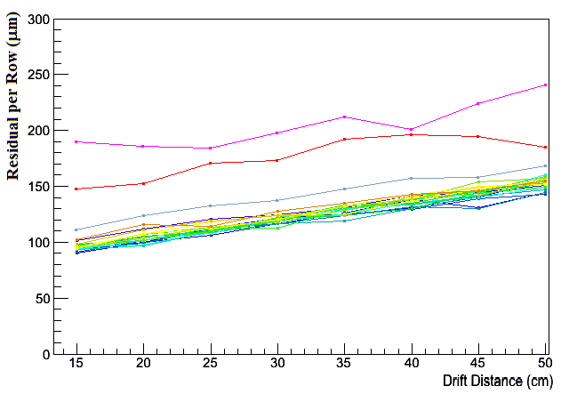
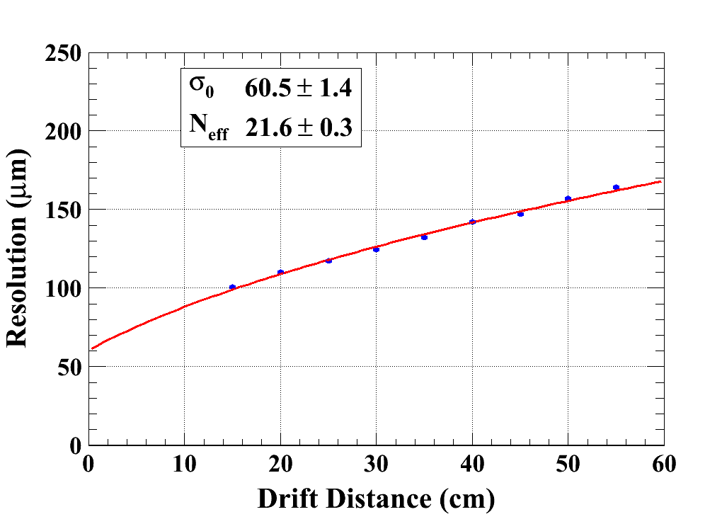
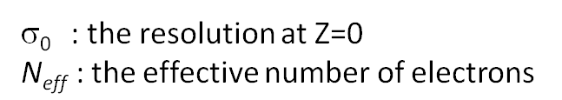
Spatial resolution
B=1 T C_{d} = 94.2 µm/√cm (Magboltz)

Slide 17
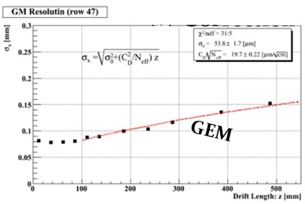
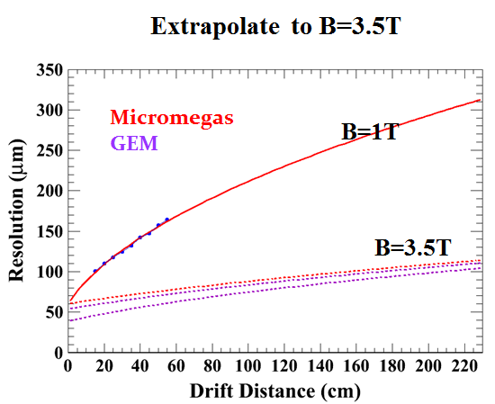
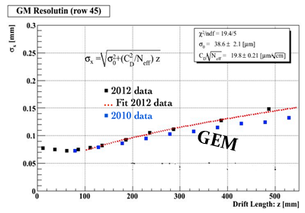
Compare with GEM
( Spatial resolution )

Slide 18
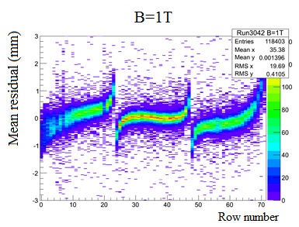
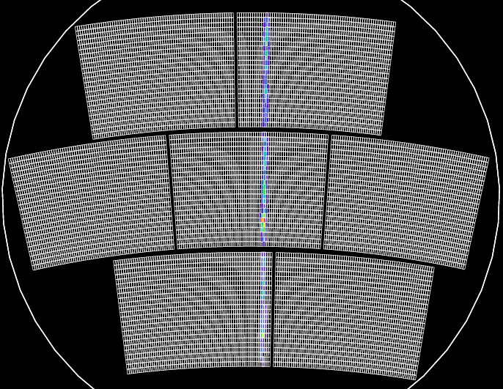
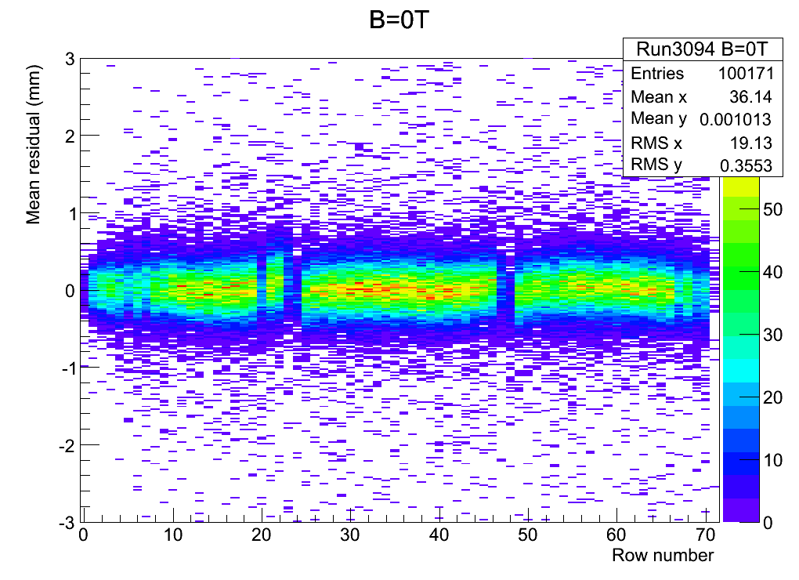
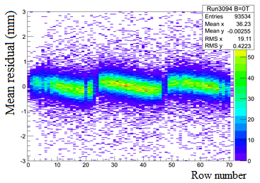
Field distortions
B=1T
After alignment
B=0T
B=0T

Slide 19
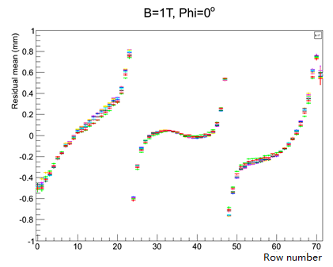
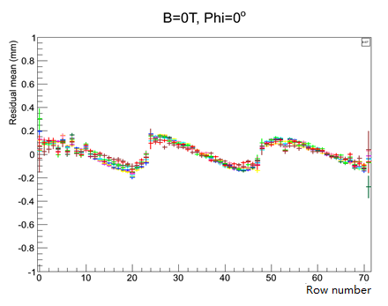
Field distortions
B=1T
Distortions at different drift distances
in B=0T or B=1T
B=0T

Slide 20
Conclusion
A lot of experience has been gained in building and operating Micromegas TPC panels.
The characteristics of the Micromegas modules, such as the uniformity, energy resolution, stability have been studied in detail.
7 modules have been successfully tested with full integration of the electronics at the same time.
Thanks to the resistive technology, the measured resolution is about 60 microns at zero drift distance with 3 mm wide pads. This meets ILC needs.
Distortions are observed. Their detailed study will allow to correct them and improve the design to minimize them.

Slide 21
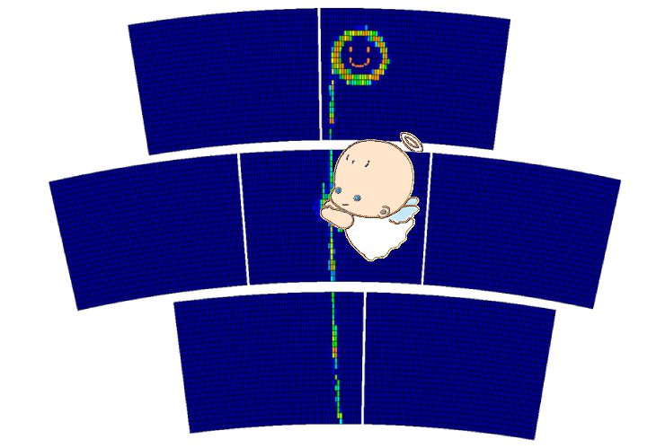
Thank you !

Slide 22
