Slide 1
Energy measurement with Micromegas res. foil
LCTPC – 10th analysis meeting
Wenxin Wang

Slide 2
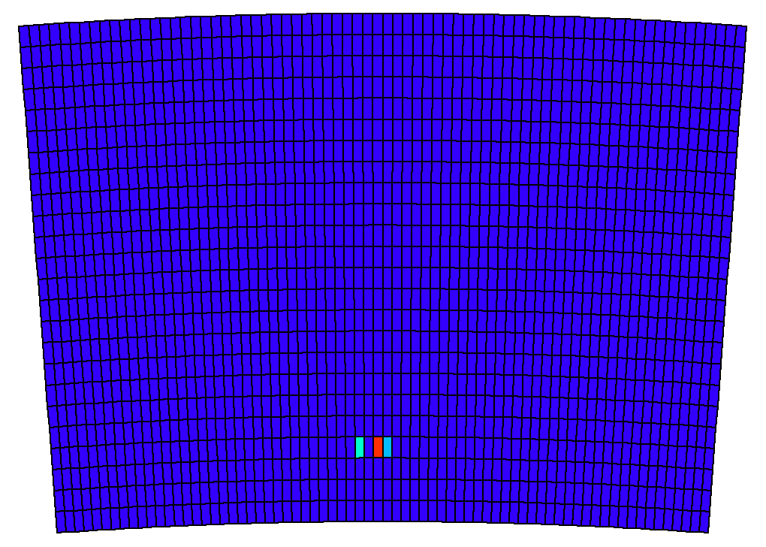
⁵⁵Fe Event

Slide 3
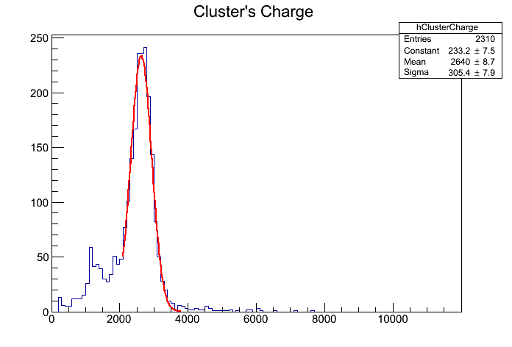
Module S8G

Slide 4
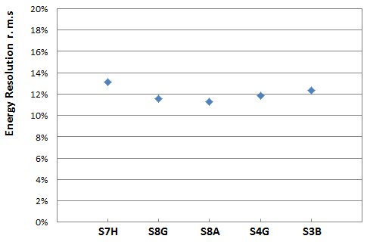
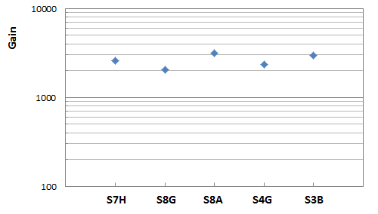
Modules

Slide 5
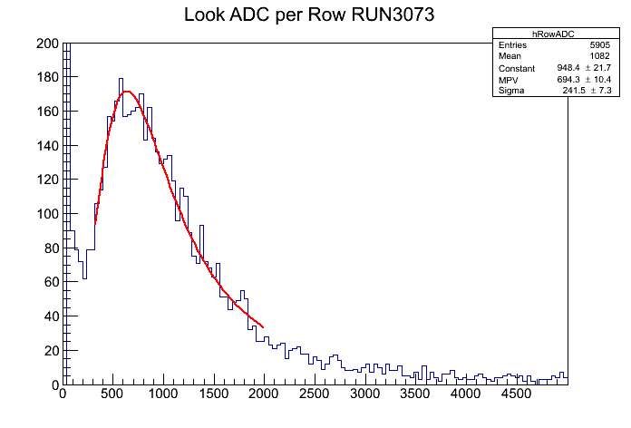
Test with Beam
Only using center module (S10X)
For 6.84 mm pitch and 5 GeV e-
Expectations for Ntot: 61.9
(from HEED simulation)
$$694×\frac{120×{10}^{−15}}{4096}×\frac{1}{1.6×{10}^{−19}}/61.9$$
Gain =
= 2053

