Slide 1
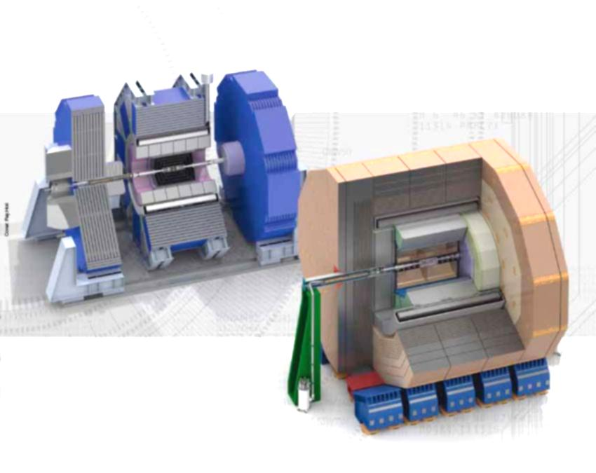
ILD & SiD concepts
and R&D
David Attié
Club ‘ILC Physics Case’
CEA Saclay
June 23, 2013
Notes:
I’m here to present a TPC review

Slide 2
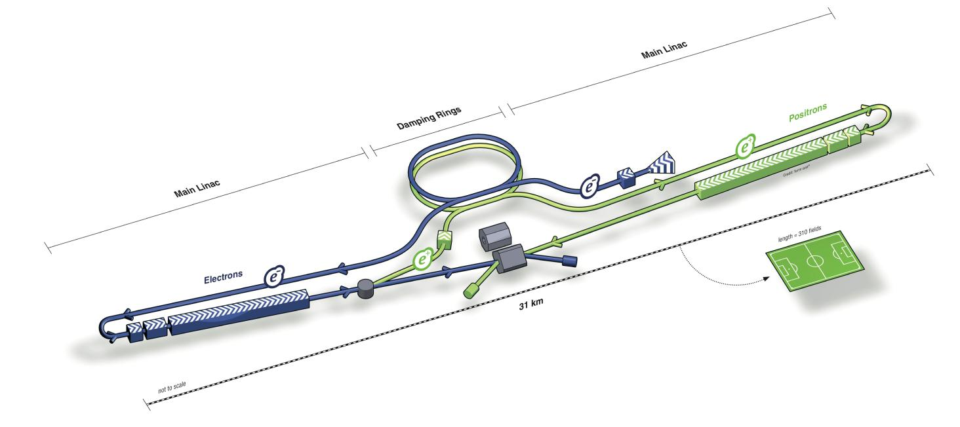
Introduction: Physics Case at ILC
Next collider: linear e+e– collider, length: ~ 31km
Tunable center of mass energy of 200-500 GeV
Two detectors with push-pull concept
Both need to fit into Particle Flow concept

Slide 3
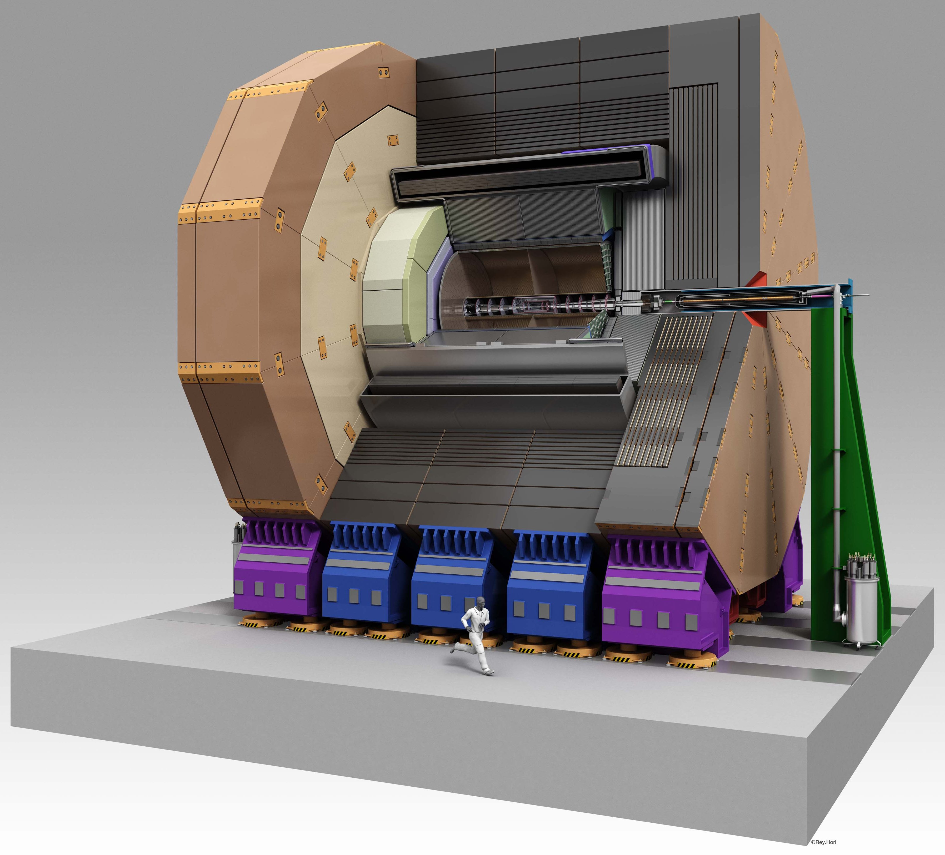
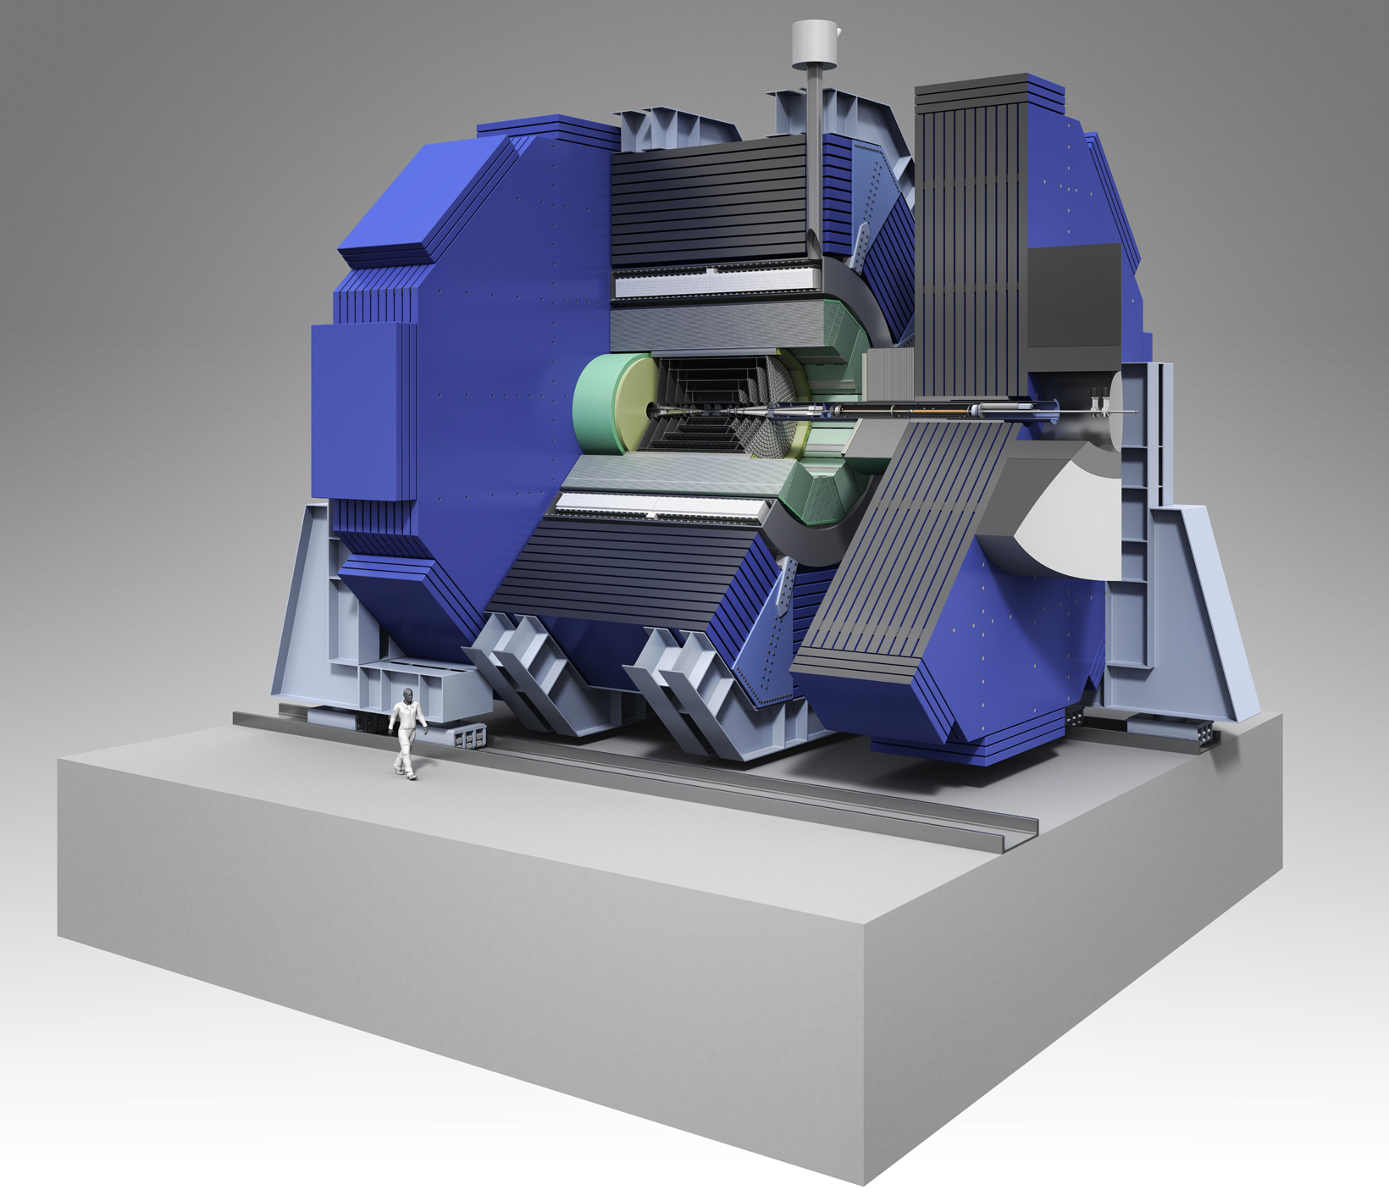
Two detector concepts
LoI: 2009 (SiD)-2010 (ILD)
DBD: 2012 (ILD)-2013 (SiD)
International Large Detector
Silicon Detector

Slide 4
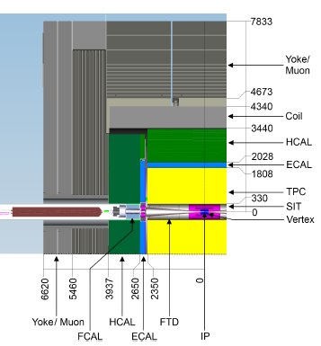
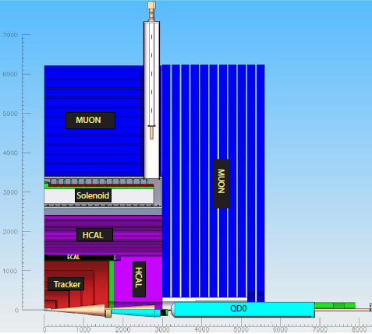
Side (quadrant) views
ILD
SiD

Slide 5
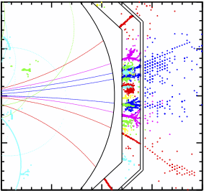
Particule Flow Algorithm (PFA) Approach
Traditionally, E_{jet} = E_{ECAL} + E_{HCAL}
Multi-jet energy resolution needed at the ILC: (σ_{E}/E ≈ 0.3/√E)
Solution = PFA: cross-checking of the measurements of all sub-detectors which will be highly segmented from IP
Trackers→charged particles
Calorimeters→separation charged/neutral
particles

Slide 6
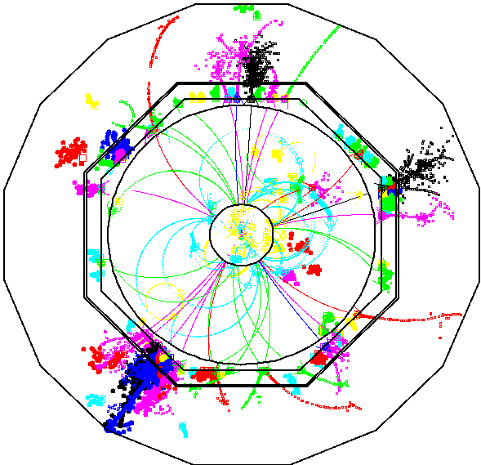
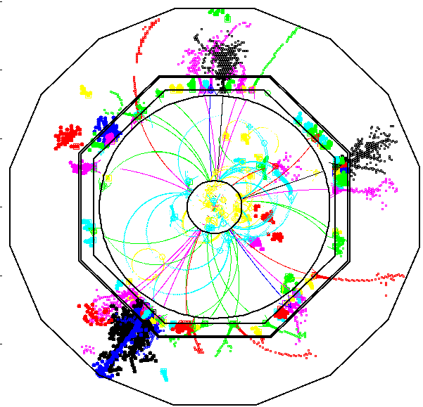
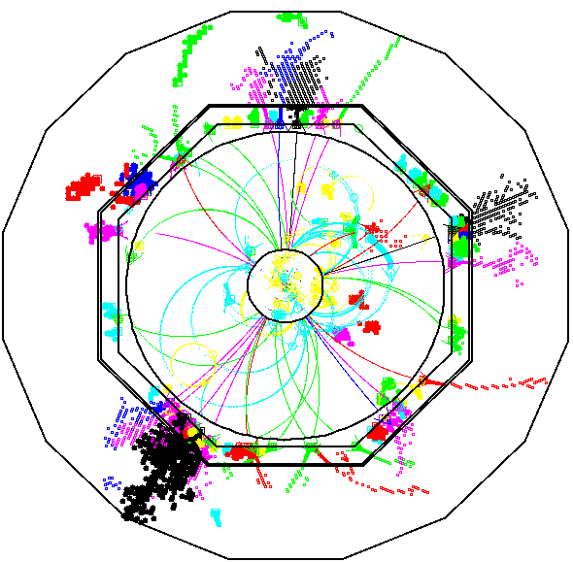
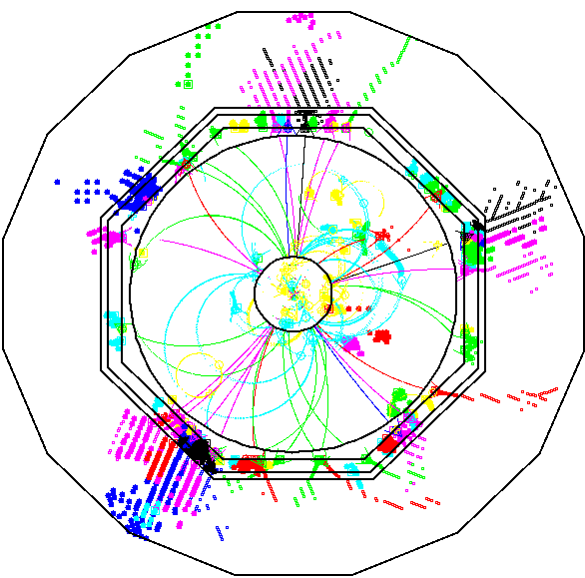
Particule Flow Algorithm (PFA) Approach
Analogue scintillator tile HCAL: change tile size from 1×1  10×10 mm²
1×1
3×3
5×5
10×10
1×1 cm² and 3×3 cm² cell size
Cell size > 5×5 cm² degrades PFA

Slide 7
Concept overview for SiD
5T magnet
Silicon-based tracking
  Vertex detector: 5 Si pixel layers, pixel size of 20 × 20 μm²
  Si main tracker: Si strip of 5 nested cylinders in central region and 4 disks, pitch 50 μm
Main calorimeters (barrel+2 end-caps) inside solenoid with imaging capabilities
  30 Si active layers using 5 × 5 mm² Si pixels between W absorber
  (Two other technologies (GEM & Micromegas) are currently prototyped and evaluated as potential options)
Forward calorimeters (compact ECALs): LumiCal + BeamCal
  30 layers of semiconductor-tungsten technology
Muon system: few 10³ m² scintillator (or RPCs)

Slide 8
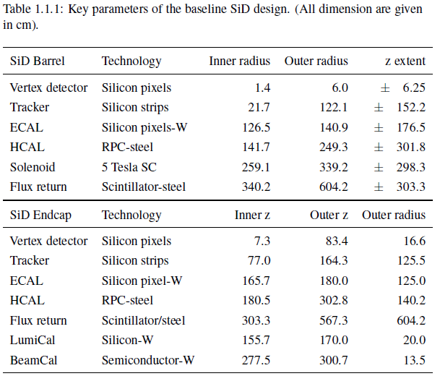
Concept overview for SiD

Slide 9
Concept overview for ILD
3.5T magnet
Vertex detector (VTX):
  MAPS
Silicon strip detector (SIT):
Time Projection Chamber (TPC):
  MPGD readout (GEM or Micromegas) with <1 mm pad size
Calorimeters (layers of W and Fe):
  ECAL: Si diodes or scintillators (30 samples in depth)
  HCAL: 3×3cm² scintillator tiles or 1×1cm² gas based (48 long. samples)
Forward calorimeters (compact ECALs): LumiCal + BeamCal
  30 layers of semiconductor-tungsten technology
Muon system:
  Scintillator strips or resistive chambers (RPCs)

Slide 10
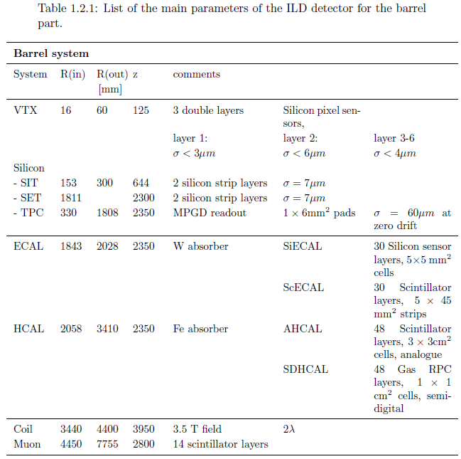
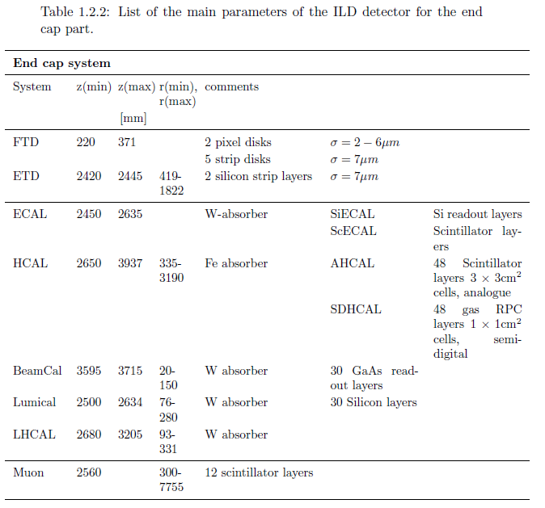
Concept overview for ILD

Slide 11
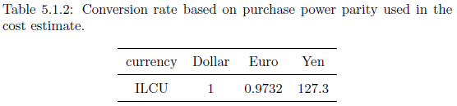
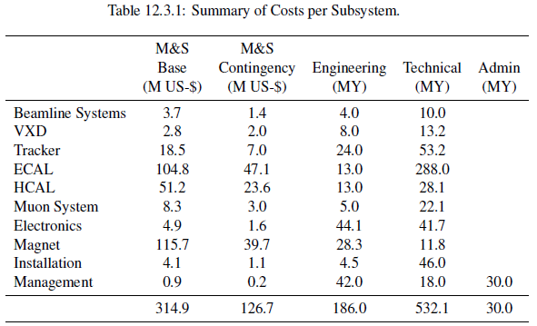
SiD costs
≈860 M $

Slide 12
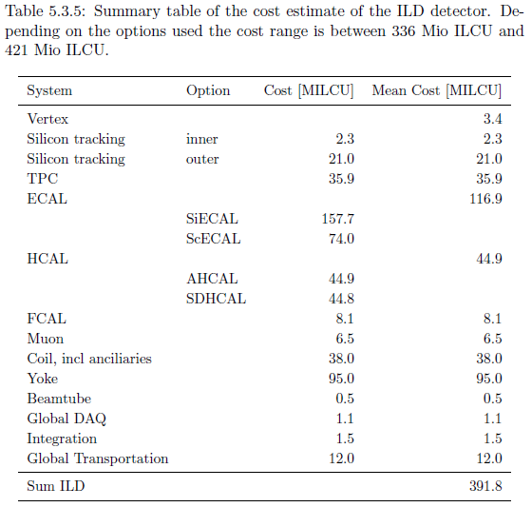
ILD costs

Slide 13
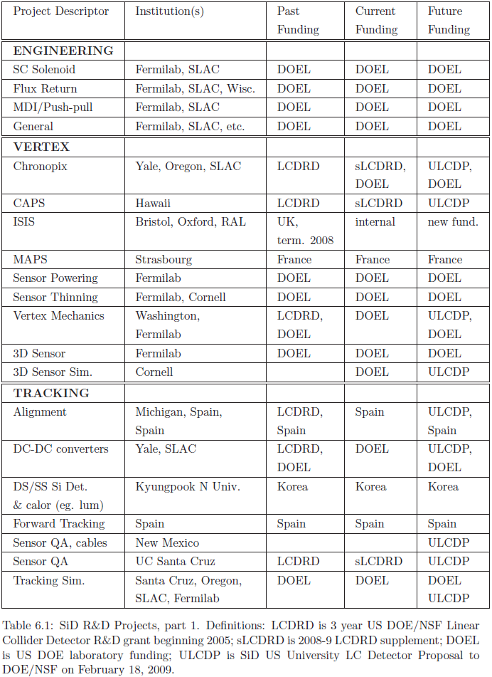
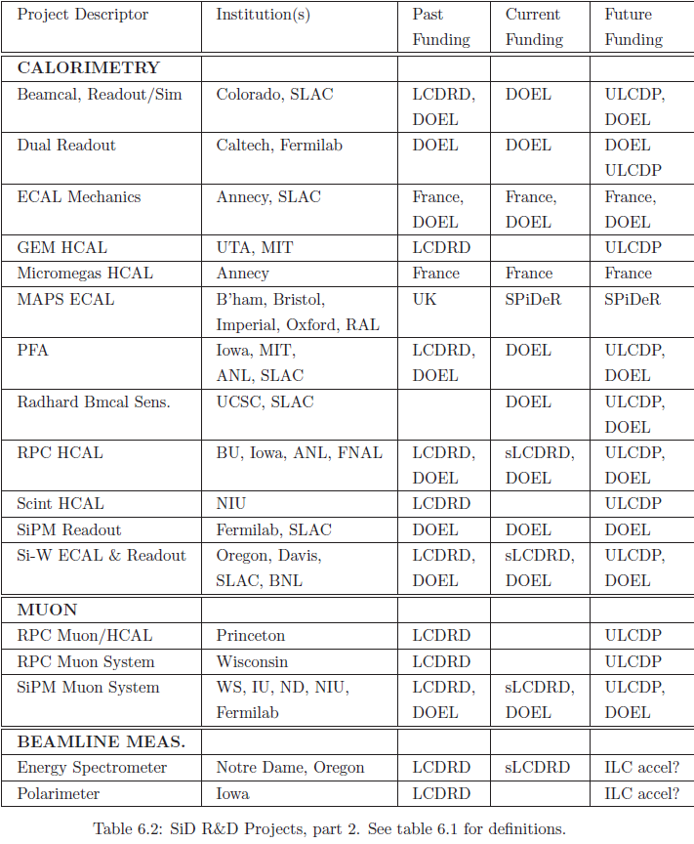
SiD R&D

Slide 14




R&D
MAPS: monolithic active pixel sensor
DEPFET: active pixel detectors for a future linear e+e- collider

Slide 15
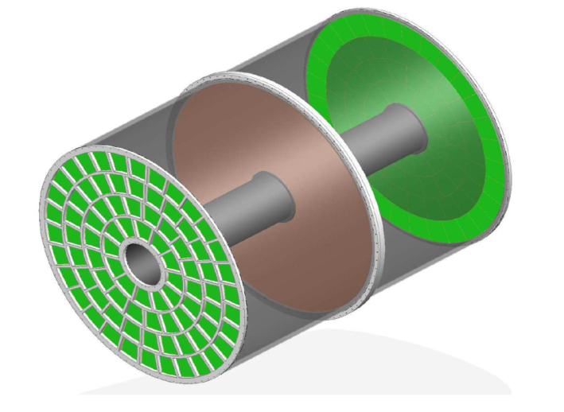
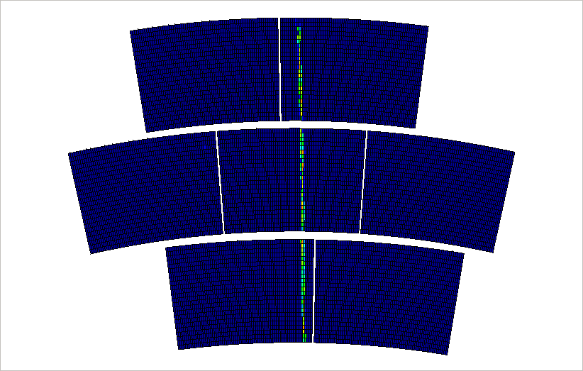
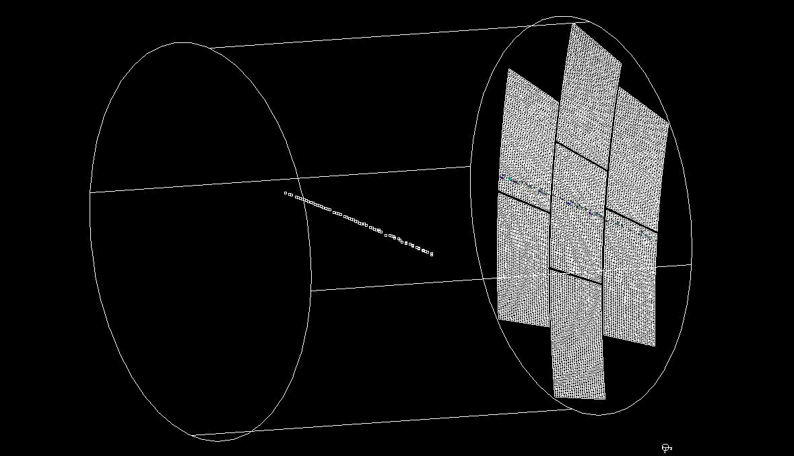
Micromegas TPC in Saclay
L: 4.7m
φ: 3.6m
Offline monitor

