Slide 1
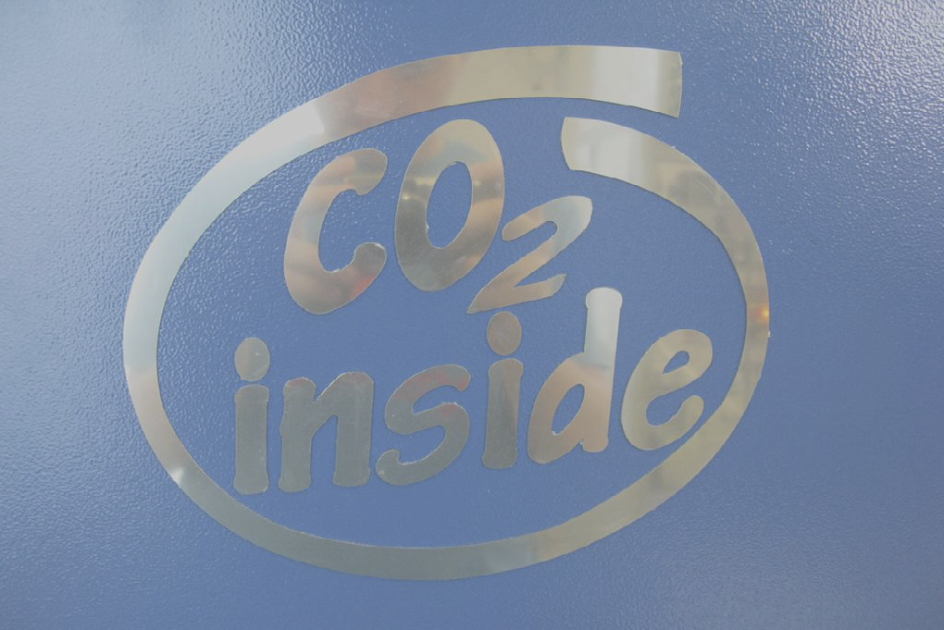
Two-Phase CO₂ cooling
David Attié
JLC13, Saclay
Notes:
I’m here to present a TPC review

Slide 2
Overview
Introduction: why CO₂ cooling?
‘2-Phase Accumulator Controlled Loop’ CO₂ circulation method
Portable cooling system: Traci
Application to a Large Prototype TPC
Conclusions

Slide 3
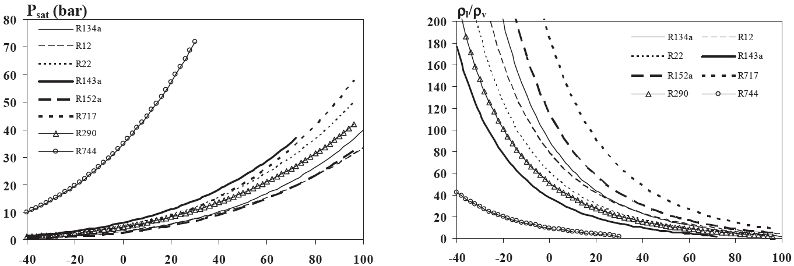
Comparison of refrigerants vs. CO₂
Higher slope of the vapor pressure curve means that ΔP in the system is smaller
Low ratio of liquid and gas densities resulting in a more homogenous two-phase flow (Pettersen 2002)
Equilibrium vapor pressure
Ratio of liquid and vapor densities
CO2
CO2
T (°C)
T (°C)

Slide 4
Why CO₂ cooling?
Evaporative CO2 cooling for HEP detectors: CO2 allows small tubing
  low radiation length X₀
  compact detector
Large latent heat
& Low viscosity
& High Pressure
allows low flow
allows high
pressure drop
Low pressure drop
Low pressure drop
allows very
small tubing
5e-4
C3F8
300
CO2
Better
(KJ/kg)
Better
(Pa*s)
4e-4
200
3e-4
100
2e-4
C3F8
1e-4
CO2
0
0
-40
-20
0
20
-40
-20
20
Temperature (°C)
Temperature (°C)
bart@nikhef.nl

Slide 5
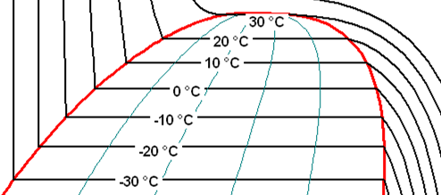

Cooling tube
Pressure (bar)
Liquid
Gas
2-phase
Enthalpy (J/K)
Temperature (°C)
90
Liquid super heating
60
Tube Temperature
30
Low ΔT
0
Increasing ΔT
(Dry-out)
Fluid Temperature
-30
Target flow condition
Dry-out zone
Sub cooled liquid
Sub cooled liquid
Super heated vapor
bart@nikhef.nl

Slide 6


How to evaporate liquid CO₂ in your detector?
Refrigeration method: Vapor compression system
(Atlas)
Pressure
Liquid
Gas
Compressor
Heater
B.p. regulator
Warm transfert
2-phase
Enthalpy
Cooling plan
Detector
2PACL method: Pumped liquid system,
(Atlas) cooled externally
Pressure
Gas
Compressor
Liquid
Pump
Chiller
Liquid circulation
Cold transfert
2-phase
Enthalpy
Cooling plan
Detector
bart@nikhef.nl

Slide 7


2-Phase Accumulator Controlled Loop
Pressure
Liquid
Gas
Pressure control
using accumulator
→Change set-point
2-phase
(Evaporation)
2
3
Lower the pressure
7
1
6
4&5
Isothermal line
Enthalpy
Cooling
7
Detector: follows saturation line
Pump
6
5
1
2
3
4
bart@nikhef.nl

Slide 8
2-Phase Accumulator Controlled Loop
Pressure
Liquid
Gas
2-phase
(Evaporation)
2
3
Lower the pressure
7
4&5
1
6
Isothermal line
Enthalpy
Cooling
7
Detector: follows saturation line
Pump
6
5
1
2
3
4
bart@nikhef.nl

Slide 9
2-Phase Accumulator Controlled Loop
Pressure
Liquid
Gas
2-phase
(Evaporation)
2
3
Increase pressure
of saturation
7
4&5
1
6
Isothermal line
Enthalpy
Heating
7
Detector: follows saturation line
Pump
6
5
1
2
3
4
bart@nikhef.nl

Slide 10
2-Phase Accumulator Controlled Loop
Pressure
Liquid
Gas
2-phase
(Evaporation)
2
3
Switching on detector
Increasing pressure
7
1
6
4&5
Isothermal line
Enthalpy
Heating
7
Detector: follows saturation line
Pump
6
5
Heat
1
2
3
4
bart@nikhef.nl

Slide 11
2-Phase Accumulator Controlled Loop
Pressure
Liquid
Gas
2-phase
(Evaporation)
2
3
Powering detector
7
1
6
4&5
Isothermal line
Enthalpy
Cooling
7
Detector: follows saturation line
Pump
6
5
Heat
1
2
3
4
bart@nikhef.nl

Slide 12
2-Phase Accumulator Controlled Loop
Pressure
Liquid
Gas
2-phase
(Evaporation)
2
3
Unpower detector
Detector is off
7
1
6
4&5
Isothermal line
Enthalpy
Heating
7
Detector: follows saturation line
Pump
6
5
1
2
3
4
bart@nikhef.nl

Slide 13
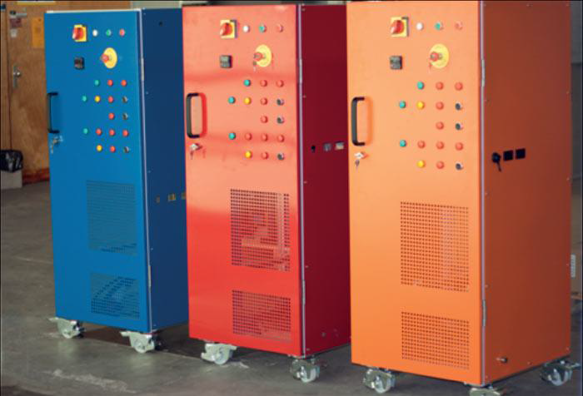


Traci Project
Development of a portable CO₂ laboratory cooling unit called Traci
  TRACI=Transportable Refrigeration Apparatus for CO₂ Investigation.
Development in AIDA framework together with interested partners.
  Nikhef & CERN lead development with engineering support of the Cracow University of Technology.
  Co-funding from clients
Designed for applications like:
  Test beam telescope (AIDA)
  Micro channel development (LHCb)
  Pixel development (CMS)
  Detector thermal/mechanical support structure development (Atlas IBL, ILCTPC)
  Detector commissioning (Atlas IBL)
Focus on simplicity for easy production in series
bart@nikhef.nl

Slide 14
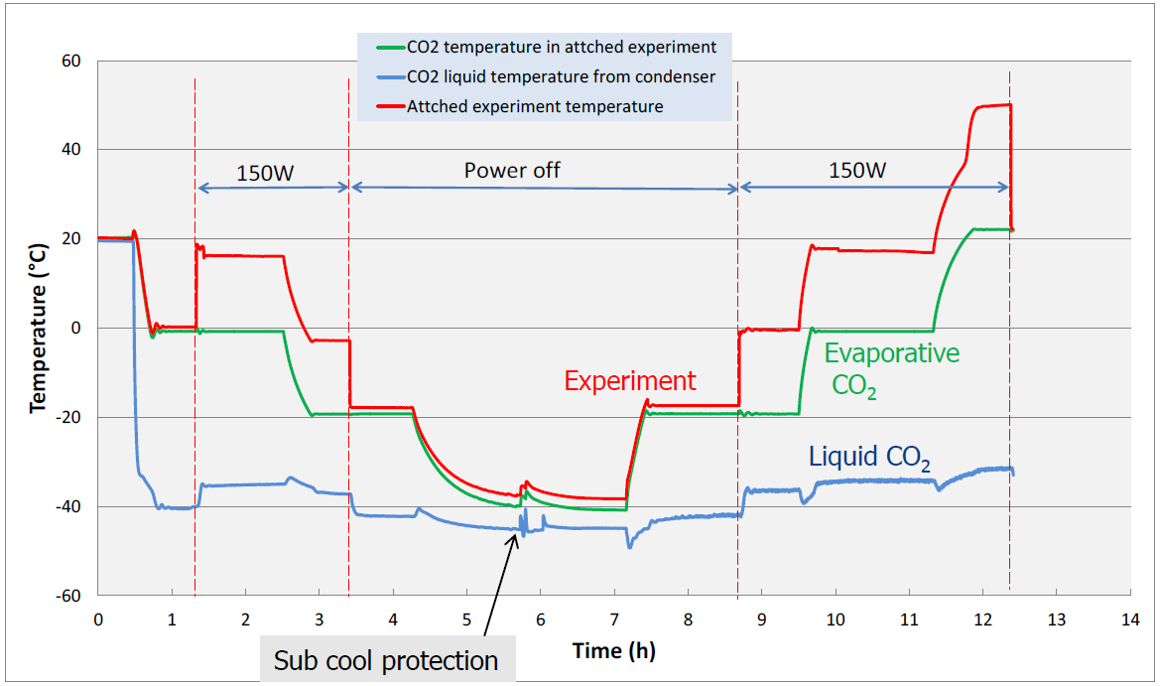
Traci performance
Stable cooling over a large temperature range
bart@nikhef.nl

Slide 15
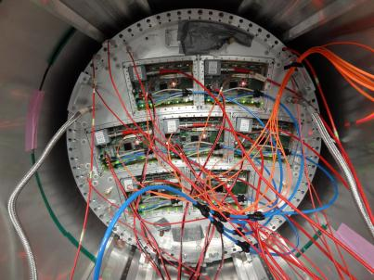
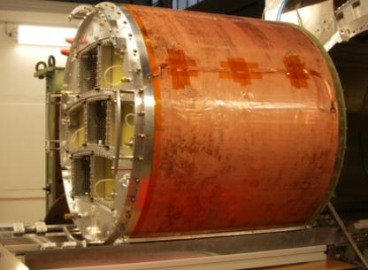

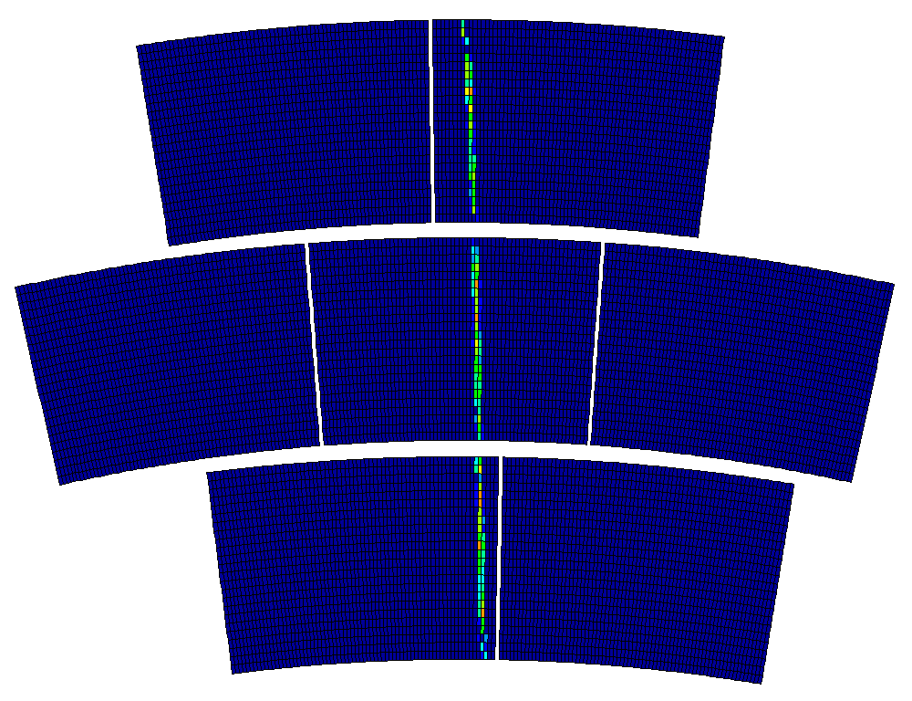
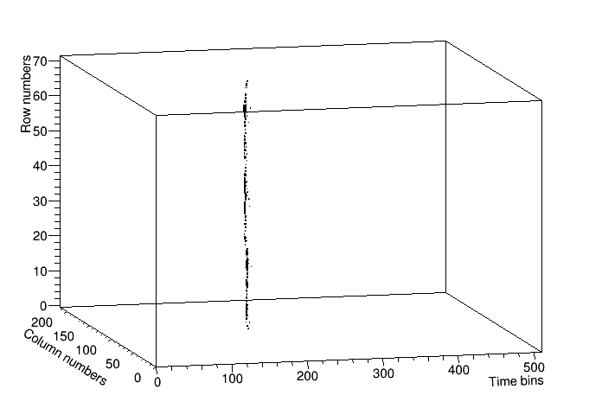
Large Prototype Micromegas TPC for ILC
Endplate + 7 Micromegas modules in 1T magnet
Large Prototype (LP) TPC in DESY
24 rows
72
columns
5 GeV electron beam
12 000 channels in 7 modules

Slide 16
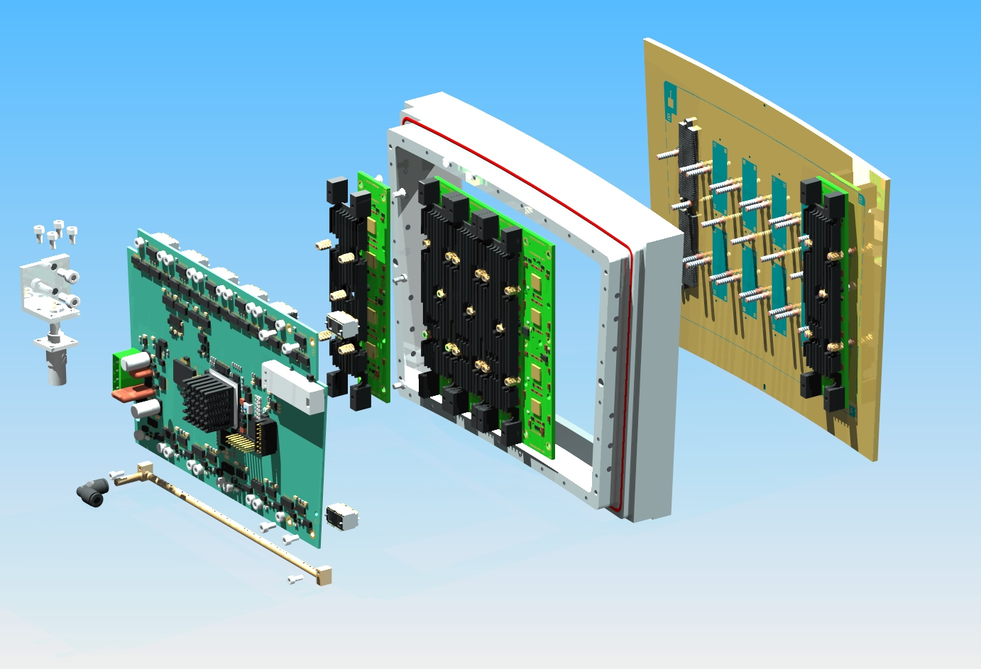
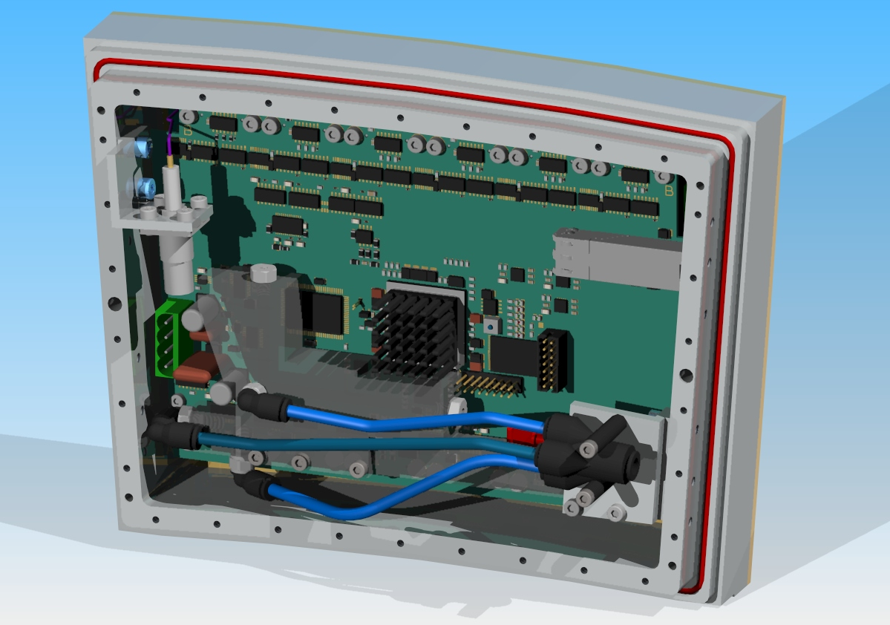
Micromegas Module of the LP-TPC
Micromegas
FEC
FEM
Air cooling

Slide 17
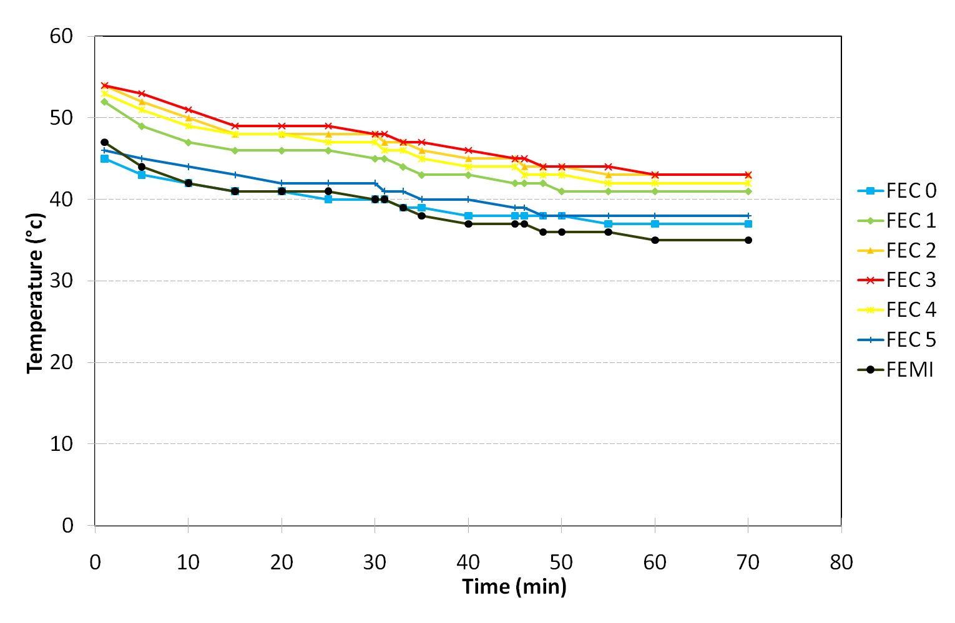
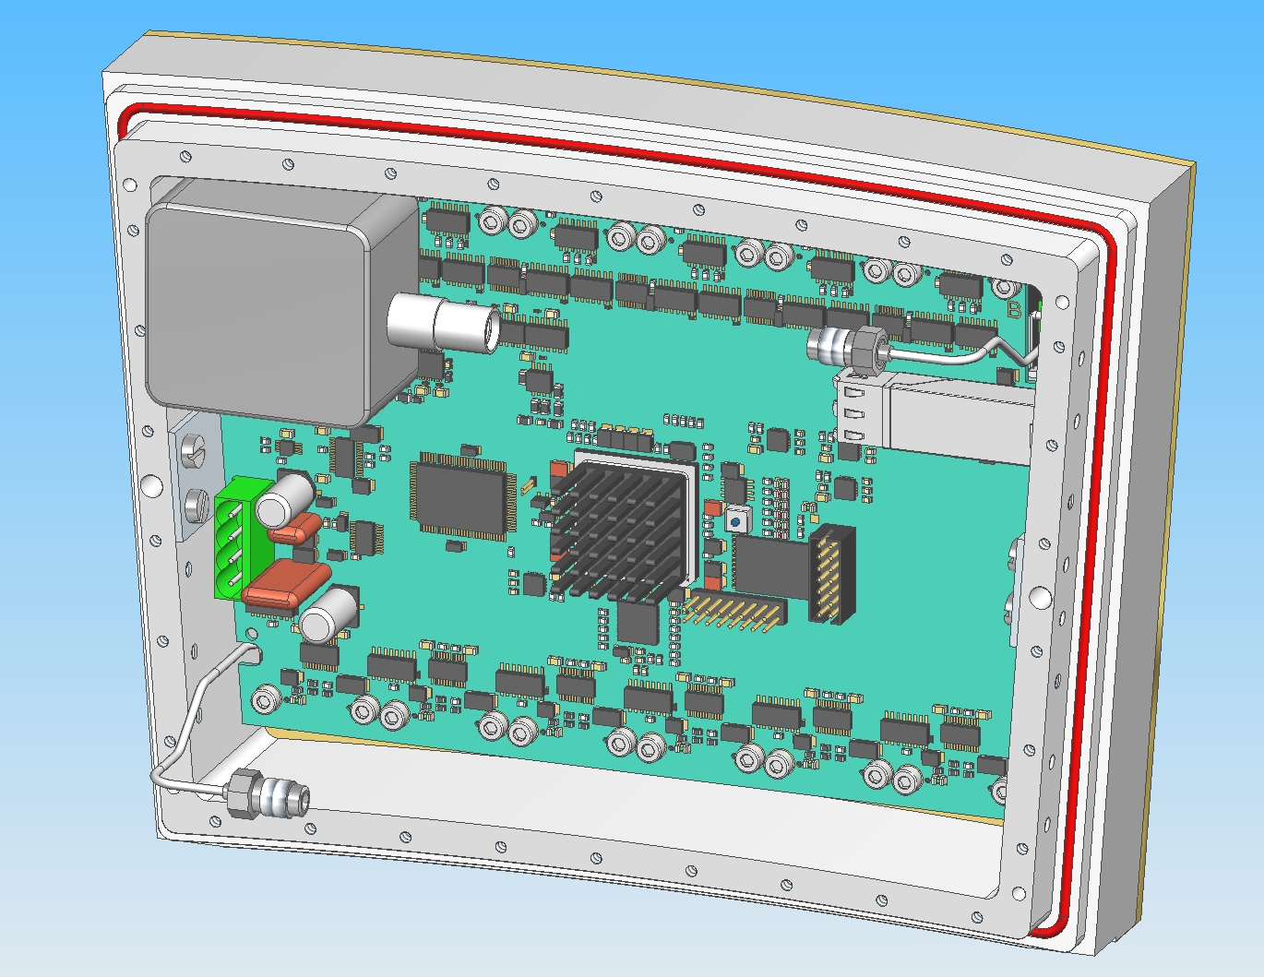
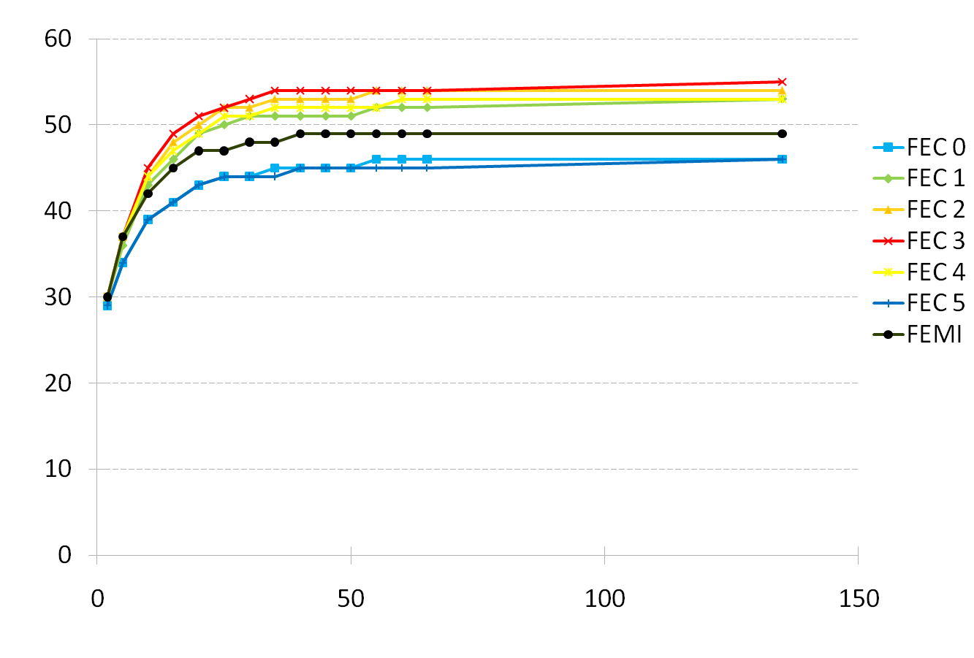
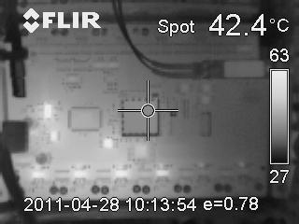
Air Cooling for the Micromegas Module
No cooling
Picture taken from IR camera
Nitrogen cooling

Slide 18
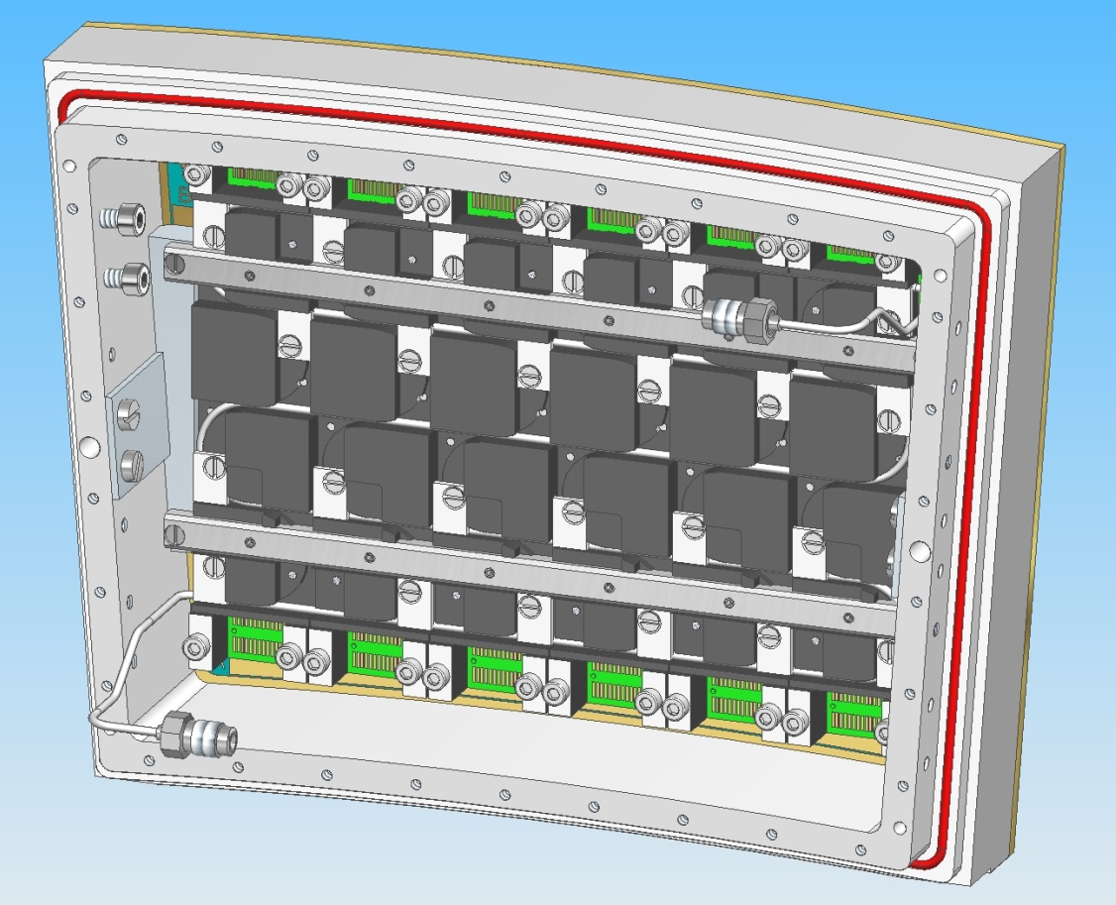
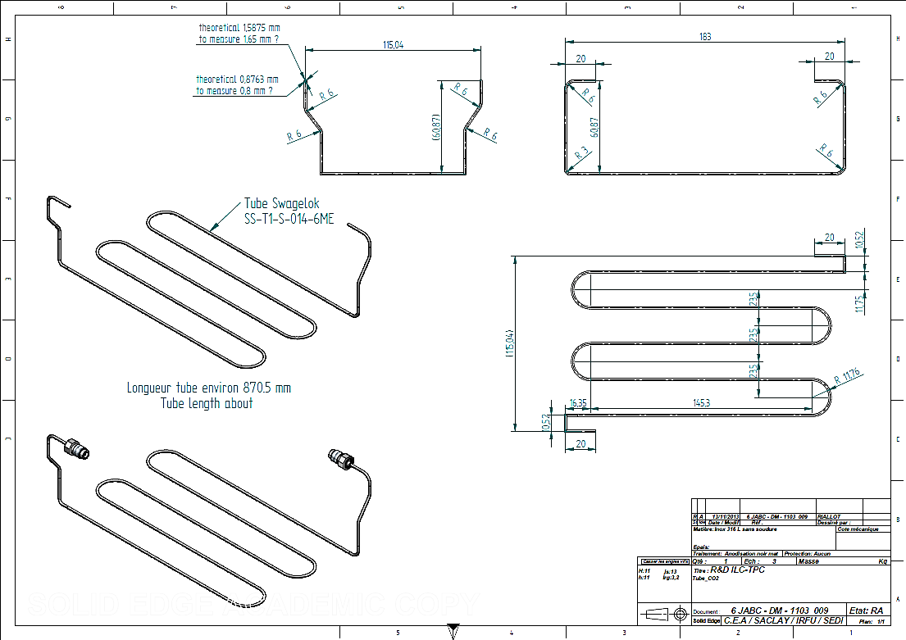
2P-CO₂ Cooling for ILC-TPC Micromegas LP
Calculation for a
single module cooling
Calculation for
7 modules cooling
∅_{Internal} =0.876 mm

Slide 19
7 modules in serial
∅_{Internal} =1.5 mm
∅_{Internal} = 2.0 mm
A serial configuration needs a diameter of 1.5 to 2mm depending on the allowed temperature gradient.

Slide 20
Conclusions
Two operating CO₂ systems in HEP experiments:
  AMS-TTCS (Tracker Thermal Control System)
  LHCb-VTCS (VELO Thermal Control System)
CO₂ cooling is a suitable solution for future HEP detectors (ex: ILC)
  cheap and « natural » element
  high heat transfert with low X₀
2PACL technology is interesting as a system principle:
  High stability
  Easy to operate
First test with the Micromegas detector in a Large Prototype will be done
in 2014 (February)

