Slide 1

Detector structure:
Carbon-aluminum composite structures for the TPC
Pierre MANIL
CEA/IRFU/SIS
28 November 2013

Slide 2
Content
1| Context and constraints
2| Large prototype: status and options
3| Options for the ILD-TPC

Slide 3
Content
1| Context and constraints
2| Large prototype: status and options
3| Options for the ILD-TPC

Slide 4
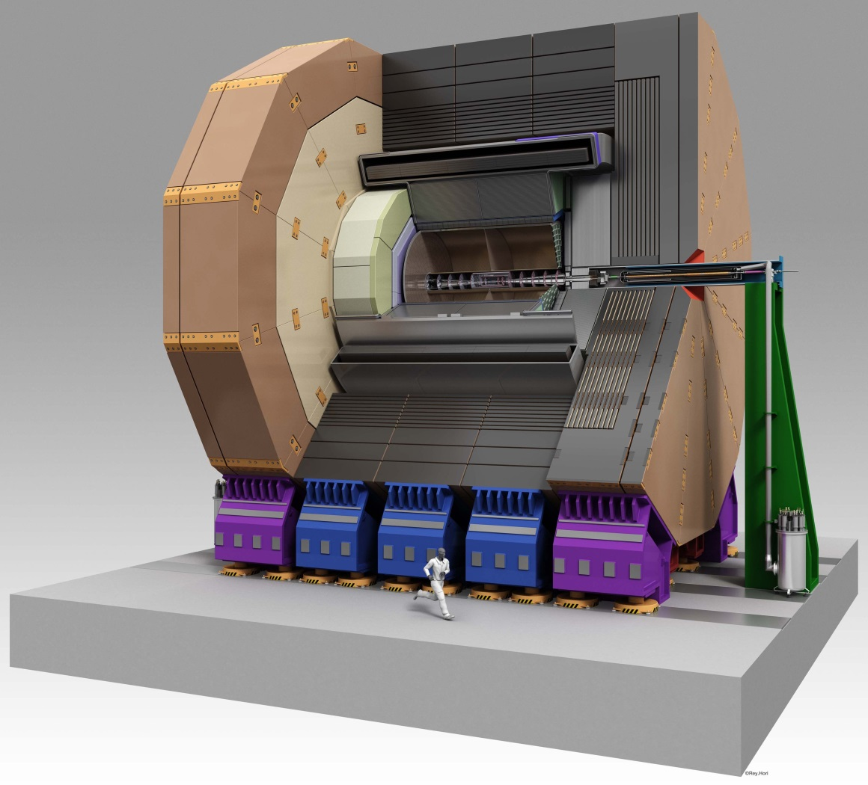
1| Context and constraints
Φ3600
Φ600
[mm]
4 700
Overall parameters are defined (field & dimension range)

Slide 5
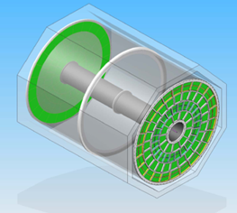
1| Context and constraints
Detector resolution strongly depends…
…on the layout of the tracking system…
…which depends on mechanical design…
…which depends on structural materials and layout.
Material budget of the TPC:
5% X₀ in the barrel region
25% X₀ in the endcap region
+ Challenge of high precision ~10 μm syst. error on Sagitta
[TPC-PRC2010 report]

Slide 6
1| Context and constraints
Focus on the endplate
Barrel
Field cage
Endplate
[courtesy of M. Carty]

Slide 7
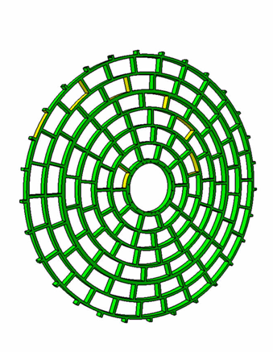
1| Context and constraints
Constraints on the endplate:
Maximum surface coverage
Dismontability of individual modules
X-Y precision and stability < 50 μm
Thickness < 100 mm
Material budget: 25% X₀
  Readout & FEE: 5%?
  Cooling: 2%?
  Power: 10%?
  Mechanics: 8%?
Interface with the field cage / barrel + support
[courtesy of J. Kaminski]

Slide 8
Content
1| Context and constraints
2| Large prototype: status and options
3| Options for the ILD-TPC

Slide 9
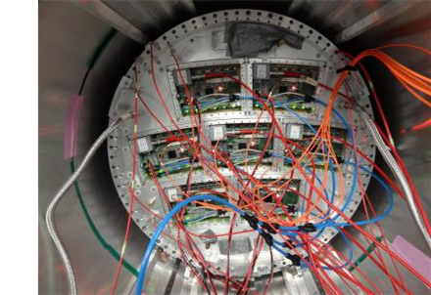
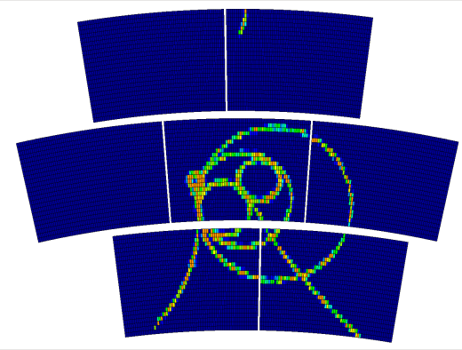
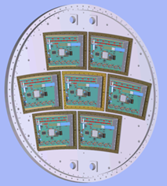
2| Large Prototype status
Detector R&D (readouts)
Hands-on experience of integration
Design of a large TPC with high precision & stability
3 modules (GEM) / 7 modules (Micromégas)
Φ ~1 500 mm
with 3 GEM modules with 7 MM modules
[courtesy of P. Colas, J. Kaminski]

Slide 10
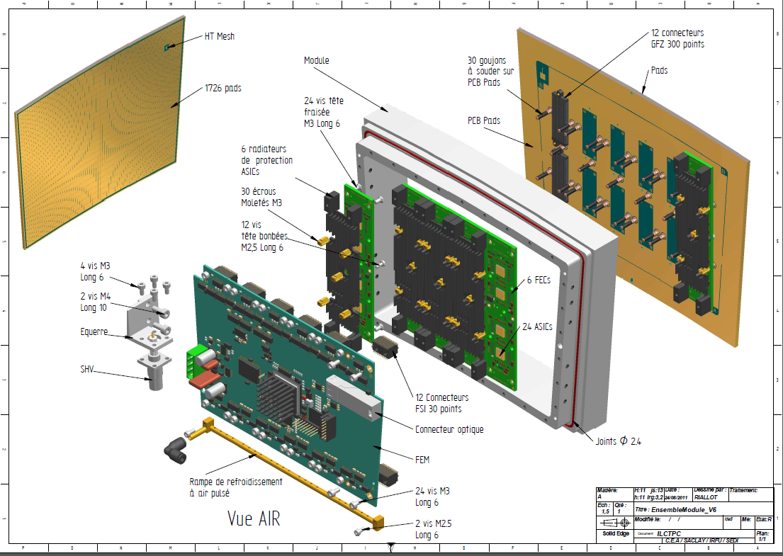
2| Large Prototype status
374 cm²
~1 500 g
4 g/cm² on Si/Al → < 25% X₀
Frame
+ Detector
= 750 g
Aluminum = 300 g
(Micromégas option)
Air cooling = 140 g
(cf. David Attié’s talk)
FEMI = 170 g
6 FECS = 300 g
[courtesy of M. Riallot]

Slide 11
2| Large Prototype status
« LP1 »: 100% aluminum frame
Built by Cornell in 2008 (accuracy ~30 μm)
Tested at DESY in 2008-11 with 1 module,
2010 with 6 modules, 2013 with 7 modules
Precision OK with plain aluminum (deflection = 33 μm)
Still too heavy: ~19 kg over 4 650 cm² → 17 % X₀

Slide 12
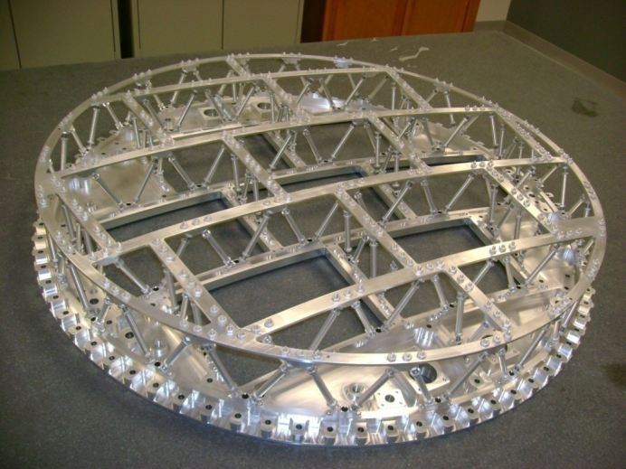
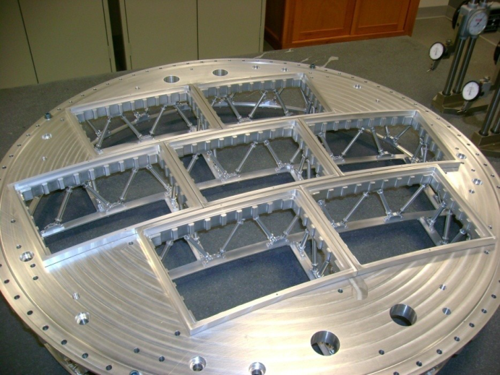
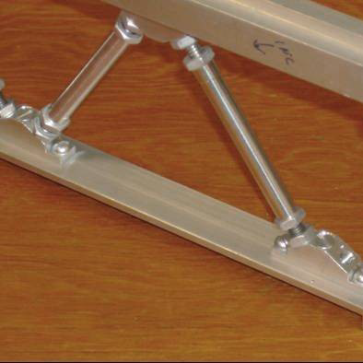
2| Large Prototype status
« LP2 »: 100% aluminum strut-based space-frame
Built by Cornell in 2013 (2 ex.)
Shipped to DESY for tests
Max. deflection = 23 μm for 100 N load
~8.5 kg after optimization → 8.6 % X₀
Additional work on lateral rigidity & stability
struts
132
struts
mass
optimization
[courtesy of D. Peterson]

Slide 13
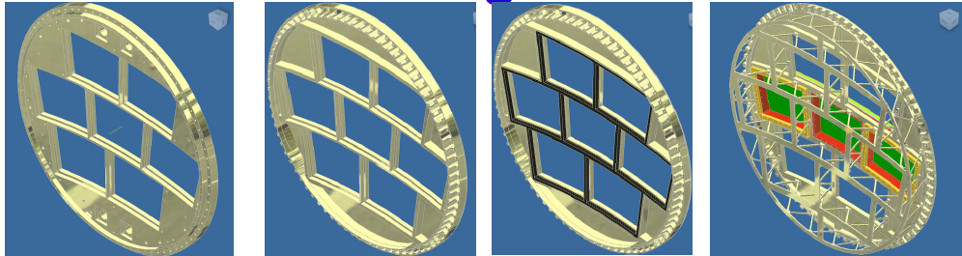
2| Large Prototype options
Aluminum brings surface precision (planarity…)
Carbon can bring stiffness/light
Al plates and struts + C backframes seem attractive
Struts + C backframes is a good candidate to meet ILD’s requirements (8 % X₀)
  LP1 LP1+ Al+C LP2
[courtesy of J. Kaminski]

Slide 14
Content
1| Context and constraints
2| Large prototype: status and options
3| Options for the ILD-TPC

Slide 15
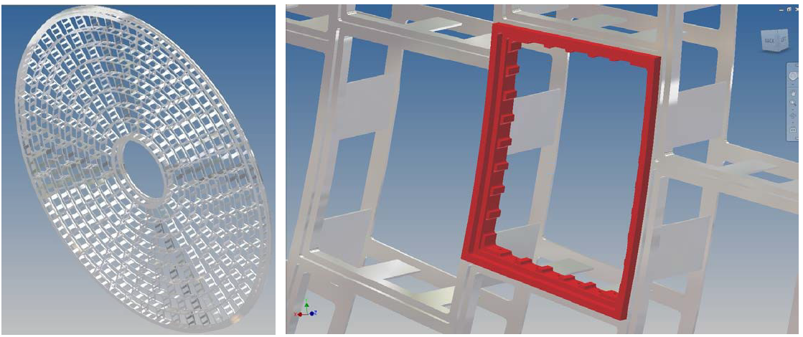
3| Options for the future ILD-TPC
ILD endplate design (8 rows):
Frame = 136 kg → 5.7 % X₀
Backframe: C-fiber necessary to keep < 2.3 % X₀ !
[courtesy of D. Peterson]

Slide 16
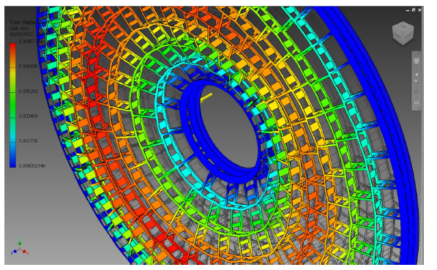
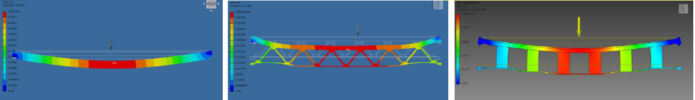
3| Options for the future ILD-TPC
FEM performed by Dan Peterson (Cornell)
Cross-check with sample tests
[courtesy of D. Peterson]

Slide 17
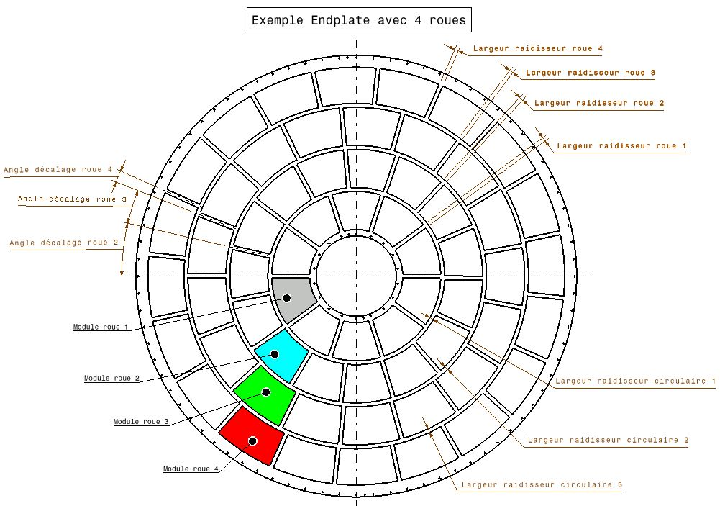
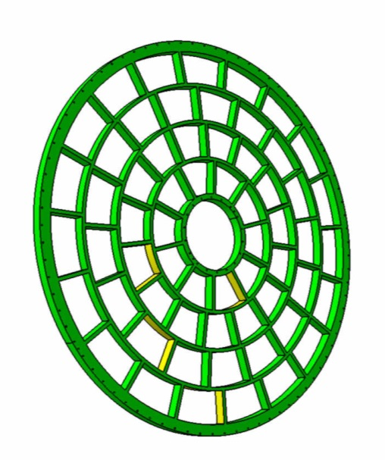
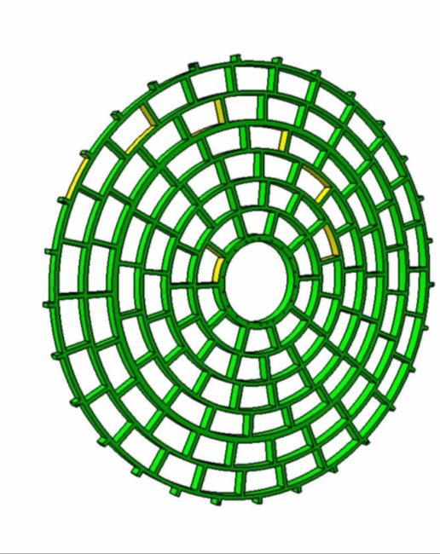
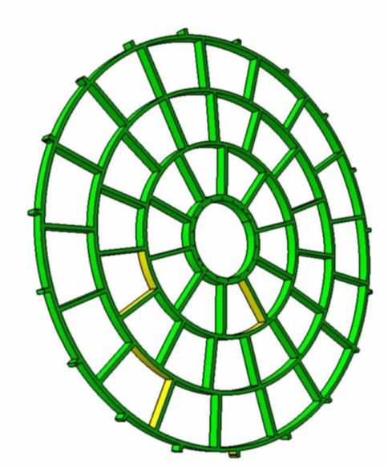
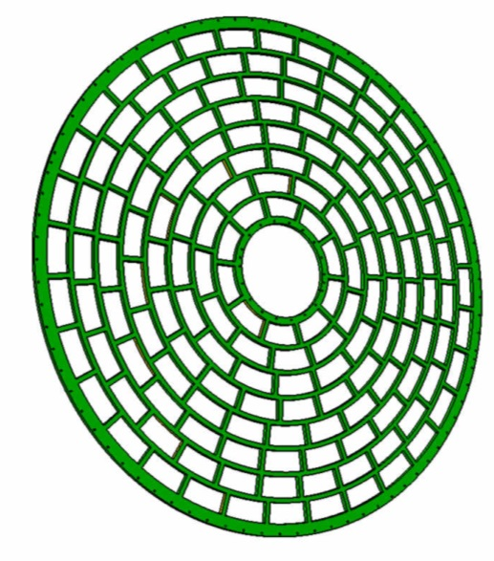
3| Options for the future ILD-TPC
[courtesy of D. Bachet]
Changing the
modules’ dimensions?
AIDA 2014
  3 wheels 4 wheels 6 wheels 8 wheels
  42 modules 61 modules 110 modules 171 modules
  m 1.5 m 1.9 m 2.2 m

Slide 18
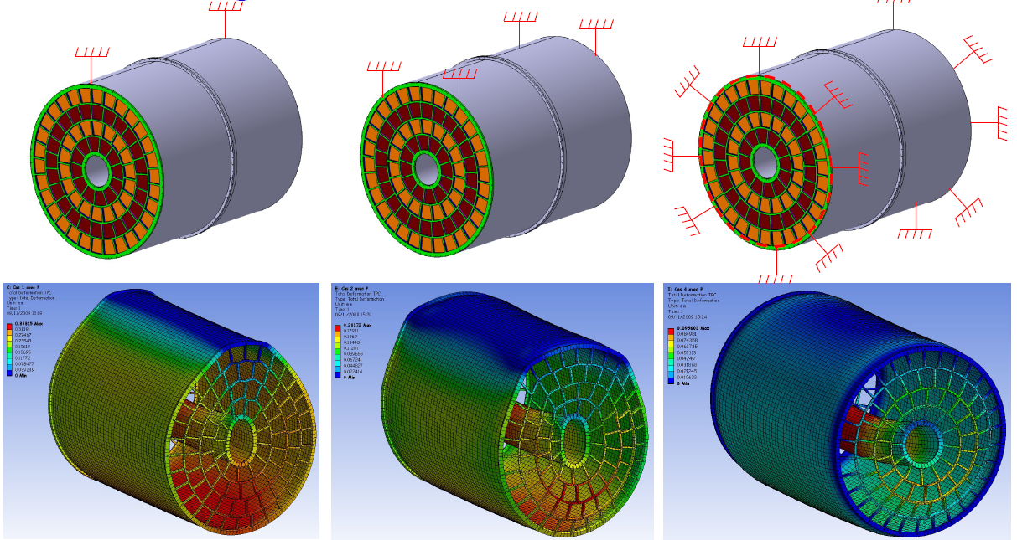
3| Options for the future ILD-TPC
Full TPC analysis:
Self-weight and mounting (2 tons)
Overpressure (ΔP = 3 mbar)
2 x 370 kg (Al)
2 x 530 kg (G11)
265 kg (NIDA)
~200 μm
[courtesy of M. Carty]

Slide 19
Conclusions
Large Prototype (LP) was built and tested
Strut-based aluminum endplate will be tested
Satisfying solution in terms of mass for LP
Hybrid carbon-aluminum solution necessary for ILD
Parametric simulations are necessary
  On materials
  On detector layout

Slide 20
Thank you

