Slide 1

A TPC for the Linear Collider
Instrumentation for Colliding Beam Physics 2014
Novosibirsk, Russia
P. Colas, on behalf of the LCTPC collaboration

Slide 2
Contents
The LCTPC collaboration
The common test setup
Micromegas and GEMs
Results on resolution
Multi-modules studies : alignment, distortions
Ion backflow effects
2-phase CO2 cooling
Electronics for the real detector

Slide 3
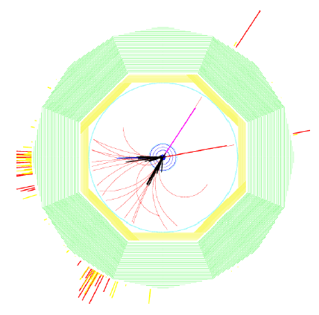
The 125 GeV Higgs at the ILC
If the ILC is built, 10⁴ Higgs will be produced accompanied by a Z ->µµ or ee.
In contrast with LHC where production involves several processes, the Higgs- Strahlung at ILC provides an unbiased tag of Higgses independent of their decay, allowing a model-independent determination of the BRs, including invisible modes
Note: this study was done with mH=120 GeV
e+e- -> HZ, Z->µµ
B=3.5 T

Slide 4
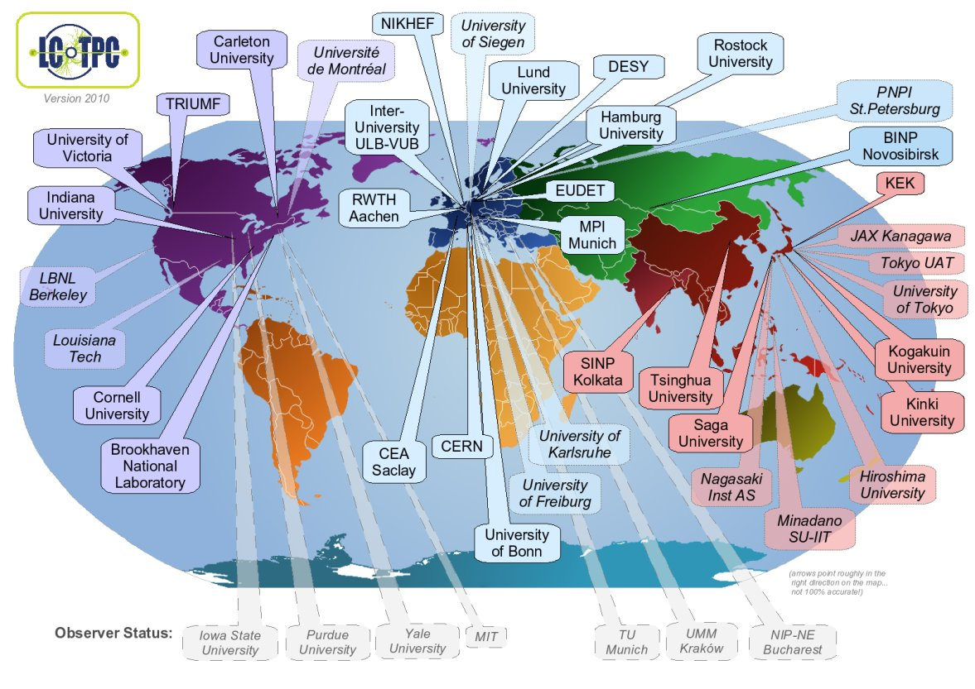
THE LCTPC COLLABORATION
27 signatories
5 pending
13 observers
All R&D for ILC carried out here
Reviewed by ECFA panel (most recent Nov. 2013)
www.lctpc.org

Slide 5
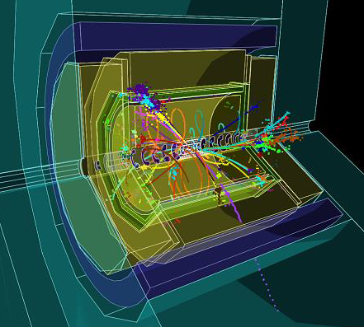
The ILD TPC
Requirements : self-sustained double cylinder with a field uniformity ΔE/E ~ 2x10⁻⁴ . Dimensions 4.7 m x φ 3.62 m
rφ resolution < 100 µm at all drift distances
z resolution O(500 µm)
For extreme case of 500 GeV tracks : systematics on the sagitta to be controlled down to 10 µm!
Inner barrel matter < 1% X₀
Outer barrel matter < 5% X₀
Endcap matter < 25% X₀ and thickness < 10 cm
(this implies mass < 500 kg)
inner sensitive radius 395 mm
outer sensitive radius 1739 mm
drift length 2250 mm

Slide 6
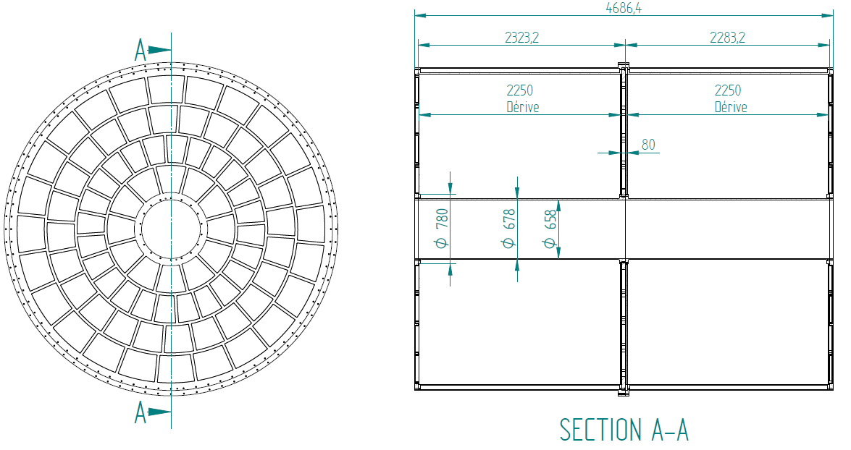
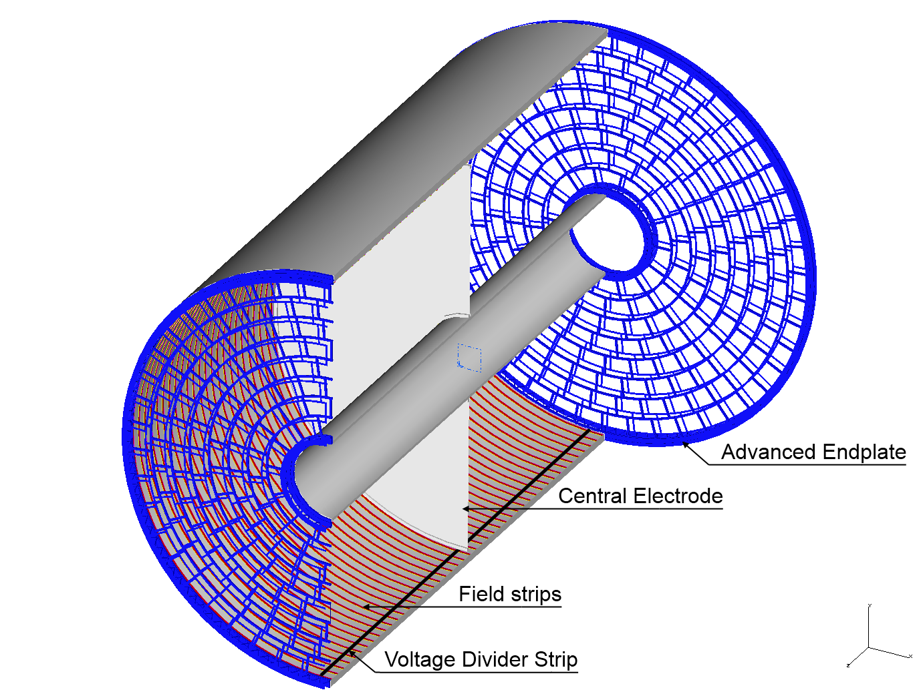
3 to 8 ‘wheels’
(GEM size limited)
4-wheel scheme : 80 modules/endplate, 4 kinds, about 40 x 40 cm² (T2K size)
8-wheel scheme: 240 modules, 8 kinds,
21x17 cm² (present beam-test size)
Advantages of larger modules:
Easier to align
Fewer different shapes
Less boundaries (thus less distortions and less cracks)

Slide 7
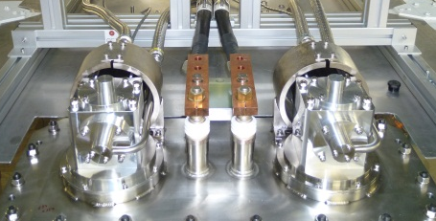
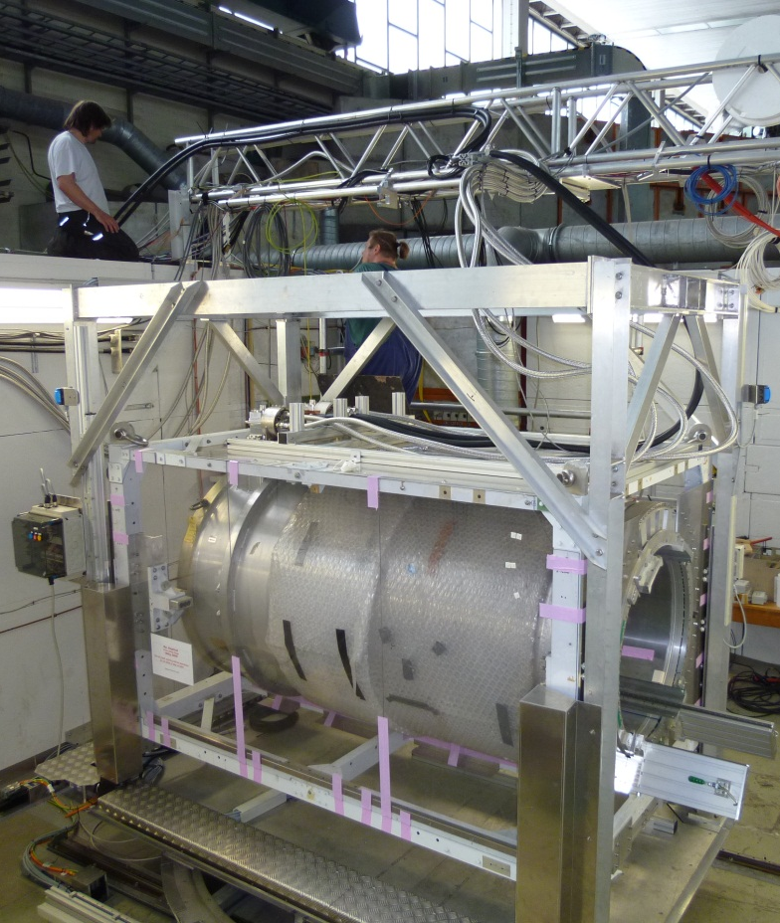
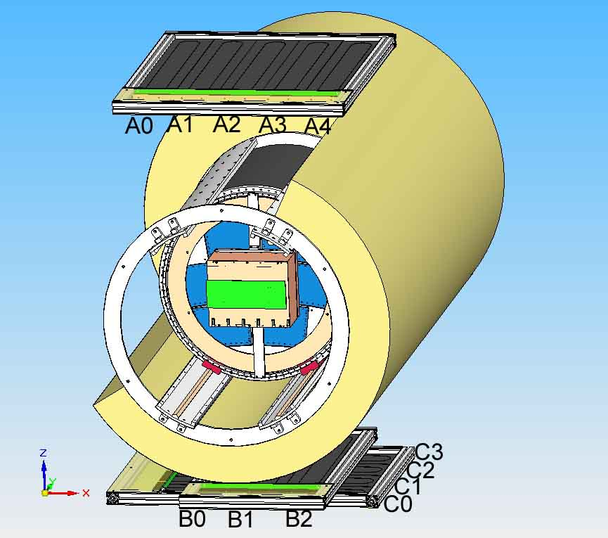
The EUDET test setup at DESY
The EUDET setup at DESY is operational since 2008
Upgraded in 2012 within AIDA: autonomous magnet with 2 cryo-coolers
SiPM trigger
Field cage

Slide 8
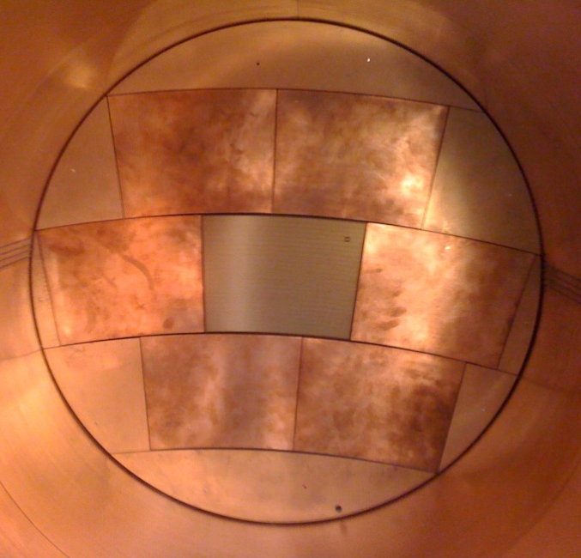
Beam tests at DESY : 5 technologies
Laser-etched Double GEMs 100µm thick (‘Asian GEMs’)
Micromegas with charge dispersion by resistive anode
GEM + pixel readout
InGrid (integrated Micromegas grid with pixel readout)
Wet-etched triple GEMs (‘European GEMs’)

Slide 9
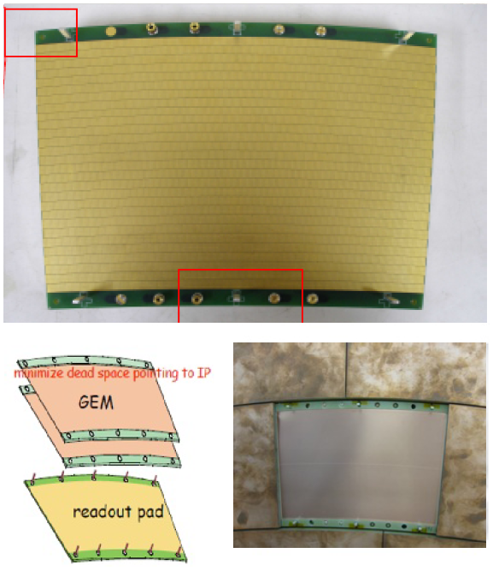
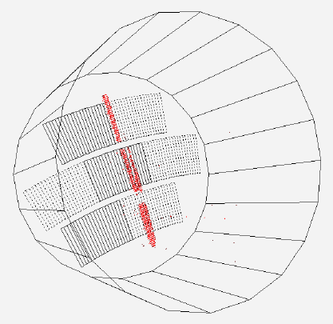
Asian GEMs
Double-GEM modules: Laser-etched Liquid Crystal Polymer 100 µm thick, by SciEnergy, Japan
28 staggered rows of 176-192 pads
1.2 x 5.4 mm²

Slide 10
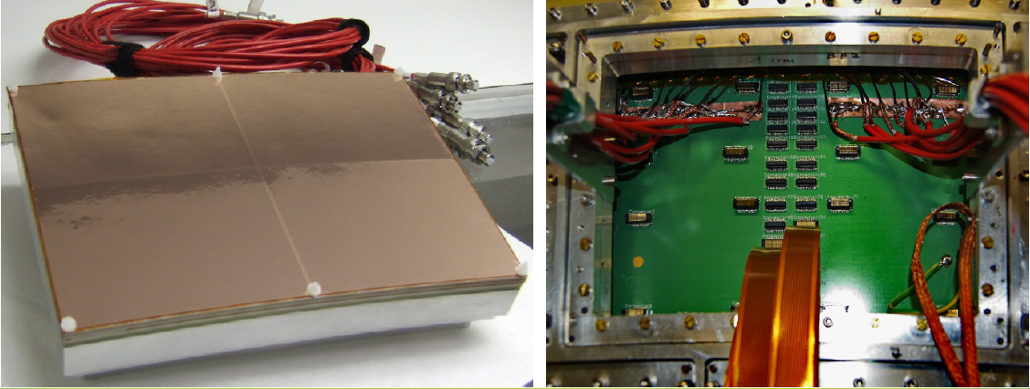
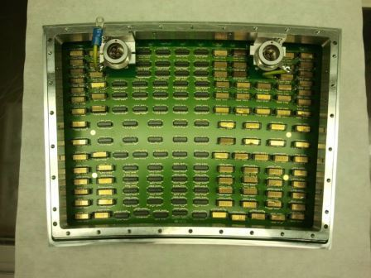
European GEMs
3 standard CERN GEMs mounted on a light ceramic frame (1 mm) and segmented in 4 to reduce stored energy. Each module has 5000 pads, 1.26 x 5.85 mm²
3 modules equipped (10,000 channels)

Slide 11
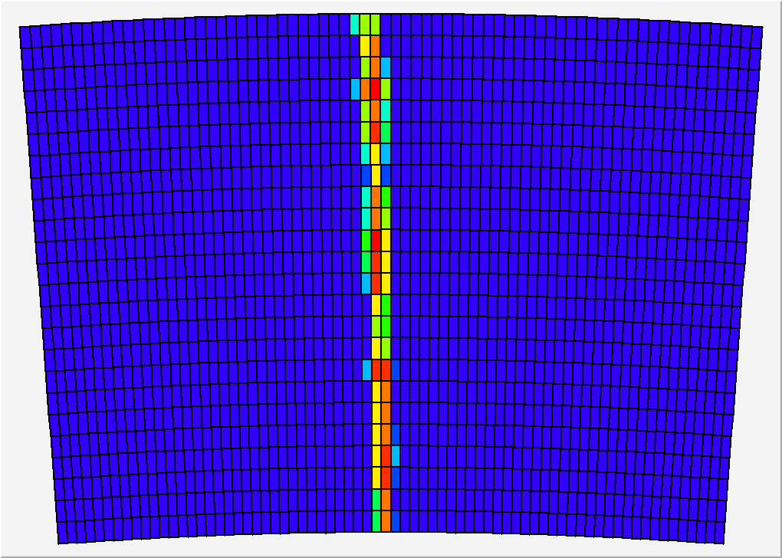
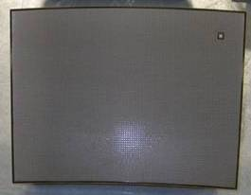
Micromegas with resistive coating
With Micromegas, the avalanche is too localized to allow charge sharing: a resistive coating on an insulator provides a Resistive-Capacitive 2D network to spread the charge
Various resistive coatings have been tried: Carbon-loaded Kapton (CLK),
3 and 5 MOhm/square, resistive ink.
24 rows x 72 columns of 3 x 6.8 mm² pads

Slide 12
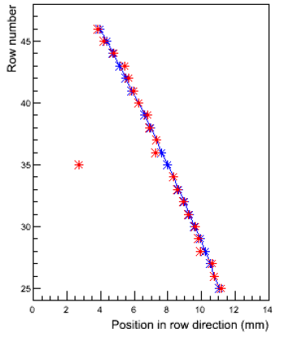
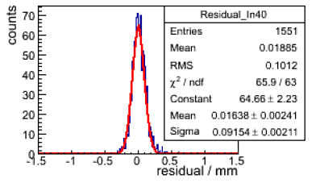
Resolution studies
Tracks are fitted through all padrows.
To determine the expected track the points with a significant contribution to the χ² are discarded (but used in the resolution calculation)
Resolution²=variance of the residuals

Slide 13
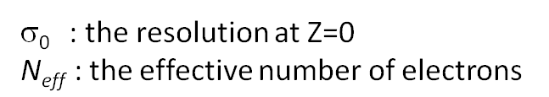
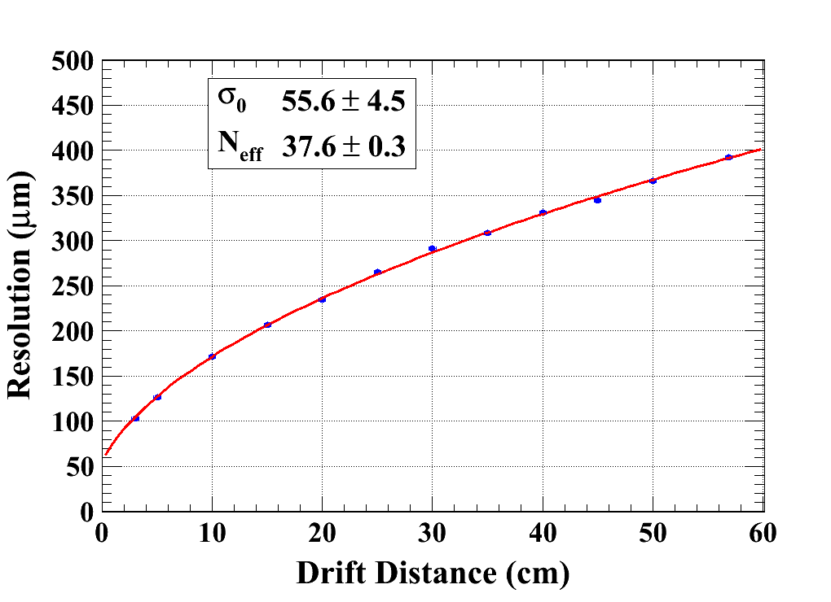
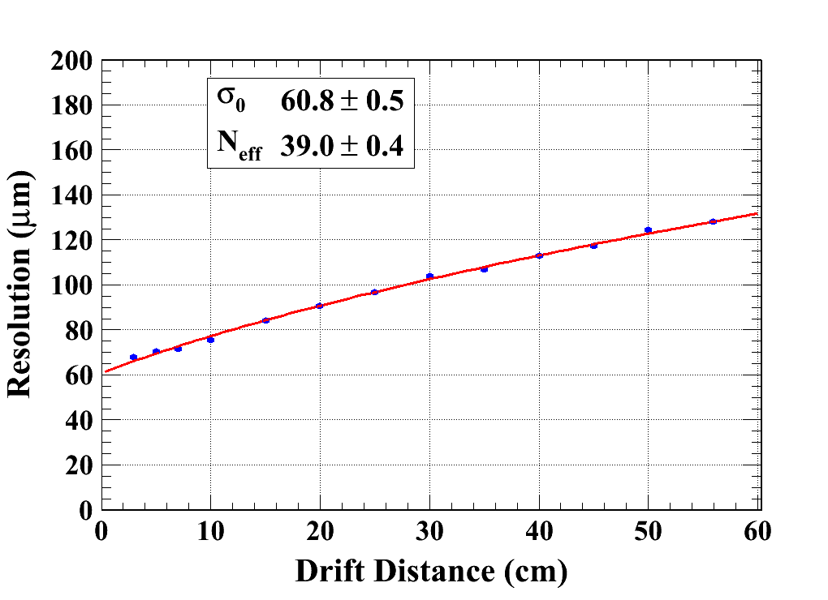
Micromegas transverse resolution
(B = 0T & 1T)Carbon-loaded kapton resistive foil
Gas: Ar/CF4/Iso 95/3/2
C_{d} : the diffusion constant
B=0 T C_{d} = 315.1 µm/√cm (Magboltz)
B=1 T C_{d} = 94.2 µm/√cm (Magboltz)

Slide 14
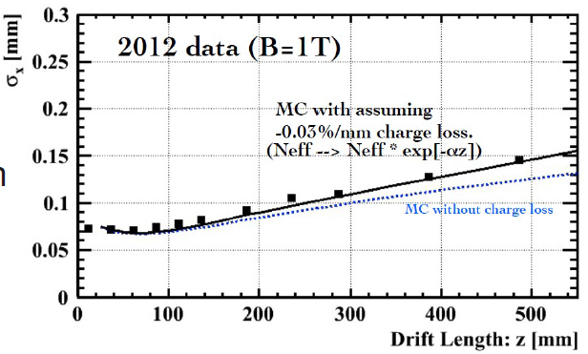
Asian GEM resolution
GEM
GEM and Micromegas resolutions are very similar. They both extrapolate to better than 100 µm at B=3.5 T and z=2.25 m

Slide 15
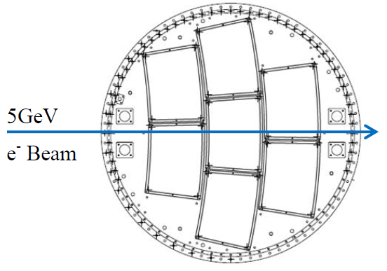
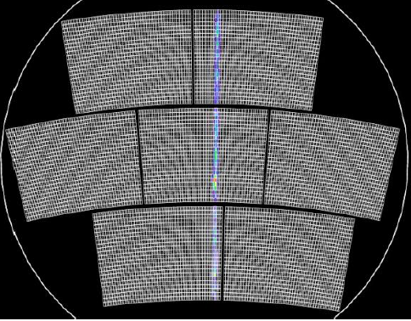
Multimodule studies
With a multi-module detector, you are sensitive to misalignment and distortions.
For Micromegas, a major miniaturization of the electronics was necessary.

Slide 16
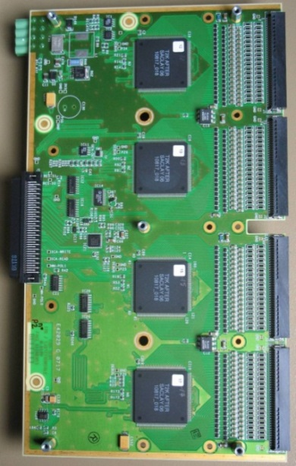
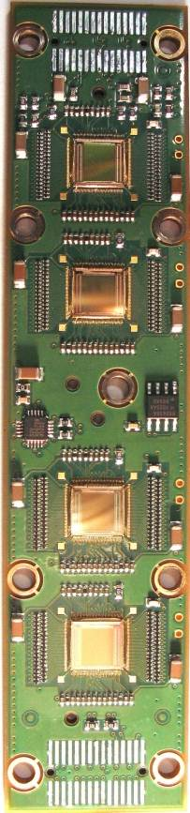
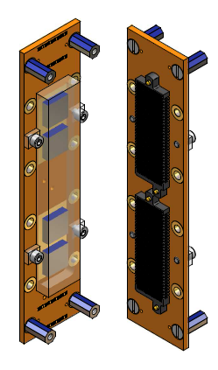
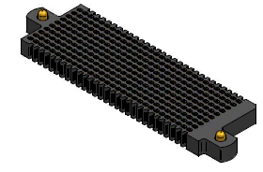
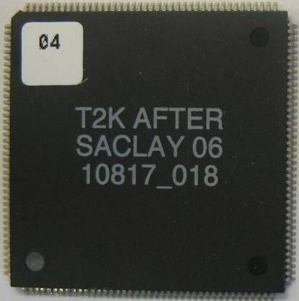
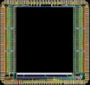
Integrated electronics
This is for AFTER chips. Similar work is being done with S-ALTRO
Remove packaging and protection diodes
Wire-bond AFTER chips
Use two 300-point connectors
Front-End Card
(FEC)
25 cm
4.5 cm
12.5 cm
14 cm
3.5 cm
2.8 cm
3.5 cm
0.78 cm
AFTER Chip
0.74 cm
  The resistive foil protects against sparks

Slide 17
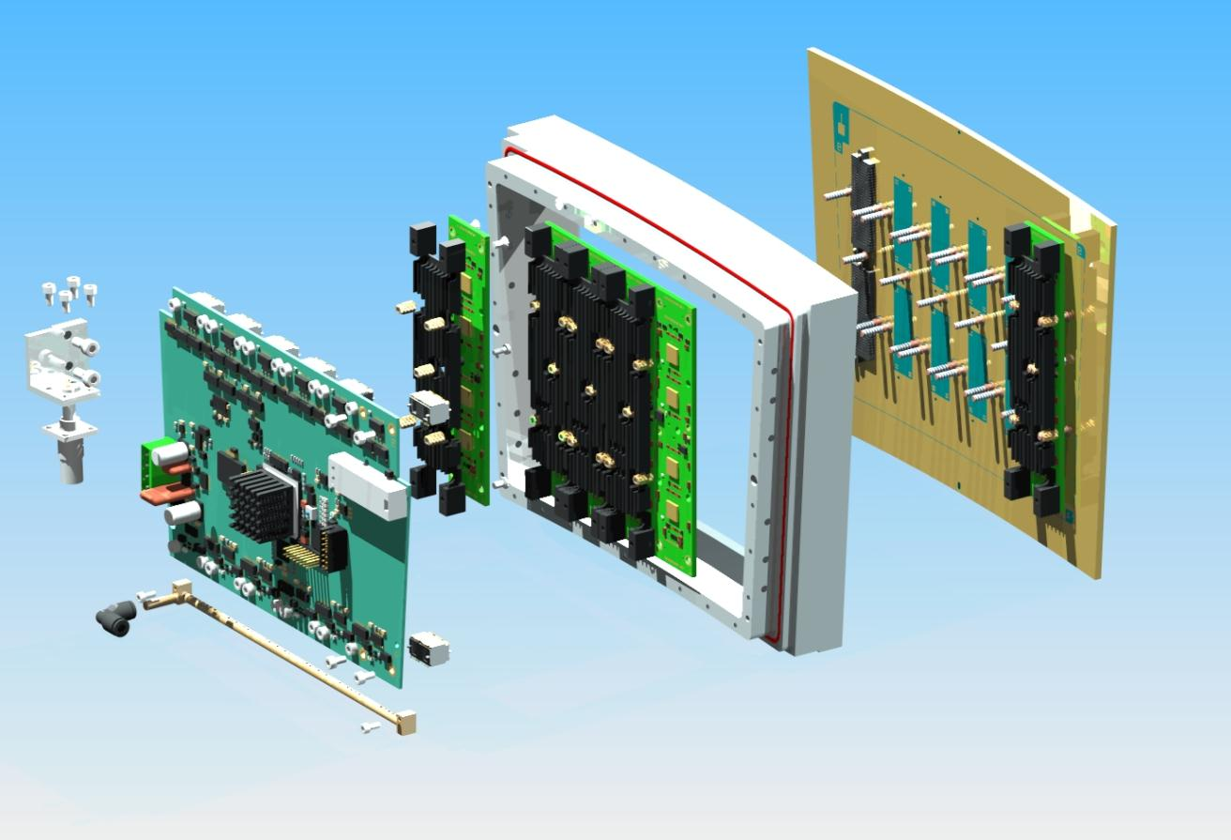
Material budget of a module
 |  | M (g) | Radiation Length (g/cm²)
Module frame + Back-frame + Radiator (×6) | Al | 714 | 24.01
Detector + FEC PCB (×6) + FEM | Si | 712 | 21.82
12 ‘300-point’ connectors | Carbon | 30 | 42.70
screws for FEC + Stud screws+ | Fe | 294 | 13.84
Air cooling | brass | 12 | 12.73
 | Plexiglas | 128 | 40.54
Average of a module |  | 1890 | 21.38
Front-End Card (FEC)
‘300-point’ connectors
Pads PCB +
Micromegas
Cooling system
Front-End Mezzanine (FEM)
Low material budget requirement for ILD-TPC:
Endplates: ~25% X₀
(X₀: radiation length in cm)

Slide 18
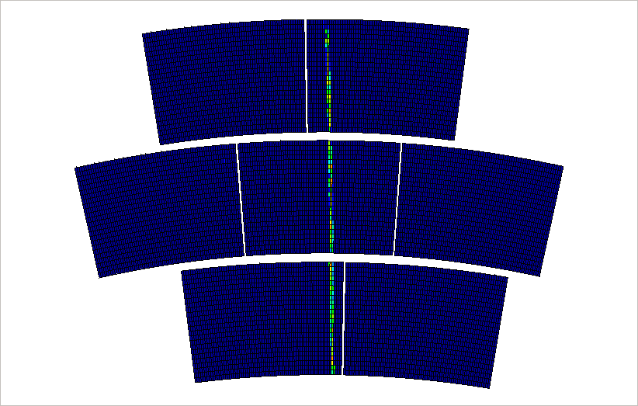

Slide 19
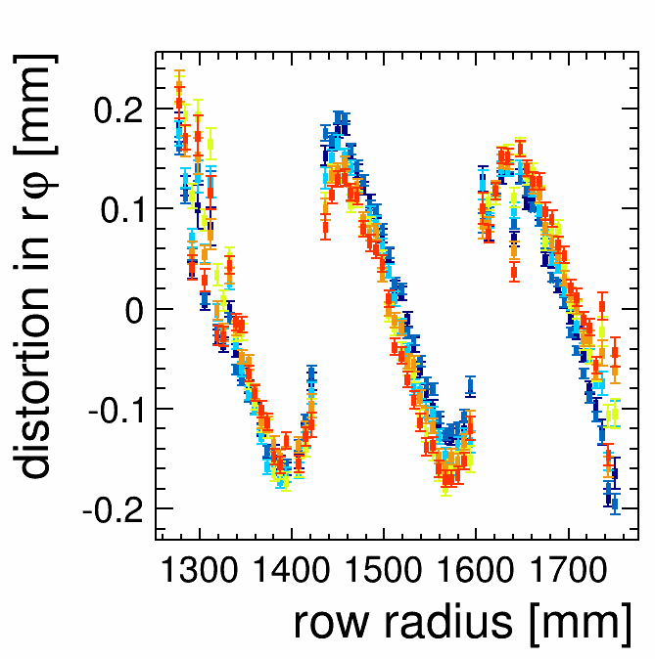
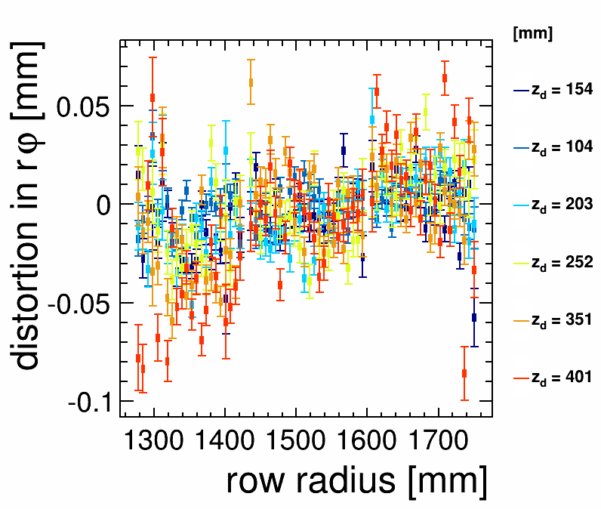
Distortions in rφ, B=0
After corrections
Micromegas, B=0
Micromegas, B=0
At B=0, distortions due to E only are observed (150 to 200 µm) and easily corrected down to 20 µm

Slide 20
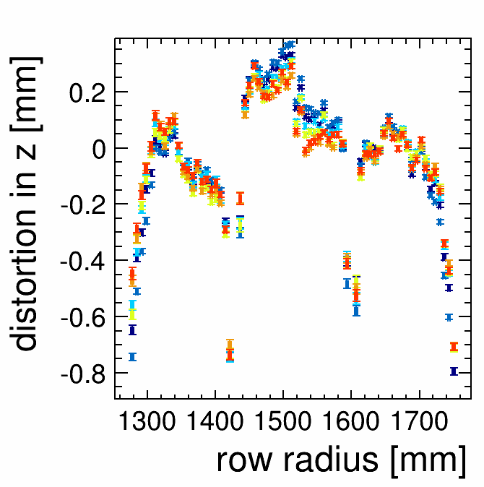
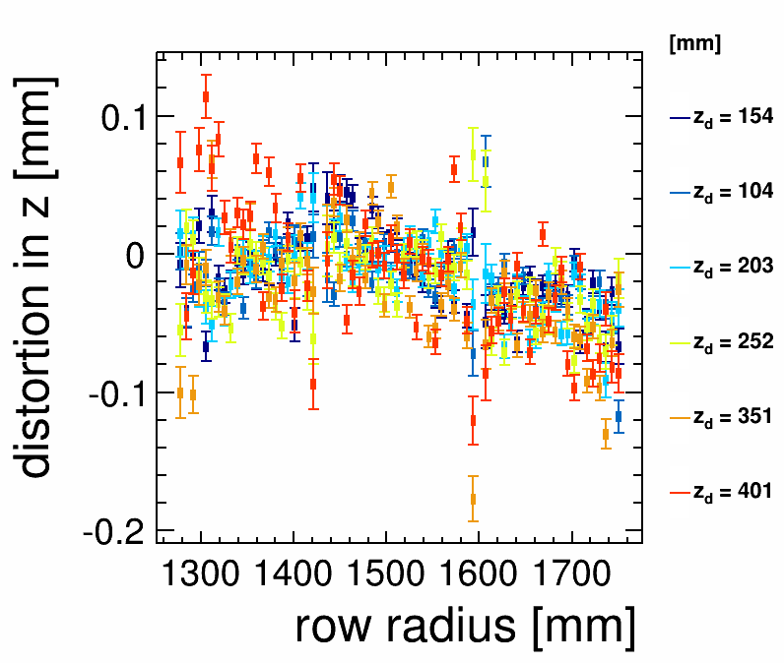
Distortions in z, B=0
After corrections
Micromegas, B=0
Micromegas, B=0
Same for the z coordinate

Slide 21
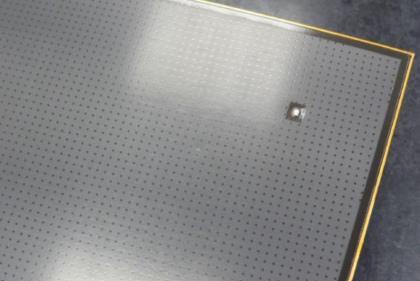
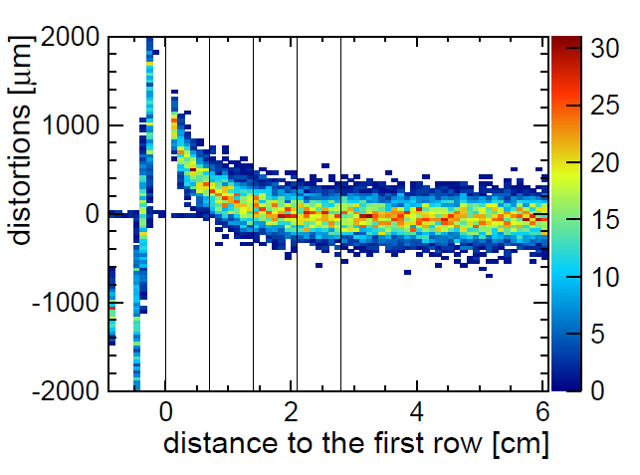
Distortions
E-field non-uniform near module boundaries (especially for the present Micromegas design with a grounding frame for the resistive foil).
This induces ExB effect.
Simulation of the distortions in the case of Micromegas

Slide 22
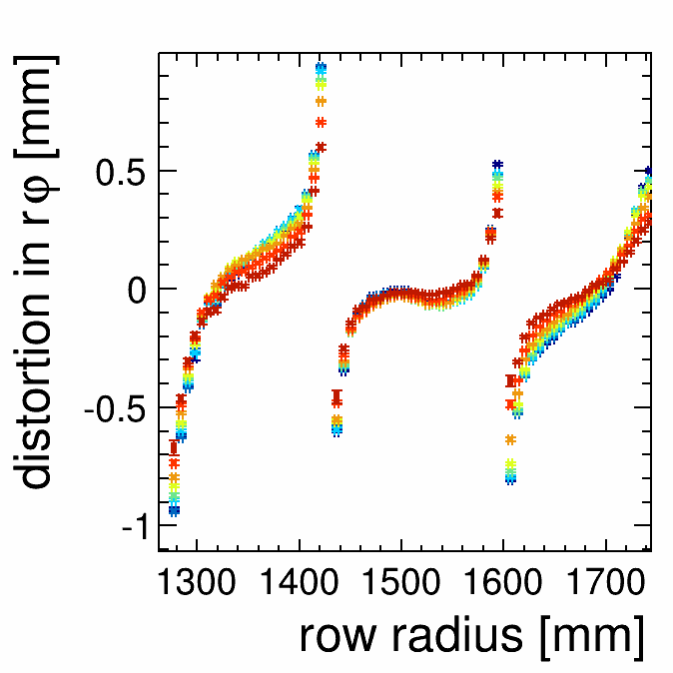
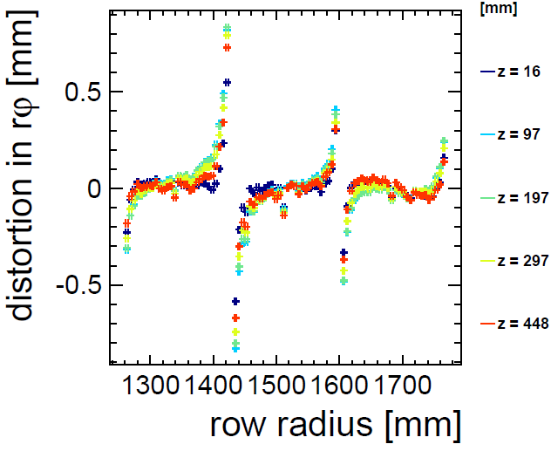
Distortions in rφ, B=1T
Micromegas, B=1T
GEM, B=1T
At B=1T, distortions due to ExB are observed (up to 1 mm)

Slide 23
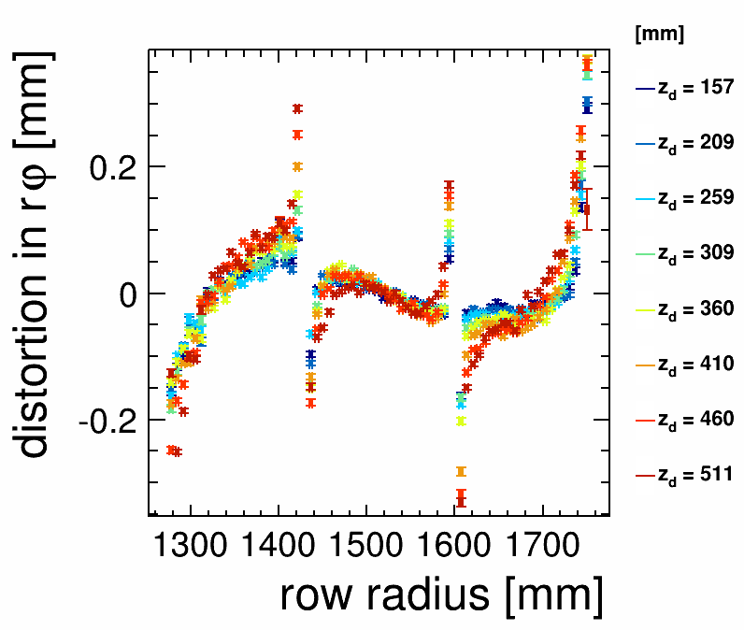
Distortions in rφ, B=1T
After corrections
Micromegas, B=1T
Micromegas, B=1T
At B=1T, 150 to 200 µm distortions remain after corrections

Slide 24
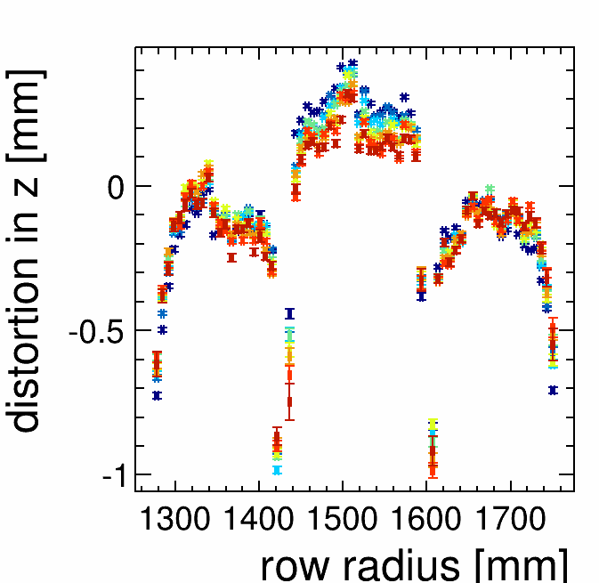
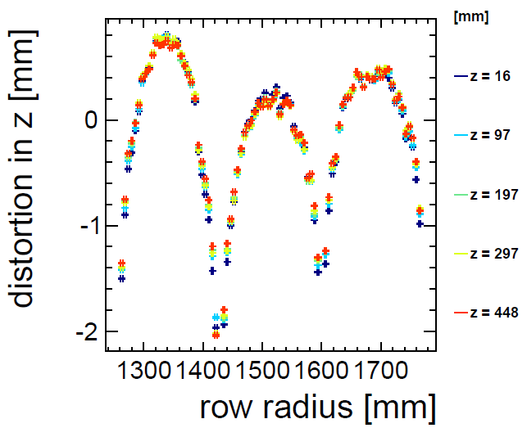
Distortions in z, B=1T
Micromegas, B=1T
GEM, B=1T
GEM, B=1T
Same for the z coordinate

Slide 25
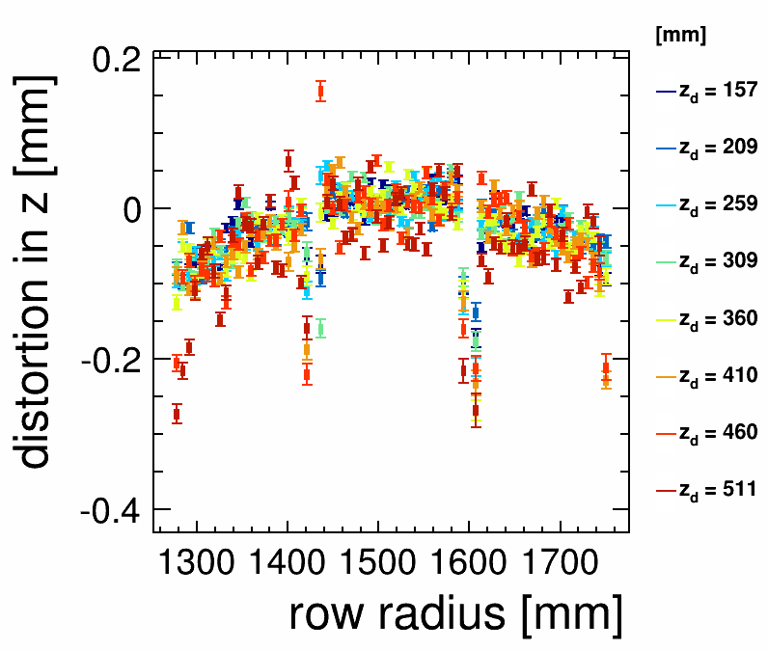
Distortions in z, B=1T
AFTER CORRECTIONS
Micromegas, B=1T
Micromegas, B=1T
Same for the z coordinate

Slide 26
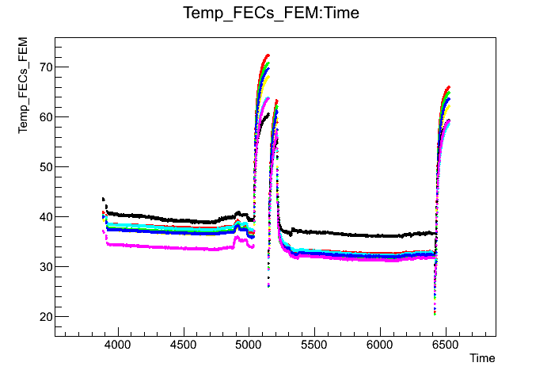
2-phase CO₂ cooling
Principle : CO₂ has a much lower viscosity and a much larger latent heat than all usual refrigerants. The two phases (liquid and gas) can co-exist a room temperature (10-20°C at P=45-57 bar).
Very small pipes suffice and hold high pressure with low charge loss.
Results from a test at Nikhef

Slide 27
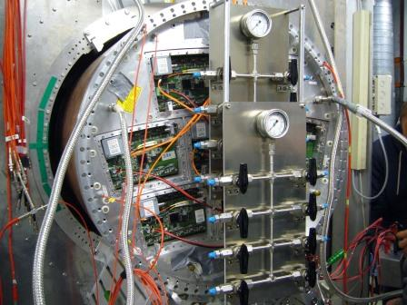
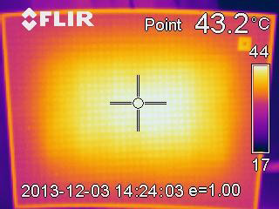
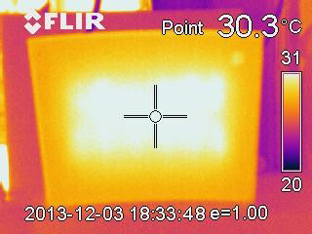
2-phase CO₂ cooling
Tests with 1 module were performed at Nikhef in December
Tests with 7 modules are ongoing at DESY

Slide 28
Electronics
The test electronics are not those to be used in the final ILD detector, for the following reasons:
  AFTER not extrapolable to Switched Capacitor Array depths of 1 bunch train
  S-Altro 16 has to evolve : improve packing factor, lower power consumption, power-pulsing from the beginning.
Present work within AIDA : Common Front End for GDSP

Slide 29
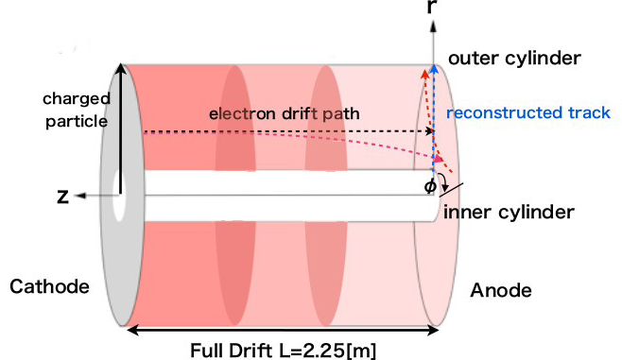
Ion space charge
Primary ions create distortions in the Electric field which result to O(<1µm) track distortions. 1 to 2 orders of magnitude safety margin with estimated BG.
However ions flowing back from the amplification region produce a high density ion disk for each train crossing. This disk drifts slowly (1m/s) to the cathode, influencing electron drift of subsequent train crossings

Slide 30
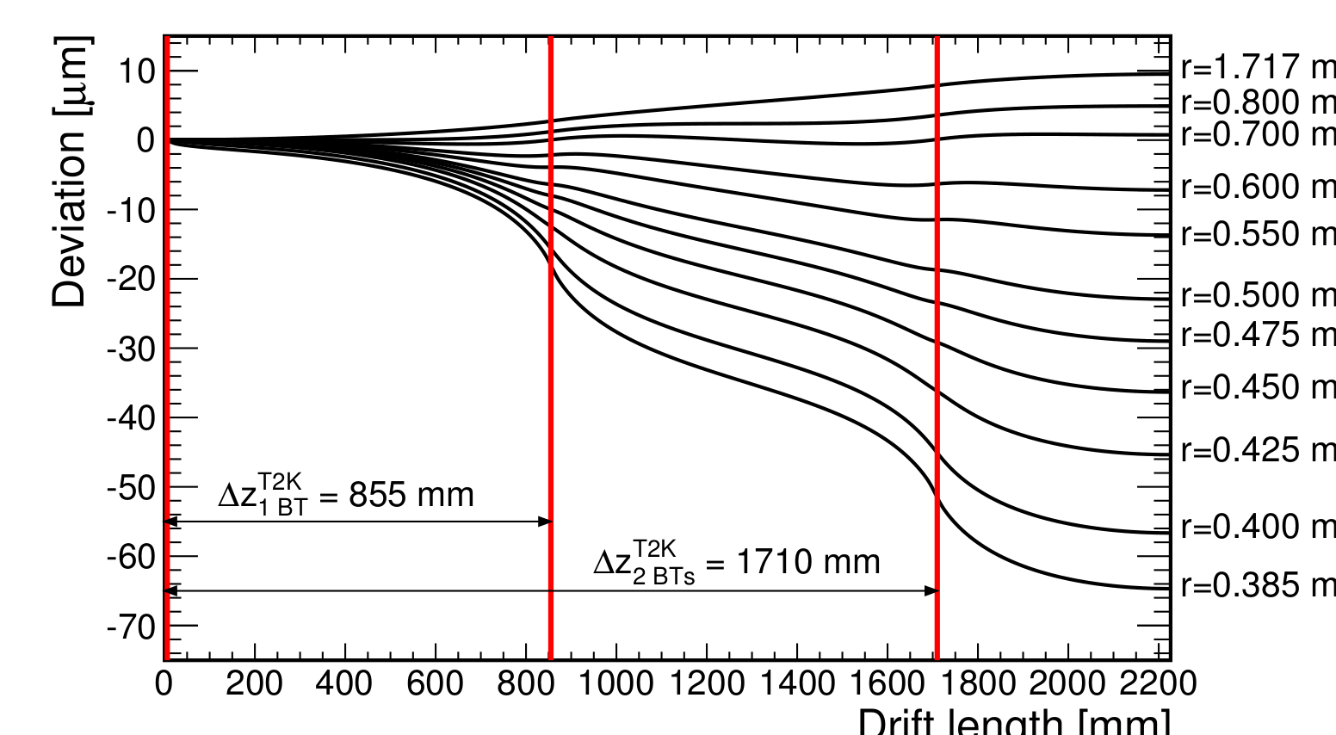
Distortions from backflowing ions
Example for the case of 2 ion disks :
60 µm distortion for ‘feed-back fraction’ x ‘gain’ = 1
GATE NEEDED

Slide 31
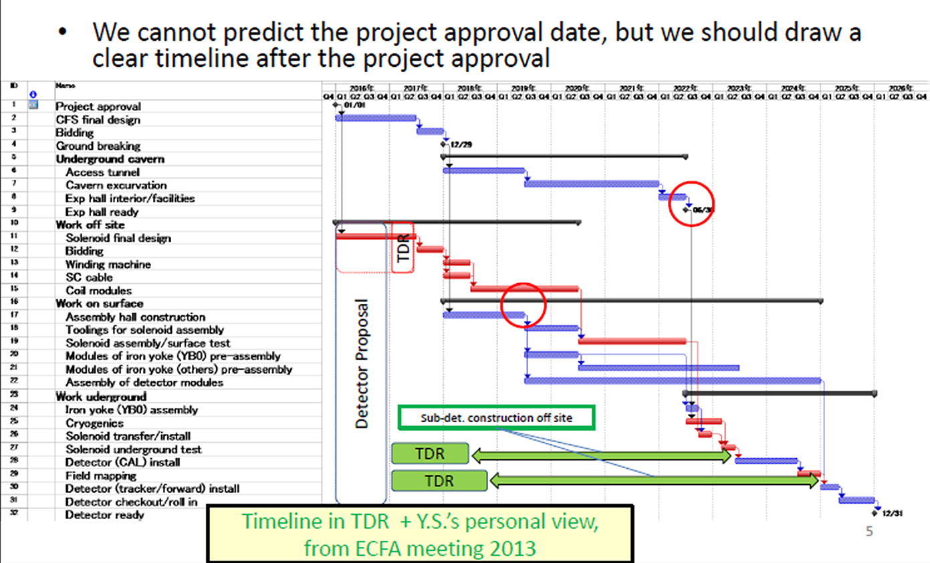
A Possible Schedule of ILC in Japan
As presented in the 2013 ILD meeting in Cracow

Slide 32
Remaining R&D issues
Ion backflow and ion gating
Fully understand, mitigate and correct distortions
Design a new electronics, at a pace adapted to the progress of the technology. Optimization of power consumption and power pulsing must be included in the design from the beginning.
Carry out technical research for connections to many channels, precision mechanics for large devices, cooling, etc…

Slide 33
Toward the Final Design of ILD TPC
The earliest timeline?
2014-15 R&D on ion gates and a decision on the ion gate:
  2015-17 Beam tests of new LP modules with the gate
  2017 Prioritization of the MPGD technology and module
  ILC LAB & ILD detector proposal
  2017-19 Final design of the readout electronics for ILD TPC and its tests
  Design of ILD TPC
2018-19 TDR for the ILD tracking system:
2019-23 Prototyping and production: Electronics (chips→boards)
Prototyping and production: Modules
Production: Field cage/endplate and all others
2024-25 TPC integration and test
2026 TPC Installation into the ILD detector
ILC commissioning

Slide 34
Conclusion
The R&D work worldwide within the LCTPC collaboration, with the tests performed at DESY in the last six years, demonstrated that MPGDs are able to fulfill the goals for main tracking at ILC
It also allowed to identify a few points requiring active R&D to be pursued in the next few years

