Slide 1
Research and development of Micromegas detector and related devices
(Project N° 4304-1)
Updated progress report and extension request
P. Colas, S. Mukhopadhyay
CEFIPRA Scientific Council, Dinard, France, May 21, 2014

Slide 2
Updated report
What is a Micromegas Time Projection Chamber?
Studies with small prototypes
The Large Prototype
Software studies, analysis of distortions
The PhD student Deb Sankar Bhattacharya
Recent achievements
Plans

Slide 3
History of the project 4304-1
First meeting in Saclay in December 2008, discussing possible collaborations
First travel from France to India in January 2010. Application to CEFIPRA.
Started April 1, 2011, due to end on March 31, 2014, extension to January 31, 2016.
Documents written : detailed project March 2009, annual report from April 2011 to March 2012, mid-term report presented on Nov. 17, 2012 at the CEFFIPRA S.C. in Aurangabad, the extension proposal in October 2013, this updated progress report and extension request.

Slide 4
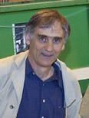
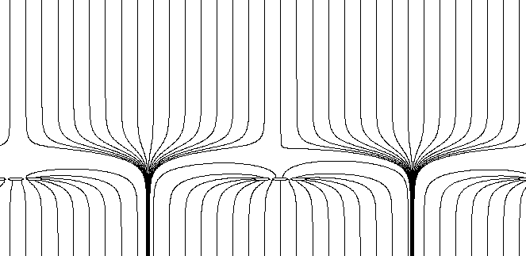
Micromegas: How does it work?
Y. Giomataris, Ph. Rebourgeard, JP Robert and G. Charpak,
NIM A 376 (1996) 29
S1
Micromesh Gaseous Chamber: a micromesh supported by 50-100 μm insulating pillars, and held at V_{anode} – 400 V
Multiplication (up to 10⁵ or more) takes place between the anode and the mesh and the charge is collected on the anode (one stage)
Funnel field lines: electron transparency very close to 1 for thin meshes
Small gap: fast collection of ions
S2
S2/S1 = E_{drift}/E_{amplif} ~ 200/60000= 1/300

Slide 6
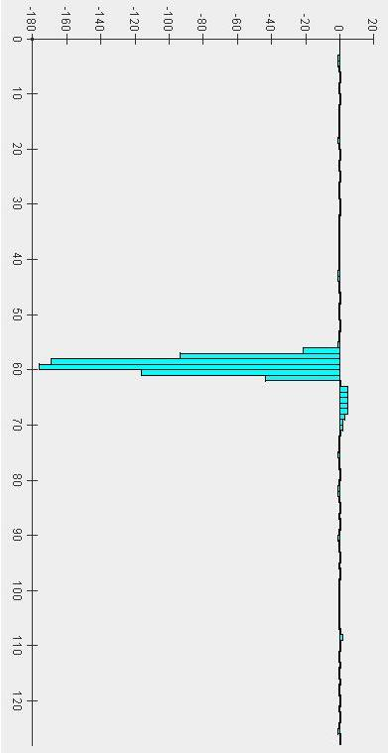

TPC: Time Projection Chamber
t
electrons diffuse and drift due to the E-field
Ionizing Particle
electrons are separated from ions
B
E
A magnetic field reduces electron diffusion
y
x
Micromegas TPC : the amplification is made by a Micromegas
Localization in time and x-y

Slide 7
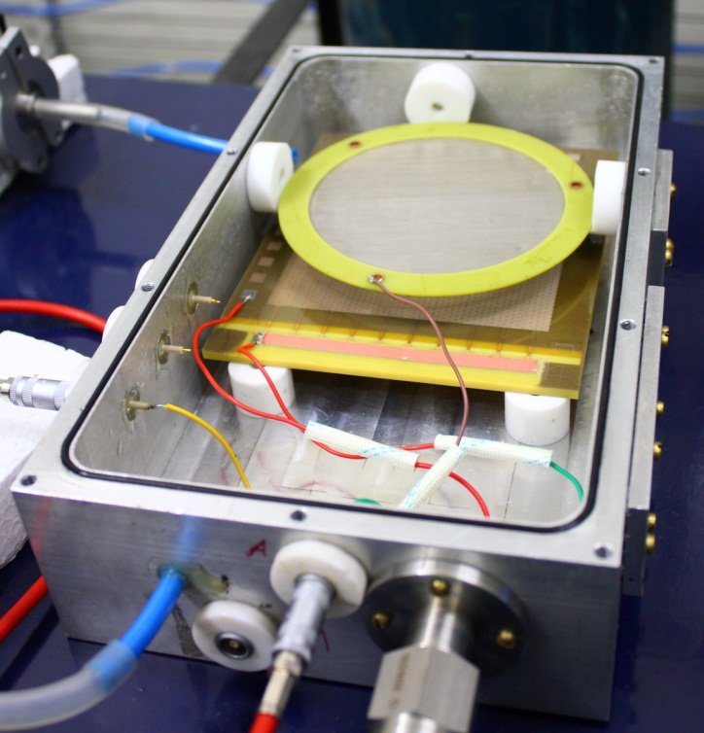
Work with small prototypes
Full equipment of the SINP lab for small detector studies, and procuration of Micromegas detectors by the Saclay team
Study of various gaps and geometry and comparison with simulation
2 publications (NIM and JINST)

Slide 8
Work with small prototypes
Ion backflow measurements in Saclay with the Indian team.

Slide 9
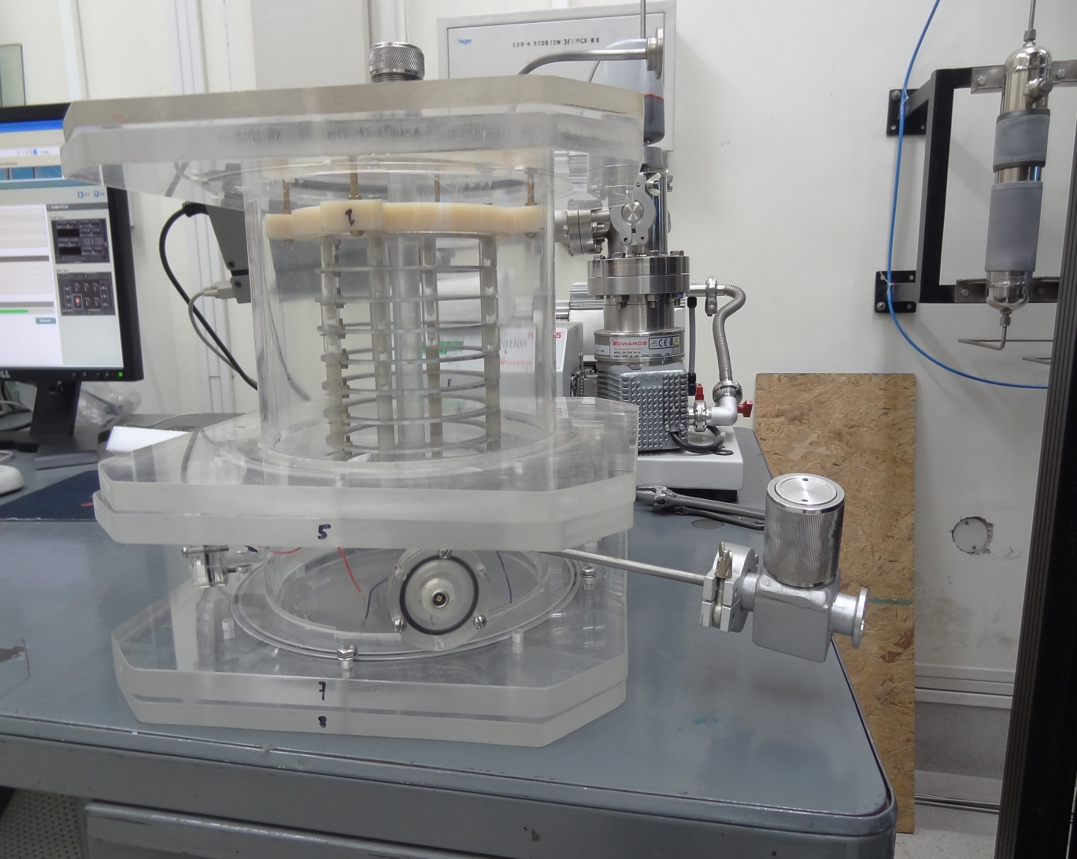
New small TPC built at SINP

Slide 10
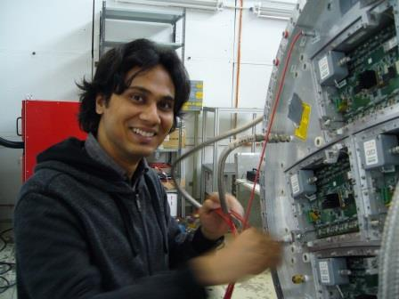
The student Deb Sankar Bhattacharya
Joined SINP in January 2013
Registered in PhD at Jadavpur University, with advisors S. Mukhopadhyay, A. Bhattacharya and P. Colas.
PhD to be defended in Kolkata, in January 2016.
Fully payed on CEFIPRA funds
SINP
Saclay
SINP
Saclay
SINP
2013
2014
2015

Slide 11
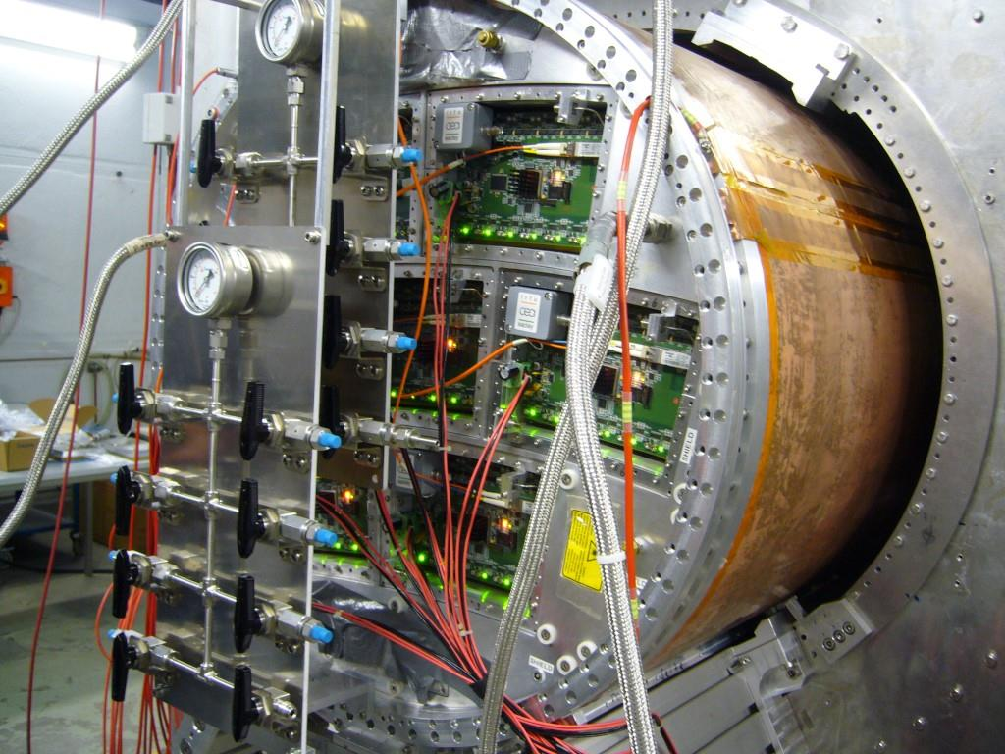
The Large prototype
Built by LCTPC collaboration
Magnet and cooling plant by KEK, Tsukuba
Equipped by Saclay with resistive anode Micromegas.
Cooling tested in February 2014 at DESY

Slide 12
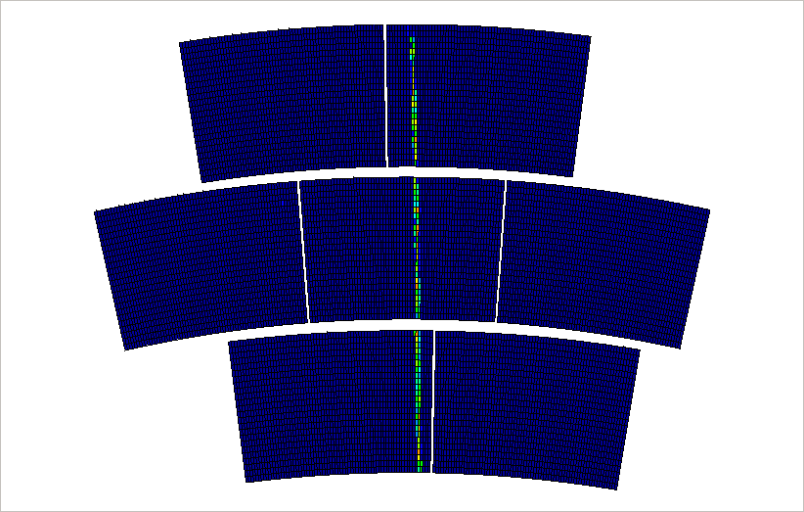
Events in the Large Prototype

Slide 13
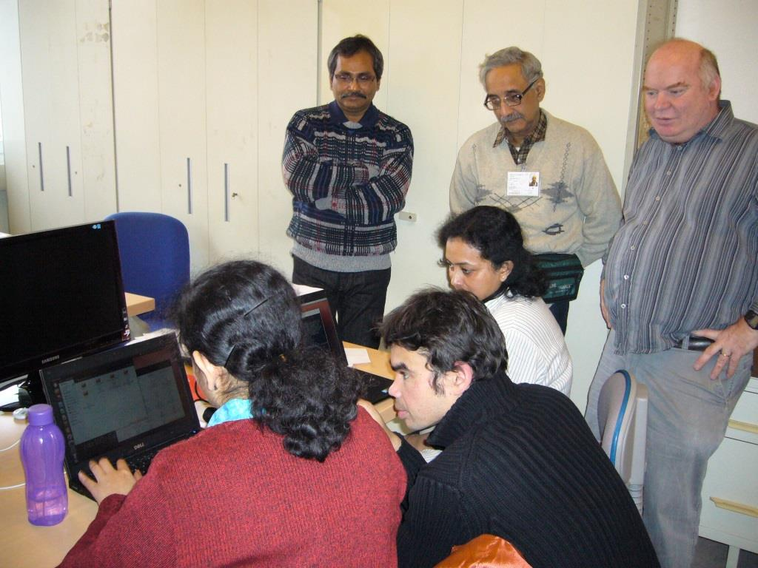
Analysis and software
‘Software week’ in Saclay, where we work on the track reconstruction and analysis.

Slide 14
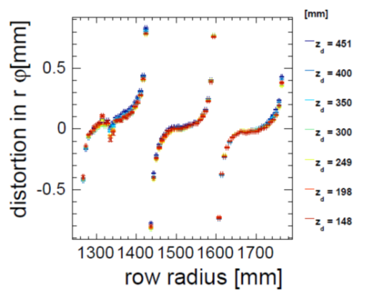
Distortions from the Large Prototype

Slide 15
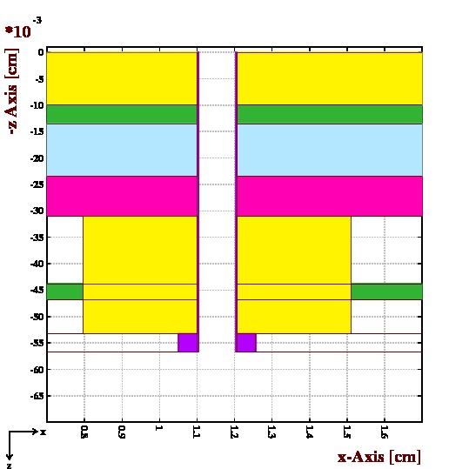
Distortions from the Large Prototype
Inhomogeneity of the Electric field near the edges of the modules induces distortions (even at B=0)
Also induces ExB effects
Changes in E also changes the drift velocity
Add up to mechanical misalignment
Detailed module edge layout

Slide 16
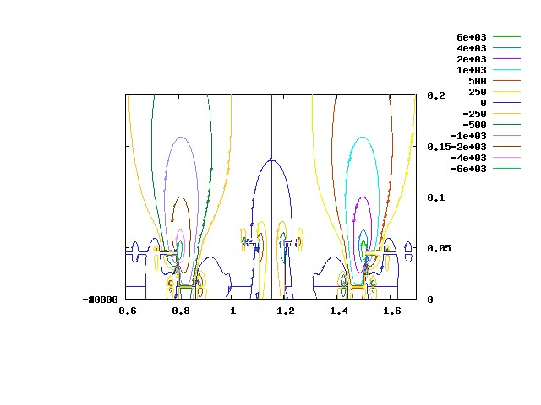
Distortions from the Large Prototype
Inhomogeneity of the Electric field near the edges of the modules induces distortions (even at B=0)
Also induces ExB effects
Changes in E also changes the drift velocity
Add up to mechanical misalignment
Calculations by S. Mukhopadhyay

Slide 17
Conclusion
Lots of achievements after 3 years.
French funds not yet spent, but just enough remains to pay salary and expenses of D.S. Bhattacharya through 2015, mainly to study distortions in the Large Prototype TPC
2 weeks in Kolkata for the French team, end of October 2014: MPGD workshop and teaching.

