Slide 1
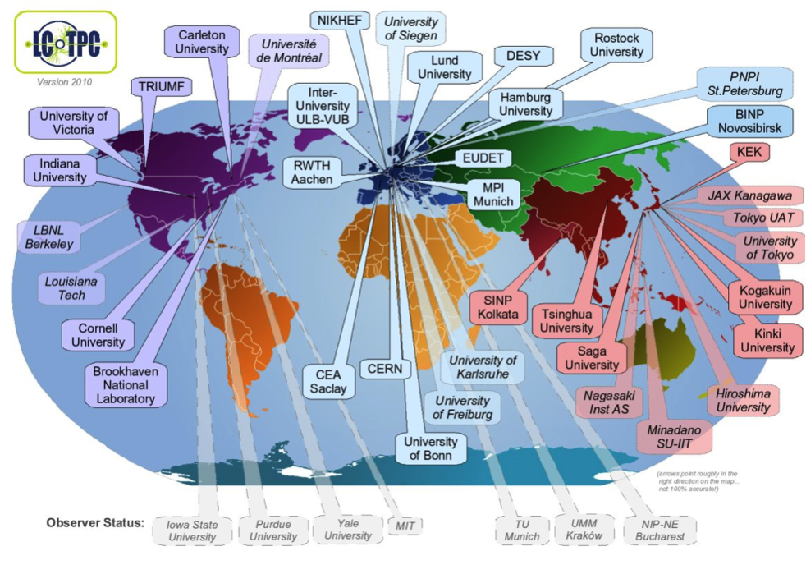



Study of a Large Prototype TPC using
Micro-Pattern Gas Detectors
─ David Attié ─
CEA Saclay/Irfu
On behalf of the LCTPC collaboration
www.lctpc.org
Notes:
I’m here to present a TPC review

Slide 2
Overview
Introduction: Physics case at International Linear Collider (ILC)
R&D of a Large Prototype Time Projection Chamber for ILC
TPC Readout using Micro-Pattern Gaseous Detectors:
  GEM modules with ALTRO electronics
  Integrated AFTER-based electronics and resistive Micromegas detector module
  Pixel readout
Studies
  Transverses resolution
  Multi-module effect & field distorsions
  Ion feedback
  2-Phase CO₂ cooling
Conclusion

Slide 3
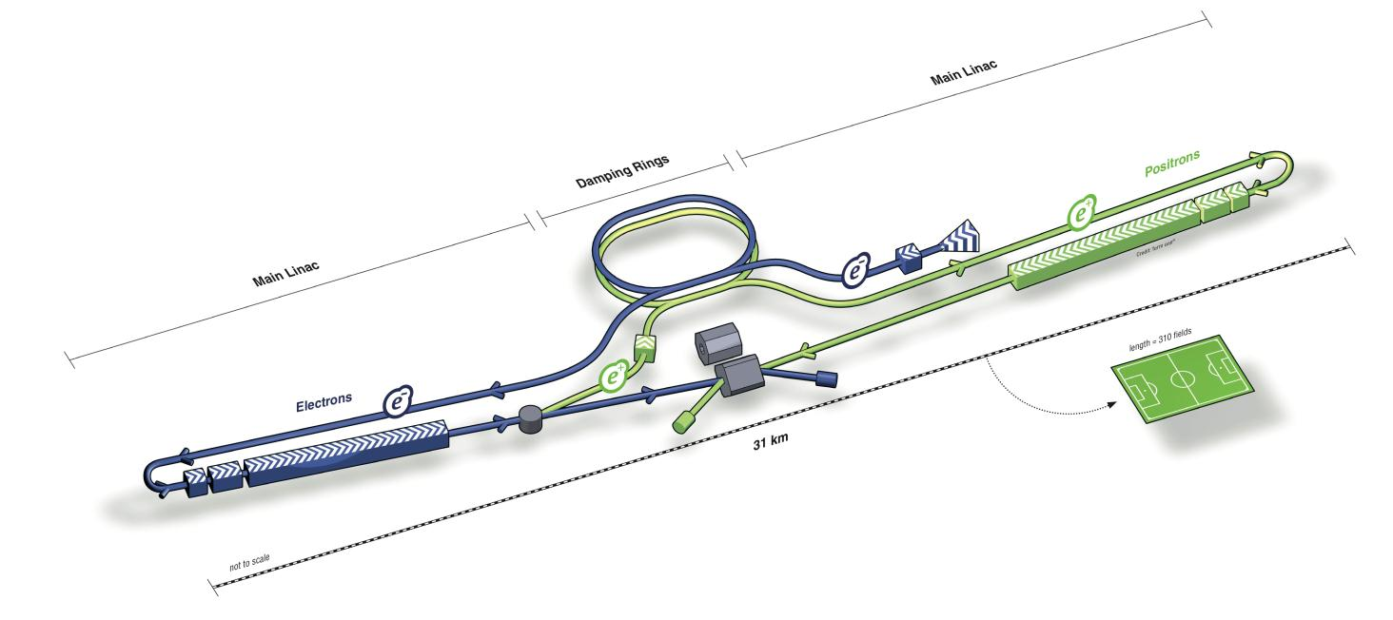
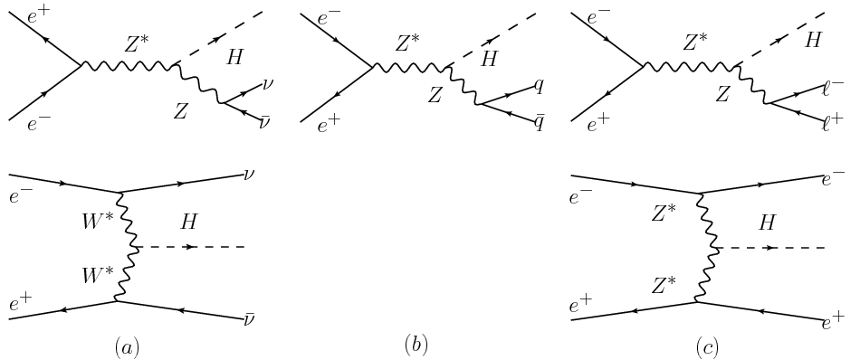


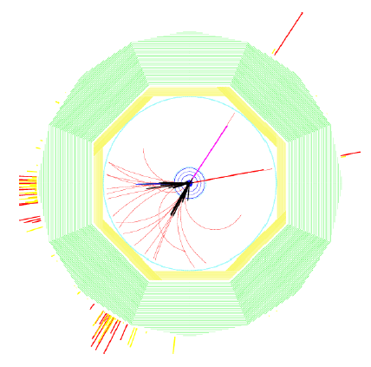
Introduction: Physics Case at ILC
Identify the particle of cosmic dark matter
Find the origin of the masses of elementary particles
  precision of Higgs coupling ∝ to each particle mass
  sensitivity of the ILC experiments to Higgs
  boson couplings in a model-independent analysis
Higgs-strahlung recoil mass: e⁺e⁻ → ZH (Z→μ⁺μ⁻/e⁺e⁻) + X
Next collider: linear e+e– collider, length: ~ 31km
Tunable center of mass energy of 200-500 GeV
Two detectors with push-pull concept
Particle Flow* concept necessary
[*] Particle flow: the aim to reconstruct every particle in the best suited sub-detector
B=3.5 T
e+e→HZ,Z→µµ

Slide 4
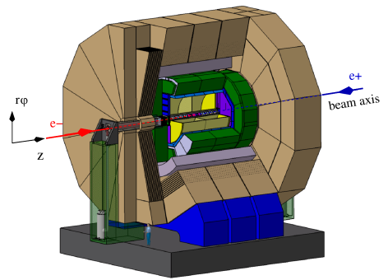
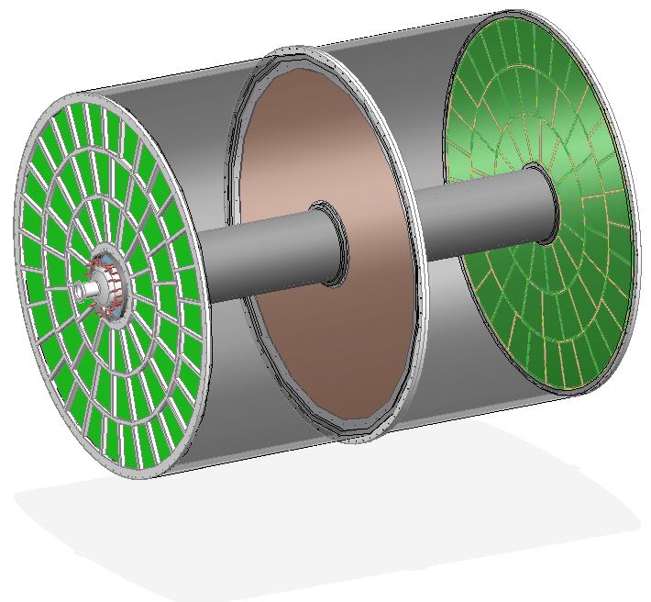
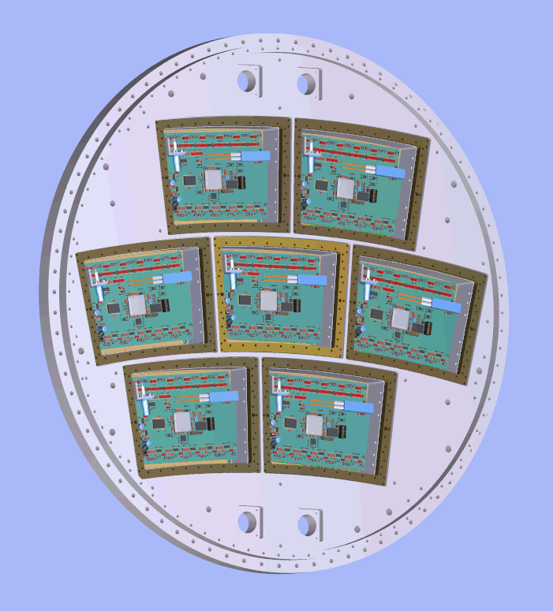
Time Projection Chamber for ILD
TPC is the central tracker for International Linear Detector
– Large number of 3D points → continuous tracking
– Good track separation and pattern recognition
• Low material budget inside the calorimeters important for PFA
– Barrel: inner <1% X₀ ; outer <5% X₀
– Endplates: ~25% X₀ (<10 cm)
• Two options for endplate readout (MPGD):
    – GEM
    – Resistive Micromegas
• Alternative: pixel readout
TPC Requirements :
Momentum resolution:
δ(1/p_{T}) < 9×10⁻⁵ GeV⁻¹
Spatial resolution at 3.5T:
σ(rφ) < 100 μm
σ(z) < 500 μm
Field uniformity:
ΔE/E~2×10⁻⁴
Tracking eff. for p_{T}>1 GeV: 97%
dE/dx resolution ~5%
4.7m
3.62m
Cathode membrane
Endplate
MPGD
ILD
TPC
Large Prototype

Slide 5
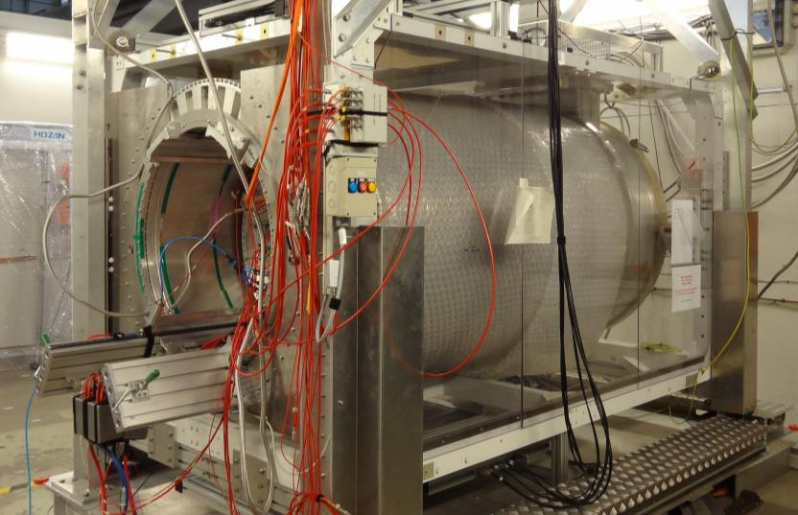


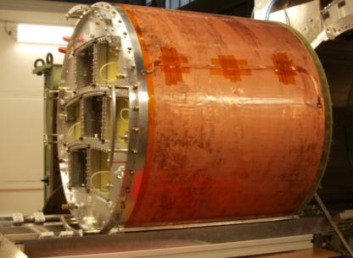
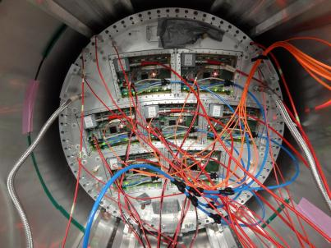
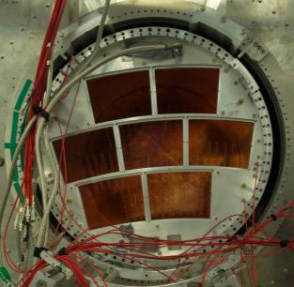
Large Prototype TPC for ILC
1T PCMagnet on lifting stage
Built by the LCTPC collaboration in 2008
Financed by EUDET
Magnet upgraded in 2012 within AIDA
Located at DESY: 6 GeV e- beam
Sharing out :
- magnet: KEK, Japan
- field cage, stage: DESY, Germany
- cosmic trigger: Irfu, France
- beam trigger: Nikhef, Netherlands
- endplate: Cornell, USA
- Resistive Micromegas: Irfu, France,
Carleton/Montreal, Canada
- Double GEMs with 100μm laser-etched
crystal polymer: Saga, Japan
- Triple 50μm GEMs: DESY, Cern
- TimePix pixel: F, G, NL<
Large Prototype TPC
Endplate + 7 Micromegas modules

Slide 6
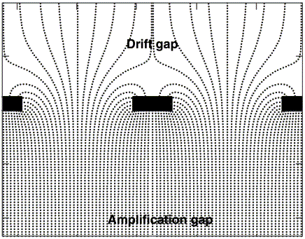
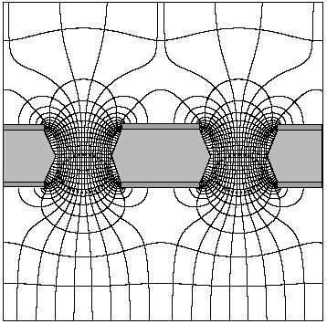
Micro-Pattern Gas Detectors: Micromegas & GEM
Technology choice for TPC readout: Micro-Pattern Gas Detector
more robust than wires
no E×B effect
fast signal & high gain
low ion backdrift
better ageing properties
easier to manufacture
Micromegas
GEM
MICROMEsh GAseous Structure
(Y. Giomataris et al., 1996)
metallic micromesh (typical pitch 50-100 µm)
supported by pillars, multiplication between anode and mesh, high gain
Gas Electron Multiplier (F. Sauli, 1997)
2 copper foils separated by kapton
multiplication takes place in holes (50-100 µm)
2-3 layers needed, high gain
Gas Electron Multiplier (F. Sauli, 1997)
2 copper foils separated by kapton
multiplication takes place in holes
use of 2 or 3 stages
Avalanche
50-100 µm
40 kV/cm
~100 µm
80 kV/cm
~1000 µm
1 kV/cm

Slide 7
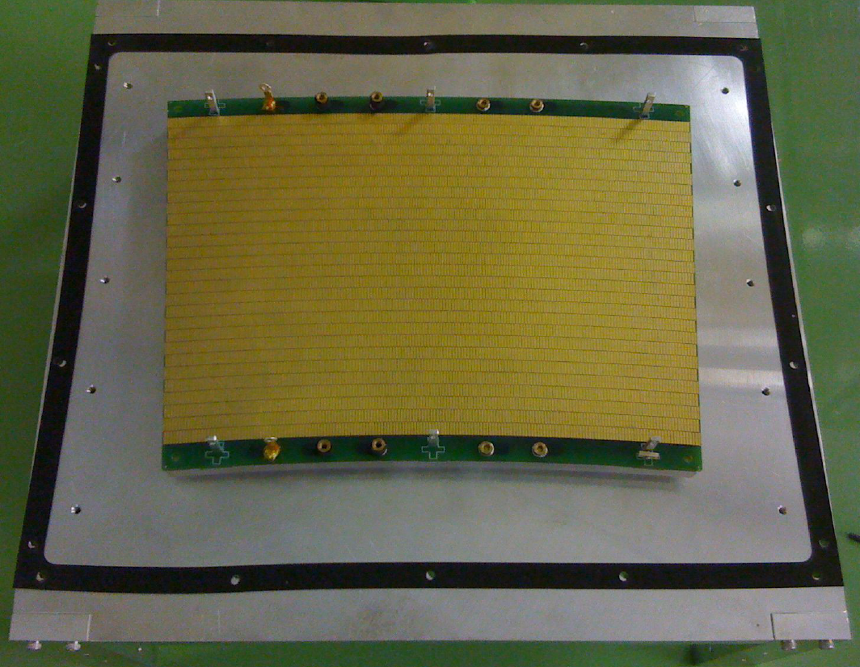
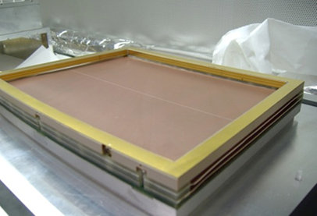
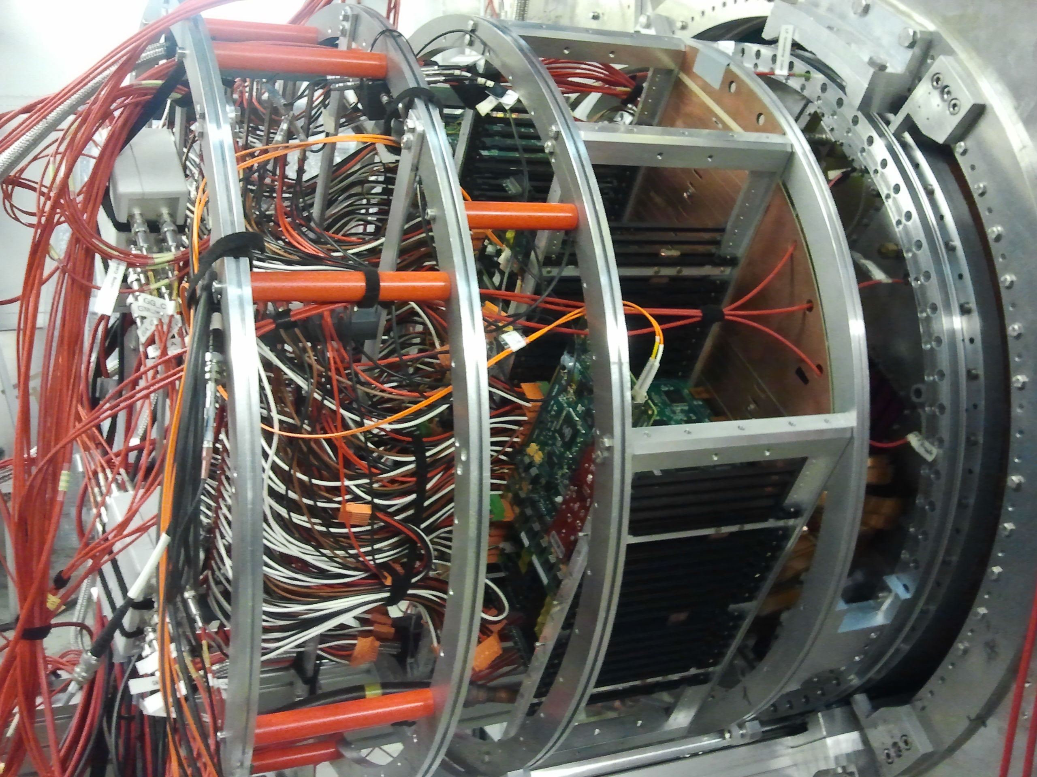
Asian GEMs
Double GEM module using Laser-etched
Liquid Crystal Polymer of 100 µm
Made in Japan (SciEnergy)
Pad size: 1.21×5.4 mm²
28 staggered rows of 176-192 pads
4829 channels
3 modules equipped (10 000 channels)
read out by ALTRO electronics
Next step: SALTRO with better integration

Slide 8
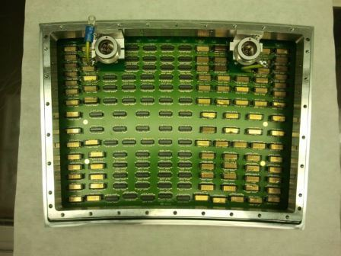
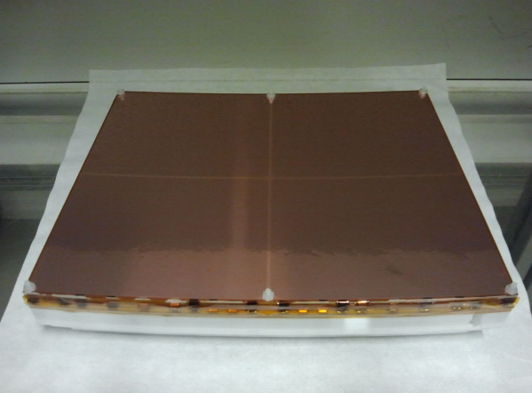
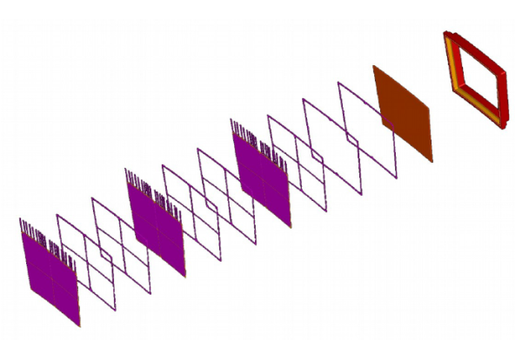
European GEMs
Triple GEM module with thin ceramic
frame (1mm)
Manufactured at Cern (50 µm)
Pad size: 1.26×5.85 mm²
28 rows (4829 channels)
3 modules equipped (10 000 channels)
read out by ALTRO electronics

Slide 9
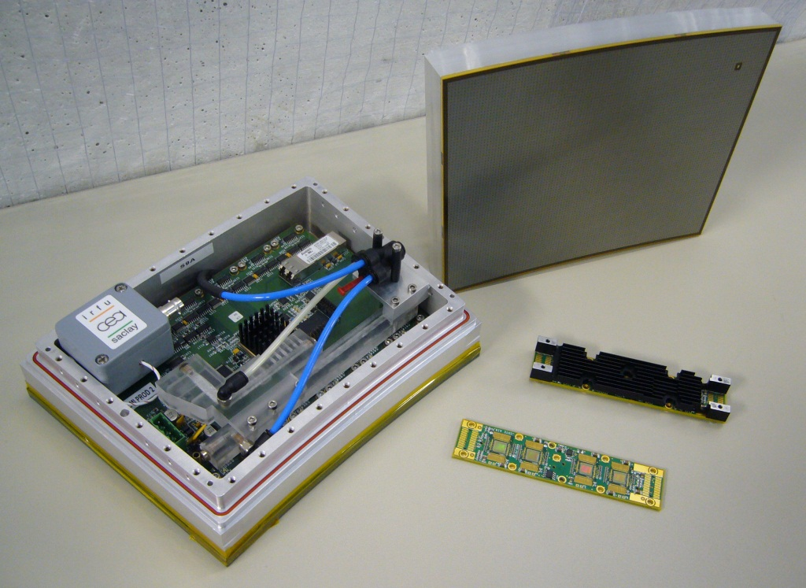
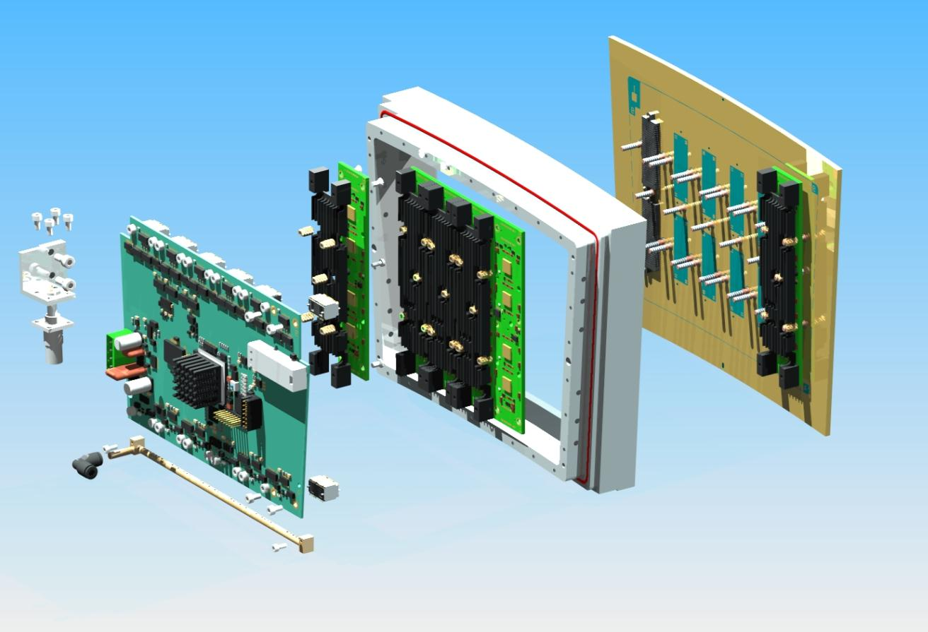
Resistive Micromegas
Micromegas with resistive coating
Various resistive coatings have been tried:
  Carbon-loaded Kapton (CLK): 3 and 5 MΩ/,
  resistive ink
Pad size: 3×6.8 mm²
24 pad rows (1726 channels)
7 modules equipped (12 000 channels)
read out by fully integrated electronics
based on AFTER chips (T2K TPC)
Resistive Micromegas Detector
FEM
FEC
Fully integrated Module
Pads PCB
+
Micromegas
Front-End Card (FEC)
Front-End Mezzanine
Micromegas mesh
Resistive foil
Isolated layer
Pads
Cooling system
d/X₀≈0.24
PCB
See Dixit et.al., NIM A518 (2004) 721

Slide 10
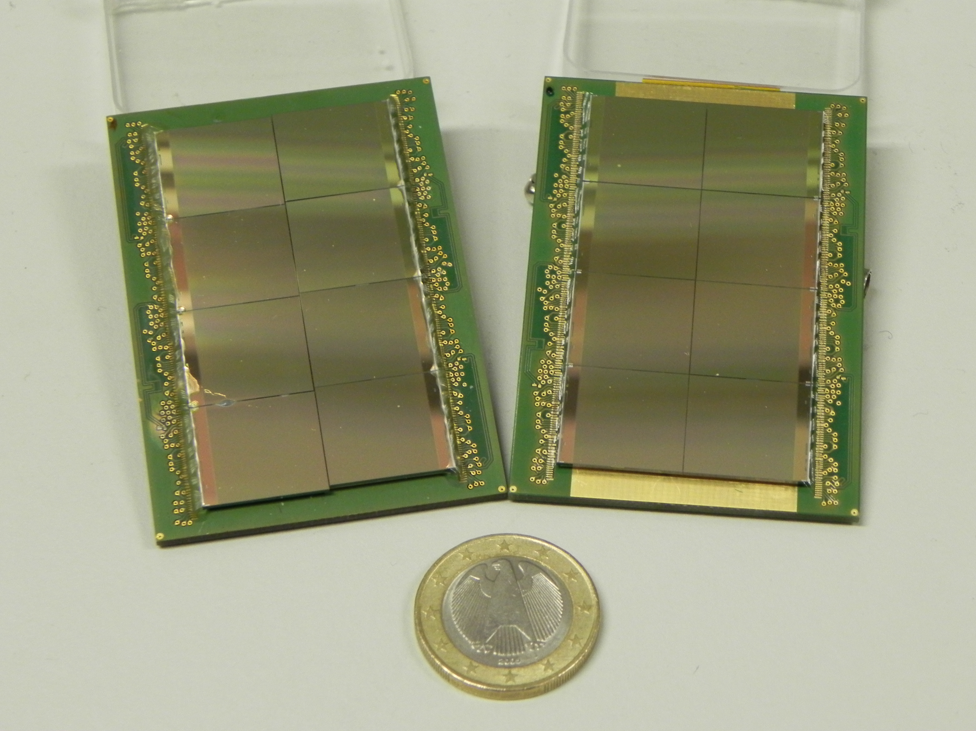
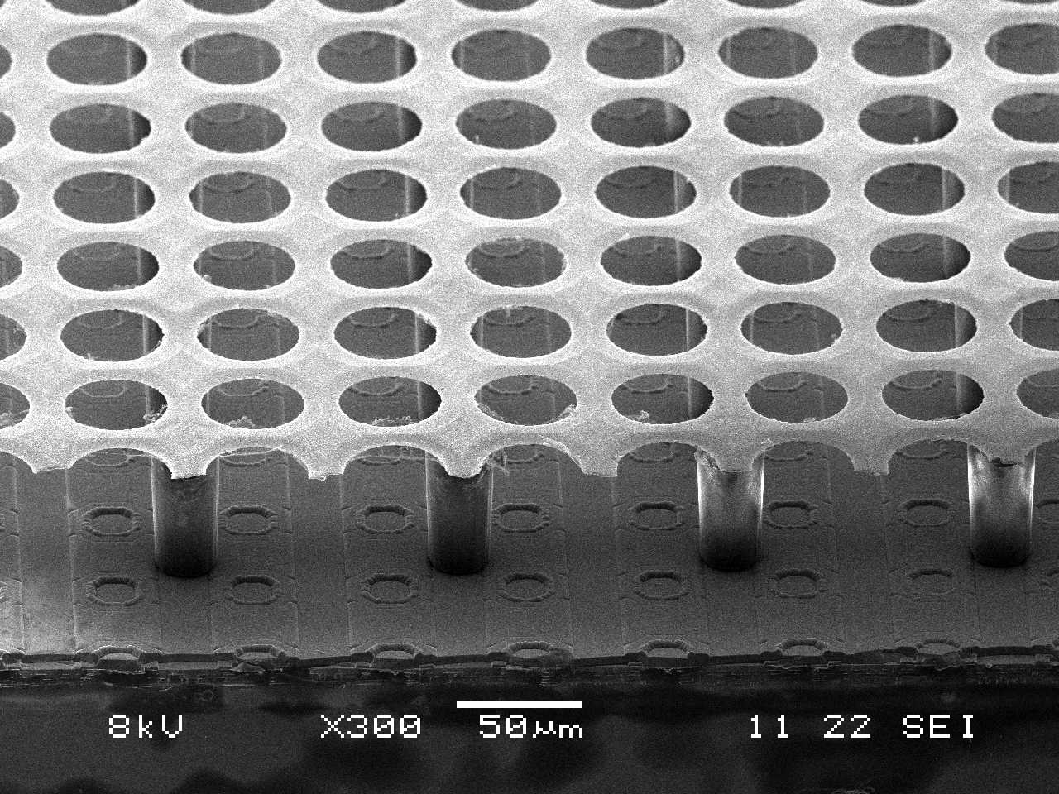

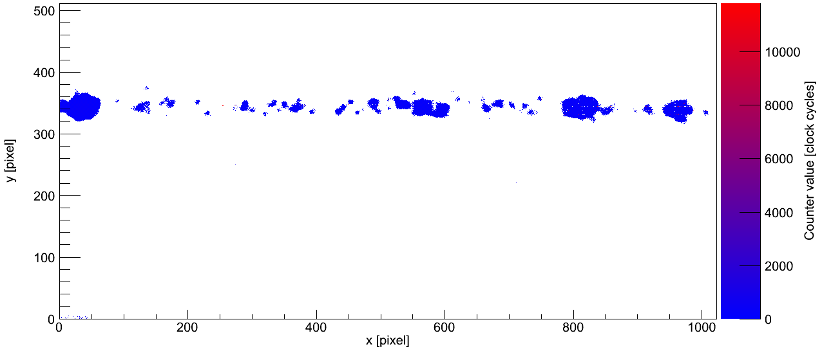
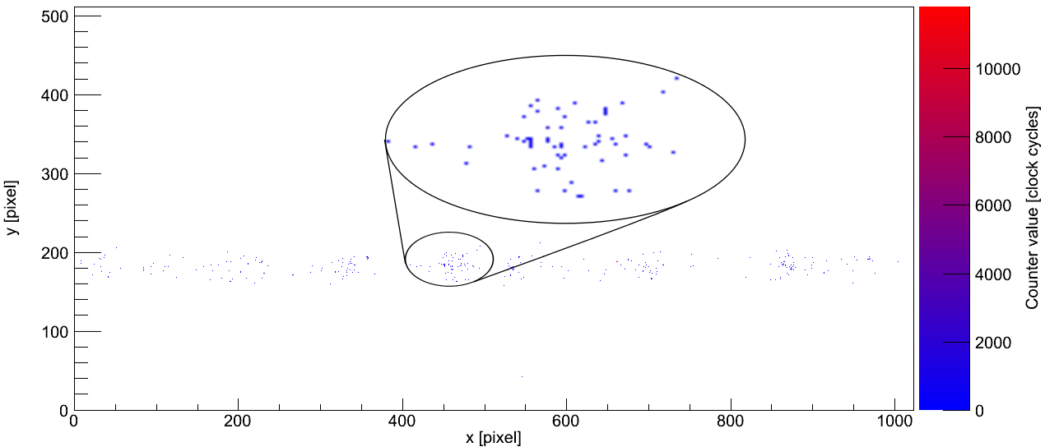
Pixel Readout R&D
TimePix chip: matrix of 256 × 256 pixels of 55 × 55 µm² size
Each pixel can be set to:
  Hit counting
  Charge measurement
  Time measurement
Bonn
Bonn, Nikhef
Irfu, Nikhef
GEM
InGrid

Slide 11
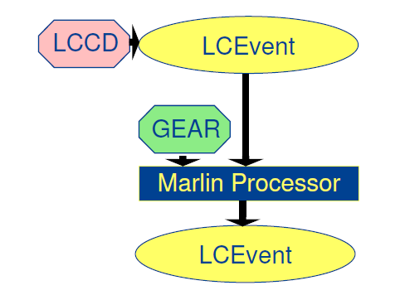
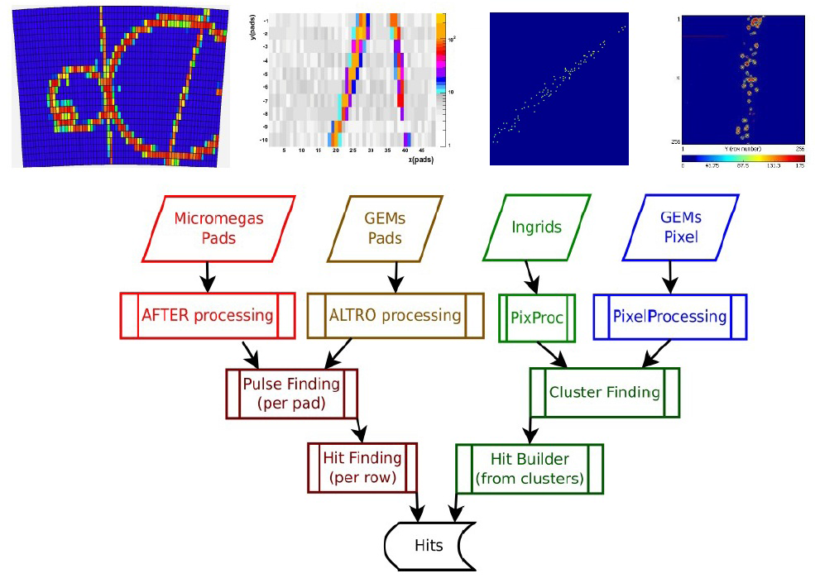
LCTPC Software Framework
Reconstruction, simulation, analysis based on common ILC software tools:
  LCIO (Linear Collider I/O): event data model
  Marlin (Modular Analysis & Reconsctruction for the LINear Collider)
  LCCD: (Linear Collider Conditions Data toolkit)
  Gear: (Geometry Api for Reconstruction)
Specific software package of LCTPC:
MarlinTPC: https://znwiki3.ifh.de/MarlinTPC/MarlinTPC
  Reconstruction processors
  Conditions handling
  Simulation (coarse to detailed)
  Common analysis for standard plots
Data
  Testbeam data stored on Grid storage
  → accessible by whole collaboration
  Common conditions database server

Slide 12
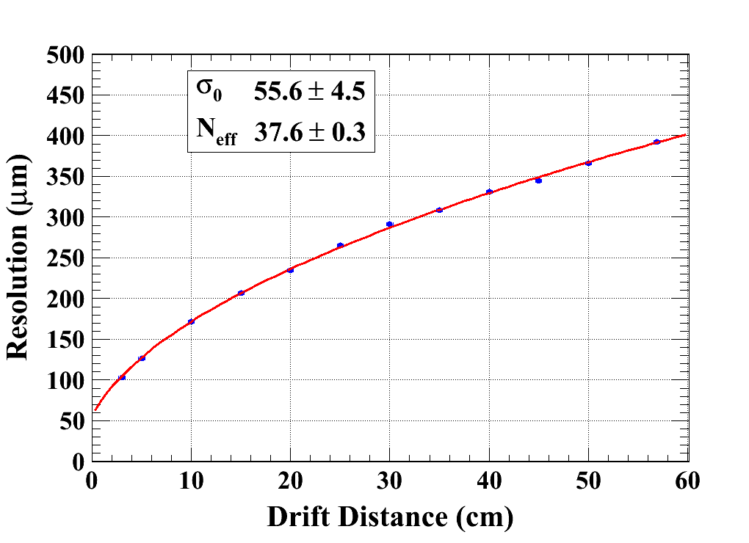
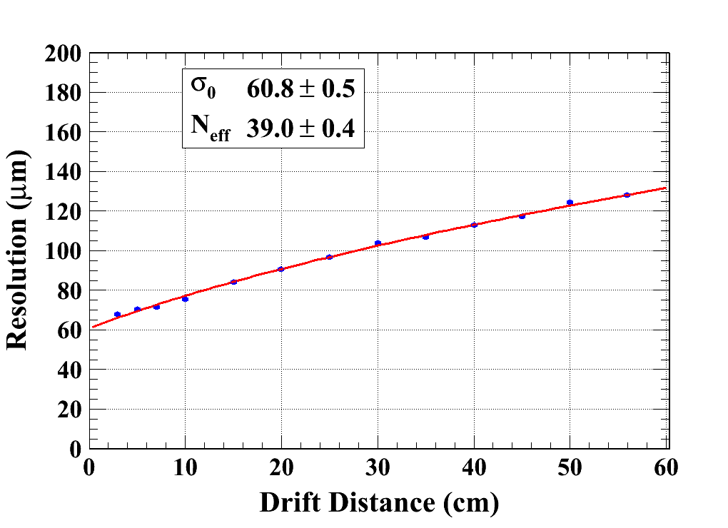
Transverse resolution [Resistive Micromegas]
Gas: Ar/CF4/Iso 95/3/2
B = 0 & 1T
σ₀: resolution at z=0
N_{eff}: effective number of electrons
C_{d} : the diffusion constant
B=0 T
C_{d} = 315.1 µm/√cm (Magboltz)
B=1 T
C_{d} = 94.2 µm/√cm (Magboltz)

Slide 13
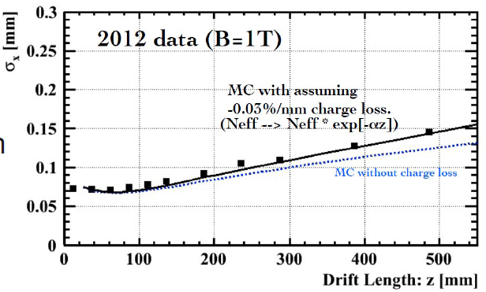
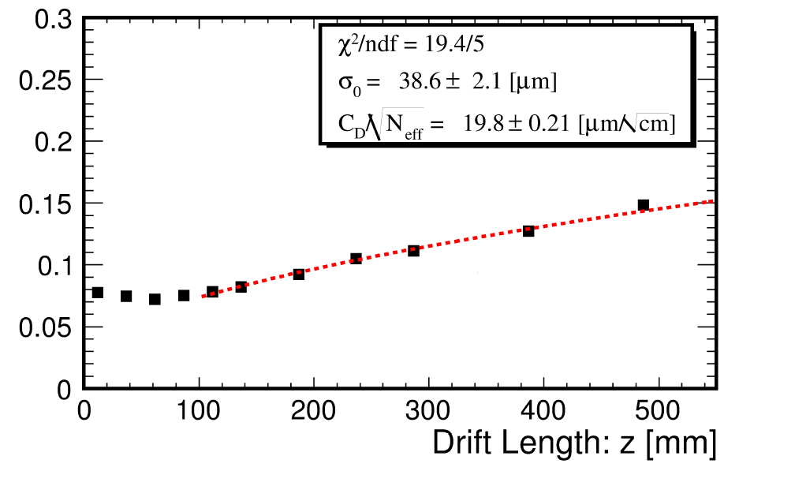
Transverse resolution [GEMs]
Gas: Ar/CF4/Iso 95/3/2
B= 1T
σ₀: resolution at z=0
N_{eff}: effective number of electrons
C_{d} : the diffusion constant
Asian GEM
European GEM

Slide 14
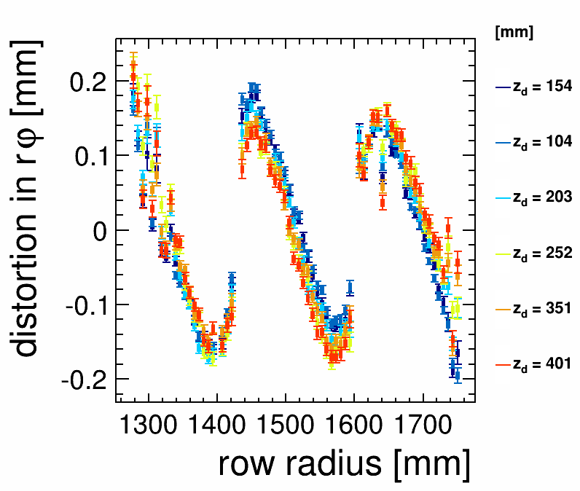
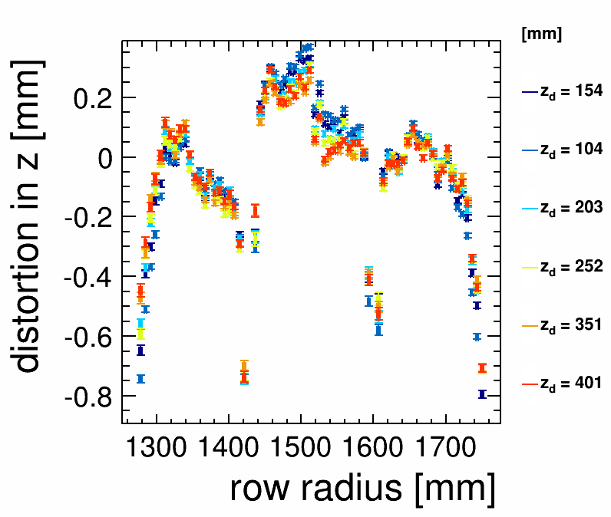
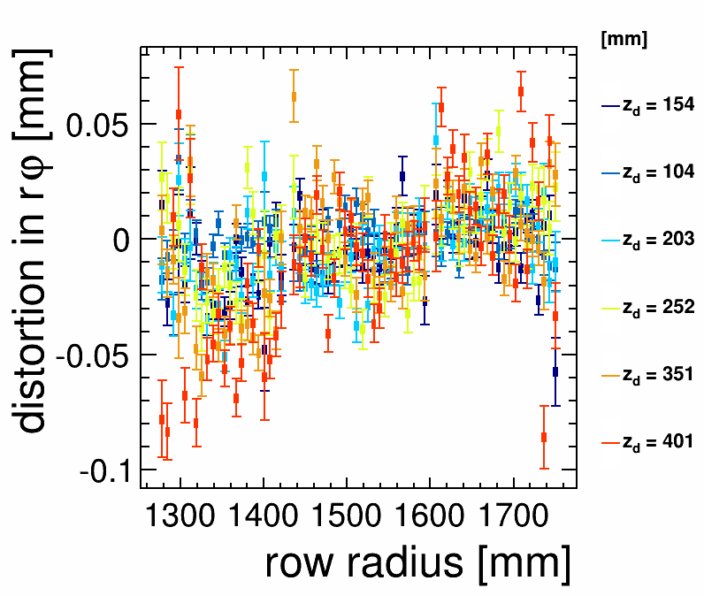
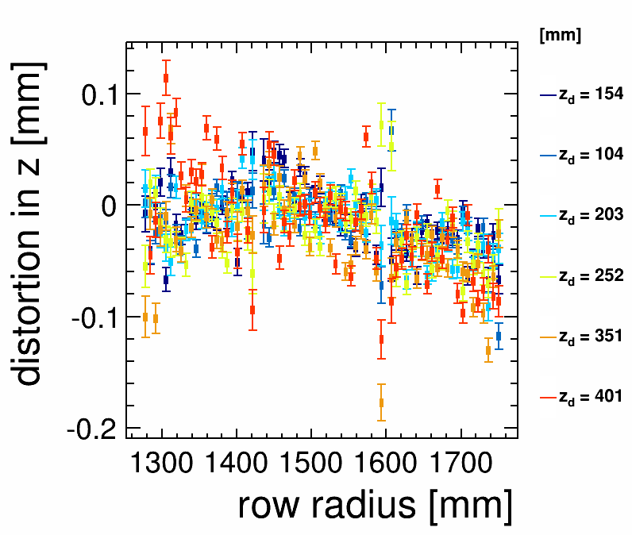
Field distorsions at B=0T
B=0T, distortions due to E only
  rΦ direction: 150 to 200 µm corrected down to 20 µm
  Z direction: few 100 µm (50 µm)
Before corrections
After corrections
rΦ
Z
14

Slide 15
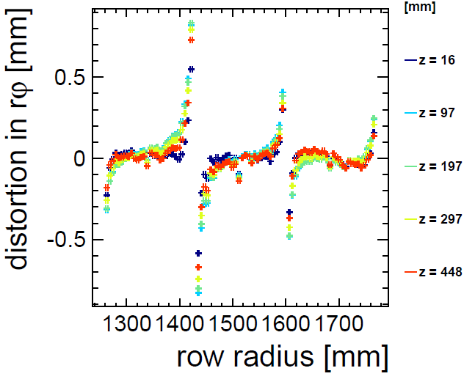
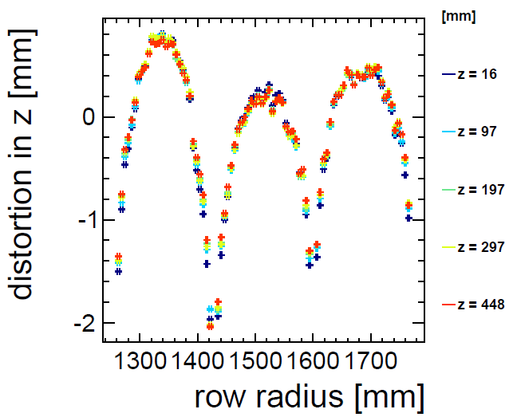
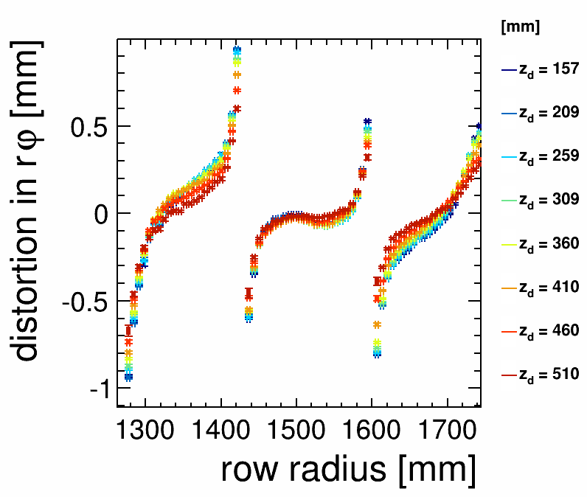
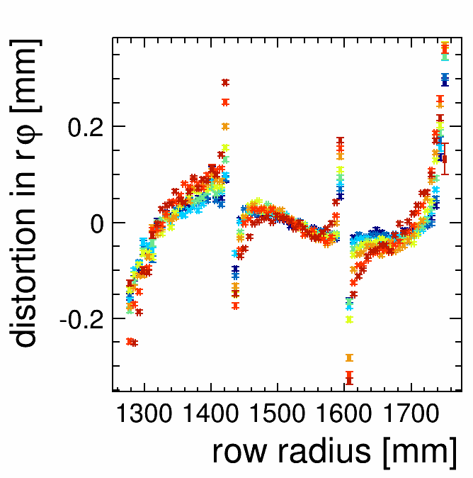
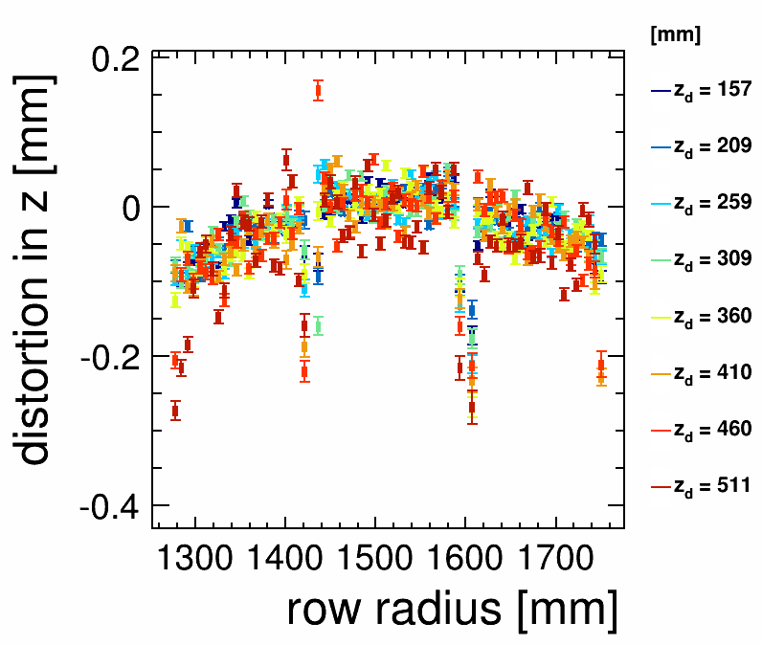
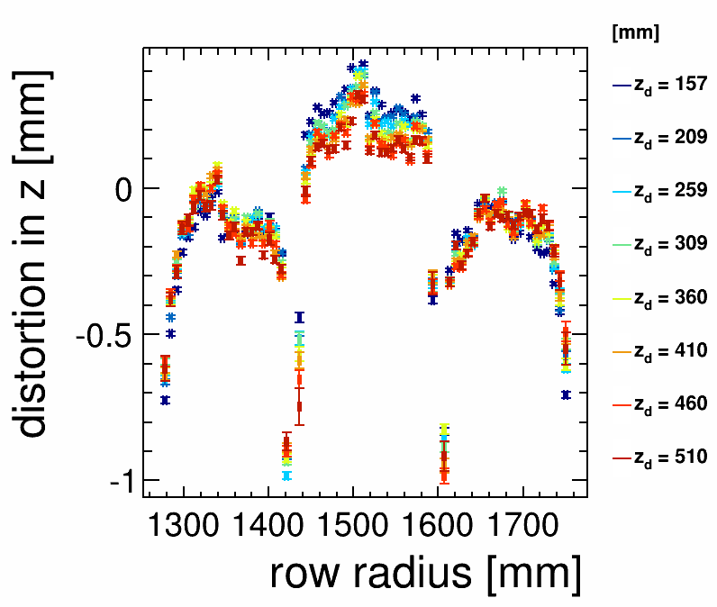
Field distorsions at B=1T
B=1T for GEM and Micromegas
  rΦ et Z directions: distorsions up to 1 mm corrected down to 200 µm
GEM
Micromegas
rΦ
Z
Before correction
After correction
Before correction

Slide 16
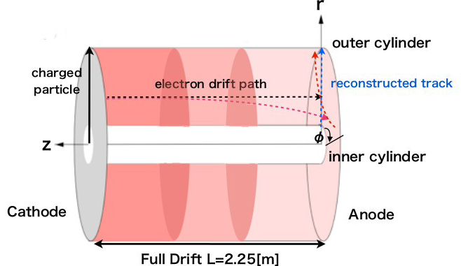
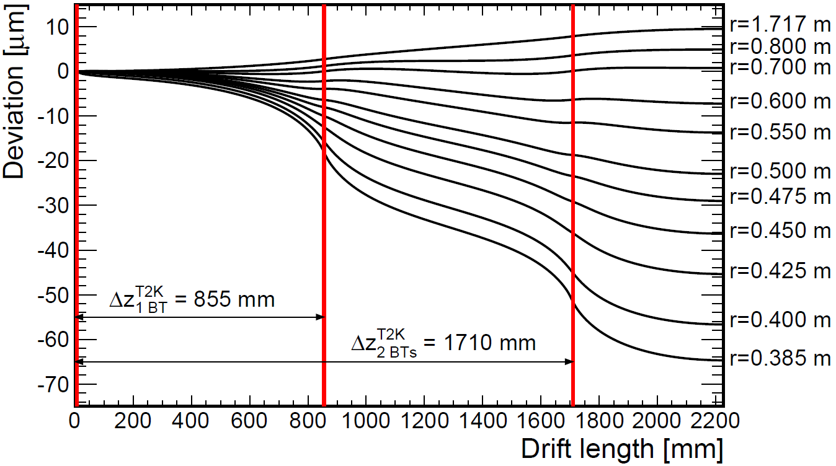
Ion Back Flow Issue
Primary ions create practically no distortions in the Electric field O(<1µm)
After each bunch train, a disk
of positively charged ions from
the amplification stage drifts
back into the TPC volume
1 to 2 orders of magnitude safety
margin with estimated background
is needed
→A gating grid will be built

Slide 17
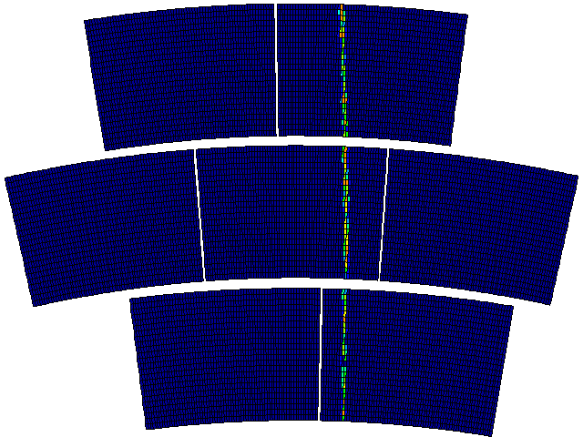
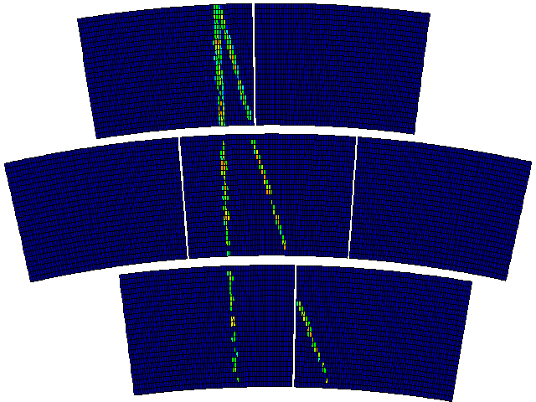
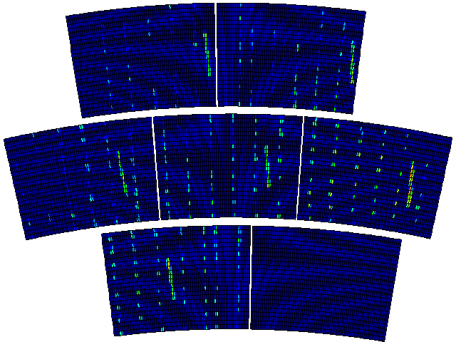
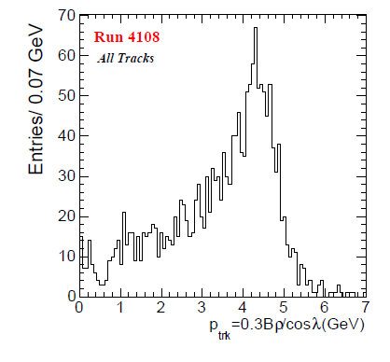
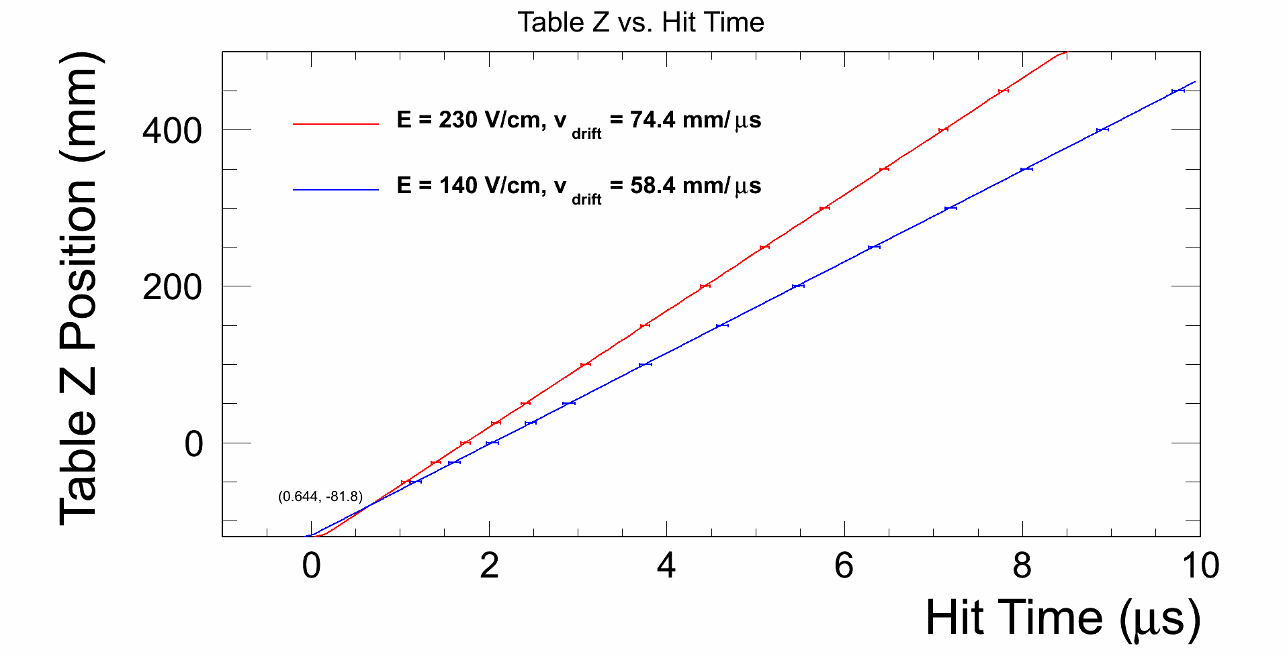
Data taking in 2014
Beam 4 GeV
Cosmics
UV Laser
T2K gas: Ar/CF4/Iso 95/3/2
Gas impurity:
  60 ppm O₂,
  150 ppm H₂O
E_{drift} (V/cm) | Drift Velocity (cm/μs)
 | Measured | Simulated
230 | 7.44±0.01 | 7,55±0.1
140 | 5.84±0.01 | 5,79±0.1
Electron momentum measurement

Slide 18
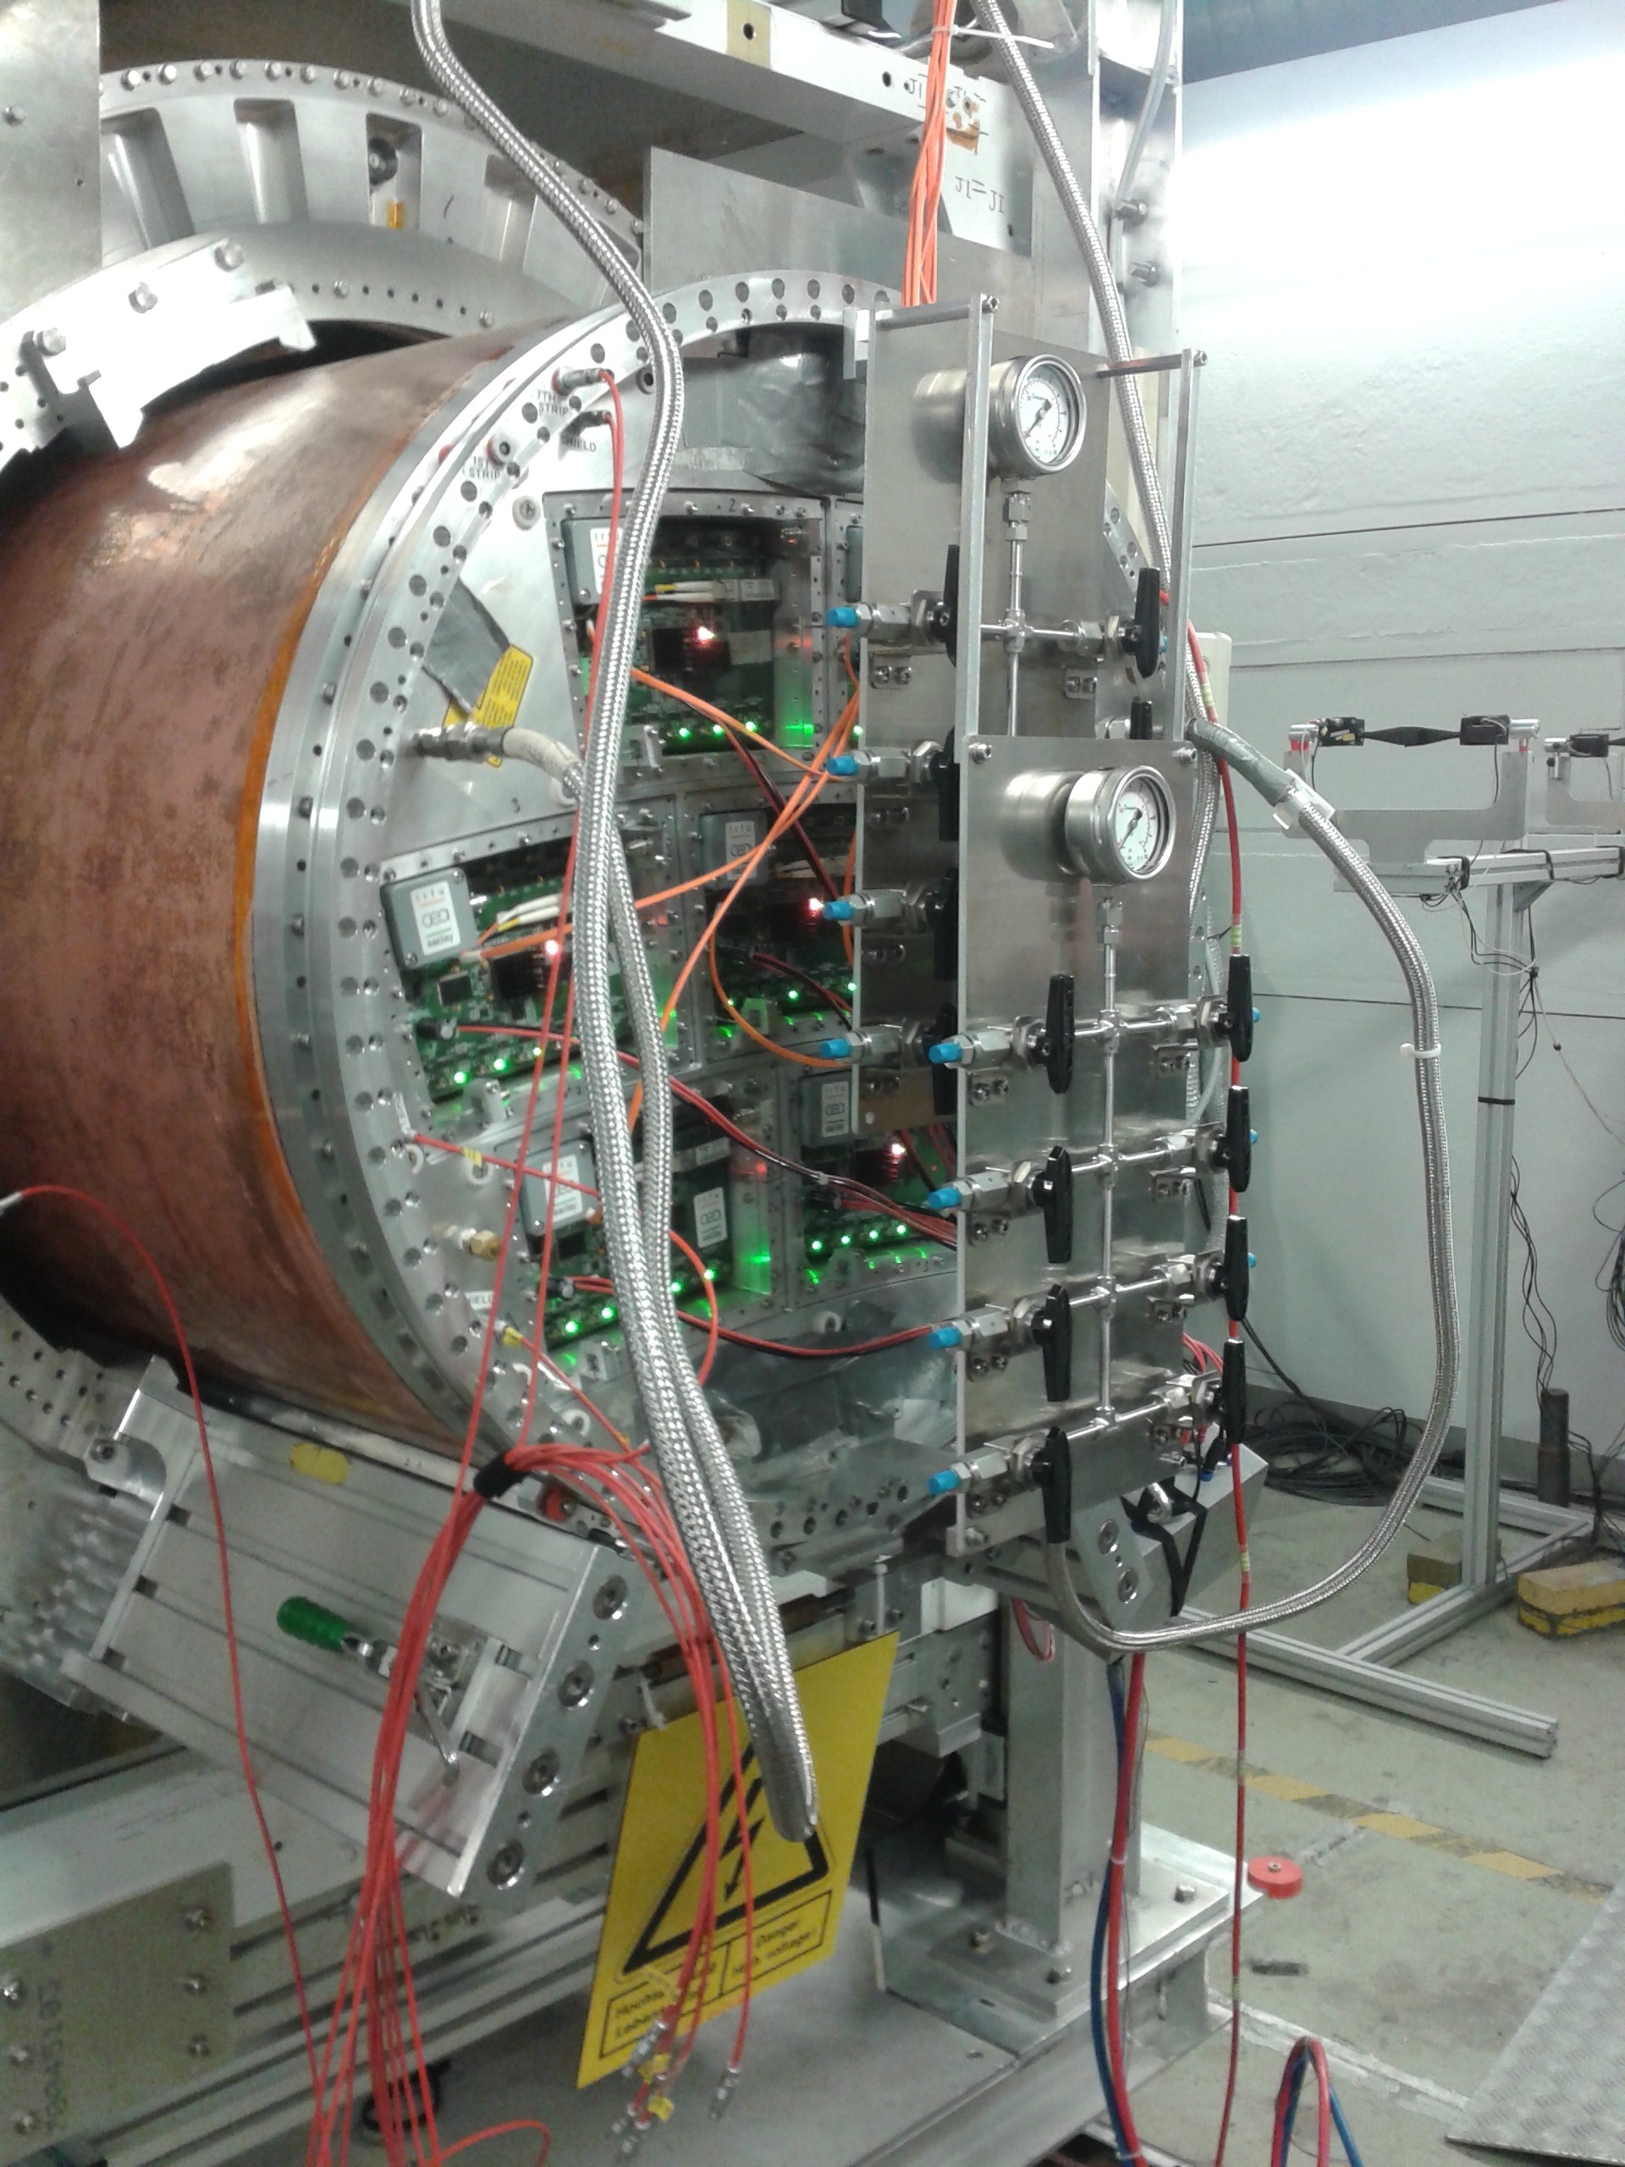
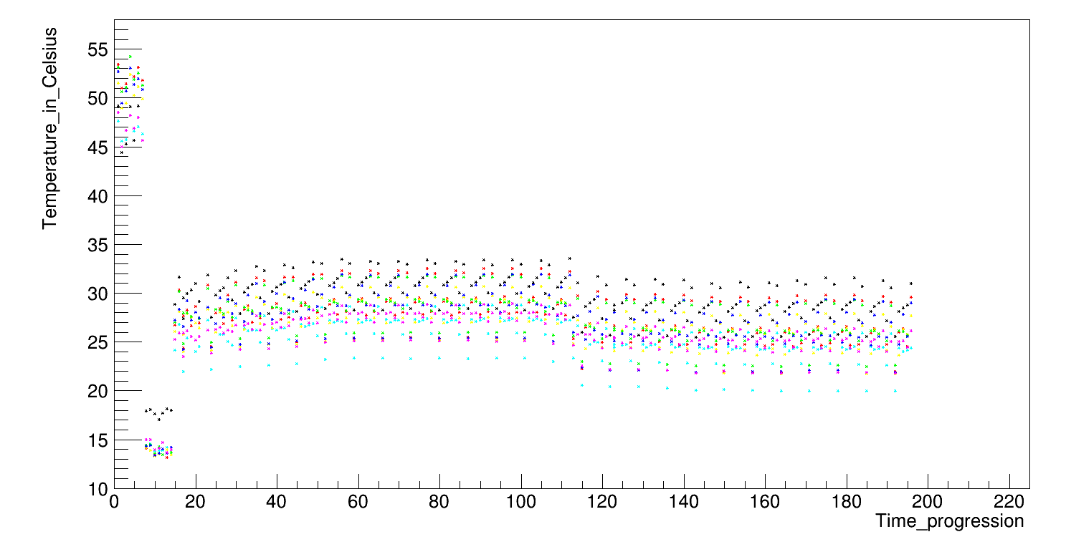
Test of CO₂ Cooling System
2-phase CO₂ cooling system (TRACI) used with the LP setup of the Micromegas modules with integrated electronics (26W/module)
CO₂ has lower viscosity & higher latent heat than all usual refrigerants
  Very small pipes (high pressure with low material budget)
  CO₂ liquid & gas can be used at room temperature
Operation and test conditions :
  2PCO₂ at 45 bars →10°C
  Temperature control during different regimes
    5V LV supply on, nocooling
    LV supply off, with cooling
    LV supply on, with cooling
    2 series of measurement
50 bars
45 bars
About 30°C stable temperature was achieved during operation of 7 Micromegas modules at DESY
7 FEMs
6 FECs per FEM

Slide 19







Pulse Shape Fit Procedure
The following analysis function f(t) is proposed for
determination of the charge using pulse shape:
$$f\left(t\right)=A ·{\left(1+\frac{∆t}{αβ}\right)}^{α}e^{−\frac{∆t}{αβ}}·θ\left(∆t+αβ\right)$$
$$∆t =t−T_{max}$$
$$β≈1$$
$αβ=T_{rise}$
$$α=5$$
Fit each individual (main) pulse with f(t)
  normalize amplitude to A_{max} pulse-by-pulse
  force pulse maximum at zero
  3 time bins before and 2 time bins after
Significatively improved compared to parabolic or
box fit

Slide 20

Pulse Shape Fit Procedure
Z resolution study with the Kalman filter is then performed in MarlinTPC
  improvement of about 25% all over drift distance
  this method shows homogeneous resolution across a module

Slide 21
Summary
The LCTPC collaboration have been working since many years on a Large Prototype of a TPC
The performance of two MPGD technology reached the requirements of the ILD detector
Studies are going on: ion back drift, electronics, mechanical integration, software processors ...
The readout technology has to be chosen (GEM or Micromegas) for the ILD
The presented infrastructure has received funding from the European Commission under
the FP7 Research Infrastructures project AIDA, grant agreement no. 262025.

Slide 22

Thank you

Slide 23
Backup slides

Slide 24

TRACI Cooling System
Development of a portable CO₂ laboratory cooling unit called Traci
  TRACI=Transportable Refrigeration Apparatus for CO₂ Investigation.
Development in AIDA framework together with interested partners.
  Nikhef & CERN lead development with engineering support of the Cracow University of Technology.
  Co-funding from clients
Designed for applications like:
  Test beam telescope (AIDA)
  Micro channel development (LHCb)
  Pixel development (CMS)
  Detector thermal/mechanical support structure
  development (Atlas IBL, ILCTPC)
  Detector commissioning (Atlas IBL)
Focus on simplicity for easy production in series
bart@nikhef.nl

