Slide 1
ILC-TPC Micromegas:
Ion Backflow Measurements
D. Attié
CEA Saclay/Irfu
RD51 – ALICE Workshop
June 18th, 2014
Notes:
I’m here to present a TPC review

Slide 2
Outline
Operational conditions in ILD-TPC for ILC
Ion Backflow in Micromegas detectors
Ion Backflow (IBF) Measurements
Principle
IBF vs. Micromegas Grid Geometry and Fields
IBF in bulk Micromegas
Ion Backflow solution

Slide 3
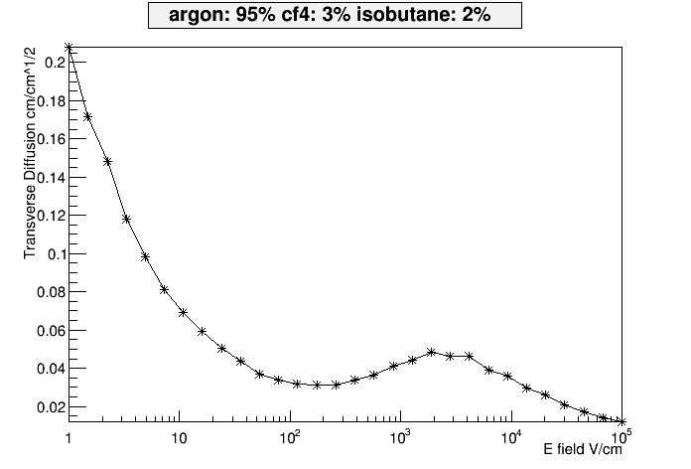
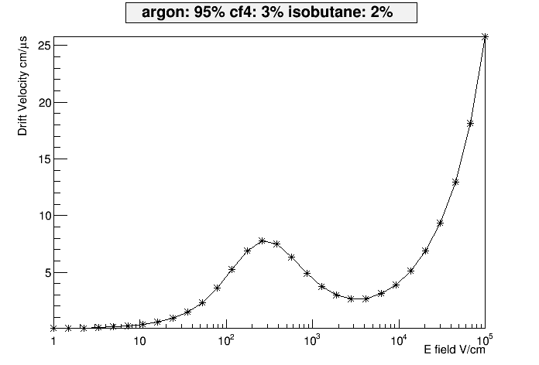
Operational Conditions in ILD-TPC for ILC
T2K gas: Ar/CF₄/iso-C₄H₁₀ 95/3/2
Drift field: E_{drift =} 230 V/cm (V_{drift} = 7.5 cm/µs)
Bulk Micromegas:
Gas gain: 2000-4000 (380-400V)
→E_{amplification}/E_{drift}=E_{A}/E_{D}=130-135
IBF requirement: < 1% (for margin <0.1%)
amplification gap: 128 µm
hole pitch: 63 µm (400 lpi)
E_{drift}=230 V/cm

Slide 4
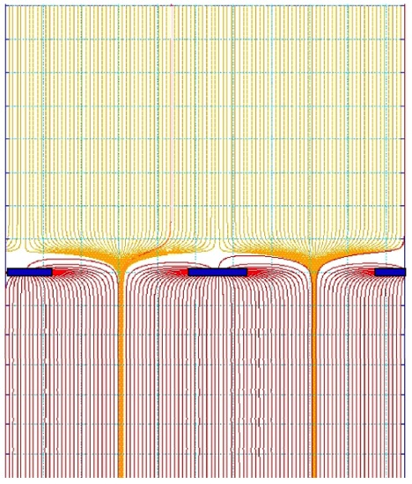
Micromegas: Intrinsic Suppresion of Ion Backflow
Electrons are swallowed in the funnel, then make their avalanche, which is spread by diffusion
The positive ions flow back with negligible diffusion (due to their high mass)
If the pitch hole is comparable to the avalanche size, only the fraction ~ S₂/S₁ = E_{DRIFT}/E_{AMPLIFICATION} drift back to the drift space. Others are neutralized on the mesh: optimally, the backflow fraction is as low as the field ratio
This has been experimentally thoroughly verified
S1
E_{D}
$FR=\frac{E_{D}}{E_{A}}$ $=\frac{S_{2}}{S_{1}}$
E_{A}
S2

Slide 5
Ion Backflow with Micromegas: Measurement Principle
The ion backflow fraction is given by:
$$IBF=\frac{I_{drift}}{I_{mesh}}=\frac{I_{1}}{I_{2}}$$
Determination of the primary ionisation from the drift current at low V_{mesh}
Using equation (1) & (2) G is eliminated → IBF
X-ray gun
V_{drift}
I₁ (drift)
(1) primaries+IBF
I₂ (mesh)
V_{mesh}
(2) I₁+I₂ ~ G × primaries

Slide 6
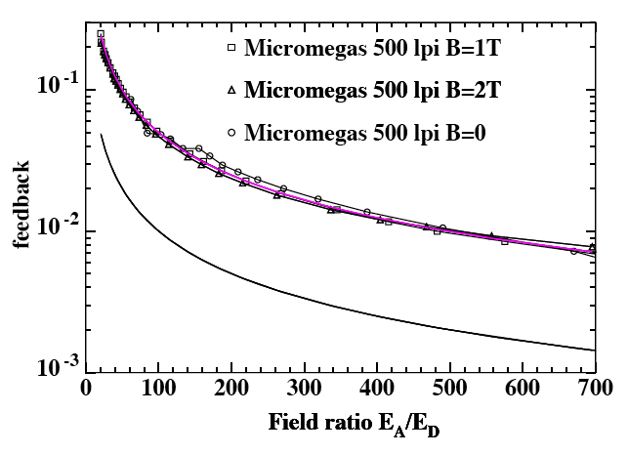
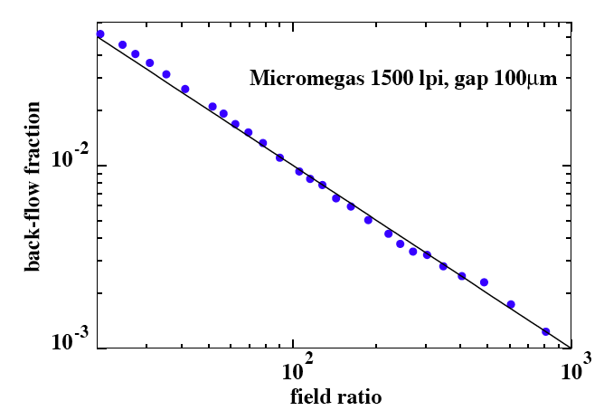
Ion Backflow with Micromegas: Measurement Results
MWPC-TPC: IBF~30%
The ions backflow depends on avalanche spread (transverse diffusion) but cannot be smaller than the field ratio
The absence of effect of the magnetic field on the ion backflow suppression has been tested up to 2T
For a E_{A}/E_{D} ~100, IBF~1-5% depending on geometry (hole pitch)
5%
1%
1%
Ar-CH₄ 97-3
P. Colas et al., NIMA535(2004)226
E_{A}/E_{D}

Slide 7
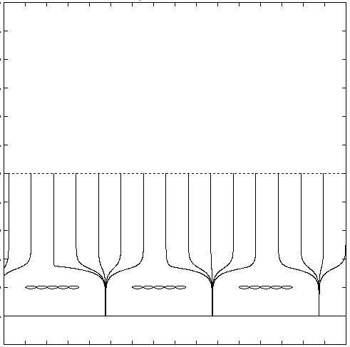
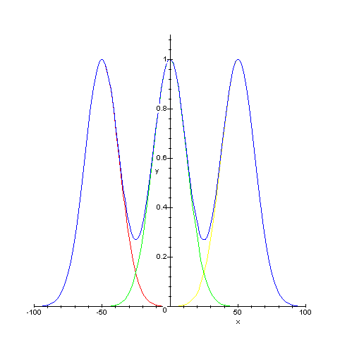
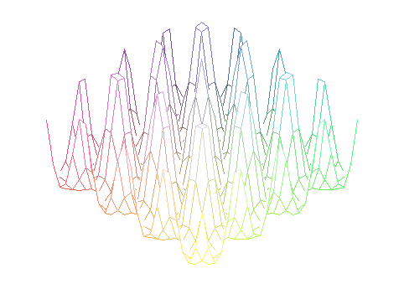
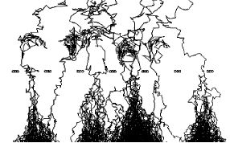
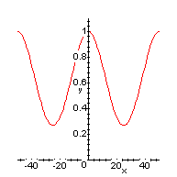
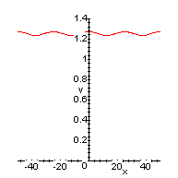
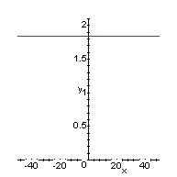
Ion Backflow with Micromegas: Simulation
Sum of gaussian diffusions
IBF calculation:
Periodical structure
2D
3D
l
Mesh
500 LPI
1000 LPI
1500 LPI
σ_{t}/p
0.25
0.5
0.75
Theoritical model
$$\frac{IBF}{FR}$$
$$2.5$$
$$1.03$$
$$1$$

Slide 8
Ion Backflow with Micromegas: Simulation

Slide 9
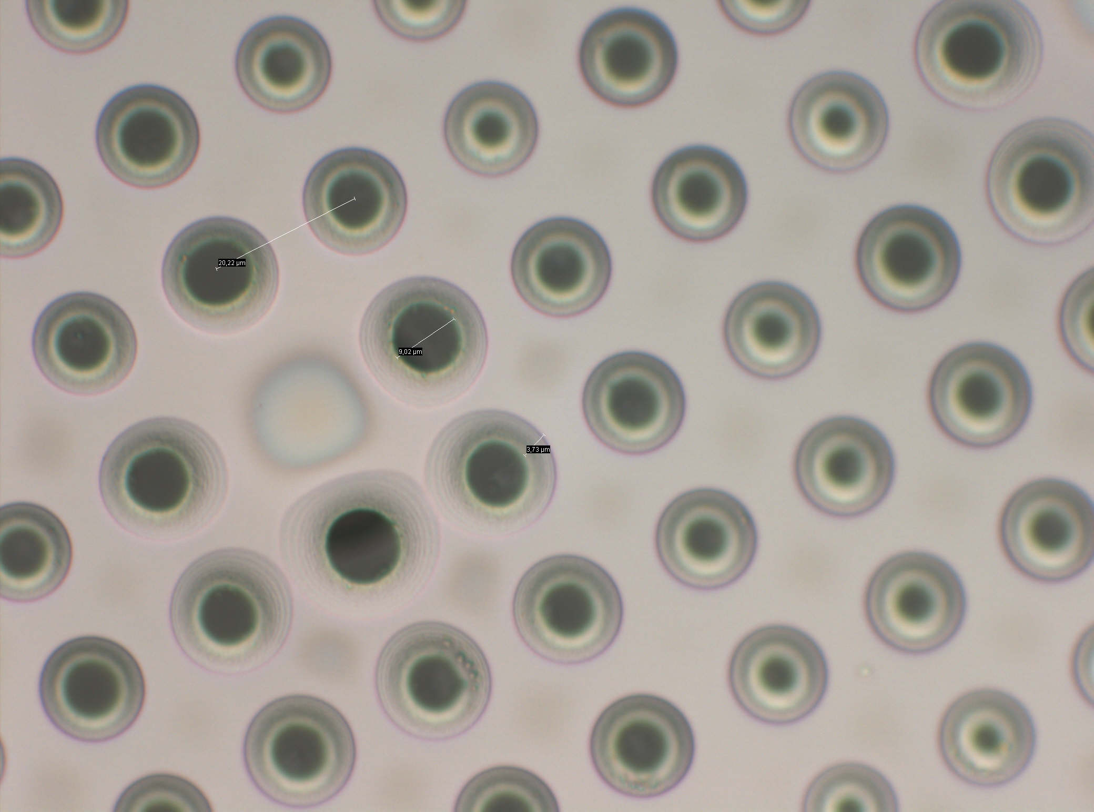
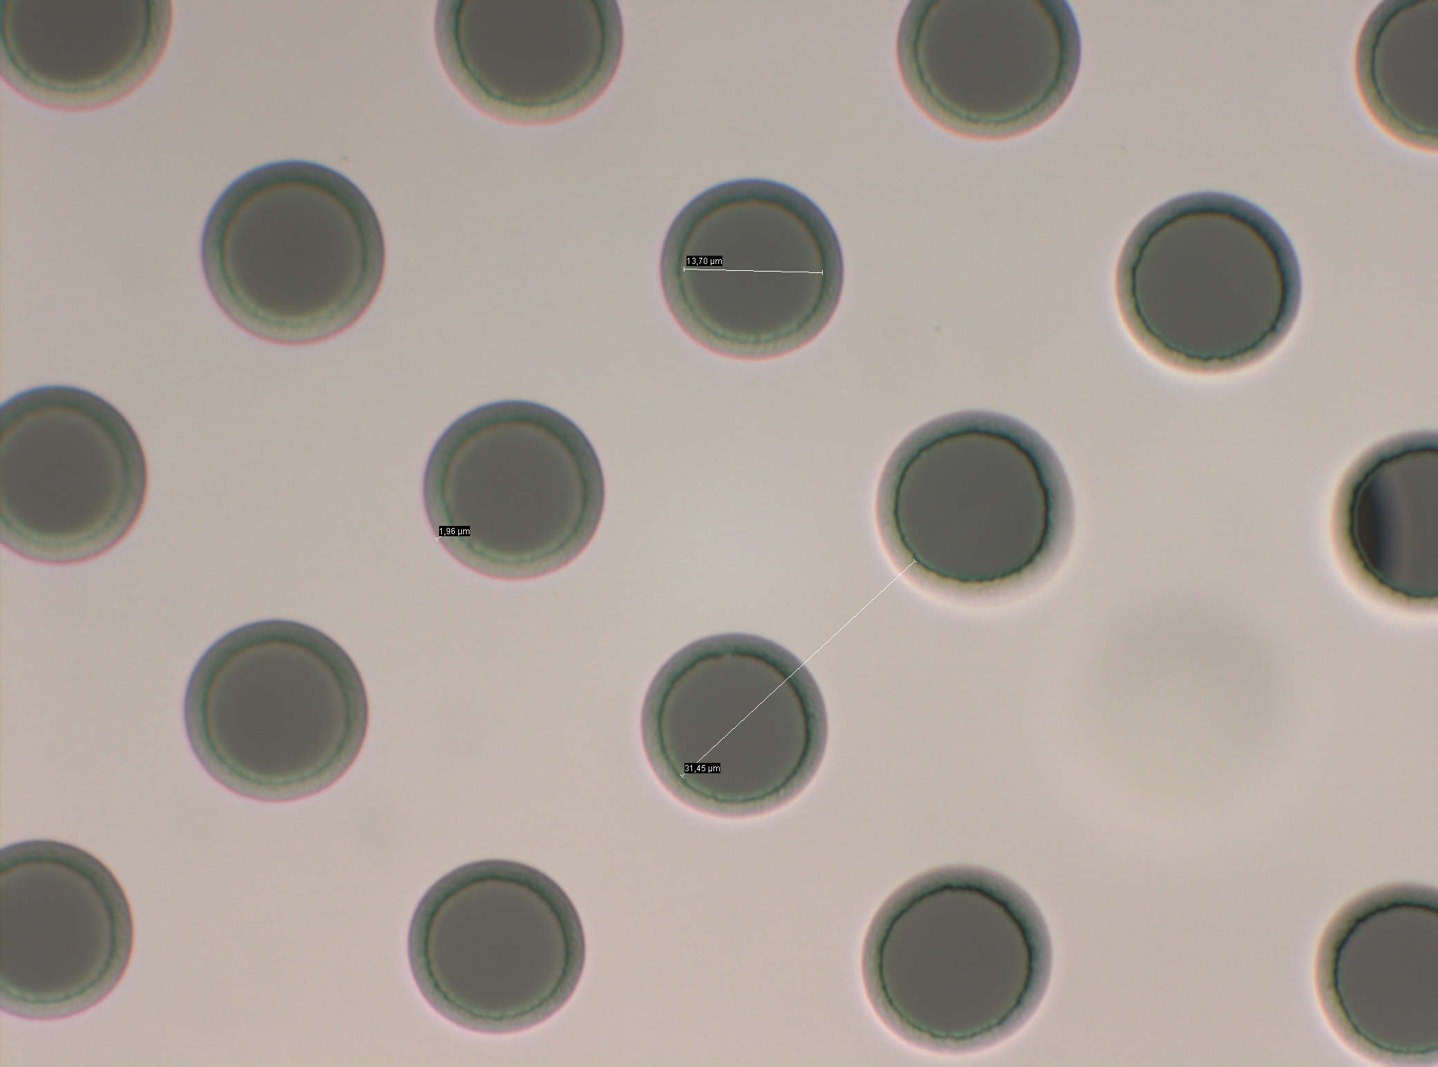
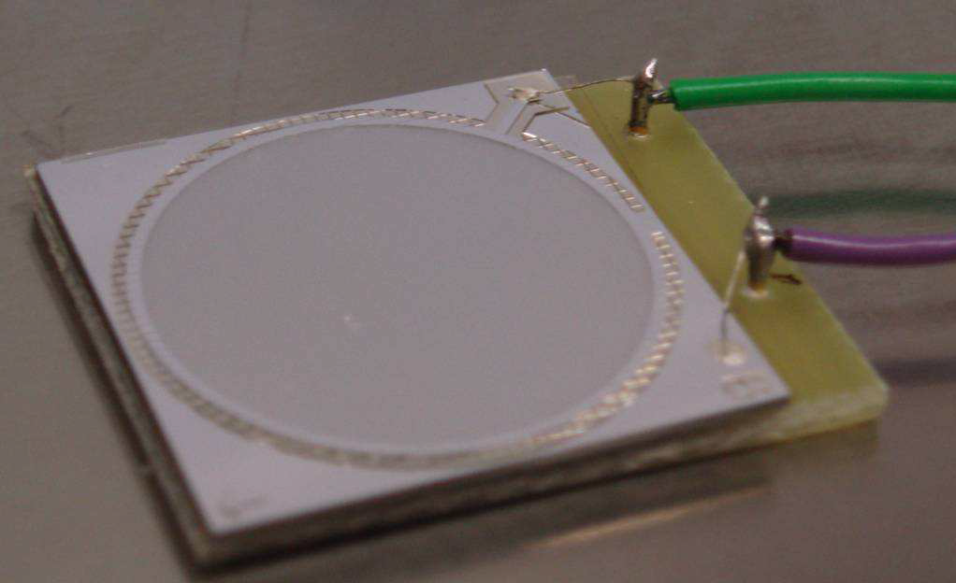
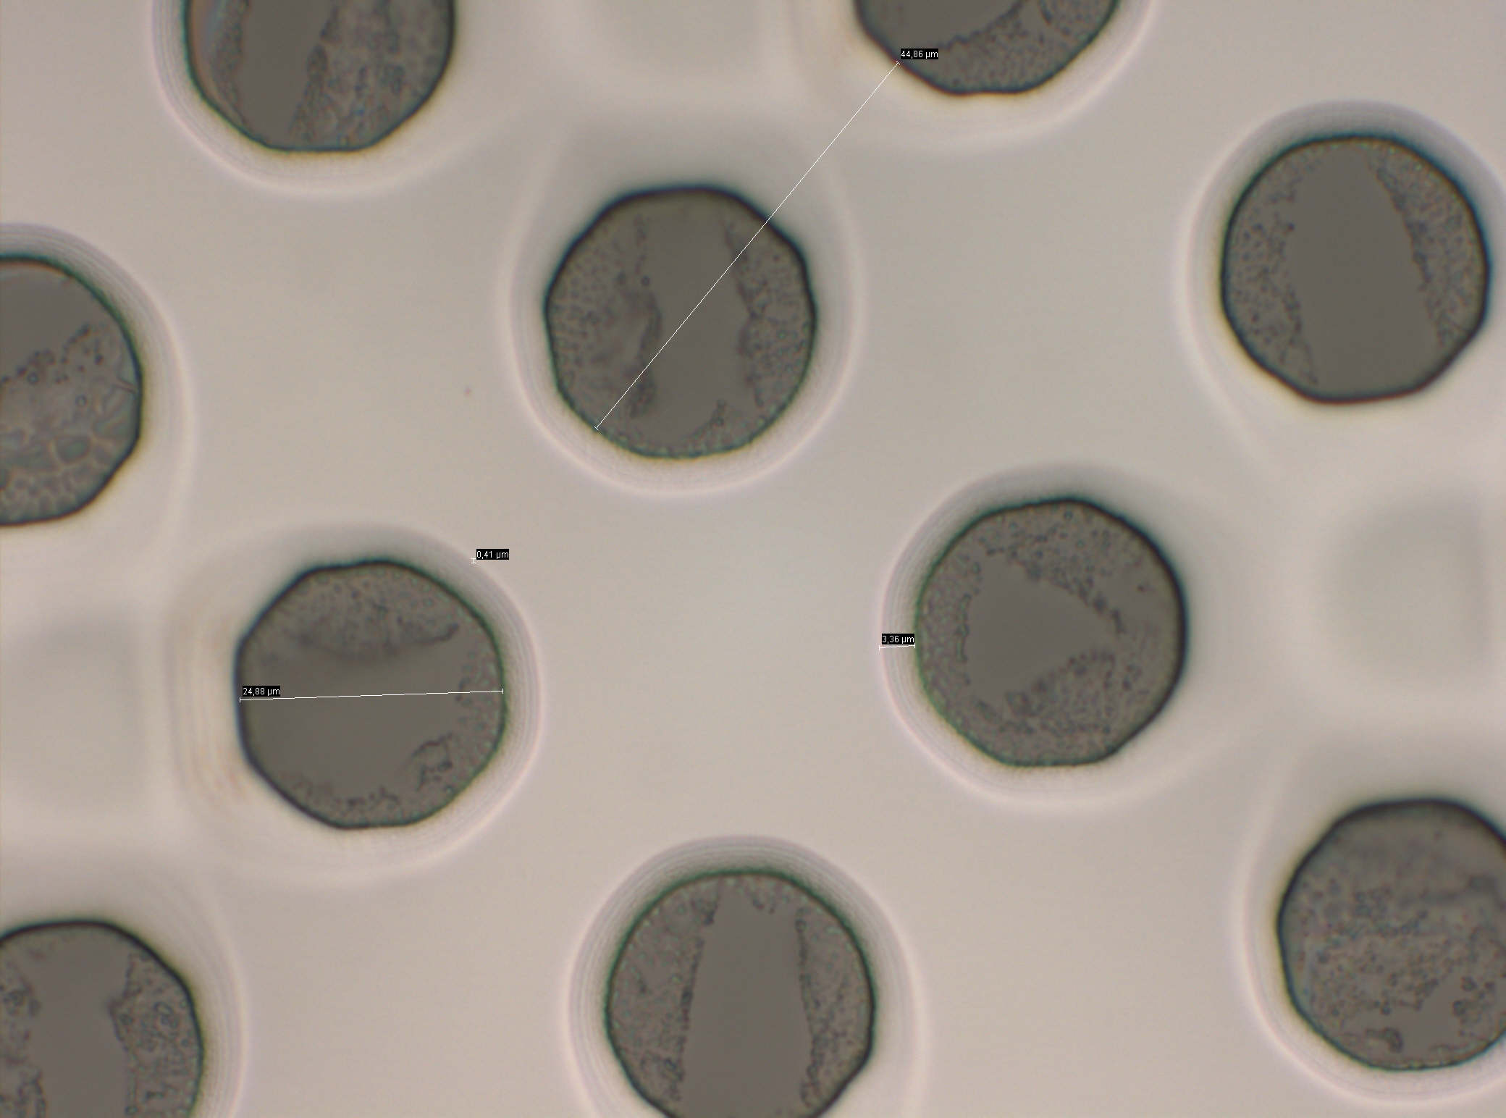
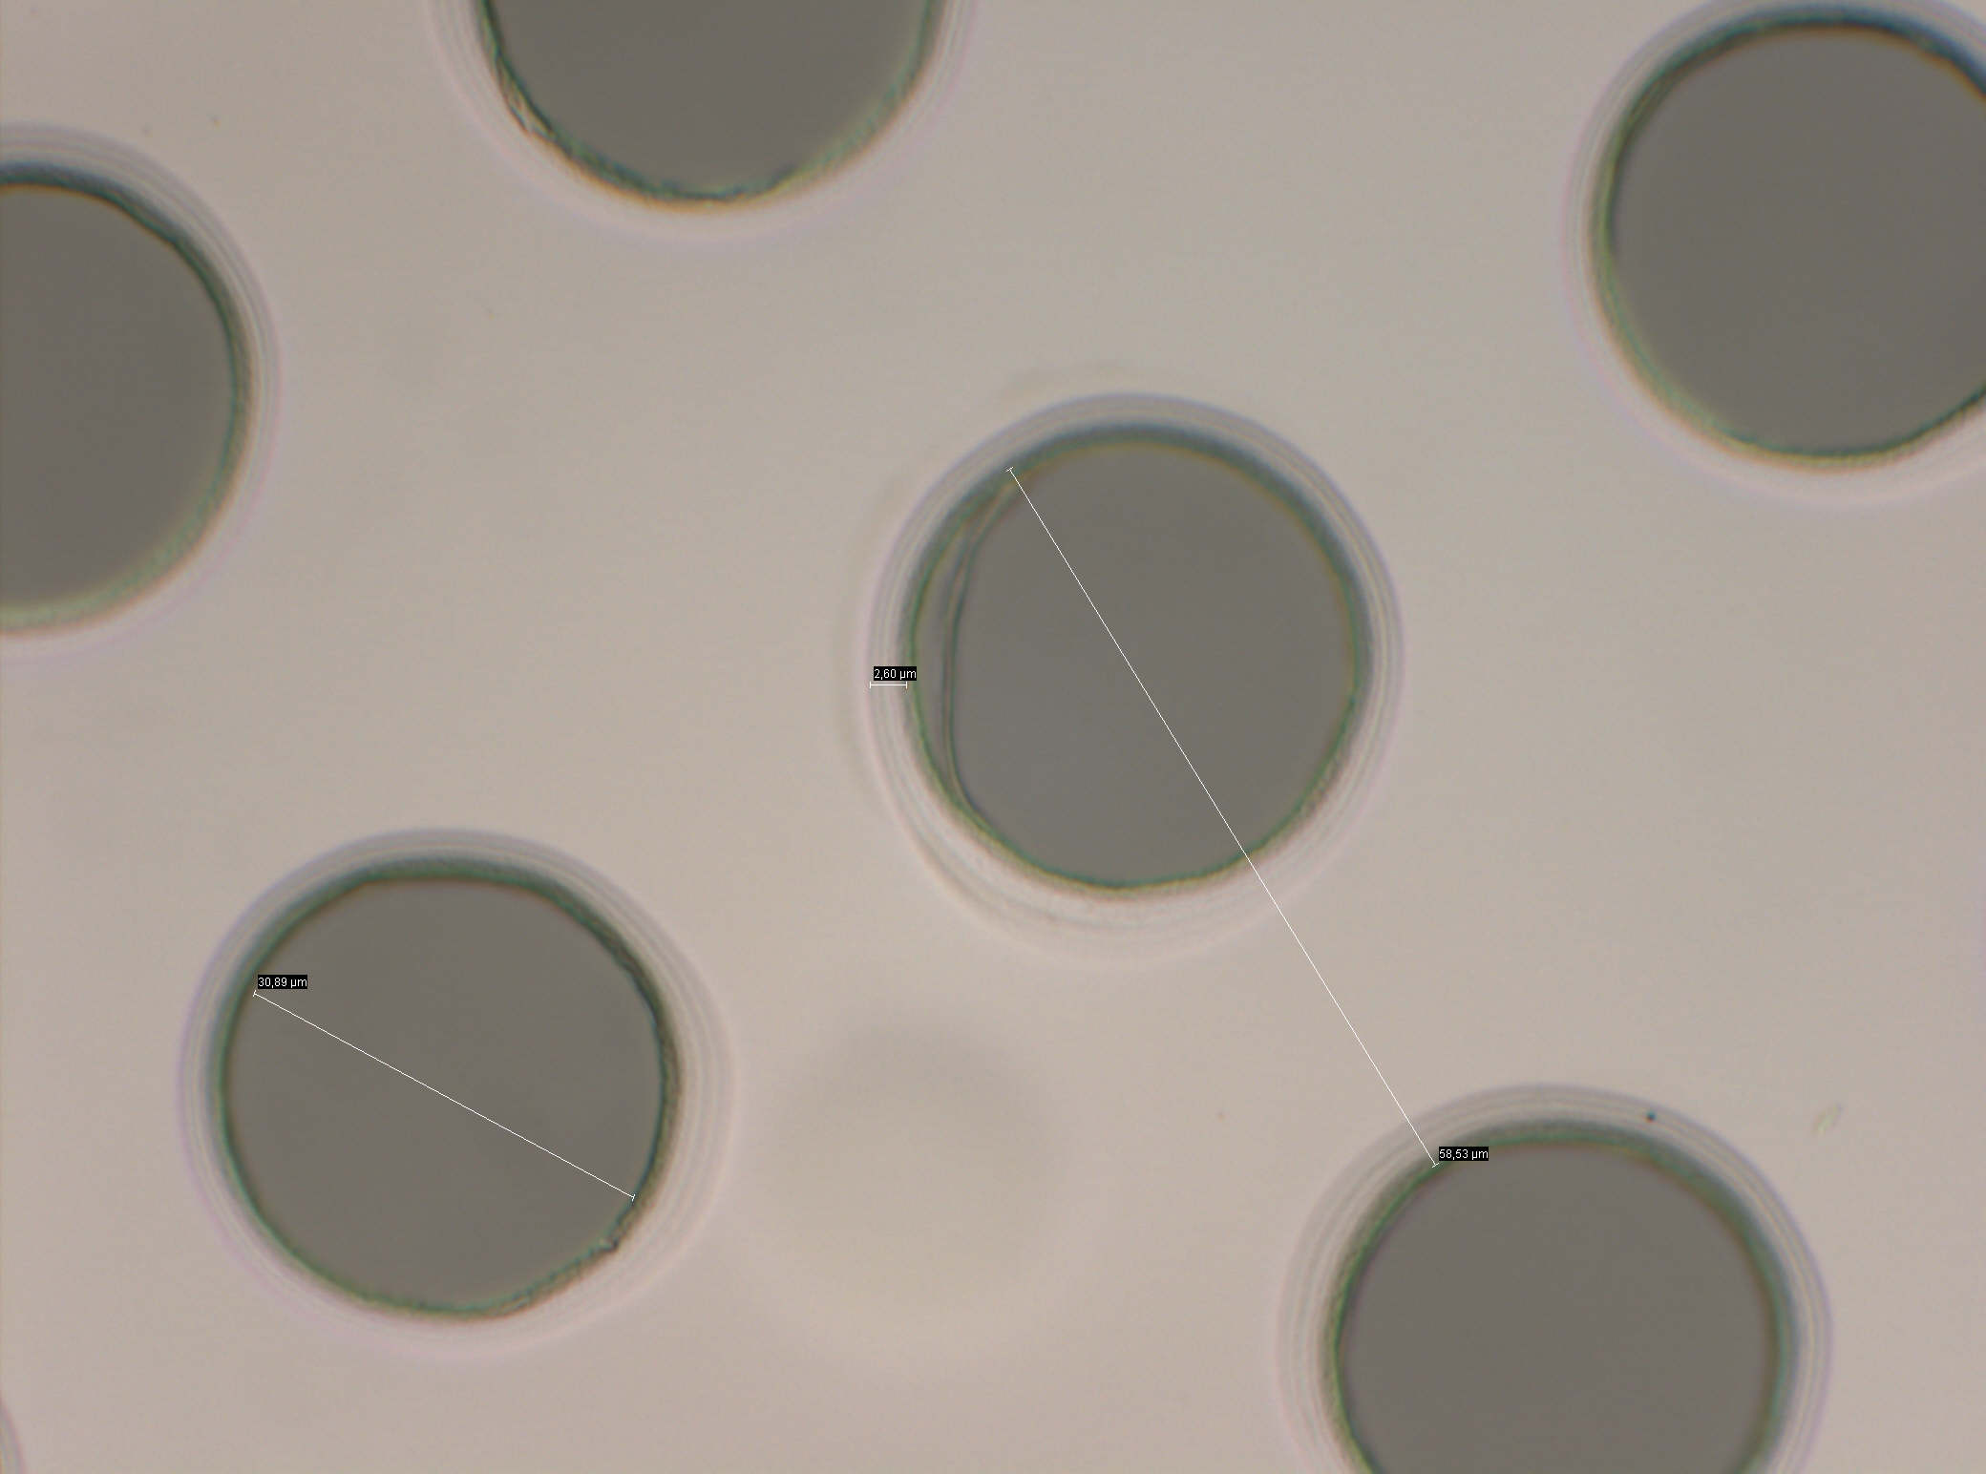
Grid Geometry and Fields
p = hole pitch
$σ_{t}$ = transverse diffusion = D_{t}$\sqrt{z}$ (D_{t}: transverse coefficient)
FR = $\frac{Edrift}{Eampplication}$
$BF∝{\frac{1}{FR}\left(\frac{p}{σ_{t}}\right)}^{2}$
20 µm hole pitch
32 µm hole pitch
45 µm hole pitch
58 µm hole pitch
Ingrid sample

Slide 10
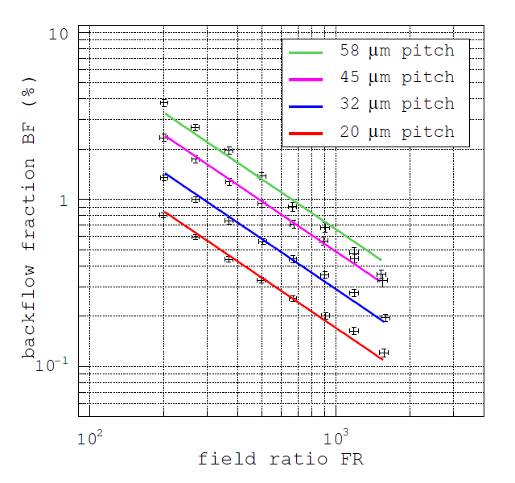
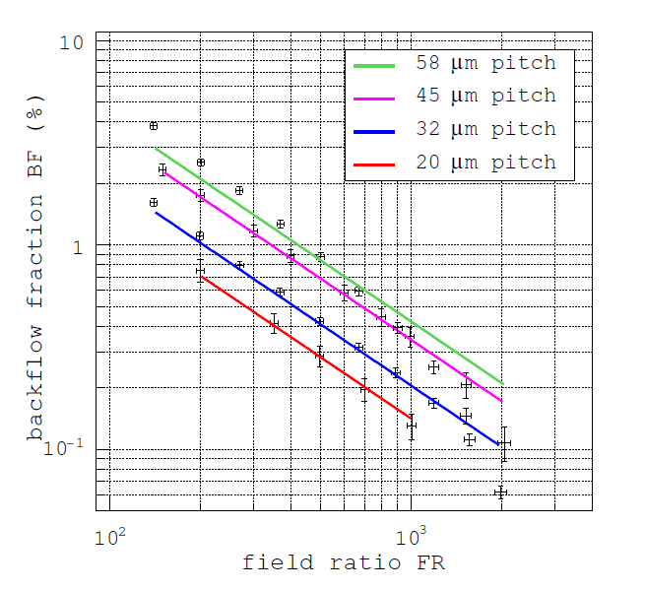
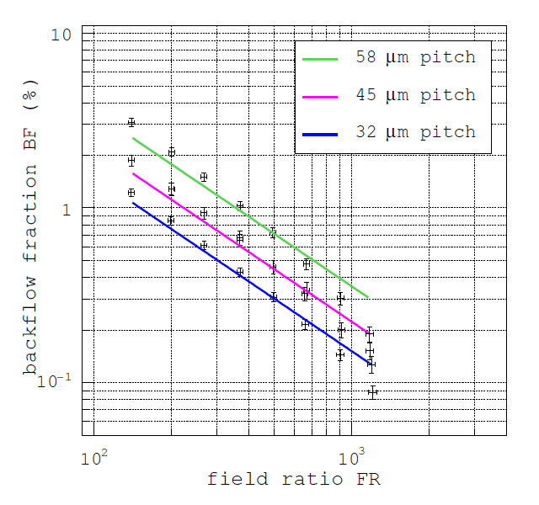
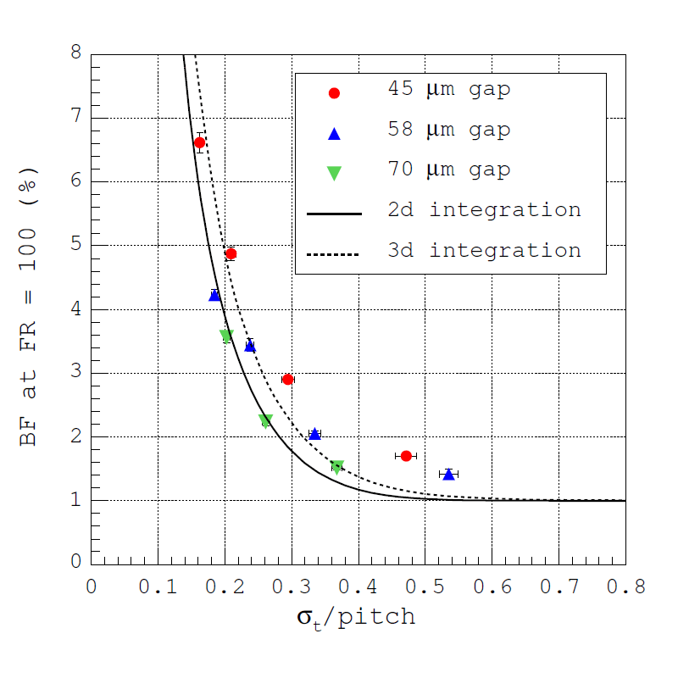
Grid Geometry and Fields
45 µm gap
58 µm gap
70 µm gap
E_{A}/E_{D}
E_{A}/E_{D}
E_{A}/E_{D}
Gap (µm) | Hole pitch p (µm) | Hole ∅ d (µm) | σ_{t} /p
45 | 20 | 12 | 0.47
 | 32 | 23 | 0.30
 | 45 | 32 | 0.21
 | 58 | 21 | 0.16
58 | 20 | 9 | 0.58
 | 32 | 15 | 0.36
 | 45 | 34 | 0.26
 | 58 | 22 | 0.20
70 | 32 | 18 | 0.43
 | 45 | 32 | 0.30
 | 58 | 22 | 0.24
Fit using:
$BF(x,y) = \frac{x}{{FR}^{−y}}$
with y~1
M. Chefdeville, PhD Thesis (2009)

Slide 11
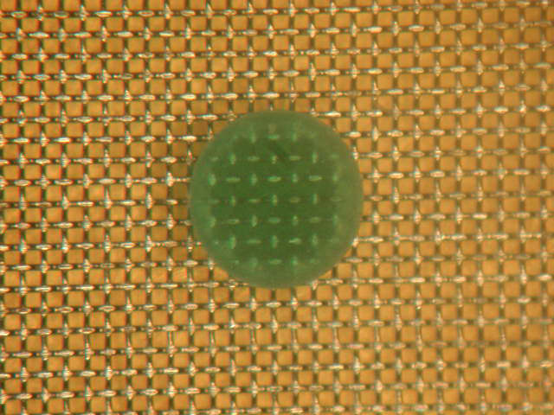
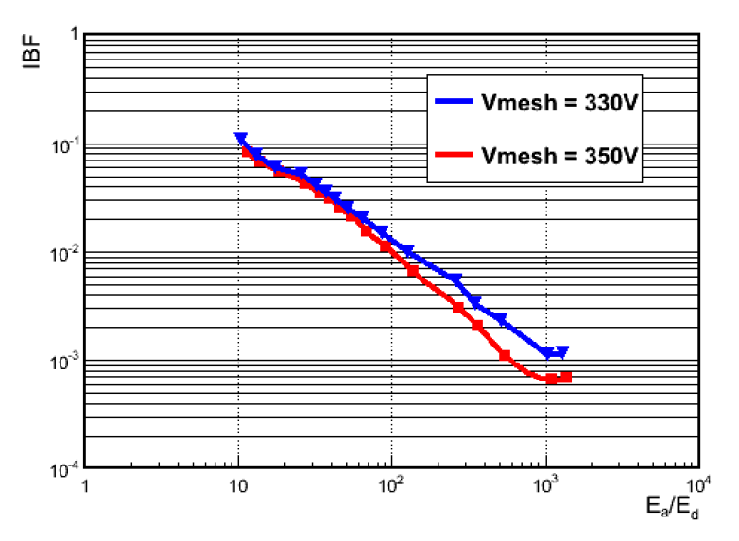
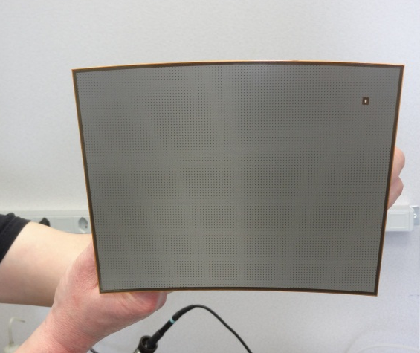
Ion Backflow in Bulk Micromegas
Micromegas for LC-TPC:
(resistive) bulk technology
128 µm gap
woven mesh with pillars
45 µm hole /18 µm wire ∅
400 LPI
W. Wang, PhD Thesis (2013)

Slide 12
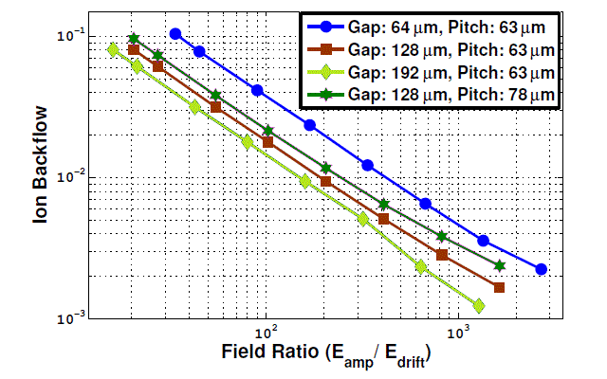
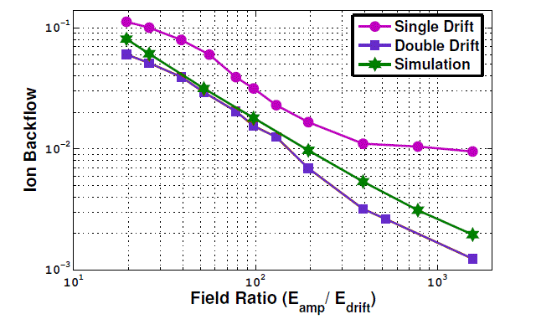
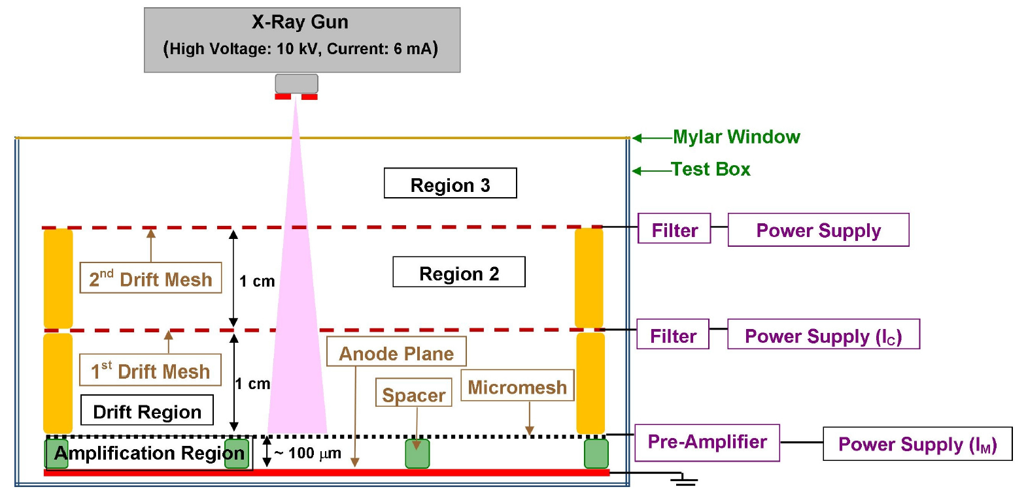
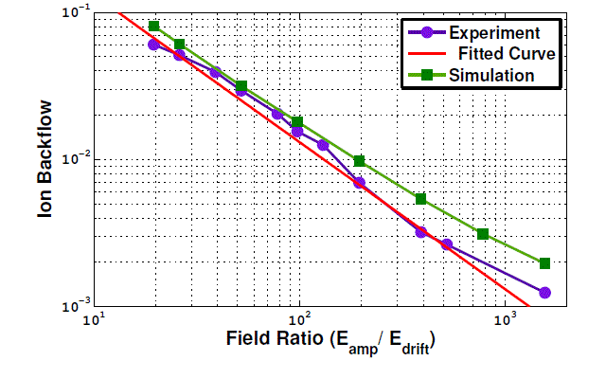
Ion Backflow in Bulk Micromegas
Bhattacharya et al. JINST 9 C04037 (2014)

Slide 13
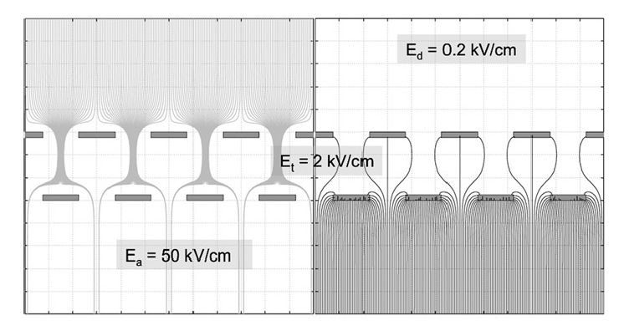
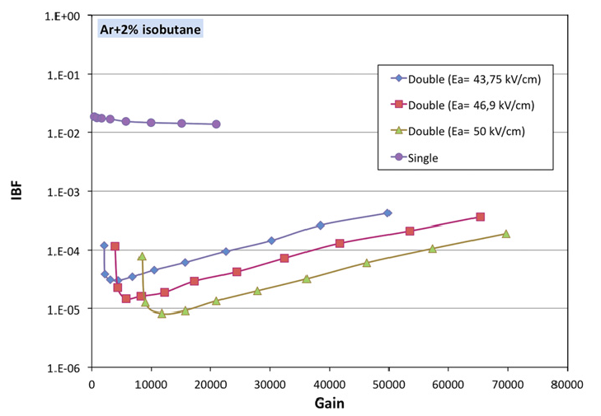
Possible Solution without Gating Grid
Micromegas with offset metal meshes (5 µm cooper):
Open questions:
- never used in TPC
- effect of magnetic field?
- large area?
50 μm
10⁻⁵
F. Jeanneau et al., NIMA623(2010)94

Slide 14
Summary & Outlook
Micromegas: natural ion backflow suppression
E_{A}/E_{D}~100 → IBF~ 1-2%
E_{A}/E_{D}~1000 → IBF~ 0.1-0.2%
For margin, grid geometry has to be optimized and/or a gating grid will be used
Inside RD51, R&D on thin grid is in progress

Slide 15
Backup Slides

Slide 16
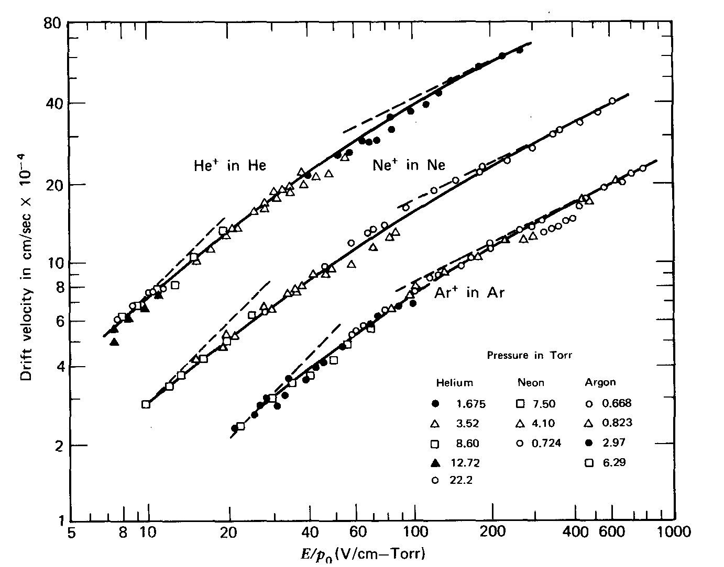
Ions Mobility in Gases
$$μ^{+}=\frac{v_{+}}{E}$$
Mobility: ratio of velocity and field
(NTP: 300K, 760 mmHg)
Ar-CH₄, E=1kV/cm
→ $v_{+}$=1.8 µm/s
Gas | Ion | µ⁺ (cm²s⁻¹V⁻¹)
He | He⁺ | 10.2
Ar | Ar⁺ | 1.7
CH₄ | CH₄⁺ | 2.26
Ar-CH₄ | CH₄⁺ | 1.87
CO₂ | CO₂⁺ | 1.09
S. C. Brown Basic Data in Plasma Physics (Wiley, New York 1959)

Slide 17
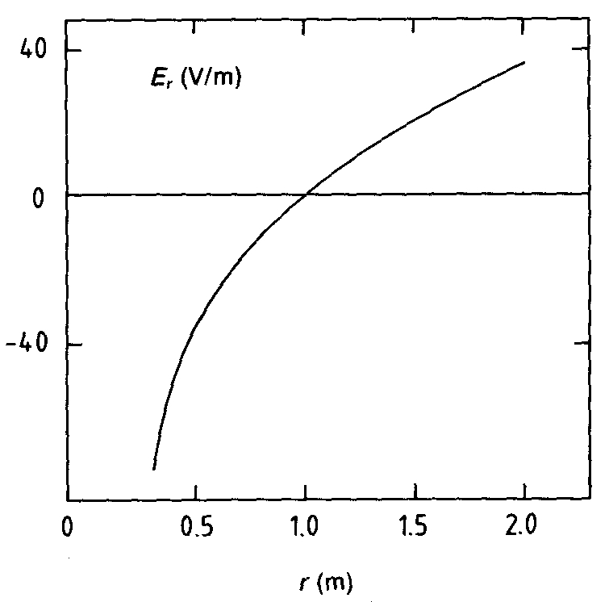
Positive Ion Feedback
A fraction of the positive ions produced in the avalanches slowly drift in the sensitive volume and modify the electric field:
Ar-CH₄ 80-20 E=200 V/cm w⁺ ~ 320 cm/s
For 1 m drift T⁺ = 300 ms
-V
-V
+
+
+
DRIFT
+
+
+
+
+
+
+
+
+
+
+
+
+
+
+
+
For uniform irradiation releasing R electrons per second per cubic meter, the positive ion charge density is given by:
MWPC
0
0
L: drift length
M: gain
ε: fractional ion feedback
EXAMPLE: ALEPH TPC
R=2.10⁶ s⁻¹ m⁻³ w⁺=1.5 m s⁻¹
M=10⁴ ε=10⁻¹
Mε=10³ : ion feedback per primary electron
E=10⁴ V m⁻¹
W. Blum, W.Riegler and L. Rolandi
Particle Detection with Drift Chambers (Springer 2008)

