Slide 1
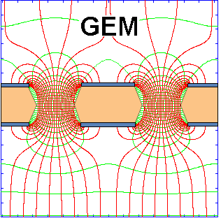
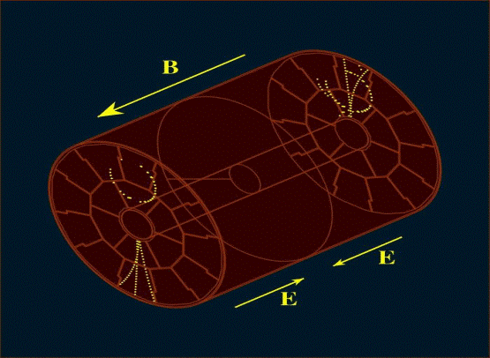
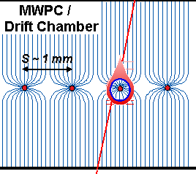
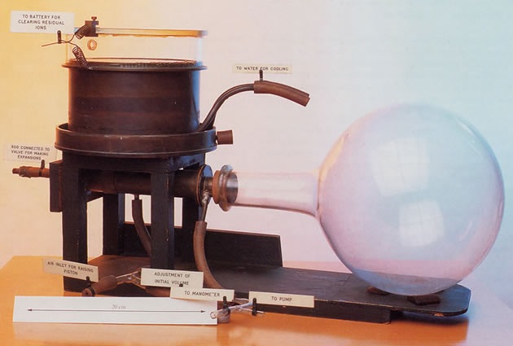
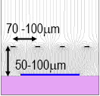
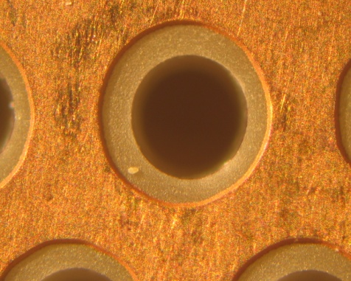

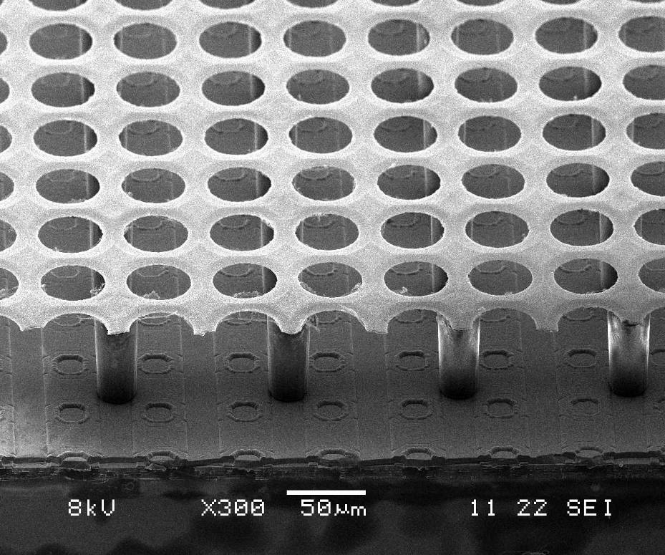
TPC
50 μm
140 μm
Micromegas:
Gaseous Detectors:
From Multi-Wire Proportional Chamber
to Novel MPGD Gaseous Detectors
Maxim Titov, CEA Saclay, France
OUTLINE:
Introduction: Gaseous detector family
Multi-wire proportional (MWPC) and drift chambers, time projection chamber (TPC)
Novel Micro-Pattern Gaseous Detectors
MPGD Technologies for future physics projects
Georges Charpak and CERN: 60 years of science for piece
Thick GEM +
(THGEM)
Ingrid
International Workshop on Advanced Detectors (IWAD),
Kolkata, India, October 27-28, 2014

Slide 2
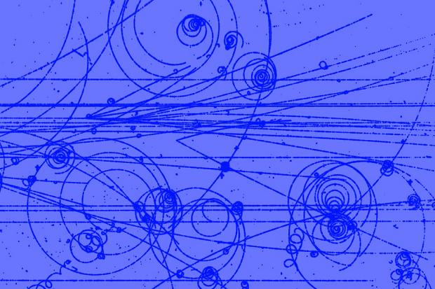
The History of Instrumentation is VERY Entertaining
A look at the history of instrumentation in particle physics
→ complementary view on the history of particle physics, which is
traditionally told from a theoretical point of view
The importance and recognition of inventions in the field of instrumentation is proven by the fact that
→ several Nobel Prices in physics were awarded mainly or exclusively
for the development of detection technologies
Nobel Prizes in instrumentation (“tracking concepts”):
1927: C.T.R. Wilson, Cloud Chamber
1960: Donald Glaser, Bubble Chamber
1992: Georges Charpak, Multi-Wire Proportional Chamber

Slide 3
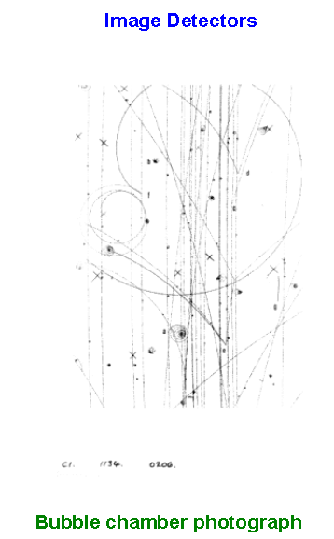
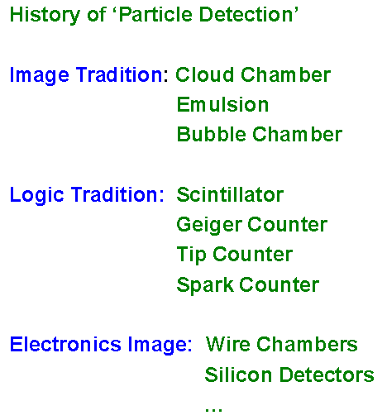
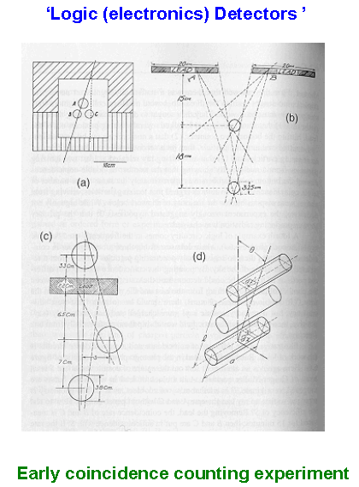
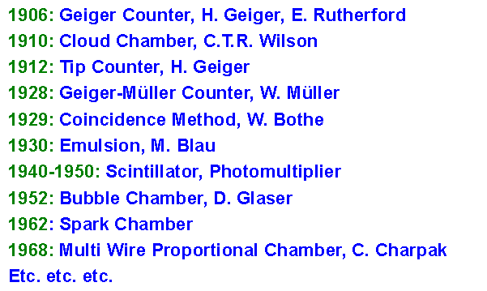
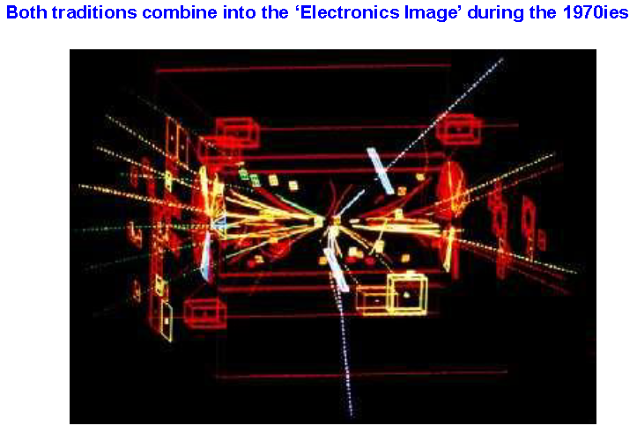
History of Particle Detection

Slide 4
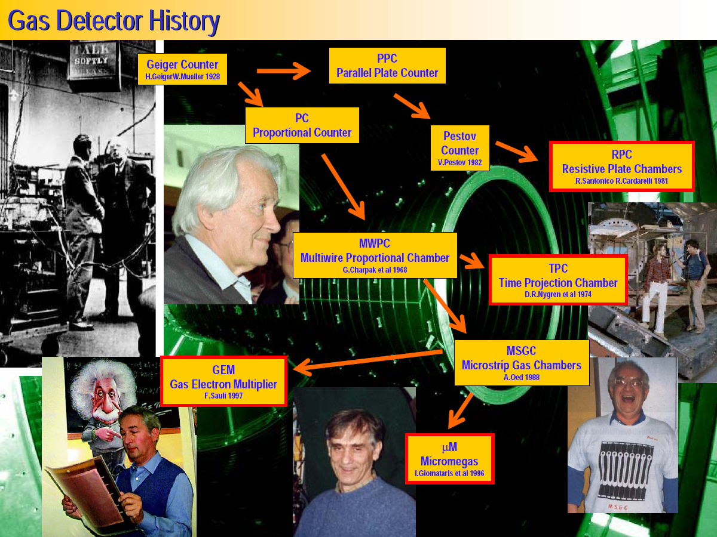
History of Gaseous Detectors
M. Hoch, 2004 Wire Chamber Conference

Slide 5
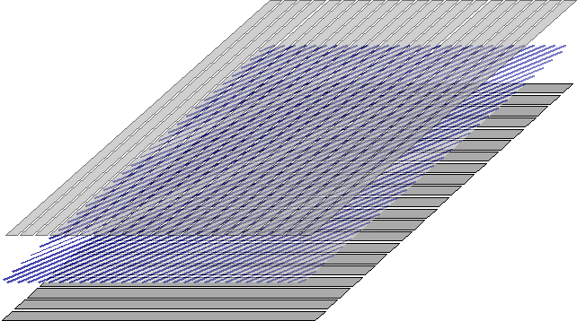
Multi-Wire Proportional Chamber (MWPC)
High-rate MWPC with digital readout:
Spatial resolution is limited to σ_{x} ~ s/sqrt(12) ~ 300 μm
TWO-DIMENSIONAL MWPC READOUT CATHODE
INDUCED CHARGE (Charpak and Sauli, 1973)
S ~ 1 mm
Spatial resolution determined by: Signal / Noise Ratio
Typical (i.e. ‘very good’) values: S ~ 20000 e: noise ~ 1000e
Space resolution < 100 μm
Resolution of MWPCs limited by wire spacing
better resolution → shorter wire spacing → more (and more) wires...

Slide 6
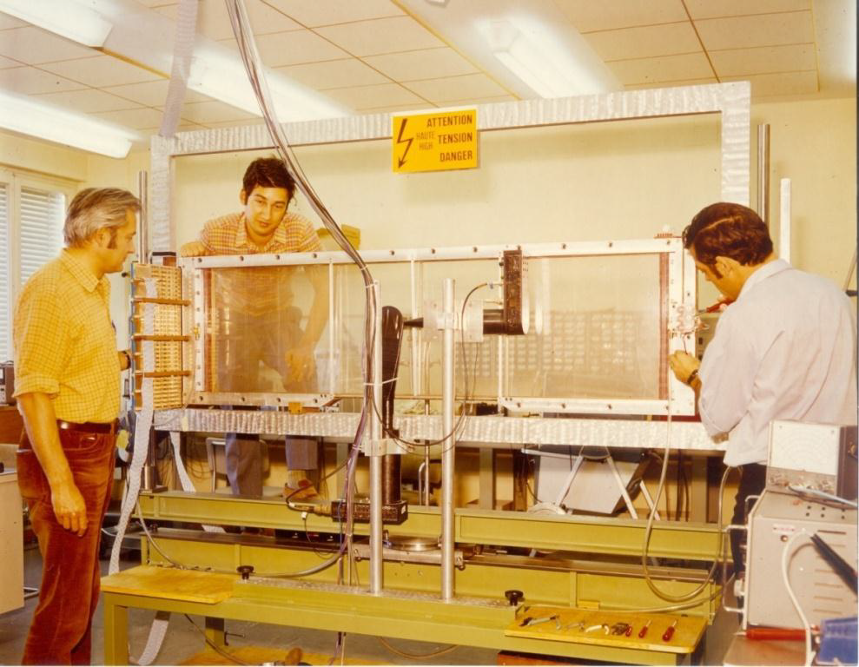
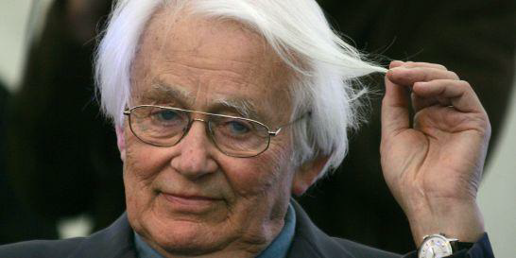
Multi-Wire Proportional Chamber (MWPC): Electronics Imaging Device
The 1st “Large Wire Chamber”:
Georges Charpak with Fabio Sauli, Jean Claude Santiard
The invention revolutionized
particle detection and
High Energy Physics, which passed from the manual
to the electronic era.
MWPC:
1968 by Georges
Charpak;
Noble Prize 1992

Slide 7
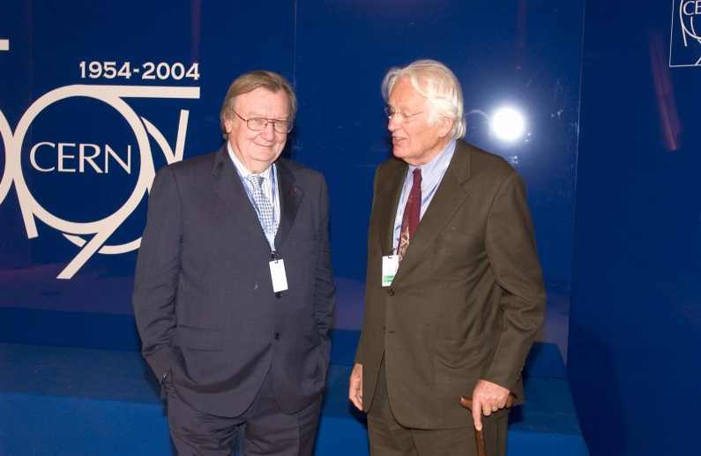
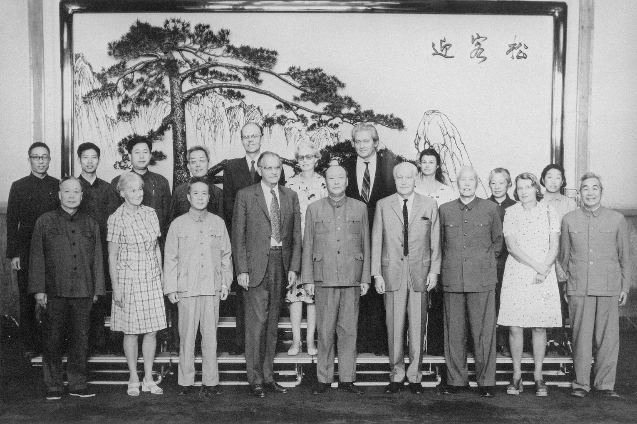
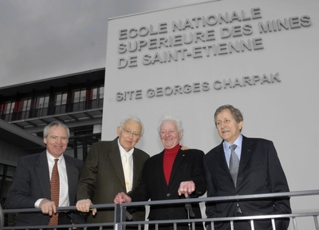
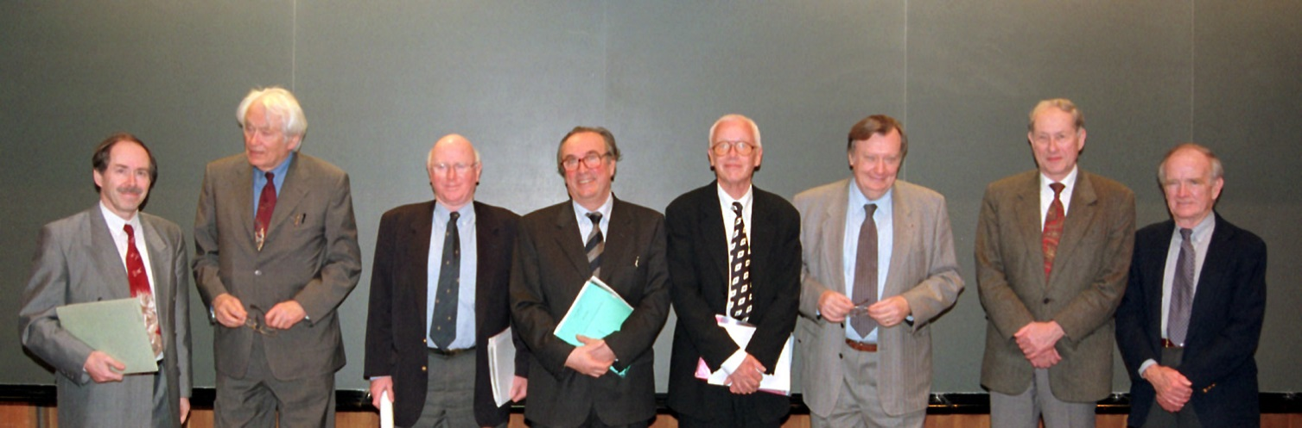
Born in Dabrowica, Poland in 1924 (now Dubrovytsia, Ukraine)
Moved from Poland to Paris in 1931
During 2nd war served in resistance and emprisoned
In 1944 he was deported to the Nazi concentration camp at Dachau
In 1955, Phd from the College de France, Paris, under Frederic Joliot-Curie
In 1985 member of the French Academy of Science
Nobel Prize for Physics in 1992
Georges
Charpak

Slide 8
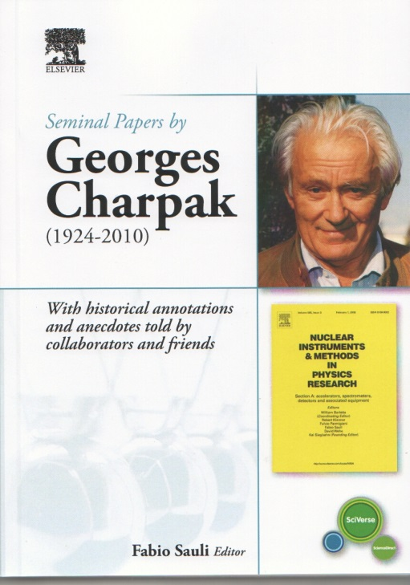
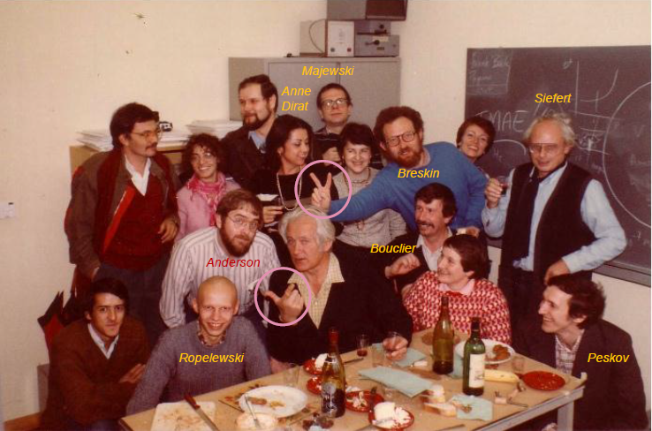
Georges Charpak with Friends
Slides and/or photos are taken from presentations of his colleagues and friends:
Amos Breskin, Fabio Sauli, Yannis Giomataris

Slide 9
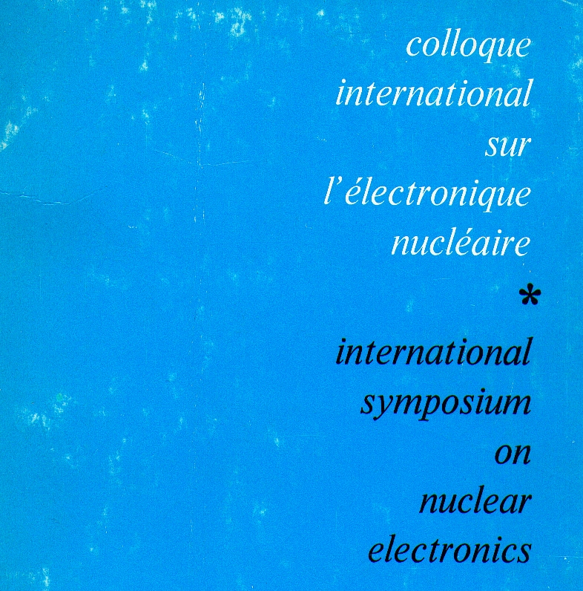
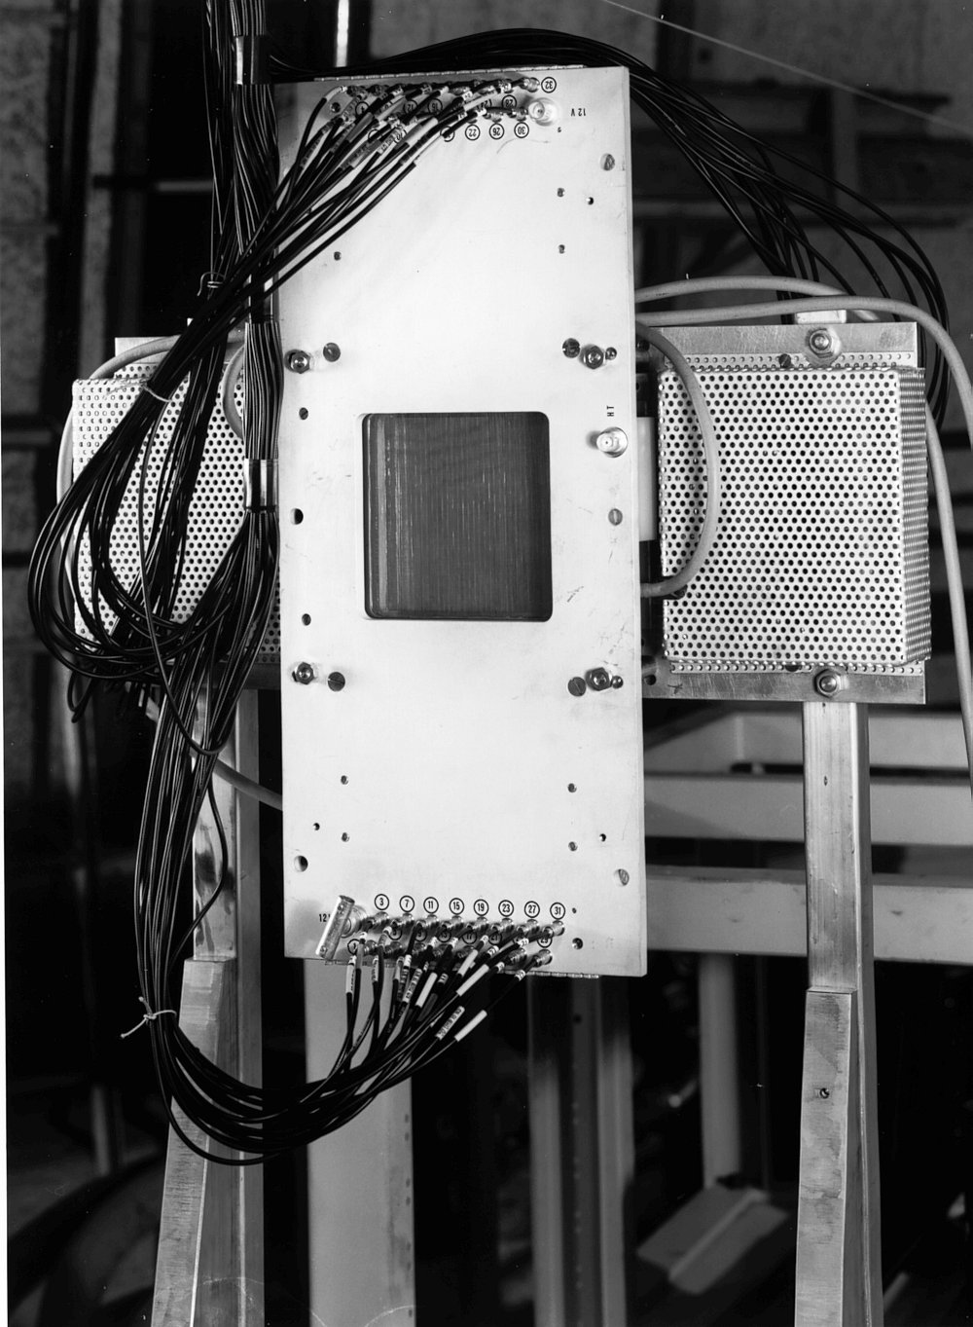
First Public Presentation of the Multi-Wire Proportional Chamber
MWPC # 1
VERSAILLES,
10-13 September 1968

Slide 10
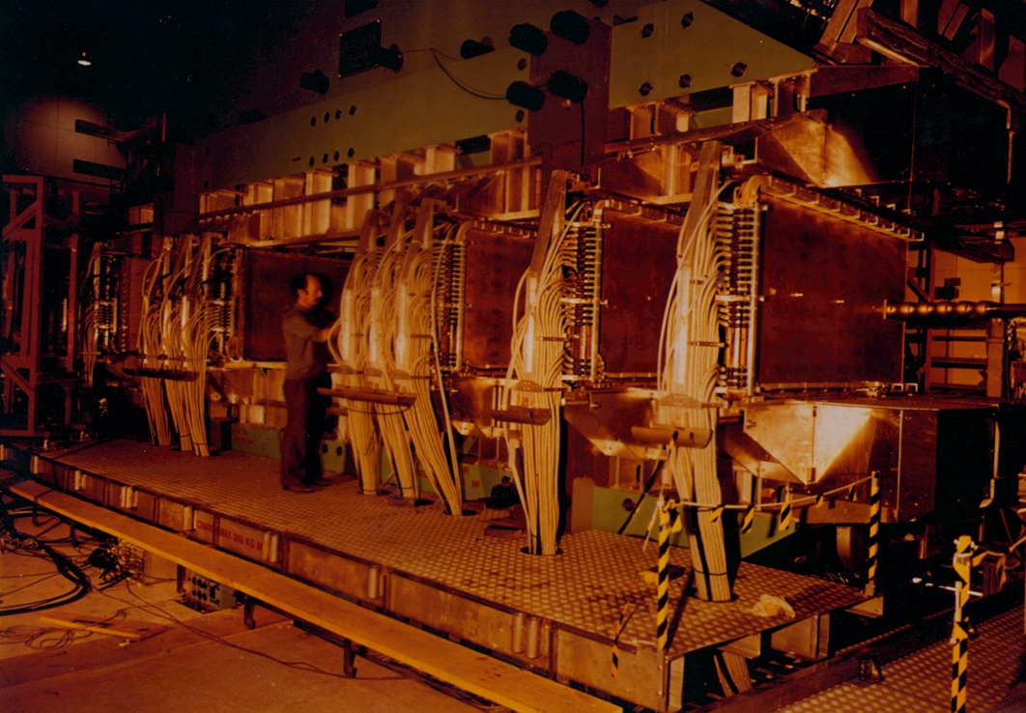
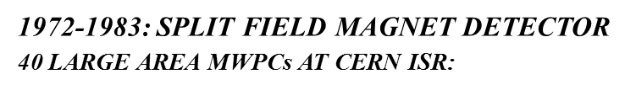
First Large Experiment with MWPCs

Slide 11
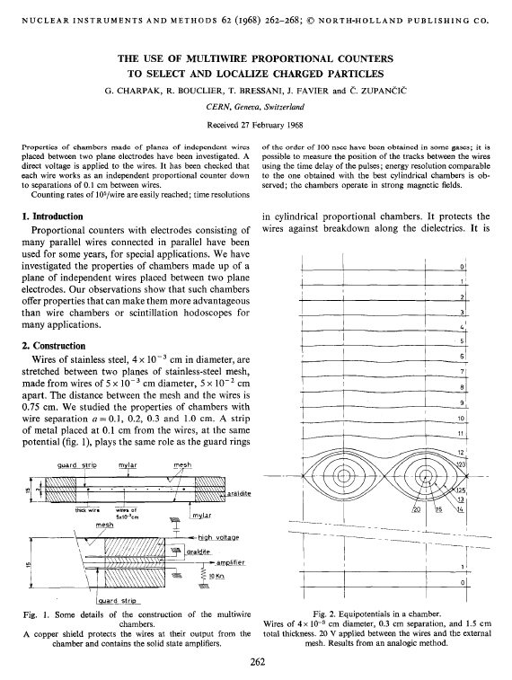
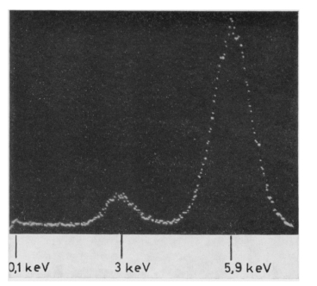
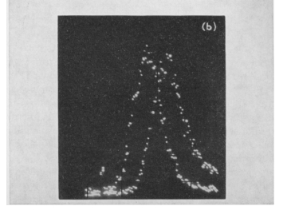
1968: Multi-Wire Proportional Chamber (MWPC)
ENERGY RESOLUTION ON 5.9 KeV:
DEPENDENCE OF COLLECTION TIME FROM TRACK’S DISTANCE:
DRIFT CHAMBERS
G. Charpak,R. Bouclier, T. Bressan,J. Favier and C. Zupancic: The use of Multiwire Proportional Counters to select and localize Charged Particles, Nuc. Instr. and Meth. 62(1968)262

Slide 12
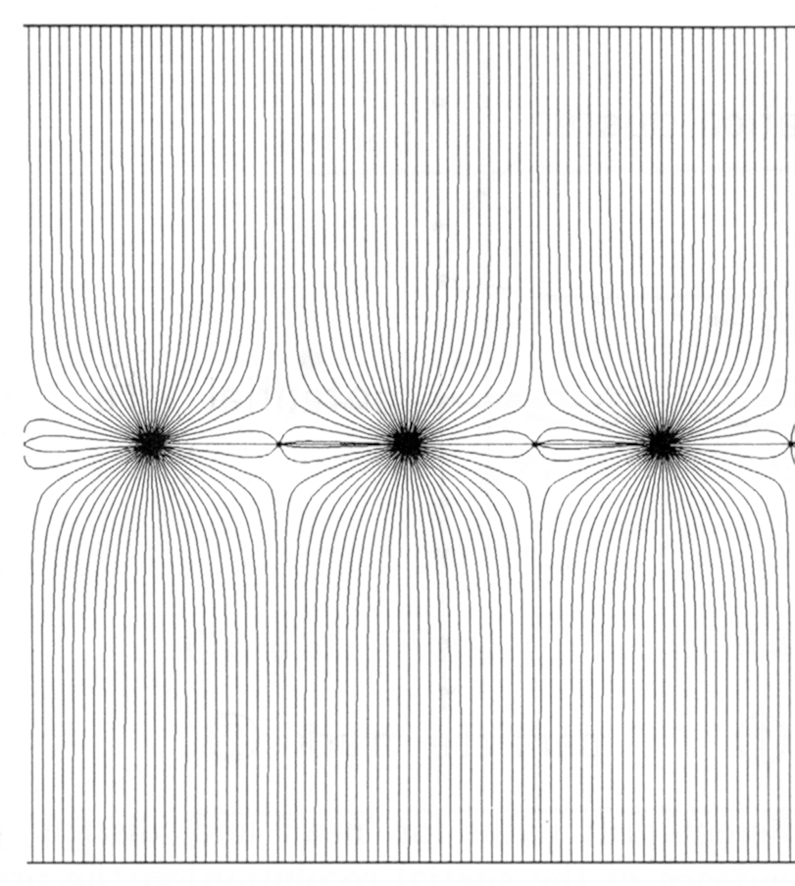
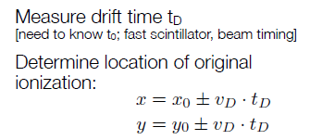
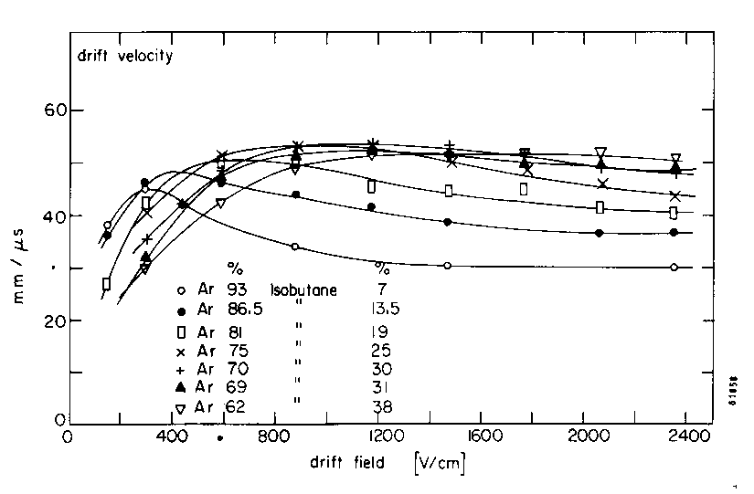
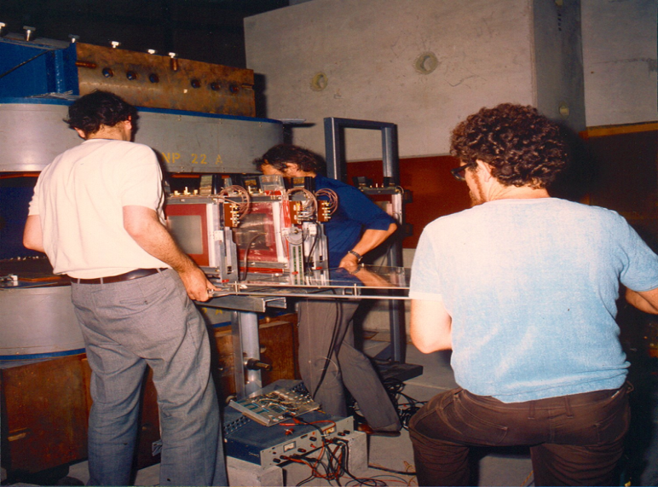
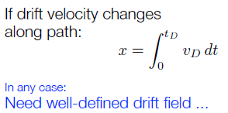
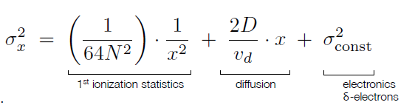
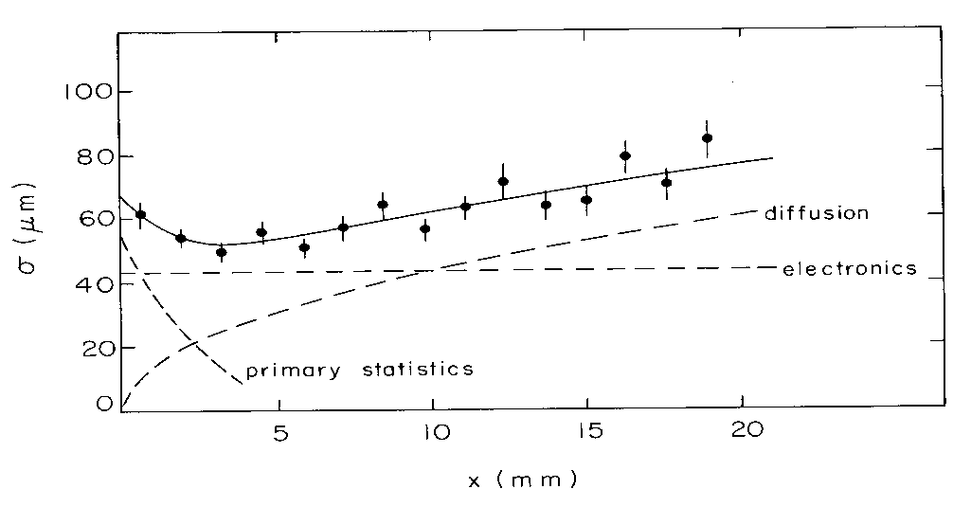
Drift Chambers
FIRST DRIFT CHAMBER OPERATION (H. WALENTA ~ 1971)
HIGH ACCURACY DRIFT CHAMBERS (Charpak-Breskin-Sauli ~ 1973-75)
THE ELECTRONS DRIFT TIME PROVIDES THE DISTANCE OF THE TRACK FROM THE ANODE:
ANODE
FIELD
The spatial resolution is not limited to the cell size
Factors affecting spatial resolution:
Distribution of primary ionization
Diffusion
Readout electronics
Electric field (gas amplification)
Range of ‘delta electrons’

Slide 13
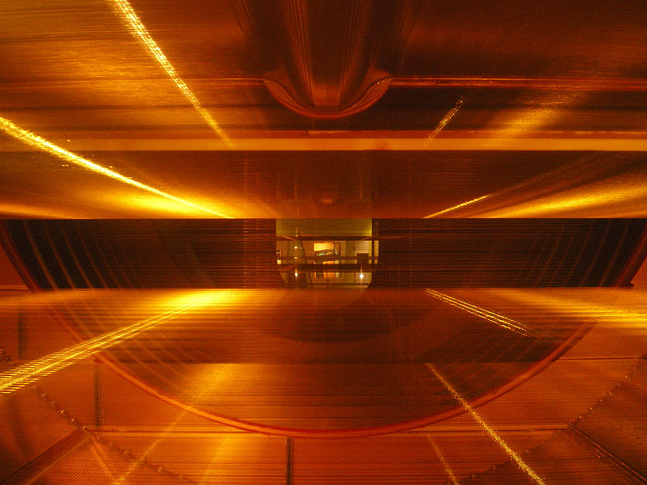
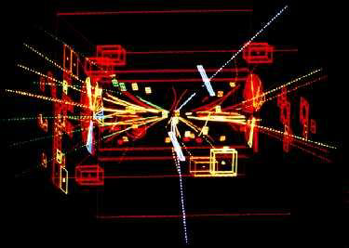
Nobel Prize: W, Z - Discovery at UA1/UA2 (1983)
UA1 used the largest imaging drift chamber of its day
(5.8 m long, 2.3 m in diameter)
It can now be seen in the CERN Microcosm Exhibition
Particle trajectories in the CERN-UA1
3D Wire Chamber TPC
Discovery of W and Z bosons
C. Rubbia & S. Van der Meer Nobel 1984
Z → ee (white tracks)

Slide 14
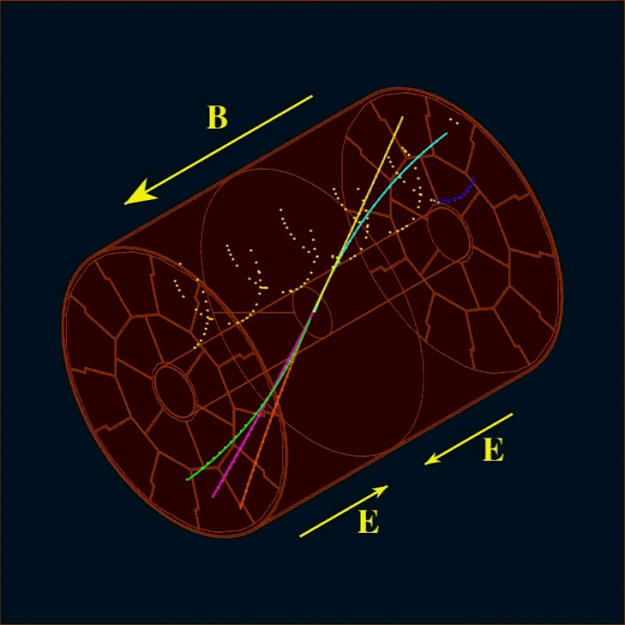
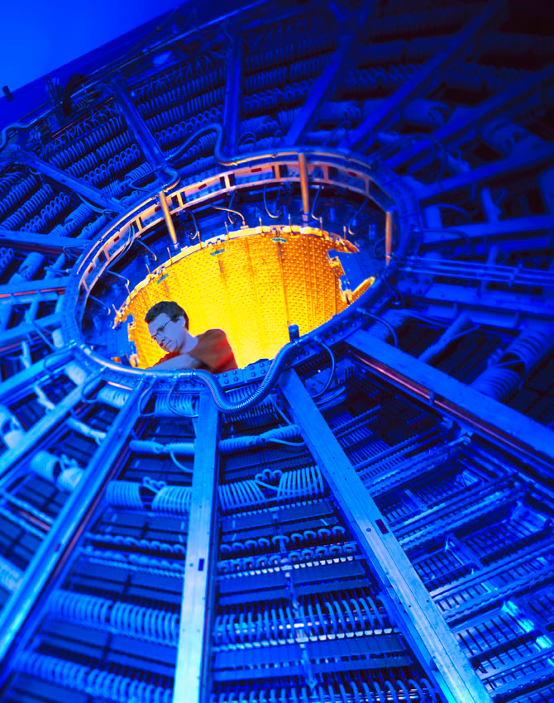
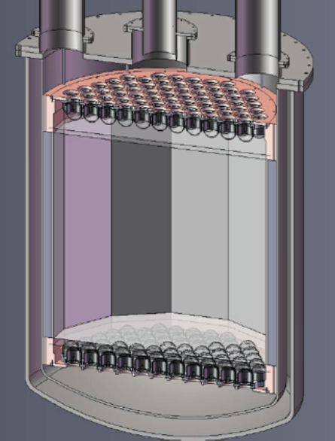
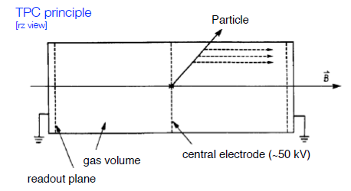
Time Projection Chamber (TPC)
The TPC is a gas-filled cylindrical chamber with 1 or 2 endplates (D. Nygren, 1974)
ALICE
LXe TPC
Readout
Gas volume
x
z
y
Separate two regions:
Long drift along z ~ 1-3 m;
Amplification at the end plate
Challenges:
Long drift time; limited rate capability

Slide 15
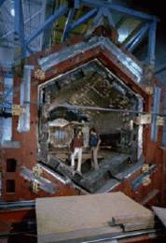
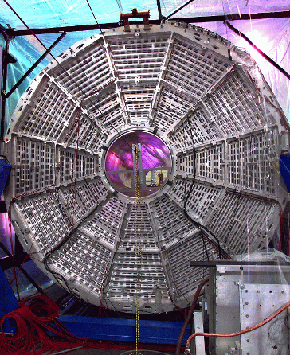
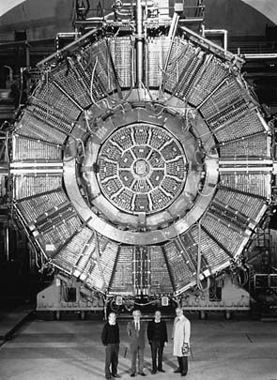
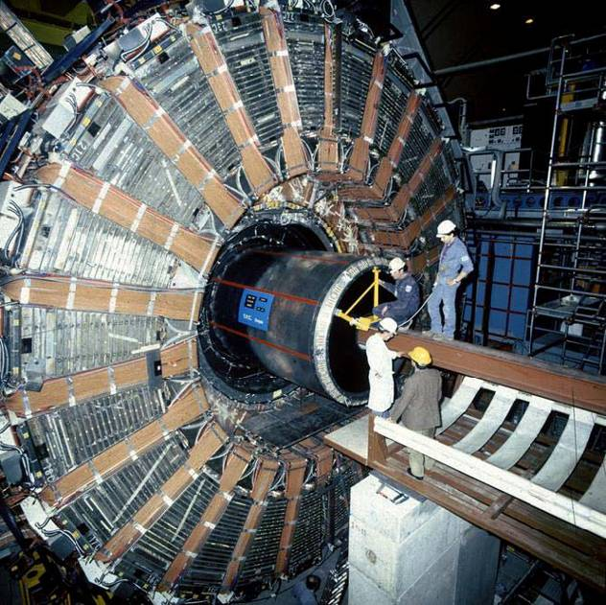
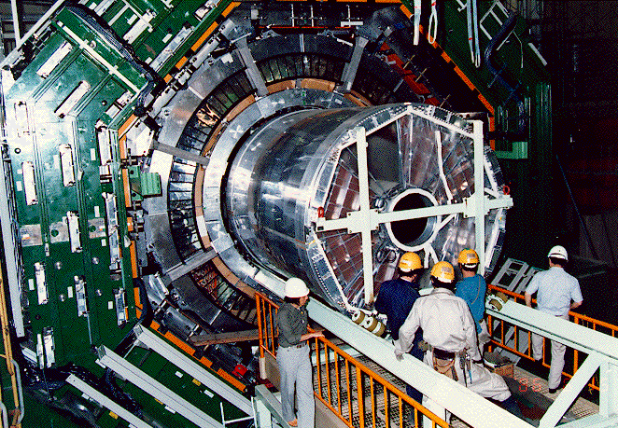
Some Detectors in Particle and Heavy Ions Physics using a TPC
PEP4 (SLAC)
STAR (LBL)
ALEPH (CERN)
DELPHI (CERN)
TOPAZ (KEK)

Slide 16
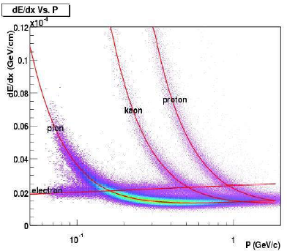
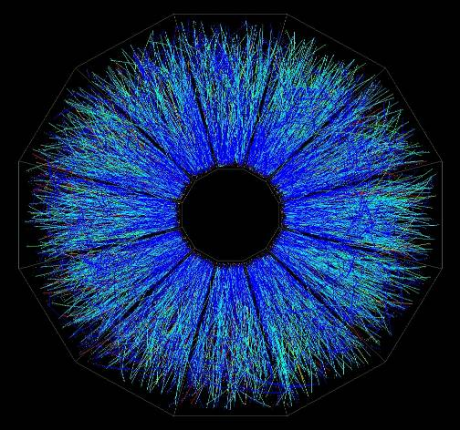


TPC Characteristics
Track point recorded in 3-D
  (2-D channels in x-y) x (1-D channel in z = v_{drift} x t_{drift})
Particle identification by dE/dx
  long ionization track, segmented in 100-200 measurements
STAR ion TPC BNL-RHIC
LBL STAR TPC
at BNL RHIC ion collider
Powerfull tool for:
Lepton Colliders
Modern heavy ion collisions
Liquid and high pressure noble gases for neutrino and dark matter physics program

Slide 17



CERN – LHC: Enormous Gaseous Detector Systems
 | Vertex | Inner Tracker | PID/ photo- det. | EM CALO | HAD CALO | MUON Track | MUON Trigger
ATLAS | - | TRD (straws) | - | - | - | MDT (drift tubes), CSC | RPC, TGC (thin gap chambers)
CMS ----- TOTEM | - | - | - | - | - | Drift tubes, CSC ----- GEM | RPC, CSC ----- GEM
LHCb | - | Straw Tubes | - | - | - | MWPC | MWPC, GEM
ALICE | - | TPC (MWPC) | TOF(MRPC), PMD, HPMID (RICH-pad chamber), TRD (MWPC) | - | - | Muon pad chambers | RPC
ALICE TPC
Straw tubes
CMS CSC
Gaseous detectors are still the first choice whenever the large-area coverage (e.g. muon systems) with low material budget is required

Slide 18





ALICE Multi-Gap RPC: Timing Resolution
Relevant scale in HEP: t ~ L(m)/c ~ o(ns)
Traditional technique:
  Scintillator + PMT ~ o (100 psec)
Breakthrough with a spark discharge in gas
  Pestov counter → ALICE MRPC ~ 50psec
ALICE-TOF has 10 gaps (two stacks of 5 gas gaps);
each gap is 250 micron wide
Technology | Time resolution
Pestov Counter | 30-50 ps
RPC | ~ 1-5 ns (MIP)
MultiGap RPC | ~ 50 ps (MIP)
GEM | ~ 1-2 ns (UV) ~ 5 ns (MIP)
Micromegas | ~ 700 ps (UV) ~ 2-5 ns (MIP)
C. Williams, CERN Detector Seminar
“ALICE Time of Flight Detectors”:
http://indico.cern.ch/conference
Display.py?confId=149006

Slide 19




ATLAS Muon Detector: Modern Large-Volume Spectrometer
L3 Muon Spectrometer (LEP):
~ 40000 chan. ; σ (chamber) < 200 μm
ATLAS Muon Drift Tubes (LHC):
~ 1200 chambers, σ (chamber) ~ 50 μm
370000 tubes, 740000 end-plugs
12000 CCD for optical alignment
Intrinsic limitation of wire chambers:
(resolution degradation at high rates):
1 chamber → 2 layers of 3 drift tubes
Spatial resolution /chamber (2 layers of 3 drift tubes)
σ_{space} ~ 50 μm

Slide 20








AGING PHENOMENA IN GASEOUS DETECTORS
A permanent degradation of operating characteristics
of gaseous detectors under sustained irradiation,
has been and still remains the main limitation to their use in high-rate experiments

Slide 21



Aging Phenomena in Wire Chambers: 30 Years Ago
1986
First systematic attempts to summarize aging results and
to provide remedies minimizing wire chamber aging
It was difficult to understand truly any aging measurement and extrapolate it to other operating conditions → reality is a complex mixture of many processes

Slide 22



Aging Phenomena in Gaseous Detectors: “High-Rate Era” (15 years ago)
High Energy Physics Experiments enters a new era which required operation of gaseous particle detectors at unprecedented high rates and integrated particle fluxes
(… a lot of “new and unexpected experience”
from HERA-B @ DESY)
2001
The HERA-B Experiment was the first high-rate experiment, which
addressed SYSTEMATICALLY aging phenomena in gas detectors,
followed later by ALL LHC Experiments

Slide 23
Aging Phenomena in Gaseous Detectors
Implicit
assumption:
aging rate is proportional only to the total accumulated charge
R = - (1/G)(dG/dQ) (% per C/cm)
(Kadyk’1985)
Aging phenomena depends on many highly correlated parameters:
1985
Microscopic parameters:
Cross-sections
Electron or photon energies
Electron, ion, radical densities
…
Macroscopic parameters:
Gas mixture (nature of
gas, trace contaminants)
Gas flow & Pressure
Geometry/material of electrodes & configuration of electric field
Construction materials
Radiation intensity
Gas gain, ionization density
Size of irradiation area
1985
CLASSICAL
AGING:
There are simply too many variables in the problem →
would be too naive to expect
that one can express the aging rate
using a single variable (C/cm)
‘NEW
AGING’
EFFECTS:
2000

Slide 24







Radiation Hardness of Gaseous Detectors: Rules of Thumb
Build a “full-size prototype” (the smallest independent element of your detector)
Expose full detector area of to the real radiation profile (particle type, gas gain, ionization density)
Choose your gas mixtures (hydrocarbons are not trustable) and materials very carefully
Vary all parameters systematically (gas gain, irradiation intensity, gas flow, …)
and verify your assumptions → make aging studies on several identical prototypes
Do not extrapolate aging results for any given parameter by more than an order of
magnitude
If you observed unexpected result - understand the reason – and reproduce results …
Many ORIGINAL PROBLEMS in HIGH RATE GAS DETECTORS were due to CASUAL SELECTION of chamber designs, gas mixtures, materials and gas
system components, which worked at “low rates”, but failed in harsh environments
If properly designed and constructed, gas detectors (especially Micro-Pattern Gaseous Detectors) can be robust and reliable in the high-rate environment

Slide 25




Why do Tracking Detectors Change ?
100 μm
Higher Rate, enormous occupancy:
1D easily saturated → 2D → 3D
Silicon detectors:
Strips →Pixels (2D)→ 3D det-electr. integ.
Gaseous detectors
Wire Chamber → Wireless MPGD (2D)
→ InGrid/Timepix (3D)
10 μm
50 μm
Drift Chamber
140 μm
Micromegas:
TPC
Ingrid
Advances in Micro-electronics & Etching Technology → Micro pattern Gaseous Detectors

Slide 26





CERN-LHC: Enormous Gaseous Detector Systems
ATLAS TGC
LHCb Outer
Tracker
ALICE HPMID
ALICE MRPC
Upgrade Options for HL-LHC:

Slide 27





Micro-Strip Gas Chamber (MSGC)
MWPC
MSGC
Rate capability limit due to space
charge overcome by increased
amplifying cell granularity
cathode
anode
cathode
Typical distance between
wires limited to 1 mm
due to mechanical and
electrostatic forces
Typical distance
between anodes 200 mm
thanks to semiconductor
etching technology
A. Oed, Nucl. Instr. and Meth. A263 (1988) 351.

Slide 28


Micro-Strip Gas Chambers: Discharge Problems
Major processes leading at high rates to MSGC operating instabilities:
Substrate charging-up and time-dependent modification of the E field
→ slightly conductive support
Deposition of polymers (aging)
→ validation of gases, materials, gas systems
Discharges under exposure to highly ionizing particles
→ multistage amplification, resistive anodes
“Conductive” MSGC
Uncoated
MSGC
ON EXPOSURE TO α PARTICLES
Induced discharges are intrinsic property of all single stage micropattern detectors in hadronic beams (MSGC turned out to be prone to irreversible damages)

Slide 29




MSGC Discharge Problems
Discharge is very fast (~ns)
Difficult to predict or prevent
MICRODISCHARGES
Owing to very small distance between
anode and cathode the transition from
proportional mode to streamer can be
followed by spark, discharge, if the
avalanche size exceeds
RAETHER’S LIMIT
Q ~ 10⁷ – 10⁸ electrons
FULL BREAKDOWN

Slide 30




Micro-Strip Gas Chamber (MSGC)
Telescope of 32 MSGCs tested at PSI in Nov99 (CMS Milestone)
HERA-B Inner Tracker
MSGC-GEM detectors
R_{min} ~ 6 cm
⇒ 10⁶ particles/cm² s
300 μm pitch
184 chambers: max 25x25 cm²
~ 10 m²; 140.000 channels
The D20 diffractometer MSGC
is working since Sept 2000
1D localisation
48 MSGC plates (8 cm x 15 cm)
Substrate: Schott S8900
Angular coverage : 160° x 5,8°
Position resolution : 2.57 mm ( 0,1°)
5 cm gap; 1.2 bar CF4 + 2.8 bars 3He
DIRAC
4 planes MSGC-GEM
Planes 10x10 cm²

Slide 31








Micro-Pattern Gaseous Detector Technologies for Future Physics Projects
Micromegas
GEM
Thick-GEM, Hole-Type and RETGEM
MPDG with CMOS pixel ASICs (“InGrid”)
Micro-Pixel Chamber (μPIC)
Rate Capability:
MWPC vs MSGC
Micromegas
GEM
THGEM
MHSP
μPIC
Ions
40 %
60 %
Electrons
InGrid

Slide 32

Christian Lippmann, 2nd ECFA High Luminosity LHC Experiments
Workshop, Aix-les-bains, France, October 21-23 (2014)

Slide 33
Historical Roadmap of the MPGD Technologies and RD51 Collaboration
MicroMEGAS (CEA Saclay, Y. Giomataris)
RD51
collaboration
MSGC (ILL, A. Oed)
GEM (CERN, F. Sauli)
RD28
1988
1996
1992
1997
2003
LEM (Periale)
THGEM(Chechik)
2008
1996
2000
2005
InGrid
μ-PIC (A. Ochi, T. Tanimori)
Capillary plate (Yamagata U., H. Sakurai)
Many of the Micro-Pattern Gaseous Detector Technologies were introduced before
the RD51 Collaboration was founded
With more techniques becoming available (or affordable), new detection concepts
are being introduced and the existing ones are substantially improved

Slide 34





RD51 – Development of Micro-Pattern Gaseous Detector Technologies
The main objective is to advance MPGD technological development and associated electronic-readout systems, for applications in basic and applied research”
A fundamental boost is offered by RD51: from
isolate MPGD developers to a world-wide net
1998
2014
http://rd51-public.web.cern.ch/rd51-public
World-wide Collaboration for the
MPGD Developments →
RD51 (91 institute, > 500 people):
Large Scale R&D program to advance MPGD Technologies
Access to the MPGD “know- how”
Foster Industrial Production
Advances in photolithography →
Large Area MPGDs (~ m² unit size)

Slide 35
















Future RD51 Collaboration Activities (beyond 2013)
Large Area Detectors
Assembly Optimization
RD51 Common Projects
Generic R&D, QA
Long Term Stability
WG2:
WG1:
WG5:
Software Tools and
Simulations
MPGD Electronics
RD51
WG4:
WG3/NEW WG:
WG7:
WG6:
Conferences / Schools
Academia-Industry
Matching Events
CERN MPGD
Workshop,
Quality Control
and Industrialization
RD51 Common
Test Beam and Lab Facilities

Slide 36


MPGD Technologies for Energy Frontier (HL-LHC, LC)
Ongoing R&D Projects using MPGDs in the framework of HEP Experiments
 | Vertex | Inner Tracker | PID/ photo- det. | EM CALO | HAD CALO | MUON Track | MUON Trigger
ATLAS | GOSSIP/ InGrid | GOSSIP/ InGrid |  |  |  | Micromegas | Micromegas
CMS |  |  |  |  |  | GEM | GEM
ALICE |  | TPC (GEM) | VHPMID (CsI-THGEM)
Linear Collider |  | TPC(MM,GEM, InGrid) |  |  | DHCAL (MM,GEM, THGEM)
ATLAS Micromegas:
On a road to large-area detectors:
(1.2 * 0.6 m²)
CMS GEM:
Trapezoidal GEM Prototype (99 x 45-22 cm2)

Slide 37




MPGDs: Technology Developments Highlights
MM for the ATLAS Muon System Upgrade:
GEMs for the CMS Muon System Upgrade:
R&D Started in 2007 within the RD51 collaboration:
Standard Bulk MM suffers from limited efficiency at
high rates due to discharges induced dead time:
R&D Started in 2009 within the RD51 collaboration:
Single-mask GEM technology (instead of double-mask)
→ Reduces cost /allows production of large-area GEM
Self-stretching technique: assembly time reduction
from 3 days → 2 hours
ATLAS small wheels upgrade project resistive MicroMegas prototype ( ~ 1 m²)
During LS2, a New Small Wheel containing
~ 1000 m² of resistive MM will be installed in
ATLAS → the largest MM system, ever built
FOSTER INDUSTRIAL PRODUCTION NEEDS
During the LHC End-Year stop of 2016/2017, two GEM super-chamber demonstrators will be installed

Slide 38



MPGD-Based Readout for ALICE TPC Upgrade
ALICE TPC Upgrade
→ replace MWPC with GEM
Continuous TPC readout at 50 kHz
Physics requirement: IBF < 1%, energy:
σ(E)E < 12% achieved
TDR Baseline Solution: 4-GEM Stack
Also option under study: Micromegas + 2 GEM
4 GEM Stack Configuration
(to minimize IBF)
Energy resolution vs IBF (4-GEM detector):
4 GEM Stack
engineering design
Special ALICE TPC / RD51 workshop
during the RD51 Collab. Week in June 2014:
http://indico.cern.ch/event/323839/other-view?view=standard

Slide 39











MPGD-based Readout for ILC TPC
Efforts to improve the modules design for all technologies. Several test beams campaigns:
7 Micromegas modules with 2-phase C02 cooling
With beam and laser dots:
UV laser gererates MIP tracks
& illuminate calibration spots
2P CO2
Cooling
Large TPC Prototype with versatile endplate @ DESY
Diameter 77cm
Goal for final TPC can be reached:
GEM / MM performance similar
MM (B=0): Before correction
MM (B=0): After correction
(note – different scale)

Slide 40




MPGD-Based Gaseous Photomultipliers (GPM)
GEM Gaseous Photomultipliers (GEM+CsI photocathode) to detect single photoelectrons
Semitransparent
Photocathode (PC)
Reflective
Photocathode (PC)
Multi-GEM Gaseous Photomultipliers:
Largely reduced photon feedback
(can operate in pure noble gas & CF₄)
Fast signals [ns] → good timing
Excellent localization response
Able to operate at cryogenic T
CsI ~ 500 A
CsI ~2500 A
Single Photon Time Resolution:
Single Photon Position Accuracy:
CF₄
770 torr
200 µm
3 GEM
σ = 1.6 ns
Intrinsic accuracy
σ (RMS) ~ 55 µm
FWHM ~160 µm
Beam ~ 100 µm
Micromegas: σ ~ 0.7 ns with MIPs
E.Nappi, NIMA471 (2001) 18; T. Meinschad et al, NIM A535 (2004) 324; D.Mormann et al., NIMA504 (2003) 93

Slide 41





COMPASS RICH: Long-Term Experience, Performance and Upgrades
COMPASS RICH I:
UPGRADE OF COMPASS RICH I:
PMTs not adequate because of large angular acceptance ➔ only small demagnification
factor of optical system allowed (large distortions); 5 m2 of PMTs not affordable.
1999-2000: 8 MWPC with CsI (RD26 @ CERN)
MPGD-Photon Detectors are the best option
→ Micromegas +THGEM, the hybrid architecture
structure, is one of the most advanced scheme:
After a long-term fight for increasing electrical stability
at high rates: robust operation is not possible at gain~10⁵ because of photon feedback, space charge & sparks
beam off: stable
operation up to > 2300 V
beam on: stable operation
possible only up to ~2000 V
2006: 4 central CsI+cathodes:
remove and insert frames with
MAPMTs and lense telescopes
PMTs not adequate → only small demagnification
factor allowed; 5 m² of PMTs not affordable.
Higher performance reached with the MM + THGEM
architecture (than multiple-THGEM structures)

Slide 42















MPGD-Based Cryogenic Avalanche Detectors: Concept Gallery
L.Periale et al, IEEE TNS 52 (2005) 927
A.Bondar et al, NIMA 556 (2006) 273
A.Rubbia, J. Phys. Conf. Ser. 39 (2006) 129
A.Buzulutskov et al, IEEE TNS 50 (2003) 2491;
A.Bondar et al, NIMA 524 (2004) 130
P.K.Lightfoot et al, JINST 4 (2009) P04002
N.McConkey et al, IPRD 2010, Siena, Italy; Nucl. Phys. B Proc. Suppl. 215 (2011) 255
Y.L.Ju et al, Cryogenics 47 (2007) 81
M.Gai et al, Eprint arxiv:0706.1106 (2007)
A.Bondar et al, JINST 3 (2008) P07001
A.Buzulutskov, A.Bondar, JINST 1 (2006) P08006
A. Bondar et al, JINST 5 (2010) P08002
A.Buzulutskov et al, EPL 94 (2011) 52001
D.Akimov et al, JINST 4 (2009) P06010
S. Duval et al, JINST 4 (2009) P12008
D.Akimov, NIMA 628 (2011) 50
S. Duval et al, JINST 6 (2011) P04007

Slide 43





Advancing Concepts: Double Phase Ar LEM/TPC for Neutrino Physics
Double-phase Ar LEM TPC

Slide 44

Development of MPGD Simulation Tools
Focus on providing techniques for calculating electron transport in small-scale structures
The main difference with traditional gas-based detectors is that the electrode scale
(~ 10 μm) is comparable to the collision mean free path
Development and Maintenance of Garfield++:
Garfield++ is a collection of classes for the detailed simulation of small-scale detectors.
Garfield++ contains:
- electron and photon transport using cross sections provided by Magboltz
- ionisation processes in gases, provided by Heed and MIP
- ionisation and electron transport in semi-conductors
- field calculations from finite elements, boundary elements, analytic methods
Simulation Improvements:
→ Transport:
- ion mobility and diffusion, measurement and modelling
- Magboltz cross sections (Ar, Xe, He, Ne; GeH₄, SiH₄, C₂H₂F₄ ) are frequently
updated in collaboration with LXCAT (http://www.lxcat.laplace.univ-tlse.fr)
- e-ion recombination process in Xe
- thermal motion
→ Photons:
- update in UV emission
- inclusion of IR production
- photon trapping and resulting excitation transport
- photon absorption in the gas (gas feedback)
- photon absorption in and electron emission from walls (feedback)
- photo cathodes

Slide 45



Development of MPGD Simulation Tools
Applications:
GEM: multiplication process and polyimide properties; charging up effects
MicroMegas: timing and effects of resistive layers
TPC GEM: ion backflow
→ ALICE TPC end-cap upgrade studies: rate dependence of the Ion Back Flow in GEM
Simulation
Measurement
Summary of simulation improvements in 2013:
Systematic calculations of GEM charging-up as function of hole shape; these reproduce the trends observed in experimental data
Measurements in Krakow for numerous gas mixtures of energy transfer rates which permit much more accurate avalanche gain calculations
Start of a collaboration with Coimbra on ion transport measurements in mixtures and start of an effort to model ion transport microscopically, which will help to predict charging-up and ion feedback
Measurement in Orsay at particularly low gain and low noise of the avalanche fluctuations in He/iso, Ne/iso and Ar/isobutane (these fluctuations are reproduced by MC run)

Slide 46








Advancing MPGD Concepts for Future Projects
Applications :
HEP and Nuclear Physics
Neutrino Experiments
Dark Matter
Ground-based Astroparticle
Space Experiments
Spin-off outside HEP field
(some) experimental requirements:
HL-LHC (LHC luminosity upgrade)
→ radiation, pileup, backgrounds
ILC
→ high precision, hermeticity
Neutrino Facilities
→ sensitivity (mass, size), efficiency, purity
Dark Matter
→ purity, low bkg, large sensitive areas
Tracking
TPC readout
UV photon detection
Neutron detection

Slide 47






Spin off is important key word for the HEP labs to survive …
Cosmic Ray Muon Tomography
Using GEMs for Homeland security
T2DM2: Temporal Tomography
Densitometric by the Measure of Muons
MPGD
Technology
Liquid xenon detectors for functional medical imaging
CsI-RETGEM for UV
flame detection

Slide 48



Gaseous Tracking: Detector-Electronics Integration Trends
Wire Chambers, TPC, RPC → MPGD (GEM, Micromegas) → InGrid (3D)
YESTERDAY:
INTEGRATION
TODAY:
INTEGRATION
FUTURE:
Micromegas:
HL-LHC
ILC
ILC
CLIC
LHC
Ingrid
High rate capability ~10⁶ Hz/mm²
Spatial res. ~ 30-50 μm (TRACKING)
Time res. ~ 3-5 ns (TRIGGER)
Advances in photolithography →
Large Area MPGDs (~ m² unit size)

Slide 49

CERN: 60 Years
Science for Piece

Slide 50


CERN – European Center for Nuclear Research
was founded in 1954:
12 European States “Science for Peace”
Today: 21 Member States
~ 2300 staff
~ 1600 other paid personnel
~ 10500 users
Budget (2014) ~1000 MCHF
Member States: Austria, Belgium, Bulgaria, the Czech Republic, Denmark, Finland, France, Germany, Greece, Hungary, Israel, Italy, the Netherlands, Norway, Poland, Portugal, Slovakia, Spain, Sweden, Switzerland and
the United Kingdom
Candidate for Accession: Romania
Associate Member in Pre-Stage to Membership: Serbia
Applicant States for Membership or Associate Membership:
Brazil, Cyprus, Pakistan, Russia, Slovenia, Turkey, Ukraine
Observers to Council: India, Japan, Russia, Turkey, United States of America; European Commission and UNESCO
50

Slide 51


CERN: 60 Years Science for Piece
Four Seas Conference: « Physique-sans-Frontières »
“Physique-sans-Frontières” (PSF) was born in 1992, during the war in Bosnia when many scientists felt the necessity to "do something" for their colleagues of South East of Europe
Georges CHARPAK has kindly accepted to preside "Physics-without-Borders” and supported the effort of the association to set up the “Four-Seas-Conference”
The 1st Trieste-95 conference was a real success, despite the renewed war in Bosnia : 150 physicists, half of them from the South-Eastern Europe; all the countries of the Balkanic area were represented, despite the existing state of war between some of them

Slide 52

Four Seas Conference: Physics in Service of Mankind
Five conferences were organized (Trieste-95, Sarajevo-98, Thessaloniki-02, Istanbul-04, Iasi, Romania-07) to give opportunity for scientists, mainly the youngest ones, to hear about the most recent developments in sciences and technologies
Served as a way to express the solidarity of the scientific community with all those who, under difficult conditions, seek to keep alive the diverse intellectual and cultural links that constitute the essence of our civilization
2014: CERN is celebrating
“60 Years of Science for Peace!”

Slide 53
Four Seas Conference: Physics in Service of Mankind
Five conferences were organized (Trieste-95, Sarajevo-98, Thessaloniki-02, Istanbul-04, Iasi, Romania-07) to give opportunity for scientists, mainly the youngest ones, to hear about the most recent developments in sciences and technologies
Served as a way to express the solidarity of the scientific community with all those who, under difficult conditions, seek to keep alive the diverse intellectual and cultural links that constitute the essence of our civilization
2014: CERN is celebrating
“60 Years of Science for Peace!”

Slide 54


A conference: “90th Anniversary
of Georges Charpak“
Bringing Nations Together
Through Science:
In 2014, CERN is celebrating “60
Years of Science for Peace”!
In a particularly fragile time for
Ukraine, physicists from France,
Ukraine, Poland and CERN get
together in Lviv, Ukraine in memory of Georges Charpak personality, continuing his scientific and cultural traditions.
Slides are available at:
https://indico.cern.ch/event/
331478/timetable/#20140721
CERN Courrier, November 2014

Slide 55

CERN: Bringing Nations Together Through Science
TODAY, SCIENCE IS GETTING MORE AND MORE GLOBAL
Global Science: go beyond the national interests
Power of Science: improve life of people via development of novel technologies (multinational community – competition and collaboration)→ providing unique scientific environment
Science Diplomacy: in a world which is exceedingly fragile today, science diplomacy opens the possibility to tackle global challenges, ensures cultural exchange of different nations
CERN is of a Global Influence (“Virtual Nation”) → work peacefully together at the frontiers of research and disseminate results as widely as possible
Science requires a long-term thinking and long-term planning → often underestimated by politicians' in a view of the short-term economical goals

