Slide 1
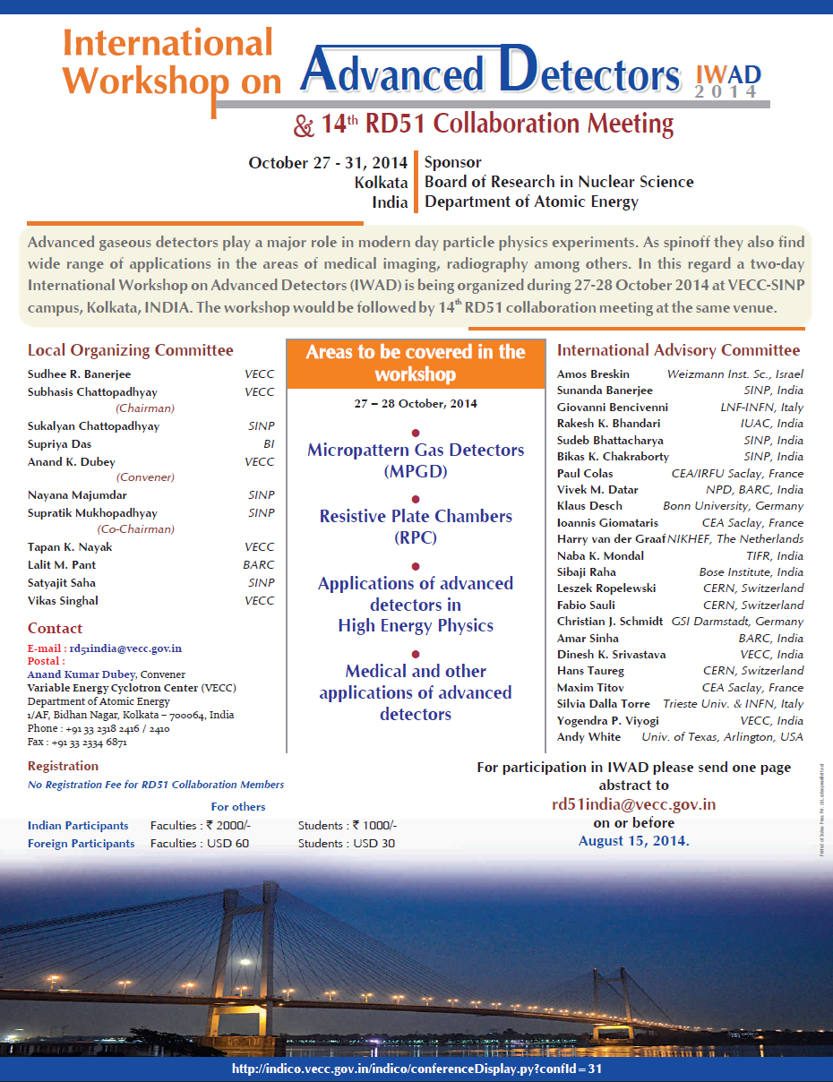
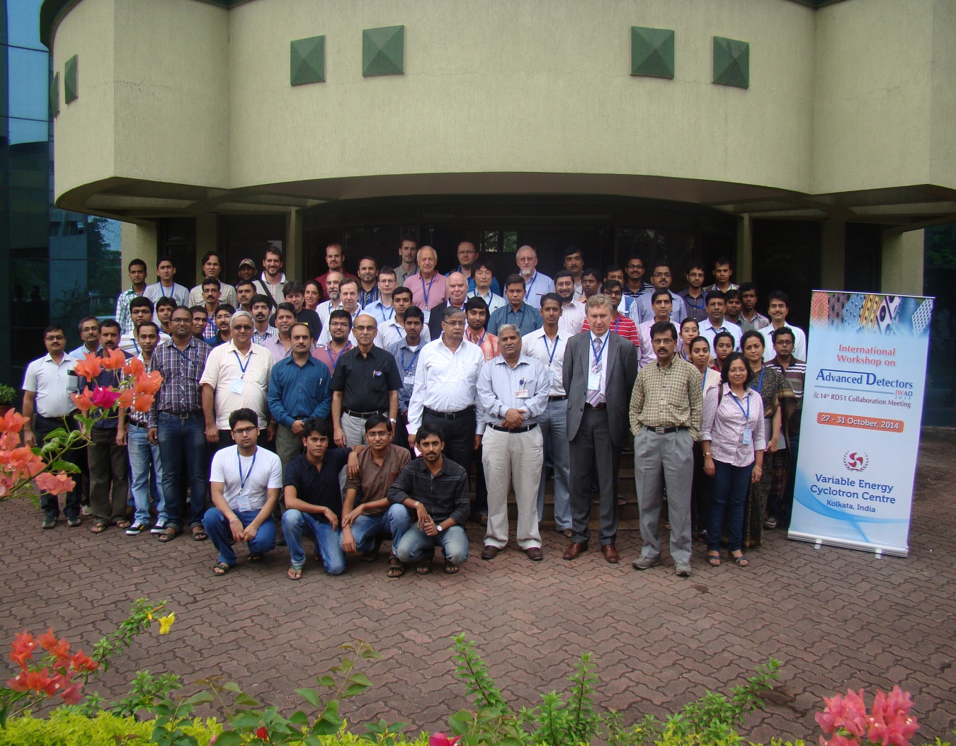
RD51 Collaboration News
Leszek Ropelewski, CERN Switzerland / Maxim Titov, CEA Saclay France
14th RD51 Collaboration Meeting, Kolkata, India, October 29-31, 2014

Slide 2
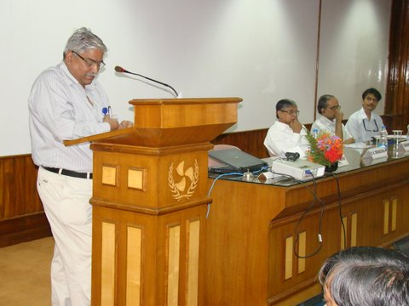
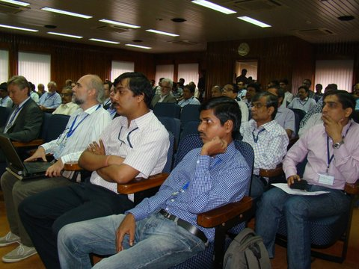
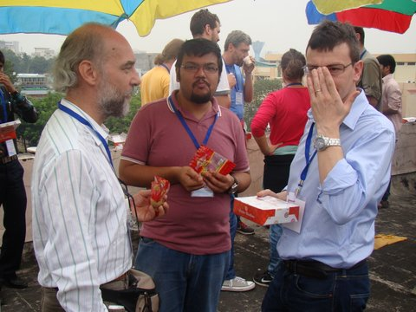

International Workshop on Advanced Detectors (Oct. 27-28, 2014)
Many young scientists &
excellent presentations
“Warm Welcome Address” from
the VECC and SINP officials
and fantastic conference organization
Dance Academy -
Revealing
“Cultural Heritage
of India”
Coffee break discussions – ohhh … well
how to improve these MPGD detectors ?

Slide 3
14th RD51 Collaboration Meeting (Oct. 29-31, 2014)
https://indico.cern.ch/event/348222/other-view?view=standard
Today:
Wednesday, October 29
09:30 – 10:10 RD51 Collaboration News
10:10 – 13:30 WG6 Production
13:30 – 14:30 Lunch
14:30 - 18:30 WG4 Software
18:30 - 20:00 RD51 Collaboration Board Meeting
Thursday, October 30
09:30 – 10:00 WG5 Electronics
10:00 - 12:00 WG1 MPGD Technologies and New Structures
12:00 - 13:30 Lunch
13:30 - 19:00 Excursion
Friday, October 31
09:30 - 13:30 WG2 Physics Issues
14:30 – 16:30 WG7 Test Beams

Slide 4
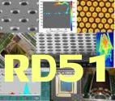
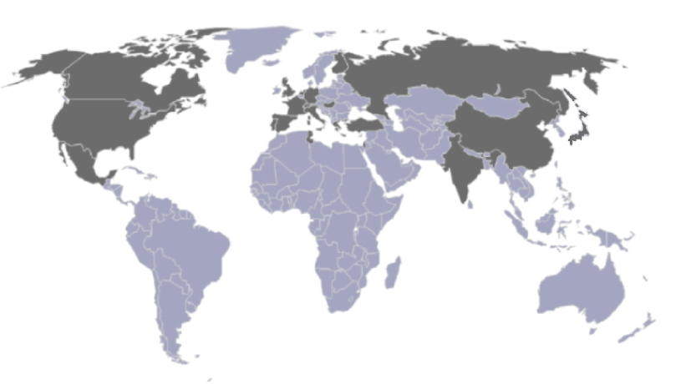
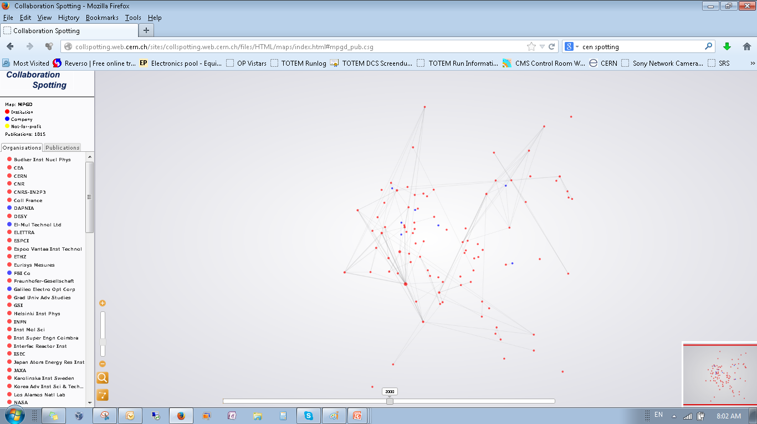
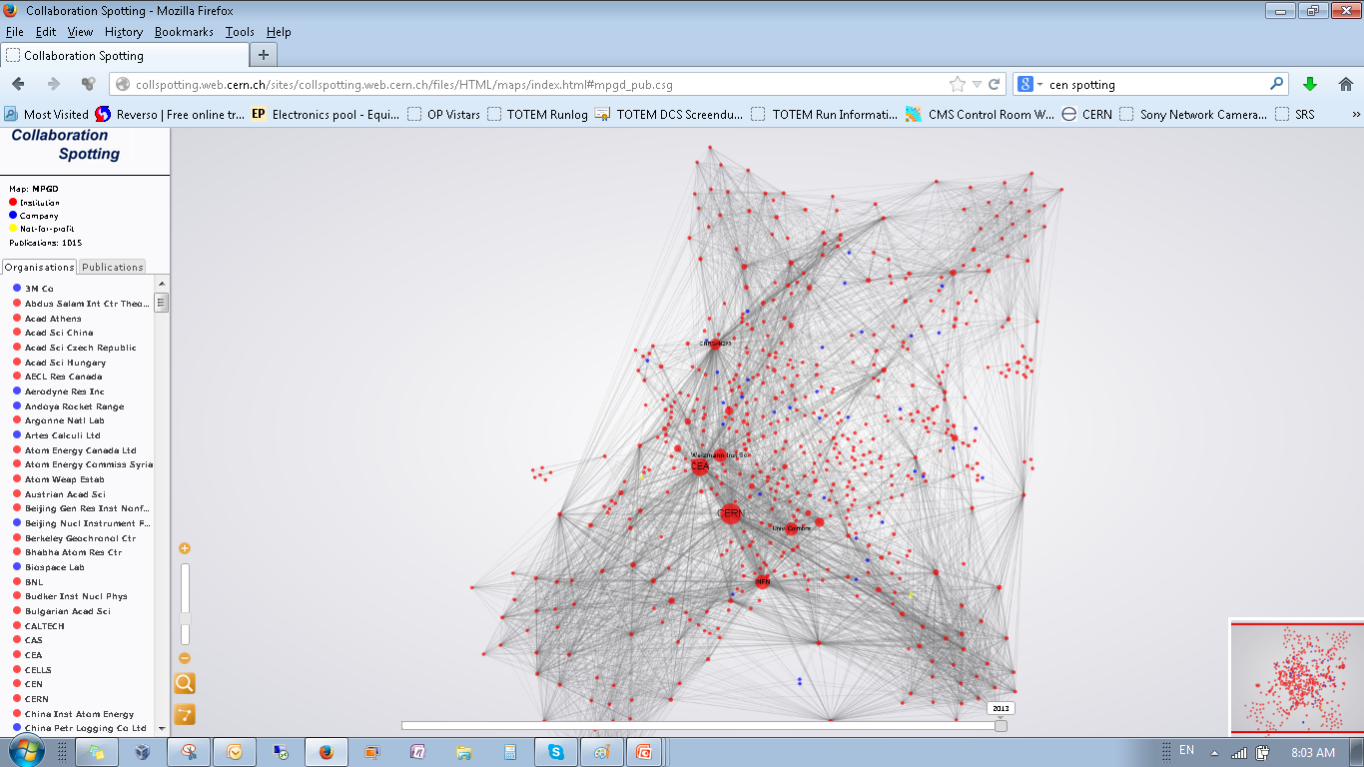
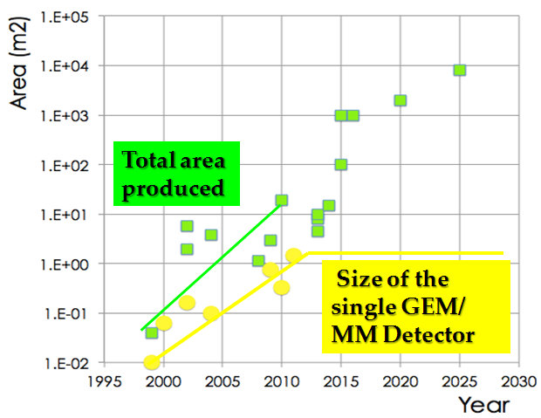
RD51 – Development of Micro-Pattern Gaseous Detector Technologies
The main objective is to advance MPGD technological development and associated electronic-readout systems, for applications in basic and applied research”
A fundamental boost is offered by RD51: from
isolate MPGD developers to a world-wide net
1998
2014
Enhancing geographical diversity and expertize of the RD51 community:
4 institutes from Brazil, India, Japan, Republic of Korea expressed
interest to join RD51 → will be discussed at the RD51 CB Meeting tonight
http://rd51-public.web.cern.ch/rd51-public
World-wide Collaboration for the
MPGD Developments →
RD51 (~ 90 institute, > 500 people):
Large Scale R&D program to advance MPGD Technologies
Access to the MPGD “know- how”
Foster Industrial Production
Advances in photolithography →
Large Area MPGDs (~ m² unit size)

Slide 5
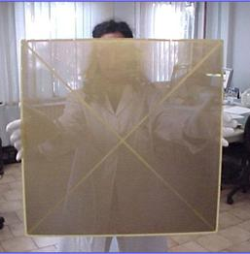

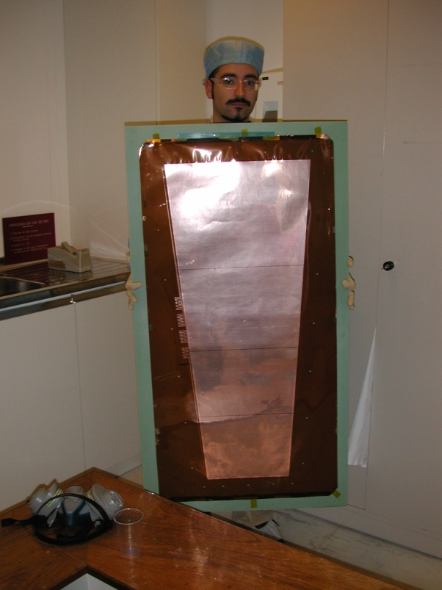
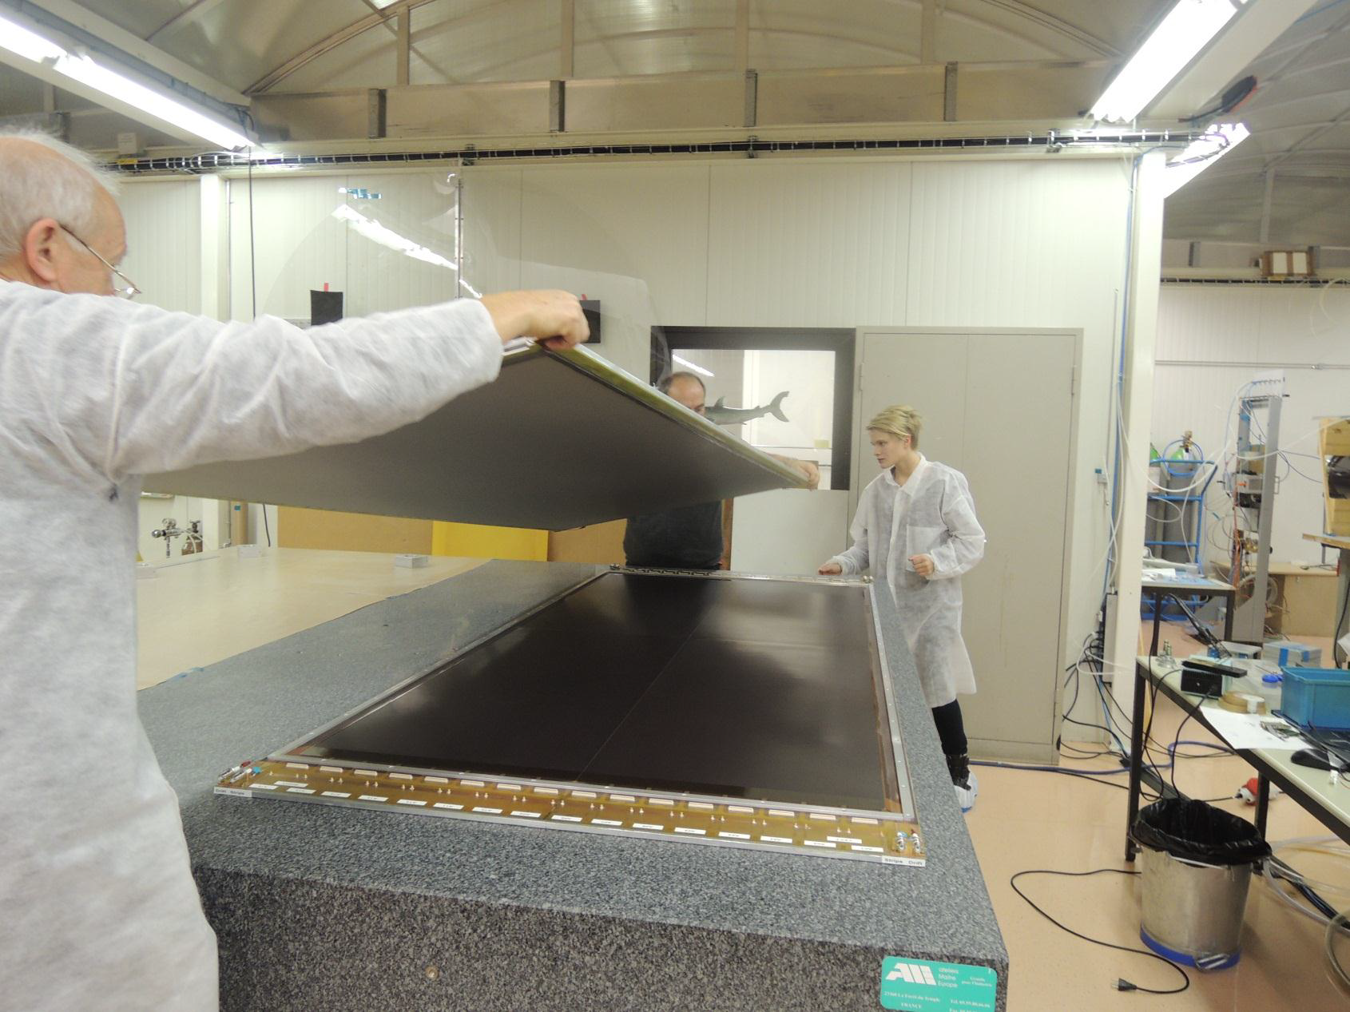
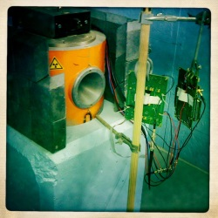
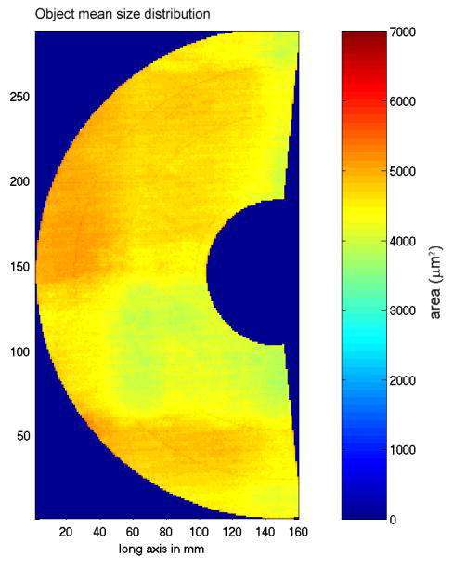
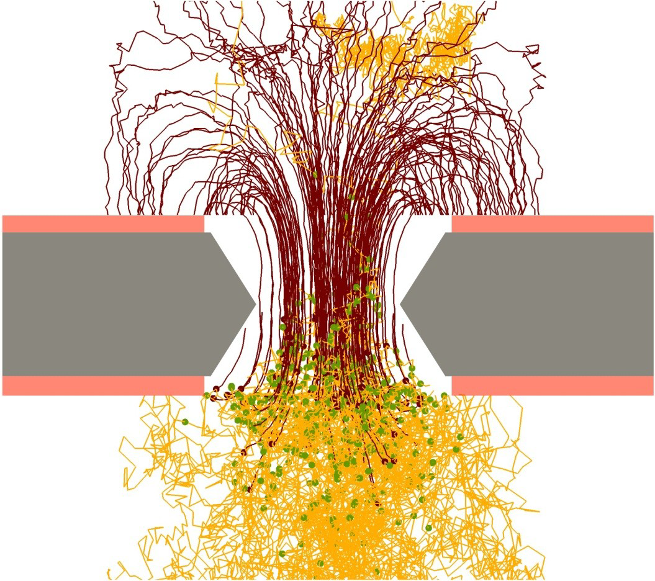
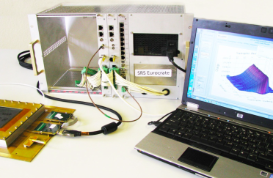
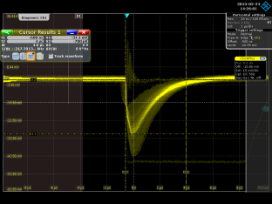
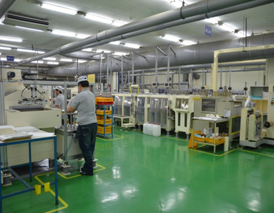
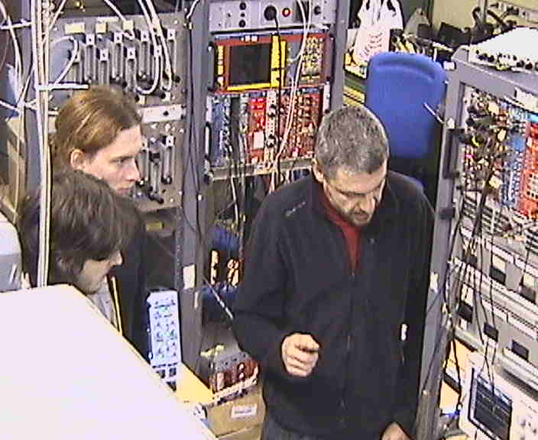
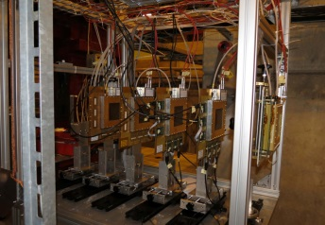
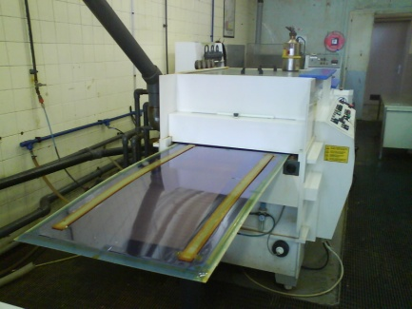
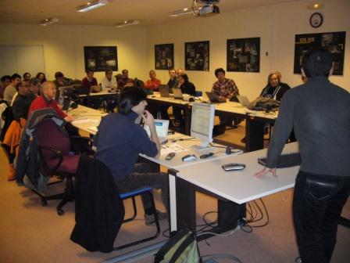
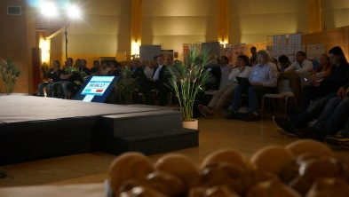
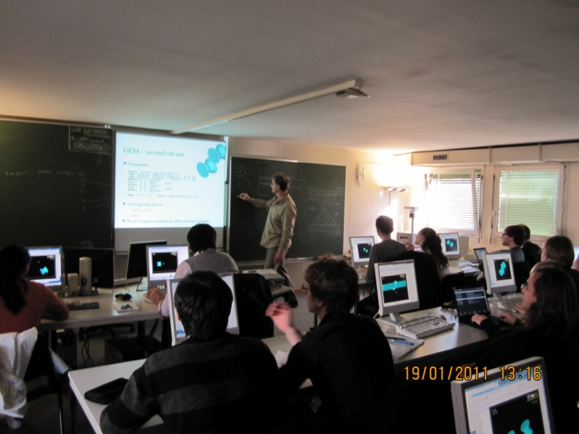
RD51 Collaboration Organization
Large Area Detectors
Assembly Optimization
RD51 Common Projects
Generic R&D, QA
Long Term Stability
WG2:
WG1:
WG5:
Software Tools and
Simulations
MPGD Electronics
RD51
WG4:
WG3/NEW WG:
WG7:
WG6:
Conferences / Schools
Academia-Industry
Matching Events
CERN MPGD
Workshop,
Quality Control
and Industrialization
RD51 Common
Test Beam and Lab Facilities

Slide 6
RD51 Working Group Activities and Future Projects
WG1: Continuation of the R&D support for the experiments and LHC upgrades
WG2: Generic R&D (long-term stability, quality control); RD51 Common Projects Development of new structures and consolidation of the existing structures
WG3 (NEW): Applications - organization of series of specialized workshops disseminating MPGD applications beyond fundamental physics – RD51, potential users and industry (e.g. dosimetry, neutron detection, medical physics, …)
WG4: Development and Maintenance of Software & Simulation Tools; basic studies & software support for the RD51 community
WG5: Development and Maintenance of the SRS Electronics; An extended support for the SRS including new developments and implementations of additional features
WG6: MPGD Production and QA Control - GEM, MicroMegas, Thick GEM; completion of the industrialization of main technologies
WG7: Maintenance and extension of the RD51 Lab and Test-Beam Infrastructure
WG (NEW): MPGD Education and Training : organization of schools for students and newcomers & academic training
Participation in the funding requests / funding contributions: Marie-Curie/GASNET, AIDA2

Slide 7
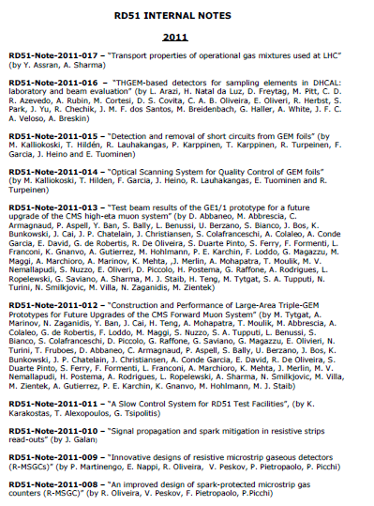
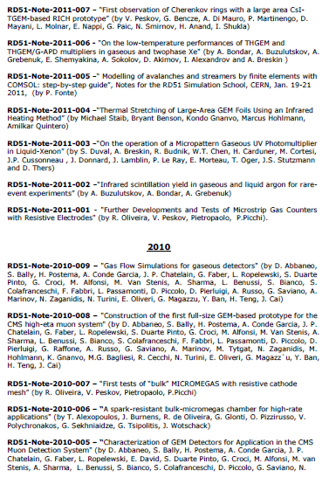
RD51 Collaboration Notes
https://espace.cern.ch/test-RD51/RD51%20internal%20notes/Forms/AllItems.aspx
RD51 Notes: 4 in 2014
8 in 2013
12 in 2012
17 in 2011;
9 in 2010;
7 in 2009
Please submit results of your work, in parallel with journal publication, as RD51 Note:
Efficient way to disseminate your results to the MPGD/RD51 community
(rd51-all email goes to ~ 500 people)

Slide 8
2014 RD51 Collaboration Meetings and Communications:
February 3-5: RD51 Electronics School (CERN) - https://indico.cern.ch/event/283113
February 5-7: RD51 Collaboration Meeting (CERN) - https://indico.cern.ch/event/283108
June 4: RD51 Report to the LHCC (CERN) - https://indico.cern.ch/event/319702
June 16-20: RD51 Mini-Week (CERN) - https://indico.cern.ch/event/323839
July 21: Special Event - Georges Charpak - 90th Anniversary (Lviv, Ukraine) - “CERN 60 Years of Science for Peace” - https://indico.cern.ch/event/331478/overview
October 27-28: International Workshop on Advanced Detectors (Kolkata, India) -
http://indico.vecc.gov.in/indico/conferenceTimeTable.py?confId=31#20141027
October 29-31: RD51 Collaboration Meeting (Kolkata) - https://indico.cern.ch/event/348222
December 8-12: RD51 Mini-Week (CERN); Neutron Detection with MPGD: follow-up event
RD51 Communications:
RD51 Collaboration Meetings Agenda:
http://rd51-public.web.cern.ch/RD51-Public/Meetings/CollaborationMeetings.html
Collaboration Board Minutes:
https://espace.cern.ch/test-RD51/CB%20meeting%20minutes/Forms/AllItems.aspx
Management Board Minutes:
https://espace.cern.ch/test-RD51/MB%20meetings/Forms/AllItems.aspx

Slide 9
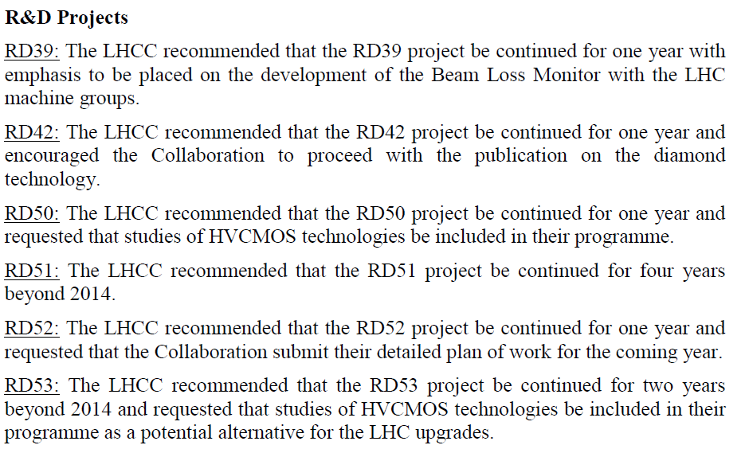
RD51 LHCC Review (2014)
LHCC Executive Summary:
LHCC Minutes
(June 4-5, 2014):
Following RD51
presentation to the
LHCC
Recognition of
the RD51 efforts
Referee Report on RD51:
The Committee took note of the numerous RD51 achievements. Recent support for LHC-related activities
includes development of Micromegas for the ATLAS muon system upgrade, GEMs for the CMS muon system
upgrade as well as GEMs for the ALICE TPC upgrade. The developments of the Scalable Read-out System
(SRS) electronics over last year was considerable with ~30 experimental groups procuring elements of this
system and ~20 more orders in the pipeline with 27 students attending SRS electronics school this year.
The referee also reported on RD51’s plans for beyond 2014. The plans include continuation of R&D support for the LHC experiments and their upgrades; generic R&D; development and maintenance of software and simulation tools; development and maintenance of software of SRS electronics; industrialization of the MPGD technology; maintenance and extension of the RD51 laboratory and test beam infrastructure
RD51 is a successful R&D Collaboration with well-defined and important future plans.

Slide 10
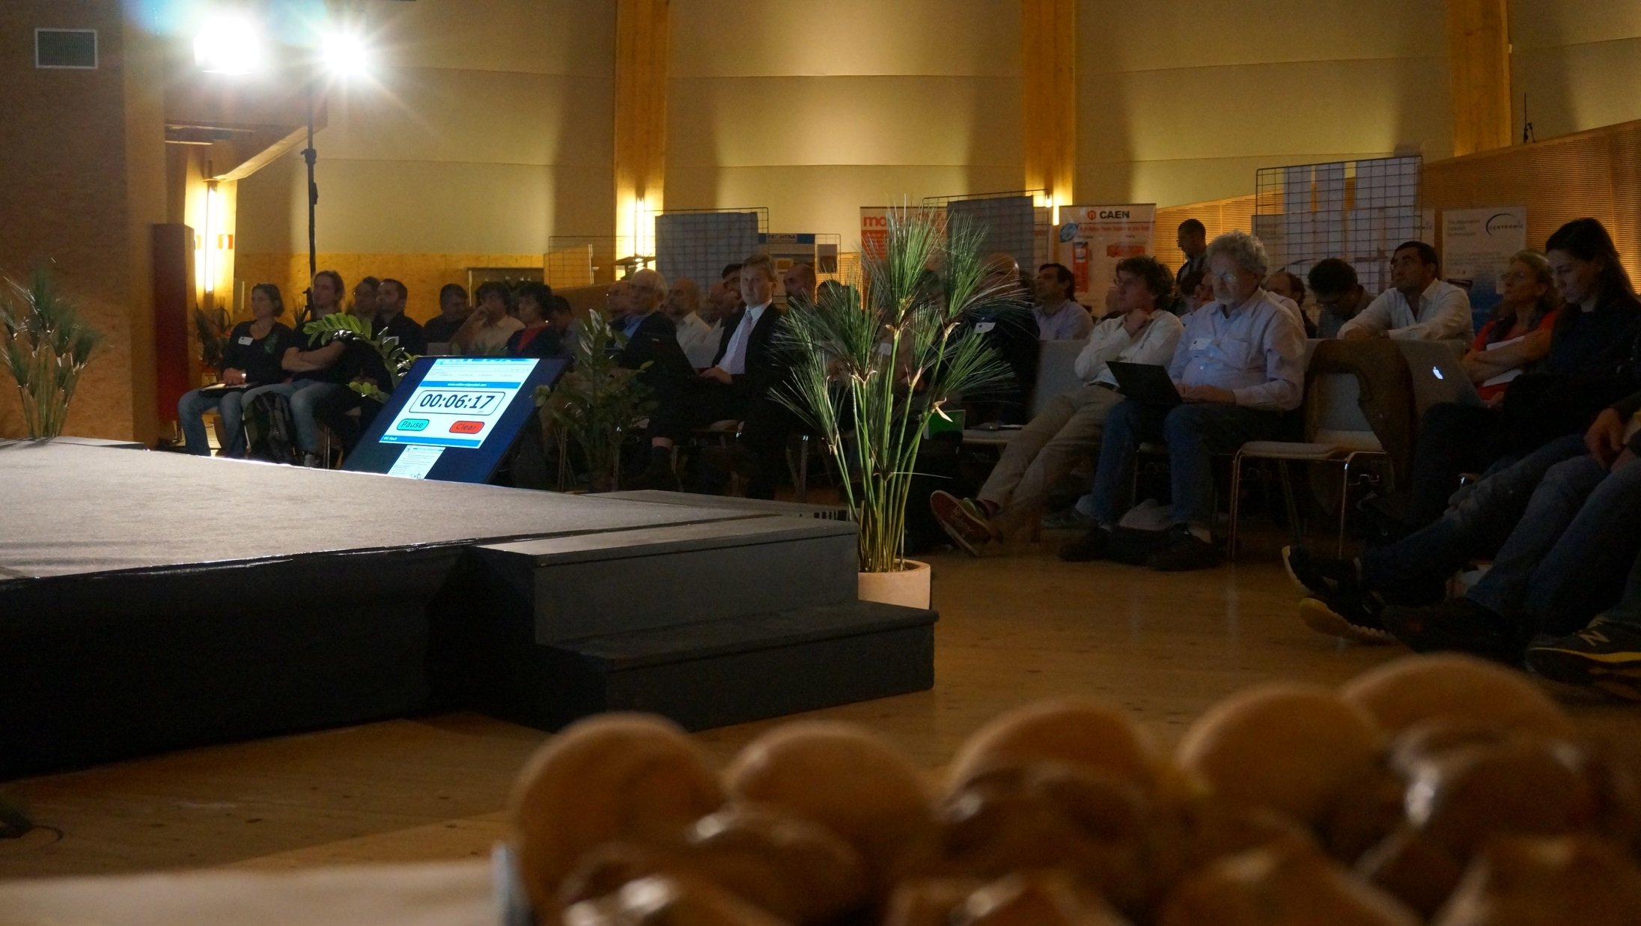
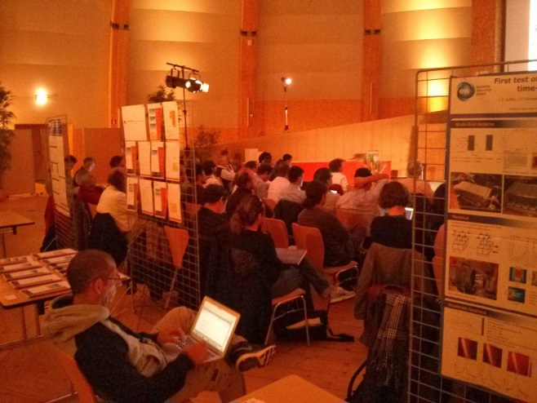
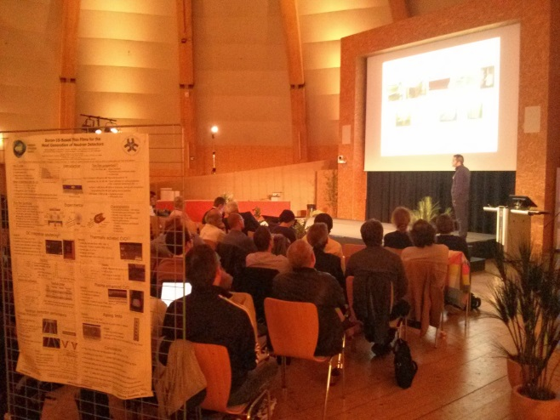
14-15 October 2013: 1st RD51 Academia – Industry Matching Event
“Special Workshop on Neutron Detection with MPGDs”
Research + industry + potential users focused on dedicated applications
91 participants: https://indico.cern.ch/conferenceDisplay.py?confId=265187

Slide 11

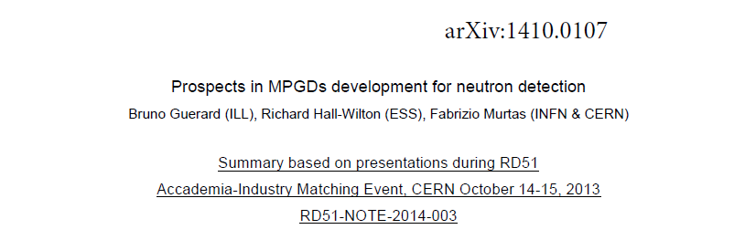
Summary of the 1st Academia – Industry Matching Event
“Neutron Detection with MPGDs”
… IS NOW PUBLISHED !!!
Many thanks to the
efforts of organizers:
Bruno Guérard
Fabrizio Murtas
Richard Hall-Wilton
Discussions are ongoing about organization:
Follow-up Event on
“Neutron Detection with MPGD”
2nd Academia-Industry Matching Event
“Photon Detection with MPGD”

Slide 12
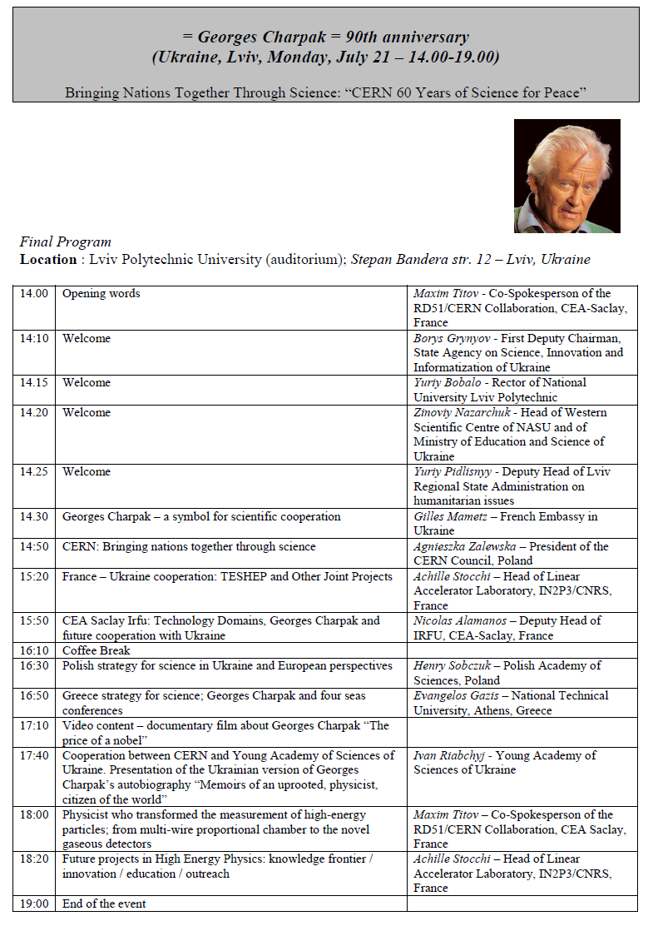
90th Anniversary of
Georges Charpak
Ukraine, Lviv
July 21, 2014
Bringing Nations
Together
Through Science
“CERN 60 Years of
Science for Peace”

Slide 13
A conference: 90th Anniversary
of Georges Charpak
was organized in the framework of the
Trans-European School of High Energy Physics (TESHEP)
by the
French Embassy in Ukraine,
EU – “Science and Technology Center in Ukraine (STCU)"
LAL/IN2P3 – CNRS
Irfu/CEA Saclay
CERN
RD51 Collaboration
Ukrainian State Agency on Science, Innovation and Informatization
Lviv Polytechnic University

Slide 14
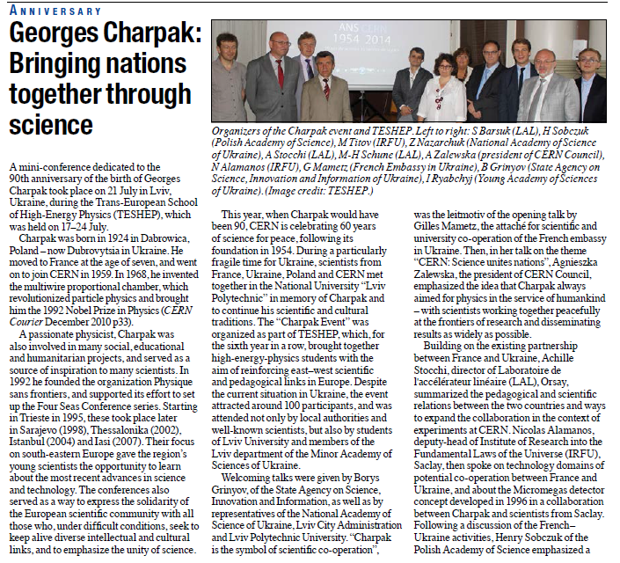
Georges Charpak : 90th Anniversary – Bringing Nations together through Science
During a particularly
fragile time for Ukraine,
scientists from France,
Ukraine, Poland and
CERN met together in
the National University
“Lviv Polytechnic” in
memory of Charpak and
to continue his scientific
and cultural traditions.
Slides are available at:
https://indico.cern.ch/event/
331478/timetable/#20140721
CERN Courrier Article, November 2014
Slides/photos are available:
https://indico.cern.ch/event/
331478/timetable/#20140721
http://cern60.web.cern.ch/en/galleries

Slide 15
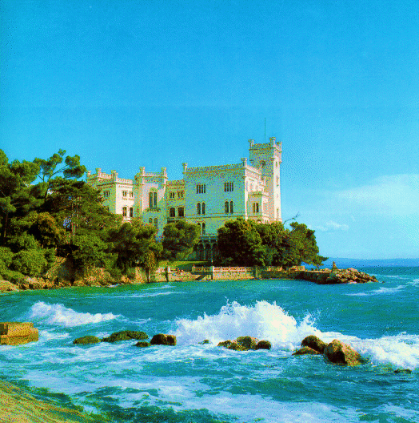
4th MPGD Conference in 2015 @ TRIESTE, ITALY
DATES: 12 (Monday) – 16 (Friday) Oct. 2015, arrival on 11 Oct. (Sunday)
including
3 fully days: conference
1.5 days: RD51 meeting
0.5 days: excursion
According to the scheme →
Ongoing activity
  Preparing the contract with the Congress Centre
  Pre-booking of the hotels
  Preparation of the web page
S. Dalla Torre

Slide 16
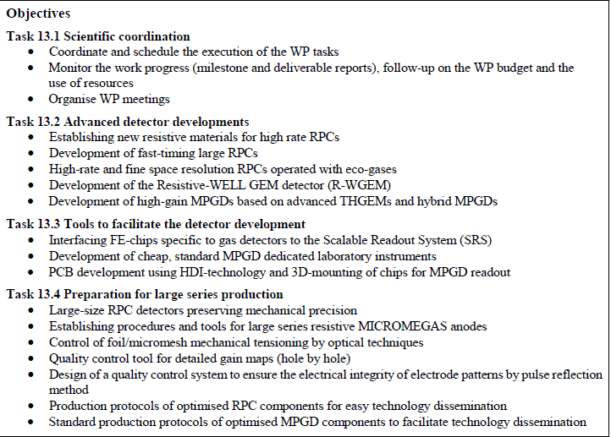
EU- AIDA2020 Proposal
Proposal submitted
on 2/9/2014
It includes the WP:
JRA1 - Innovative Gas
Detectors (MPGD & RPC)
  coordinators:
  S. Dalla Torre
  I. Laktineh
Several tasks of
general interest for RD51
Institutions involved in MPGD tasks:
CEA, CERN, INFN,
MPG, Ulund, Wigner
The MPGD Items are evident in the list:
S. Dalla Torre
Thanks to coordination of Silvia Dalla Torre (INFN Trieste)

Slide 17
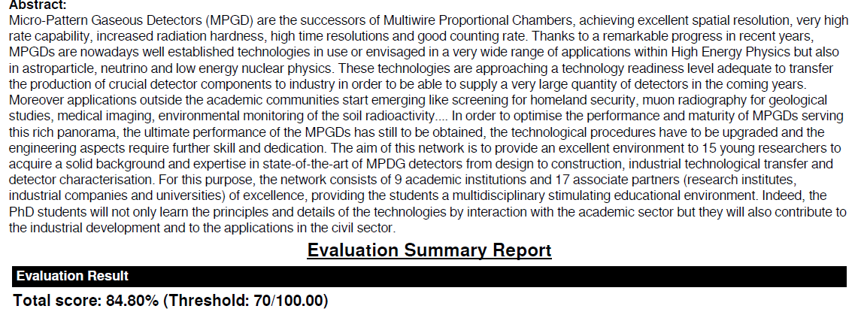
RD51 GASeous detectors NEwork Training for academic and industrial applications (GASNET)
Horizon 2020 / GASNET: 9 academic institutions and 17 associate partners
Thanks to coordination of Esther Ferrer Ribas (CEA Saclay)
→ The overall score leads to a ranking which does not allow your proposal to be funded
Strong proposal, but some areas of improvements identified by the referees:
The role of non-academic partners in the training programme is modest and apparently still
under investigation.
The participation of the non-academic partners in the management is not entirely convincing in the description, reflecting the fact that their roles are not central in this research and training
GOAL IS TO RE-SUBMIT proposal early 2015
IDEAS OF HOW TO IMPROVE PARTNERSHIP WITH INDUSTRY IS OF A KEY IMPORTANCE

Slide 18
RD51 Support for Common Projects
A. White
This RD51 funding is intended to support part of the project cost in the areas of common interest to the community described in the RD51 proposal:
Generic R&D projects towards developments of novel techniques, improvements of existing structures, characterization methods and dedicated tools;
Developments and optimization of MPGDs for applications outside HEP with a possibility of technology transfer to industry.
The minimum number of participating institutes in the common project is 3;
The maximum contribution from the RD51 common fund per each institute is 5000 CHF;
The maximum contribution from the RD51 common fund per project is 30000 CHF per calendar
year. This implies that a minimum number of 6 institutes is required to reach the maximum
allowed contribution of 30000 CHF.
At least, 50% of the total cost for the RD51 common project must be provided by the participating
institutes. Each participating institute should provide list of internal financial resources (grants,
institute financing, … etc. ) to complement RD51 Common fund contribution. The internal
financial resources will stay within the participating institutes.
Financial contribution from the RD51 common fund can be used to purchase materials and
consumables (ordered via CERN). Manpower cost could not be supported under this call.
The MB selects new proposals:
Institutes can participate in a new project only if they finished already approved projects +
note submitted
Continued funding of a project will be reviewed and decided on a case by case basis.
RD51 Common Fund could not be used for orders of existing MPGD detectors
(e.g. standard GEM, MM, THGEM) and electronics (e.g. SRS, ASICs)

Slide 19
Current RD51 Common Projects
A. White
Thin and high-pitch laser-etched mesh manufacturing and bulking (Saclay / CERN / Bari)
Contact: vincenzo.berardi@ba.infn.it; paul.colas@cea.fr
2) Development of innovative resistive GEM alpha detectors for earthquakes prediction and
homeland security (INFN Bari / UNAM, Mexico / INFN Padova / INFN Frascati)
Contact: vladimir.peskov@cern.ch
3) MPGDs technology laboratory for training, development, fabrication, applications and innovation
(Universidad Antonio Nariño, Columbia / Brookhaven National Laboratory/ Helsinki Institute of
Physics / HEPTech / GSI Helmholtzzentrum) Contact: director.sistemas.complejos@uan.edu.co
4) A low mass microbulk with real XY strips structure (NCSR Demokritos / Saclay/ Laboratorio de
Física Nuclear y Astropartículas, Universidad de Zaragoza / CERN )
Contact: geral@inp.demokritos.gr
High resolution UV scanner for MPGD applications” (Wigner FCP/INFN Trieste/ INFN Bari )
Contact: Dezso.Varga@cern.ch
2) Large-area THGEM detector evaluation with SRS electronics
(Weizmann/Coimbra/Aveiro) Contact: amos.breskin@weizmann.ac.il
3) R&D on large area GEMs for the ALICE TPC upgrade (GSI/ Tokyo / UNAM)
Contact: chilo.garabatos.cuadrado@cern.ch
2011 Common Projects:
2012 Common Projects:

Slide 20
Evaluation Procedure for the RD51 Common Projects
A. White
Each Common Project (CP) should be evaluated annually
The first review should occur 12 months after the award approval notice
The primary goals of the review would be:
1) Evaluation of status of the CP with respect to the originally approved project description
2) Adherence to the rules for RD51 CP's
3) Status of the use of the approved RD51 funds
4) Prospects for completion of the CP and expected time of completion
5) Evaluation of potential benefit(s) to RD51 and HEP community
6) Opportunity for guidance from the reviewers towards successful completion of the CP
- Two reviewers with requisite expertise will be drawn from the HEP community:
- Reviewers to be nominated by the Chair and Deputy Chair of the CB.
- Approval of reviewers by the RD51 MB.
- A reviewer should not currently be receiving support for a RD51 CP.
Each CP to be reviewed will submit a report to the Deputy Chair of the CB at least
one month ahead of the start of the review.

Slide 21
RD51 Common Projects
Potential to streamline procedures, evaluation process
and outcome for the community
Evaluation of current Common Projects
Seven projects in progress.
Spring 2014 – request sent for CP progress reports
Expert reviewers selected from RD51 community
Pair of reviewers/CP – one combined report from each pair
Status of reviews: 6/7 reports received, 3/6 reviews received
- pursuing the completion of the remaining reviews
- reviews will be considered by RD51 MB
=> Modification of evaluation procedure for future reviews:
- keep pairs of reviewers, but ask for independent reports
New Common Project requests
Four new projects proposed.
Under consideration by the MB.
A. White
Silvia Dalla Torre – CB Chair
Andy White – CB Deputy Chair

Slide 22
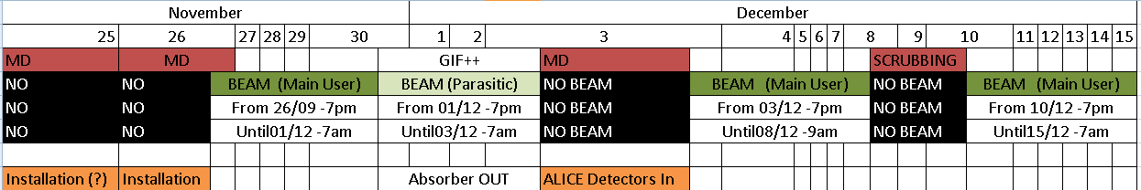
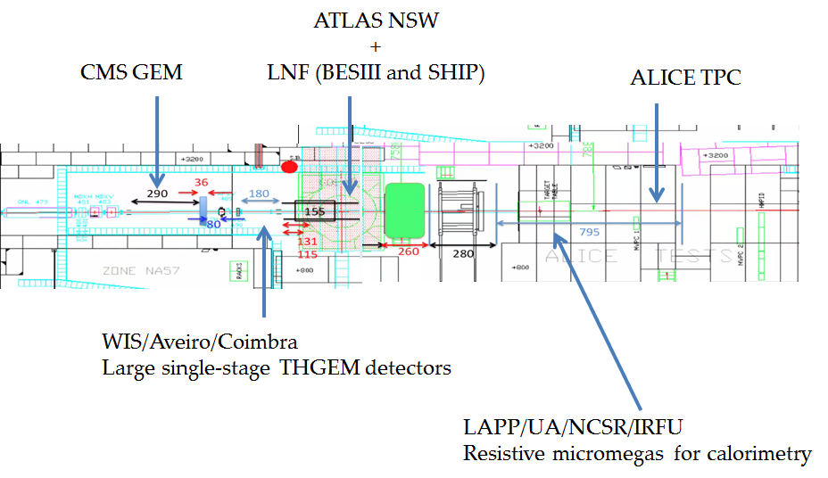
WG7: Common Test Beam Facility at H4 SPS
2014 RD51 test beam period (Nov 26 - Dec 15): based on
http://ps-schedule.web.cern.ch/ps-schedule/schedules/sps/2014/v205/SPSDetailedSchedule.pdf
Preliminary
Layout:
E. Oliveri,
Y. Tsipolitis

Slide 23
WG7: Common Test Beam Facility at H4 SPS
6 RD51 groups expressed interest to participate → details in WG7 session on friday
ALICE TPC Upgrade with MPGD
Specific Requirements: End of the beam line (Shower)
chilo.garabatos.cuadrado@cern.ch, alexander.deisting@cern.ch
ATLAS NSW Project (micromegas)
Specific Requirements: GOLIATH
paolo.iengo@cern.ch, Theodoros.Alexopoulos@cern.ch
CMS GEM Muon Upgrade : GEM Collaboration
Specific Requirements: One Tracker and APV/SRS & VFAT/TURBO readout
jeremie.alexandre.merlin@cern.ch, brian.l.dorney@cern.ch
FRASCATI - Triple GEM in magnetic Field (BESIII and Ship experiment)
Specific Requirements: GOLIATH, Mixer with Isobutane
Giovanni.Bencivenni@lnf.infn.it, Danilo.Domenici@lnf.infn.it, giulietto.felici@lnf.infn.it
WIS/Aveiro/Coimbra - Large single-stage THGEM detectors
Specific Requirements: One Tracker and APV/SRS readout
shikma.bressler@cern.ch, cdazevedo@ua.pt
LAPP/UA/NCSR/IRFU – Resistive micromegas for calorimetry
Specific Requirements: End of the beam line
Theodoros.Geralis@cern.ch, chefdevi@cern.ch
E. Oliveri,
Y. Tsipolitis

Slide 24
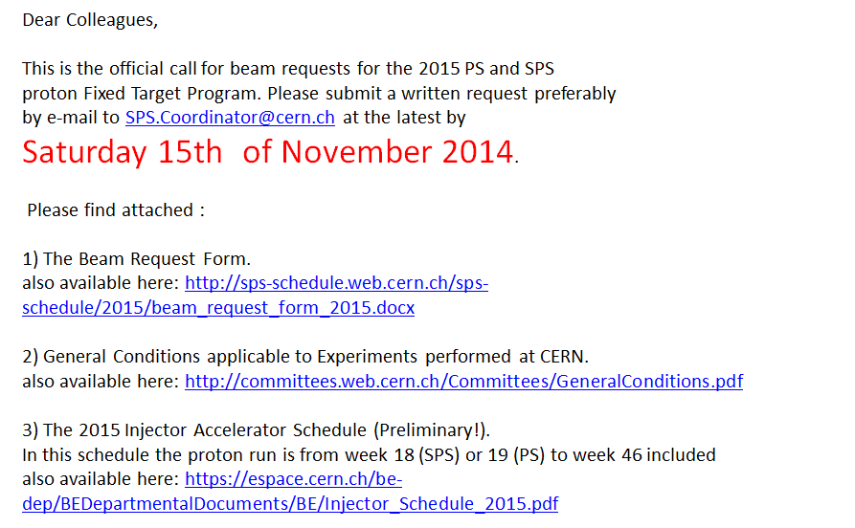
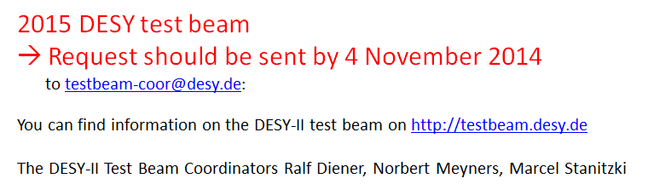
WG7: 2015 SPS RD51 Test - Beam
Three RD51 test-beam
periods in 2015 will be
requested by the RD51:
→ June / August /
November
“Expression of Interest”
will be coordinated by
the WG7 Conveners
RD51 equipments and
support available
if needed
E. Oliveri,
Y. Tsipolitis
Message from the SPS coordinator:
RD51 Equipments
(no support in DESY)
available if needed

Slide 25
14th RD51 Collaboration Meeting (Oct. 29-31, 2014)
https://indico.cern.ch/event/348222/other-view?view=standard
Today:
Wednesday, October 29
09:30 – 10:10 RD51 Collaboration News
10:10 – 13:30 WG6 Production
13:30 – 14:30 Lunch
14:30 - 18:30 WG4 Software
18:30 - 20:00 RD51 Collaboration Board Meeting
Thursday, October 30
09:30 – 10:00 WG5 Electronics
10:00 - 12:00 WG1 MPGD Technologies and New Structures
12:00 - 13:30 Lunch
13:30 - 19:00 Excursion
Friday, October 31
09:30 - 13:30 WG2 Physics Issues
14:30 – 16:30 WG7 Test Beams
The RD51 Meeting in Kolkata is open to ALL
IWAD participants and Detector Instrumentation Experts
Please join us if you are interested in the MPGD technology
(even if you are not a member of the RD51)
We strongly encourage young people to participate in the RD51 Meeting

