Slide 1
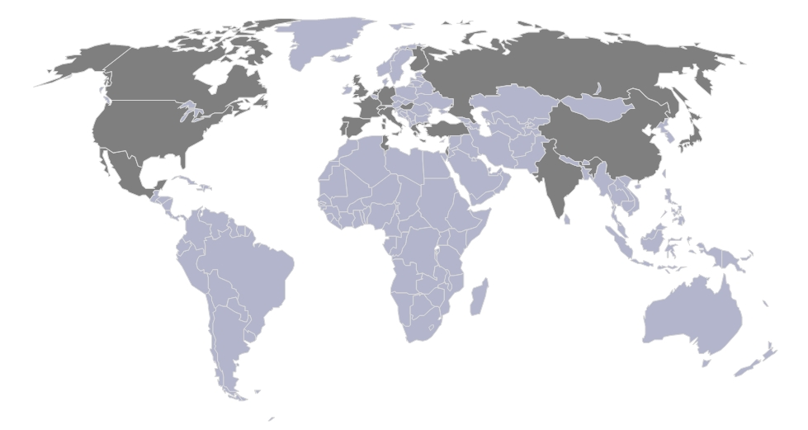
Micropattern Gas Detectors Technologies
and
RD51 Collaboration
Paul Colas and Leszek Ropelewski
CEA Saclay and CERN PH DT DD
OUTLINE:
Overview of MPGD Technologies
RD51 Collaboration Activities
Technology Achievements
Detector Assembly Optimization, QA, Long Term Stability
Electronics for MPGDs
Software tools
MPGD workshop upgrade & industrialization
Lab and test beam facilities
Training and Outreach
RD51 Collaboration Site

Slide 2
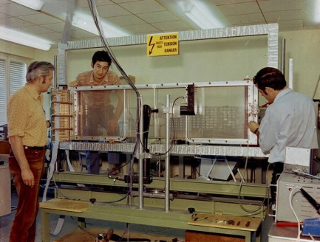
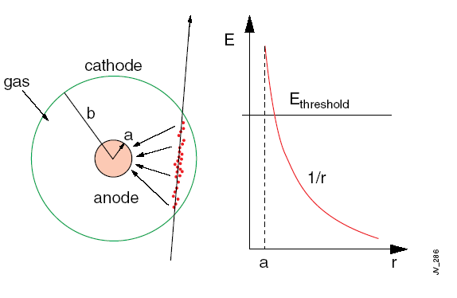

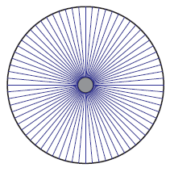
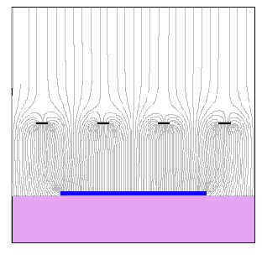
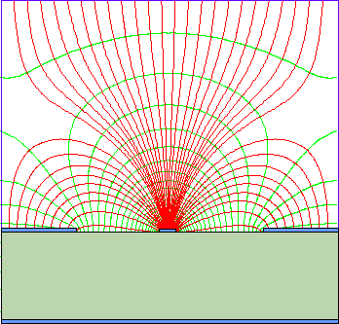
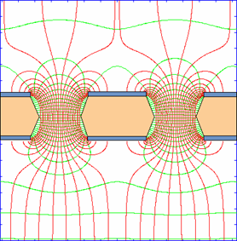
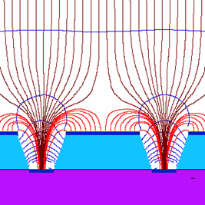
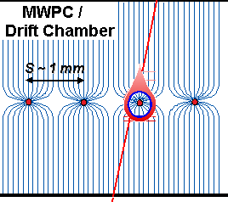
Gaseous Detectors
Best way to make detectors on large volumes with little matter and at low cost
Electrons liberated by ionization drift towards
the anode wire.
Electrical field close to the wire (typical wire Ø
~few tens of μm) is sufficiently high for electrons
(above 10 kV/cm) to gain enough energy to ionize
further → avalanche – exponential increase of
number of electron ion pairs.
The influence of (slower) ions on a conductor
generates a current in a pre-amplifier
The cylindrical geometry is not the only one to generate a strong electric field:
wire
mwpc
parallel plate
strip
hole
groove/well

Slide 3
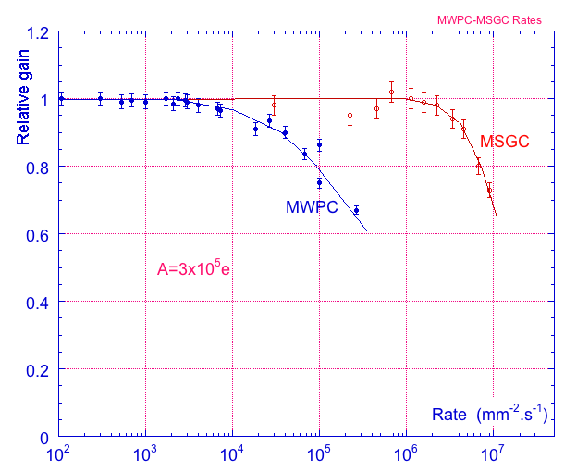
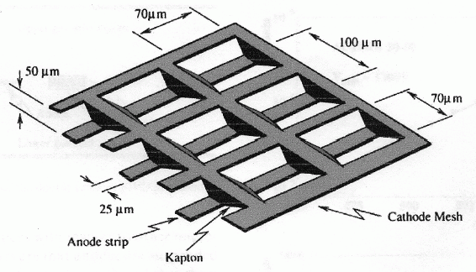
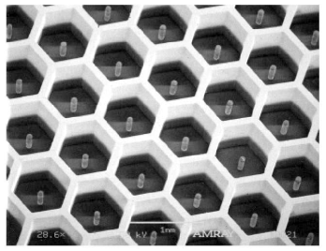
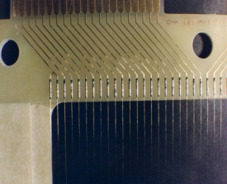
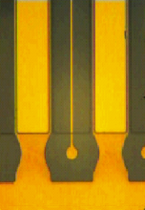
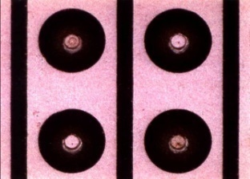
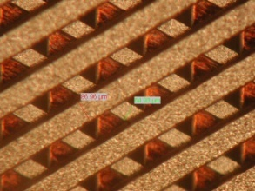
Micro-Pattern Gas Detectors
Printed Circuit Board (PCB) technology allowed micro-structures to be patterned
In the 1990s
Photolithography
Etching
Coating
And later silicon wafer post-processing allowed to go further in small patterns
Amplifying cell
size reduction by
factor of 10
Operational instabilities:
Substrate charging-up
Discharges
Polymer deposition (ageing)
Rate Capability>10⁶/mm²
Position Resolution ~40μm
2-track Resolution ~400μm
MWPC
MSGC

Slide 4
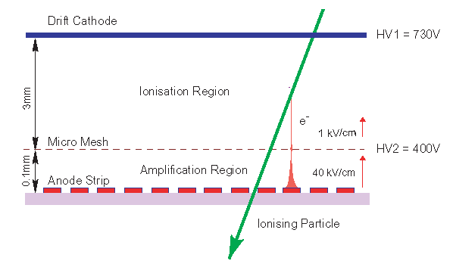
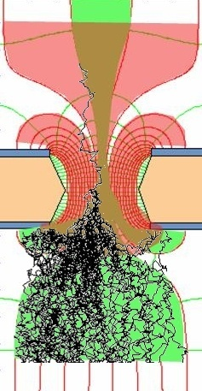
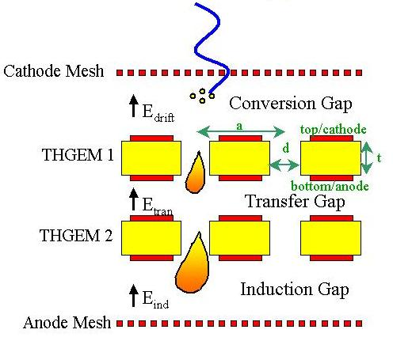
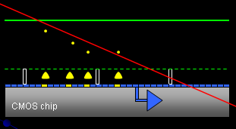
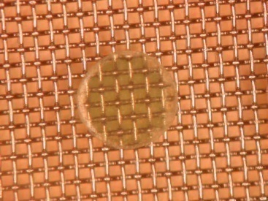

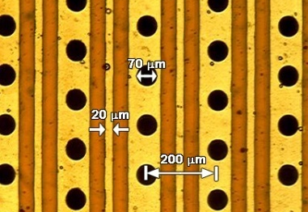
Micro-Pattern Gas Detectors
High Rate Capability
High Gas Gain
Good Space, Time and Energy Resolution
Good Ageing Properties
Ion Backflow and Photon Feedback Reduction
Large Size
Low Cost
Rate Capability Comparison for MWPC and MSGC
Ions
40 %
60 %
Electrons
Micromegas
GEM
THGEM
MHSP
Ingrid
4

Slide 5
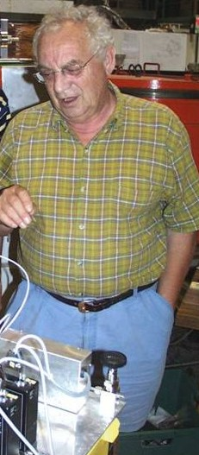
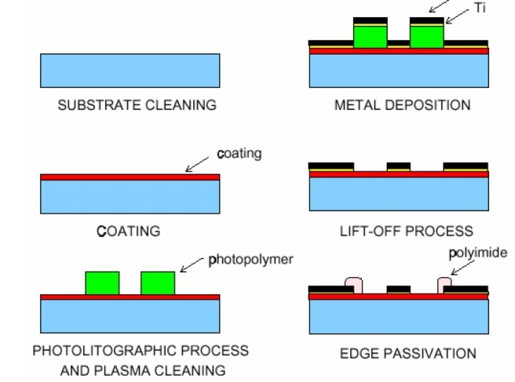
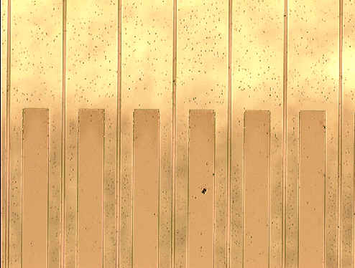
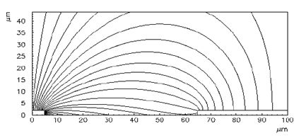
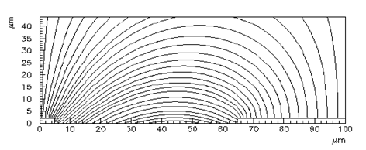
MSGC – MicroStrip Gas Chamber
Thin metal strips on insulating support replace the wires
However
High discharge probability under exposure to highly ionizing particles caused by the regions of very high E field on the border between conductor and insulator.
Charging up of the insulator and modification
of the E field → time evolution of the gain.
Anton Oed
200 μm
insulating support
slightly conductive support
Solutions:
slightly conductive support
multistage amplification
R. Bellazzini et al.

Slide 6
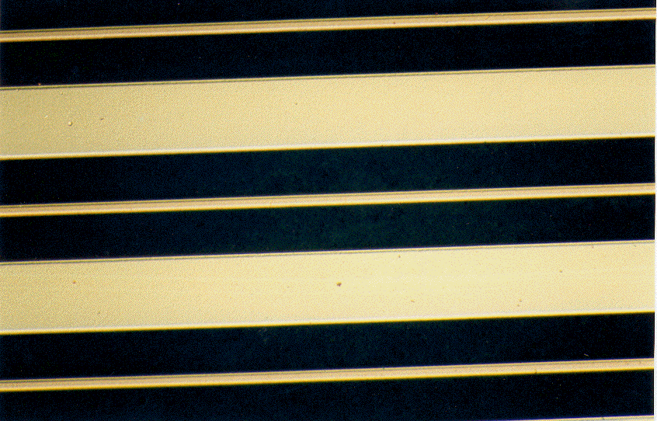
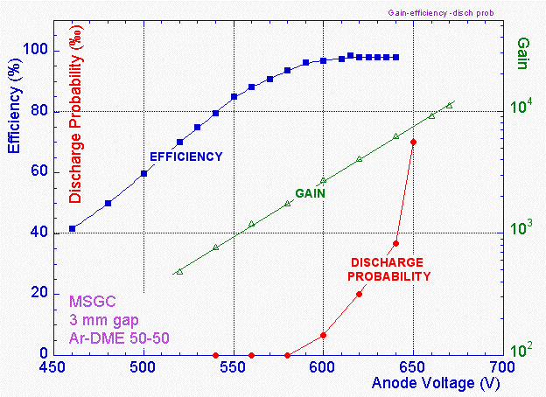
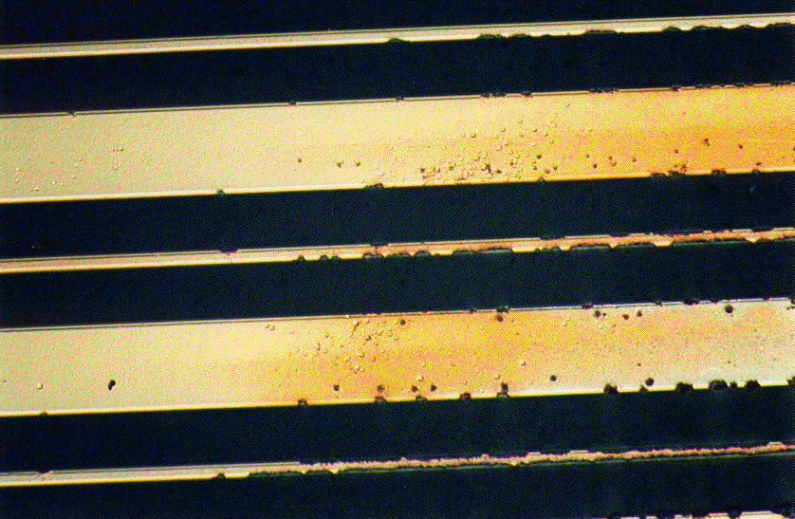
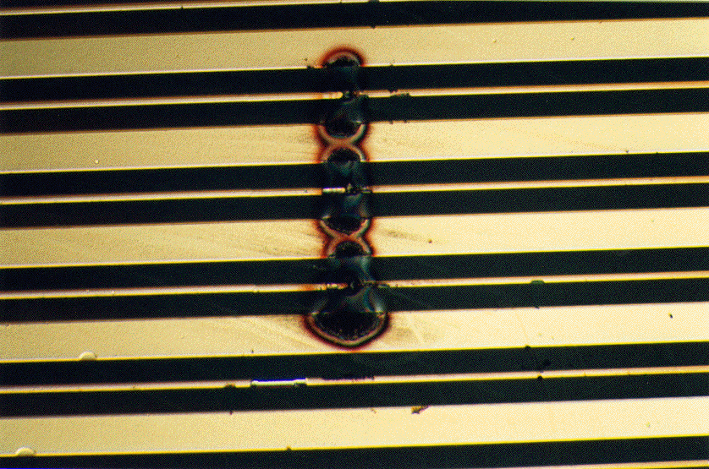
MSGC – MicroStrip Gas Chamber
Surface charging
Bulk resistivity of the support material
Surface modification by doping or deposition
Discharges
High gain is at the cost of instability
LETHAL DAMAGES

Slide 7
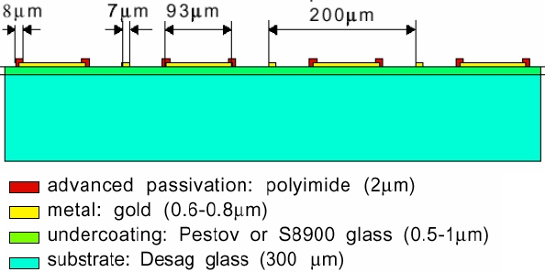
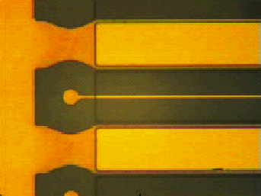
MSGC – MicroStrip Gas Chamber
Cathode edge passivation
Advanced passivation
Standard passivation
Bellazzini et al.

Slide 8
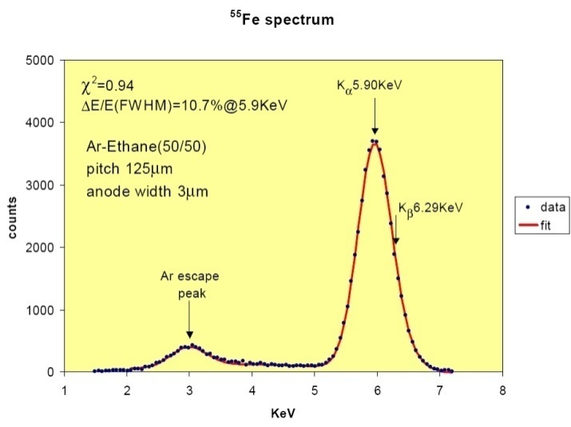
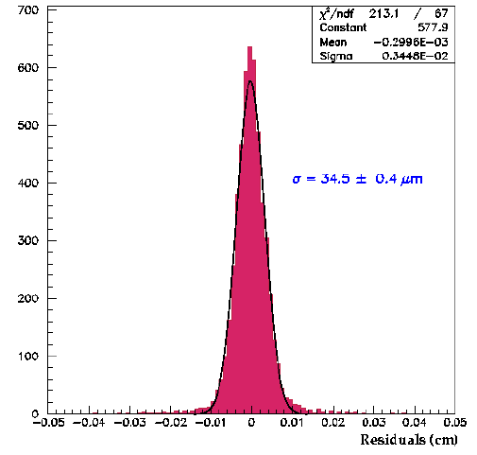
MSGC – MicroStrip Gas Chamber
Energy resolution ~11% for 5.9 keV
Single event wire map
Ne(25)-DME(75)
Vcath= -530 V
Vdrift= -3000 V
Surface resistivity !!
Spatial resolution = 34.5 ± 0.4 μm
2-track resolution ~400 μm
Rate capability > 1 MHz/mm²

Slide 9
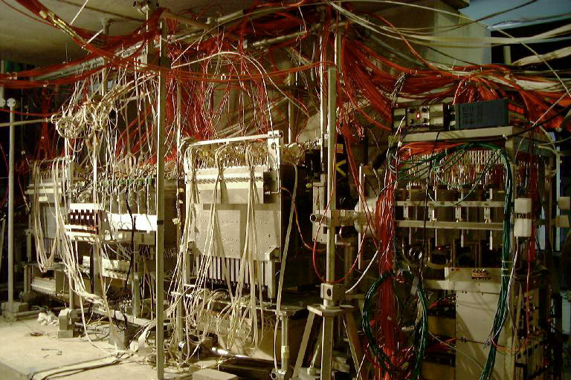
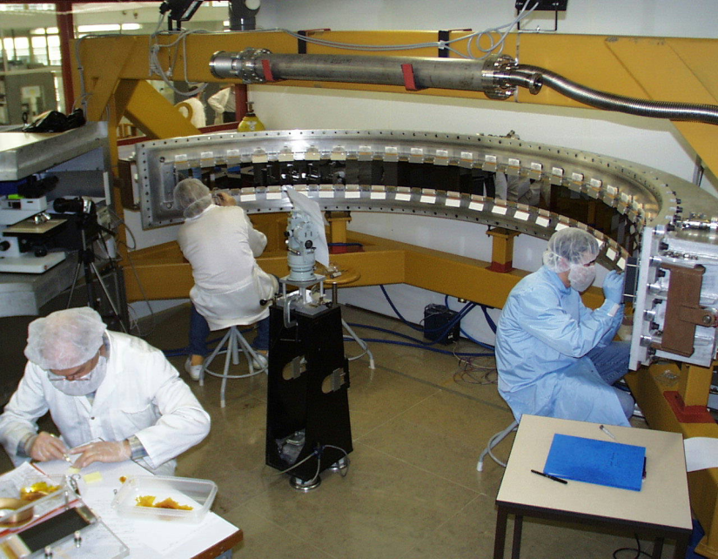
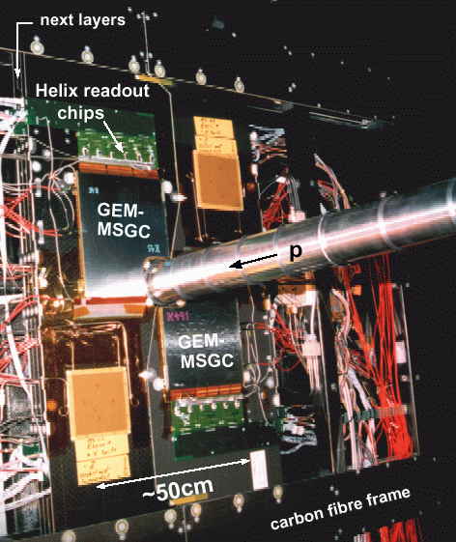
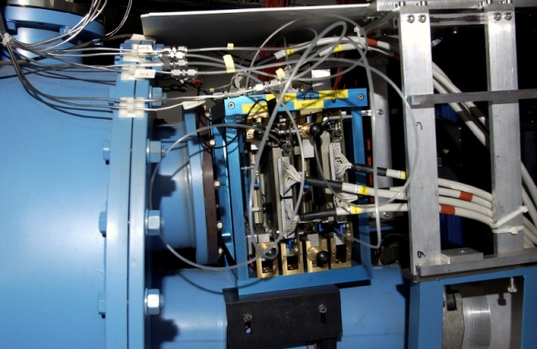
MSGC – MicroStrip Gas Chamber
Telescope of 32 MSGCs tested at PSI in Nov99 (CMS Milestone)
HERA-B Inner Tracker
MSGC-GEM detectors
R_{min} ~ 6 cm
⇒ 10⁶ particles/cm²•sec
300 μm pitch
184 chambers: max 25x25 cm²
~ 10 m²; 140.000 channels
The D20 diffractometer MSGC
is working since Sept 2000
1D localisation
48 MSGC plates (8 cm x 15 cm)
Substrate: Schott S8900
Angular coverage : 160° x 5,8°
Position resolution : 2.57 mm ( 0,1°)
5 cm gap; 1.2 bar CF4 + 2.8 bars 3He
Efficiency 60% @ 0.8 Å
DIRAC
4 planes MSGC-GEM
Planes 10x10 cm²

Slide 10
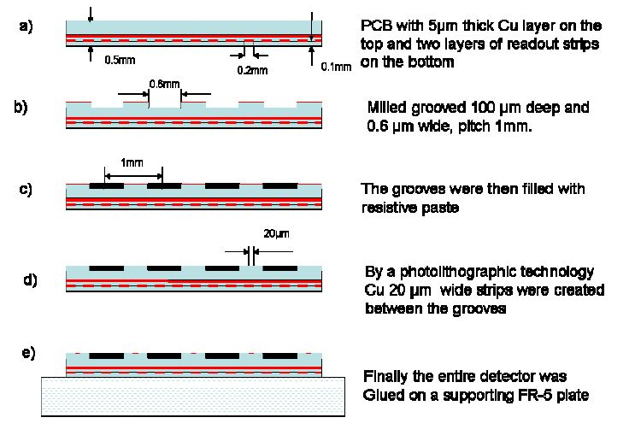
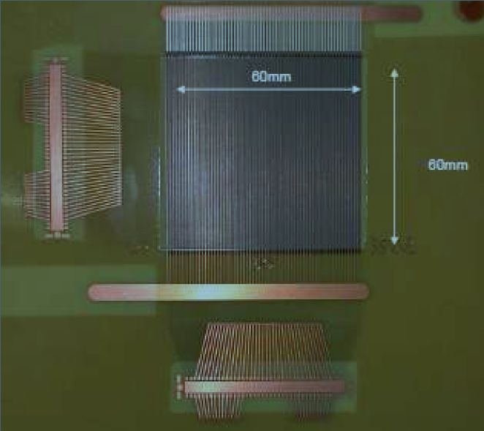
MSGC – MicroStrip Gas Chamber
2D resistive MSGC
V. Peskov

Slide 11
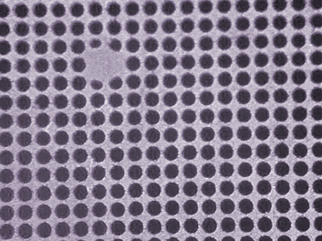
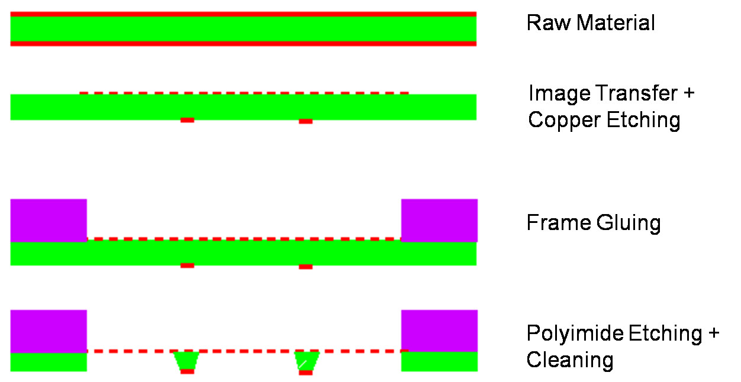
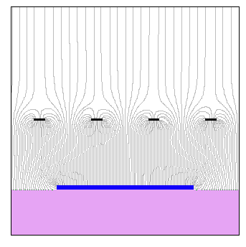
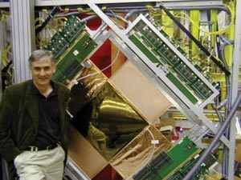
Micromegas – Micromesh Gaseous Structure
Micromesh mounted above readout
structure (strips or pads).
E field similar to parallel plate detector.
E_{a}/E_{i} ~ 50-500 to secure electron transparency
and positive ion flow back suppression.
100 μm
E_{i}
Ioannis Giomataris
E_{a}
Y.Giomataris et al, NIM A 376 (1996) 29

Slide 12
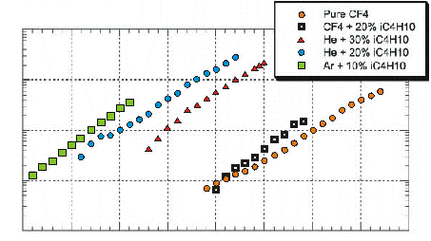
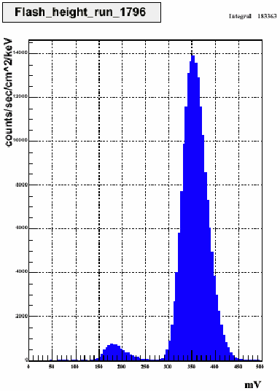
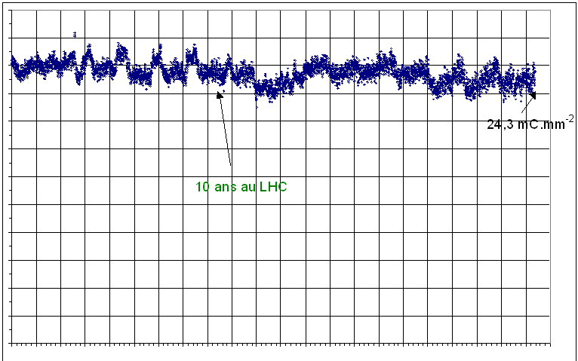
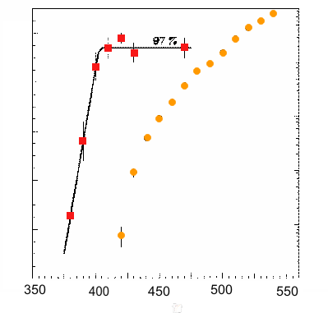
Micromegas – Micromesh Gaseous Structure
gain
efficiency & discharge probability
10⁻⁴
gain
1
0.9
10⁻⁵
10⁵
efficiency
discharge probability
10⁵
10⁻⁶
10⁴
0.8
0.7
10⁻⁷
10³
10⁻⁸
0.6
10²
350
400
450
500
550
600
650
High Voltage [V]
High voltage [V]
energy resolution ~ 10%
ageing:Ar-iC₄H₁₀ 94-6% up to 24.3mC/mm²
1
0.8
0.6
0.4
0.2
⁵⁵ Fe
Ar + 10% C₄H₁₀
1.8*10¹² particles/mm²
10 years LHC
1000 10000 20000 30000 time[min]
D.Thers et al NIM A 469 (2001) 133

Slide 13
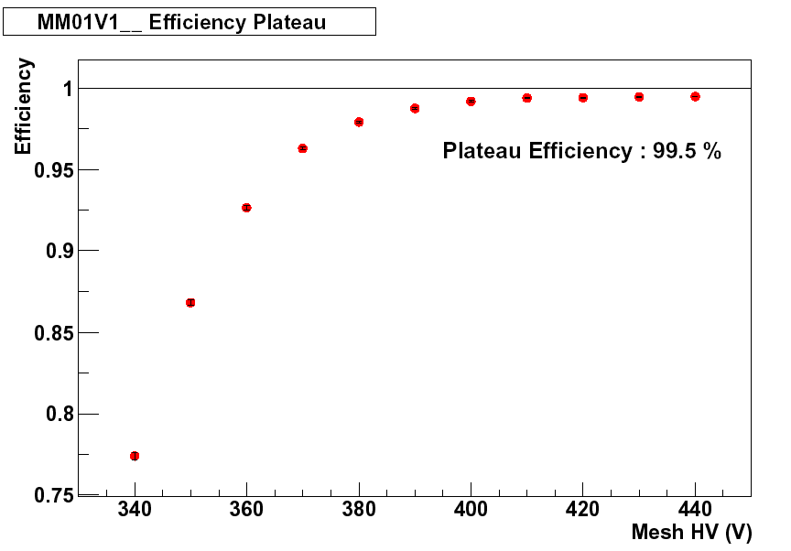




Micromegas – Micromesh Gaseous Structure
σ =70 µm
420 V operating point
~3-4.10³ Gain
Large efficiency plateau > 40 V
Spatial resolution < 70 µm
σ = 9 ns
300mm
Time resolution : 9 ns
D.Thers et al NIM A 469 (2001) 133

Slide 14




Micromegas – Micromesh Gaseous Structure
Pixelized Micromegas
D. Neyret
COMPASS Micromegas
P. Rebourgeard, F. Kunne

Slide 15


Bulk Micromegas technology
Y. Giomataris
R. de Oliveira
M. Chefdeville
PCB
lamination
Mesh deposit
lamination
Fine segmentation 1cm², thickness 8mm for ILC Hadronic calorimetry
Tested in the RD51 1 kHz beam
development
Bulk Micromegas ILC DHCAL first m²
LAPP Annecy
15

Slide 16


Micromegas – Micromesh Gaseous Structure
T2K TPC, A. Delbart, M. Zito
24 bulk-Micromegas
3 m² of bulk Micromegas
41472 FEE channels
Reconstructed cosmics
by a readout plane

Slide 17


Micromegas – Micromesh Gaseous Structure
Curved Micromegas CLAS12,
S. Aune
Micromegas ILC-TPC,
D. Attie, P. Colas
Red – thick
Micromegas
Blue – thin curved
Micromegas

Slide 18



Micro-Bulk Micromegas
Low background Micromegas,
J. Galan, E. Ferrer, A. Tomas
Micro-Bulk Micromegas
Th. Papaevangelou
Micromesh
5µm copper
Readout plane + mesh all in one
Kapton 50 µm
Readout pads
An I. Giomataris and R. De Oliveira idea
Lower capacitance
Under development
⁵⁵Fe Calibration with Ar – 5% isobutane @ 1 bar
Collimated source to avoid border effects
FWHM @ 6 keV = 11.5 %

Slide 19

MicroMegas detectors for the upgrade of the ATLAS muon system
Goal: development of large-area (≈2 x 1 m²) bulk-MicroMegas chambers for high-rate applications that combine precision measurement and trigger functionality
MAMMA Collaboration (21 institutes, including Arizona, Athens, BNL, CEA Saclay, CERN, Naples) in close collaboration with CERN/TE-MPE (R. de Oliveira) & CERN/PH-DT
Spark neutralization and/or suppression
  Resistive coating on readout strips
  Multi-stage amplification schemes
Underlying philosophy:
  Development and evaluation of full-size prototype chambers at CERN and in the collaborating institutes
  Transfer of know-how to competent industry
  Large-scale production in industry
March 2011
1.2 x 0.6 m² prototype chamber with 2048 readout strips (0.5 mm strip pitch) during construction in CERN/TE-MPE workshop
J. Wotschack

Slide 20

J. Wotschack
R. De Oliveira

Slide 21






MM Resistive strip protection
Bulking
Double sided Board
Res-strip depositing
Coverlay technique
Closing
Test before closing
Test
R. De Oliveira

Slide 22


MM Resistive strip protection
J. Wotschack

Slide 23


Bulk MicroMegas resistive anode and 2D readout
X/Y read-out
U/V/X read-out
R. De Oliveira

Slide 24
CAT – Compteur à trous
An insulator with holes is metalized both sides. A high potential difference is held between the two
sides. Avalanches take place after the holes.
Lemonnier
This is the ancestor of GEMs. According to F. Sauli, this is not a MPGD (but in this case, is THGEM a MPGD?
(Bartol et al., 1996 ; J. Chaplain et al., 1999)

Slide 25




GEM – Gas Electron Multiplier
Ions
I⁺
e⁻
40 %
Induction gap
60 %
e⁻
5 µm
50 µm
Electrons
55 µm
70 µm
Fabio Sauli
Thin, metal coated polyimide foil perforated
with high density holes.
Electrons are collected on patterned readout board.
A fast signal can be detected on the lower GEM electrode
for triggering or energy discrimination.
All readout electrodes are at ground potential.
Positive ions partially collected on the GEM electrodes.

Slide 26









GEM – Gas Electron Multiplier
Full decoupling of the charge amplification
structure from the charge collection and
readout structure.
Both structures can be optimized
independently !
Cartesian
Compass, LHCb
A. Bressan et al, Nucl. Instr. and Meth. A425(1999)254
Small angle
Hexaboard, pads
MICE
Compass
Totem
Most of the detectors use three GEM foils in cascade for amplification
to reduce discharge probability by reducing field strength.
Mixed
Totem

Slide 27


Multi-GEM Detectors
Discharge Probability on Exposure to 5 MeV Alphas
Multiple structures provide equal gain at lower voltage.
Discharge probability on exposure to a particles is strongly reduced.
S. Bachmann et al Nucl. Instr. and Meth. A479(2002)294

Slide 28




GEM – Gas Electron Multiplier
3.10⁶ particles/mm²
A. Bressan et al, Nucl. Instr. And Meth. A425(1999)262
Efficiency for minimum ionizing particles with 3 mm gap
Rate capability > 10⁶ Hz mm⁻²
GAIN ~ 10⁴
Ar-CO₂ 70-30
1 mC~2.10¹⁰ min.ion. particles
Space resolution ~ 40 μm rms
Cluster size ~ 500 μm FWHM
C. Altunbas et al, DESY Aging Workshop (Nov. 2001) Nucl. Instr. and Meth. A
J. Benlloch et al, IEEE NS-45(1998)234

Slide 29






GEM – Gas Electron Multiplier
9.7 ns
5.3 ns
4.5 ns
4.8 ns
Time resolution
Charge correlation (Cartesian readout)

Slide 30





GEM – Gas Electron Multiplier
Pixel GEM
B. Ketzer
COMPASS
B. Ketzer

Slide 31




LHCb Muon Trigger
Fast TripleGEM Detectors for LHCb Muon Trigger
12 double TGEM detectors operated with fast gas mixture (Ar-CO₂-CF₄)
Rate - 5 kHz mm⁻²
Time resolution 4.5 ns rms
Radiation hard up to integrated charge of 20 mC mm⁻² (15 LHCb years)
G. Bencivenni
20x24 cm² GEM modules
Pad readout plane
M. Alfonsi et al, Nucl. Instr. and Meth. A535(2004)319

Slide 32



GEM – Gas Electron Multiplier
TOTEM GEMs, T. Hilden, V. Greco
KLOE2 - Cylindrical Triple GEM
G. Bencivenni
Coincidence
Chips
VFAT Hybrids
11thCard
GEM
Chamber
Horse Shoe
Card
HV cables
Electronics cooling
S. Duarte Pinto
Read-out
Induction
Transfer 2
Anode
2 mm
Transfer 1
GEM 3
2 mm
GEM 2
2 mm
Conversion & Drift
GEM 1
3 mm
Cathode

Slide 33



TOTEM GEM - Readout Board
pads
radial strips
bonding contact
for pads
Ni Au
15 μm Cu
50 μm Polyimide
15 μm Cu
Epoxy glue
25 μm Polyimide
5 μm Cu
10 μm Cu
Epoxy glue
2004 prototype
125 μm FR4

Slide 34




GEM – Gas Electron Multiplier
GEM ILC HCAL, A. White
GEM ILC TPC,
T. Behnke, T. Matsuda
A. Sugiyami

Slide 35
Single Mask GEM
Base material : Polyimide 50um + 5um on both sides
Polyimide : Apical NP from company Kaneka (Japan)
Supplier of the copper clad material : Nippon Mining (Japan)
Double mask
Single mask
Same base material
Hole patterning in Cu
Polyimide etch
Bottom electro etch
Second Polyimide Etch
Limited to 40cm x 40cm due to
Mask precision and alignment
Limited to 2m x 60cm due to
Base material
Equipment
R. De Oliveira

Slide 36


Single Mask GEM
R. De Oliveira
Similar patterns , similar behavior, same material.
Angles can be adjusted in both structure (Typ. value : 70um copper hole , 50um polyimide hole)
  Steeper angles give lower gain but also reduced charging up ( similar as RIM in THGEM)

Slide 37




Single mask GEM technology
KLOE2 - Cylindrical Triple GEM
G. Bencivenni
Chemical Polyimide etching
Copper electro etching
Stripping
Second Polyimide etching
Result
Large area GEM detectors for KLOE2 tracker
Frascati
37

Slide 38


CMS High Eta MPGD Project (GE1/1 1.6>η>2.1)
CMS High Eta MPGD - Workshop (30 September 2010)
15 institutes, 60 participants
A. Sharma
Large Prototype: GE1/1
Beam Test @ RD51 setup
October 2010
Rate capability : 10⁴/mm²
Space/Time resolution: ~ 100 μm / ~ 4-5 ns
Efficiency > 98% ; Excellent Long Term Operation
Gas Mixture: Argon CO2 (non flammable mixture)
Large areas ~ 1m x 2m with industrial processes
38

Slide 39


CMS High Eta MPGD Project
  Time resolution for different
  gas mixtures and gap configurations:
  Ar(45):CO₂ (15):CF₄ (40)
  [gaps 3/1/2/1]
  Ar(70):CO₂(30)
  [gaps 3/2/2/2]
A. Sharma
39

Slide 40



THGEM – Thick GEM
(called LEM in Switzerland)
Standard GEM
THGEM
1mm
1mm
Thick GEM
A. Breskin
PCB tech - etching + drilling
Simple and robust
V_{TGEM}~2KV (at atmospheric pressure)
10⁵ gain in single- & 10⁷ double-TGEM
Sub-mm to mm special resolution
Fast (ns)
Low pressure (<1Torr) gain 10⁴
Microlithography + etching
High Spatial resolution (tens of microns); V_{GEM}~400V
>10³ gain in single GEM
10⁶ gain in cascaded GEMs
Fast (ns)
Low pressure – gain~30
V. Peskov, A. Breskin …

Slide 41

THGEM – Thick GEM
Thick GEM
A. Breskin

Slide 42




THGEM – Thick GEM – the role of the rim
Thick GEM
A. Breskin
Drilling + chemical rim etching without mask
Mask etching + drilling; rim = 0.1mm
10⁴
6 keV X-ray
pitch = 1 mm; diameter = 0.5 mm;
rim=40; 60; 80; 100; 120 μm

Slide 43






THGEM – Thick GEM / RetGEM Resistive Thick GEM
RET-thick GEM
R. Akimoto
V. Peskov
Thick GEM
S. Dalla Torre
F. Tessaroto
THGEM 1
CsI
drift
Gain increase → stability gets worsen.
At first few hours, gain drops down.
After that, the fluctuation of gain is within ±4%.
THGEM 2
2.0 mm
THGEM 3
2.0 mm
E_{transfer}
anode
2.0 mm
Notes:
43

Slide 44


RD51 Collaboration
The main objective of the R&D programme is to advance technological development of Micropattern Gas Detectors
http://rd51-public.web.cern.ch/rd51-public/
89 institutes
~ 500 people involved
Representation (Europe, North America, Asia, South America, Africa)
“RD51 aims at facilitating the development of advanced gas-avalanche detector technologies and associated electronic-readout systems, for applications in basic and applied research”
http://gifna.unizar.es/mpgd13/
Kobe, Japan, September 2011
RD51 contributes to the LHC upgrades, BUT, the most important is:
RD51 serves as an access point to
MPGD “know-how” for the world-wide community
44

Slide 45















RD51 Collaboration
RD51 Common Projects
Generic R&D
Long Term Stability
Large Area Detectors
Assembly Optimization
WG2:
WG1:
WG5:
RD51
Software Tools and
Simulations
MPGD Electronics
WG4:
WG7:
WG6:
Conferences, Meetings and Schools
CERN MPGD Workshop
Quality Control
and Industrialization
RD51 Common
Test Beam and Lab Facilities

Slide 46


Technology Development Highlights
GEM Single Mask Technique
Ions
40 %
60 %
GEM Single Mask Process
Electrons
Chemical Polyimide etching
CMS high eta upgrade triple GEM prototype in the RD51 test beam facility
Time resolution
4 ns
Copper electro etching
Stripping
Second Polyimide etching
Result
Standard double mask method limits max. size of the detector to 30x30 cm²
Single mask technique reduces costs and production time
Performance comparison (max. gain, stability, rate capability..) shows no difference
ALICE triple GEM TPC end-cap module
46
KLOE2 inner tracker: 4 layers of triple cylindrical GEM detectors

Slide 47

Technology Development Highlights
Resistive MicroMegas
Bulk MicroMegas Process
Standard Bulk MicroMegas suffers from limited efficiency at high rates due to discharges induced dead time
PCB
Lamination
Mesh deposit
Lamination
Development
ATLAS small wheels upgrade project
resistive MicroMegas prototype
47

Slide 48








Technology Development Highlights
THGEM Surface Treatment
Polyurethane Treatment
Non-treated THGEM suffers from: limited max. gain, response non-uniformity and time instabilities
Polishing and Cleaning
COMPASS RICH photo-detector upgrade prototype
48

Slide 49





Detector Assembly Optimization
Industrialization and Cost Reduction
Simplified Bulk MicroMegas & GEM NS2
ATLAS muon system MicroMegas upgrade assembly
CMS high eta project triple GEM detector assembled using self-stretching method
49

Slide 50







Quality Control
Electrical rigidity
Hole diameter uniformity in GEM
Gap uniformity in MicroMegas
THGEM thickness uniformity
Final detector calibration and characterization protocols and infrastructure
50

Slide 51



Long Term Stability
Classical gas detectors ageing detector
Radiation hardness and activation of detector components
Sustainability to neutrons and heavily ionizing particles induced discharges
Exposure to X-Ray, Gamma, Neutron and Alpha Sources
Monitoring infrastructure
Portable gas monitoring system for detector stability studies; to be used by LHCb and CMS upgrade of the muon system
Resistive MicroMegas stability performance under X-Ray irradiation
Discharge studies of the triple GEM detector exposed to the low energy neutron flux

Slide 52




New Developments Examples
Piggy Back, Light Beam Monitors, Glass GEM
Light ( 0.4 % X₀ ) 2D GEM detector for low energy antiproton beam monitoring
Glass GEM for sealed photon large area detector
Piggy Back – a novel method of the readout of the MPGD detectors using pixel chips; Electronics is completely separated from the detector volume
52

Slide 53






Development of Scalable Readout System (SRS) for MPGDs
Development of a portable multi-channel readout system (2009-2012):
Scalable readout architecture: a few hundreds channels up to very large LHC systems (> 100 k ch.)
Project specific part (ASIC) + common acquisition hardware and software
Physical Overview of SRS:
Scalability from small to large system
Common interface for replacing the chip
frontend
Integration of proven and commercial
solutions for a minimum of development
Default availability of a very robust and
supported DAQ software package
ADC frontend adapter
for APV and Beetle chips
ADC plugs into FEC to make a
6U readout unit for up to 2048
channels
FEC cards (common):
Virtex-5 FPGA, Gb-Ethernet, DDR buffer, NIM and LVDS pulse I/O, High speed Interface connectors to frontend adapter cards
Frontend hybrids:
based on
APV25, VFAT, Beetle, VMMx and Timepix chips
53

Slide 54


SRS Users Status
Produced by PRISMA Company (Greece), sold via the CERN store
ALICE EMCal Calorimeter upgrade, ORNL, SRS readout backend via DTCC links and 24 SRU’s , DATE Online system, being installed
ATLAS upgrade CERN, MAMMA project NSW , µMEGAS , APV frontend SRS Eurocrates-SRU, MMDAQ Online, installed
ATLAS upgrade Mainz, µMEGAS for MBTS, APV frontend- SRS Eurocrate, MMDAQ Online, waiting delivery
ATLAS Muon upgrade R&D, INFN Rome, APV frontend SRS Eurocrate, MMDAQ Online, delivered
ATLAS Saclay, µMEGAS R&D, APV frontend SRS Minicrate, MMDAQ Online, delivered
NA62 CERN straw tracker upgrade with µMEGAS, APV frontend with SRS Minicrate, MMDAQ Online, delivered
CMS upgrade CMS GEM collaboration CERN, Muon Endcaps, design of VFAT frontend digital readout SRS, ongoing with IFIN-HH
TOTEM upgrade GEMs Baris testlab, OPTO-Rx card design, Minicrate,Eurocrate, SRU, DATE Online, delivered
BNL GEM detectors, APV frontend-SRS Minicrate, RCDAQ Online, delivered
Stony Brook GEM detector R&D, APV frontend SRS Minicrate, RCDAQ Online, delivered
Bonn Phys. Inst. R&D for ILC, T24 DESY testbeam, Timepix Array Ingrid Module adapter for SRS , Eurocrate, Online unknown, ongoing
Florida Inst Tech GEMs, Muon Tomografy for Homeland security, 15k channel SRS prototype Eurocrate, DATE Online, delivered
Géosciences Azur-CNRS-UNSA, Muon Tomography w.µMEGAS for geology, APV frontend SRS Eurocrate, Date Online, delivered
GDD lab RD51, CERN, R&D for GEM and µMEGAS, APV frontend SRS Euro and Minicrates, DATE, Labview MMDAQ, delivered
HIP, HELSINKI, characterization MPGAD detactors, APV frontend SRS Eurocrate, DATE and Labview, delivered
INFN Napoli, ATLAS. Development of SRS Hardware and Firmware, Labview, delivered
Jefferson Lab, Virginia UVa upgrade GEM readout system, APV frontend SRS Eurocrate, DATE online, partially delivered
Yale University , GEM development ALICE, APV frontend SRS Eurocrate, DATE Online, delivered
NEXT Coll. small Xenon TPC with PM and Si PMs, SRS readout electronics co-development, SRS Eurocrate and SRU, DATE, delivered
UNAM, MEXICO, MX , R&D on THGEM, APV frontend SRS Minicrate, DATE Online, delivered
Radiation Laboratory, Nishina Center, RIKEN , APV frontend SRS Eurocrate, Online unknown, delivered
J-PARC /E16 experiment, GEM based tracking, APV frontend SRS Minicrate, Online Unknown, partially delivered
Jefferson Lab SHM spectrometer triple GEM, APV frontend SRS Eurocrate, DATE Online, waiting
Harward Univ. Physics, APV frontend SRS Minicrate, Online unknown, waiting
Tokyo Univ. ATLAS, APV frontend SRS Eurocrate, Online unknown, waiting
WIS and Aveiro Univ. GEM validation, APV Frontend SRS Eurocrate, MMDAQ and Labview, being delivered
East Carolina University, Health Physics, APV frontend, SRS Eurocrate, Labview, waiting
Munich LMU / ATLAS µMEGAS, APV frontend SRS Eurocrate –SRU, MMDAQ Online, partially delivered
NCSR Democritos ATHENS, APV frontend SRS Minicrate, Online unknown, waiting
IFIN-HH-Bucharest new Detector lab, APV and VFAT frontend, SRS Eurocrate and SRU, Labview, delivered
ATLAS NSW CERN, SRS-ATCA pilot system, MMDAQ Online, waiting
ALICE FOCAL ORNL, SRS-ATCA pilot system, DATE Online, waiting
NEXT Collaboration, SRS-ATCA pilot system, DATE Online, waiting
Lunds Univ, ILC TPC, SRU for 24 channel DTCC link readout, Online unknown, delivered
54

Slide 55
Potential New SRS Users
LAPP, Annecy, SRS hybrid with MicroROC chip for ATLAS , no news
Pacific Northwest National Laboratory, Radiation detection and Nucl. Sci, interest in APV SRS system, no CERN team account
Radcore LTD Republic of Korea, GEM production , small SRS system , no team account
Newflex GEM production, South Korea , small SRS system , enquiry status
GIF++ team CERN, interested in SRS as GIF++ base installation with DATE Online system , ongoing discussions, waiting
Budker INP, Novosibirsk, Deuteron Exp. @ VEPP-3 , APV readout SRS , APV order impossible, radhard export restriction
Tsinghua Univ. China , R&D on GEM Imaging detectors, APV readout SRS , APV order impossible, radhard export restriction
SAHA Inst Nucl Phys,KOLKATA, IN , Laboratory for characterization of MPGDs , APV order impossible, radhard export restriction
USTC Shanghai, CN , characterization of GEM and MicroMega with SRS , APV order impossible, radhard export restriction
Univ . Texas, DOE proposal with 18 GEMs , no news
National Univ. of Colombia, Dosimetry for mediical appl, no team account, no news
BNL Phenix upgrade, small SRS systems already delivered , no news
Helsinki University, Totem , no news
Freiburg University, verbal enquiry for SRS system, no news
Univ Calabria It, email enquiry for SRS, no news
Uni. Kobe, JP J-PARC /E16 upgrade , large SRS system, prelim offer sent
ALICE ITS, SRS 16 ch. ADC card for test of ITS chips , enquiry
NEOHM Italy, SRS system for test of hybrid production for CERN store, sending offer
Geoazur-CNRS-UNSA, Valbonne, FR, upgrade of existing SRS uMega readout systrem, APV readout Eurocrates ,waiting for news
A main feature of SRS, apart from its scalability, portability and affordable cost
(< 2 EUR/ channel), possible choice of the frontend ASIC (APV, VFAT, Beetle, VMMx, Timepix).
System was used for R&D for upgrades in ATLAS, CMS, ALICE ECAL and for SiPM readout
55

Slide 56





Towards a Complete SRS-Lab Equipment for MPGDs
AVD box : Active Voltage Divider with monitoring for GEMs (under test )
Remote I2C readout of AVD and CM via SRS (in progress)
CM box: Current Monitoring range 10 pA -100 μA ( design status )
QSA frontend: quad signal amplifier 2 GHz, factor 20, for MPGD’s (tb revised)
TPB trigger pickup box: generates triggers from Meshes ( working in several places)
I-GEM: Anode current summing hybrid for GEMs (planned)
Shaper-Discriminator: SRS card 50 OHM triggers from TPB (planned )
HGM: SRS card , programmable High Voltage for mesh grounded MM ( design status)
Active Voltage Divider
for GEM’s
High Voltage Monitoring
Readout pAmmeter
High Voltage pAmmeter
Hans Muller (CERN) et al.,
56

Slide 57
MPGD Simulation Tools
Focus on providing techniques for calculating electron transport in small-scale structures
The main difference with traditional gas-based detectors is that the electrode scale (~ 10 μm) is comparable to the mean free path between collisions
Development and Maintenance of Garfield++:
Garfield++ is a collection of classes for the detailed simulation of small-scale detectors.
Garfield++ contains:
- electron and photon transport using cross sections provided by Magboltz
- ionization processes in gases, provided by Heed and MIP
- ionization and electron transport in semi-conductors
- field calculations from finite elements, boundary elements, analytic methods
Simulation Improvements:
Transport:
- ion mobility and diffusion, measurement and modeling
- ongoing update of electron cross sections
- e-ion recombination process in Xe
- thermal motion
Photons:
- update in UV emission
- inclusion of IR production
- photon trapping and resulting excitation transport
- photon absorption in the gas (gas feedback)
- photon absorption in and electron emission from walls (feedback)
- photo cathodes
57

Slide 58

MPGD Simulation Tools
GEM Avalanche Development

Slide 59



MPGD Simulation Tools
TPC Ion Back Flow
Applications:
TPC GEM: ion backflow
GEM: multiplication process and polyimide properties; charging up
MicroMegas: timing and effects of resistive layers
ALICE TPC end-cap upgrade studies of rate dependence of the Ion Back Flow in GEM. Left: measurement; Right: Garfield++ simulation results

Slide 60


MPGD Simulation Tools
GEM Charging Up

Slide 61


RD51– MPGD Production
Currently CERN-MPGD workshop is the UNIQUE MPGD production facility
(generic R&D, detector components production, quality control)
2008 RD51 Collaboration Survey:
GEM:
Continuous polyimide etcher
Cu electroetch line
MicroMegas:
Large laminator
Large Cu etcher
Large UV exposure unit
Large resist developer
Large resist stripper
Large oven
Large dryer
Construction of the new workshop’s building
Start : beginning 2012
Upgrade of the workshop approved by CERN management (Nov. 2009):
Installation of the new infrastructure to fabricate 2x1m² Bulk MM and 2x0.5m² GEM
61

Slide 62




Demand for the Micro-Pattern Gas Detectors – LHC Upgrades
Atlas MM 1200 m²
CMS GEM 1000 m²
Alice GEM 130 m²
LHCb GEM 57 m²

Slide 63




MPGD Technology Industrialization
Technology Industrialization → transfer “know-how” from CERN workshop to
Industrial partners for MASS PRODUCTION
THGEM Technology – ELTOS S.p.A. (Italy), PRINT ELECTRONICS
GEM Technology
Mecharonix (Korea, Seoul)
New Flex (Korea, Seoul)
Tech-ETCH (USA, Boston)
Scienergy (Japan, Tokyo)
TECHTRA (Poland, Wroclaw)
MicroMegas Technology
ELTOS S.p.A. (Italy)
TRIANGLE LABS (USA, Nevada)
SOMACIS (Italy, Castelfidarco)
ELVIA (France, CHOLET)
GEM Licenses signed by:
-Mecharonics, 21/05/2013
-TECH-Etch, 06/03/2013
-China IAE, 10/01/2012
- SciEnergy, 06/04/2009
- Techtra, 09/02/2009
- CDT, 25/08/2008
- PGE, 09/07/2007
2012-2013: Industrial test runs for GEM and MM in companies (Techtra, ELTOS, ELVIA)
2013: Two large area MMs (1*0.5 m²) are ordered in ELVIA for GEOAZUR Project (Tomography Densitometric Meas.); 4 more det. to be produced at CERN
63

Slide 64






RD51 Test Beam Facility at H4 SPS
Common RD51 infrastructure: 3 beam telescopes, services, DAQ, FEE
GEM-TRT 1-period
CALICE-umegas 1 period
JLAB-GEM 1-period
CMS-GEM 3-periods
TOTEM-GEM 3-periods
RD51-umegas-telescope
RD51-GEM-telescope
~ 25 m
2008-2013: > 20 RD51 groups participated;
3-beam telescopes
1 Bulk MM, 1 resistive MM and 1 triple-GEM with SRS readout
DT GDD lab infrastructure
DHCAL-THGEM 1 period
COMPASS-THGEM 2 periods
64

Slide 65






Gas Detectors R&D Lab

Slide 66




Training session

Slide 67





Education & Training
Dear Colleagues,
It is my pleasure to inform you that the talk “Activity of CERN and LNF Groups on Large Area GEM Detectors”, presented by Danilo Domenici (LNF-Frascati) on behalf of the RD51 Collaboration at the "Frontier Detectors for Frontier Physics - 11th Pisa Meeting on Advanced Detectors", held in Isola d'Elba, Italy, has won the "Young Scientist Award" for the "contribution to the development and test of large area planar and cylindrical Gas Electron Multiplier detectors (GEM) in view of their use for various detector upgrades at SLHC and KLOE at LNF-Frascati”. I hope that this Award will motivate even stronger our younger collaborators to devote their efforts to the MPGD developments.
Congratulations !
Leszek Ropelewski

Slide 68








Technology Transfer
Cargo container
MPGD Tracking Detector (GEMs)
hidden &
shielded
high-Z
nuclear
material
Θ
Θ
~ 1.5 cm
68

Slide 69
RD51 Future – 2014 and beyond
Continuation of the R&D support for the experiments and LHC upgrades WG1
Generic R&D (new structures, ideas, detector physics) – RD51 Common Projects WG2 Development of new structures and consolidation of the existing structures, support to ALICE TPC upgrade
Applications - organization of series of specialized workshops disseminating MPGD applications beyond fundamental physics – RD51, potential users and industry (e.g. dosimetry, neutron detection, medical physics, …) WG3https://indico.cern.ch/conferenceDisplay.py?confId=265187
Development and Maintenance of Software & Simulation Tools; basic studies & software support for the RD51 community WG4
Development and Maintenance of the SRS Electronics; An extended support for the SRS including new developments and implementations of additional features WG5
MPGD Industrialization and QA Control - GEM, MicroMegas, Thick GEM; Completion of the industrialization of main technologies WG6
Maintenance and extension of the RD51 Lab and Test-Beam Infrastructure WG7
MPGD Education and Training : organization of schools for students and newcomers & academic training NEW WG, THESE LECTURES.

Slide 70
SPARES

Slide 71
RD51 Collaboration Notes
https://espace.cern.ch/test-RD51/RD51%20internal%20notes/Forms/AllItems.aspx
RD51 Notes: 6 in 2013
12 in 2012
17 in 2011
9 in 2010
7 in 2009

Slide 72
RD51 Collaboration Supported Projects
2012:
R&D on large area GEMs for the ALICE TPC upgrade (GSI/ Tokyo / UNAM)
High resolution UV scanner for MPGD applications (Wigner FCP/INFN Trieste/ INFN Bari )
Large-area THGEM detector evaluation with SRS electronics (Weizmann/Coimbra/Aveiro)
2011:
Thin and high-pitch laser-etched mesh manufacturing and bulking (Saclay / CERN / Bari)
Development of innovative resistive GEM alpha detectors for earthquakes prediction and homeland security (INFN Bari / UNAM, Mexico / INFN Padova / INFN Frascati)
MPGDs technology laboratory for training, development, fabrication, applications and innovation (Universidad Antonio Nariño, Columbia / Brookhaven National Laboratory/ Helsinki Institute of Physics / HEPTech / GSI Helmholtzzentrum)
A low mass microbulk with real XY strips structure (NCSR Demokritos / Saclay/ Laboratorio de Física Nuclear y Astropartículas, Universidad de Zaragoza / CERN )

Slide 73
Demand for the Micro-Pattern Gas Detectors
MPGD are mostly used/proposed for high-rate tracking and photodetectors
COMPASS Upgrade:
Micromegas and GEM detectors for high-rate tracking
Photon Detectors Using THGEM technology for RICH 1
KLOE2 Upgrade:
Large-area cylindrical GEMs for Inner Tracker
RHIC Upgrades:
GEM Tracking for STAR Experiment
GEM Tracking for PHENIX Experiment(+ drift micro-TPC);
development of Ring Imaging version of HBD for particle ID
Future JLAB Projects:
Thin-Curved Micromegas for JLAB/CLAS12
GEM Tracker for JLAB/Hall A High Luminosity (SBS) experiments
Future FAIR Facility:
GEM Tracker PANDA Experiment
GEM/Micromegas tracking in CBM Muon Chamber (MUCH)
Future Electron - Ion Collider Facility:
Tracking and particle ID detectors based on MPGD-technology

Slide 74





Micro-Pattern Gas Detectors Performance Summary
GEM
THGEM
Rate Capability
High Gain
Space Resolution
Time Resolution
Energy Resolution
Ageing Properties
Ion Backflow Reduction
Photon Feedback Reduction
2x10⁶ p/mm²
Micromegas
GEM
Ar/CO2/CF4
(45/15/40)
rms = 4.5ns
Spatial
resolution
σ ~ 12 μm
MHSP
Micromegas
Micromegas

Slide 75





Perspectives
Tracking and triggering
TPC end cap readout
X-ray radiography
UV light detection
Parallax error free detector
Hadron blind
Neutron detection
Optical GEM
Cryogenic detectors
Two-phase detectors
High resolution detectors integrated with pixel CMOS chips
Non planar large acceptance detectors
Light detectors – mass reduction
New readout structures adopted to experimental needs
Large size detectors
Radiation hardness of assembly materials
Industrialization of the mass production
Medical applications
Double mask process
Single mask process

Slide 76



INGRID
Integrated Micromegas and Pixel Sensor
Postprocessing of the TIMEPIX chip to build a metal mesh on insulating pillars
Electron tracks from⁹⁰Sr in magnetic field (0.2 T):
Cosmic track in He-iC₄H₁₀
H. Van der Graaf ,
IEEE Nucl. Sci. Symp. Conf. Rec. (Dresden, October 2008)

Slide 77






Pixel MPGDs
Cosmic track: short Drift
Triple GEM TPC with Solid State Pixel Readout
TIMEPIX
256x256 pixels, 55x55µm²
14x14 mm² active area
Long Drift:
Field Cage 26 cm
RWTH Aachen
J. Kaminski, RD51 Workshop, Paris (October 2008)
Bonn University ILC-TPC

Slide 78




Technology Development Highlights
Pixel Readout Integration
Octoboards
Results of the tests of the GridPix type detector with TimePix chip readout with RD51 SRS mounted in LP TPC prototype for LC TPC application
78

Slide 79
RD51 Achievements Highlights
Consolidation of the Collaboration and MPGD community integration ( >80 Institutes, 450 members);
Major progress in the MPGD technologies development in particular large area GEM (single mask), MicroMegas (resistive), THGEM; some picked up by experiments (including LHC upgrades);
Secured future of the MPGD technologies development through the TE MPE workshop upgrade and FP7 AIDA contribution;
Contacts with industry for large volume production, MPGD industrialization and first industrial runs;
Major improvement of the MPGD simulation software framework for small structures allowing first applications;
Development of common, scalable readout electronics (SRS) (many developers and > 50 user groups); Production (PRISMA company and availability through CERN store); Industrialization (re-design of SRS in ATCA in EISYS);
Infrastructure for common RD51 test beam and lab facilities (>20 user groups)

Slide 80

RD51 Collaboration – Working Groups
“Transverse organization” of MPGD activities in 7 Working Groups
80

Slide 81
RD51 Collaboration Organization
RD51 Collaboration Organization
Consolidation around common projects: large area MPGD R&D, CERN/MPGD
production facility, common electronics developments, software tools, beam tests
WG1: large area Micromegas, GEM; THGEM R&D; MM resistive anode readout (discharge protection); design and detector assembly optimization; large area readout electrodes and electronics interface
WG2: double phase operation, radiation tolerance, discharge protection, rate effects, single-electron response, avalanche fluctuations, photo detection with THGEM and GridPix
WG3: applications beyond HEP, industrial applications (X-ray diffraction, homeland security)
WG4: development of the software tools; microtracking; neBEM field solver, electroluminescence simulation tool, Penning transfers, GEM charging up; MM transparency and signal development, MM discharges
WG5: scalable readout system; Timepix multi-chip MPGD readout
WG6: CERN MPGD Production Facility; industrialisation; TT Network (HEPTech)
WG7: RD51 test beam facility and GDD lab
81

Slide 82


MSGC – MicroStrip Gas Chamber
MSGC: Discharge mechanisms
Electric field strength close to support plane in MSGC
Field emission from the cathode edge
Charge pre-amplification for ionization
released in high field close to cathode
Coated MSGC
Uncoated MSGC
Surface resistivity modification
Very high ionization release:
avalanche size exceeds Reather’s limit: Q ~ 10⁷

