Slide 1
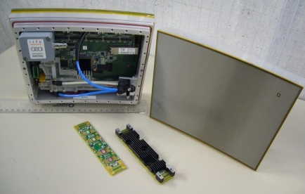
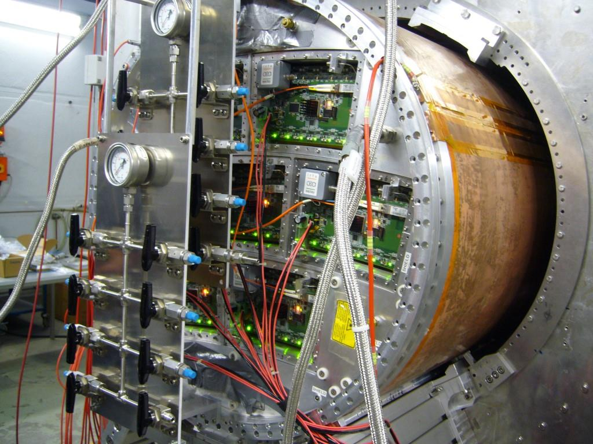
New Results from the LC Large TPC prototype
Kolkata, RD51 WG1
P. Colas, CEA/Saclay

Slide 2
The evolving context
Kitakami site chosen
ILD collaboration being formed (Chair of I.A. elected). Governance under construction
Many contacts at every level : hope to lead into a signal from Japanese government to international community in 2016, for a kick-off in 2018
10 years of construction : some parts have to start Day One.

Slide 3
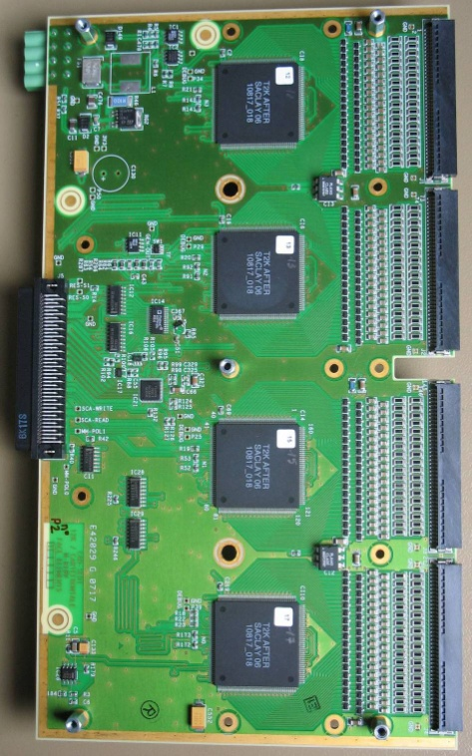
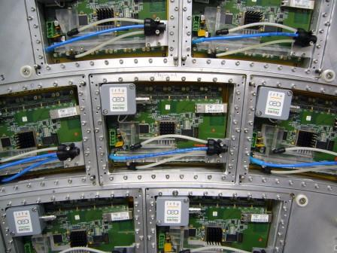
Hardware development
Go multi-module. Requires miniaturization of RO
Cooling (see D.S. Bhattacharya’s talk in WG1)
LV, HV, Fibre signal and DAQ

Slide 4
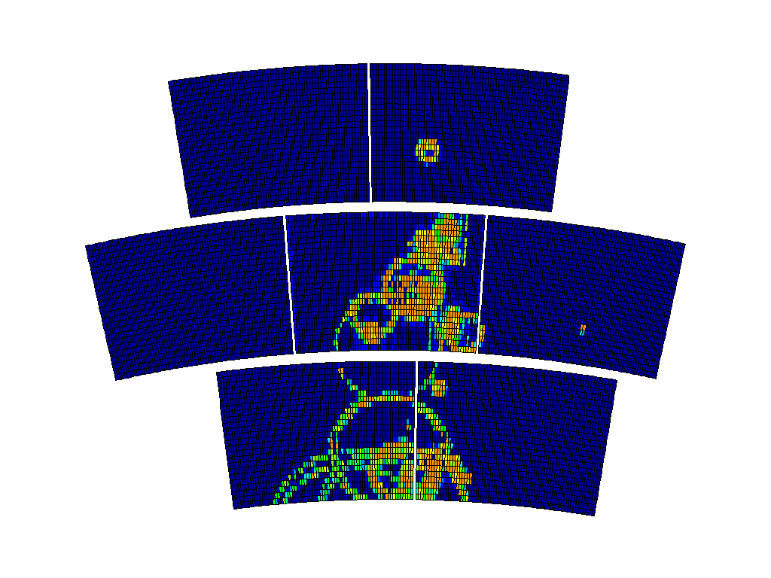

Slide 5
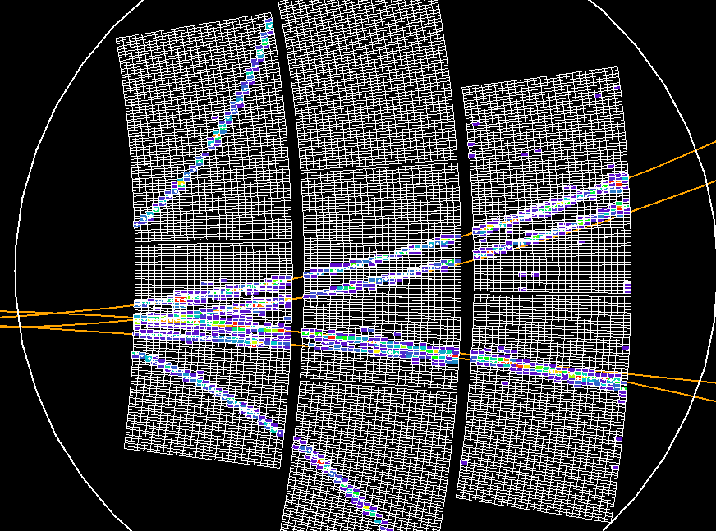
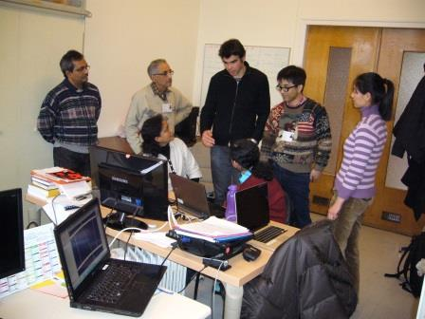
Software development
Use the ILC environment for Micromegas (still in progress)
Kalmann filter in multi-module configuration

Slide 6
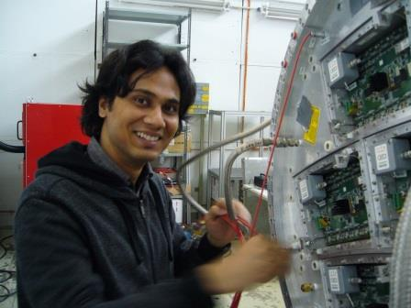

Slide 7
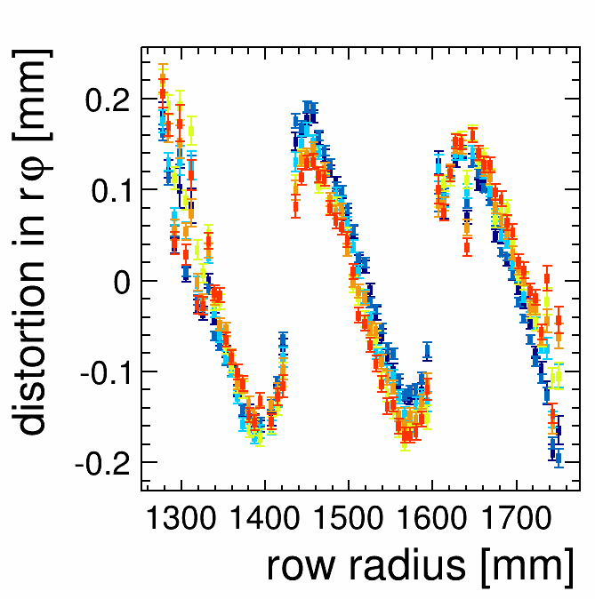
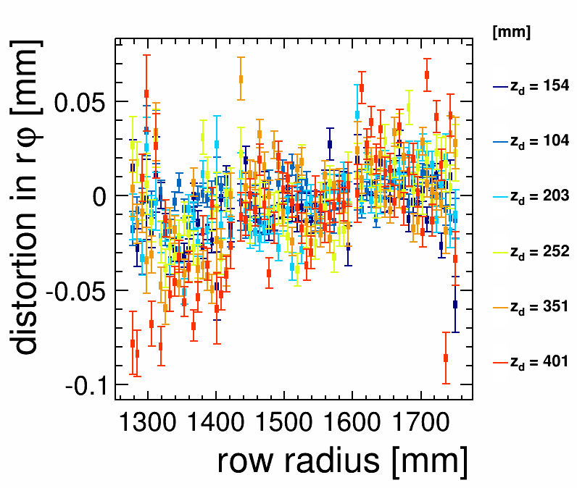
Distortions
Distortions under study (see DSB at IWAD14)
Residuals from tracks fittedd through 3 modules show distortions. (For B=0, these are easily corrected)

Slide 8
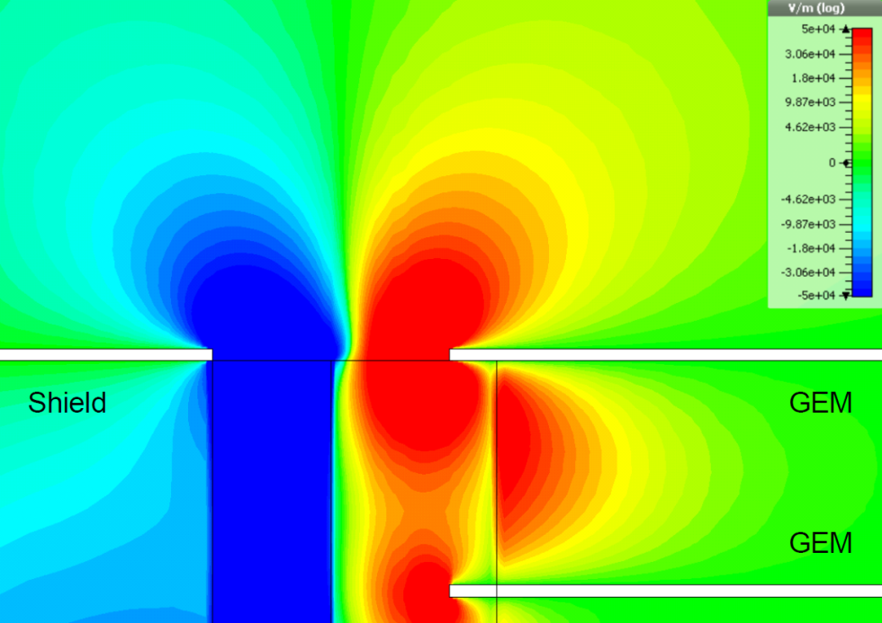
Field shaping electrode tested for GEM
Without
With

Slide 9
Attempt to correct the E-field for GEM modules (in blue)

Slide 10
Will be studied in detail with laser data

Slide 11
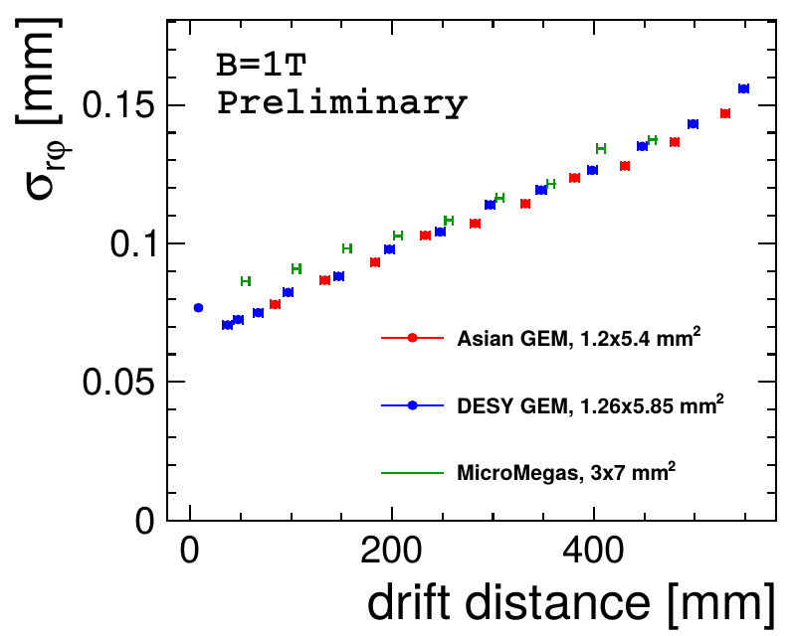
Resolution

Slide 12
Conclusions and outlook
Smooth operation of Micromegas + resistive foil allowing 60-70 micron resolution with 3 mm wide pads
Possibility to mitigate module boundary field inhomogeneity shown on 3-GEM prototypes.
Cooling by 2P CO2 demonstrated. Still needs a lot of development and studies
2 new modules made at CERN with Ochi’s resistive coating, to be tested by March 2015.

Slide 13
Thank you

