Slide 1

A TPC for ILC
Deb Sankar Bhattacharya
D.Attie, P.Colas, S. Ganjour,

Slide 2
Outline
ILC and ILD
Resistive foil Micromegas
Results of beam test 2015
2 Phase CO2 cooling results

Slide 3
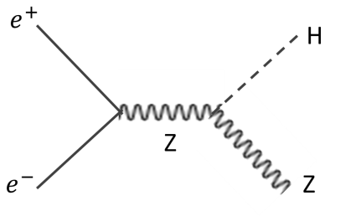

General Physics goal at ILC
The 125 GeV Higgs and possibly other Higgses, can be produced at ILC by Higgs-stahlungs.
$HZ→b\overline{b}μ^{+}μ^{−}$
This allows an unbiased selection by Z recoils, to measure mass and all possible decay modes. Jet reconstruction also benefit from continuous tracking in a TPC.
This sets the goal resolution of 100 μm per pad row.

Slide 4
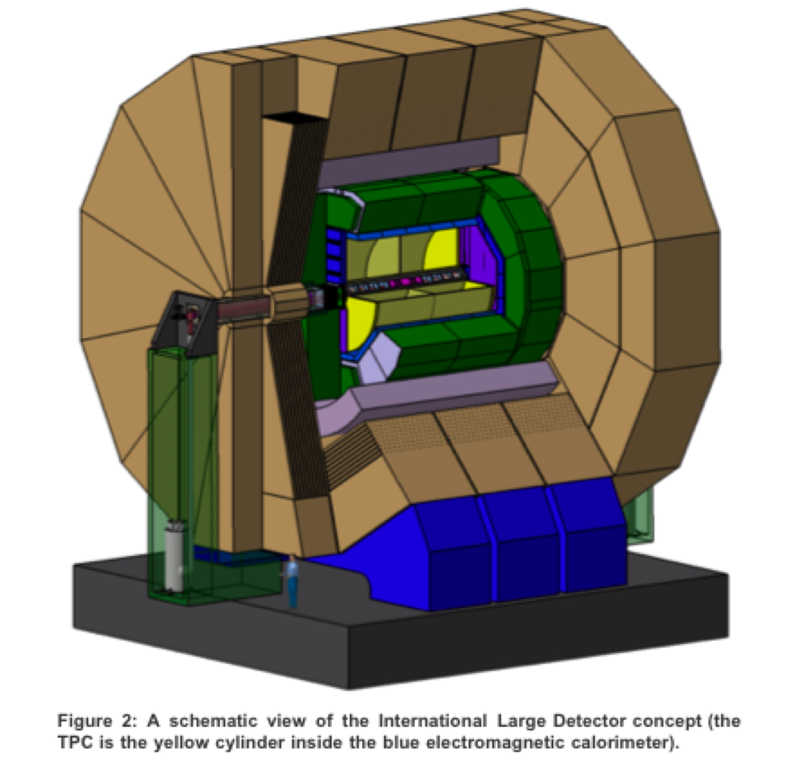
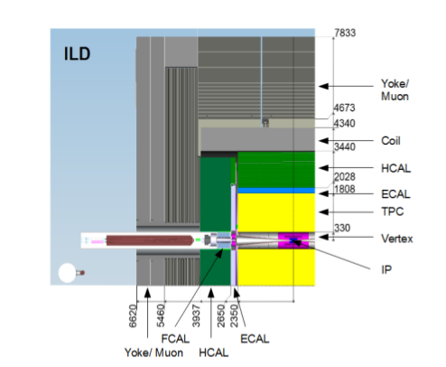
Proposed ILD
ILD
Cross section
Length of the TPC ~ 4.6 m
Diameter of the TPC ~ 3.6 m
Magnetic field ~ 3.5 T

Slide 5
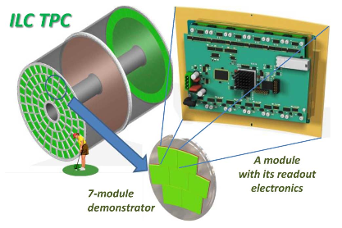
Proposed ILC-TPC

Slide 6
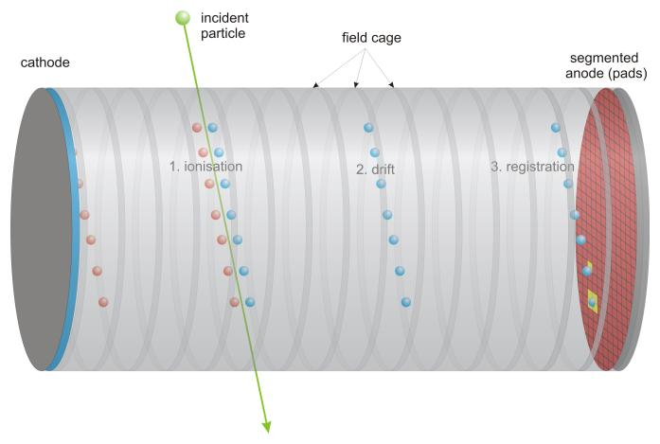
What is a TPC ?
A Time projection Chamber

Slide 7
Micromegas was invented by ‘Ioanis Giomataris’ in 1995
Drift plane
Drift gap
(few hundred V/cm)
Amplification
Gap
30-40 KV/cm
Mesh
Spacers
Anode Plane

Slide 8
Drift plane
Mesh
Spacers
Anode Plane

Slide 9
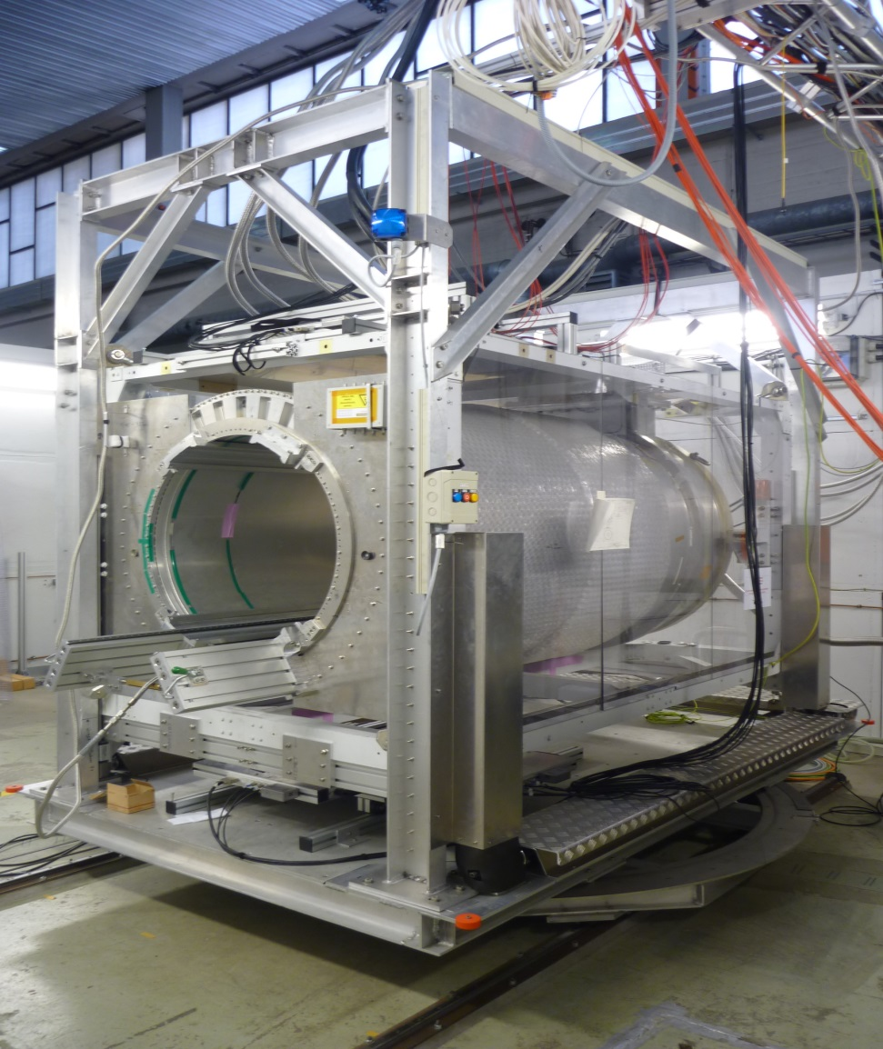
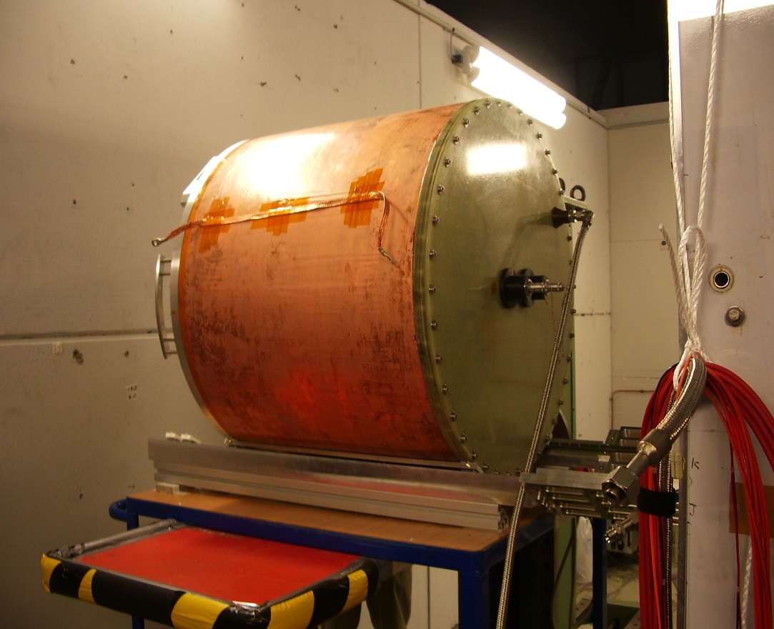
Large prototype TPC for ILC
1-6 GeV
e- beam
The 60 cm long DESY field cage
The 1T magnet.

Slide 10
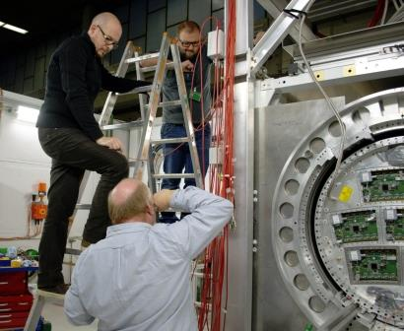
Data taking during first two weeks of March-2015 at DESY

Slide 11
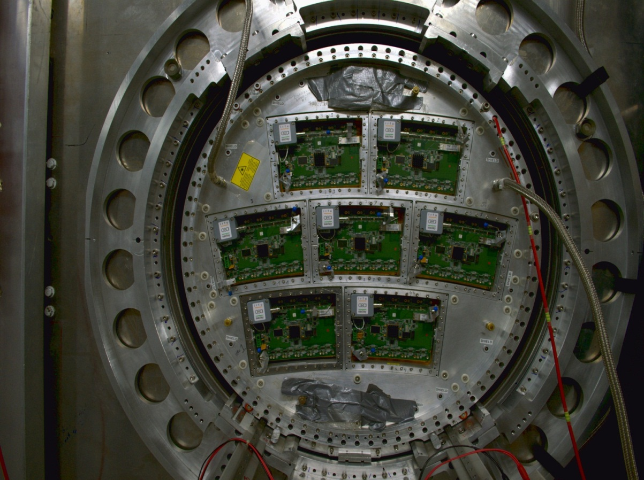
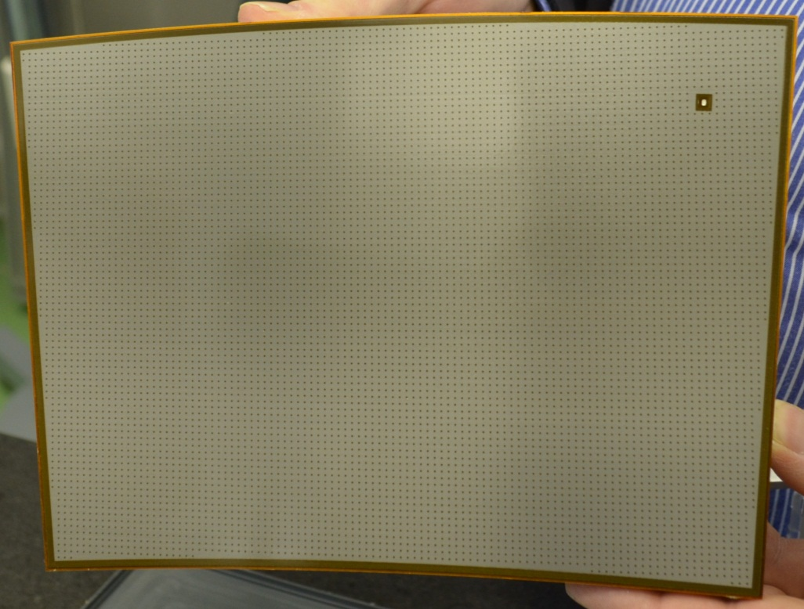
End plate of LP-TPC
The Micromegas module
Module size: 22 cm × 17 cm
24 rows × 72 columns
Readout: 1726 Pads
Pad size: ~3 mm × 7 mm

Slide 12
Different studies are done:
Studies | Range
At different drift distances | full available drift length of 60 cm
At different phi | 0, 2, 4
At different theta | 10 to 30 in steps of 5
At different X positions | ‘-40’ mm to ‘30’ mm
At different peaking time of the electronics. | 100 ns to 1000 ns
At two different fields | 140 V/cm, 230 V/cm
At different noise thresholds | 3 sigma and 4.5 sigma
At two different magnetic fields | 0 T and 1 T
At different momenta | 1 GeV to 5 GeV
Cosmic | B = 1 T and B = 0 T

Slide 13



We are using resistive Micromegas
mesh
E
B
~100μm Amplification gap:
In standard Micromegas
resolution is given by,
resistive foil: ~75μm
insulator: ~100μm
pads
$$σ=w/√12$$
Charge is dispersed in
Resistive Micromegas
$$σ=√(2t/RC)$$
R is the the surface resistivity of the resistive layer, C is the capacitance per unit area and t is the shaping time of the electronics.
Charge dispersion $≅$ 2mm
Before we have been using Carbon Loaded Kapton which is now unavailable.
A new resistive material, Diamond Like Carbon is available from Japan.
We used both in the beam test.

Slide 14
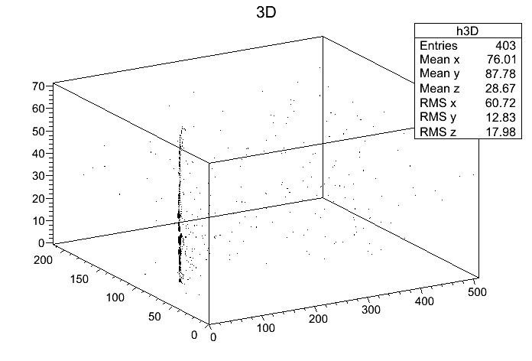
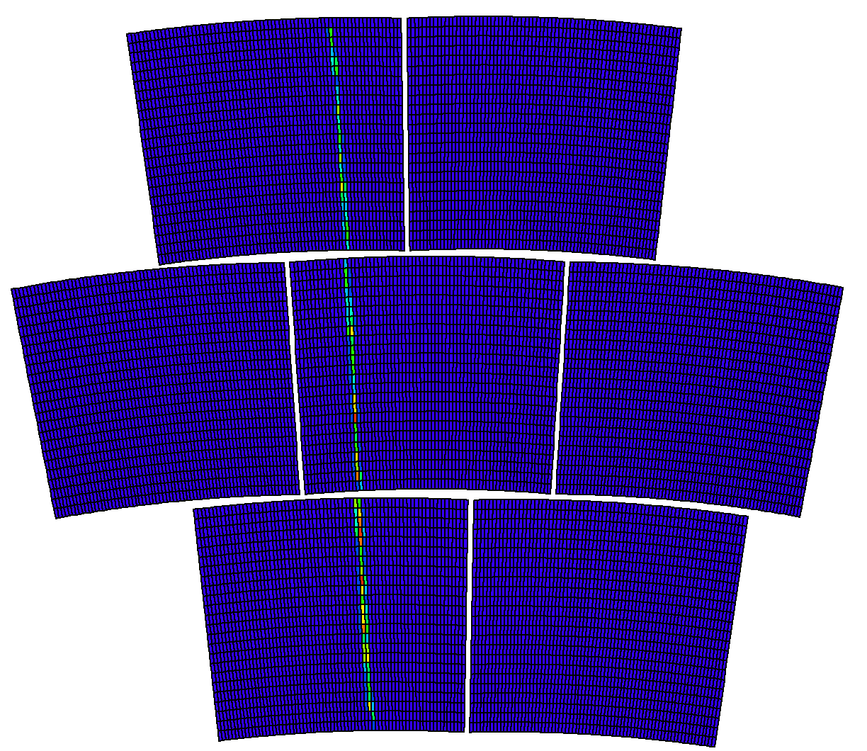
Track in 3-D space
Track on 7-module Micromegas
Mod 5
Mod 6
Mod 2
Mod 3
Mod 4
Row number
Mod 0
Mod 1
5-GeV electron beam
5-GeV electron beam

Slide 15
The analysis is done within the framework of ‘MarlinTPC’
Data is converted from ‘acq’ to ‘slcio’
General processing
Geometry / Mapping are connected
Noise threshold, Physical conditions are checked.
Reconstruction
Pulse Finder and the Hit Finder
Track Finder and Track Fitter
Distortion Correction
Analysis
Resolution Calculation

Slide 16
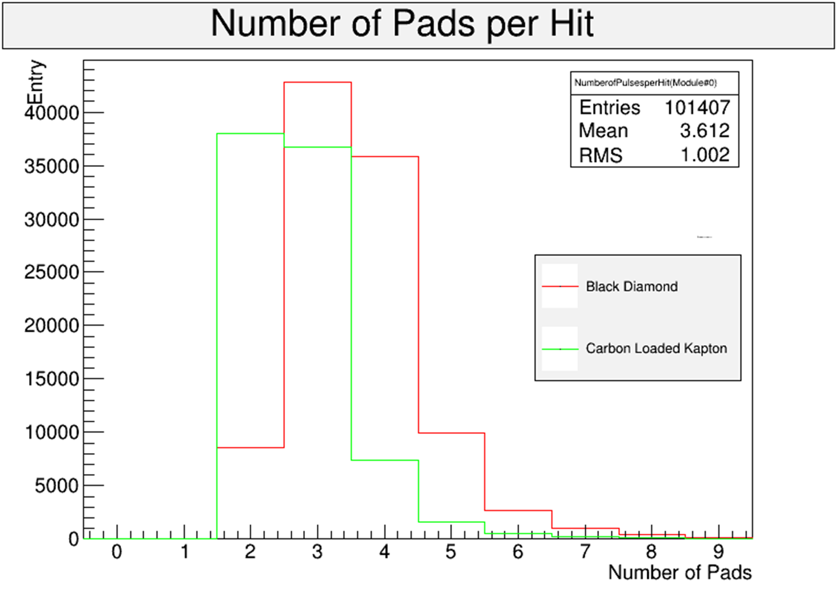
Number of Pads per Hit
Comparison between Black Diamond and the CLK modules
For CLK, number of pads per hit=2.8
For BD, number of pads per hit=3.6
Surface resistivity of BD modules is slightly less than in CLK

Slide 17
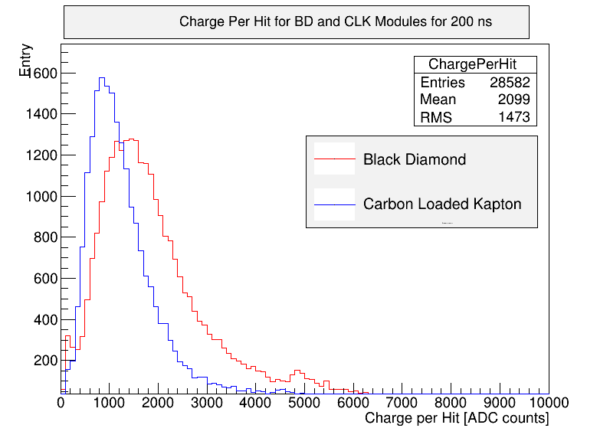
Charge per Cluster for CLK and BD modules at 200 ns peaking time of the electronics
Charge per cluster in BD is slightly more than CLK.
This is because, BD has slightly large capacitance than CLK.

Slide 18
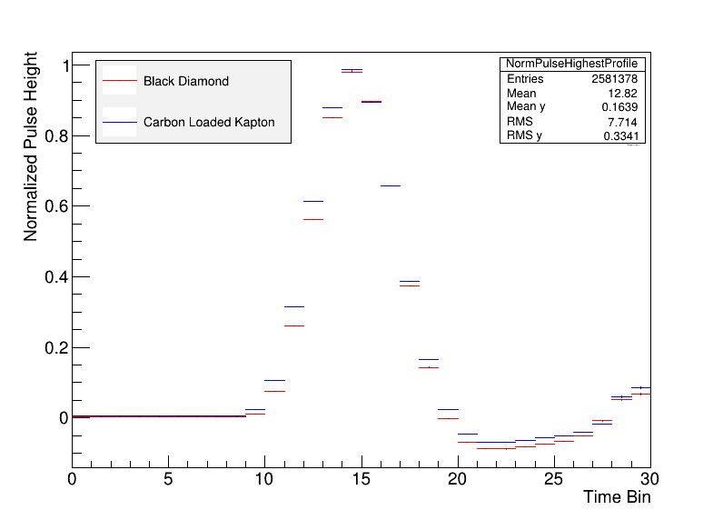
Normalised main pulse for BD and CLK

Slide 19
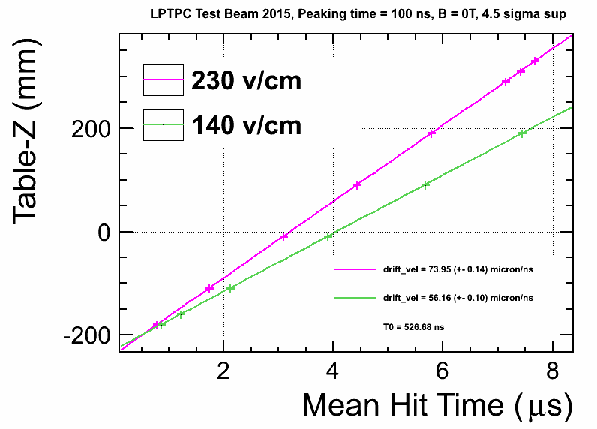
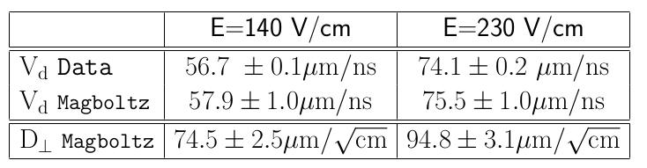
Measurement of drift velocity

Slide 20
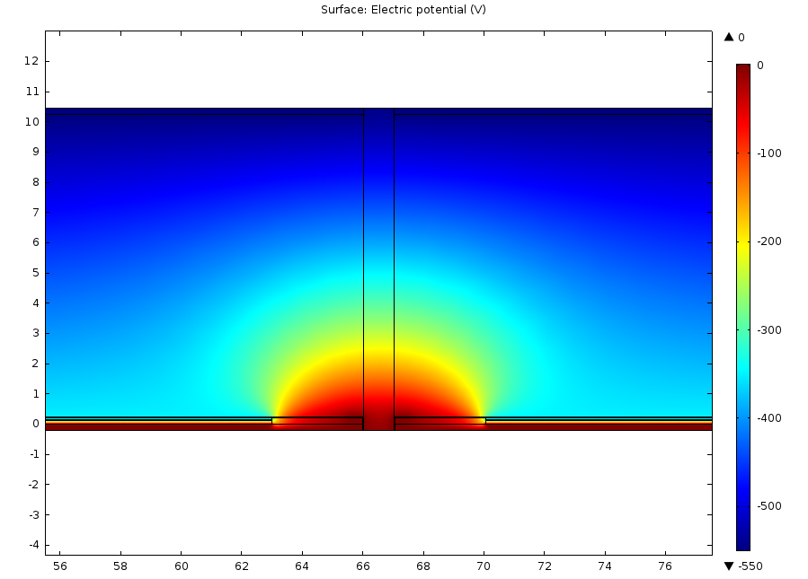
Potential distribution shows distortion
Cathode
MM module 1
MM module 2
mm
mesh
mesh
Anode
Anode
Simulation with COMSOL

Slide 21
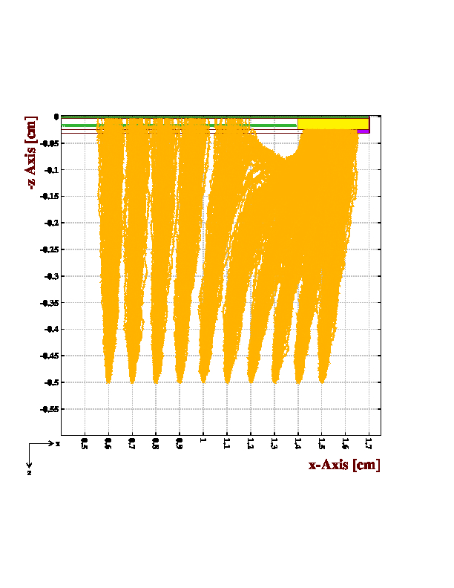
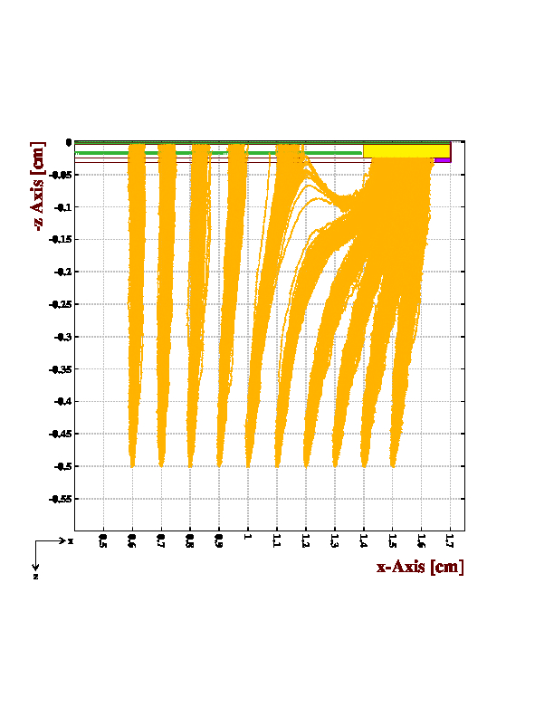
Drift of the electrons
Cathode
Z (drift)
Cathode
ground
Mesh
Anode
B = 0
B = 1
Simulation with Garfield

Slide 22
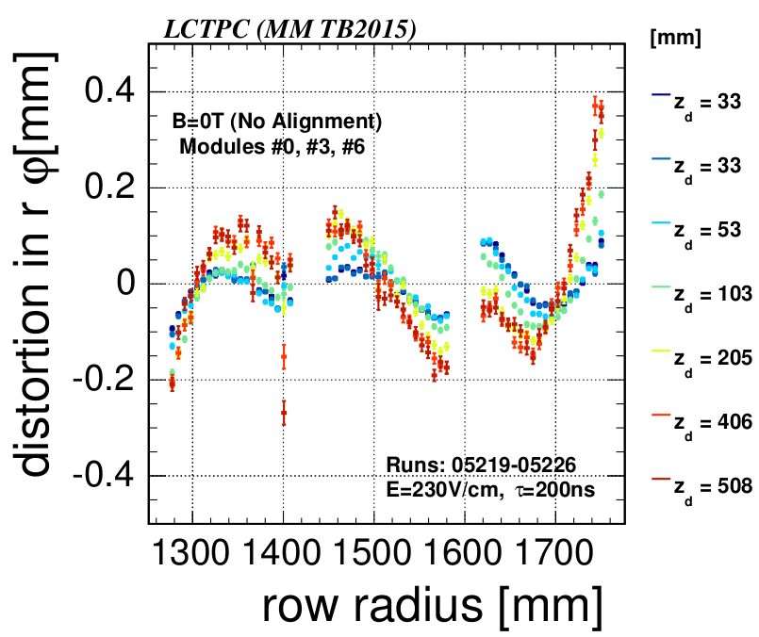
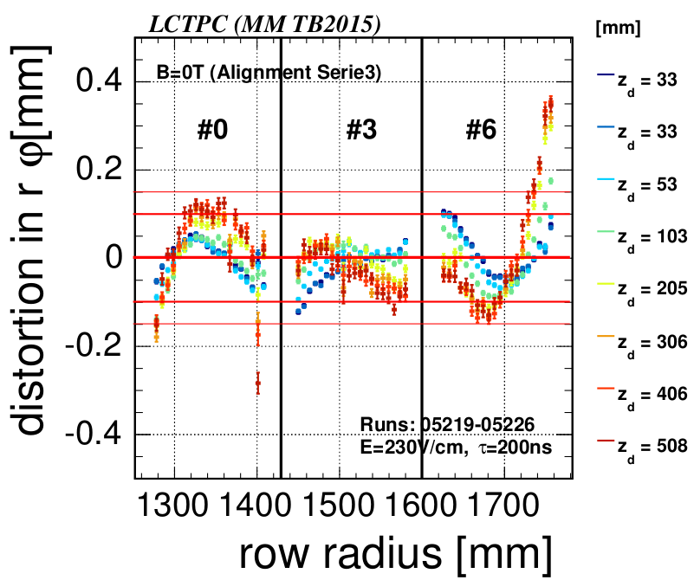
Distortion at B = 0 T
Before alignment of the modules
After alignment of the modules

Slide 23
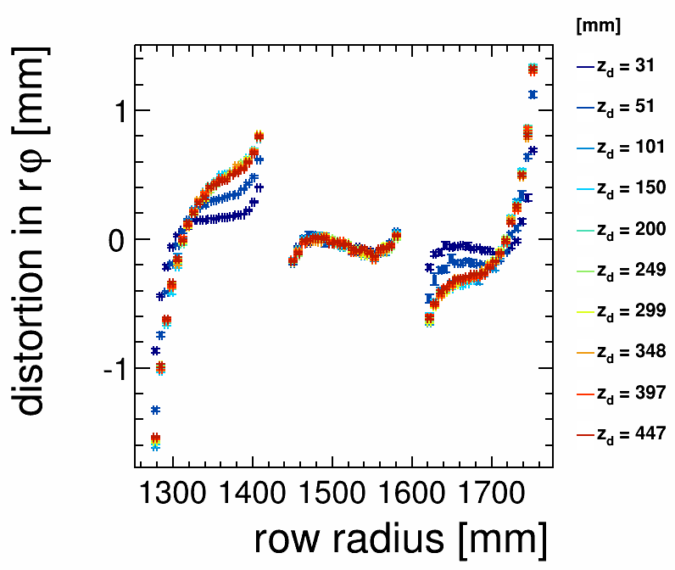
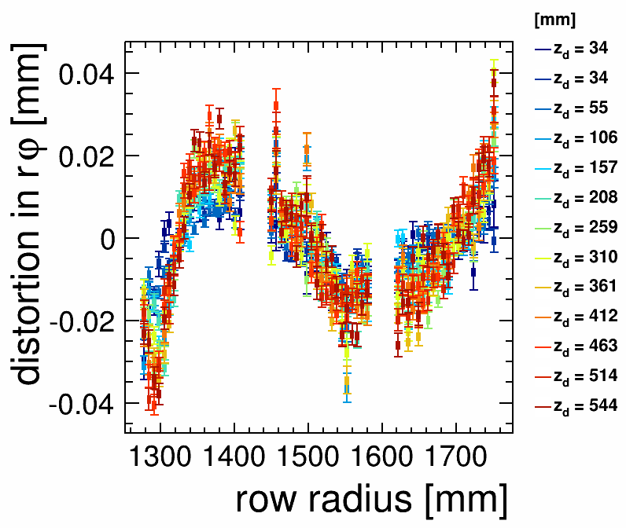
Distortion in B = 1 T
Before distortion correction
After distortion correction
The E×B effect can be seen near the edges
Distortion correction is done in MarlinTPC/DistortionCorrectionProcessor

Slide 24
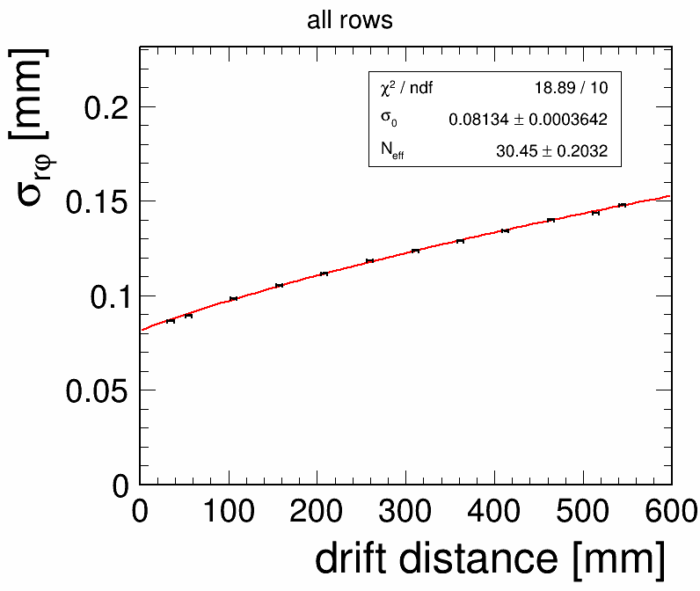

r-phi resolution vs drift distance for B = 1 T
B=1T, peaking time = 200 ns, E=230 V/cm, phi =o
Preliminary

Slide 25
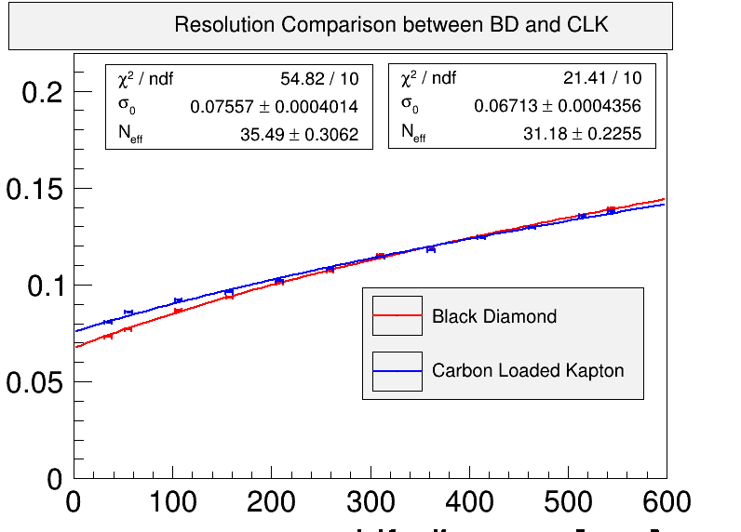
r-phi resolution vs drift distance for B = 1 T
B=1T, peaking time = 200 ns, E=230 V/cm, phi =o
Preliminary

Slide 26
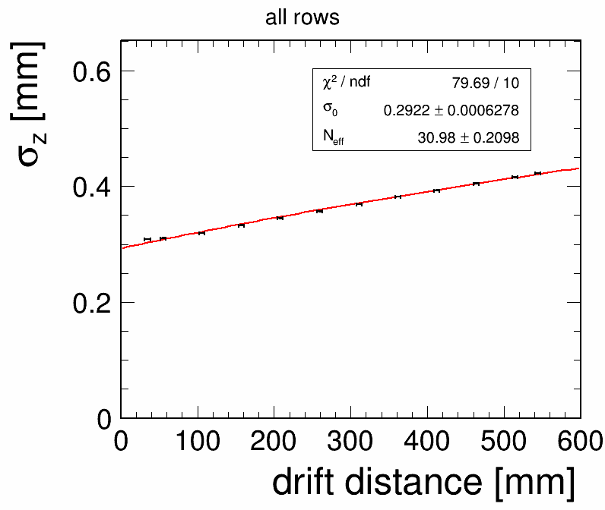
z resolution vs drift distance for B = 1
B=1T, peaking time = 200 ns, E=230 V/cm, phi =o
Preliminary

Slide 27
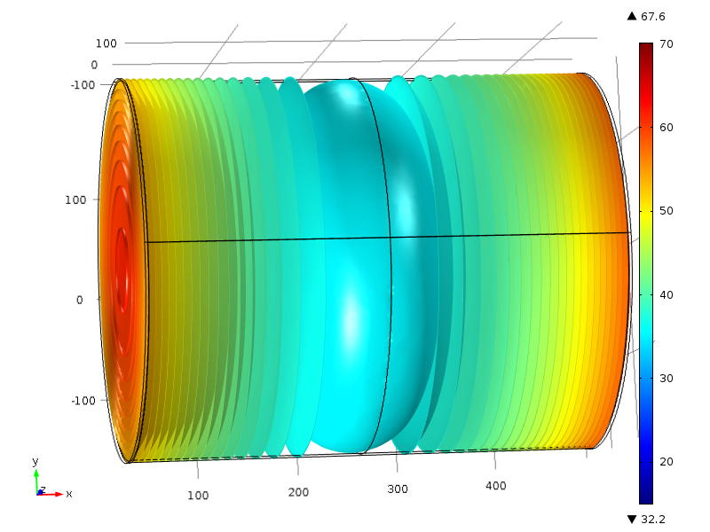
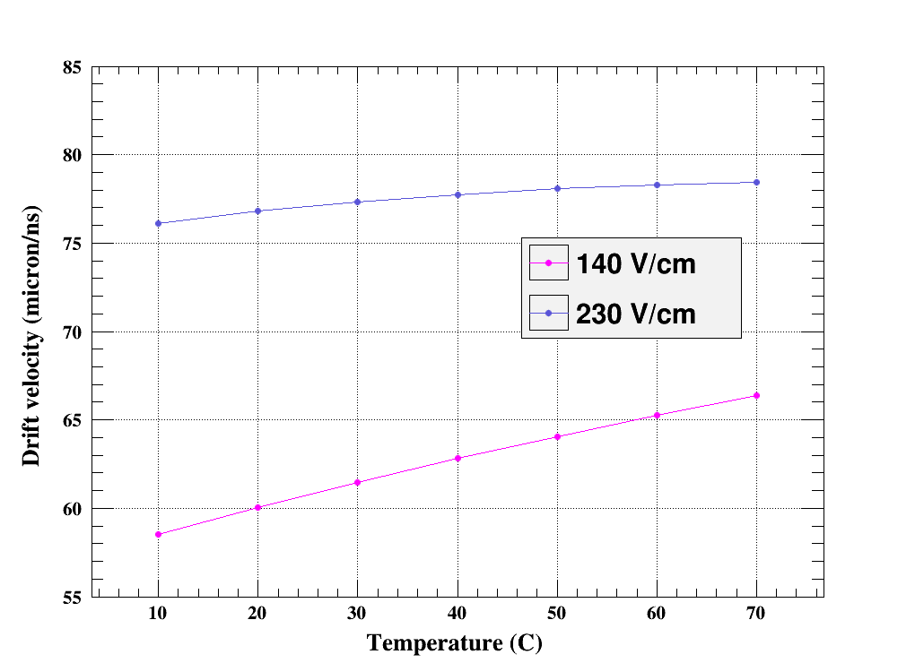
Two-phase CO2 cooling
Each module’s electronic takes nearly 30 W of electric power.
This rises the temperature of the detector up to 70 deg C
Temperature gradient in ILC-TPC
Simulation with COMSOL
Drift Distance Vs Temperature
Simulation with Magboltz

Slide 28
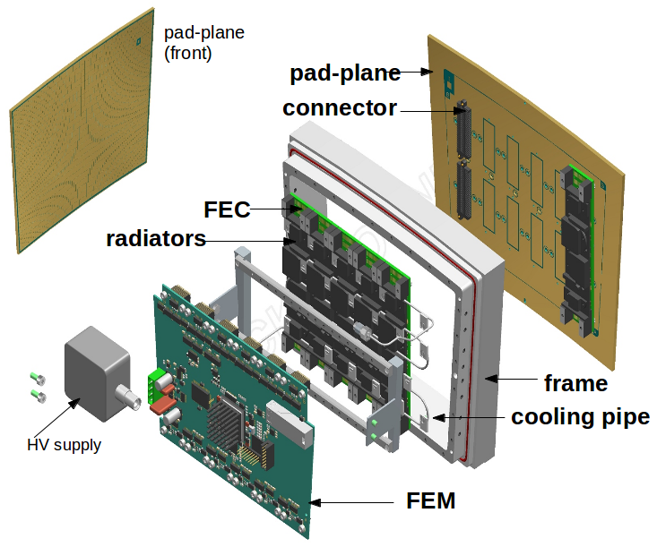
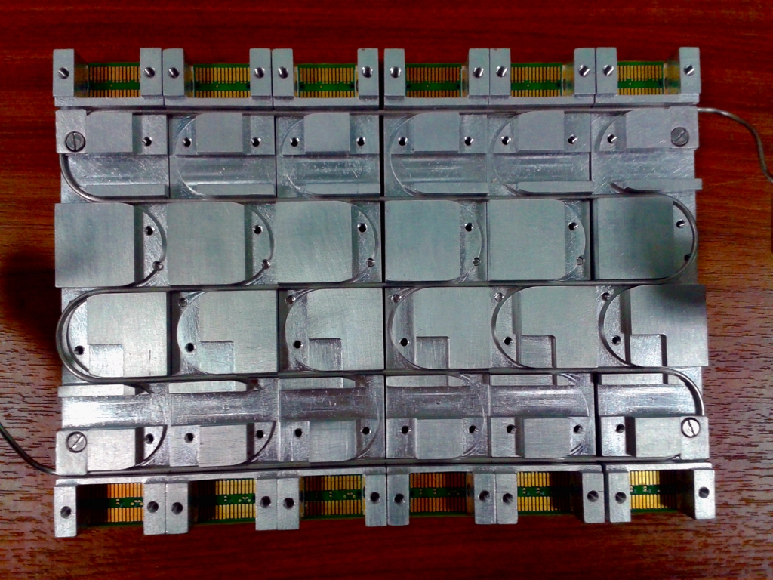
Two-phase CO2 cooling
Benefit of two-phase CO2 cooling is that the cooling happens during
phase change which ensures uniform cooling at constant temperature.
General lay out of the MM module
The radiators and the cooling pipe

Slide 29
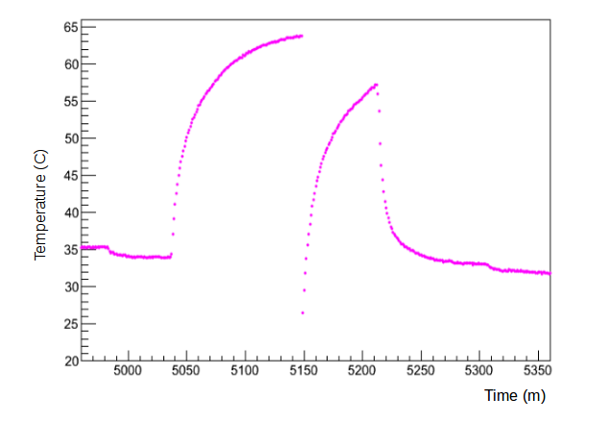
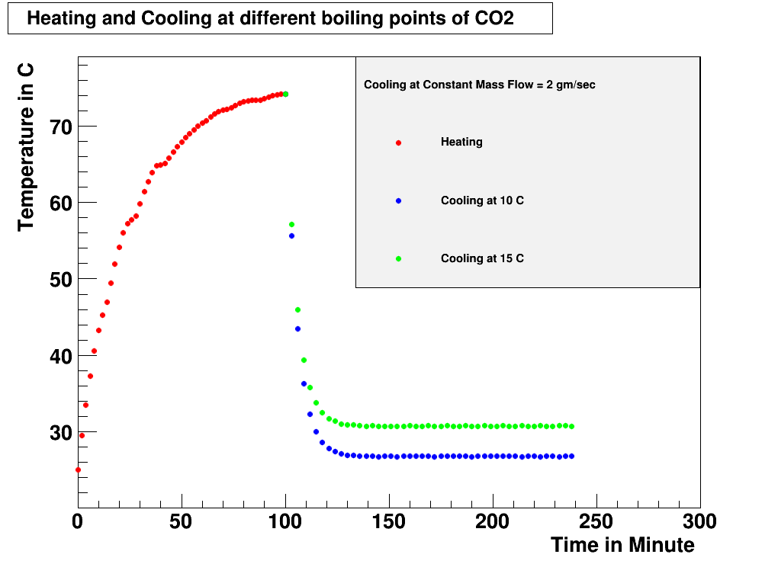
Two-phase CO2 cooling
Experimental and simulation result for one MM module shows heating and cooling
Experimental result with one module
Shows the heating and cooling
Simulated result for one module
Shows heating and cooling

Slide 30
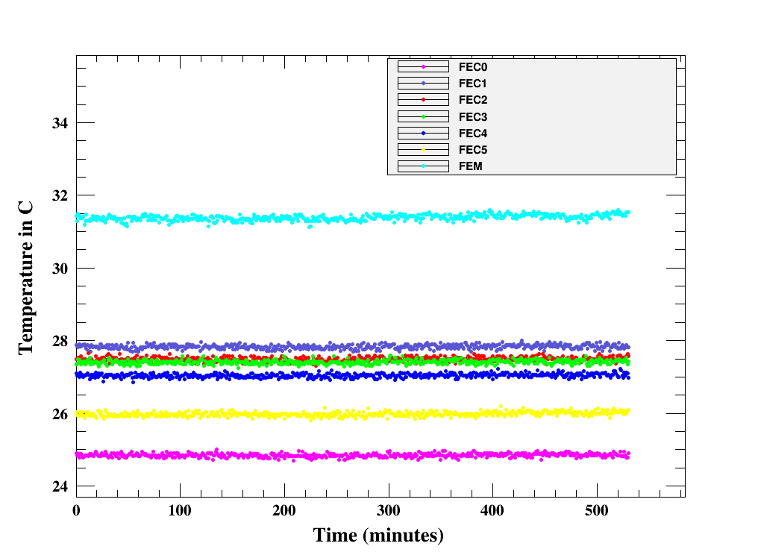
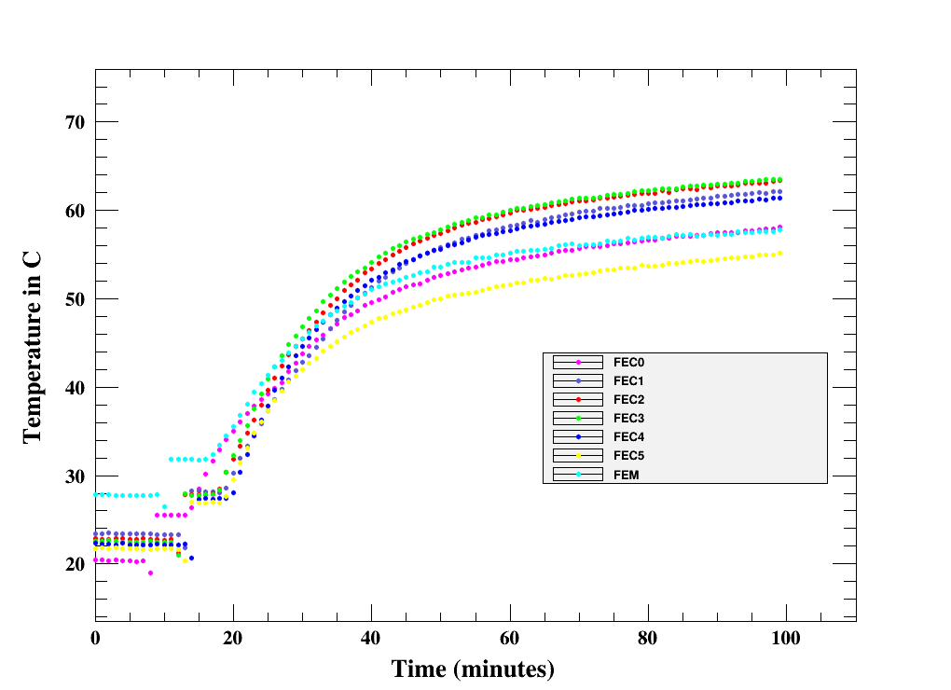
Two-phase CO2 cooling during 2015 beam test
During cooling, temperature is below 30 deg C and
Stable within 0.2 deg C.
Stable temperature during cooling
Temperature rises when cooling is stopped

Slide 31
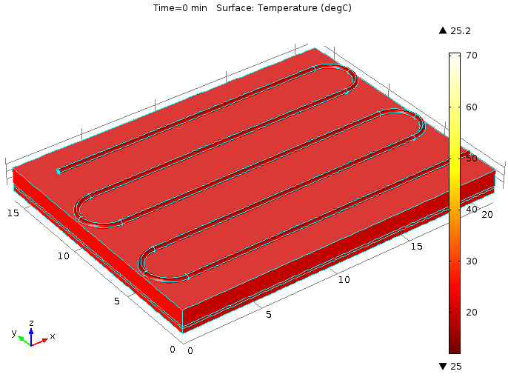
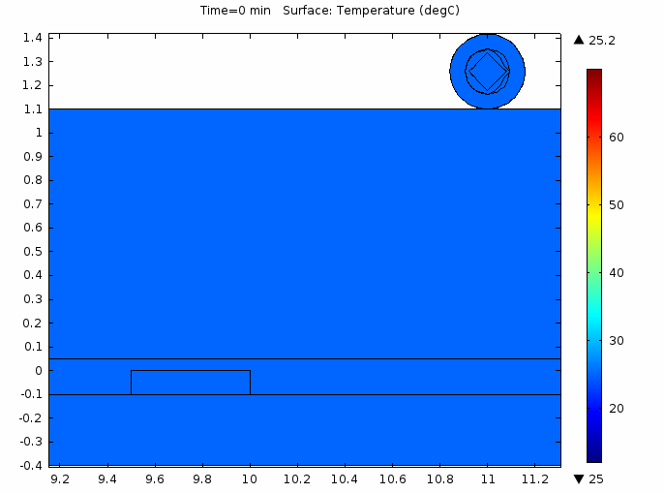
Two-phase CO2 cooling
simulated model (COMSOL) shows how cooling works

Slide 32
Summary
Different studies have been carried out with 7 Micromegas modules during beam test 2015.
In 1 Tesla magnetic field, the space resolution of Micromegas modules is below 150 micron in 60 cm drift length, which satisfies ILC requirement.
Two new Micromegas modules with resistive layer of Diamond Like Carbon (DLC) have been tested and the result is satisfactory.
Two-phase CO2 cooling is used uninterruptedly for more than 80 hrs. Temperature of individual Front End Cards (FECs) is stable within 0.2 degree C during the beam test. Recently a paper on two-phase CO2 cooling for Micromegas has been accepted in JINST.

Slide 33
I sincerely thank to :
Maksym Titov
Boris Tuchming
Fabrice Couderc
Marc Riallot
Supratik Mukhopadhyay

Slide 34
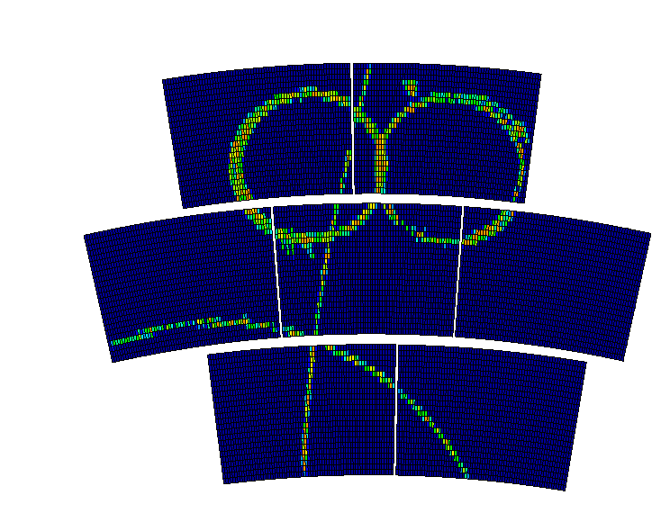
THANK You

Slide 35
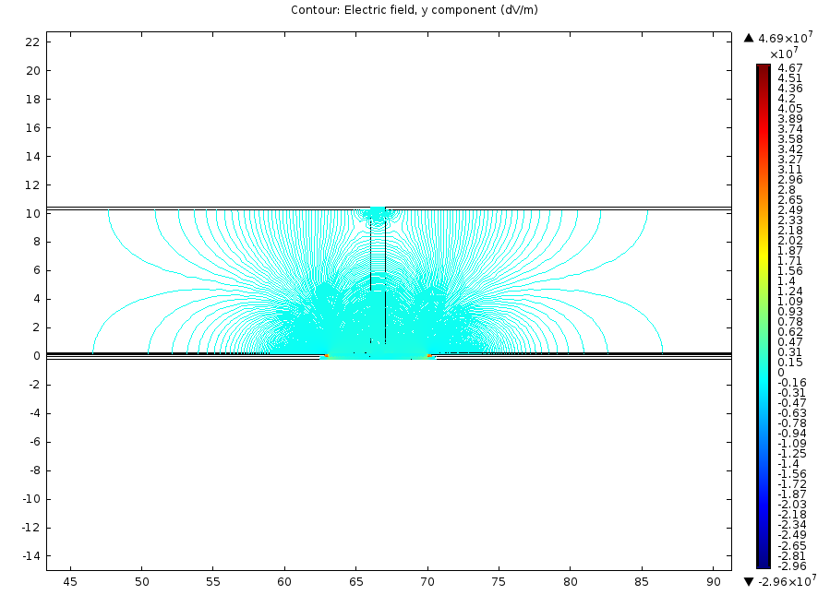
Backup Slides
Distortion of electric field lines

Slide 36
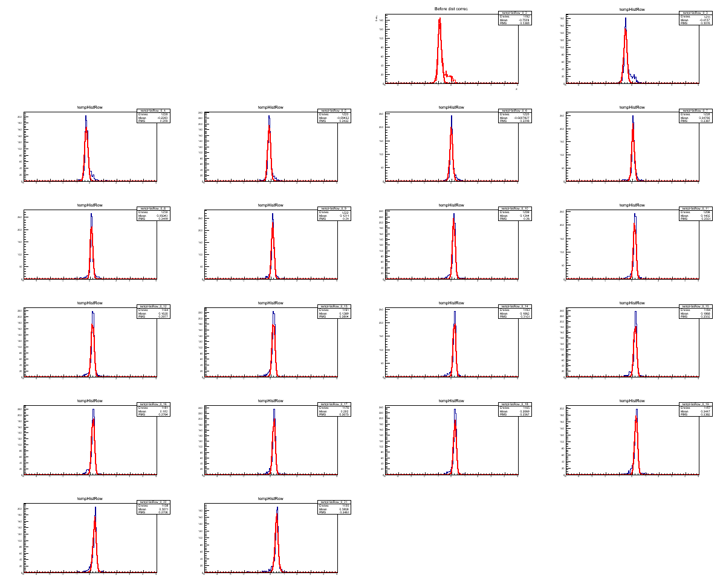
Backup Slides
Before distortion correction

Slide 37
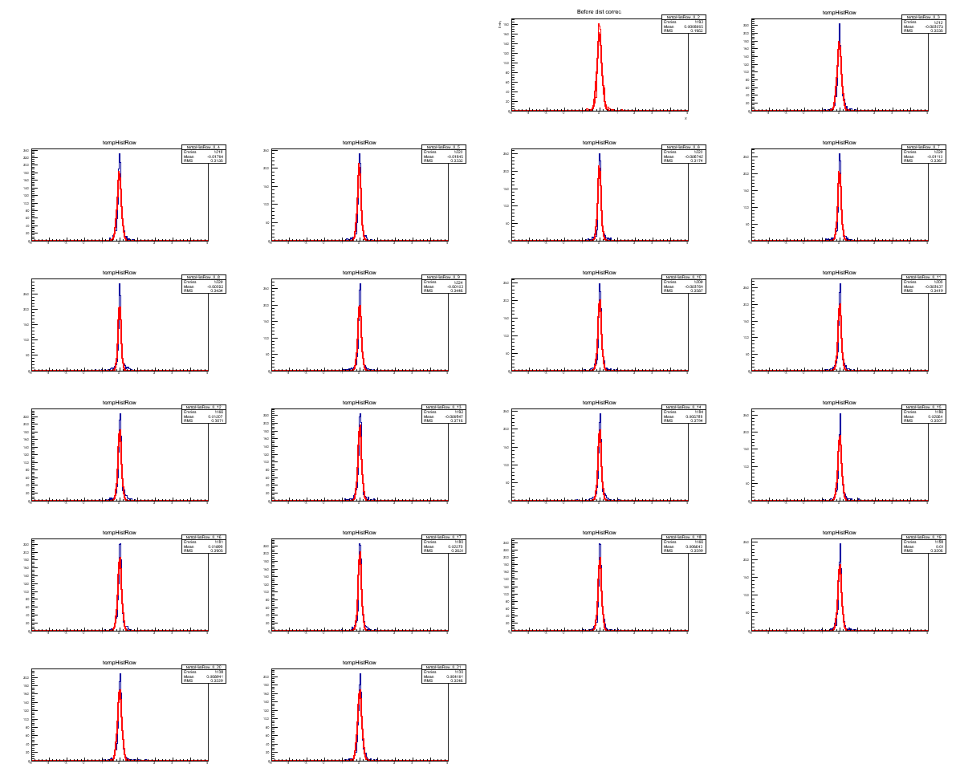
Backup Slides
After distortion correction

