Slide 1
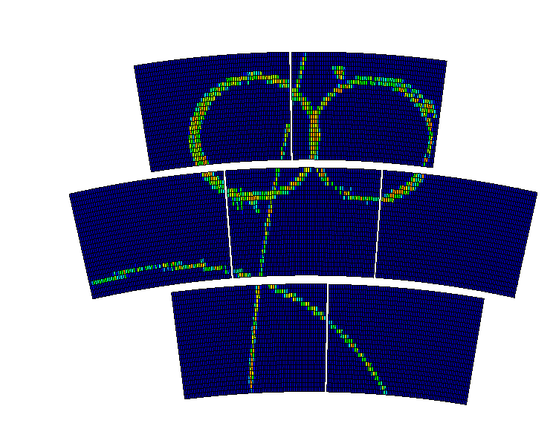
Data taken at the 2015 beam test
P. Colas

Slide 2
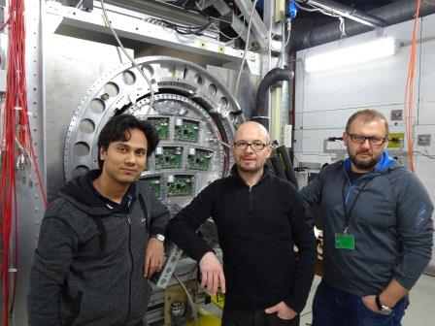
March 1-14, 2015
D. Bhattacharya, P. Colas, F. Couderc, R. Diener, M. Dixit, K. Fujii, S. Ganjour, J. Kaminski, R. Mehdiyev, B. Tuchming
(Remotely: D. Attié et al.)

Slide 3
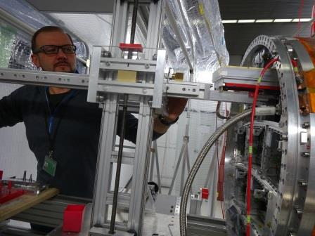
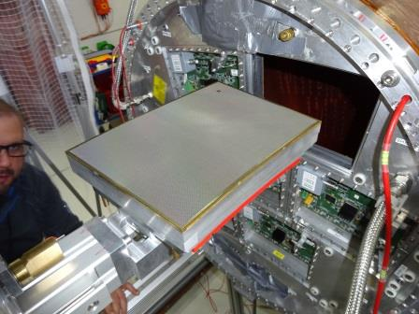
Arrival at DESY March 1, 2015 evening.
Several incidents delayed the start of the test: disparition of our 30 kW LV supply, Stage often stuck, lack of CO2 in TRACI, one module broken while mounting (S8G). Replace by S10X.
Then start gas on March 5 and 2PCO2 cooling. Take data.
On Saturday March 7, frost was found on the pipes: lack of CO2, have to wait until March 8.
Decided to dismount S5D and replace it by S3B.
BD2 limited to 370 V.

Slide 4
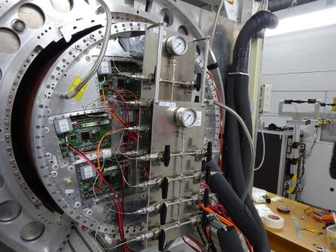

Slide 5
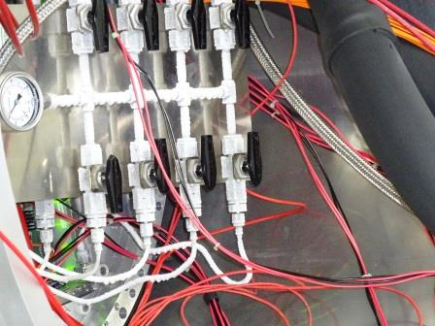
Frost deposited on the pipes (-10 °C)

Slide 6
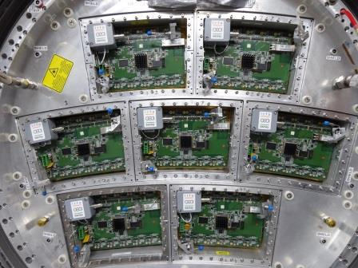
S5D
BD1
S3B
S1F
S10X
S6C
S4E
BD2

Slide 7
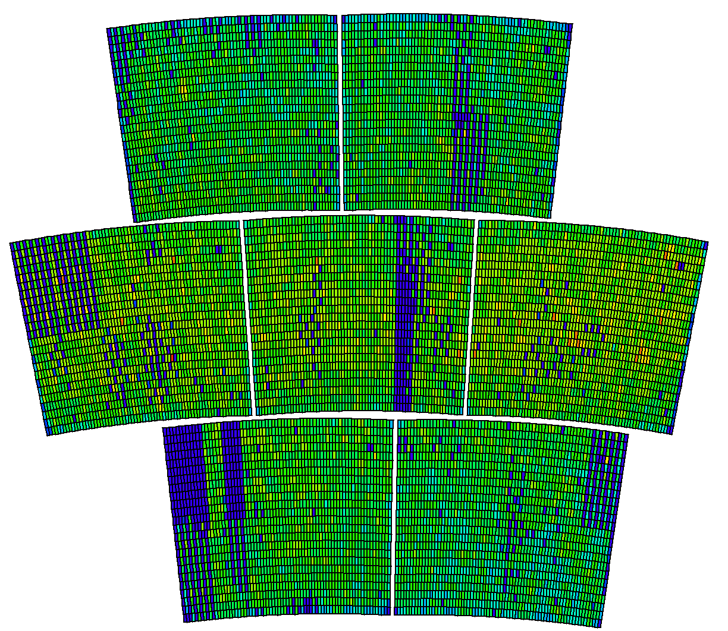
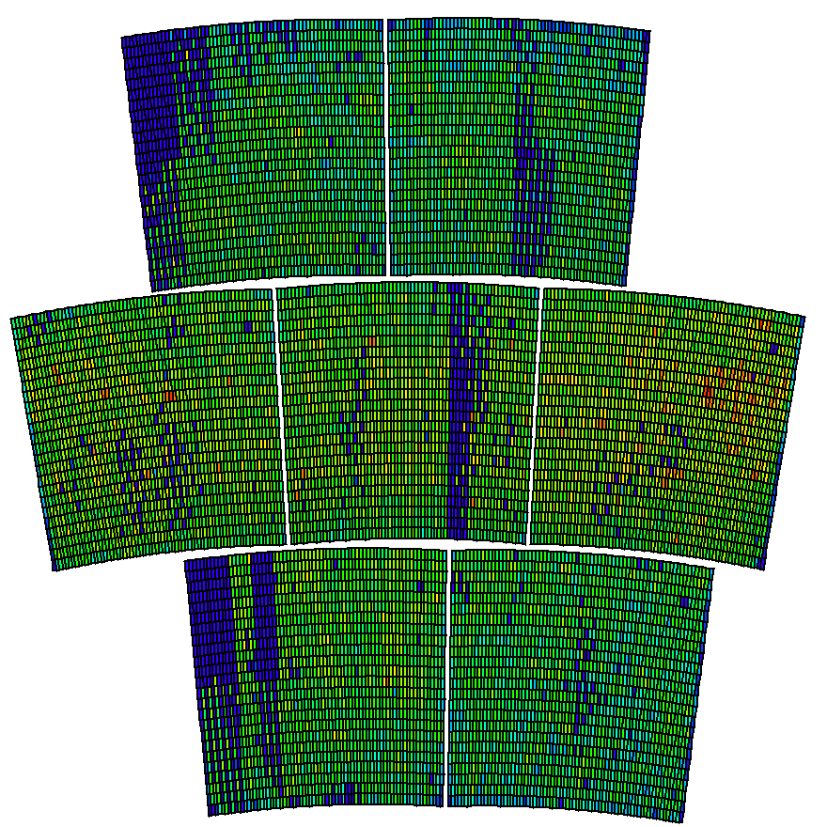

Slide 8
Beam positions
X=40
X=-30
5
6
3
2
4
0
1

Slide 9
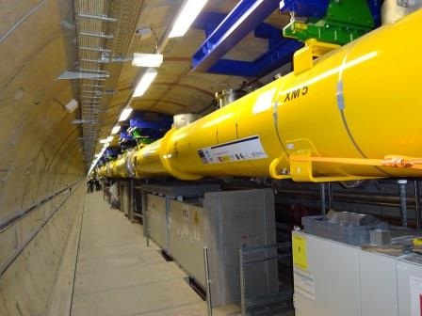
The End

