Slide 1
Studies on Electrostatic Distortion
SINP Kolkata

Slide 2
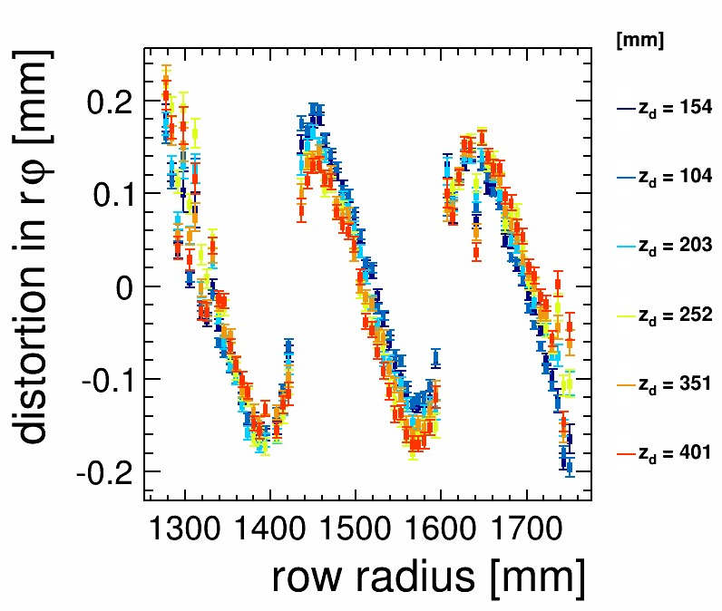
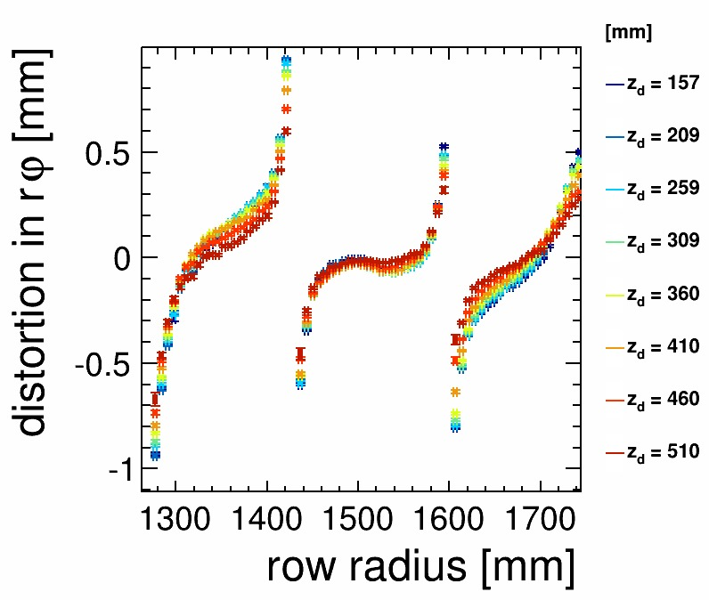
Test Beam Experiment at DESY (2013)
Large Prototype TPC with an end-plate, using seven Bulk Micromegas modules
Variation of DESY electron beam energy from 1 – 5 GeV during various phases of experiment
Gas mixture of Ar:CF₄:ISO-C₄H₁₀ (95:3:2)
Collection of data related to the cosmic rays, drift velocity estimation, Z scan, phi scan, variation of gain, effect of different shaping times, effect of different magnetic fields
Distortion in the residual data at the edge of the module
Electric field distortion introduced by the gap between two modules

Slide 3
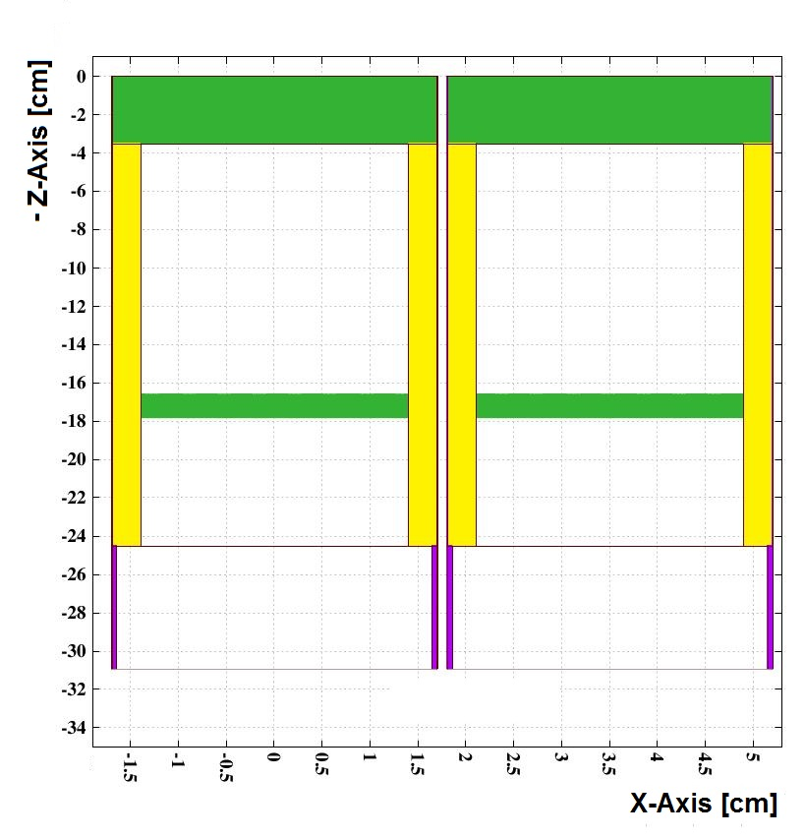
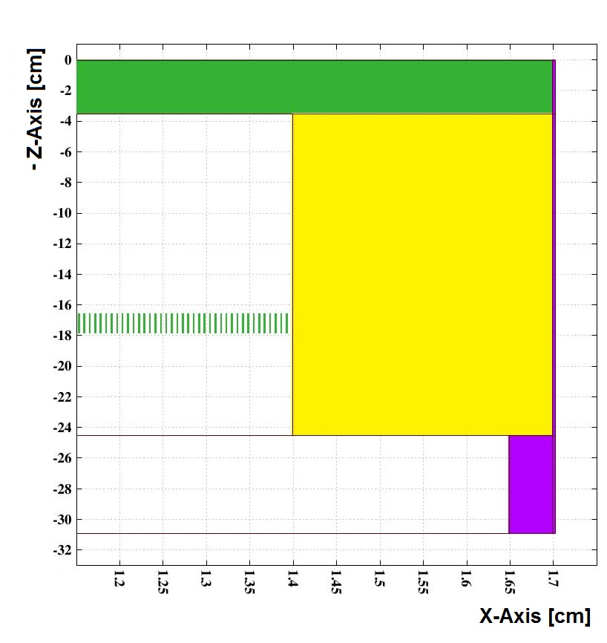
Simulated model:
Two modules placed next to each other
Closer view of the edge of one module

Slide 4
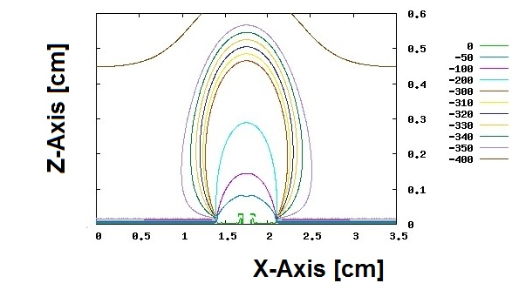
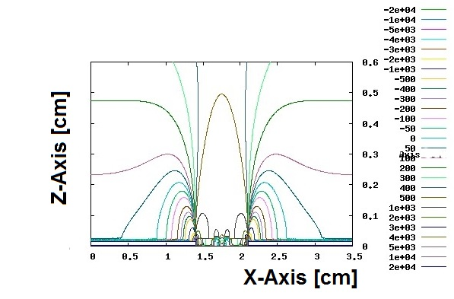
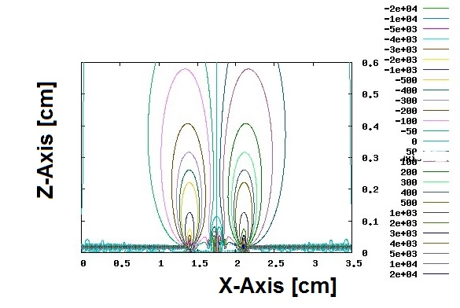
Potential contour
Electric field in axial direction
Electric field in poloidal direction

Slide 5
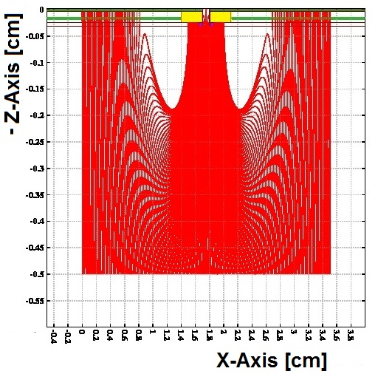
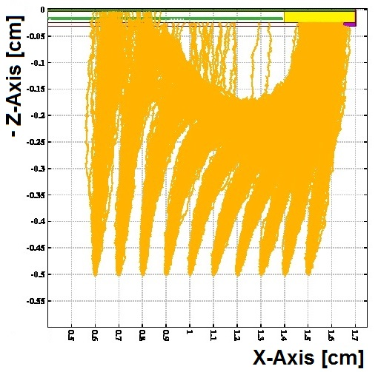
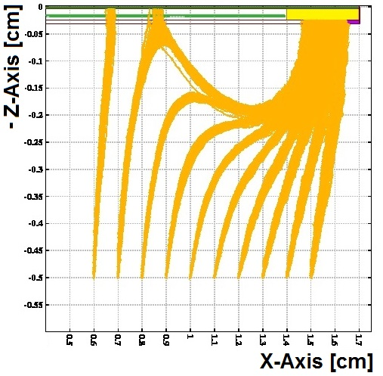
Electron drift lines
Without considering diffusion
B = 0 T
B = 1 T

Slide 6
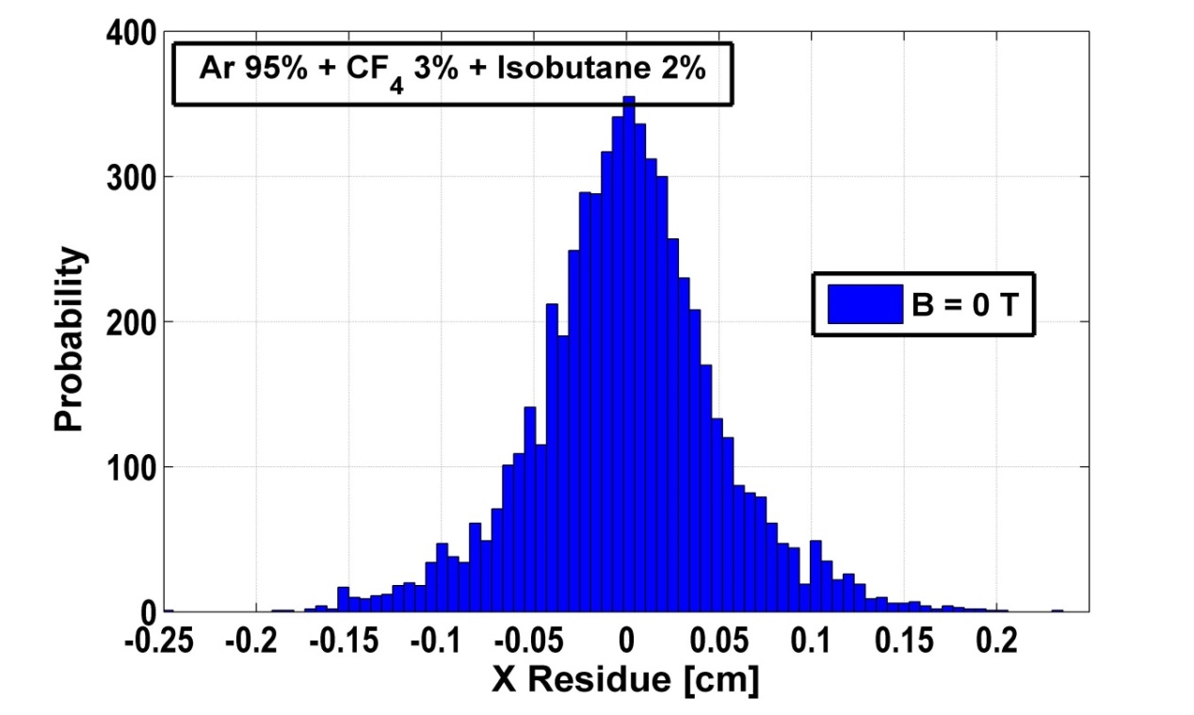
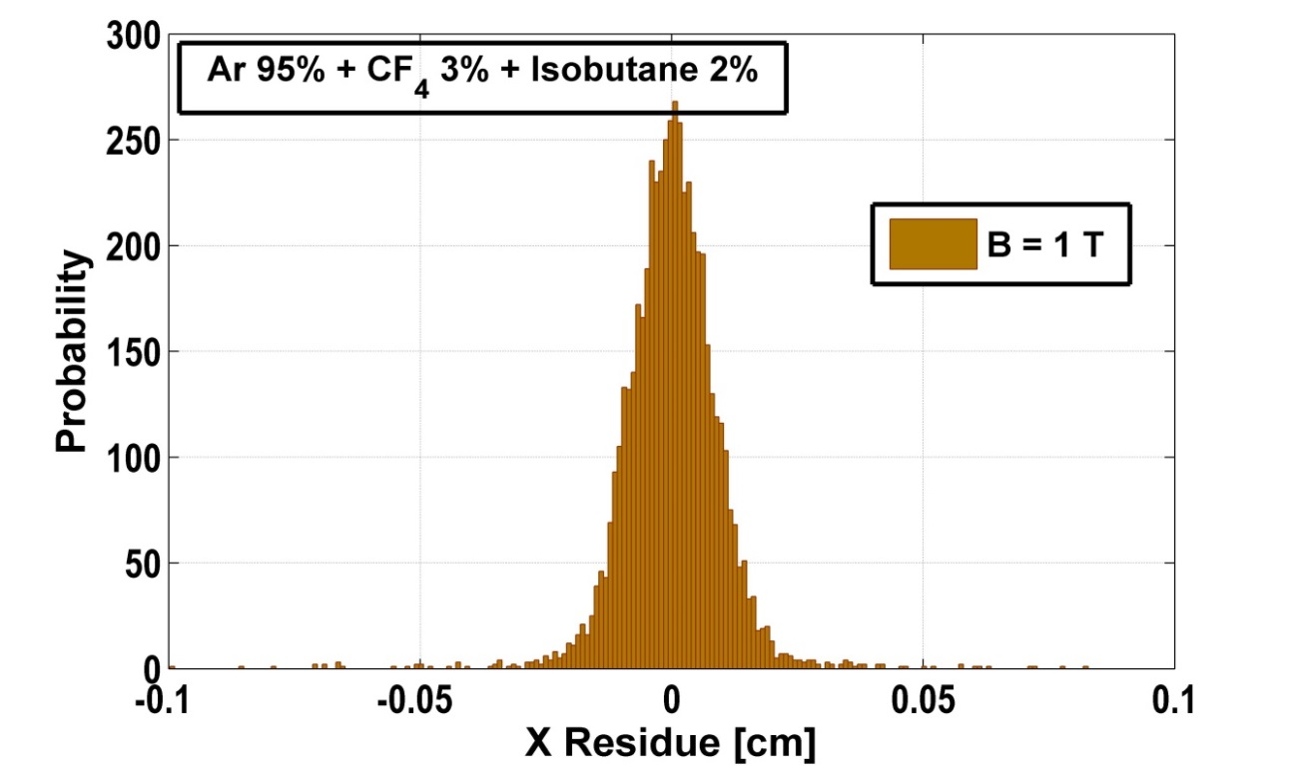
Histogram of residual along X-Axis
B = 0 T
B = 1 T

Slide 7
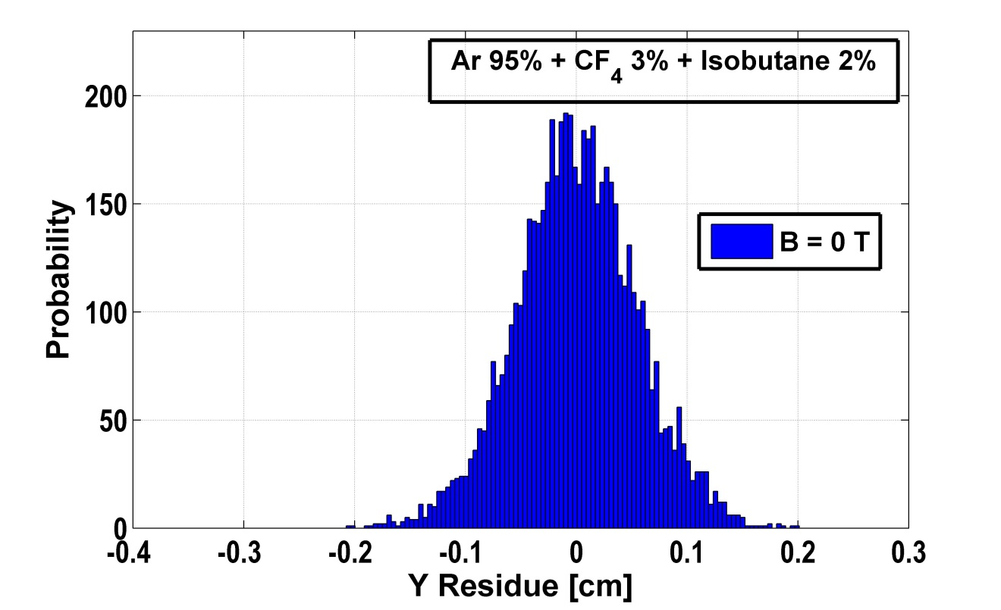
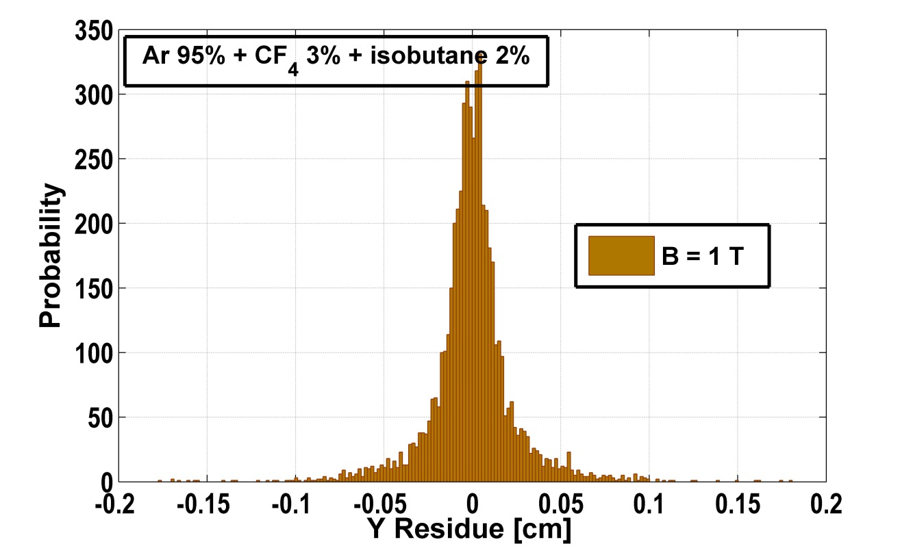
Histogram of residual along Y-Axis
B = 0 T
B = 1 T

