Slide 1
Toward the final design of a TPC for the ILD detector
D-RD9
TYL-FJPPL Okinawa 2015
P. Colas, K. Fujii et al.

Slide 2
D_RD9 Toward the final design of a TPC for the ILD detector
From 2007 to March 2013, the feasability of a MPGD TPC for the LC was demonstrated in D_RD2 (Construction and tests of a MPGD TPC endplate prototype for the Linear Collider), and ILD Detailed Baseline Document was completed in March 2013
Started in April 2013 : New project D_RD9, now mid-term
Multi-module prototypes, 2P CO2-cooled and software
In Bordeaux (May 2014) : remaining issues : electronics, cooling, software, gating
Steps toward an engineered design

Slide 3
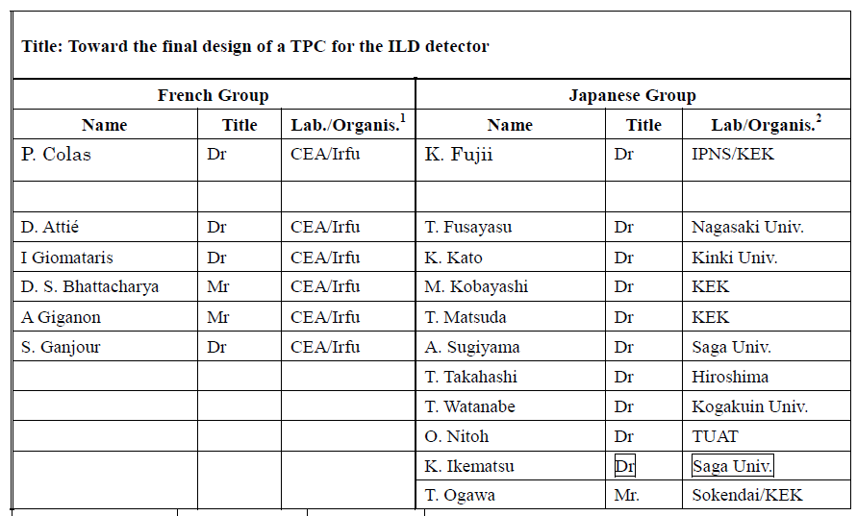

Slide 4
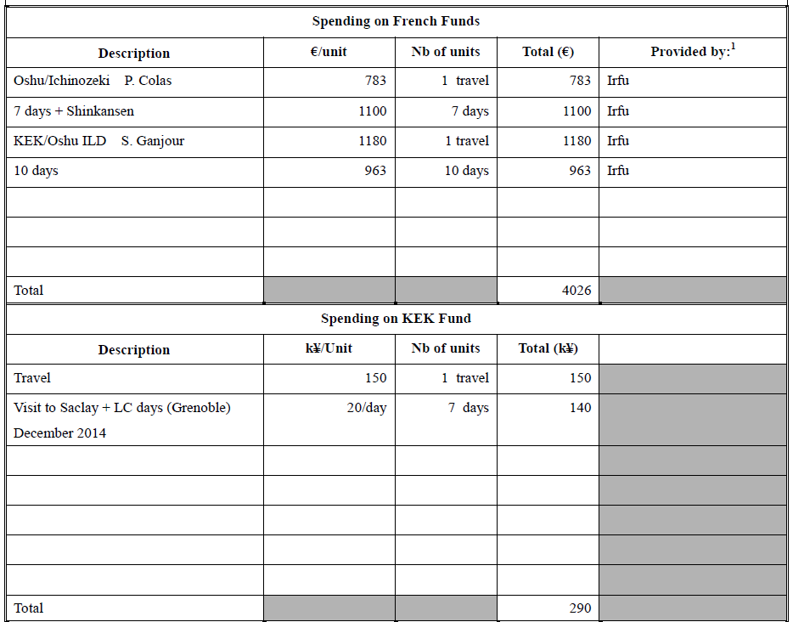

Slide 5
4000 € granted in June 2015
1500 kY requested
(4 travels)
1200 kY granted in June 2015

Slide 6
M. Titov and S. Ganjour
Attended ALCWS, KEK (April 2015)
+ TYL work with K. Fujii et al.
4000 € granted in June 2015
K. Fujii took advantage of a visit for another project to visit CEA
1500 kY requested
(4 travels)
1200 kY granted in June 2015
A Large part of Japanese funds were not used because it was not allowed for univ. members

Slide 7
Extra funding
*
**
* Ended in January 2015 ** 30,000 in 2015
AIDA 2020 has been granted. It contains a gaseous detector part that could serve the ILD TPC (especially on resistive materials). It spans 2015-2018.
Saclay (with other European groups) applied to an EU RiSE grant (GANDALF project) to fund travels to Japan for 4 years. It includes TPC R&D.

Slide 8
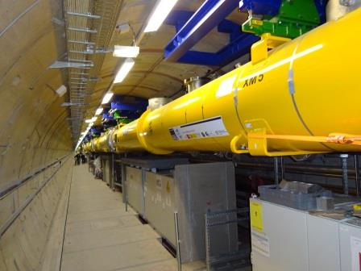
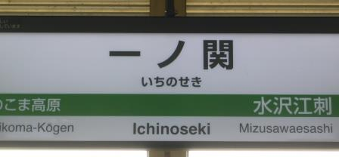
The new context
Triggered by H(125) discovery in 2012
Detailed site studies are going on in Japan
The XFEL is being assembled at DESY (March 2015)
This calls for realism in the design
En route for one of the possible locations of the Interaction Region (Sept. 2014)

Slide 9
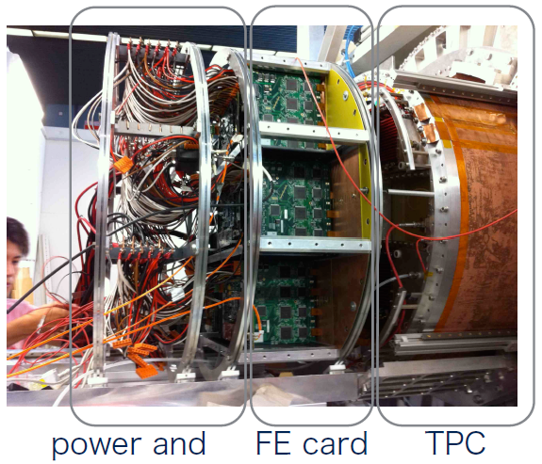
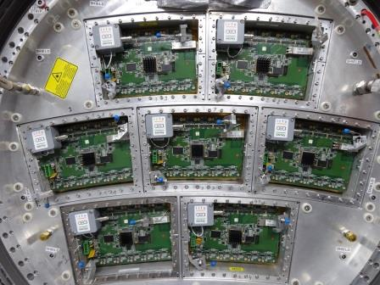
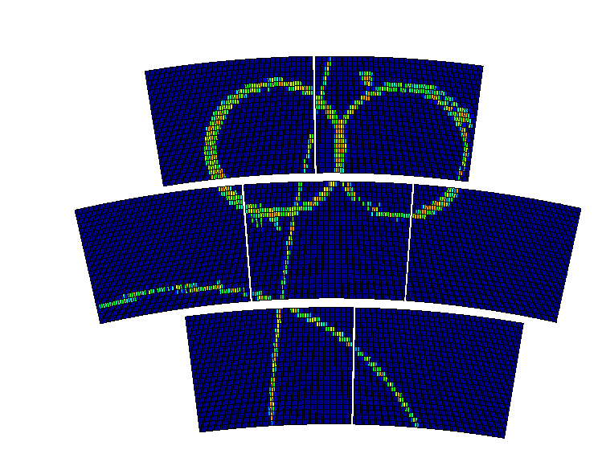
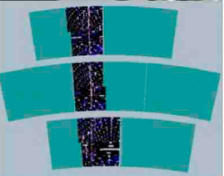
TPC Large Prototype at DESY
GEMs (Japan)
Micromegas (France)
March 2015

Slide 10
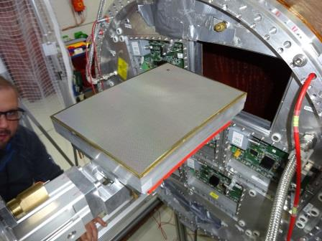
New Micromegas data taking in March 2015 at DESY
New modules with new (japanese) resistive anode: Diamond-like Carbon rather than Carbon-loaded kapton.
More robust, easier to achieve the wanted resistivity, easier to procure

Slide 11
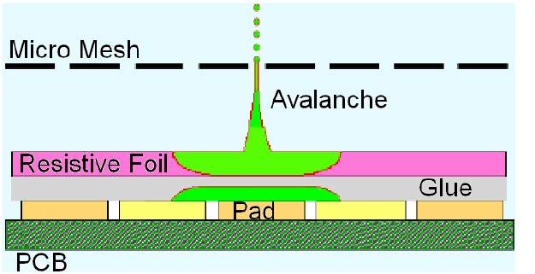
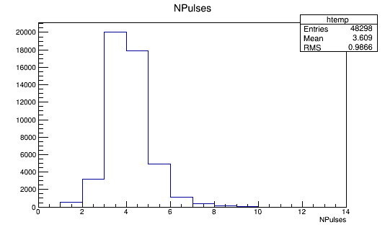
Pad multiplicity
Need to spread the charge to improve resolution.
‘Black diamond’ spreads better the charge than Carbon-loaded kapton
CLK
BD
m=2.6
m=3.6
Npad / hit
Npad / hit
Npad / hit

Slide 12
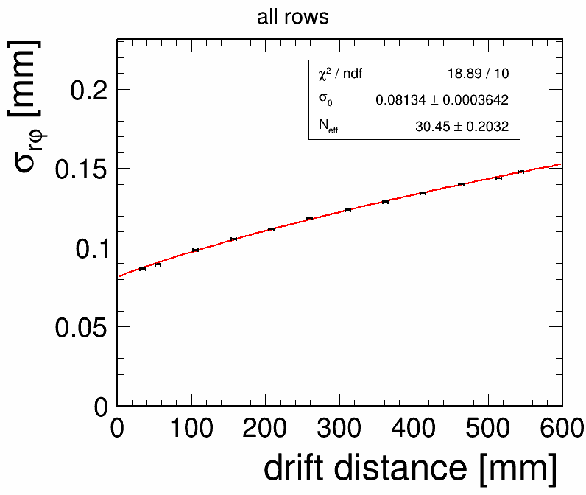
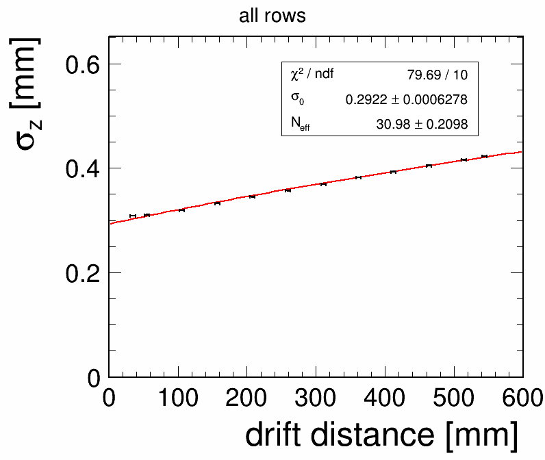
Analysis now in the same framework for MM and GEM
PRELIMINARY
Resolution 80 µm in rφ and 200 µm in z at zero drift distance
Drift dependence follows expectation from diffusion

Slide 13
Remaining R&D issues
Fully understand, mitigate and correct distortions
Cooling and power management
Ion backflow and ion gating
Design a new electronics, at a pace adapted to the progress of the technology. Optimization of power consumption and power pulsing must be included in the design from the beginning.

Slide 14
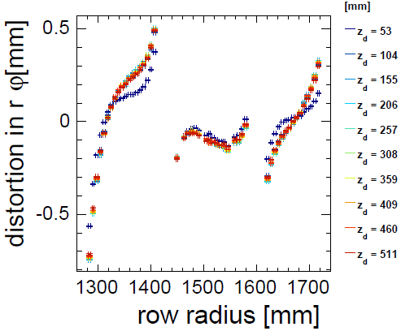
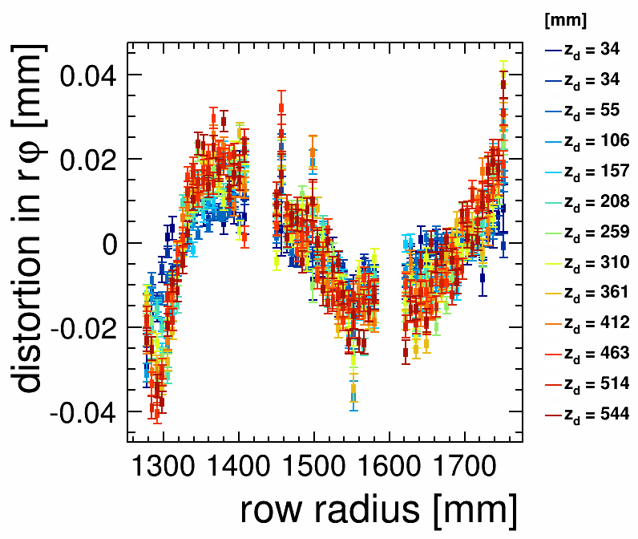
Distortions from the Large Prototype
O(mm) distortions can be corrected down to the 20 µm level

Slide 15
Understanding of Distortions
due to Non-uniformities of E Field
B=0T
y
Li Bo
x
electrons are sucked
into the gap
and lost
y
electron
loss
happens
here!
x
x
Li Bo
Li Bo
No C.O.G shift
C.O.G shift
pad row boundaries
This effect is track-angle-dependent and flips its sign with the track-angle!

Slide 16
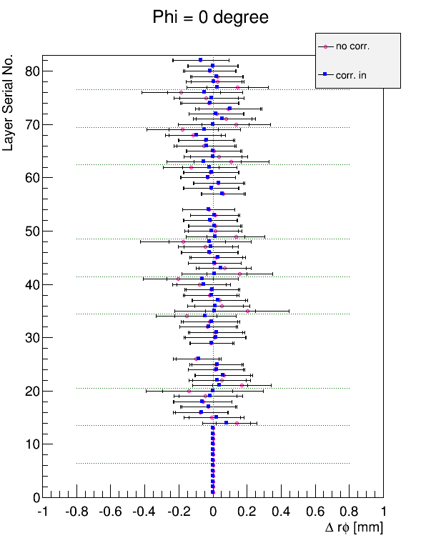
Understanding of Distortions due to
Non-uniformities of E and B Fields
B=1T
Distortion Correction
using the simulation result
ExB shifts the hits
in the opposite directions
on the different sides of the gap.
Mai Nozoe
Li Bo
Good agreement with simulation
2012
Beam Test
The ExB effect is track-angle independent!

Slide 17
Track Fitting in Non-uniform
B Field in the Case of ILD TPC
Detector Solenoid
Karlsten Buesser
Bsum
Br
Tracking Volume
Tracking Volume
>10% variation!
significant radial component!
+ Anti-DID effect!
Using the DBD field map with the anti-DID, study the bias in
momentum measurement when a single helix is assumed and test the new KalTest for non-uniform B field.

Slide 18
Track Fitting in Non-uniform
B Field in the Case of ILD TPC
Li Bo
Uniform B field (idealistic)
Non-uniform B field (DBD realistic)
1/p
1/p
φ
φ
Both reconstructed assuming uniform B field (single helix model)
Significant systematic shift can be seen depending on φ, which will degrade effective momentum resolution significantly!
→ We need to take into account B-field non-uniformity in the track fitting!
→ New KalTest for non-uniform B-field

Slide 19
Track Fitting in Non-uniform
B Field in the Case of ILD TPC
Li Bo
Momentum Resolution
reconstructed assuming B=0
δ(1/p) [GeV⁻¹]
δ(1/p) [GeV⁻¹]
reconstructed assuming B=0
New
New
θ
θ
Mean Value
reconstructed assuming B=0
reconstructed assuming B=0
<1/p> [GeV⁻¹]
<1/p> [GeV⁻¹]
New
New
θ
θ
New KalTest gives results consistent with those for uniform B-field !

Slide 20
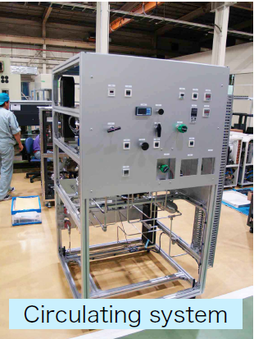
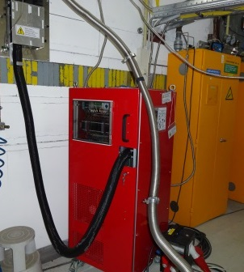
2-phase CO₂ cooling
CO₂ has a much lower viscosity and a much larger latent heat than all usual refrigerants. The two phases (liquid and gas) can co-exist a room temperature (10-20°C at P=45-57 bar). Very small pipes suffice and hold high pressure
Cooler developped at Nikhef and CERN/KEK
Pump system TRACI
Compressor system FPCCD and TPC

Slide 21
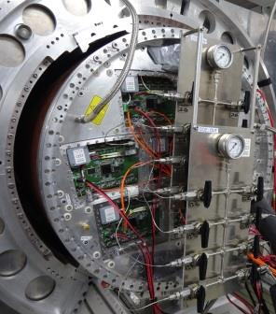
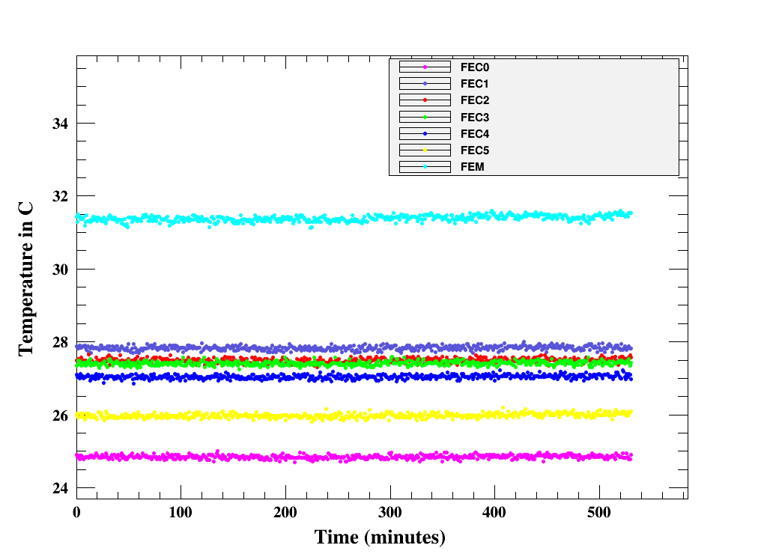
… and applied to the Large Prototype for many days in a row
And observe a very good temperature stability

Slide 22
Electronics
The test electronics are not those to be used in the final ILD detector, for the following reasons:
AFTER (T2K chip) not extrapolable to Switched Capacitor Array depths of 1 bunch train
S-Altro 16 (ALICE-based) has to evolve : improve packing factor, lower power consumption, power pulsing from the beginning (probably 65nm)
Present work within AIDA : Common Front End for Gas Detector Signal processor, 130 nm

Slide 23
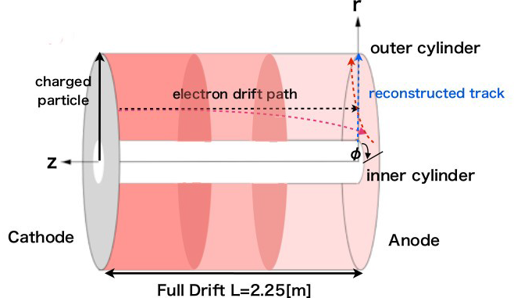
Ion space charge
Primary ions create distortions in the Electric field which result to O(<1µm) track distortions. 1 to 2 orders of magnitude safety margin with estimated BG.
However ions flowing back from the amplification region produce a high density ion disk for each train crossing. This disk drifts slowly (1m/s) to the cathode, influencing electron drift of subsequent train crossings

Slide 24
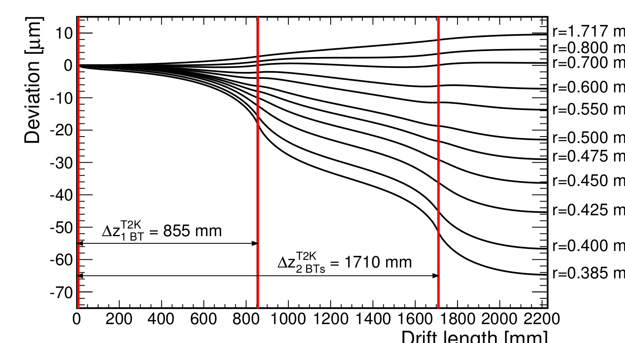
Distortions from backflowing ions
Example for the case of 2 ion disks :
60 µm distortion for
‘feed-back fraction’ x ‘gain’ = 1
GATE NEEDED

Slide 25
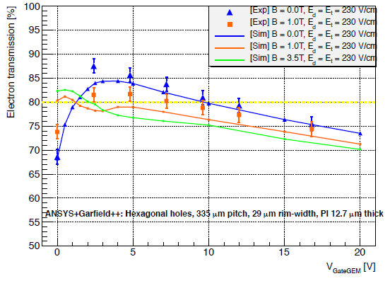
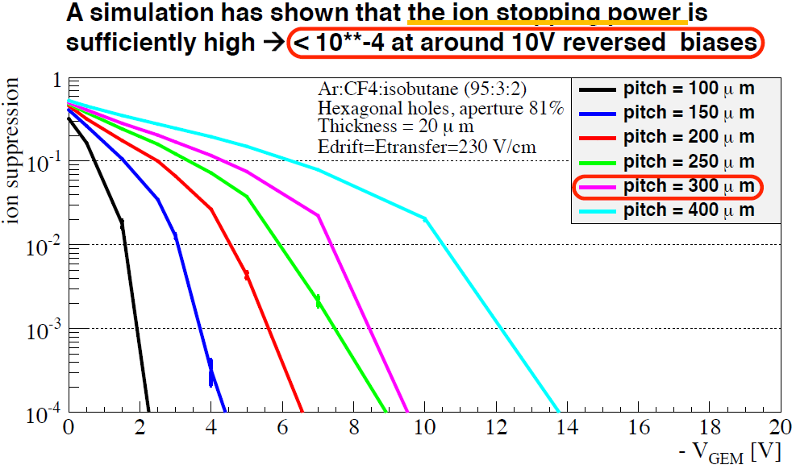
Gating : open GEM to stop ions while keeping transparency for electrons
Extrapolation to 3.5 T shows acceptable transmission for electrons (80%)

Slide 26
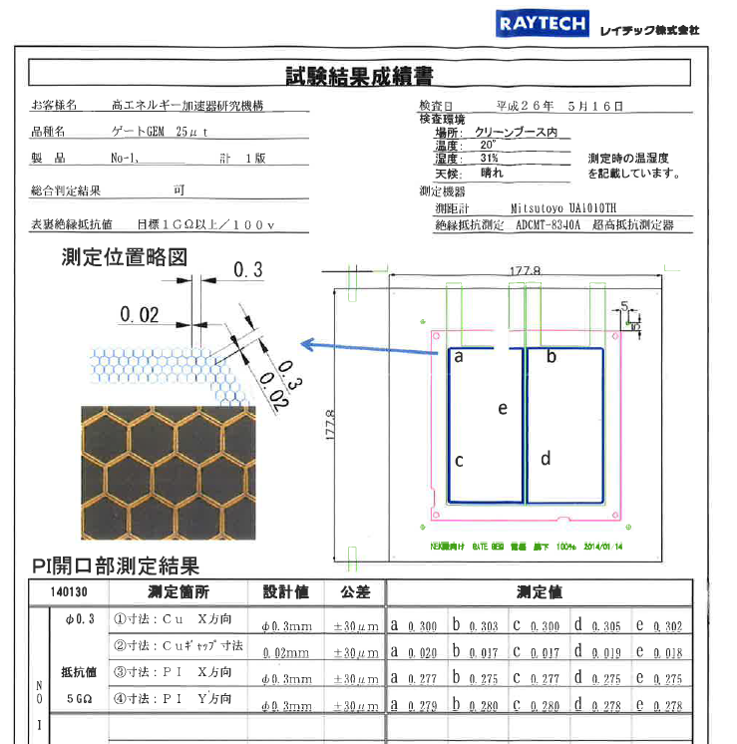
GEM Gating grid
A large-aperture gating grid from Japan has been handed to Saclay for transparency measure-ments.

Slide 27
Request for April 2015 to March 2016

Slide 28
Conclusion
The French-Japan R&D work within the LCTPC collaboration is in a new phase, more engineered and realist.
It also allowed to identify a few points requiring active R&D to be pursued in the next few years
Special thanks to K. Ikematsu, T. Matsuda, S. Ganjour, D.S. Bhattacharya

Slide 29
Backup slides

Slide 30
Events in the Large Prototype

Slide 31
Toward the Final Design of ILD TPC
The earliest timeline?
2014-15 R&D on ion gates and a decision on the ion gate:
2015-17 Beam tests of new LP modules with the gate
2017 Prioritization of the MPGD technology and module
ILC LAB & ILD detector proposal
2017-19 Final design of the readout electronics for ILD TPC and its tests
Design of ILD TPC
2018-19 TDR for the ILD tracking system:
2019-23 Prototyping and production: Electronics (chips→boards)
Prototyping and production: Modules
Production: Field cage/endplate and all others
2024-25 TPC integration and test
2026 TPC Installation into the ILD detector
ILC commissioning

Slide 32
A Possible Schedule of ILC in Japan As presented in the 2013 ILD meeting in Cracow

