Slide 1
Research and development of Micromegas detector and related devices
(Project N° 4304-1)
Updated progress report and second extension request
(up to March 2016)
P. Colas, S. Mukhopadhyay
CEFIPRA Scientific Council, Nice, France, May 29, 2015

Slide 2
Updated report
Introduction : ILC, Micromegas and TPC
Small prototypes
The Large prototype
The PhD student Deb Sankar Bhattacharya
Recent achievements :analysis, cooling, new resistive material
Plans

Slide 3
History of the project 4304-1
First meeting in Saclay in December 2008, discussing possible collaborations
First travel from France to India in January 2010. Application to CEFIPRA.
Started April 1, 2011, due to end on March 31, 2014, extended to September 30, 2015.
Documents written : detailed project March 2009, annual report from April 2011 to March 2012, mid-term report presented on Nov. 17, 2012 at the CEFFIPRA S.C. in Aurangabad, updated progress report April 2014 and extension request, this updated progress report (April 2015) and extension request to March 2016.

Slide 4
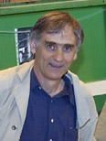
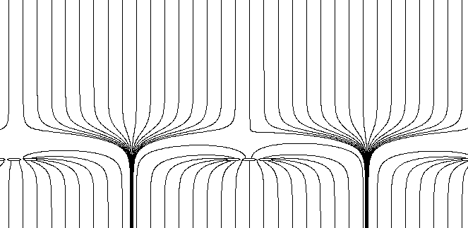
Micromegas: How does it work?
Y. Giomataris, Ph. Rebourgeard, JP Robert and G. Charpak,
NIM A 376 (1996) 29
S1
Micromesh Gaseous Chamber: a micromesh supported by 50-100 μm insulating pillars, and held at V_{anode} – 400 V
Multiplication (up to 10⁵ or more) takes place between the anode and the mesh and the charge is collected on the anode (one stage)
Funnel field lines: electron transparency very close to 1 for thin meshes
Small gap: fast collection of ions
S2
S2/S1 = E_{drift}/E_{amplif} ~ 200/60000= 1/300

Slide 5
TPC:
-Long conversion and drift region
-Measurement of drift time gives transverse coordinate

Slide 6
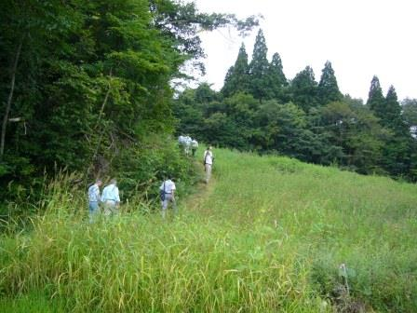
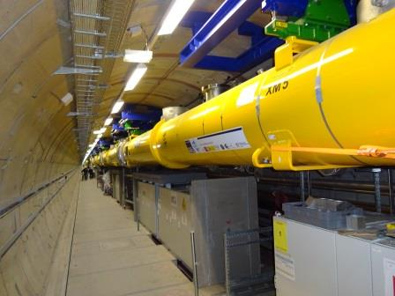
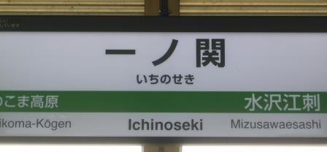
The new context of the ILD TPC
Triggered by H(125) discovery in 2012
Detailed site studies are going on in Japan
The XFEL is being assembled at DESY (March 2015)
This calls for realism in the design
En route for one of the possible locations of the Interaction Region (Sept. 2014)

Slide 7
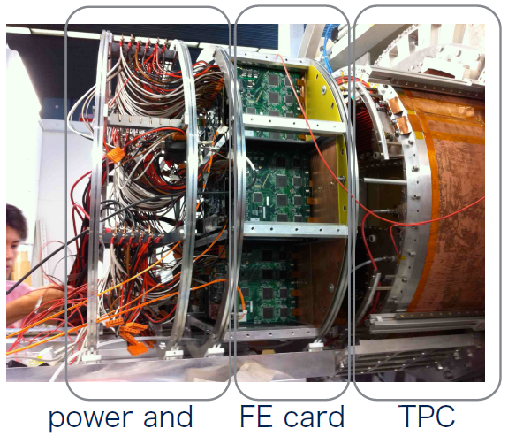
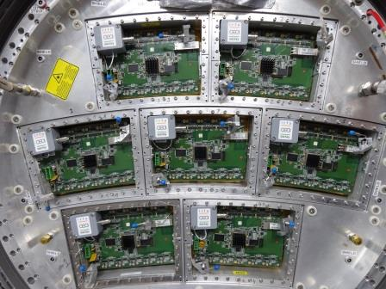
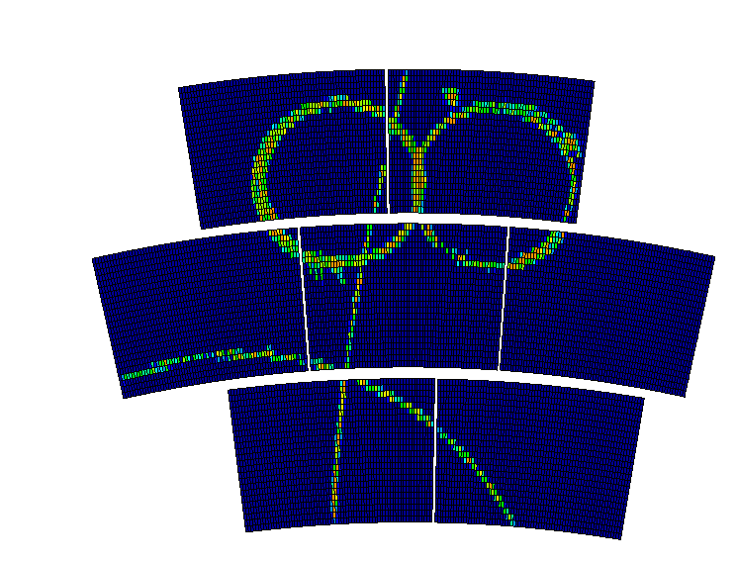
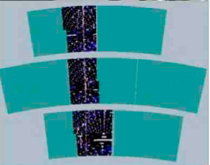
TPC Large Prototype at DESY
GEMs
Micromegas
March 2015

Slide 8
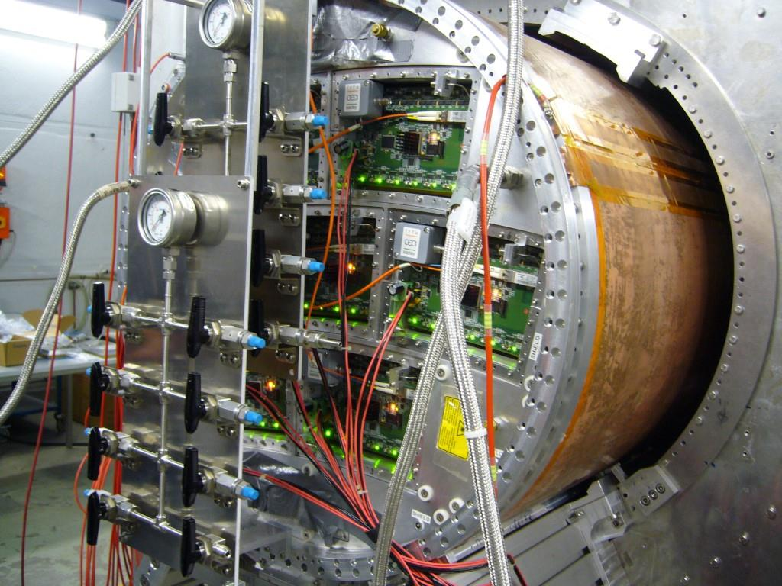
The Large prototype
Built by LCTPC collaboration
Magnet and cooling plant by KEK, Tsukuba
Equipped by Saclay with resistive anode Micromegas.
Cooling tested in February 2014 at DESY

Slide 9
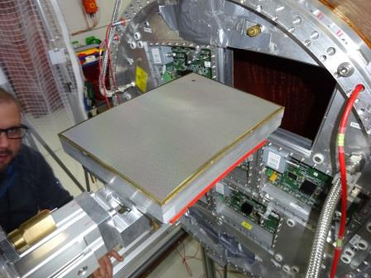
New Micromegas data taking in March 2015 at DESY
New modules with new (japanese) resistive anode: Diamond-like Carbon rather than Carbon-loaded kapton.
More robust, easier to achieve the wanted resistivity, easier to procure

Slide 10
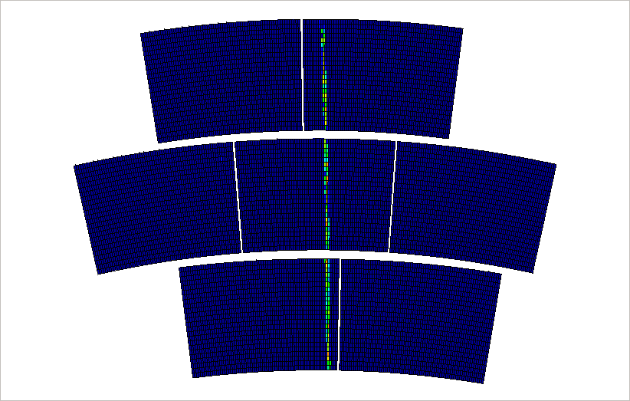
Events in the Large Prototype

Slide 11
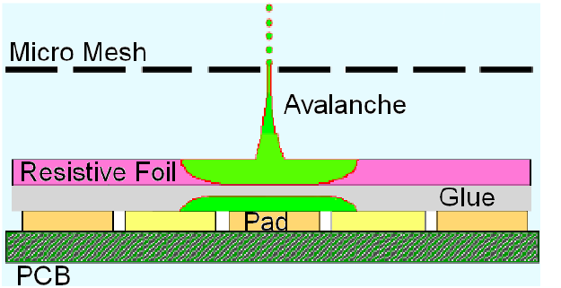
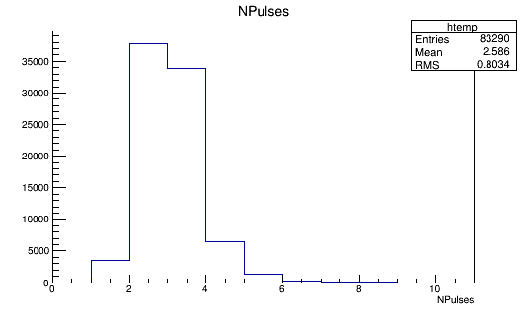
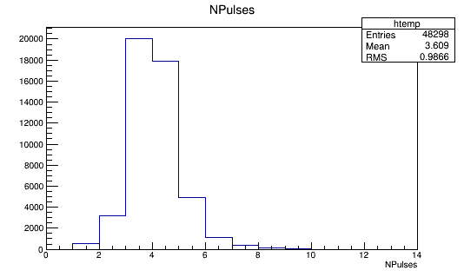
Pad multiplicity
Need to spread the charge to improve resolution.
‘Black diamond’ spreads better the charge than Carbon-loaded kapton
CLK
BD
m=2.6
m=3.6
Npad / hit
Npad / hit
Npad / hit

Slide 12
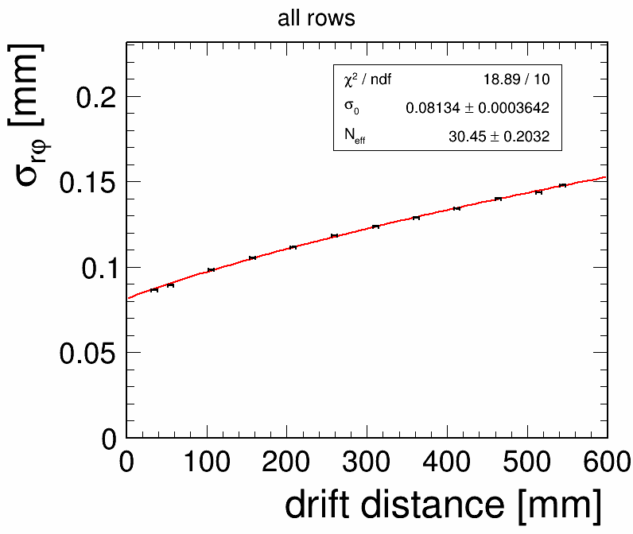
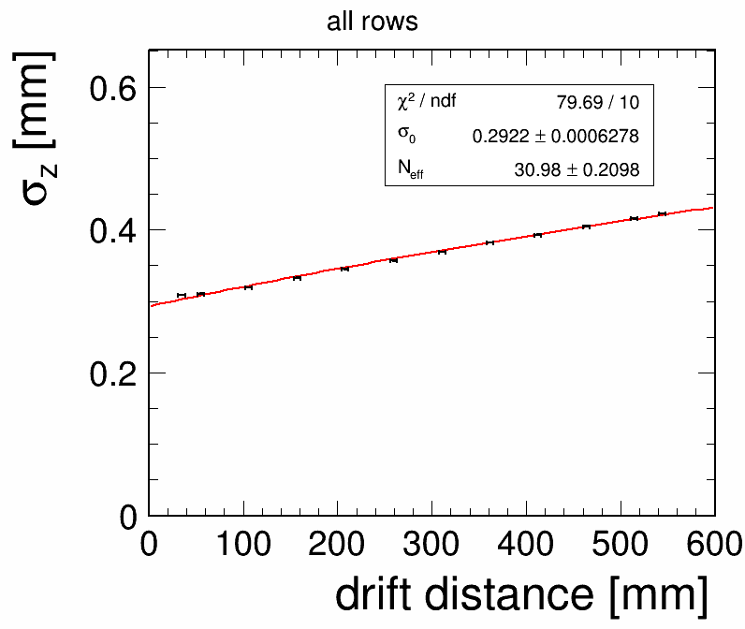
Analysis now in the same framework for MM and GEM
PRELIMINARY
Resolution 80 µm in rφ and 200 µm in z at zero drift distance
Drift dependence follows expectation from diffusion

Slide 13
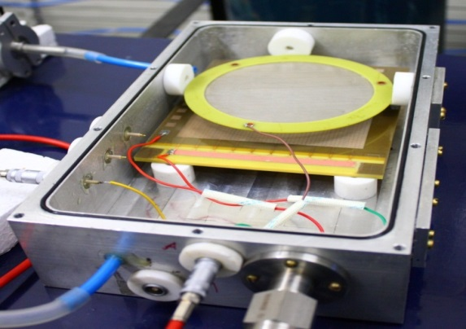
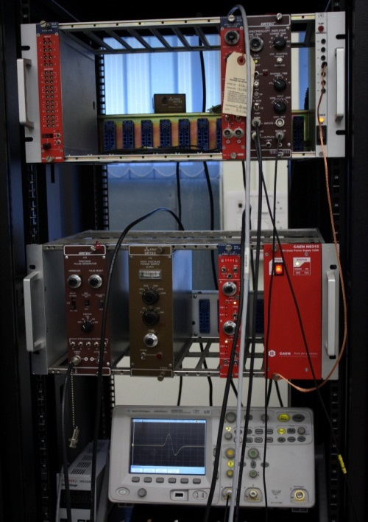
Work with small prototypes
Full equipment of the SINP lab for small detector studies, and procuration of Micromegas detectors by the Saclay team
Study of various gaps and geometry and comparison with simulation
4 publications (NIM and JINST)

Slide 14
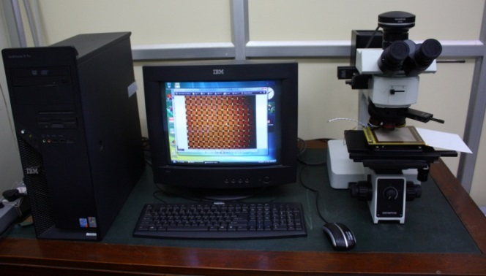
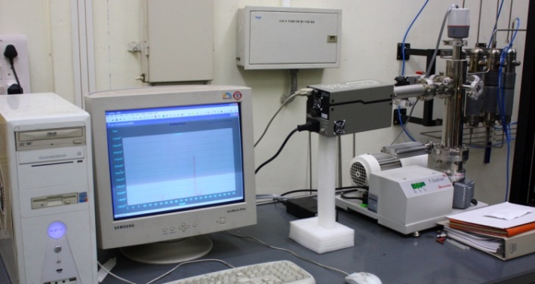
High-standards equipment at SINP
Digital imaging Microscope
Residual gas analyser

Slide 15
Work with small prototypes
Ion backflow measurements in Saclay with the Indian team, followed by complementary measurements at SINP.
Now published in JINST

Slide 16
Work with small prototypes
Detailed simulations at SINP to understand the operation of Micromegas. (example : effect of pillars sustaining the mesh on the electron endpoint)
Published in NIMA

Slide 17
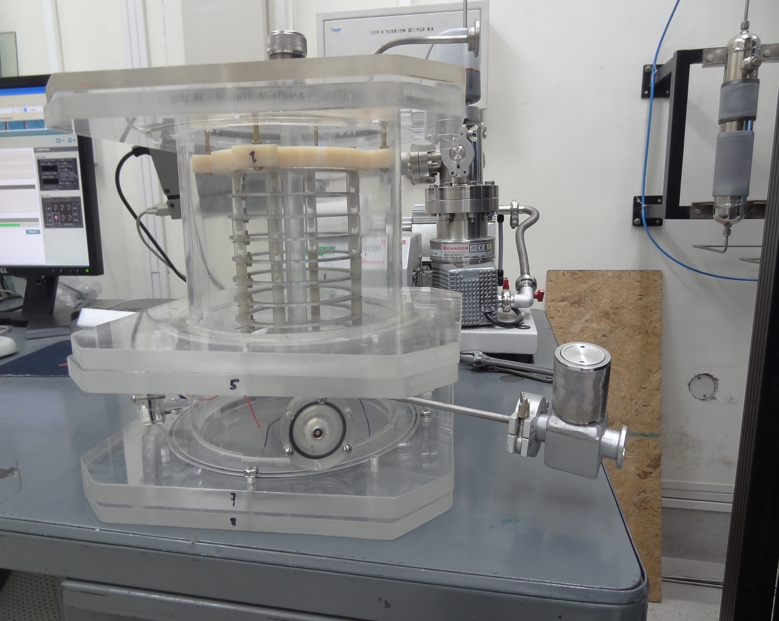
New small TPC built at SINP

Slide 18
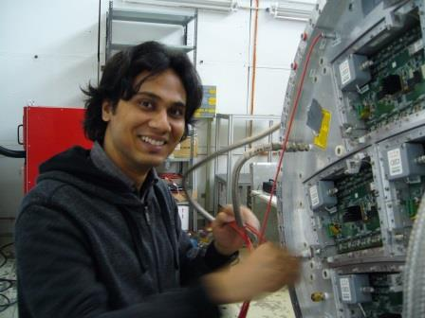
The student Deb Sankar Bhattacharya
Joined SINP in January 2013
Registered in PhD at Jadavpur University, with advisors S. Mukhopadhyay, A. Bhattacharya and P. Colas.
PhD to be defended in Kolkata, in January-March 2016.
Fully payed on CEFIPRA funds
SINP
Saclay
SINP
Saclay
SINP
2013
2014
2015

Slide 19
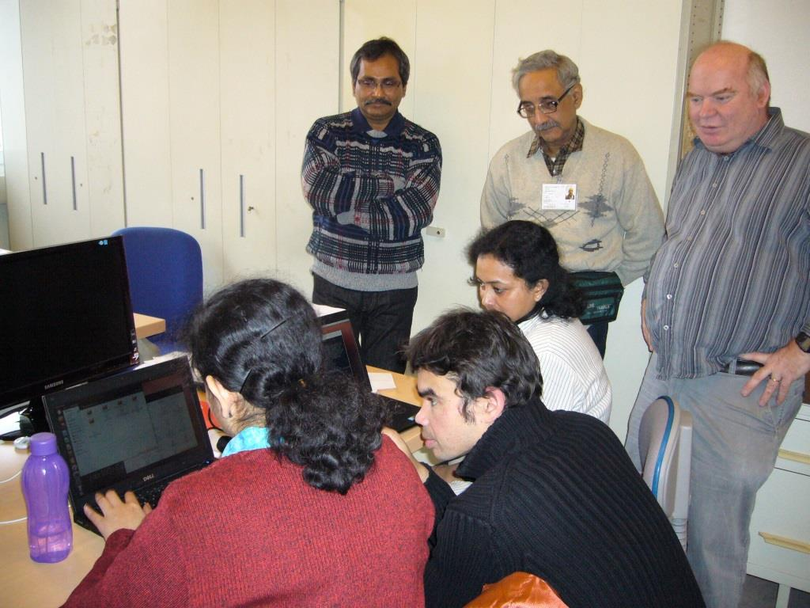
Analysis and software
‘Software week’ in Saclay, where we work on the track reconstruction and analysis.

Slide 20
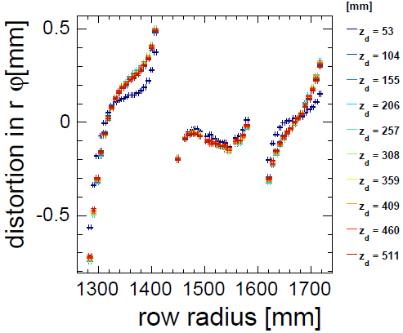
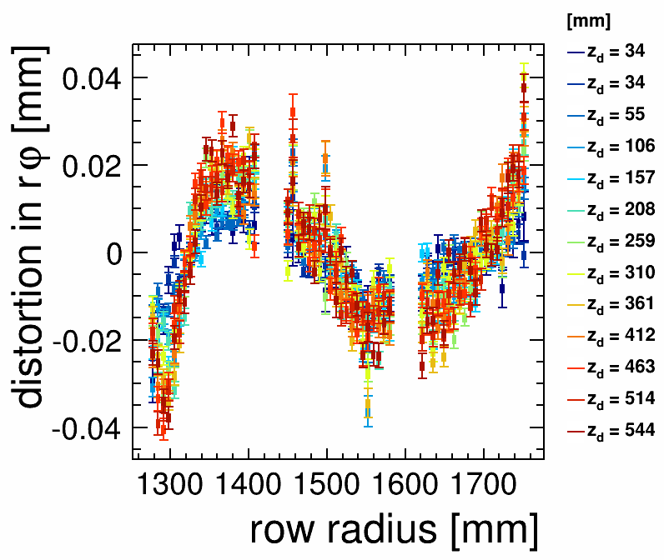
Distortions from the Large Prototype
O(mm) distortions can be corrected down to the 20 µm level

Slide 21
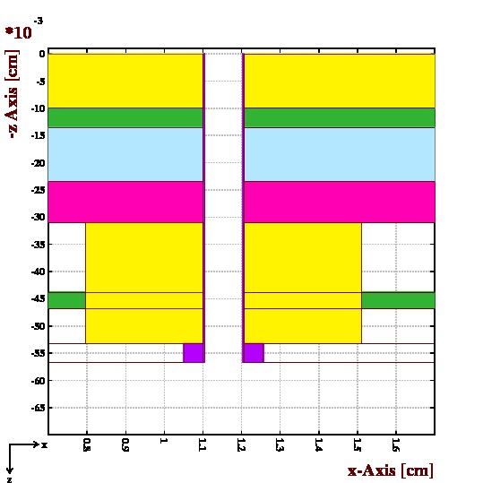
Distortions from the Large Prototype
Inhomogeneity of the Electric field near the edges of the modules induces distortions (even at B=0)
Also induces ExB effects
Changes in E also changes the drift velocity
Add up to mechanical misalignment
Detailed module edge layout

Slide 22
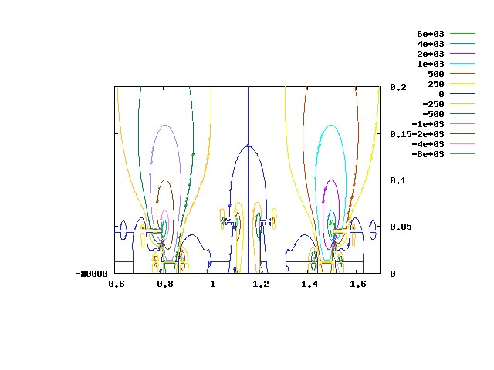
Distortions from the Large Prototype
Inhomogeneity of the Electric field near the edges of the modules induces distortions (even at B=0)
Also induces ExB effects
Changes in E also changes the drift velocity
Add up to mechanical misalignment
Calculations by S. Mukhopadhyay

Slide 23
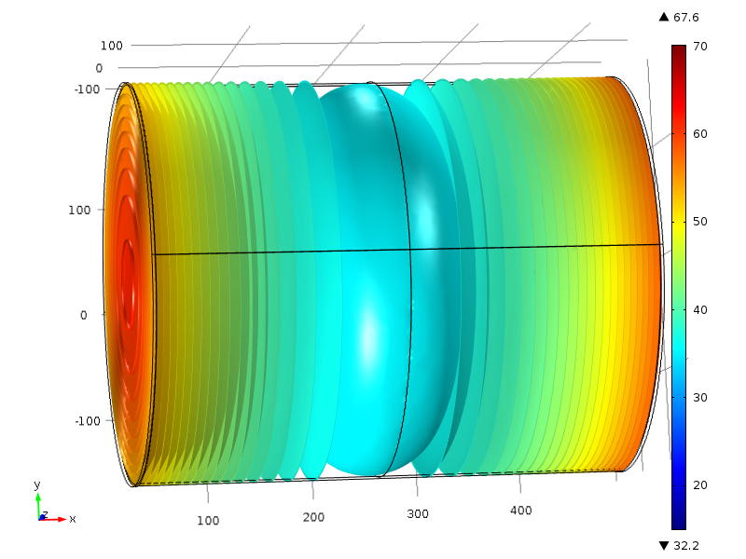
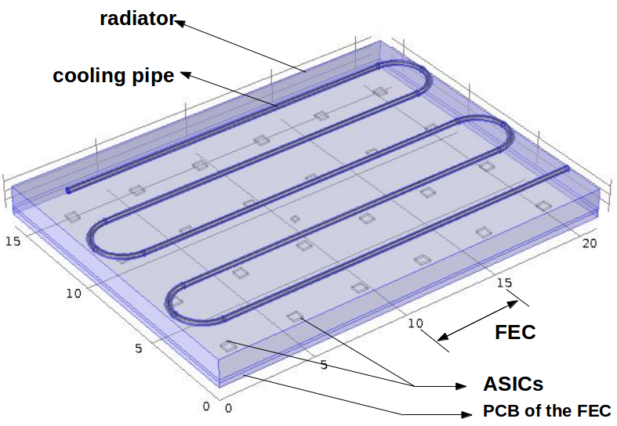
D.S. Bhattacharya carried out thermal simulation of the gas volume and of the endplate modules
Thermal inhomogeneities cause changes in drift properties in the gas, hence distortions. Needs simulations.

Slide 24
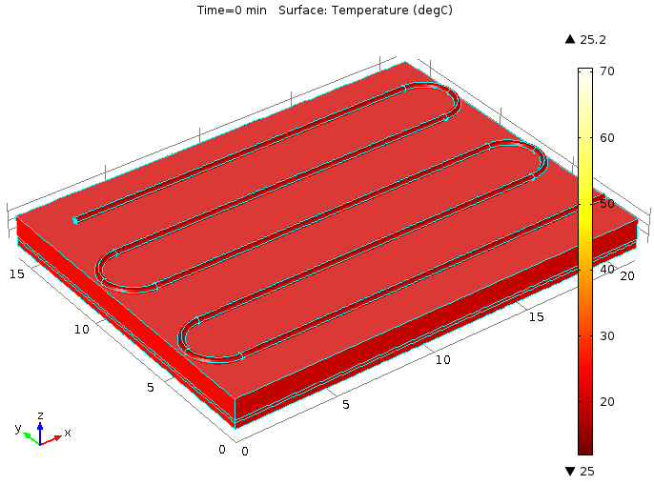
Warming up and cooling down of a module. Good agreement with data

Slide 25
Recent achievements
October 2014: Visit of French team to SINP, Kolkata: organization of IWAD (International conference on Advanced Detectors), Lectures, and RD51 MPGD meeting
Outreach event for CEFIPRA in November
Papers in progress

Slide 26
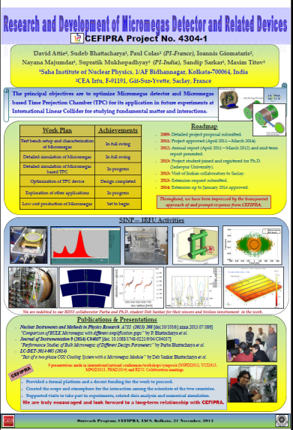
Outreach poster for CEFIPRA event, Kolkata, Nov. 2014

Slide 27
Conclusion
Lots of achievements after 3 years.
French funds not yet spent, but just enough remains to pay salary and expenses of D.S. Bhattacharya through 2015, mainly to study distortions in the Large Prototype TPC
2 weeks in Kolkata for the French team, end of October 2014: MPGD workshop and teaching.
Last installment + travels necessary to ‘wrap up’ nicely the project (and DSB thesis)

Slide 28
Funding on French side
 | Salaries | Recurring exp | Left to be spent
Received | 25,000 | 20,143 | 4 mo (5,600)
spent | 11,600 | 14,150 | Travels ~4,300
total | 36,600 | 34,293 | 9,900
Travels : PC to Kolkata 900, MT to Kolkata 1,400, thesis defence ~2,000
X : DSB to EPS conf. 1,500
Last instalment as foreseen should be fine
Same on Indian side, plus 2 more travels if possible

