Slide 1
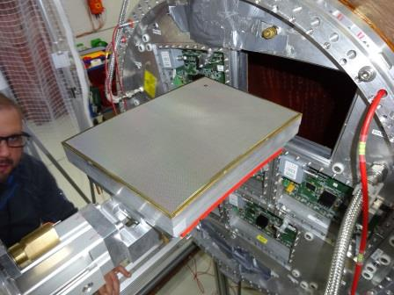
Test of a new anode resistive coating for a Micromegas TPC
D. Attié, A. Bellerive, D.Bhattacharya, P. Colas, M. Dixit, S. Ganjour, R. Mehdiyev
Resistive coatings for charge spreading and spark mitigation
Carlon-Loaded Polyimide and Diamond-like Carbon
Beam test
Comparaison of CLP and DLC
Part of the data used here were taken at the DESY test facility of the LCTPC collaboration.

Slide 2
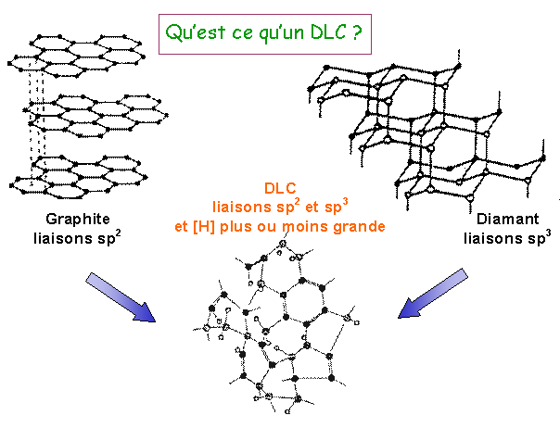
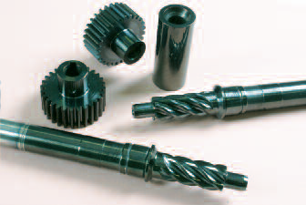
What is a DLC?
Diamond-like Carbon
Robust, flexible, resistive with a large range of resistivity, precisely tunable, lubricant
Available from Japan (by A. Ochi). 100 nm layer deposited on kapton
Used to make lubricated mechanical parts
A4 foils used by Rui de Oliveira to make 2 Micromegas TPC modules
Graphite
Diamond
C. Donnet et al., Surface and coatings technology 120’129 (1999) 548

Slide 3
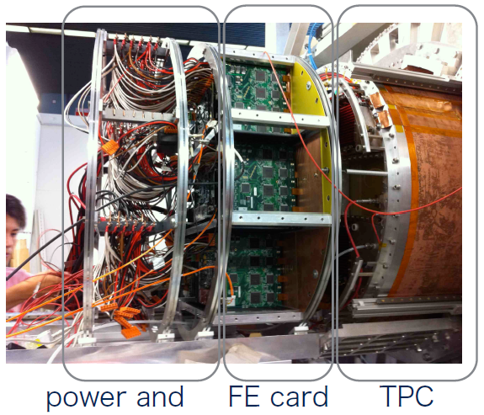
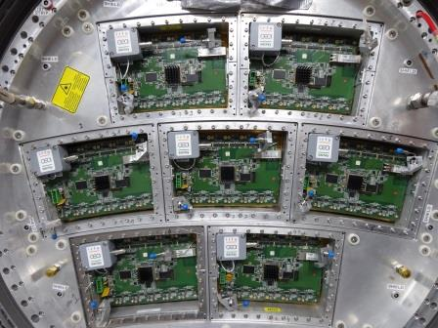
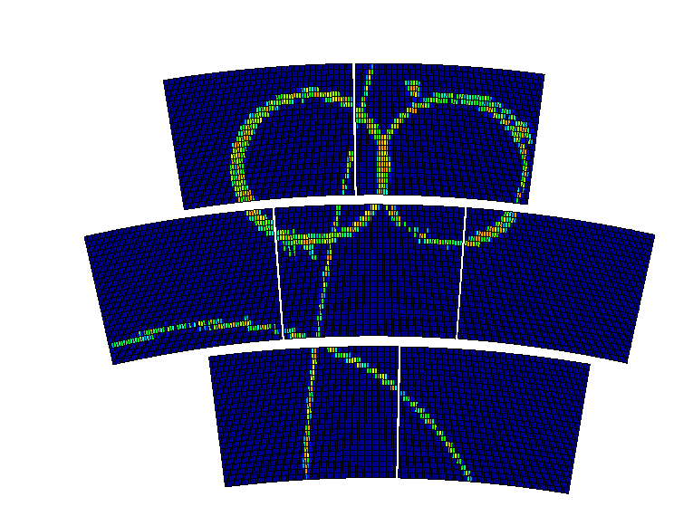
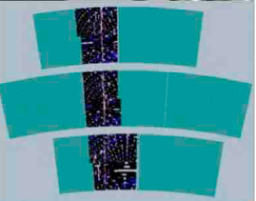
TPC Large Prototype at DESY
GEMs (see talk by D. Tsionou and A. Vauth)
Micromegas
March 2015

Slide 4
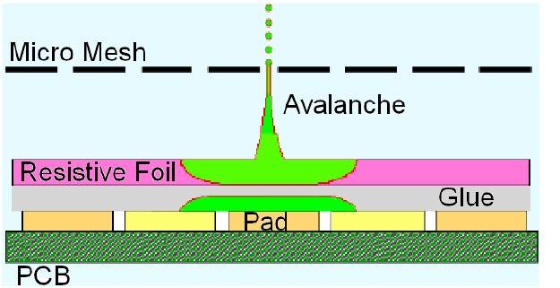
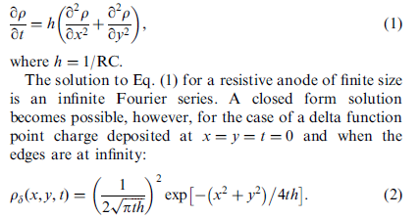
Pad multiplicity
Need to spread the charge to improve resolution.
Insulator + resistive coverlay = resistive-capacitive continuous network. (M. Dixit et al.)
For t ~shaping time, r~sqrt(2t/RC)
Should be close to the pad size.
Npad / hit

Slide 5
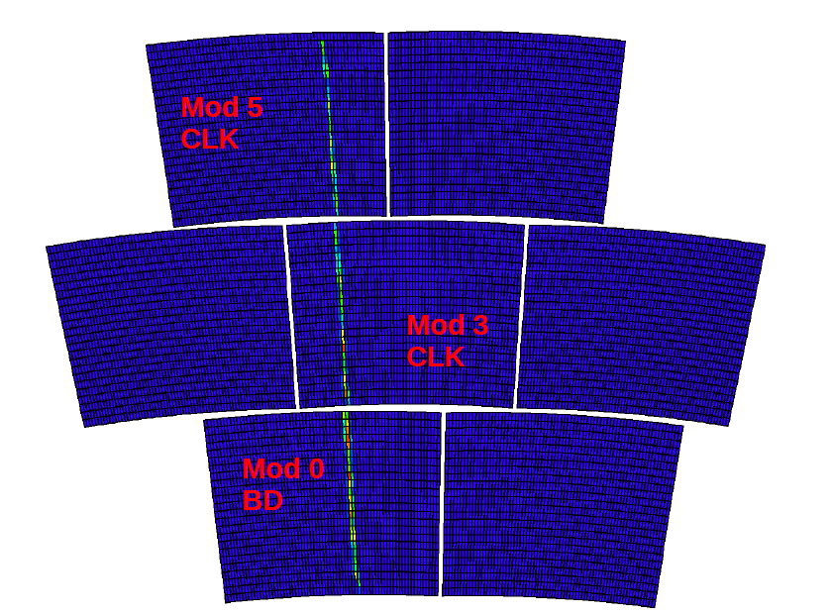
Black diamond’ and Carbon-loaded kapton

Slide 6
Pad multiplicity
Npad / hit

Slide 7
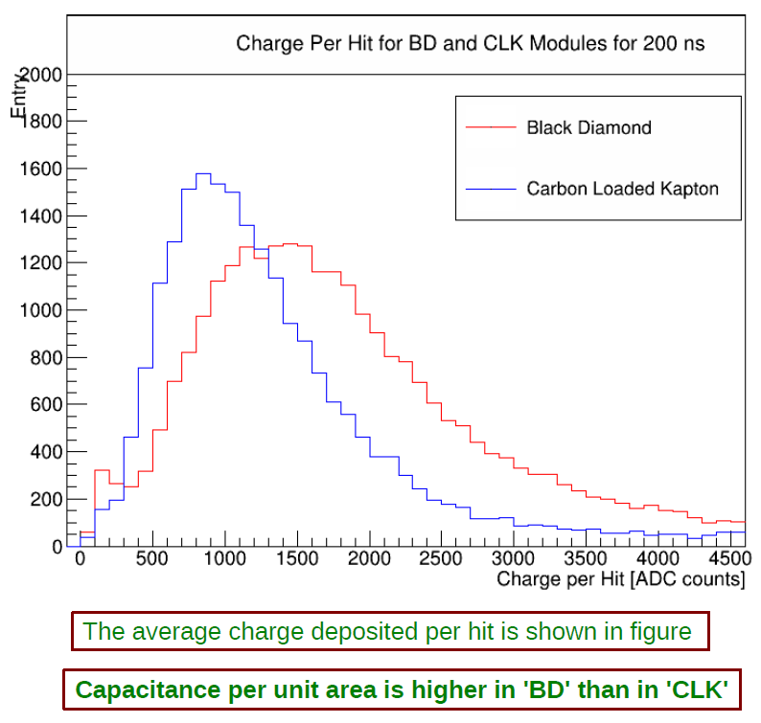
Charge deposition
Black Diamond (DLC) modules give more charge than Carbon loaded Kapton (CLK)
Npad / hit

Slide 8
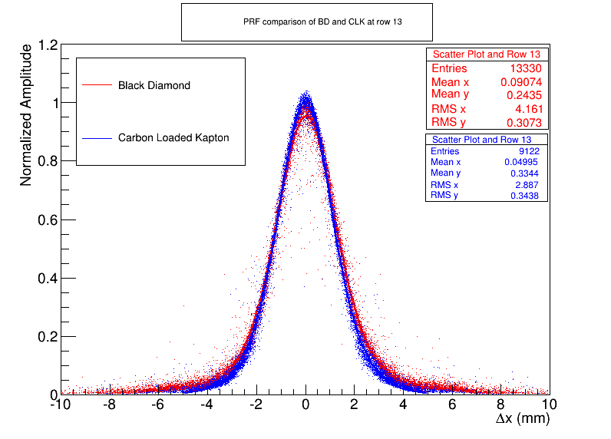
The Pad Response Function is wider for Black Diamond than for Carbon-loaded Kapton.
r.m.s.
CLK : 2.55 mm
BD : 2.85 mm

Slide 9
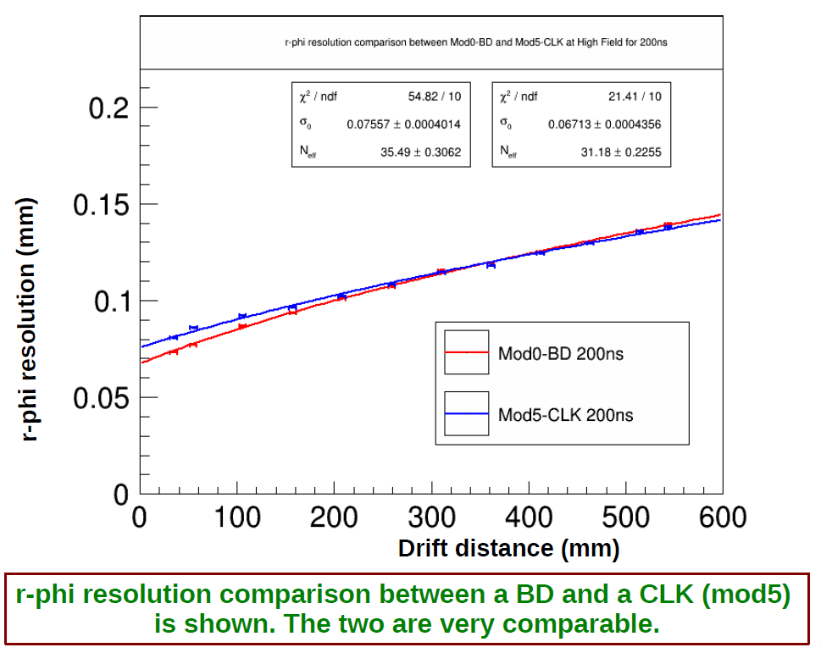

Slide 10
Robustness
Note that both modules underwent a short (one after 10 days, the second at the very end of the 2-week period)
However apparently not connected to the layer (but a free wire of the mesh touching the ground; rather frequent in present design)

Slide 11
Conclusion
In conclusion, a very nice material is now available to make resistive anodes
It is robust and performant
We will explore the industry to find more providers
Thanks to Rui de Oliveira and Atsuhiki Ochi!

Slide 12
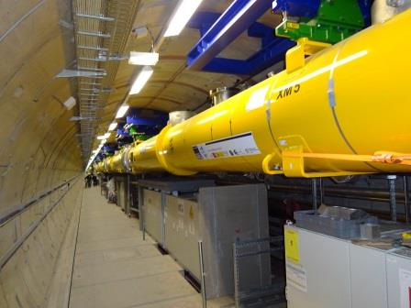
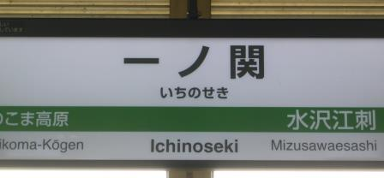
The new context of the ILD TPC
Triggered by H(125) discovery in 2012
Detailed site studies are going on in Japan
The XFEL is being assembled at DESY (March 2015)
This calls for realism in the design
En route for one of the possible locations of the Interaction Region (Sept. 2014)

Slide 13
CLK and DLC give same resolution
BD
CLK
CLK

