Slide 1
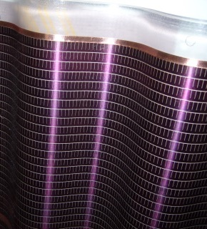

Resistive coatings
P. Colas, CEA/Irfu Saclay
Definition of surface resistivity
Practical examples of coating applications
Measurement techniques
Applications of resistive coatings
Charge dispersion
Spark mitigation
protection
Drawbacks
Characterization (uniformity, robustness,…)
New ideas
‘Wallpaper’ ASIP photo-cell (EPFL/MIT)

Slide 2
Surface resistivity
R = ρ L/S
: bulk resistivity
Metal : 10⁻⁶ - 10⁻⁵ Ω.cm
Insulator >10¹⁷ Ω.cm
S
L
R = ρ L/wt
Flat layer: t small
Square L=w
Surface resistivity R= ρ/t
Units : Ohm per square
t
w

Slide 3
Measurement techniques (1)
Cut a long band of resistive. Hold it both ends with conductive adhésive on an insulating surface, measure the resistance and divide by the number of squares L/w.

Slide 4
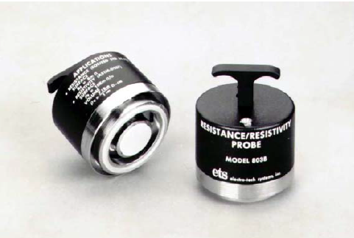
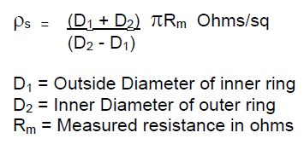
Measurement techniques (2)
Circular probe
(for example ETS model 803B)
Measure the resistance between 2 rings

Slide 5
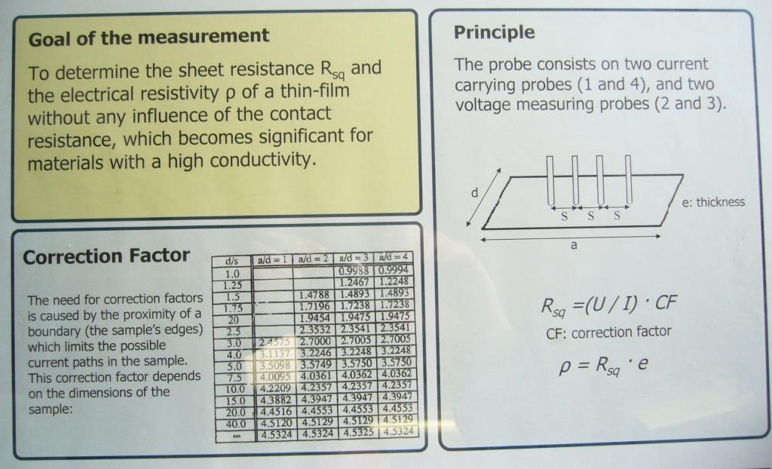
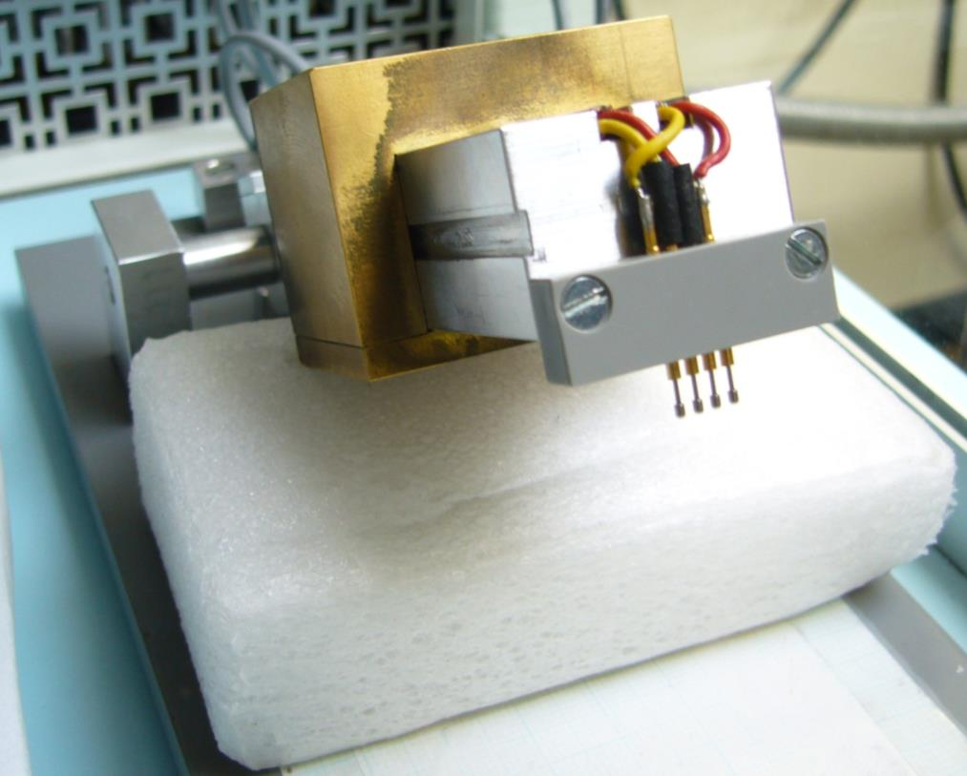
Measurement techniques (3)
Four-point probe
Necessary for uniformity measurements, but might scratch the layer
Measurement techniques (4)
Use the saturation of the rate on a counting chip (GridPix) in a X-ray gun (M. Lupberger, H. van der Graaf, see talk by Fred Hartjes)

Slide 6
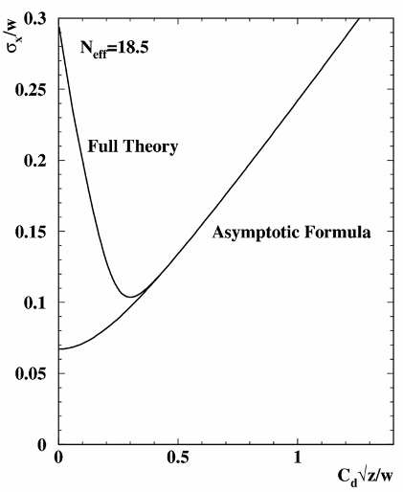
Applications of resistive coatings
Analytical theory of resolution
In a MPGD (especially Micromegas) with pads or strips, the avalanche is typically 15-20 micron wide. Charge sharing between pads is only due to diffusion in the drift gas
Taking into account ionization fluctuations, gain fluctuations, and the finite pad size, the resolution of a MPGD as a function of z (the drift distance, is given by the following plot
D. Arogancia et al., NIM A602 (2009) 603
1/√12
1/√(12.N_{eff})

Slide 7
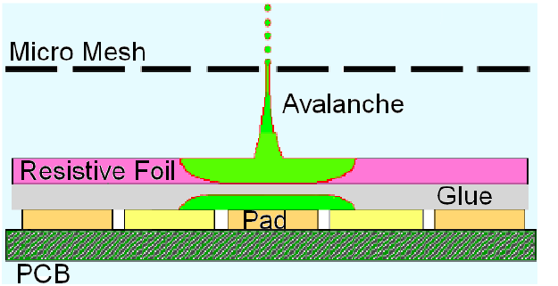
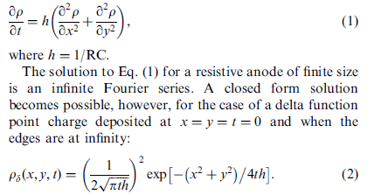
Applications of resistive coatings
Charge spreading
Need to spread the charge to improve resolution.
Insulator + resistive coverlay = resistive-capacitive continuous network. (M. Dixit et al.)
For t ~shaping time, r~sqrt(2t/RC)
Should be close to the pad size.
M. Dixit, A. Rankin, NIM A 566 (2006) 28

Slide 8
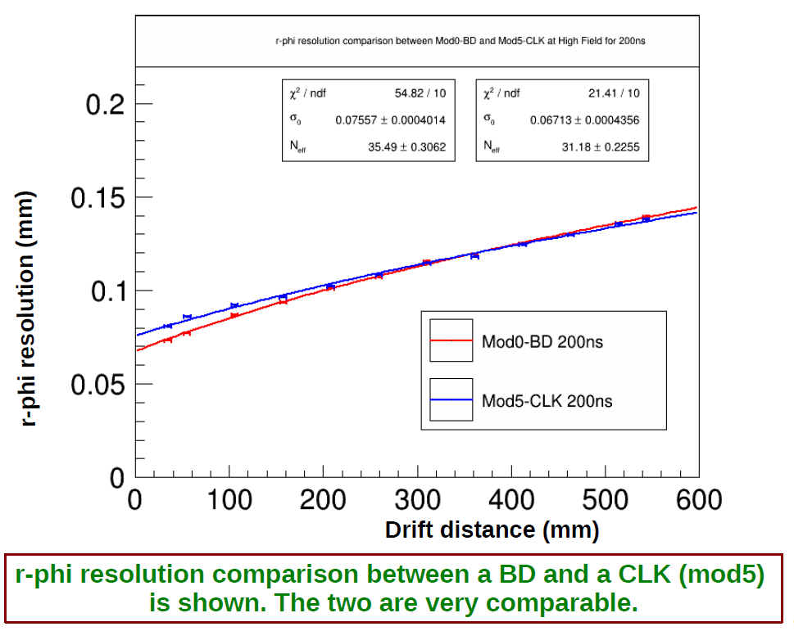

Slide 9
Applications of resistive coatings
Spark mitigation
The avalanche charge is kept locally for some time
This lowers the potential locally
This in turn lowers the gain and avoid the Rather limit to be attained
Moreover, as the charge goes to ground through a resistance, this limits the current through the preamplifiers, protecting them
You can also pattern resistors in your PCB (see Max Chefdeville’s talk)

Slide 10
Different sparking behaviours of standard and resistive detector:
Standard SLHC2(@10KHz):
Resistive R3(@wide beam,15KHz):
S. Wu
SLHC2: HV=400 V (Gain ~3000): current when sparking < 0.4 μA
voltage drop< 5%
R3: HV=410 V (Gain ~3000): current when sparking < 0.2 μA
voltage drop<2%

Slide 11
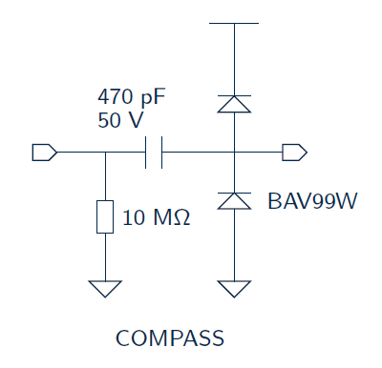
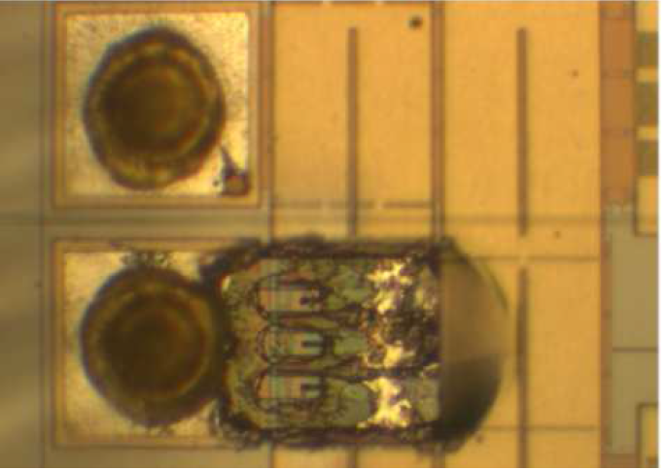
Spark protectection
Protection diodes, resistors and capacitors no longer needed : this saves space on the FE boards

Slide 12
Resistive coating technologies
Sheldal film + cermet (Al Si) (Madhu Dixit)
Resistive paste or ink (Rui de Oliveira, Imad Laktineh, Nick Lumb, José Répond)
Spray of carbon powder in glue (G. Mikenberg)
Kapton with Diamond-like Carbon by sputtering (see Atsuhiko Ochi’s talk)
aSiH deposition (Nicolas Wyrsch)
…
Several presentations in WG1

Slide 13
Simulating and understanding SiProt
A single spark kills a TimePix chip
  High current, hot plasma -> destroys circuit
  A sufficiently thick SiProt layer reduces and softens the sparks
How protection works?
  Allows charge to stay over the pad, lowering the local potential
  Limits the current thru the amplifier
  Protects mechanically
  Avoids points, softens the surface?
Any damage to the signal?
  Amplitude loss?
  Charge sharing with neighbouring pads?
  Short-circuit of the amplifiers
  Introduces dead time?
TO ANSWER, NEED A SIMULATION

Slide 14
Orders of magnitude
R_{neighb} = ρ L/el = ρ/e for square pads
For 10 µ aSi, ρ=10¹¹ Ω.cm, R=10¹⁴ Ω/square
R_{thru} = ρ e/Ll ~ 0.04 10¹⁴ Ω
R_{neighb}/R_{thru} = L²/e²
e<<L to avoid spreading the charge by side conductivity. The charge preferentially escapes thru the pad, but with an extremely high resistance.
L
l
e
R neighbour
R thru
C_{neighb} = ε_{r} ε₀ Le/l = ε_{r} ε₀ /e for square pads
C_{thru} = ε_{r} ε₀ Ll/e (note ε_{r} ~11 for Si)
The influence acts preferentially thru the pad if L>>e

Slide 15
L
l
e
R neighbour
1/C_{neighbour}ω
R thru
1/C_{thru}ω
Also R_{thru} >> 1/Cω to leave the induced signal
(OK with 10¹¹ Ω.cm within 3 orders of magnitude for 10 ns signals)
Equivalently, RC time constant >> 10ns
The signal is fully capacitive

Slide 16
Charge injected in the middle of the pad
thickness | Signal frac. on central pad (Full pads) | Signal frac. on central pad (cross)
10 µ | 94 % | 76 %
15 µ | 83 % | 57 %
20 µ | 70 % | 44 %

Slide 17
Pad Response Function

Slide 18
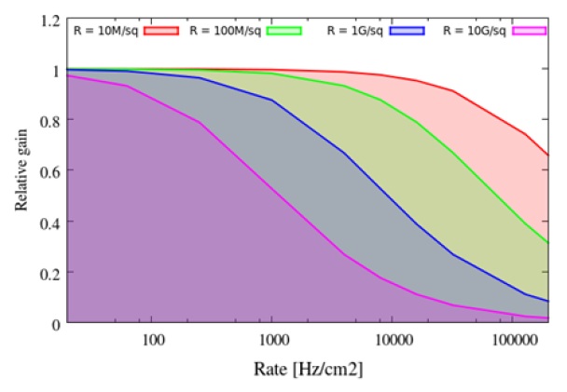
Drawbacks
Resistive layers slow down the detector, as the charge remains some time on the anode. They degrade slightly the rate capability.
Simulation by J. Galan
D. Attié et al., JINST (2013), ‘A piggyback Micromegas’
For 10 MΩ, there is a 20% gain drop at 100 kHz/cm2

Slide 19
New Ideas
Use photo-lithographic and electro-lithographic techniques to make patterned protection layers, burried resistors, on pixel chips

