Slide 1

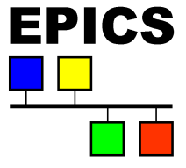
Diagnostic controls of LIPAc
Jean-François DENIS
October 22th 2014 EPICS meeting
Notes:
Good afternoon everyone! I’m Jean-François DENIS from CEA Saclay and I work as an EPICS developer engineer.
The goal of my presentation today is to speak about the Diagnostics controls of IMIF EVEDA Prototype accelerator:LIPAC

Slide 2
Outline
  Context P.03
  Description of each diagnostic P.06
  Conclusion P.23
Notes:
I’ve divided my presentation into four sections.
The first section will remind you of the context of the IFMIF project
The second section will describe all controls diagnotic
The third section will be a short report about the status
And I will finish by a conclusion

Slide 3
  Context
  Description of each diagnostic
  Conclusion
Notes:
So just some informations to remind you of about the context of IFMIF project

Slide 4
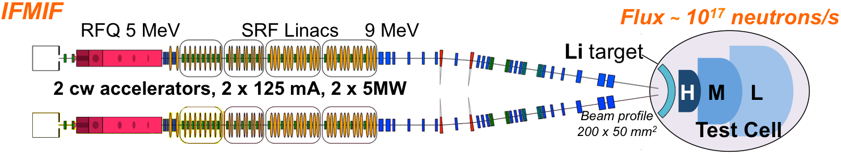
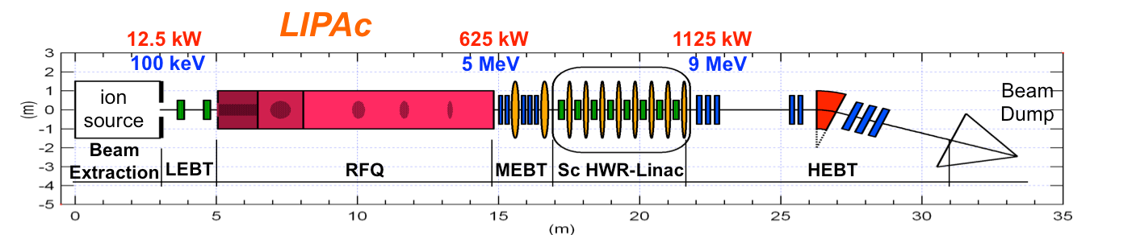
context
  IFMIF (International Fusion Materials Irradiation Facility) will be built to provide an accelerator based on a neutron source to produce high-energy neutrons (deuterons) at sufficient intensity and irradiation volume to qualify materials for fusion reactors of the future
  A prototype LIPAc(Linear Ifmif Particle Accelerator) identical to the low energy section of IFMIF is being built to check the validity of the design before launching the IFMIF construction
Notes:
The goal of IFMIF is to provide a beam of 40 MeV with a sufficient intensity of 250 mA. It will be based on a set of two accelerators. Each accelerators will produce a deuterium beam of 125 mA with an energy of 40 MeV.
This facility will accelerate a deuteron beam at 9 MeV & 125 mA, CW

Slide 5

context
  This facility will be installed at Rokkasho JAEA
  (Japan Atomic Energy Agency) site
  Irfu-Saclay has developed the control system for several work packages like the injector and a set of the diagnostic subsystem
Notes:
So I’m going to present you the diagnostics controls who are in charge by CEA on this prototype!

Slide 6
  Context
  Description of each diagnostic
  Conclusion

Slide 7
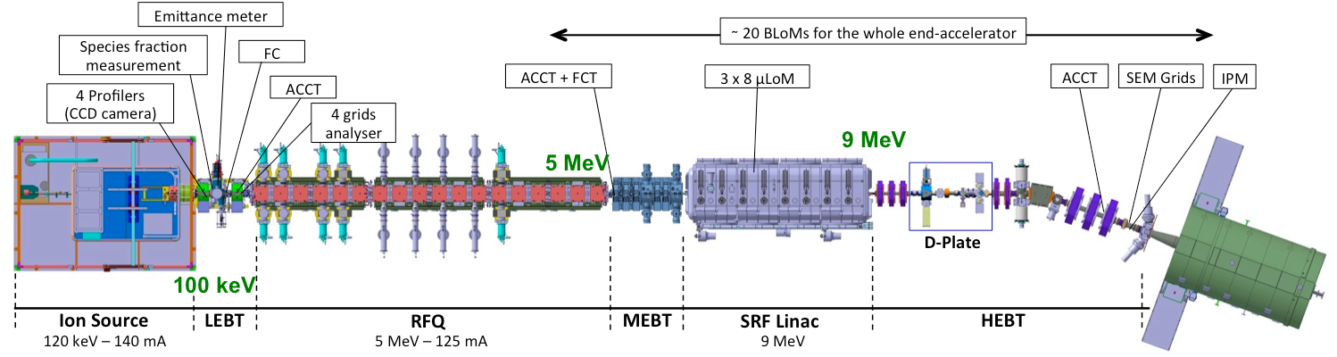
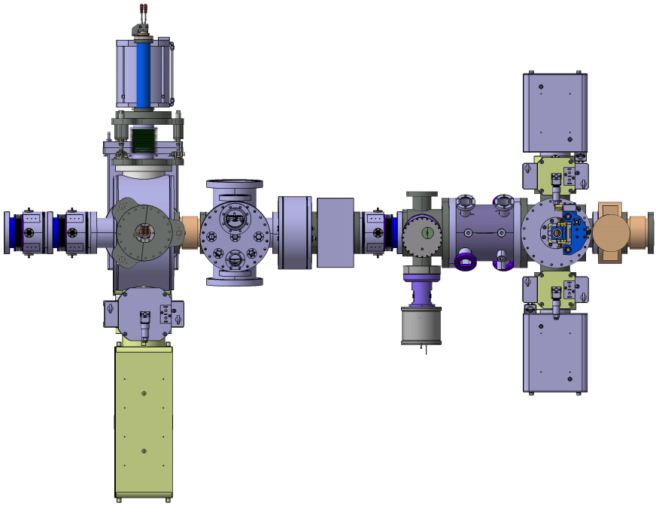
Diagnostics INVOLVED…
D-Plate
2 BPMs (stripline)
ACCT + DCCT
Steerer for SEM
IPM
SEM Grids
  Current transformers (CT)
  Beam loss monitor (BLoM)
  Electron Emission Grids (SEM-Grid)
  Ionization Profile Monitors (IPM)
2 Slits (Emittance)
FFC
RGBLM
1 BPM (Stripline)
FPM
Notes:
Diagnostics involved…. Before starting the description, I’m going to list all included diags on this workpakage. Because as you see, there are lot of them on this facility.
So this workpakage integrates : …
Now we can start the description :

Slide 8
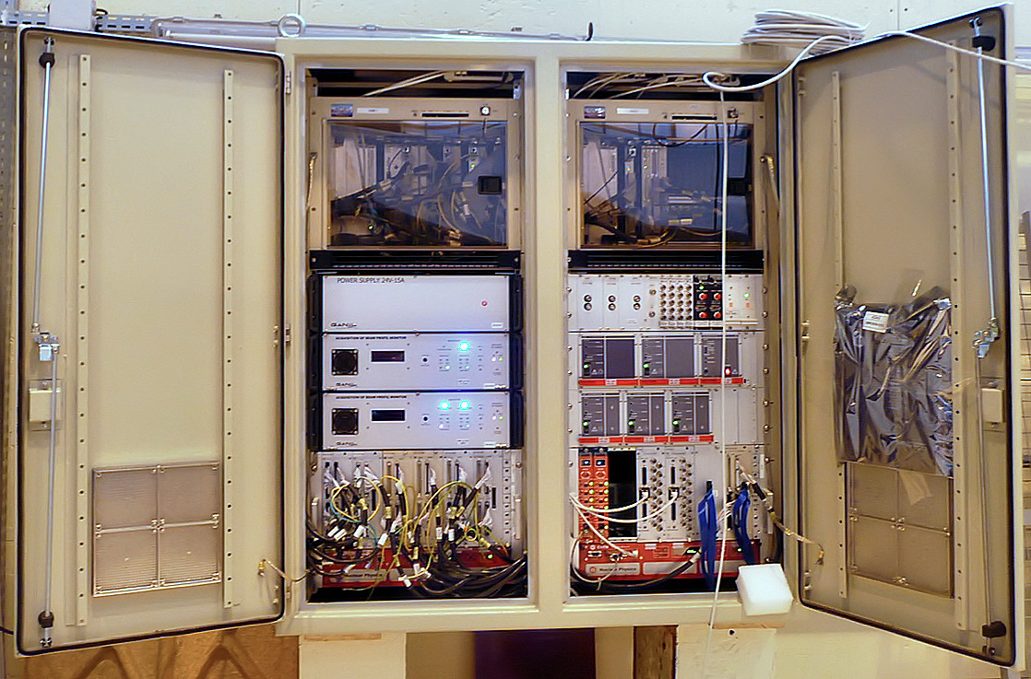
let's start WITH the cabinet…
VME
Amplifiers
(CT)
Electronics
(SEM-Grids)
Power Supplies
( IPMs & BLOMs)
Customized
electronic boards
(IPMs & BLOMs)
Notes:
I’m starting the description of the control with the cabinet… It integrates all controls of diagnositics previouly mentionned. You can find on this cabinet: 2 VME, the core of the control is based on VxWorks and EPICS; Then Electronic to control SEM-Grid wich was designed by the french laboratorie GANIL and used on SPIRAL2; Customized Electronics board to control IPM and BLOM wich was designed by CEA; Powers supplies for (IPM and BLOM), and Amplifier for CT. After the description of the cabinet, I show you the main panel of the control

Slide 9
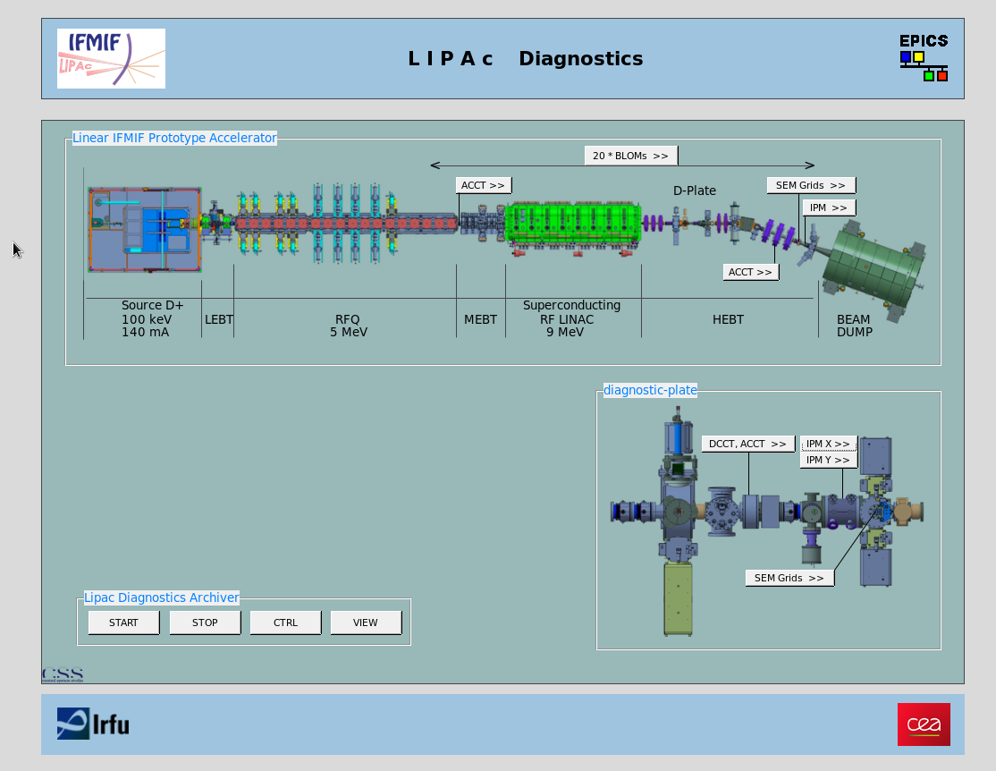
let's CONTINUE WITH the main launcher…
Current Transformers
Notes:
This slide show you the main launcher. It includes the main synoptic of the facility integrating all diag included on the workpakage. To access to a specific diagnostic, you have just to push on the button dedicated.
Let’s start by current transformer: We have 2 ACCT on the main line, and a cupple of ACCT & DCCT on the diagnostic plate.

Slide 10

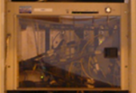
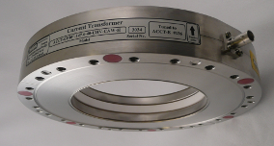
Current Transformers
Diagnostics cabinet
  The fast acquisition is based on two VME boards, ADAS ICV108 and ADAS ICV178
  The ICV108 is a controller board with an external trigger and includes a 4 MB RAM dedicated to measurements with possibility of DMA transfer.
  The ICV178 is an 8 channels board with 16-bit resolution for each ADC.
  The sampling frequency goes from 50kS/s up to 1.2MSamples/s
VME
GOAL
  CT is a kind of monitor which allows measuring the beam current with a precision of 0.15 mA
Particule beam
Notes:
What’s the goal of a current trasnformer? CT is a kind of monitor which allows measuring the beam current with a precision of 0.15 mA. It’s a non interceptive diagnostic!
How to control it?
You are going from the cabinet, we have the VME. On this VME is integrated Fast acquisition.
….
The driver was designed by CEA and already used sucessfully on The spiral2 project
If you come back to the click on the main launcher, on the previous slide, you will open this panel.

Slide 11
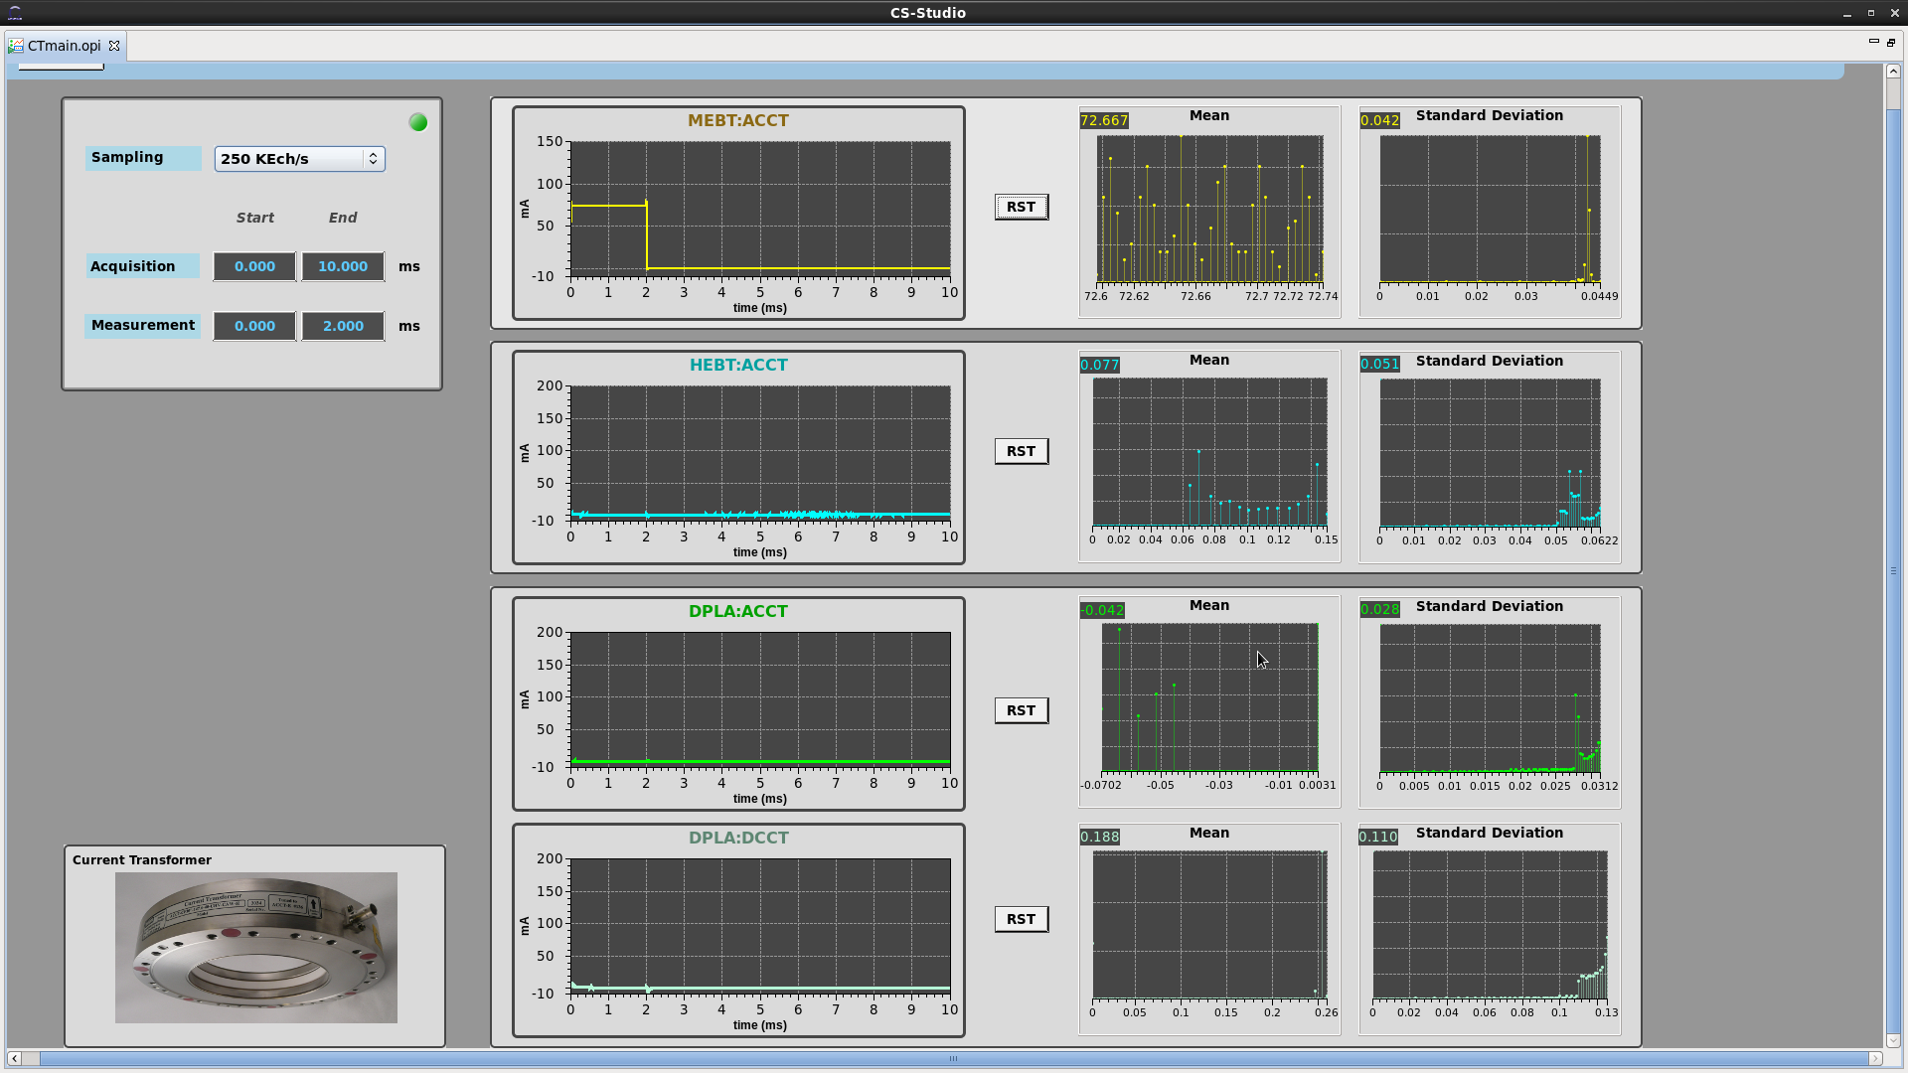
Current Transformers
Acquisition parameters
Ctrl of one CT
Beam Current
Mean & Std. dev histogram
Notes:
This screen allows to control them in one view. we have to select the acqusition frequencey up to 1Mhtz, and some paameters like the duration of sampling.
For each you have the beam courant directly integrated by FEE, and the histogram of mean and standard deviation associated.

Slide 12
From the main launcher…
IPMs
Notes:
Let’s come back on the launcher to work with another diagnostic : IPM.
We have one IPM on the HEBT, and a cupple (X,Y(why)) on the diagnostic plate

Slide 13
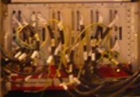
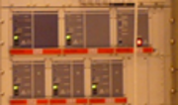
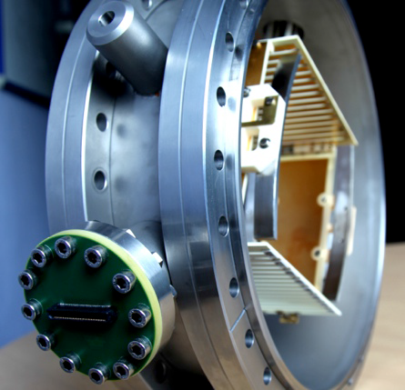
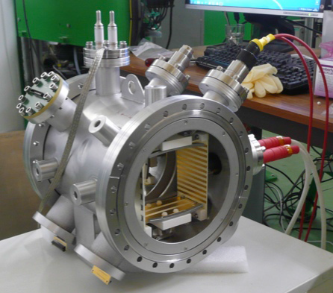
Ionization Profile Monitors
Diagnostics cabinet
VME
  ADAS VME Board to control Front End Electronic (FEE) and make slow acquisition
  FEE integrates the output current from the IPM over longer time, typically 0.1 to 1 second and was specially designed to manage the sample and hold functions for all beam configurations (pulse or cw)
FEE
HV PS
  Power supplies (FUG)
GOAL
  The goal of an IPM is to measure the transverse beam profile
HEBT
D-Plate
Notes:
What’s The goal of an IPM? to measure the transverse beam profile.
How to control it?
We come from always the cabinet, the VME. On this VME is integrated ADAS VME board to control Front End Electronic and make slow acquisition.
The goal of the FFE is …… This electronic was designed by CEA.
Signals seended to this FEE come from directly to IPM.
We need also to control FUG PS.

Slide 14
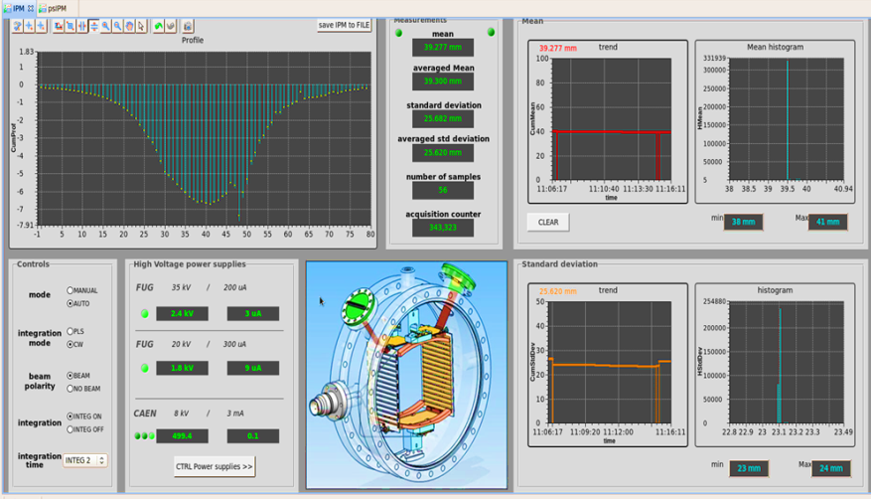
Ionization Profile Monitors
Profile
Measures
ctrl
Power supplies
Notes:
When you click on the main launcher you obtain this screen! It allows to control them : we have to select the acqusition mode (How to control front end Electronic), control the power suppplies, in order to abtain this kind of profil with measure.
We have also some information baout the mean and the standard deviation

Slide 15
From the main launcher…
BLoMs
Notes:
Going back to the main launcher again with another diagnostic : BLOM. About 20 BLoMs are installed all along the accelerator.

Slide 16
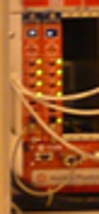
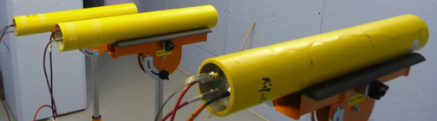
BEAM LOSS MONitor
Diagnostics cabinet
  ADAS VME Board to control Front End Electronic and make slow acquisition
VME
  FFE integrates
  Monitoring : the output current from the BLOM over longer time, typically 0.1 to 1 second and was specially designed to manage the sample and hold functions for all beam configurations (pulse or cw)
  Safety: It provides also a fast interlock signal to the Machine Protection System (MPS).
HV PS
FEE
  Powers supplies (CAEN)
MPS
GOAL
  The main goal of the BLoM system is to measure the particle loss to insure the machine safety
Notes:
The goal is …..
How to control it?
We go from the cabinet, the VME. On this VME is integrated ADAS VME board to control Front End Electronic and make slow acquisition.
About the FEE : We have the same FEE than used on IPM control except we have to amplifier signal before the integration. And for the safety of the machine, electronic have also to send in less than 10µs a signal to MPS if looses are higher than threshold.
Signals seended to this FEE come from directly to BLOM.
We need also to control CAEN PS by TCP
So from the control room, what we have?

Slide 17
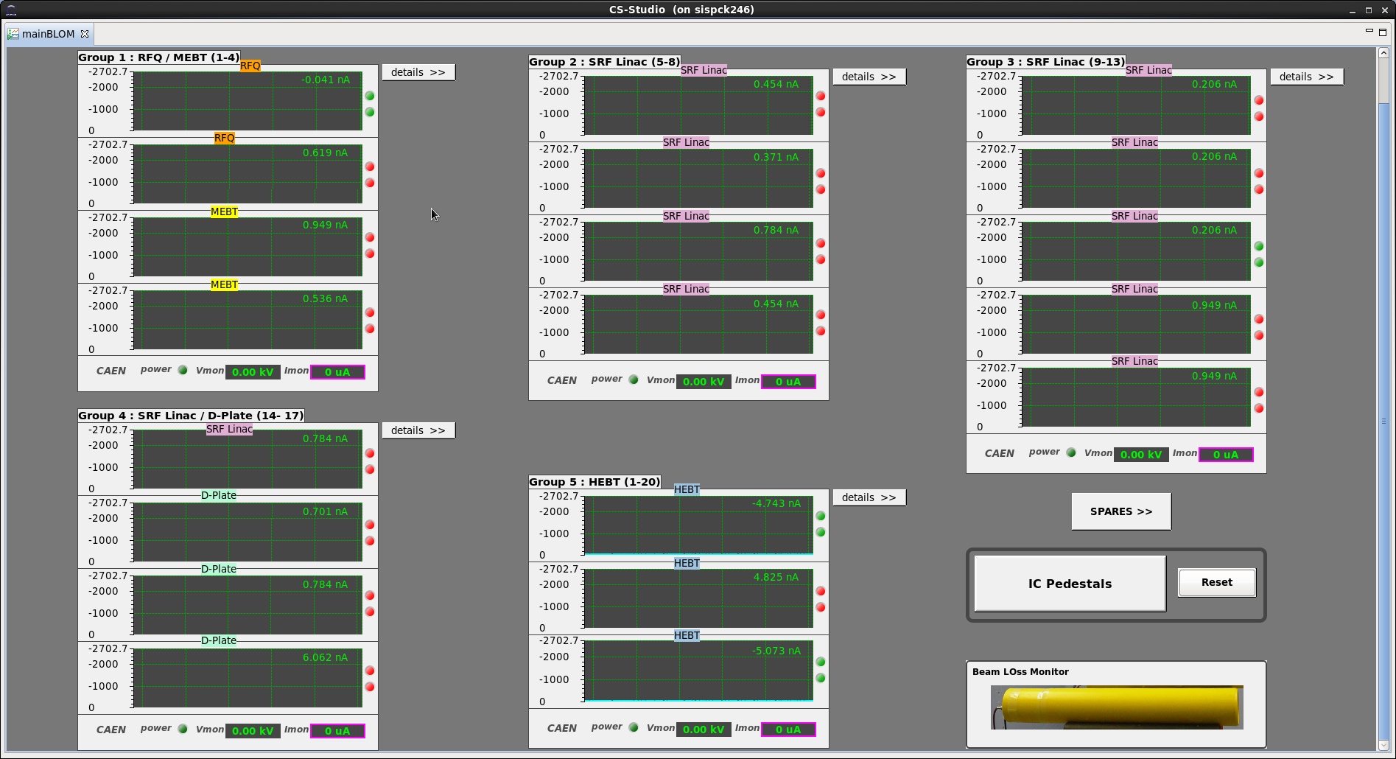
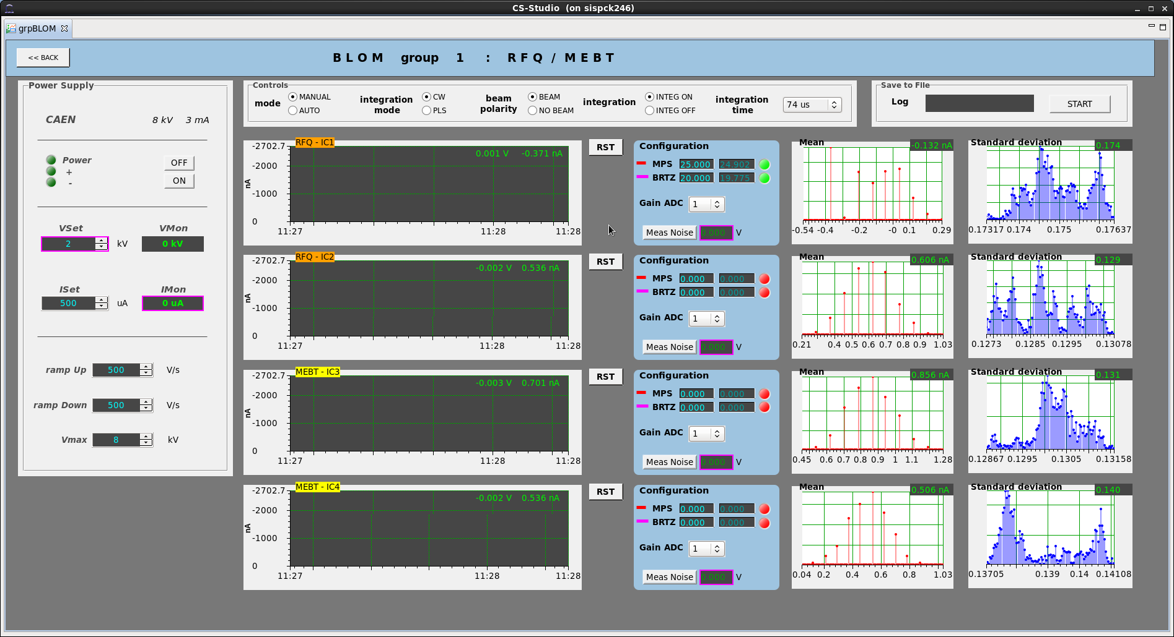
BEAM LOSS MOnitor
HV Ps
Acquisition ctrl
Ctrl of one BLoM
Current
Threshold (MPS)
Mean & Standard deviation histogram
Notes:
When you are on the main launcher, you click and you arrive on this view. All BLoM are representated and grouped by area. For each BLoM, you can see quickly the integrated current, and the status of threshold (MPS). When you want more details of a group, you have just to click on this buton. You can control power supplies associatied to this group, see the acquisition parameters. And for each BLOm, you have the beam current, the control of MPS threshold, and histogram of current Mean and standard deviation

Slide 18
From the main launcher…
SEM-Grid
Notes:
Now the SEM-Grid

Slide 19
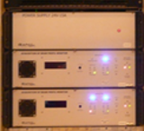

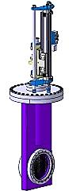
SEM-Grid
Pour insérer une image :
Menu « Insertion / Image »
ou
Cliquer sur l’icône de la zone image
VME
Diagnostics cabinet
Modbus
  A complete integrated solution with the EPICS driver, provided by Ganil laboratory, will be used to manage the measurement and acquire the data
GOAL
  The goal of a SEM-Grid is to have a beam profile measurement at low duty cycle in case of IPM measurement is not sensitive enough.
Notes:
The goal …..
Always from VME, we have the VME
Then, there is a complete….
The same solution is used on SPIRAL2 project?
How to control it ?

Slide 20
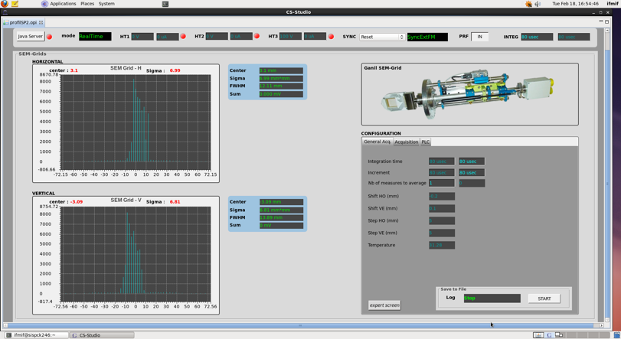
SEM-Grid
PS
H profile
Measures
ctrl
V profile
Notes:
On this panel, you can control Ps, You have the Horizontal and Vertical Profile, whith measure associated for each. You can change the configuration of electronic : integration time, etc…

Slide 21
From the main launcher…
Post mortem
Notes:
Now the SEM-Grid

Slide 22
POSt mortem…
Diagnostics cabinet
  Signals from all BLoM & CT will be sampled at 1 MHz, and recorded on the circular buffer of 4MB
  When a trigger from the MPS occurs, acquisition is stopped and the circular buffer gets frozen for analysis.
  The fast acquisition is based on two VME boards, ADAS ICV108 and ADAS ICV178
VME
In progess
MPS
GOAL
In order to understand what has just happened when the beam shuts down
BLoMs
CT
Notes:
What’s the goal of a current trasnformer? CT is a kind of monitor which allows measuring the beam current with a precision of 0.15 mA. It’s a non interceptive diagnostic!
How to control it?
You are going from the cabinet, we have the VME. On this VME is integrated Fast acquisition.
….
The driver was designed by CEA and already used sucessfully on The spiral2 project
If you come back to the click on the main launcher, on the previous slide, you will open this panel.

Slide 23
  Context
  Description of each diagnostic
  Conclusion

Slide 24
CONCLUSION
  European Acceptance tests were successfully done at Saclay for every kind of diagnostics
  The cabinet left Saclay in September, and arrived last week at Rokkasho! ☺
  The commissioning will be done in 2 phases :
    - Injector + RFQ + Dplate : in 2016
    - The whole accelerator : in 2017

Slide 25
IRFU
DSM
SIS
THANKS FOR YOUR ATTENTION !
Commissariat à l’énergie atomique et aux énergies alternatives
Centre de Saclay | 91191 Gif-sur-Yvette Cedex
T. +33 (0)1 69 08 37 42
Etablissement public à caractère industriel et commercial | RCS Paris B 775 685 019

