Slide 1
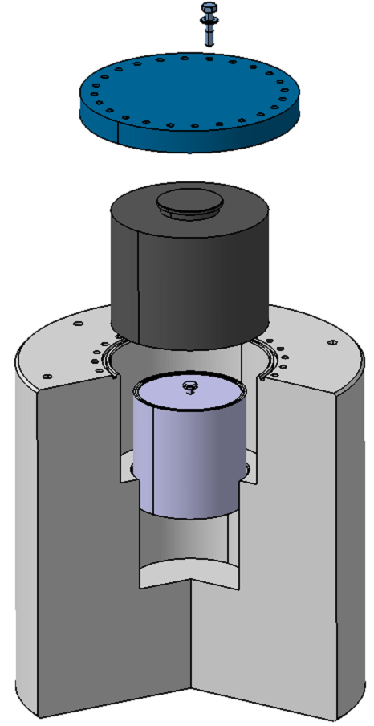
W shielding
Mechanical design
CeSOX meeting
APC 05/02/2014
On behalf of Loris Scola and Henry Przybilski
February 5th 2014
Christian VEYSSIERE

Slide 2
Shielding functionalities
 |  | FUNCTIONS
1 | Shield | Biological shielding
2 |  | 2.18 MeV γ shielding
3 | Introduction | Should accept Ce capsule
4 |  | The capsule should be removed (at least at the end of the experiment)
5 |  | Should fit in transport container
6 |  | Should fit in CeSOX dedicated calorimeter wrt thermal conductance
7 | Handling | Should be handled in or outside hot cell for capsule introduction
8 |  | Should be handled to transportation container
9 |  | Should be handled in Borexino
10 | Thermal | Capsules bottom and side surfaces for thermal conductance (keep control on contacts)
11 |  | Wires and connections for calibration should stay
12 |  | Tightness of the cap when vacuum in calorimeter

Slide 3
Shielding constraints
 | CONSTRAINTS
1 | Air and vacuum tightness
2 | Shield. surface temp. limited (in the container and for handling in Borexino)
3 | Differential thermal expansion between capsules and W (8mm for the diameter, driven by easiness for insertion)
4 | Materials resistant to temperature (SS, W and Helicoflex)
5 | W Weight for all supports and cranes (container and baskets, calorimeter)
6 | Should not be polluted (surface contamination in hot cell)
7 | Movement of the capsule in the shielding allowed?
8 | Internal surfaces should be cleaned prior to CeO₂ capsule insertion
9 | External surfaces should be cleaned prior and after to CeO₂ capsule insertion
10 | W corrosion by water? See Matthieu talk

Slide 4
General characteristics
  Machined in W alloy (equivalent to Densimet 185 ® from Plansee, Polema, Starck or Xiamen)
  19cm W thick walls
  Central shielding will be delivered to PA MAYAK, cleaned (potentially with double protection to avoid a contamination of its surface during its introduction in hot cells)
  Weighs 2.2 tons (metric)

Slide 5
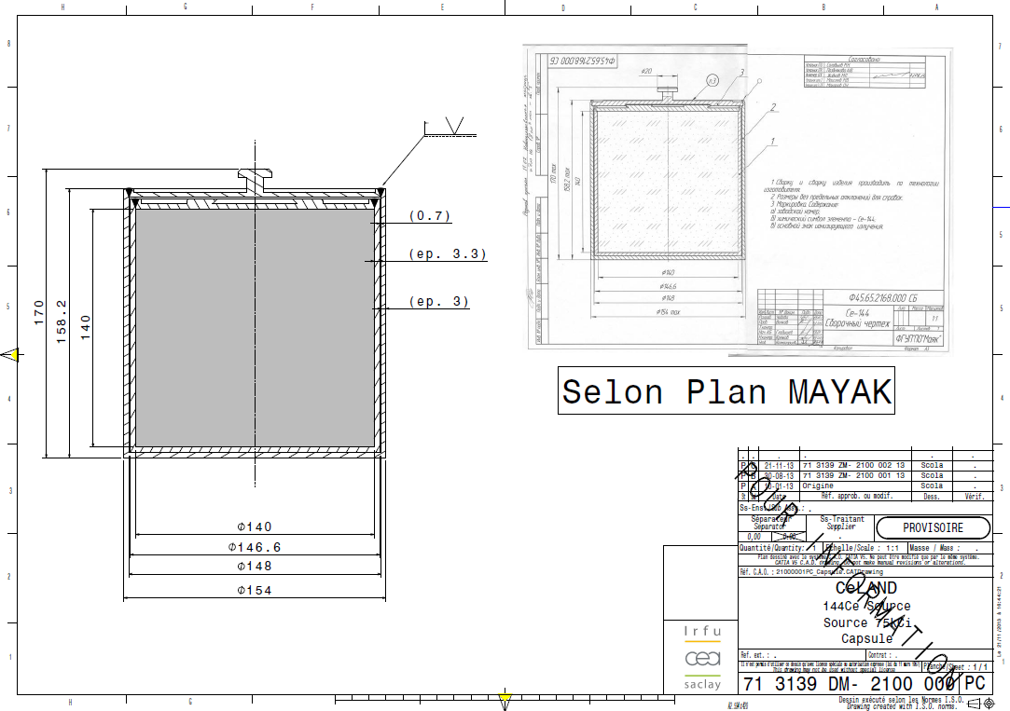
Interfaces / Capsules
  Sealed, complies with ISO 9978-92
  SS differential expansion for 140mm between 20 and 400°C: 0.4mm

Slide 6
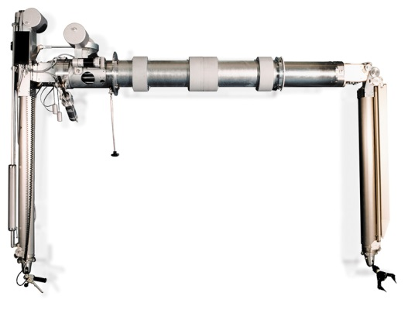


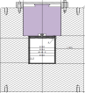
Interfaces / handling for capsule Introduction in the shielding
5T
1T

Slide 7
Interfaces / Handling for capsule Introduction in the shielding
5T
1T

Slide 8
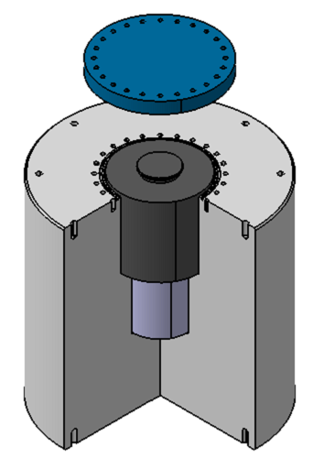
Interfaces / Handling of the different parts
  Lid
  Plug
  Inner and outer capsules
  Shielding
  Screws and eyelets
  + interface parts
  Helicoflex gasket

Slide 9
Interfaces / Handling in Borexino
See talk deployment of ANG system in the SOX pit : P. Lombardi

Slide 10
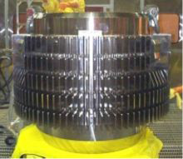
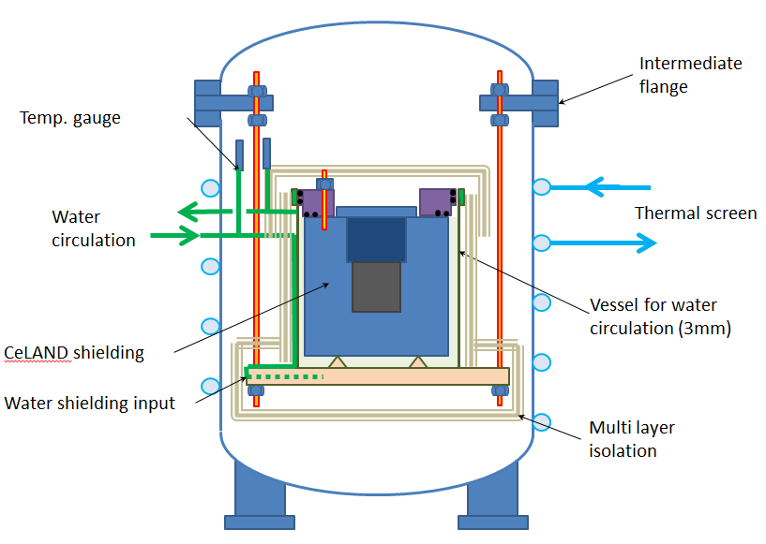
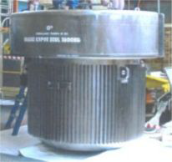
Interfaces / other devices
Calorimeter
Transport container
For TN-MTR, inner volume: Ø96 X 108 cm

Slide 11
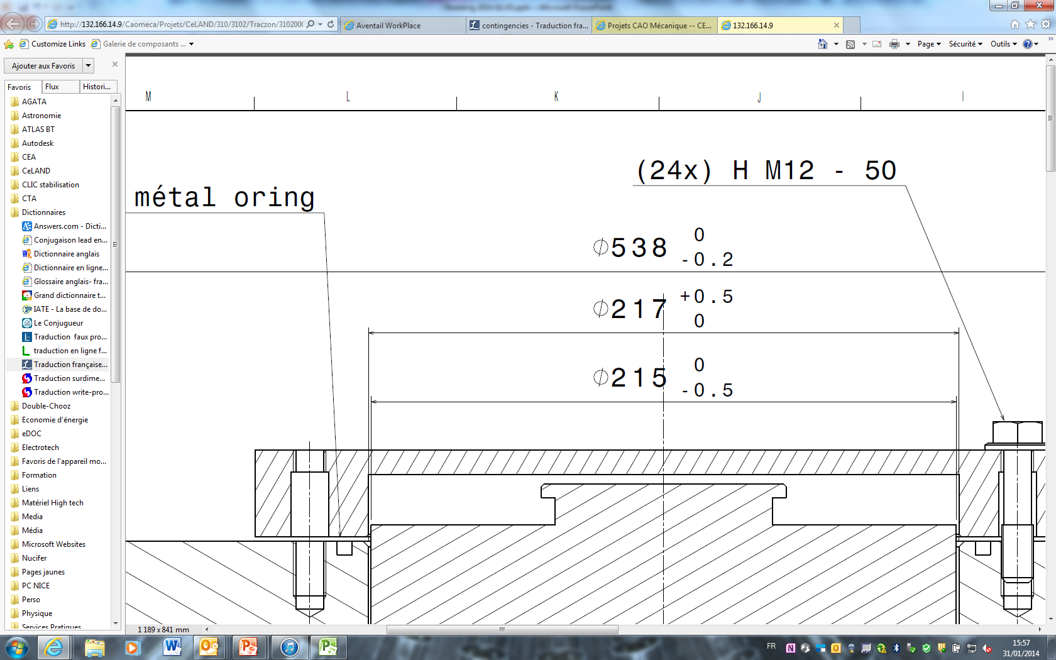
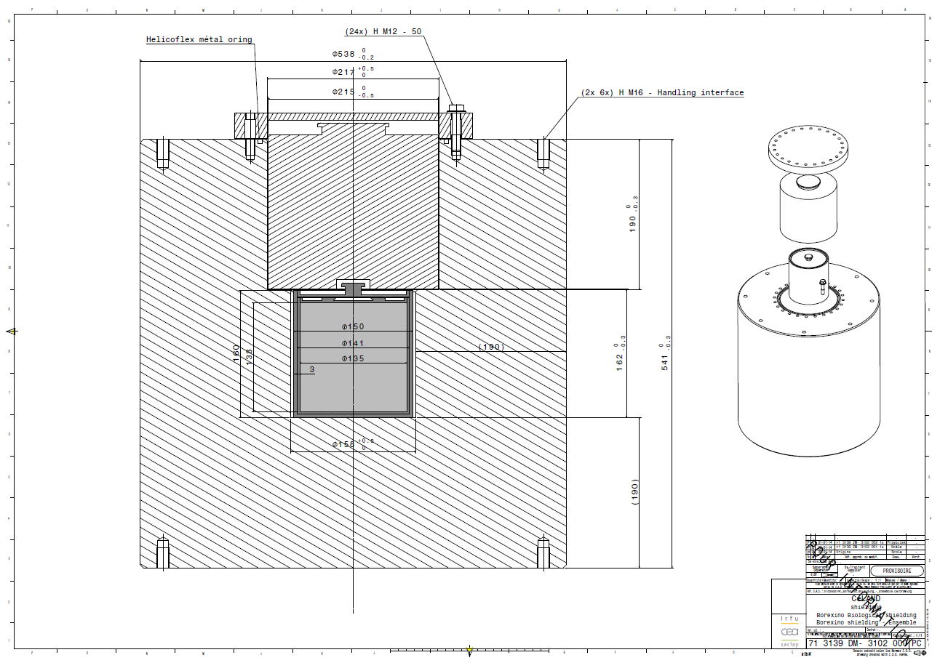
Preliminary dimensions
Surface roughness for Helicoflex and water gasket: Ra 0.8

Slide 12
Rough assessment of price and delays
3 months for realization
250 k€

Slide 13
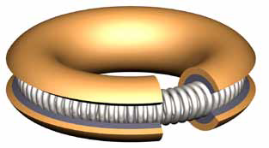
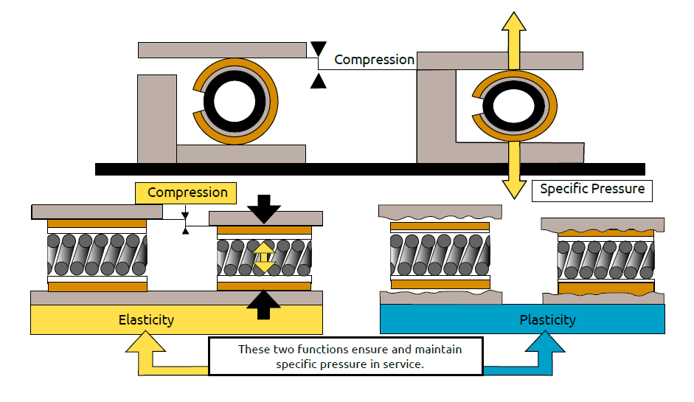
Helicoflex® gasket

